Slide 1
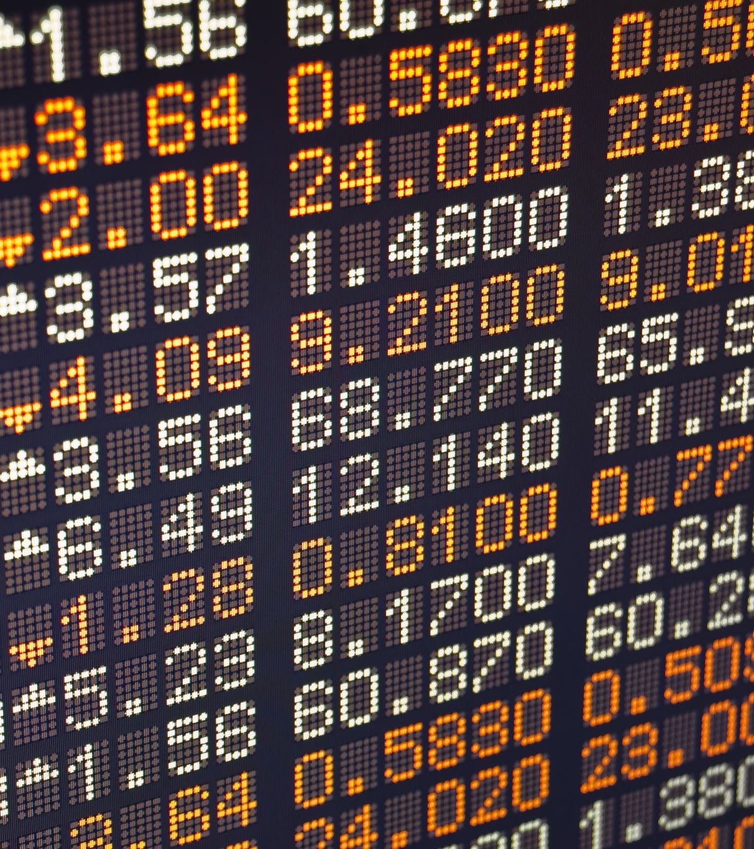

UNLOCKING INVESTMENT POTENTIAL GOLD PRICE PREDICTION WITH MARKET SENTIMENT ANALYSIS DSC 630 PREDICTIVE ANALYTICS
NAME: ANBUSELVAN MAHALINGAM

Slide 2

Executive Summary-Introduction
Gold has been treasured for thousands of years, serving various roles from a symbol of wealth and medium of exchange to being the backbone of economic systems.
Current Global Scenario:
Geopolitical tensions - Between Russia and Ukraine, Israel and Palestine, Inflation and higher rate.
Is the market stable now?
Is it going to be stable in the future?
What if the market goes down?
Benefits To Our Investors:
When to invest in gold: Identifying the optimal times for investment based on
predictive insights.
When not to invest in gold: Recognizing periods of potential decline to avoid
losses.
Maximizing returns: Ensuring our investments in gold yield the highest possible
returns even during periods of market instability.

Slide 3
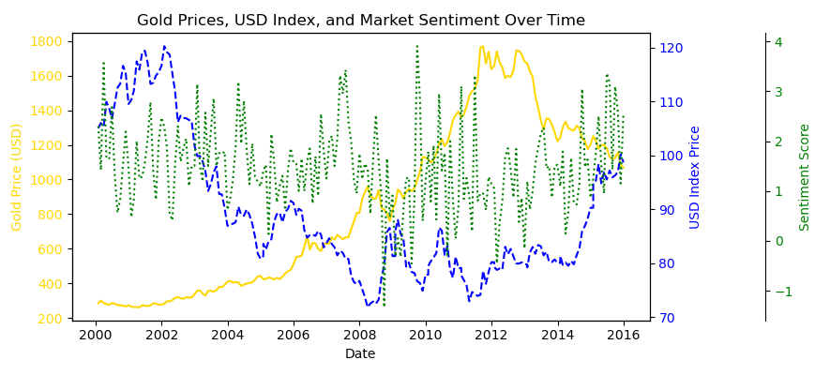
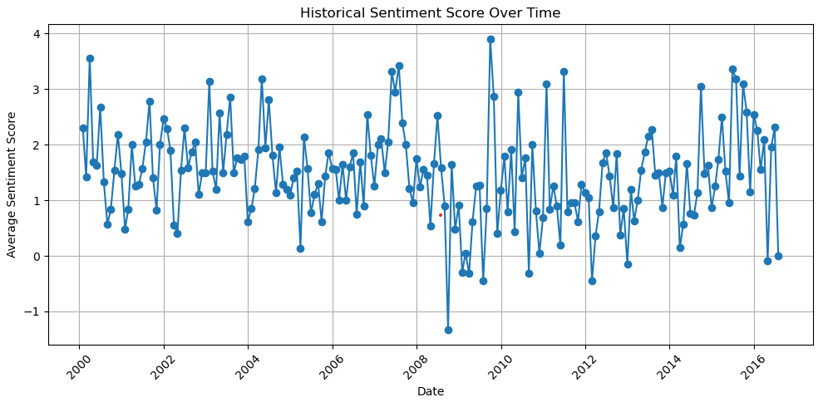
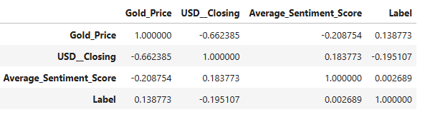
Data Selection and EDA
Historical GOLD Price per Ounce, available from AURONUM gold price dataset for public usage, to analyze and understand the pattern, trend and seasonality.
Historical US dollar index, available from Market Watch, for public usage, to analyze the relationship between gold prices and the DXY.
Market Sentiment dataset, news headlines Kaggle Stock Market Sentiment Analysis using NLP, We leverage Natural Language Processing (NLP) techniques to analyze market sentiment from global news headlines.
Solution Approach
Data Analysis: We start by collecting and analyzing historical gold prices and related financial data.
Geopolitical Analysis: We assess the impact of current global events on gold prices.
Predictive Modeling: We use sophisticated models networks to predict future price movements.
The plot clearly shows the inverse relationship between gold prices and the USD Index, the sentiment score, while less pronounced in its correlation, does show variations that occasionally align with shifts in the other two metrics, especially noticeable during periods of economic uncertainty or significant market events.

Slide 4
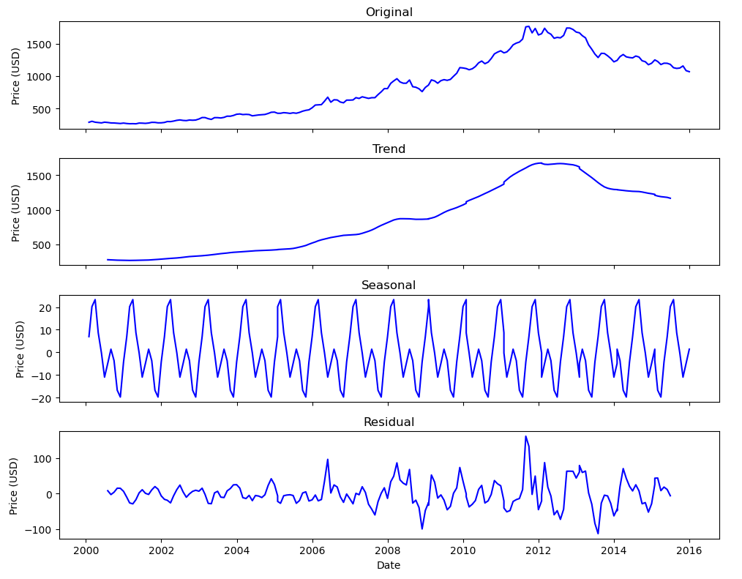
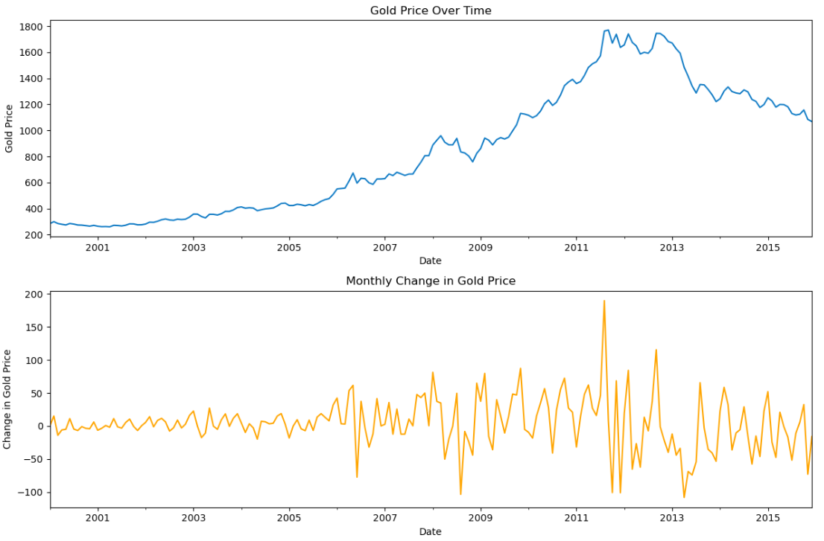
GOLD Price - Time Series Decomposition
Observed Data: Shows the actual gold price movements over time, which seem to have increased substantially after 2008, with some fluctuations.
Trend Component: Indicates a general upward trend over the last two decades, with a noticeable rise post-2008, possibly due to economic factors like inflation or political, global economic events.
Seasonal Component: Exhibits periodic fluctuations within a year, which could be due to cyclical factors affecting gold demand and supply.
Residual Component: Shows irregular fluctuations that are not explained by the trend or seasonality. This could include effects of unforeseen political events, economic news, or market sentiment.
Gold Price Change: There is a long term upward trend in gold price and has increased monthly fluctuation from 2005.

Slide 5
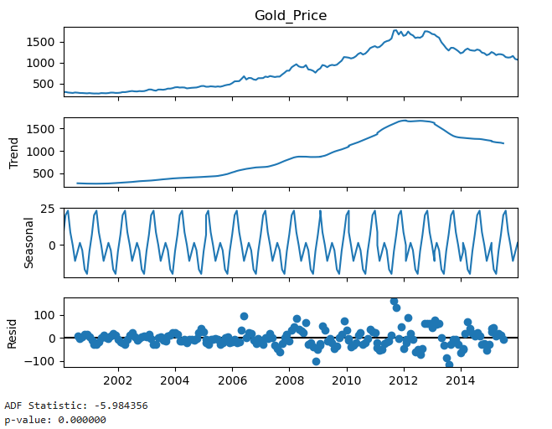
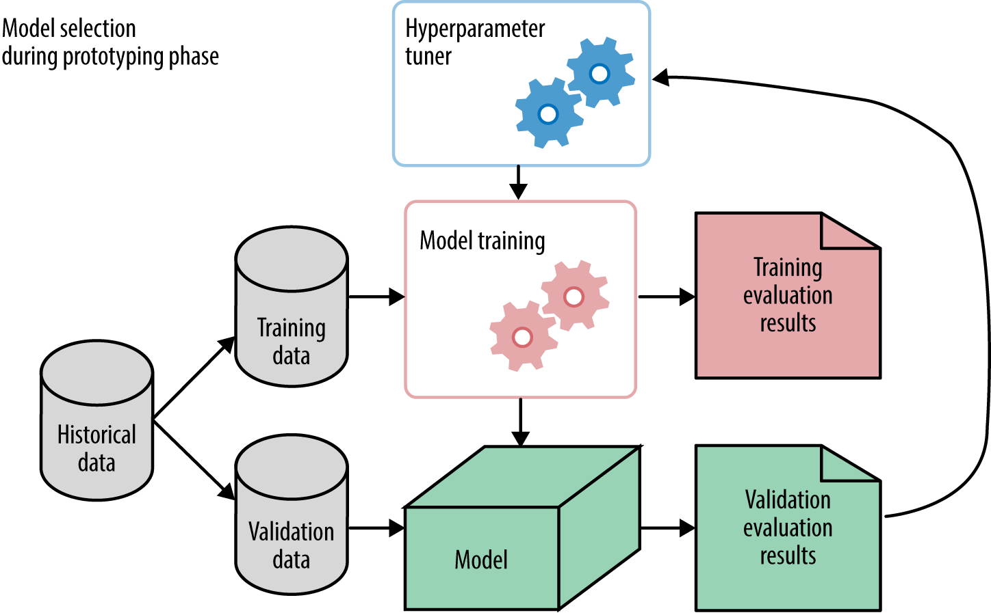
Prediction Models We aim to develop a comprehensive prediction model for gold prices by analyzing historical data, understanding the correlation with the U.S. Dollar Index, and incorporating market sentiment. By leveraging different time series analysis and modeling approaches. we aim to achieve accurate and insightful forecasts, aiding investors and stakeholders in making informed decisions
Following are the different prediction models we considered for the target variable gold price.
ARIMA model
SARIMAX model
Prophet model
Hybrid VAR + LSTM model
Stationarity Validation (ADF Test):
ADF Statistic: -5.984356 & p-value: 0.000000
The Augmented Dickey-Fuller (ADF) test is used to test for stationarity. The null hypothesis of the ADF test is that the time series has a unit root (i.e., it is non-stationary). Given the very low p-value (0.000000), we reject the null hypothesis, indicating that the gold price series is stationary after decomposition.

Slide 6
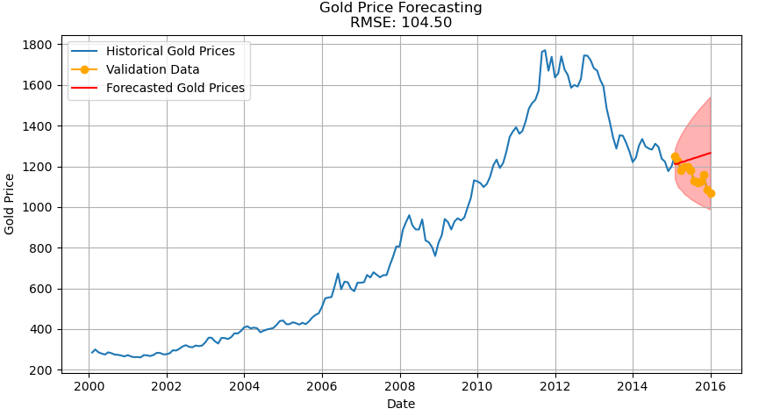
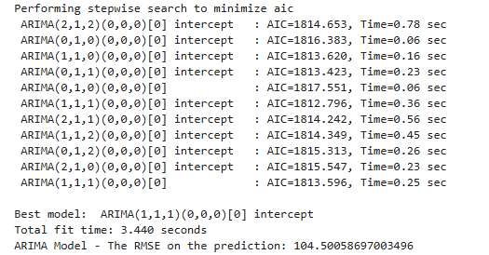
Approach 1 : ARIMA (AutoRegressive Integrated Moving Average)
ARIMA is well-suited for time series data where the goal is to capture the autocorrelation within the data. It is a powerful model for short-term forecasting when the data is stationary or can be made stationary through differencing.
The auto_arima function from the pmdarima library is used to find the best ARIMA model automatically.
The ARIMA(1,1,1) model was selected based on the lowest AIC value, suggesting it is the best fit among the tested models.
The RMSE for this model is 104.50, indicating the average deviation of the forecasted gold prices from the actual values.
The model's predictions align well with the actual data, but there is some deviation, as indicated by the RMSE value of 104.50.
Limitations: While the ARIMA model is effective for short-term forecasting, it may not fully capture complex patterns or external influences on gold prices.
Conclusion: The ARIMA model provides a solid foundation for predicting gold prices based on historical data. It effectively captures the trend and produces forecasts with a moderate level of accuracy, as reflected by the RMSE value. However, further improvements could be achieved by considering additional factors and exploring more sophisticated models.

Slide 7
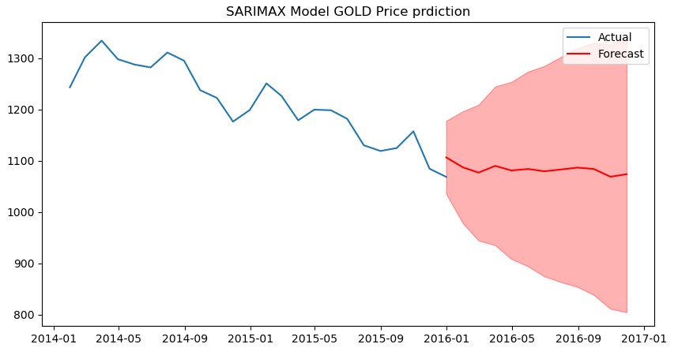
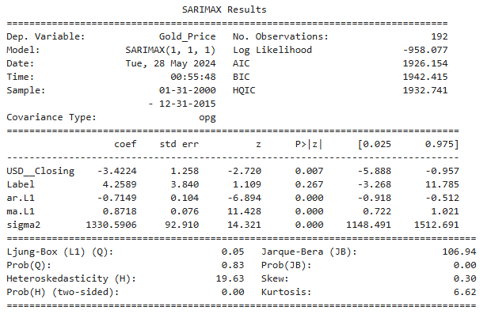
Approach 2 : SARIMAX (Seasonal AutoRegressive Integrated Moving-Average with eXogenous factors) SARIMAX extends ARIMA by including seasonal components and external regressors (DXY and sentiment scores). It is ideal for capturing both seasonal effects and the influence of external variables on gold prices.
We make use of optimal ARIMA model parameter (p,d,q) (1,1,1) order, and added external regressors.
The model includes the U.S. Dollar Index (USD_Closing) and market sentiment labels (Label) as external regressors.
The SARIMAX model is trained on the historical gold prices, incorporating the exogenous variables to better predict the future prices.
The RMSE for the SARIMAX model is 89.96, which is an improvement over the ARIMA model.
The coefficients for the exogenous variables (USD_Closing and market sentiment) are significant, indicating that these factors have a substantial impact on the gold prices.
Conclusion: The SARIMAX model enhances the predictive power by incorporating exogenous variables, resulting in more accurate forecasts of gold prices. This approach provides valuable insights for investors by considering external market factors, leading to better-informed investment decisions.

Slide 8
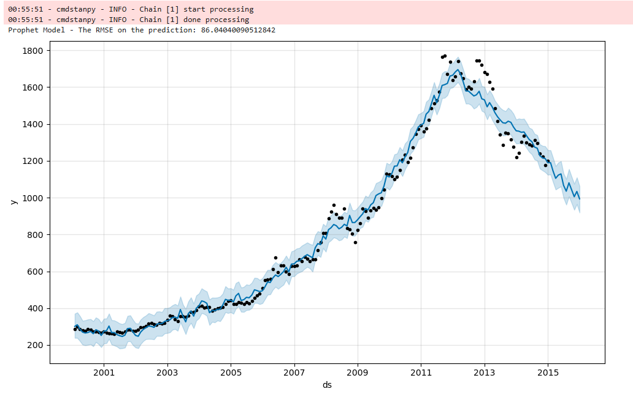

Approach 3 : Prophet ML for predicting GOLD Price
Developed by Facebook, Prophet is a forecasting tool designed to handle time series data with strong seasonal patterns and missing data. It decomposes the time series into trend, seasonality, and holidays, making it suitable for predicting gold prices with seasonal variations.
The model incorporates exogenous variables such as the U.S. Dollar Index (USD_Closing) and Average Sentiment Score to improve the forecast accuracy.
The RMSE for the Prophet model is 86.04, indicating high prediction accuracy.
Advantages: Prophet is user-friendly and robust, handling missing data and outliers effectively. It provides interpretable results by decomposing the time series into trend, seasonality, and holidays.
Conclusion: The Prophet model offers a robust and accurate approach for predicting gold prices. By effectively capturing seasonal patterns and incorporating external factors, Prophet delivers precise forecasts, aiding investors in making well-informed decisions.

Slide 9

Approach 4 : Hybrid VAR + LSTM Approach VAR: Vector Autoregression, useful for multivariate time series where the prediction variable is influenced by other variables. LSTM: To capture the non-linear relationships in the residuals of the VAR model.
The hybrid VAR+LSTM model has a high RMSE, indicating potential issues that need to be addressed.
The model's complexity and integration of both VAR and LSTM might be contributing to its high error rate. Further refinement and troubleshooting are necessary before it can be considered a reliable forecasting method.

Slide 10

Conclusion The Prophet model stands out as the most accurate and reliable method for predicting gold prices, effectively capturing trends and seasonal patterns. The SARIMAX model also shows strong potential, especially with enhanced sentiment data. While the ARIMA model is useful, it is less accurate than the others. Addressing the issues in the hybrid VAR+LSTM model could unlock further forecasting capabilities. Overall, leveraging superior sentiment analysis and continuously refining models will lead to more precise predictions and informed investment decisions.
Best Performing Model:
Prophet: RMSE 86.04, captures trends and seasonality, highly accurate.
Strong Performance:
SARIMAX: RMSE 89.96, effective with external factors, potential for improvement with better sentiment data.
Moderate Performance:
ARIMA: RMSE 104.50, good for short-term forecasting but less accurate.
Hybrid Model Concerns:
VAR+LSTM: High RMSE indicates issues needing resolution.

Slide 11
Question & Answers? - email: amahalingam@my365.bellevue.edu
Reference:
GOLD contract and Dollar index historical data yahoo finance, Historical data obtained from Auronum - British Gold, Silver and Platinum Bullion Company, for the range year 2000 to 2024.
Market Sentiment dataset, news headlines Kaggle- Stock Market Sentiment Analysis using NLP, obtained from Stock Market Sentiment Analysis using NLP (kaggle.com)
ARIMA time series analysis and prediction, reference Machine Learning plus - ARIMA
SARIMAX time series analysis and prediction, reference Geeks for Geeks - SARIMAX
PROPHET Forecasting at scale, reference facebook github io - prophet
Vector AutoRgressive (VAR) Machine learning model, reference Machine Learning plus - VAR
Long Short-Term memory recurrent neural network machine learning – reference Machine Learning Mastery - LSTM

