Slide 1

Analyzing the Impact of U.S. Presidential Cycles on Economic and Stock Market Performance
A Study of SPY ETF and GDP Growth Trends

Slide 2
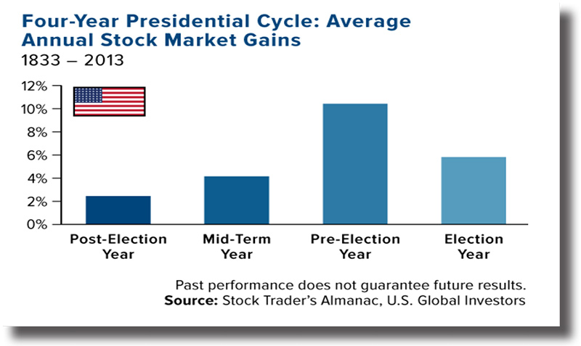
Introduction
Objective:
Validate the Presidential Election Cycle Theory.
Analyze patterns in SPY ETF returns and GDP growth.
Key Research Question:
Do U.S. presidential cycles influence economic and market performance?
Background
Presidential Election Cycle Theory (Yale Hirsch, 1960s):
Market returns are lower in the 1st year.
Returns improve in the 2nd year, peak in the 3rd year, and remain strong in the 4th year.

Slide 3
Business Problem & Solution Approach
Goal:
Understand the relationship between presidential terms, SPY ETF performance, and GDP growth.
Why It Matters:
Helps investors and policymakers make informed decisions.
Explores how deviations occur due to modern policies and global events.
Data Sources:
SPY ETF Data: S&P 500 performance, Investing.com
GDP Growth Data: Quarterly GDP rates, Federal Reserve (FRED)
Presidential Term Data: Term years, presidents, party affiliation, White House Presidents Page
Research Approach
Exploratory Data Analysis (EDA): Visualize trends in SPY and GDP across presidential terms.
Theory Validation: Compare SPY returns and GDP growth to the cycle theory.
Forecasting: Predict SPY prices for 2024 and 2025 using Facebook’s Prophet model.

Slide 4
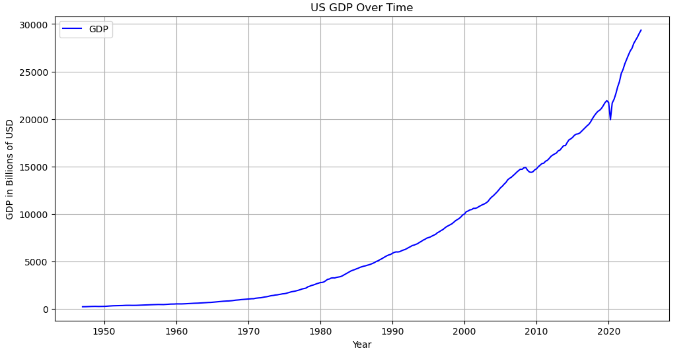
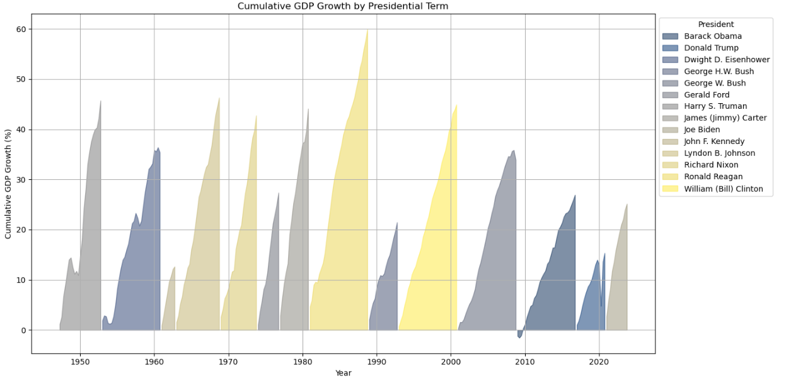
Key Findings: GDP Growth
The graph illustrates the exponential growth of the U.S. Gross Domestic Product (GDP) from 1950 through 2020. The trajectory shows a sustained increase with notable accelerations post-1980, reflecting periods of economic expansion and technological advancement.
The filled area chart effectively emphasizes the extent and variation of growth under each president, illustrating periods of economic expansion and slowdown.

Slide 5
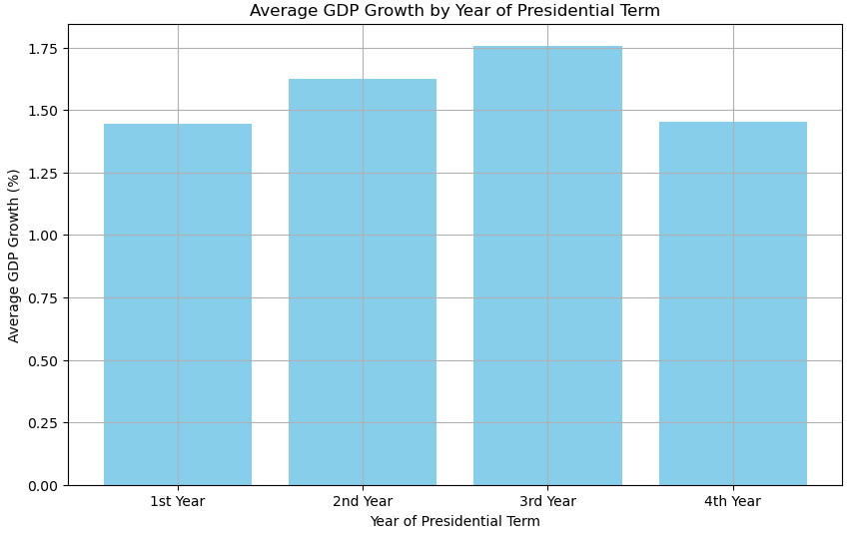
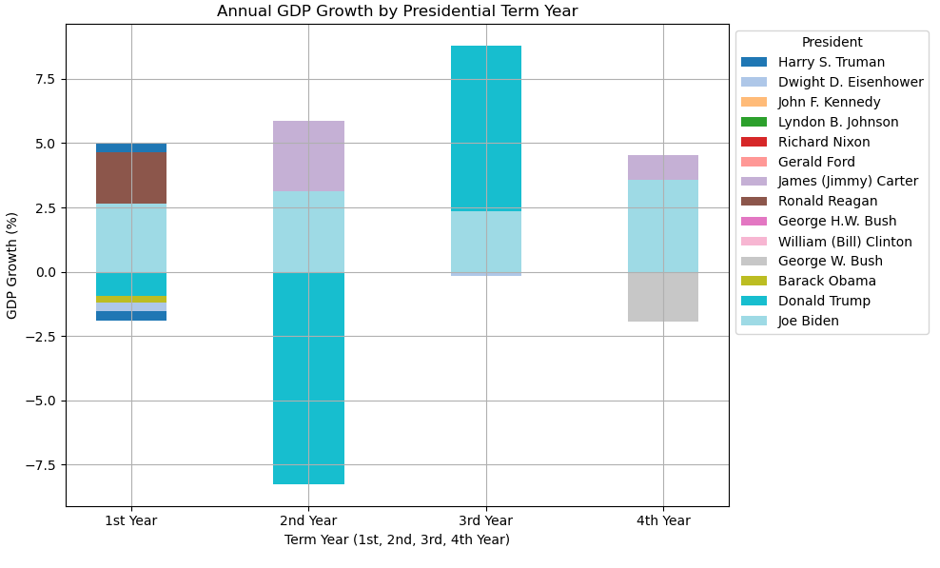
Key Findings: GDP Growth(continue..)
While the theory traditionally applies to the stock market (SPY), GDP growth shows a similar cyclical pattern.
1st Year: Lowest average GDP growth
2nd and 3rd Years: Growth increases, peaking in the 3rd year
4th Year: Growth moderates
Political cycles influence both market sentiment and economic fundamentals (GDP).

Slide 6
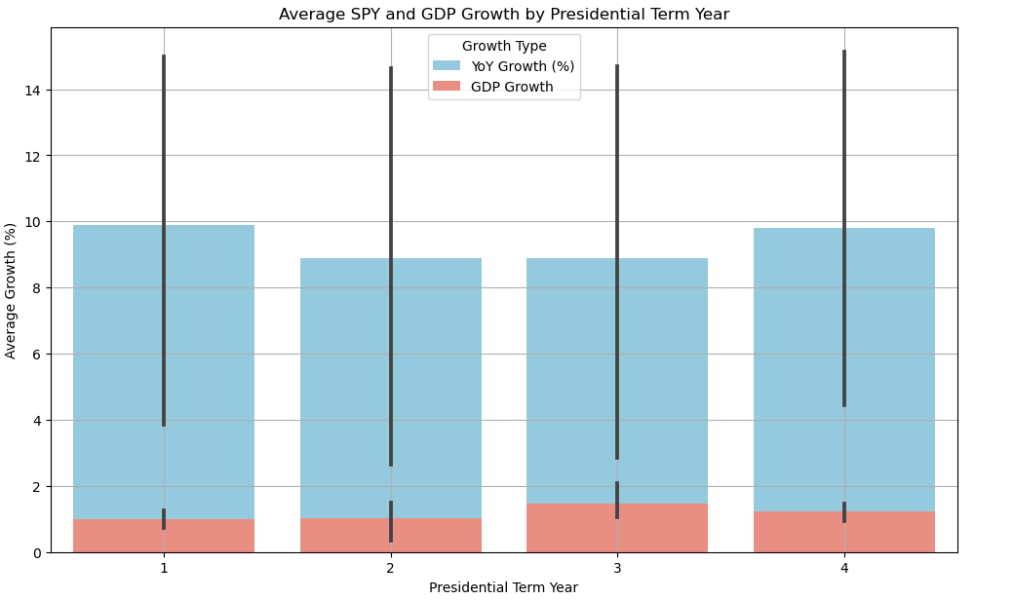
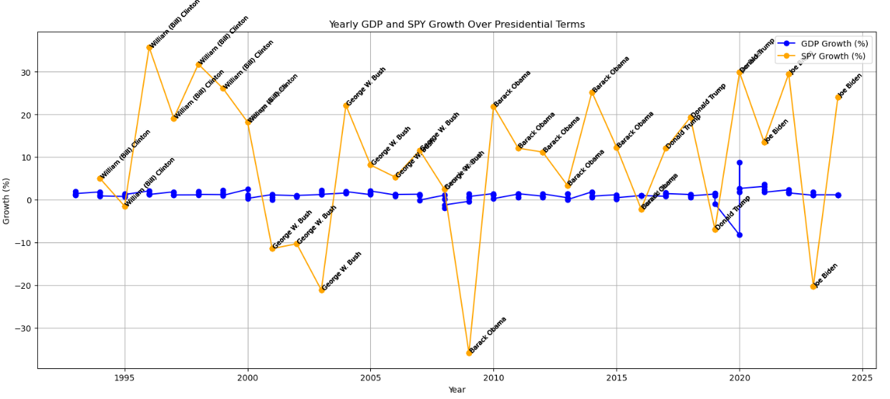
Key Findings: SPY vs. GDP Growth – Timing of Presidential Cycle Impact
Alignment: The visualizations support this theory, showing higher SPY growth in the 2nd and 4th years, consistent with historical patterns of increased market optimism
Key Insights: 1st Year Performance: The visualization shows that the 1st year has higher-than-expected average SPY growth, which deviates from the classic theory.
GDP implications to Presidential cycle
This reflects the notion that the impact of economic stimulus and policy changes on GDP tends to materialize gradually over the course of a presidential term

Slide 7
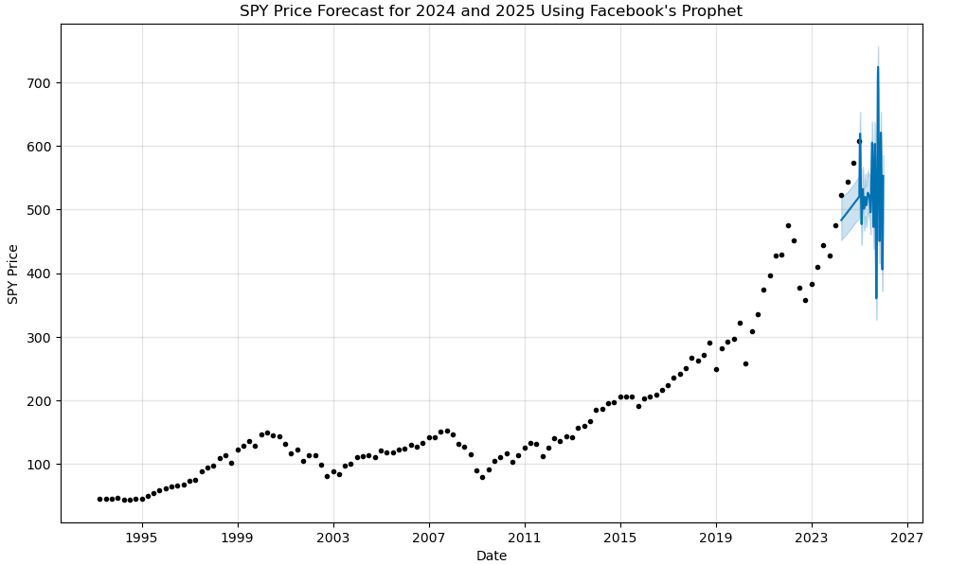
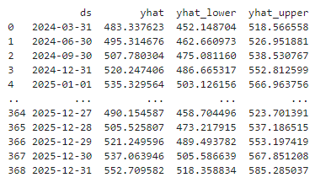
SPY Price Forecast (2024-2025)
Model: Forecast generated using Facebook’s Prophet.
Results:
Projected upward trend with volatility.
Evaluation Metrics:
MAE: 18.58, RMSE: 25.57, MAPE: 12.48%

Slide 8
Conclusion
GDP Growth Trends:
GDP growth tends to follow the theory, showing:
Weaker growth in the 1st year.
Stronger growth in the 2nd and 3rd years, peaking in the 3rd year.
This aligns with the idea that economic stimulus and policy stabilization take time to impact GDP.
SPY Performance:
The Presidential Election Cycle Theory generally holds, predicting strong SPY returns in the 3rd and 4th years.
However, the notable SPY performance in the 1st year of some terms challenges this theory.
Overall Insight:
While the theory provides a useful framework, modern factors introduce variability.
Understanding these deviations helps in making informed investment and policy decisions.

