Slide 1
DSC 530 DATA EXPLORATION AND ANALYSIS – S&P 500 AND DOW 30 INDEX DATA ANALYSIS
ANBUSELVAN MAHALINGAM

Slide 2
ABOUT INDEX DATA SETS
The data exploration project experiment on S&P 500 and Dow 30 index is to analyze the market data and help investors with true insights.
This analytical project focuses on the S&P 500 and Dow Jones Industrial Average (Dow 30) indices. The dataset encompasses 5 years of historical data.
S&P 500: Stock market index tracking the stock performance of 500 of the largest companies listed on stock exchanges in the United States. It is one of the most commonly followed equity indices and includes approximately 80% of the total market capitalization of U.S. public companies.
Dow 30: The Dow Jones Industrial Average, Dow Jones, or simply the Dow, is a stock market index of 30 prominent companies listed on stock exchanges in the United States.
Reference: Yahoofinance.com for obtaining these indices 5 year historical data.

Slide 3
Statistical Questions
How do the returns of the Dow 30 compare to the S&P 500 over the 5-year period? Calculate and compare the annualized returns of the Dow 30 and S&P 500 over the 5-year period to see which index offered better performance.
How do the trends in the moving averages (e.g., 50-day and 200-day moving averages) of the Dow 30 compare with those of the S&P 500 over the same period?
What is the market volatility comparison between the Dow 30 and S&P 500? based on investors risk taking and acepted volatility investor can choose best suited one for them.
do we have any significant correlations between the movements of the Dow 30 and S&P 500 indexes? Is there a strong correlation between the closing prices of the Dow 30 and S&P 500? How does this correlation change when considering their moving averages?

Slide 4
Variables & Impact Description
Close_sp500: The closing price of the S&P 500 index on a given trading day.
Close_dow30: The closing price of the Dow Jones Industrial Average (Dow 30) on a given trading day.
50_day_MA_sp500: The 50-day moving average of the S&P 500 index, indicating the average closing price over the past 50 trading days.
50_day_MA_dow30: The 50-day moving average of the Dow 30 index, indicating the average closing price over the past 50 trading days.
200_day_MA_sp500: The 200-day moving average of the S&P 500 index, showing the average closing price over the past 200 trading days and often used to determine long-term market trends.
200_day_MA_dow30: The 200-day moving average of the Dow 30 index, reflecting the average closing price over the past 200 trading days and commonly used to assess long-term market direction.
Daily_Returns_sp500: The daily percentage change in the closing price of the S&P 500 index, measuring the index's performance from one day to the next.
Daily_Returns_dow30: The daily percentage change in the closing price of the Dow 30 index, providing a measure of the index's day-to-day performance.
Note: 50_day_MA_sp500,50_day_MA_dow30, 200_day_MA_sp500,200_day_MA_dow30,Daily_Returns_sp500 & Daily_Returns_dow30 are derived elements from closing price as part of Data exploration feature creation activity.

Slide 5
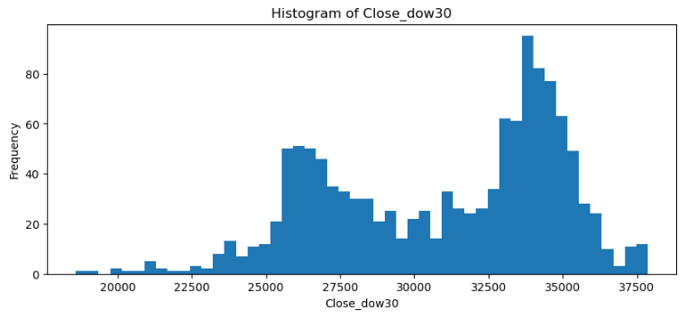
Close_dow30 histogram Summary: The data spans a range from around 20,000 to over 35,000, indicating a wide spread in closing prices over the 5-year period. Outliers: There seems to be fewer instances of extremely low or high closing prices those looks to be outliers but in real scenario those are market volatility.

Slide 6
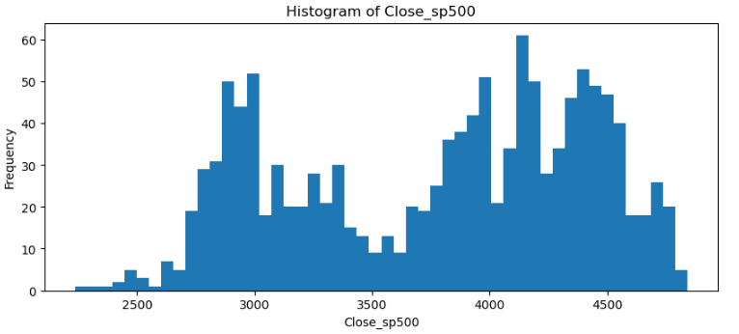
Close_sp500 histogram Summary: The S&P 500 closing prices range from approximately 2500 to above 4500, showing a significant spread and suggesting that the index experienced substantial growth and/or fluctuations during the 5-year period. Outliers: There seems to be fewer instances of extremely low or high closing prices those looks to be outliers but in real scenario those are market volatility.

Slide 7
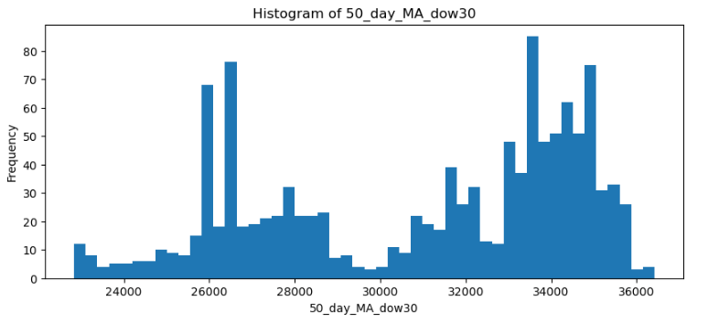
50_day_MA_dow30 histogram Summary: The values range from around 24,000 to 36,000, displaying a broad range which reflects the movement of the Dow 30 over time. Outliers: The presence of bars at the extremes suggests that there are tails in the distribution, indicating periods where the moving average was significantly higher or lower than the norm.

Slide 8
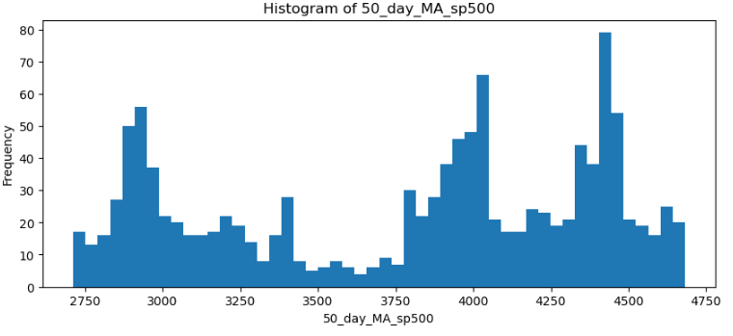
50_day_MA_sp500 histogram Summary: The spread is from approximately 2750 to 4750, which is a substantial range, demonstrating that the S&P 500 also had significant movement in its 50-day moving average over time. Outliers: The tails suggest that the 50-day moving average occasionally fell into these extreme high or low ranges.

Slide 9
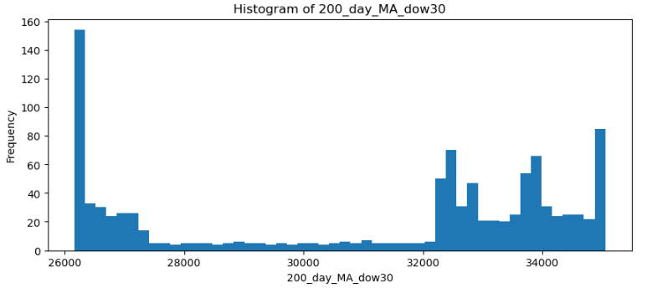
200_day_MA_dow30 histogram Summary: The range of the 200-day MA for the Dow 30 is broad, extending from around 26,000 to 34,000, which indicates significant movement over the 5-year period. Outliers: The right tail show fewer occurrences of extremely high 200-day moving averages.

Slide 10
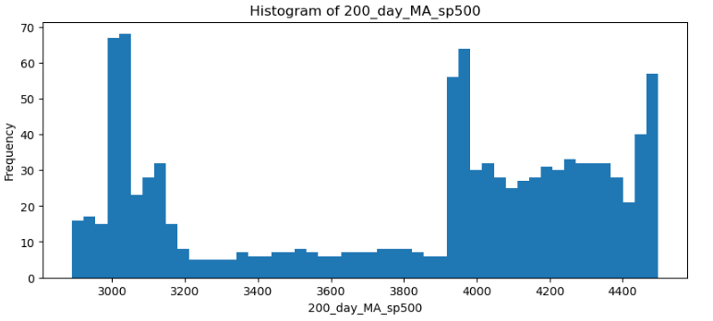
200_day_MA_sp500 histogram Summary: The distribution ranges from around 3000 to 4400, which is a wide spread, reflecting the movement in the S&P 500 over time. Outliers: Like the Dow 30, the right tail has peaks that could indicate periods of growth or recovery in the market.

Slide 11
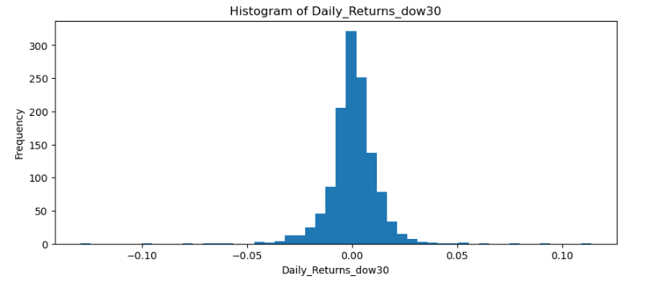
Daily_Returns_dow30 histogram Summary: The distribution covers a range of returns from approximately -0.10 to 0.10. This spread provides insight into the typical daily movement of the Dow 30 index. Outliers: The tail represent the less frequent occurrence of very high or very low returns.

Slide 12
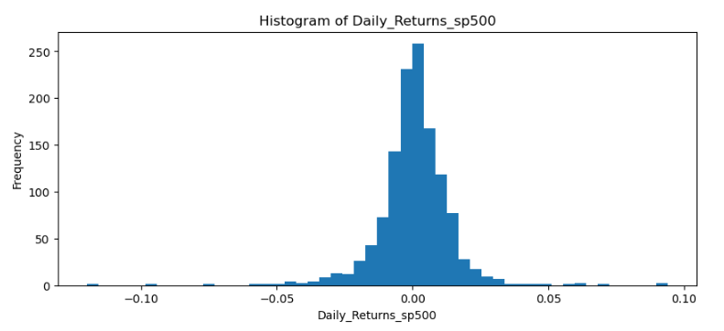
Daily_Returns_sp500 histogram Summary: The range is also similar to the Dow 30's, with returns extending from -0.10 to 0.10. Outliers: The tails of this distribution are also indicative of the infrequent extreme returns that can occur in the market.

Slide 13
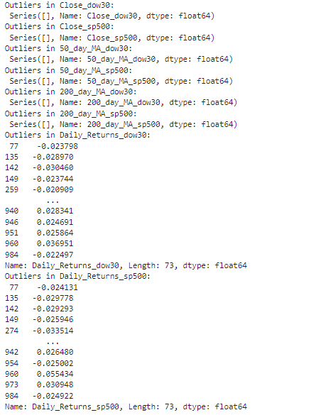
Summary: Outliers Based on Interquartile Range technique, there is no significant Outliers in Close_dow30, Close_sp500, 50_day_MA_dow30, 50_day_MA_sp500, 200_day_MA_dow30, 200_day_MA_sp500, Daily_Returns_dow30. The daily returns, shows some outliers, they are the days with returns that significantly deviate from the norm, which might be attributed to specific market events, news, or economic data releases that caused unusual market volatility.

Slide 14
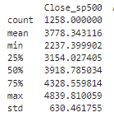
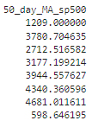
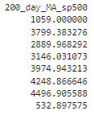
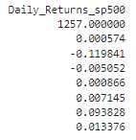
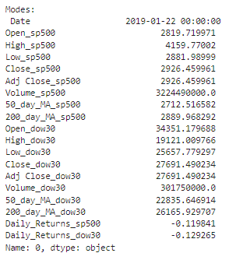
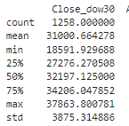
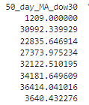
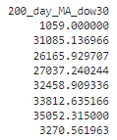
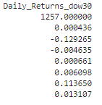
Descriptive characteristics about the variables

Slide 15
Descriptive characteristics about the variables(continue..)
S&P 500 Insights:
The mean closing figure stands at approximately 2778 points, indicating the central trend of the index over the period.
A standard deviation of around 630 points suggests considerable variability, reflecting market volatility.
The 200-day moving average of about 3799 points highlights longer-term trends and potential resistance/support levels.
Daily returns have a mean close to zero, which is typical for such indices, but the standard deviation will give an idea about daily volatility.
Dow 30 Insights:
The mean closing value for the Dow 30 index is approximately 31000 points, which anchors the average level at which the index has traded.
The standard deviation of close to 3873 points for the Dow indicates a similar volatility pattern as seen with the S&P 500.
The 200-day moving average is around 34251 points, which, like the S&P 500, provides insight into the index's longer-term movement.
Daily returns show a slight negative mean, suggesting a small average daily decline in the index value, which could be a point of focus for investors looking at short-term movements.

Slide 16
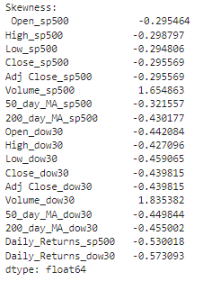
Descriptive characteristics about the variables(continue..) Summary based on the skewness values:
Most of the variables have a negative skew, meaning their distributions are skewed to the left. This includes the Open, High, Low, Close, and Adjusted Close prices for both the S&P 500 and Dow 30, as well as their 50-day and 200-day moving averages.
The Volume_sp500 and Volume_dow30 variables show a positive skew, indicating a long tail to the right of the distribution. as trading volume can spike significantly on certain days due to market events, leading to a distribution that is not symmetrical.
The Daily_Returns_sp500 and Daily_Returns_dow30 variables also show a negative skew, suggesting that negative returns might be more pronounced than positive returns in their distributions.

Slide 17
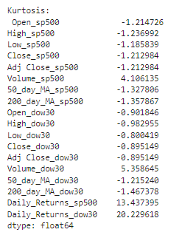
Descriptive characteristics about the variables(continue..) Summary based on Kurtosis:
Negative kurtosis indicates a distribution with lighter tails than the normal distribution.The Open_sp500, High_sp500, Low_sp500, Close_sp500, Adj Close_sp500, 50_day_MA_sp500, 200_day_MA_sp500, Open_dow30, High_dow30, Low_dow30, Close_dow30, Adj Close_dow30, 50_day_MA_dow30, and 200_day_MA_dow30 variables exhibit negative kurtosis, suggesting that their distributions are relatively flat with lighter tails than a normal distribution. This indicates fewer outliers and less extreme values in these variables.
Positive kurtosis indicates a distribution with heavier tails than the normal distribution, meaning it has more outliers.The Volume_sp500 and Volume_dow30 variables have positive kurtosis values,This suggests the presence of outliers or extreme values, which is common in trading volume data due to large fluctuations on specific days.
Positive kurtosis indicates a distribution with heavier tails than the normal distribution, meaning it has more outliers. The Daily_Returns_sp500 and Daily_Returns_dow30 variables show very high positive kurtosis, indicating extremely heavy tails. This suggests a significant presence of outliers and a high risk of extreme values.

Slide 18
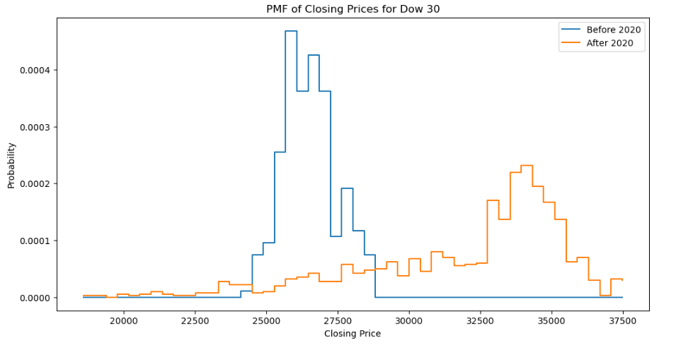
PMF of closing price dow30 - closing price before and after 2020 Here we can consider only the closing price, and compare Closing Prices Before and After 2020 Using PMFs. here the 2020 was chosen because of the century(2000) and we had COVID situation around 2020. we can plot the distribution of closing price change before and after COVID situation (2020).The PMF gives a clear visual representation of how the distribution of closing prices has changed from one period to another. dow 30 - here there is a shift in the distribution of closing prices from before to after 2020.Before 2020, the PMF is concentrated at lower closing price values, particularly around the 20,000 to 25,000 range.After 2020, the closing prices' PMF shifts to the right, indicating an increase in the closing prices of Dow 30, with a concentration around the 30,000 to 35,000 range. This suggests that the closing prices were generally higher after 2020 compared to before index price.

Slide 19
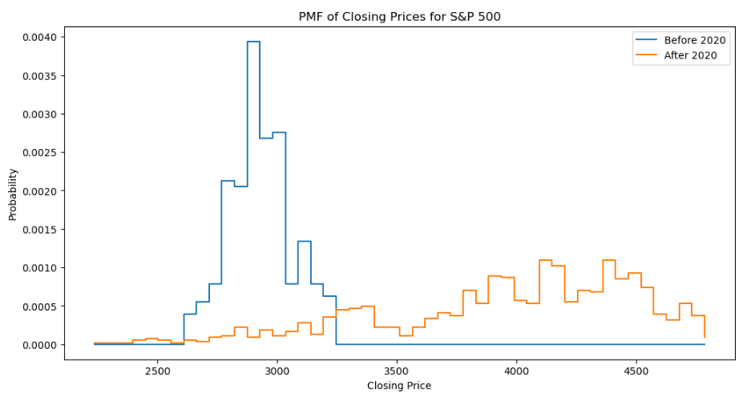
PMF of closing price dow30 - closing price before and after 2020 Here we can consider only the closing price, and compare Closing Prices Before and After 2020 Using PMFs. here the 2020 was chosen because of the century(2000) and we had COVID situation around 2020. we can plot the distribution of closing price change before and after COVID situation (2020).The PMF gives a clear visual representation of how the distribution of closing prices has changed from one period to another. S&P 500 - here there is a shift in the distribution of closing prices for the S&P 500 after 2020, with the PMF concentrated at higher closing price values.Before 2020, the PMF peaks around the 2500 to 3000 range, which indicates that most of the closing prices were within this range
After 2020, the distribution becomes flatter with a wider spread of closing prices, and the concentration seems to be more towards the 3500 to 4000 rang.The tail of the distribution for the period after 2020 extends to higher closing prices, which were less frequent before 2020. This indicates the occurrence of higher closing prices more regularly after 2020.

Slide 20
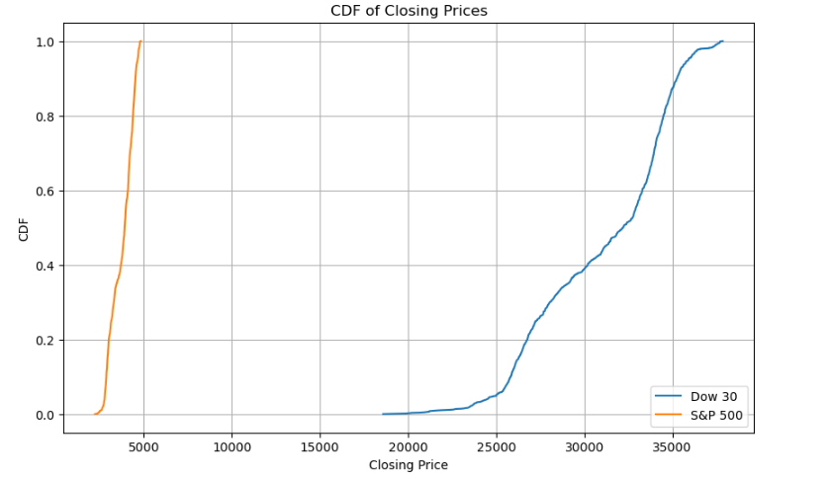
CDF of the closing prices of the Dow 30 and S&P 500 The CDF plot for the closing prices of the Dow 30 and S&P 500 provides a visual comparison of the price distributions for both indices. The S&P 500's CDF curve appears to start rising at a lower closing price and continues to a higher closing price compared to the Dow 30's CDF. The S&P 500's curve shows a more gradual slope, indicating a more even distribution of closing prices, while the Dow 30's curve is steeper, indicating more concentration in a narrower range of closing prices. The S&P 500 index exhibits a more gradual slope compared to the Dow 30, which has a steeper curve. we can infer that the S&P 500 index has greater volatility than the Dow 30.

Slide 21
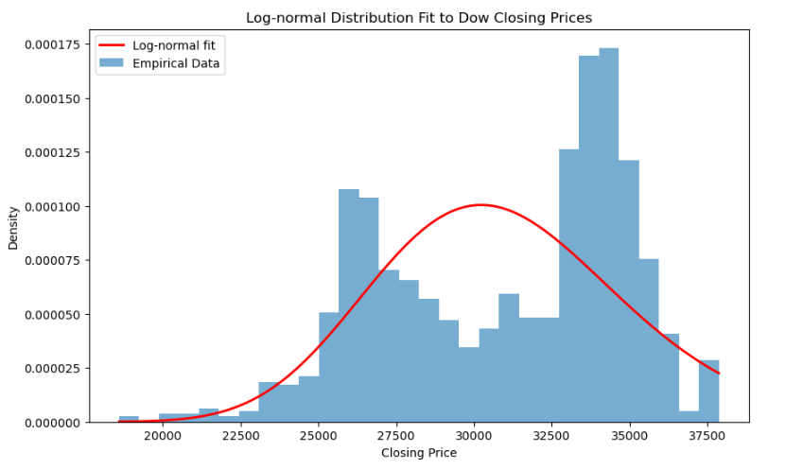
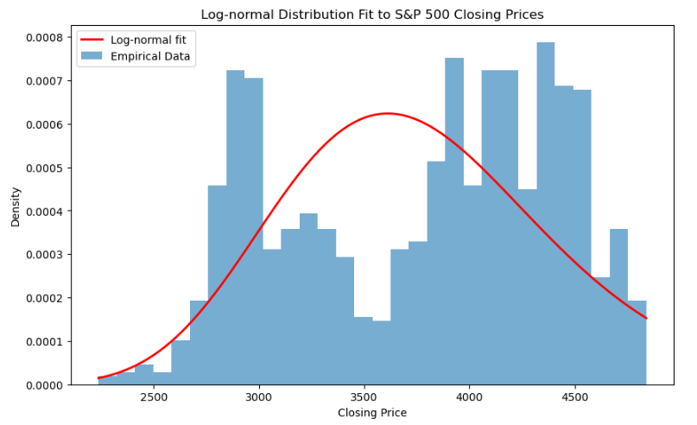
Analytical distribution plot we are using log-normal, because log-normal distribution is often used to model the distribution of stock prices because stock prices cannot be negative, and the log-normal distribution is bounded at zero from the left, which aligns with this characteristic.
S&P 500 - The histogram bars represent the empirical data of closing prices, and the curve is the log-normal distribution that has been fit to this data. The fit suggests that the majority of the data clusters around a certain range, and there's a long right tail, indicating that there are periods where the closing prices are significantly higher than the average.
Dow 30 - he fit suggests that the majority of the data clusters around a certain range, and there's a long right tail, indicating that there are periods where the closing prices are significantly higher than the average. This plot also shows a similar pattern with a peak and a long tail to the right.

Slide 22
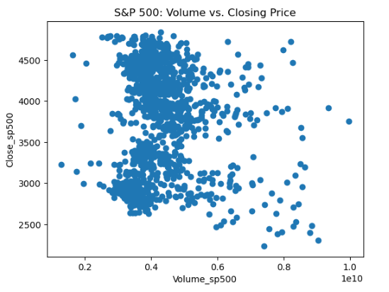
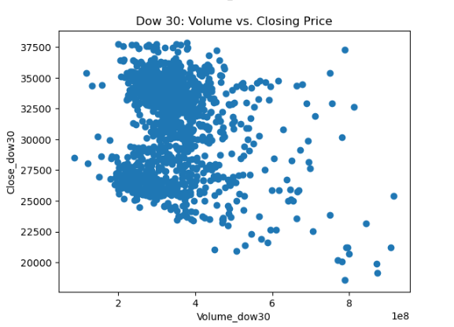
Scatter plots comparing two variables - Analysis on correlation and causation In both cases, the lack of a clear trend could suggest that on any given day, the closing price is influenced by multiple factors, not just the volume of trades.
Analyzing Correlation and Causation
Here the scatter plots imply that the trading volume isn't a strong predictor of closing price for the S&P 500/dow 30, or that the relationship isn't linear. These scatter plots suggest that for both the S&P 500 and the Dow 30, the relationship between trading volume and closing price is not strongly linear. Here S&P 500 - The Pearson's correlation coefficient of -0.063 suggests a very weak negative linear relationship between the variables. This implies that as one variable increases slightly, the other variable tends to decrease slightly, but the relationship is so weak that it's almost negligible. Here dow 30 - The Pearson's correlation coefficient of -0.178 suggests a weak negative linear relationship. It's a bit stronger than the correlation for the S&P 500 but still considered weak.

Slide 23

Hypothesis test - that the S&P 500 is more volatile than the Dow 30 - (F-Test) The null hypothesis (H0) for the F-test in this context would be:
H0: The variances of the two indices are equal.
H1: The variance of the S&P 500 returns is greater than the variance of the Dow 30 returns. The F-statistic of 1.0417 suggests that the variance of the S&P 500's daily returns is slightly larger than the variance of the Dow 30's daily returns because the value is greater than 1.
The p-value of 0.2346 is greater than the common significance levels of 0.05, which means there is not enough statistical evidence to reject the null hypothesis that the variances of the two indices are equal.
Here we cannot conclude the S&P 500 is more volatile than the Dow 30 based on the data, a high p-value does not prove the null hypothesis; it simply means that there isn't enough evidence to support the alternative hypothesis. In this case, it means that based on the available data, you cannot confirm that the S&P 500 is more volatile than the Dow 30.
The p-value tells us that if the two indices truly had the same volatility, there is a 23.46% chance of observing a ratio of variances at least as extreme as 1.0417 just by random chance.

Slide 24
Hypothesis test - that the S&P 500 is more volatile than the Dow 30 - (F-Test) The null hypothesis (H0) for the F-test in this context would be:
H0: The variances of the two indices are equal.
H1: The variance of the S&P 500 returns is greater than the variance of the Dow 30 returns. The F-statistic of 1.0417 suggests that the variance of the S&P 500's daily returns is slightly larger than the variance of the Dow 30's daily returns because the value is greater than 1.
The p-value of 0.2346 is greater than the common significance levels of 0.05, which means there is not enough statistical evidence to reject the null hypothesis that the variances of the two indices are equal.
Here we cannot conclude the S&P 500 is more volatile than the Dow 30 based on the data, a high p-value does not prove the null hypothesis; it simply means that there isn't enough evidence to support the alternative hypothesis. In this case, it means that based on the available data, you cannot confirm that the S&P 500 is more volatile than the Dow 30.
The p-value tells us that if the two indices truly had the same volatility, there is a 23.46% chance of observing a ratio of variances at least as extreme as 1.0417 just by random chance.

Slide 25
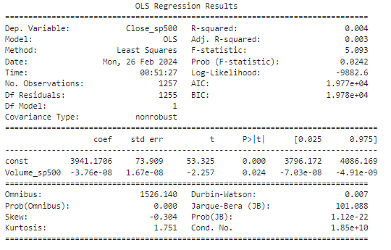
Linear regression model summary:
Dependent Variable: Close_sp500
R-squared: 0.004
Adj. R-squared: 0.004
F-statistic: 5.640
Prob (F-statistic): 0.0177
const: The intercept is 3952.0388, indicating the expected value of Close_sp500 when Volume_sp500 is 0Coefficients-
Volume_sp500: The coefficient is -3.948e-08, suggesting a very small negative impact of volume on the closing price. For each unit increase in volume, the closing price is expected to decrease by this coefficient's value, holding other factors constan
The R-squared value of 0.004 is extremely low, indicating that only 0.4% of the variance in the S&P 500's closing prices is explained by the model. This suggests that trading volume alone does not significantly explain changes in the closing price.
The F-statistic and its corresponding p-value (0.0177) indicate that the model is statistically significant at conventional significance levels (0.05). This suggests that there is some relationship between volume and closing prices, although the effect is very small.
Coefficient of Volume_sp500: The negative coefficient indicates an inverse relationship between volume and closing price
The p-value for the volume coefficient is 0.018, which is less than 0.05, suggesting that the relationship between volume and closing price, while very small, is statistically significant.
In summary, while there is a statistically significant relationship between trading volume and closing prices for the S&P 500, the actual impact of volume on closing prices appears to be minimal based on this analysis. Expanding the model to include more variables or exploring different types of models could yield more informative result.

Slide 26
THANK YOU
ANBUSLVAN MAHALINGAM
302-513-4676

