Slide 1
Battle of Neighbourhoods

Slide 2
Introduction
A chain of restaurant owners in Ontario want to expand their business. Currently they have their restaurants open in cities like Vancouver, Stratford and Hamilton.
They figured out that they would make more profit by opening up a restaurant in Toronto as Toronto is the largest city of Canada.
They are having trouble figuring out which place to chose within Toronto to open their new restaurant.
This project aims to figure out few places where there business will be good and have a competitive advantage.

Slide 3
Data Acquisition
First Dataset : List of neighbourhoods in Toronto
Data source: https://en.wikipedia.org/wiki/List_of_postal_codes_of_Canada:_M
Geospatial_Coordinates.csv file
The final Data Set contains 5 columns: Post Code, Borough, Neighbourhood, Latitude, Longitude and 103 rows having 103 unique neighbourhoods of Toronto and 5 unique Boroughs.
Second Dataset : List of different venues in the neighbourhoods of Toronto
Used Foursquare location data to explore different venues in each neighbourhood of Toronto
Use the geographical coordinates from above dataset to generate this location dataset.

Slide 4
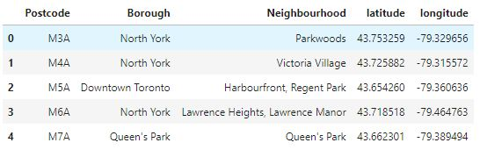
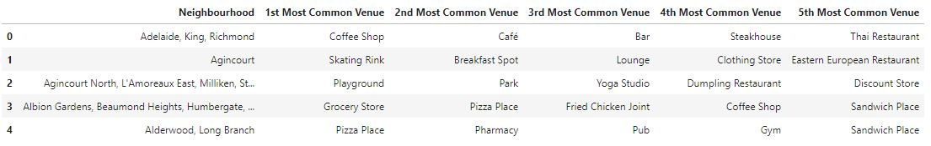
First Dataset with Postcode , Neighborhood and its Latitude and Longitude values
Second Dataset with Neighborhoods and its top 5 Common venues obtained using Foursquare data

Slide 5

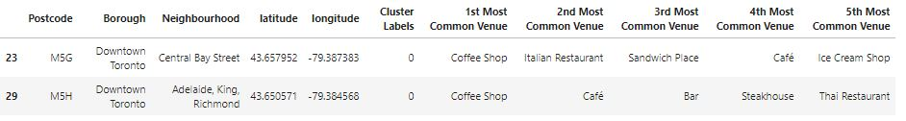
Methodology and analysis
Used K-means clustering algorithm to make clusters of the Neighbourhood dataset so that the analysis of all the neighbourhoods is easy,
5 clusters were created out of which only one was to be selected for further analysis.
Cluster with label 0 was selected as it had lowest Neighbourhood/Restaurant ratio.
After further analysis, only 2 neighbourhood remained which were perfect for opening a new restaurant- Central Bay Street, Downtown Toronto & Adelaide, King, Richmond, Downtown Toronto

Slide 6
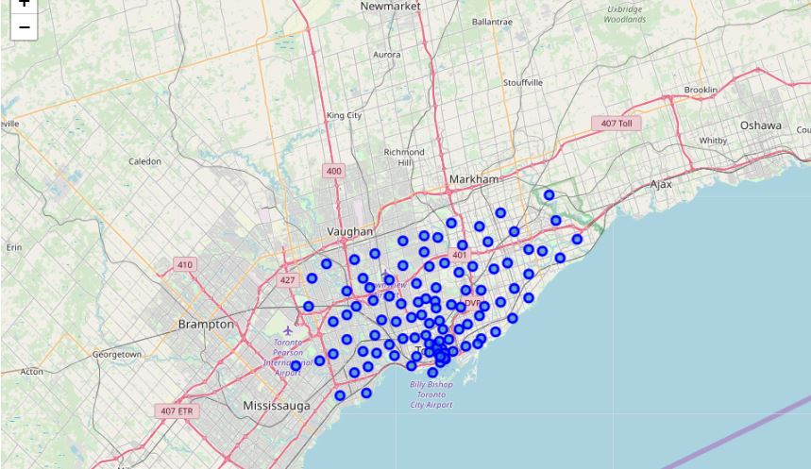
VISUALIZATION – Map Of Toronto City With All Its Neighbourhood Marked in Blue

Slide 7
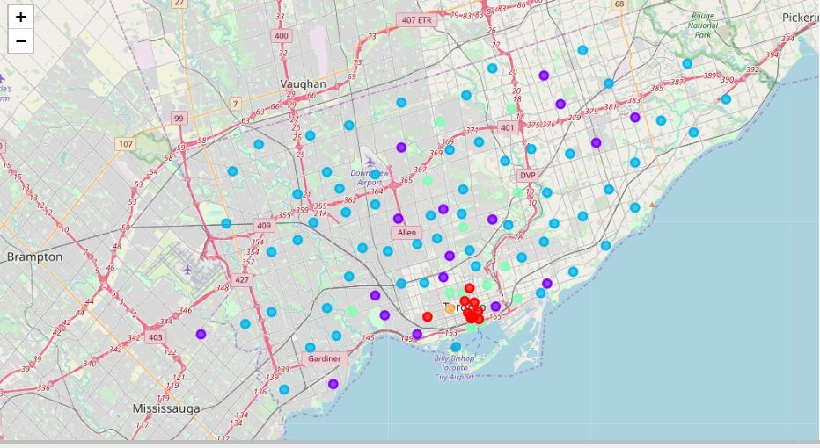
Map After Assigning 5 Cluster To Each Neighbourhood in Toronto
* Different colours represent neighbourhoods belonging to different cluster *

Slide 8
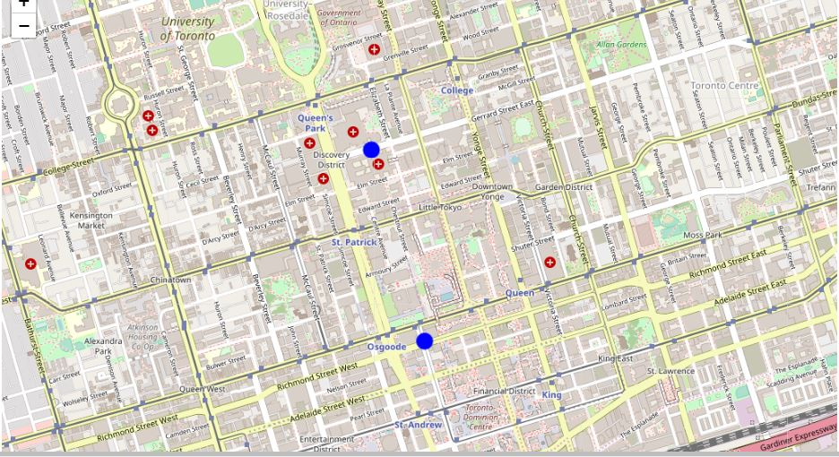
Maps Representing 2 Neighbourhoods Suitable For Opening Restaurant marked with blue dots -Central Bay Street - Adelaide, King, Richmond

Slide 9
conclusion
Purpose of this project was to identify neighbourhoods in Toronto which have low number of restaurants in order to aid stakeholders in narrowing down the search for optimal location for a new restaurant.
By calculating restaurant density distribution from Foursquare data we have first identified the most common nearby venues of each neighbourhood.
Then with the help of clustering techniques and further analysis we were able to narrow down our analysis to 2 neighbourhoods - Central Bay Street,Downtown Toronto and Adelaide, King, Richmond, Downtown Toronto which were good for opening up a new restaurant.
This concludes this project of Battle of Neighbourhoods.

Slide 10
THANK YOU

