Slide 1

Deep Learning: Convolutional Neural Networks

Slide 2
Brief Discuss About Deep Learning
Neural Network
Layer based architecture forms the basis of deep learning.
Next: Neural Network’s Architecture
Notes:
Neural network forms the basis of the deep learning.
Next we will talk about the architecture of the neural network.

Slide 3
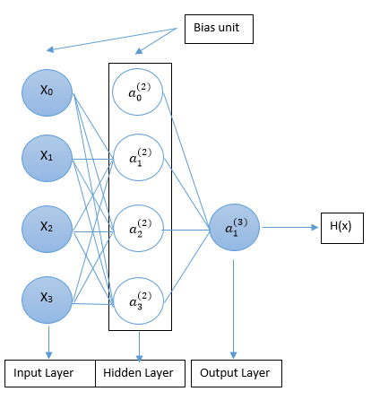

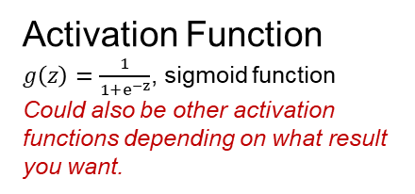
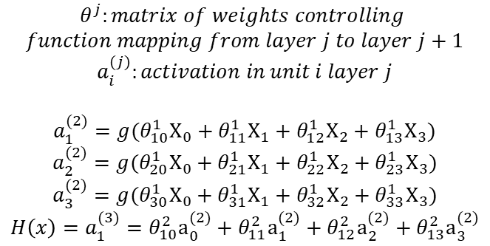
Architecture of Neural Network
Forward Pass
$$θ^{j}:matrix of weights controlling$$
$$function mapping from layer j to layer j+1$$
$$a_{i}^{(j)}:activation in unit i layer j$$
$$a_{1}^{(2)}=g(θ_{10}^{1}X_{0}+θ_{11}^{1}X_{1}+θ_{12}^{1}X_{2}+θ_{13}^{1}X_{3})$$
$$a_{2}^{(2)}=g(θ_{20}^{1}X_{0}+θ_{21}^{1}X_{1}+θ_{22}^{1}X_{2}+θ_{23}^{1}X_{3})$$
$$a_{3}^{(2)}=g(θ_{30}^{1}X_{0}+θ_{31}^{1}X_{1}+θ_{32}^{1}X_{2}+θ_{33}^{1}X_{3})$$
$$H\left(x\right)=a_{1}^{(3)}=θ_{10}^{2}a_{0}^{(2)}+θ_{11}^{2}a_{1}^{(2)}+θ_{12}^{2}a_{2}^{(2)}+θ_{13}^{2}a_{3}^{(2)}$$
$$θ_{10}^{1}$$
$$θ_{11}^{1}$$
$$θ_{12}^{1}$$
$$θ_{13}^{1}$$
Activation Function
$g\left(z\right)=\frac{1}{1+e^{−z}}$, sigmoid function
Could also be other activation functions depending on what result you want.
Notes:
There are input layer (first layer), hidden layer (layers in the middle) and output layer (layer at the end) in a neural network.
Forward pass:
We will add a bias unit at each layer. Each unit on a layer will have several connection to each unit on the next layer. If we want to compute the value of a specific unit on the next layer. We will multiply the each unit with its corresponding weight that maps it to that specific unit on the next layer. Then we will add them together.
Activation Function:
We use sigmoid function in this case. We will discuss it on the next page.

Slide 4
Activation Function
Requirements:
It must be continuous.
Better if monotonic (does not change direction).
Better if nonlinear.
Should be computed efficiently
Examples of other activation functions:
Softmax: return the probability score of each entry
Relu: converting negative entry to 0
Notes:
Several constraints an activation function has.
Examples: relu, softmax, sigmoid, etc.

Slide 5
Deep Learning
Computer Vision
Text and Sequence processing
etc

Slide 6
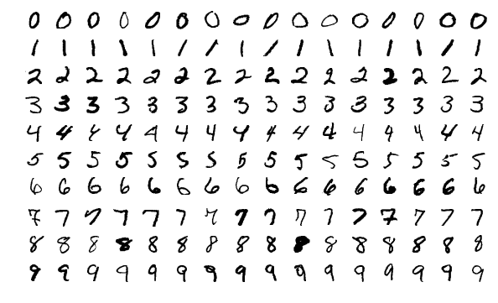
MNIST problem
Notes:
A ‘hello world’ problem in the field of deep learning (computer vision, image processing).
There are 60000 training images and 10000 test images in the dataset, while each image has a dimension of 28x28.

Slide 7
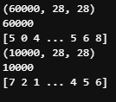
Data exploration
(train_images, train_labels), (test_images, test_labels) = mnist.load_data()
print(train_images.shape)
print(len(train_labels))
print(train_labels)
print(test_images.shape)
print(len(test_labels))
print(test_labels)
We have 60000 images in our training set; each of them is represented by a 28 x 28 matrix. The label will be represent by a integer.
We also have 10000 images in our test set.
Notes:
First, we need to import data from the keras.mnist API. This will import 60000 training images and 10000 test images mentioned previously.
As shown in the console, the shape of the training images and test image is (60000, 28, 28) and (10000, 28, 28) respectively. Each image is represented by a 2D numpy.array with a dimension of 28 x 28. There are 60000 and 10000 of this 2D numpy.array in the training set and test set.
On the other hand, the label are also imported. Their data type is integer. This is used to compare with our result generated by the neural network.

Slide 8
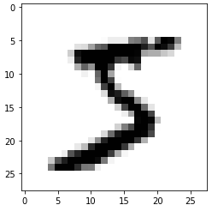
digit = train_images[0]
import matplotlib.pyplot as plt
plt.imshow(digit, cmap=plt.cm.binary)
plt.show()
Notes:
We could use the matplotlib API to show one of our train images.

Slide 9
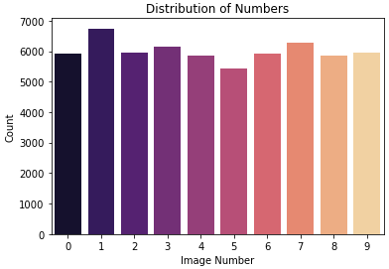
Data Distribution
This is a fairly uniformly distributed data, each with a sample number from 5000-7000

Slide 10
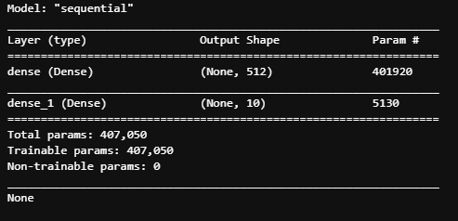
Create Layer
from tensorflow.keras import models
from tensorflow.keras import layers
network = models.Sequential()
network.add(layers.Dense(512, activation='relu', input_shape=(28 * 28,)))
network.add(layers.Dense(10, activation='softmax'))
print(network.summary())
Notes:
We will create the layer for the neural network (refer to NN).
In this case, we will simply create a dense layer (fully connected) NN.
First layer will takes in a input 1D array of 28x28 entries and then output a 1D array of 512 entries. The activation function for this layer is ‘relu’.
Second layer will takes in the 512 entries from the output of the previous layer and output a 1D array of 10 entries. The activation function of this layer is ‘softmax’. In this case, the index of entry with highest probability will be the predicted label from our NN model.

Slide 11
We just create a dense layered (fully connected) neural network.
For our first layer, the output would be an array of 512 elements. With “relu” activation function, all of the entry will be larger or equal to 0.
For our second layer, the output would be an array of 10 elements. With “softmax”, we will have a probability score on each of the entry.

Slide 12
Network compilation
network.compile(optimizer='rmsprop',
loss='categorical_crossentropy',
metrics=['accuracy'])
The loss function let the network to measure its performance on the training data.
The optimizer is the mechanism that the network use to update itself based on the loss function.
The matrices is to evaluate the model.
Notes:
We will compile the network by defining the loss function, optimizer, and the tracking matrix.

Slide 13
Data preprocessing
train_images = train_images.reshape((60000, 28 * 28))
train_images = train_images.astype('float32') / 255
test_images = test_images.reshape((10000, 28 * 28))
test_images = test_images.astype('float32') / 255
We will be reshaping the training image and test image date data set from a 3D matrix of shape (60000, 28, 28) into a 2D matrix of (60000, 28*28), which is an array of 60000 entries where each entry is an array with size of 28*28.
Also, we need to convert the value from int8 to float32
Notes:
We will preprocess the data by first reshape the training images and test image. We notice that we transform the 2D matrix used to represent the image to a 1D matrix. The number of images in both data sets remains the same. This step is to transform the input shape into the one the neural network expected.
Another thing need to be done is to convert the value in the matrix from int8 (ranges from 0 to 225) to float32 (ranges from 0 to 1).

Slide 14
Categorically encode the label
from tensorflow.keras.utils import to_categorical
train_labels = to_categorical(train_labels)
test_labels = to_categorical(test_labels)
Naive way of encoding 0-9 with a 1D matrix:
0 -> [1,0,0,0,0,0,0,0,0,0]
1 -> [0,1,0,0,0,0,0,0,0,0]
2 -> [0,0,1,0,0,0,0,0,0,0]
……
9 -> [0,0,0,0,0,0,0,0,0,1]
Notes:
This is the naïve way of encoding labels. The keras API will definitely not doing that!

Slide 15
Network Training
Procedures:
It will evaluate (predict) the output based on the input image. (Forward pass)
Then, it will compute the loss based on the loss function, which is the measurement of the mismatch between the prediction and the actual result.
Finally, the network will update its weights using the optimizer based on the loss function.
Repeat the above several times in order to get a well trained network. Here we will run 5 times, which we typically refer to epochs.
network.fit(train_images, train_labels, epochs=5, batch_size=128)
Result is on the next page.
Notes:
The above procedure will be repeated for 5 times in our case, but this will depend on how many epochs we set.

Slide 16
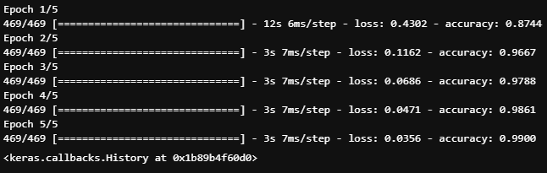
We get an accuracy of 99% from our training set. We will get into our test set shortly.
test_loss, test_acc = network.evaluate(test_images, test_labels)
print('test_acc:', test_acc)
The test accuracy is 97.9, which is quite different from our training accuracy. This is an example of overfitting.
We will improve it later.
Notes:
This is a overfitting problem, which means the prediction is too close to a particular set of data. In our case, it is too close to out training set; however, a bit far from our test set.

Slide 17
Possible modification
As you might notice, there is a gap between our training result and test result.
Is there any way to improve?
Yes, we will improve it by introducing the Convolutional Neural Network.
Notes:
We will introduce CNN for the rest of the module.

Slide 18
Computer Vision on Neural Network
Convolutional Neural Network:
Almost universally used in the field of computer vision applications.
We will apply it on our previous example MNIST, which is a image classification problem.
Notes:
Convnets has been popular and successful in the field of image processing.

Slide 19
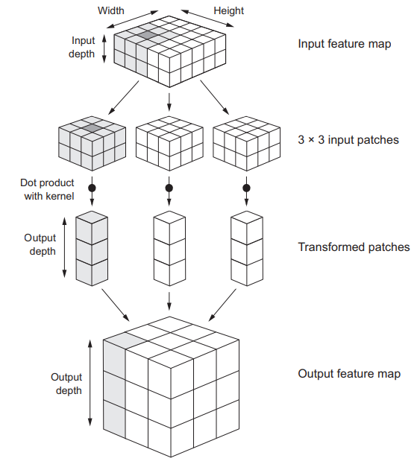
First intuition of Convnets

Slide 20
Difference between Dense layered NN
The convnets will take in tensor with shape of (image_height, image_width, image_channel)
Based on the intuition, you might have noticed that dense layer learns the global pattern while convnets learns the local pattern.
Notes:
The dense layer look at global pattern, while convnets look at local pattern.

Slide 21
Convolution Operation
Two Key parameters:
Size of the patches extracted from the inputs: in this case, it is 3 x 3, which is commonly used. It can also be 5 x 5.
Depth of the output feature map: the number of filters generated by the computation. We typically choose 32 or 64. Filter encode a certain aspect of the input data.
In keras, the parameter is passed in the following form:
Conv2D(output_depth, (window_height, window_width))
(window_height, window_width) refers to the size of patches
Notes:
When using Keras to create a covnets layer, there are two key parameters, size of patches and the depth of the output feature map.

Slide 22
Operation Procedure
Step 1: the (window_height x window_width) shaped window will stop at every possible location on the input.
Step 2: Several (window_height x window_width) input patches will be formed.
Step 3: Each of the patch will then be transformed into 1D vector of shape (output_depth,) by doing dot product with kernel.
Step 4: These 1D vectors will be spatially assembled into a 3D output of shape (height, width, output_depth).
See the 19th slides for a more intuitive understanding
Notes:
This operation articulate the four steps mentioned in the 19th slides.

Slide 23
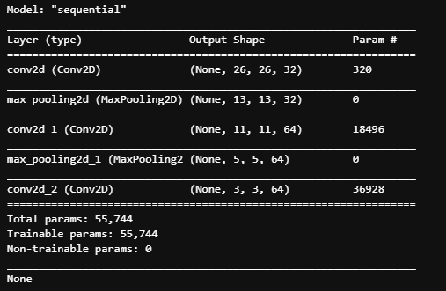
Implement the CNN
model = models.Sequential()
model.add(layers.Conv2D(32, (3, 3), activation='relu', input_shape=(28, 28, 1)))
model.add(layers.MaxPooling2D((2, 2)))
model.add(layers.Conv2D(64, (3, 3), activation='relu'))
model.add(layers.MaxPooling2D((2, 2)))
model.add(layers.Conv2D(64, (3, 3), activation='relu'))
print(model.summary())
As we can observe, the first layer takes in a input shape of (28,28,1) and the output shape become (26,26,32). This is because there are 26*26 valid positions for 3x3 patch on 28x28 input feature map.
There will be things that will effect the valid position such as border effects, padding and stride, etc.
Notes:
The implement of the CNN is shown by the python code.
Problem of border effects, padding or stride is been raised. These will be explained on next few slides.

Slide 24
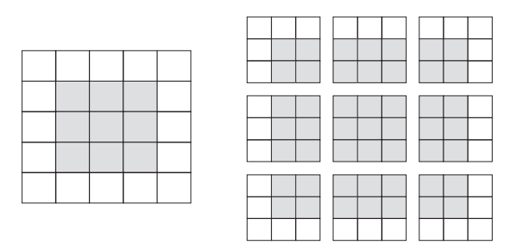
Border Effects
We could notice that the after convolutional operation; the output feature map will always shrink a little.
The example is valid locations of 3 × 3 patch in a 5 × 5 input feature map.
There is a way to avoid shrinking, which will use the padding method.
Notes:
The patches is formed by moving the specific sized patch around the image and stop at every valid location. The images shows the valid locations for 3x3 patch on a 5x5 input.
Padding will help to avoid shrinking.

Slide 25
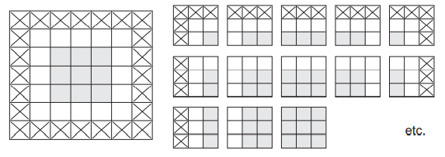
Padding
There will be more patches to be form; there should totally 25 of them, which is the same as the input feature map.
You can try to find them all.
Notes:
Padding is to add appropriate number of rows and columns to each side of the input feature map in order to fit the patch window around every input tile.
After padding, we could notice that the output shape of the 5x5 input feature map becomes 5x5 which is not shrinking.

Slide 26
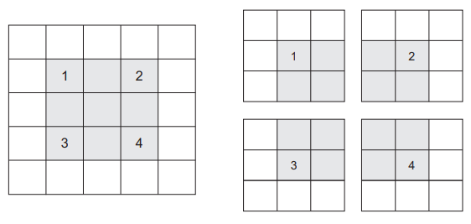
Stride
You could notice that each these patches has some distance between them on the input feature map.
Notes:
Strides refer to the distance between two successive windows. This diagram shows an example of valid locations of 3 x 3 patches with 2 strides from 5 x 5 featured map. Use 2 means downsampling the width and height of the output feature map by factor 2.
It is rarely used in convnets.

Slide 27
Max Pooling Operation
Down sampling the feature maps by transforming local patches via hardcoded max tensor operation.
It will output max value of each channel.
As we could see from the summary, the output feature map is being halved.
Notes:
Generally, it will use 2 x 2 patches with 2 strides. These 2 x 2 patches will be transformed via hardcoded max tensor operation instead using kernel as in step 3.
Its effect is similar to strides.

Slide 28
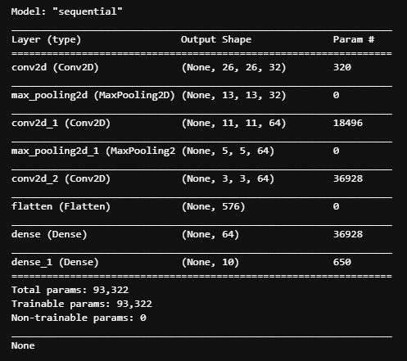
Implement Cont.
model.add(layers.Flatten())
model.add(layers.Dense(64, activation='relu'))
model.add(layers.Dense(10, activation='softmax'))
print(model.summary())
We will be creating the dense layered network after several convolutional operation
The diagram shows the structure of our convolutional neural network.
Notes:
After the convolutional operation, we still need dense layered NN to gather information from the operation and generate our desired output.

Slide 29
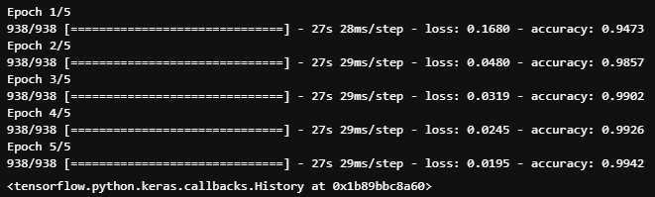
Data importing, preprocessing, etc
(train_images, train_labels), (test_images, test_labels) = mnist.load_data()
train_images = train_images.reshape((60000, 28, 28, 1))
train_images = train_images.astype('float32') / 255
test_images = test_images.reshape((10000, 28, 28, 1))
test_images = test_images.astype('float32') / 255
train_labels = to_categorical(train_labels)
test_labels = to_categorical(test_labels)
model.compile(optimizer='rmsprop',
loss='categorical_crossentropy',
metrics=['accuracy'])
model.fit(train_images, train_labels, epochs=5, batch_size=64)
Notes:
Adding previous code to import, preprocess data. Define loss function, optimizer, metrics. Then train the model for 5 epochs.

Slide 30
Improvement
test_loss, test_acc = model.evaluate(test_images, test_labels)
>>> 313/313 [==============================] - 1s 4ms/step - loss: 0.0238 - accuracy: 0.9922
As we could see, the training accuracy and test accuracy is 99.4% and 99.2% respectively. This is quite a improve, although more improvements could be made.
We make a huge progress by utilizing the convolutional neural network.
Notes:
We have made a huge improve on the accuracy by using convnets. We could still do more; however, it is a phenomenal job on our current stage.

Slide 31
Now, you might have felt the power of Convolutional Neural Network and why it has been so successful in computer vision.

Slide 32
reference
Deep Learning With Python by FRANÇOIS CHOLLET ©2018 by Manning Publications Co.
grokking Deep Learning by Andrew W. Trask ©2019 by Manning Publications Co.

