Slide 1
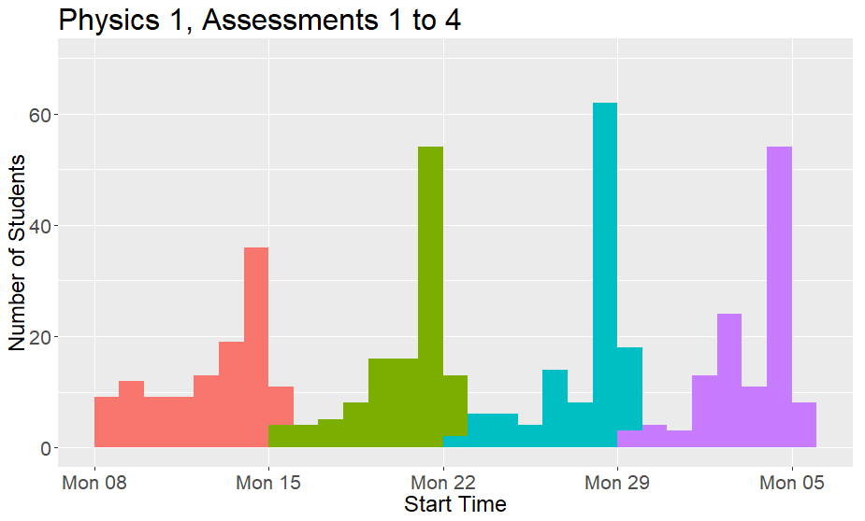
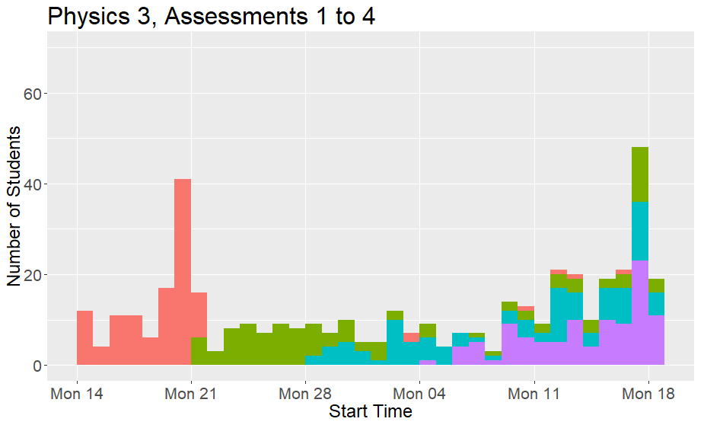
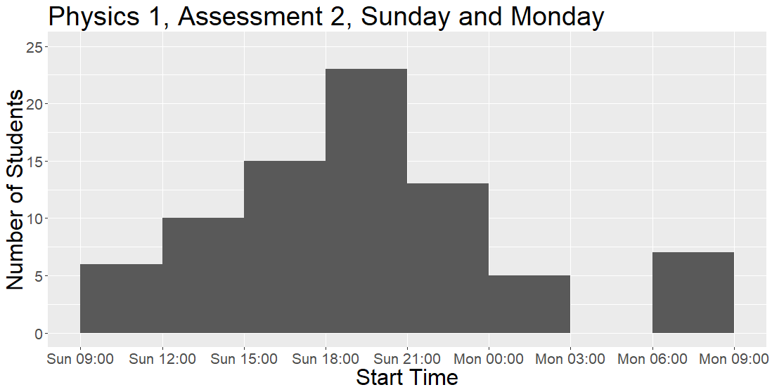
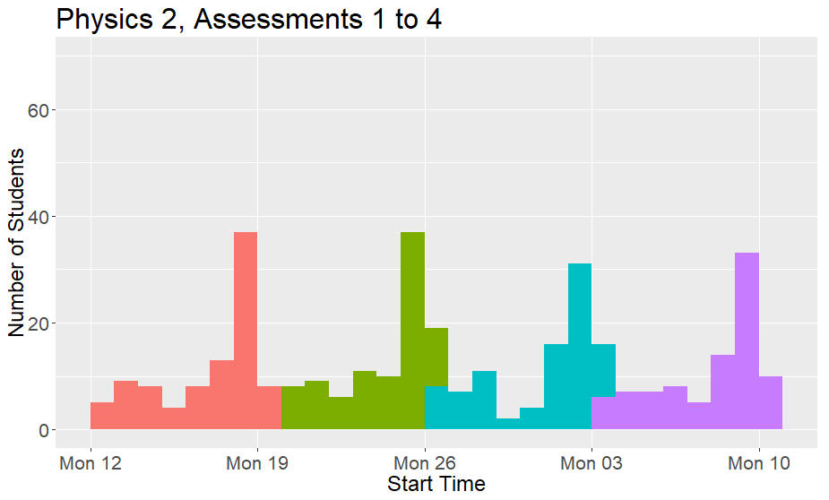
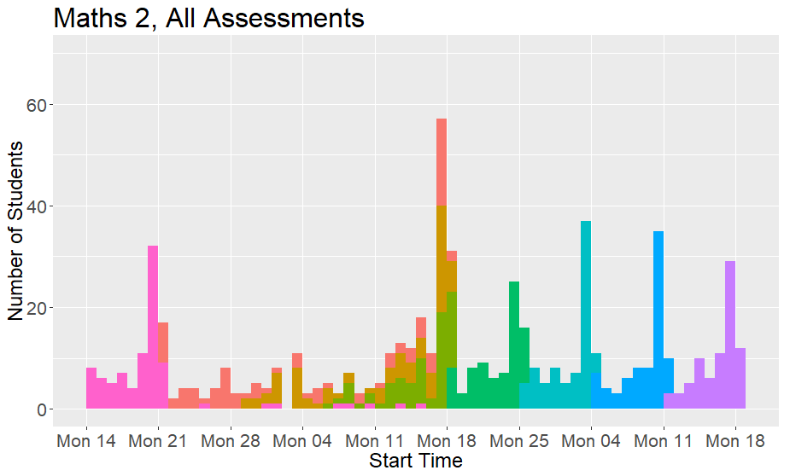
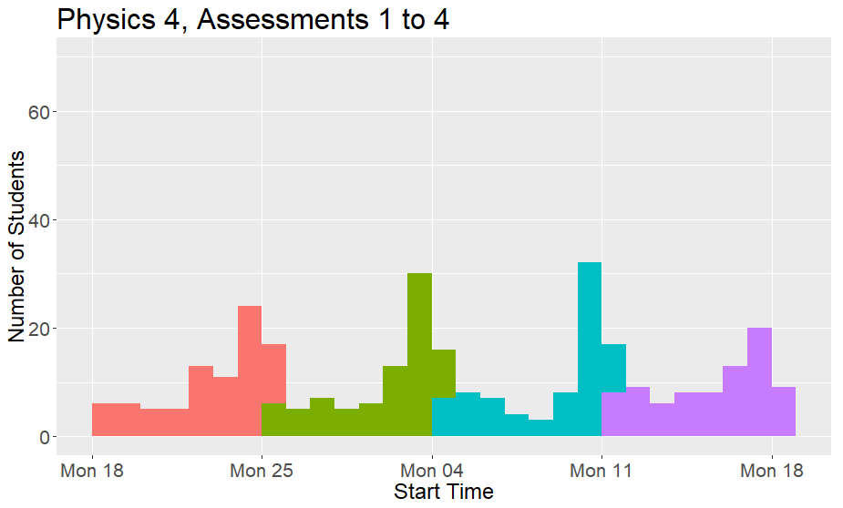
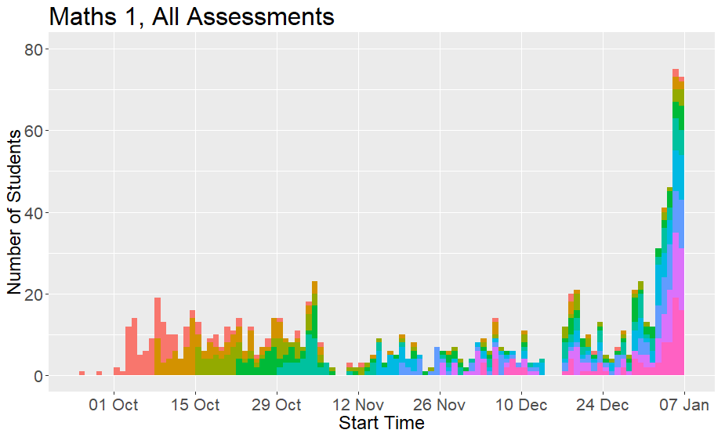
Do students do their homework last minute?
Lovkush Agarwal, la183@le.ac.uk, www.lovkush.com
Key Background Facts
Go to www.lovkush.com/homework.pdf for full details.
Start Time is the time students first open the e-assessment.
Can you determine the deadlines for the different modules and assessments?
Conclusions
Students are human! They respond to incentives.
Our choices have big impact on student behavior, as a cohort.
Particularly important if Week 2 material depends on Week 1.
Warning: Data is noisy and limited for various reasons, but overall pattern is clear.
Acknowledgements
I thank Paul Howes for obtaining the raw data from the system.
Any questions, comments, thoughts or feedback?
You are more than welcome to talk to me or send me an email.
la183@le.ac.uk, www.lovkush.com

