Slide 1


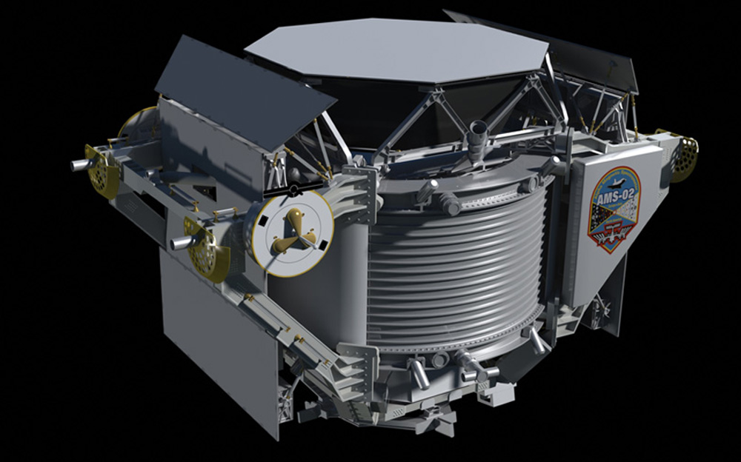
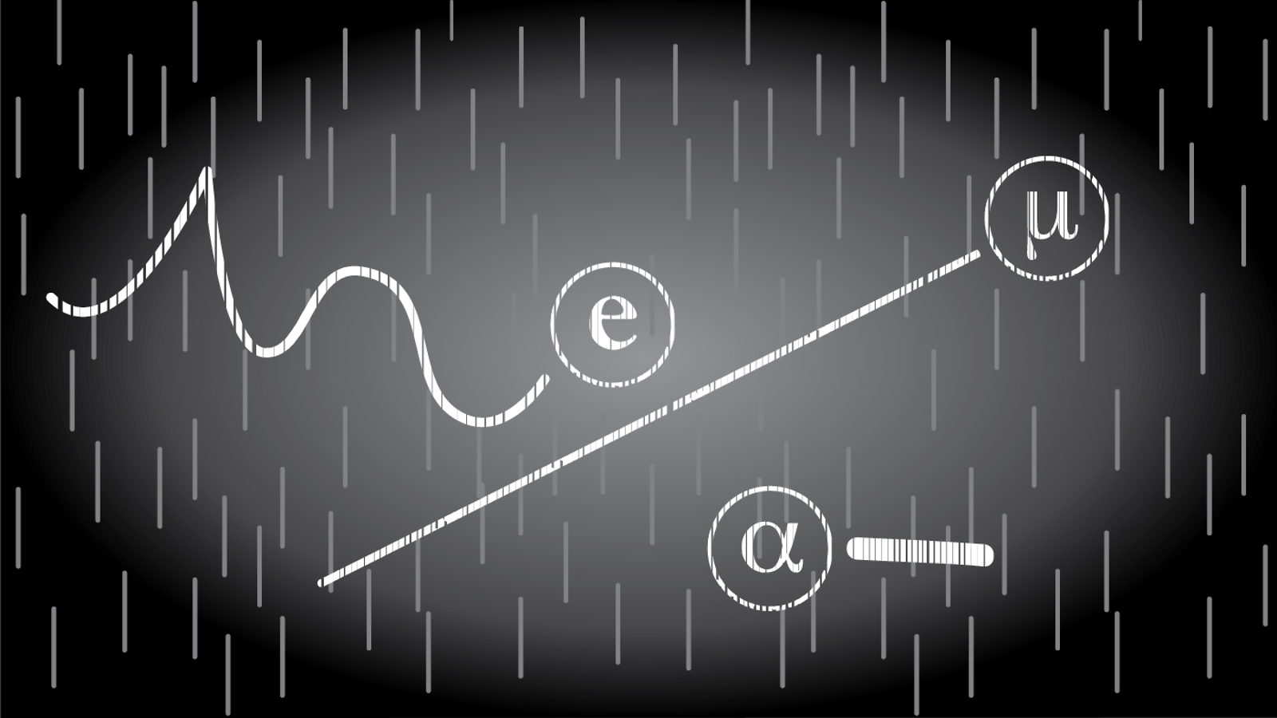
Particle Detector Project Design Review
Matilde Mazzini and Giorgia Mazzini
Issue: 18 April 2017
Artwork by NASA, Unknown. AMS Image on black [Photograph].
Retrieved from https://ams.nasa.gov/images_Overall_Summary_Photos.html
Artwork by Sandbox Studio, Chicago. Particles [Photograph]. Retrieved from
http://www.symmetrymagazine.org/article/january-2015/how-to-build-your-own-particle-detector

Slide 2
Particle Detector Project – Design Review
Outline
Introduction
Goals and Objective
What is a Particle Detector?
Components Description and Specifications
Risks Review, Issues
Schedule and Next Steps

Slide 3
Particle Detector Project – Design Review
Introduction
Matilde Mazzini
School: University of Pisa
Major: Computer Engineering
Career Interest: Computer Graphics
Hobby: Theatre
Giorgia Mazzini
School: University of Firenze
Major: Electrical Engineering
Career Interest: Robotics and Home Automation
Hobby: Kickboxing

Slide 4
Particle Detector Project – Design Review
Project Team
Project Sponsor:
Dr. Veronica Bindi (UHM, Dept of Physics and Astronomy)
Cheryl Sato Ishii (SPA)
Project Manager: Davin Sasaki (SPA)
Engineering Students: Matilde Mazzini, Giorgia Mazzini
SPA Support: Ryan Sugamoto, Clyde Kobashigawa
Space Science Outreach: Mary Kadooka, Sylvia Rocchi
Graduate Students: Katie Whitman, Claudio Corti

Slide 5
Particle Detector Project – Design Review
Goals and Objectives
Project Objectives: Actively involve students(high and middle school) in an inexpensive and simple scientific project. Known components. Modify features.
Goal: Build a detector prototype capable of detecting particles. Provide the software to pilot the device, to acquire data and to perform simple analyses.
Meeting Objectives: To share the progress of the prototype, receive suggestions to move on with the project.

Slide 6
Particle Detector Project – Design Review
What is a Particle Detector?
A particle detector : a device used to detect and track ionizing particles, produced by cosmic radiation, nuclear decay or reactions in a particle accelerator.
AMS-02 is a space detector that measure cosmic rays. Atlas is a detector that measure particles generated in accelerator.
So we want to project is a particle detector that is capable of detecting particles but also small (portable) and simple to use with:
Raspberry Pi Webcam GPS

Slide 7
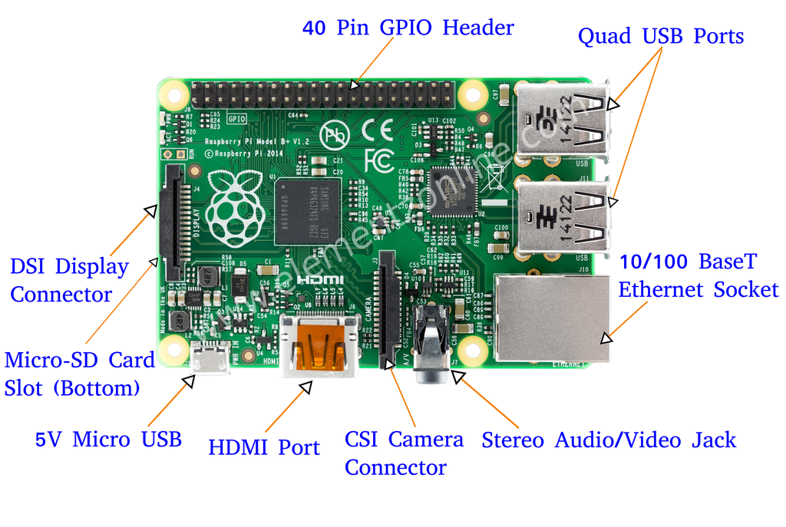
Particle Detector Project – Design Review
What is a Raspberry Pi? (1 of 2)
The Raspberry Pi is a small single-board computer developed to promote the teaching of basic computer science in schools.
Raspberry Pi 3 Model B
Dimensions:
85,6mmX56mmX21mm
CSI:Camera Serial Interface
GPIO: General Purpose Input/Output
http://beliketechies.blogspot.com/

Slide 8
Particle Detector Project – Design Review
What is a Raspberry Pi? (2 of 2)
Why?
Small, cheap, versatile.
Raspberry OS: Raspbian is Opensource.
High performances in terms of speed in image analysis and processing.
How?
Can be used with Monitor+Keyboard+Mouse (Desktop mode) or in Headless(SSH).
SSH: Secure Shell, is a network protocol to protect a client-server connection.
We can do remote login to Raspberry with our laptops.

Slide 9
Particle Detector Project – Design Review
Camera and GPS Components
Why Camera: Every camera has a CMOS sensor (complementary metal-oxide semiconductor) sensitive to ionizing particles (es: muons..).
How make CMOS as sensitive as possible: By covering with black tape and aluminium foil the camera lens, we eliminated visible light (photons). This allow us to observe penetrating rays such as beta/gamma rays and/or muons.
Which Camera:
Raspicam: Raspberry Camera Module, easiest way of communication between devices.
Webcam Logitech C270: compared to other webcams with same resolution(3MP) has bigger CMOS sensor (3,6*2mm), bigger size of pixels(2.8 µm). Often used in astronomical experiments for its versatility.

Slide 10
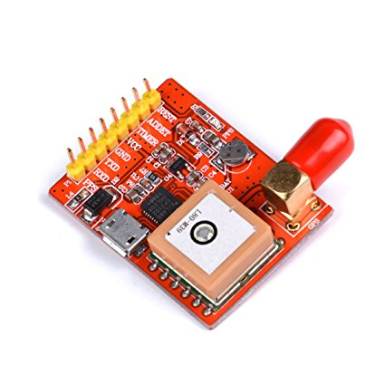
Particle Detector Project – Design Review
Camera and GPS Components
GPS Module: to keep track of time, date, position and altitude and geolocalise every image.
A USB GPS has been selected.
https://www.amazon.com/Makerfocus-Raspberry-Module-Converter-USB-Port-GPS/dp/B01MXRZRDD

Slide 11
Particle Detector Project – Design Review
Block Diagram – System (1 of 2)
Power Supply
GPS Module
Micro USB
Raspberry Pi Model 3B
TTL-USB
Keyboard + Mouse
USB
CSI/USB
Camera
GPIO
Monitor
Images Data Graphs
Protoboard (Button + LED)
CSI:Camera Serial Interface
GPIO: General Purpose Input/Outpu

Slide 12
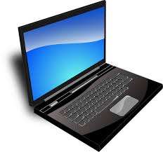
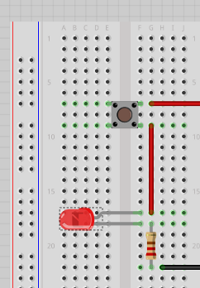
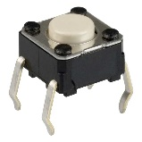
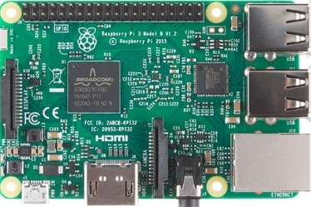
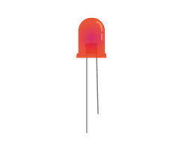
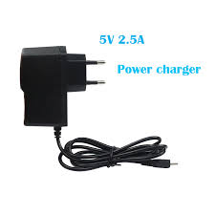
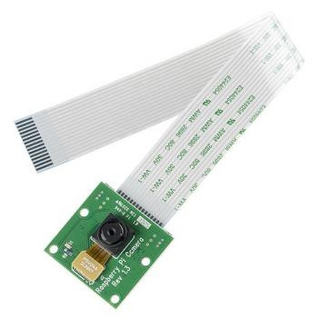
Particle Detector Project – Design Review
Block Diagram – System (2 of 2)
Switch button
Protoboard
http://laserpointerforums.com/f51/what-kind-switches-these-37117.html
https://pixabay.com/it/portatile-black-blu-schermo-33521/
https://computers.tutsplus.com/tutorials/how-to-use-a-breadboard-and-build-a-led-circuit--mac-54746
LED
https://www.raspberrypi.org/learning/python-quick-reaction-game/requirements/
https://hobbytronics.com.pk/product/raspberry-pi-3-model-b/
5V 2.4A Power Supply
GPS Module for Raspberry PI 3B
Raspberry Pi Camera Module V2 – 8MP
https://es.aliexpress.com/w/wholesale-usb-charger-raspberry-pi-3.html
https://www.amazon.com/Makerfocus-Raspberry-Module-Converter-USB-Port-GPS/dp/B01MXRZRDD
https://www.jakmall.com/computindo/raspberry-pi-camera-board-500w-pixels#6269968700855

Slide 13
Particle Detector Project – Design Review
Flow Diagram of Python code
Run program
Switch on LED
Camera starts capturing frames 10fps
c
To each frame is applied a threshold and converted to B/W
Sum the current frame with the previous one
When the button is pressed
Stop capturing frames
c
Save the final frame
c
Starts processing image, returns the number of detected events.
c
Switch off the LED

Slide 14
Particle Detector Project – Design Review
Specifications (1 of 2)
# | ID | Specification | Type | Test Method | Verification
1 | HW1 | Shall have the capability to detect light particles | Hardware | Using two camera to compare data (if both cameras return same results then it works) | Test
2 | HW2 | Shall have a button that manually starts the detecting program | Hardware | Autoboot program | Test
3 | HW3 | Weight | Hardware | To be measured | Inspection
4 | HW4 | Dimensions | Hardware | 28x22x6 cm | Inspection
5 | SW1 | Shall be able to provide the following data: number of event, timelapse, image, GPS data. | Software | Using GPS Module | Test
6 | SW3 | With avaiable Wifi shall be able to turn on and off wirelessly (via ssh) | Software | Turn on and off the Particle Detector wireless | Test
7 | SW4 | Shall be able to turn on and off manually, if there is not wifi available | Software | External battery pack | Test

Slide 15
Particle Detector Project – Design Review
Specifications (2 of 2)
# | ID | Specification | Type | Test Method | Verification
8 | SW6 | Shall be able to send data to server | Software | TBD | Test
9 | SY1 | Shall be able to reset the system both manually and wirelessly | System | Battery Pack with On/Off Button or Reset Button | Test
10 | SY2 | Shall be able to capture and store data to the SD Card | System | RSB does it automatically | Done
11 | SY3 | Shall be able to add GPS data to the filtered frames | System | Python Code | Test
12 | SY4 | The Raspberry Pi shall be able to count the number of rays that are detected in a given time | System | Python Code | Test
13 | SY5 | Shall have an Introduction on how to use the system document | System | Tutorial/Daily Report | Test
14 | SY6 | Shall have an assembly Instructions on how to put the system together | System | Tutorial/Daily Report | Test
15 | SY7 | The system shall be safe for students to handle | System | TBD | Test

Slide 16
Particle Detector Project – Design Review
Risk Review
ARDUINO OR RASPBERRY PI Arduino not powerful enough.
Mitigation: decided for Raspberry Pi.
TEST OUTSIDE WITHOUT WIFI We cannot remotely control the device.
Mitigation: create an auto-boot program.
RADIOACTIVE SOURCE Testing without a source was a waste of time. Need immediate response from camera.
Mitigation: borrow a stick of Cobalt 60(decays beta).
PARTICLES DETECTION Can’t detect particles in a reasonable amount of time (rarity).
Mitigation: find bigger sensor or include multiple cameras.

Slide 17
Particle Detector Project – Design Review
Issues
SSH: One of our laptops didn’t communicate Headless(SSH) with the Raspberry Pi. Solved with Monitor+Keyboard+Mouse
EXPOSURE We want the best view of our particles. One long exposure pic or the sum of multiple short exposure?
GPS was not locating the satellites, we were inside!
DETECTION Tests didn’t yield result! It is the camera, the source or the code? Tested camera with different software made just to analyze cosmic rays. We had results. Needed to improve our code.

Slide 18
Particle Detector Project – Design Review
Project Update (1 of 2)
Current status:
Connected with Raspberry all devices,
Modified Logitech with black tape and alluminium foil,
Wrote Python code,
Set up the protoboard with button and green LED,
Tests with Cobalto 60 source,
Provided Daily Reports which will be used as draft for instructions.

Slide 19
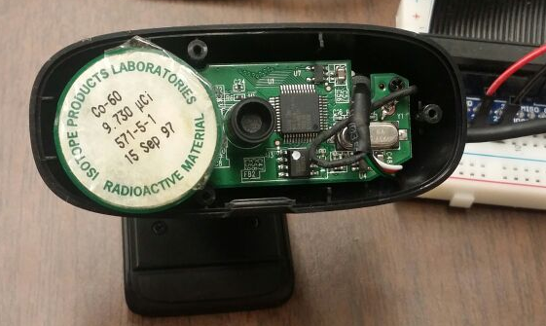
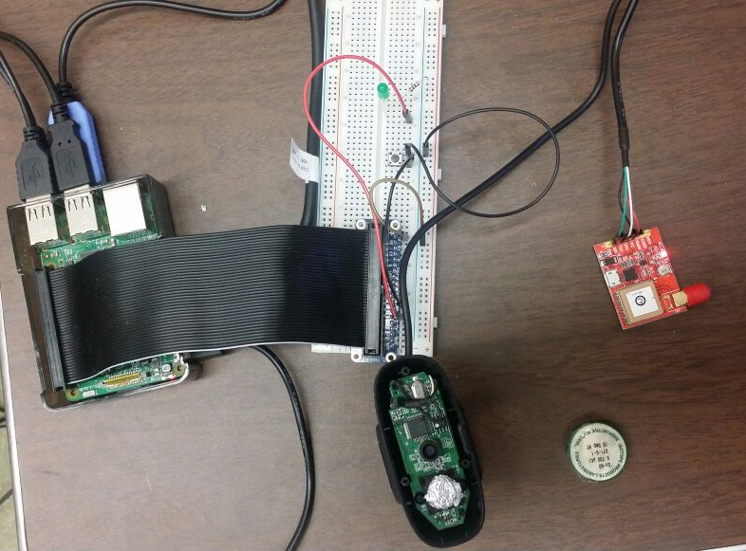
Particle Detector Project – Design Review
Project Update (2 of 2)
Whole system set up for tests
Modified Camera
Start Demonstration.

Slide 20

Particle Detector Project – Design Review
First Indoor Test <<Starry Night>>
Tests Mode: with source inside the office.
Duration of tests:
Start time: 18:11 / End time: 18:26
Total minutes: 15 min
Results:
Number of particles detected: 80.

Slide 21
Particle Detector Project – Design Review
Indoor Test 2017/04/17
Tests Mode: with cosmic muons inside the office.
Duration of tests:
Start time: 10:03 / End time:12:03
Total minutes: min=120
Results:
Number of particles detected: 3
Conclusions: rate is very low. Coeherent to the very low efficiency and size of sensor ɛ*.
* (ɛ is calculated with the source at 30fps: counted(not just seen) events per minute/decays per minute of the source ɛ=11/780=0.014 )

Slide 22
Particle Detector Project – Design Review
Next Steps
Improve Python Code:
- HW2: autoboot program - SY3: modify EXIF data to geotag images - SY1: reset program manually button - If an error occur: blinking LED - Return time of data taking
Complete Test Procedure for Acceptance Testing
Record Video Tutorial and write Documentation– How to use the Particle Detector
Complete Final Report
Prepare for Project Close and Lesson Learned

Slide 23
Particle Detector Project – Design Review
Lessons Learned
Ask for advices to experts, make research online.
Daily report of all the steps, take stock of the situation or you get lost, go off topic.
Constantly experiment without being afraid of making errors or fail, open mind.

Slide 24
Particle Detector Project – Design Review
Milestone Schedule
3/13: Kick Off Meeting - Done
4/18: Design Review
4/25: Build Prototype and Test
5/09: Acceptance Test
? : Test on Maunakea
5/23: Project Close and Lessons Learned
Today
Mar 26, '17
Apr 16, '17
May 7, '17
Start Mon 3/13/17
Finish Tue 5/23/17
Kickoff Meeting Mon 3/13/17
Design Review Tue 4/18/17
Acceptance Test Tue 5/9/17
Project Close and Lessons Learned Tue 5/23/17
Complete Prototype and Test Tue 4/25/17

Slide 25
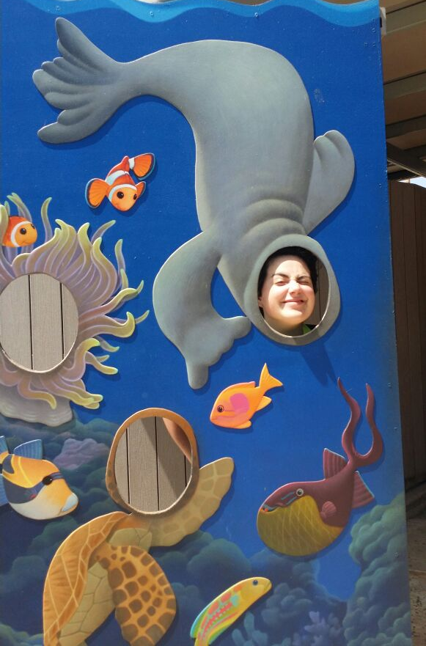
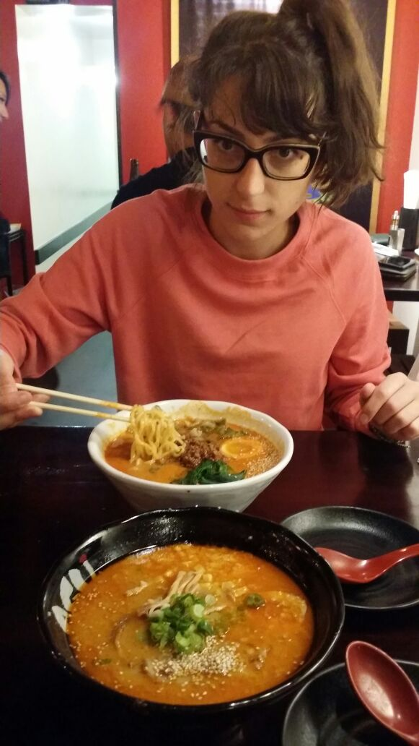
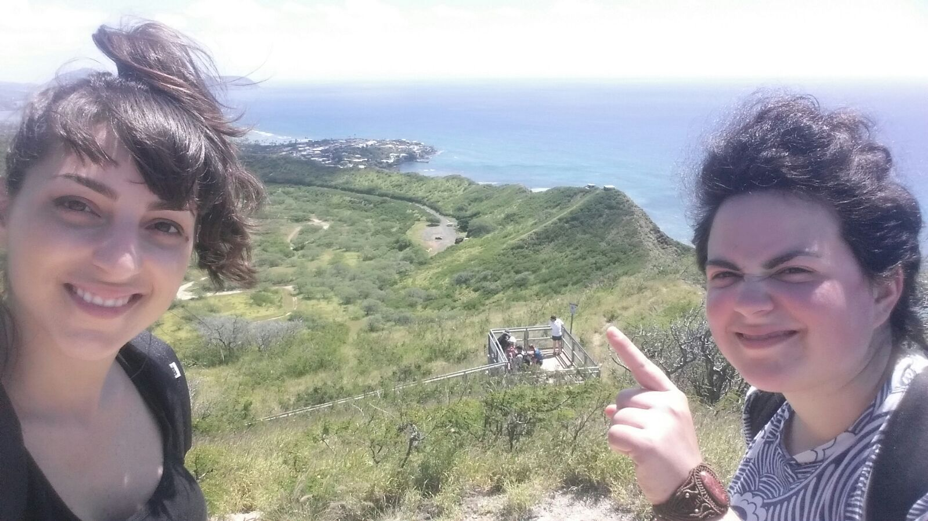
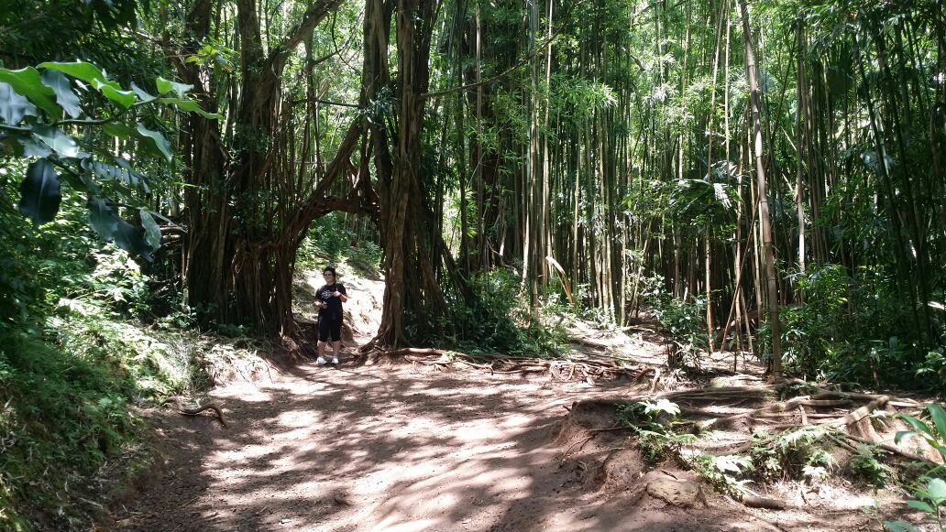
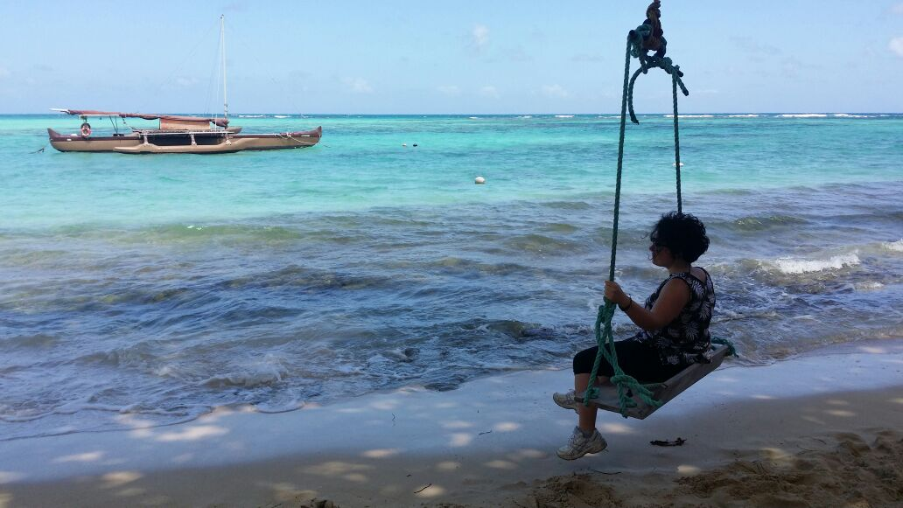
Particle Detector Project – Design Review
Enjoying Hawaii!

Slide 26
Thank you for your attention
For further information please contact:
Matilde Mazzini
Computer Engineering
University of Pisa
Email: mmazzini@hawaii.edu
Giorgia Mazzini
Electrical Engineering
University of Florence
Email: gmazzini@hawaii.edu

