Slide 1
人(溫度, ….)
遊戲(抽象化)
學生
老師
象棋
西洋棋

Slide 2
Print(UI)
Backend(logistic)
Other

Slide 3
Ary
Print(UI)
Backend(logistic)
Coordinate
把print加了class
Log

Slide 4
Ary
Print(UI)
Backend(logistic)
Log
把print加了class
Coordinate

Slide 5
Ary
ChineseChessBackend(logistic)
Interface 介面
AbstractBackend
Log
ChessBackend(logistic)
Coordinate
Print(UI)
把print加了class

Slide 6
Ary
PrintA(UI)
ChineseChessBackend(logistic)
Log
PrintB(UI)
ChessBackend(logistic)
Coordinate
PrintC(UI)
Others game

Slide 7
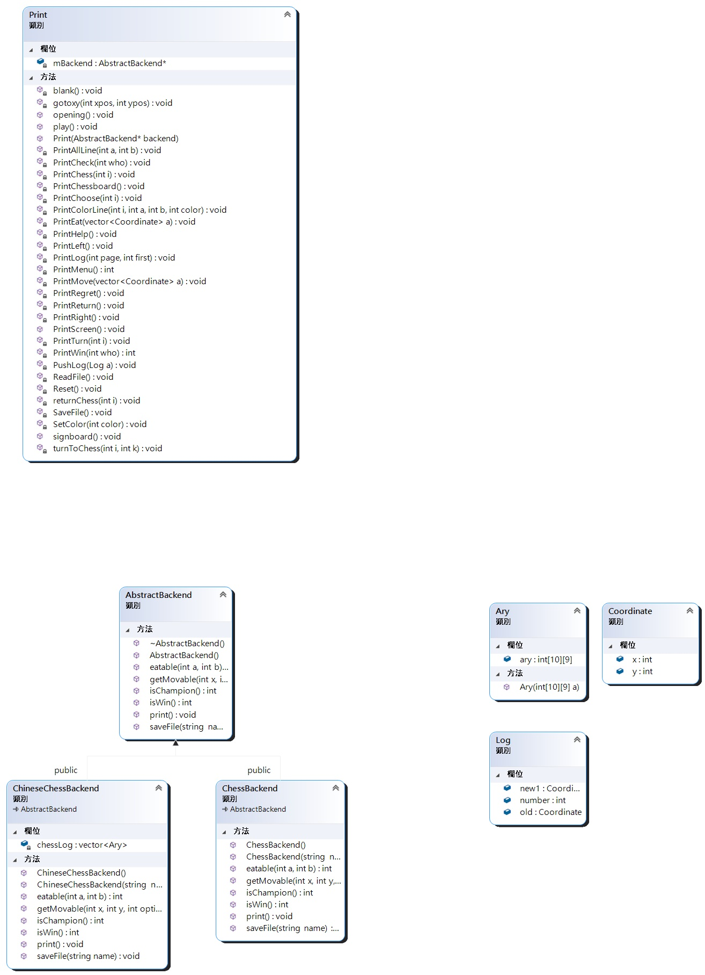

Slide 8
