Slide 1
Chapter 4
How to develop a data-driven MVC web app

Slide 2
In this chapter…
The focus is on building a simple but complete database (DB) driven ASP.NET Core MVC web app
We will use Microsoft’s framework Entity Framework (EF) core to model and interact with data stored in a relational DB
When it comes to working with EF Core there are two approaches, or schools of thought:
The code first approach
The database first approach
In this chapter we will start with a demo of the code first approach!

Slide 3
The basic idea
Our first app will be a basic CRUD (Create Read Update Delete) style web app that allows us to list, create, edit, and delete basic Movie entities
That is, “Movies” are our main domain entity for this first app
The next few slides show some screenshots of the end solution
And then let’s also demo a finished solution

Slide 4
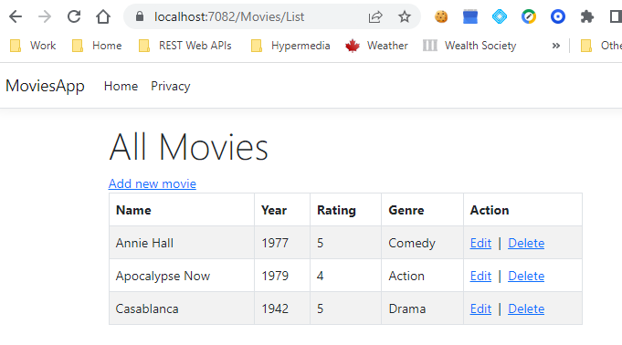
The Movie List page of the Movie List app

Slide 5
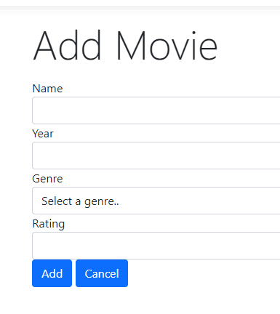
The Add Movie page of the Movie List app

Slide 6
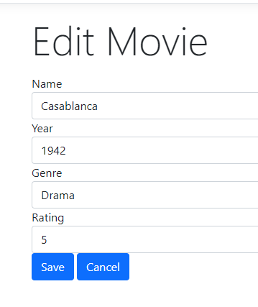
The Edit Movie page of the Movie List app

Slide 7
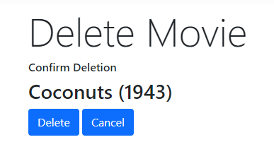
The Confirm Deletion page of the Movie List app

Slide 8
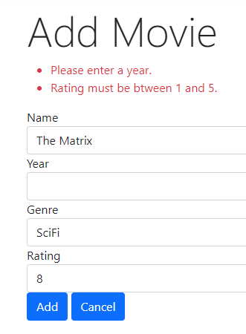
Some validation errors…

Slide 9
Putting this all together…
A series of messy diagrams but they are an attempt to make sense of the interactions in this Movie List web app
And does so in a “resource-oriented” way
More on what that means later but for now simply think of resources as the conceptual things (on the server side) that your web app interacts with via HTTP GET or POST requests
They are identified by URLs
Concrete representations (or “views”) of them are returned to the client
In formats such as HTML, JSON, jpeg, PDF, etc…

Slide 10
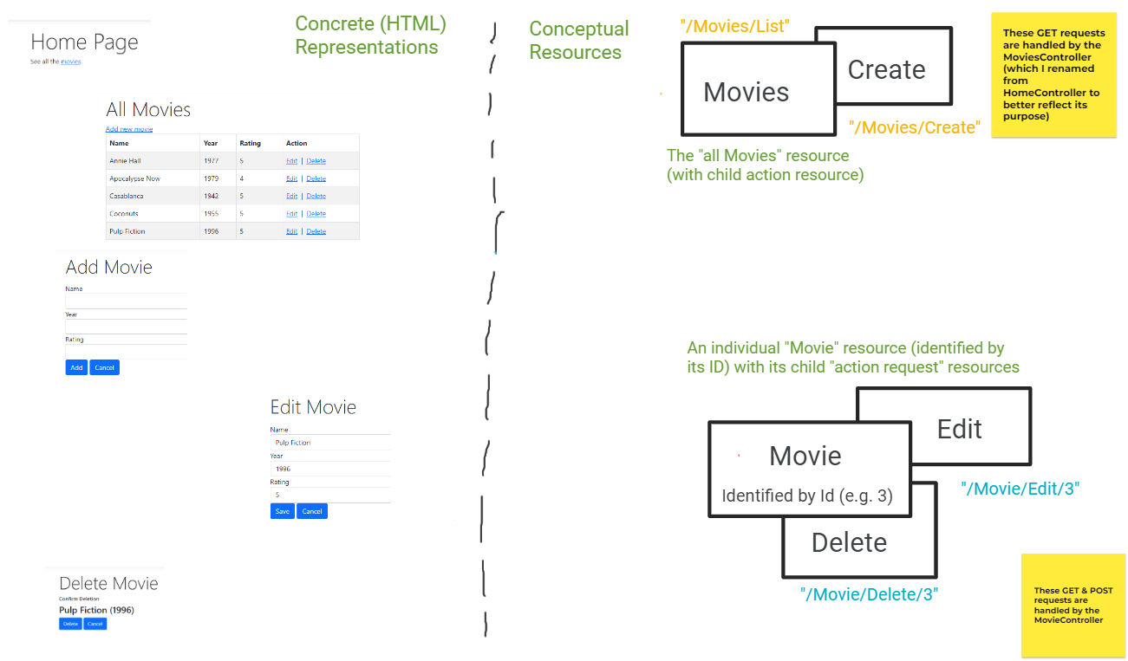
Resources & Representations (HTML views)

Slide 11
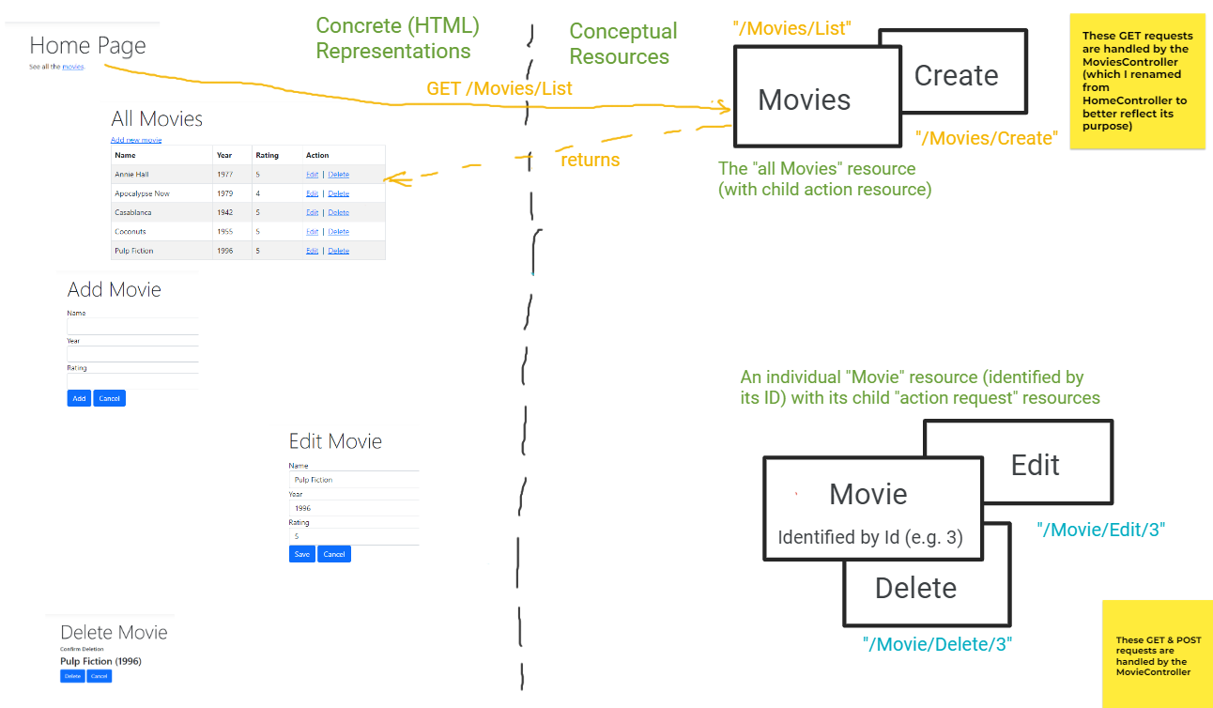
Interactions with the “all Movies” resource

Slide 12
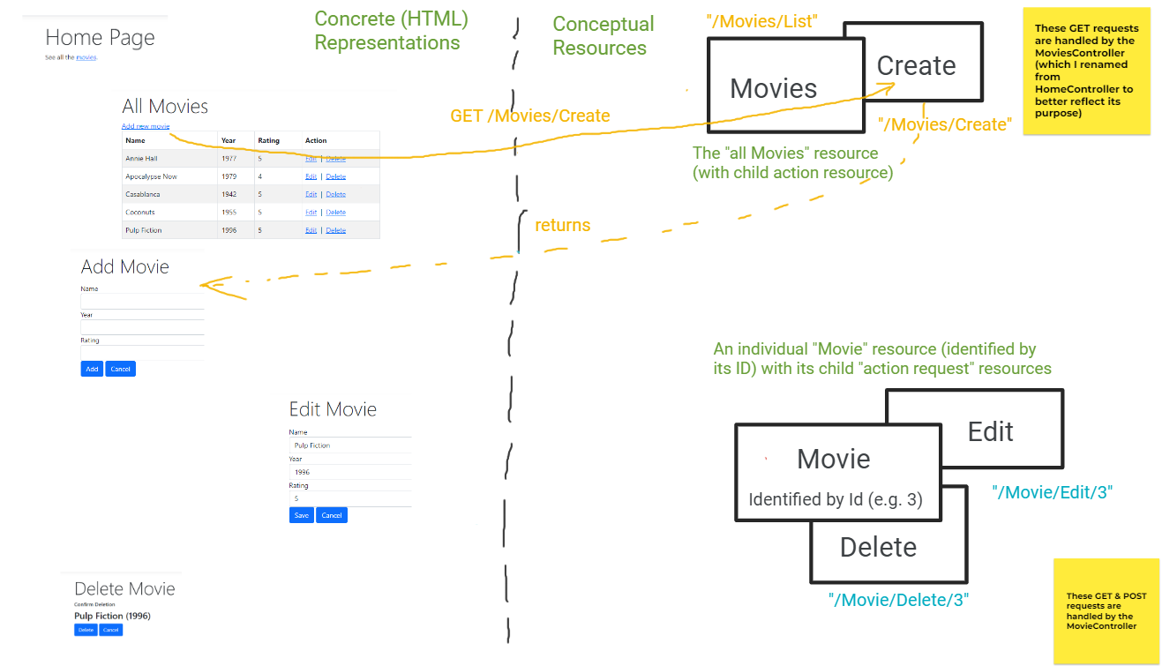
Interactions with the “all Movies” resource

Slide 13
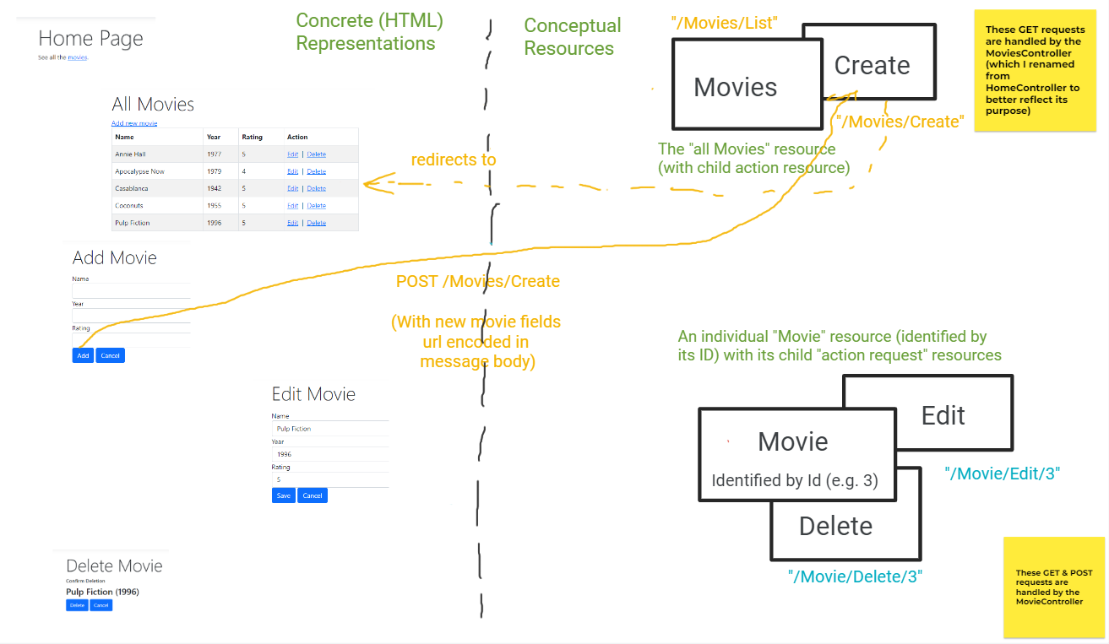
Interactions with the “all Movies” resource

Slide 14
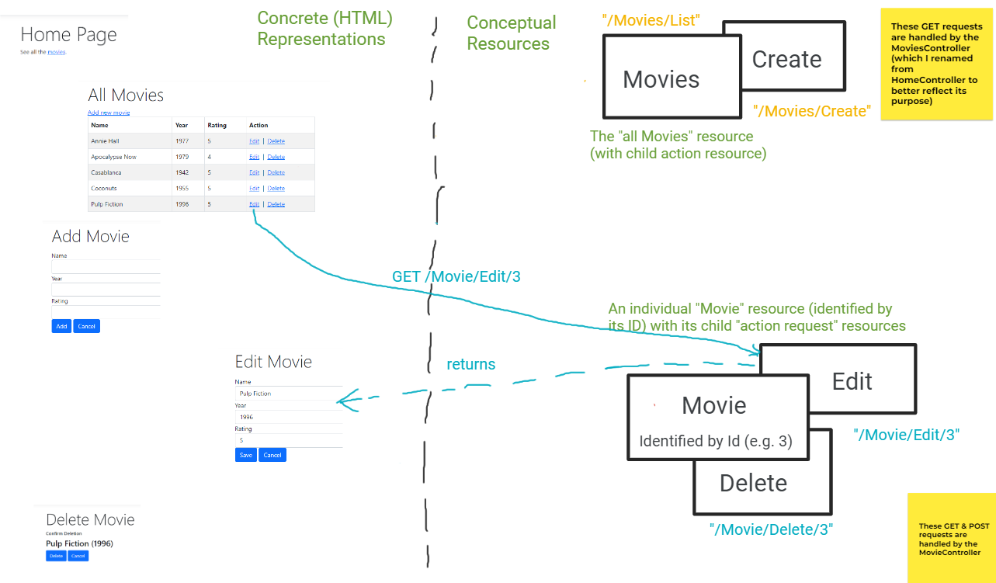
Interactions with a single “Movie” resource

Slide 15
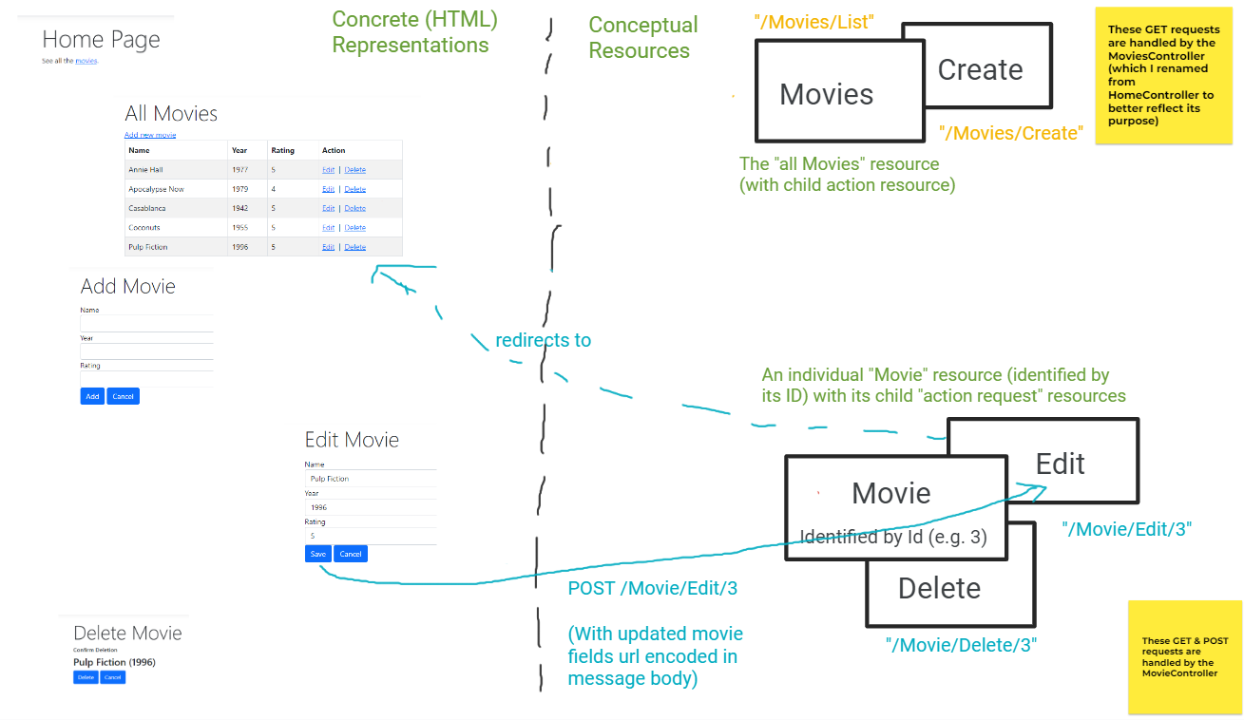
Interactions with a single “Movie” resource
Note: Delete interactions are similar

Slide 16
But…
Before we build this example “Movies List” web app from scratch we need to:
Make a few comments
And make sure we have a relational database server installed and we can connect to it
We’ll do this now and we’ll use MS SQL Server (developer edition)

Slide 17
Next: a word of caution
We are glossing over many details of working with both ASP.NET Core itself but even more so with EF Core as a means of developing DB-driven web apps
Why? Well to get you up and running quickly
But we will come back to each topic in greater depth as we proceed through the rest of this course!

Slide 18
What is EF Core?
EF Core is Microsoft’s ORM (Object-Relational Mapping) framework for .NET Core
We will return to it (and the intimately related concept of LINQ) in greater detail later (e.g. ch 12) but for now think of it as follows…
EF Core allows developers to define the basic domain (or problem domain) entities of their application using .NET Classes
Under the hood then the EF Core framework:
Maps objects of those classes to data (i.e. rows) in a relational DB
Provides developers with a context class to query, insert, update, and delete those entities
Hence the term “ORM” – objects are being mapped to relational DB entities

Slide 19
Now…
Let’s build this example “Movies List” web app from scratch and go over each step in great detail
Note: my solution differs from the Murach solution but only very slightly and I will try to highlight where and why as we proceed
And remember, as discussed in the course intro slides, we will not make use of generating code here!
You need to do it yourself to learn
And defining your controllers allows you to design interactions with your resources as you see fit

Slide 20
The high-level steps for basic version
Steps for the first (basic) version:
* Start with a MVC project template
* Add the Microsoft.EntityFrameworkCore packages
* Define our Movie Model & Context classes
- EF Core uses these classes to map to, generate and interact with the Database (DB)
- This includes seeding the DB with some data
* Add a DB connection string to the appSettings.json file
* Add MS Sql svr services in Program.cs and pass the connection string accessed
* Add a MoviesController, a List action to it; and a View/Movies sub-folder, and a View named List.cshtml to it
- Link to this page from the Home/Index view
* Add a DB context reference to the MoviesController & try to access the DB in the List action
- It will fail because we have yet to create the DB
* Get the DB going in 2 steps:
- Step1: generate DB code from our model
- Step 2: run that code to generate the DB

Slide 21
The high-level steps continued
* Get our "all movies" page working:
- Define the Index action in the MoviesController to retrieve all movies and pass to view as a List
- In the view, we iterate (using a foreach loop) over the List<Movie> model to populate HTML table data
* Get our add new movie functionality going:
- In the MoviesController add both a POST & GET version of a "Create" action
- Define a Movies/Create view with a form that allows the user to enter fields for a new movie
* For editing an existing movie:
- Add a new MovieController (why?) and both a GET & POST version of an Edit action to it
- Define a Movie/Edit view with a form that allows the user to edit the existing movie
* And finally, for deleting an existing movie:
- To the MovieController add both a GET & POST version of a Delete action
- Define a Movie/Delete view with a form that allows the user to confirm delete of an existing movie

Slide 22
So why both a MovieController and MoviesController?
Recall that I said that I conceptualize this app as being comprised of 2 main resources:
The collection of all Movies (i.e. the “Movies” resource)
And an individual Movie (identified by its ID in the URL)

Slide 23
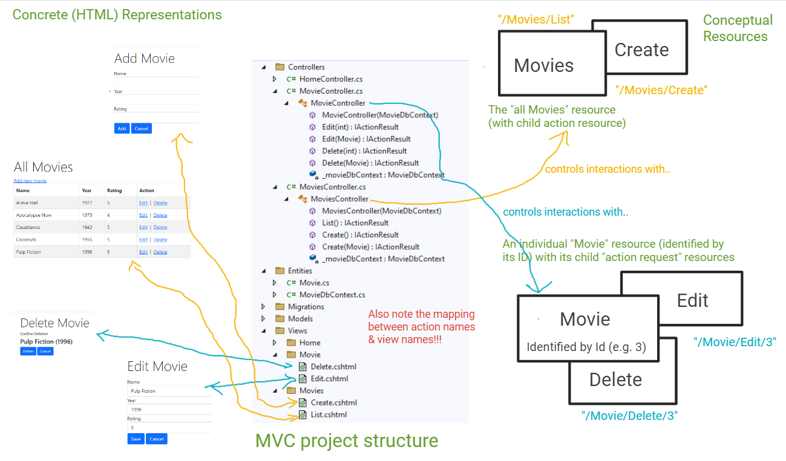
Resources drive your MVC project structure

Slide 24
Also, note…
There is no doubt some repetition between the Create.cshtml page and the Edit.cshtml page but we’ll learn later how best to avoid the repetitive code by using mechanisms like partial views, view components, tag helpers, etc…

Slide 25
We’ll develop this sample in 2 stages
Stage (or version) 1:
The basic version with only a simple Movie entity
Stage (or version) 2:
Expands on the basic version to add a Genre entity in a 1-to-many relationship with Movies
Makes use of EF Core’s migration capabilities
Likely next week

Slide 26
But..
A key point here is that the initial version of the app should still run against the updated database
That is, the migration doesn’t break old working code!!!

Slide 27
Now..
In the slides that follow, these are the steps taken by the authors
Our version that we work through is slightly different
And on the newer .NET 6 version as well!

Slide 28
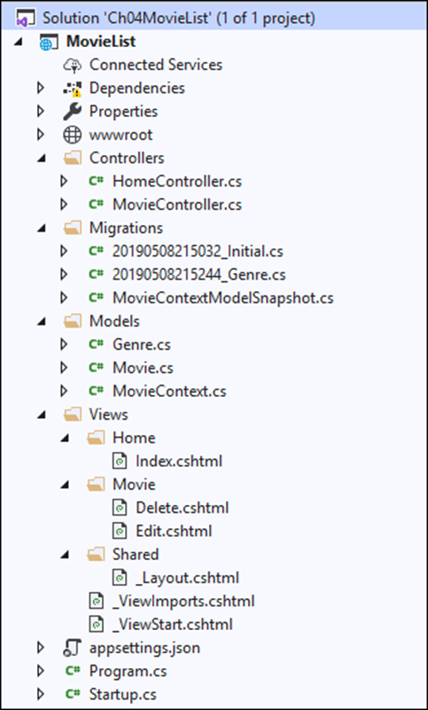
The Solution Explorer for the Movie List app

Slide 29
Folders in the Movie List app
Models
Views
Controllers
Migrations
Files in the Movie List app
appsettings.json
Program.cs

Slide 30
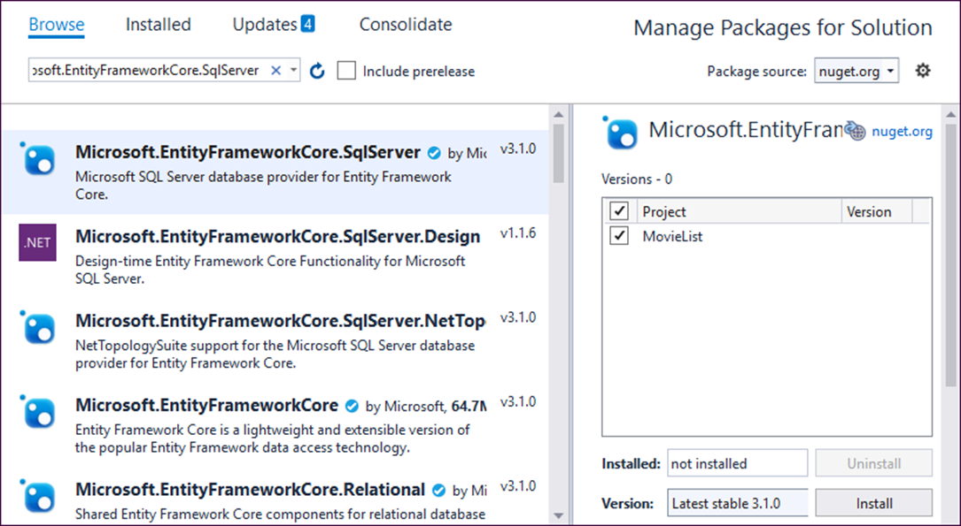
How to open the NuGet Package Manager
Select Tools→Nuget Package Manager→Manage NuGet Packages for Solution.
The NuGet Package Manager

Slide 31
How to install the NuGet packages for EF Core
Click the Browse link in the upper left of the window.
Type “Microsoft.EntityFrameworkCore.SqlServer” in the search box.
Click on the appropriate package from the list that appears in the left-hand panel.
In the right-hand panel, check the project name, select the version that matches the version of .NET Core you’re running, and click Install.
Review the Preview Changes dialog that comes up and click OK.
Review the License Acceptance dialog that comes up and click I Accept.
Type “Microsoft.EntityFrameworkCore.Tools” in the search box.
Repeat steps 3 through 6.

Slide 32
Three key classes provided by EF Core
DbContext
DbContextOptions
DbSet<Entity>

Slide 33
A MovieContext class that inherits the DbContext class
using Microsoft.EntityFrameworkCore;
namespace MovieList.Models
{
public class MovieContext : DbContext
{
public MovieContext(DbContextOptions<MovieContext> options)
: base(options)
{ }
public DbSet<Movie> Movies { get; set; }
}
}

Slide 34
A Movie class with a property whose value is generated by the database
using System.ComponentModel.DataAnnotations;
namespace MovieList.Models
{
public class Movie
{
// EF Core will configure the database to generate this value
public int MovieId { get; set; }
[Required(ErrorMessage = "Please enter a name.")]
public string Name { get; set; }
[Required(ErrorMessage = "Please enter a year.")]
[Range(1889, 2999, ErrorMessage = "Year must be after 1889.")]
public int? Year { get; set; }
[Required(ErrorMessage = "Please enter a rating.")]
[Range(1, 5, ErrorMessage =
"Rating must be between 1 and 5.")]
public int? Rating { get; set; }
}
}

Slide 35
One method of the DbContext class
OnModelCreating(mb)

Slide 36
A MovieContext class that seeds initial Movie data (part 1)
namespace MovieList.Models
{
public class MovieContext : DbContext
{
public MovieContext(DbContextOptions<MovieContext> options)
: base(options)
{ }
public DbSet<Movie> Movies { get; set; }
protected override void OnModelCreating(
ModelBuilder modelBuilder)
{
modelBuilder.Entity<Movie>().HasData(
new Movie {
MovieId = 1,
Name = "Casablanca",
Year = 1942,
Rating = 5
},

Slide 37
A MovieContext class that seeds initial Movie data (part 2)
new Movie {
MovieId = 2,
Name = "Wonder Woman",
Year = 2017,
Rating = 3
},
new Movie {
MovieId = 3,
Name = "Moonstruck",
Year = 1988,
Rating = 4
}
);
}
}
}

Slide 38
A connection string in the appsettings.json file
{
"Logging": {
"LogLevel": {
"Default": "Warning"
}
},
"AllowedHosts": "*",
"ConnectionStrings": {
"MovieContext": "Server=(localdb)\\mssqllocaldb;Database=Movies;
Trusted_Connection=True;MultipleActiveResultSets=true"
}
}
OR
{
"Logging": {
"LogLevel": {
"Default": "Warning"
}
},
"AllowedHosts": "*",
"ConnectionStrings": {
"MovieContext": "Server=localhost;Database=Movies;
Trusted_Connection=True;MultipleActiveResultSets=true"
}
}

Slide 39
Code that enables dependency injection for DbContext objects (older .NET 5 version)
using Microsoft.Extensions.Hosting;
using Microsoft.EntityFrameworkCore;
using MovieList.Models;
...
public class Startup
{
public Startup(IConfiguration configuration)
{
Configuration = configuration;
}
public IConfiguration Configuration { get; }
public void ConfigureServices(IServiceCollection services)
{
...
services.AddDbContext<MovieContext>(options =>
options.UseSqlServer(
Configuration.GetConnectionString("MovieContext")));
}
...
}

Slide 40
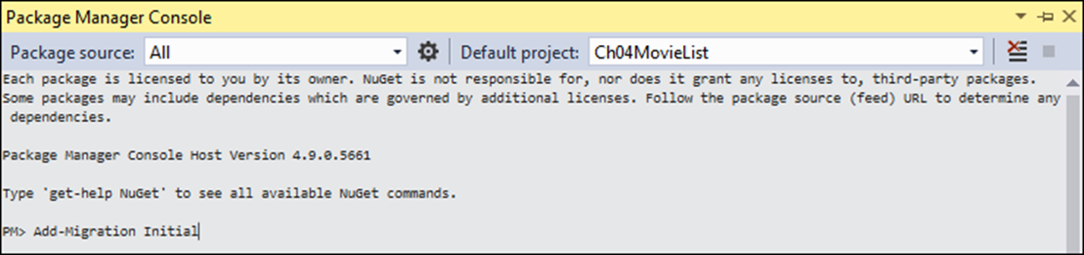
The Package Manager Console (PMC) window
How to open the PMC window
Select the Tools→NuGet Package Manager→Package Manager Console command.

Slide 41
How to create the Movies database from your code
Make sure the connection string and dependency injection are set up.
Type “Add-Migration Initial” in the PMC at the command prompt and press Enter.
Type “Update-Database” at the command prompt and press Enter.

Slide 42
The Up() method of the Initial migration file
protected override void Up(MigrationBuilder migrationBuilder)
{
migrationBuilder.CreateTable(
name: "Movies",
columns: table => new {
MovieId = table.Column<int>(nullable: false)
.Annotation("SqlServer:ValueGenerationStrategy",
SqlServerValueGenerationStrategy.IdentityColumn),
Name = table.Column<string>(nullable: false),
Year = table.Column<int>(nullable: false),
Rating = table.Column<int>(nullable: false)
},
constraints: table => {
table.PrimaryKey("PK_Movies", x => x.MovieId);
});
migrationBuilder.InsertData(
table: "Movies",
columns: new[] { "MovieId", "Name", "Rating", "Year" },
values: new object[] { 1, "Casablanca", 5, 1942 });
// code that inserts the other two movies
}

Slide 43
How to view the database once it’s created
Choose the View→SQL Server Object Explorer command in Visual Studio.
Expand the (localdb)\MSSQLLocalDB node, then expand the Databases node.
Or just localhost for full SQL Server
Expand the Movies node, then expand the Tables node.
To view the table columns, expand a table node and then its Columns node.
To view the table data, right-click a table and select the ViewData command.

Slide 44
LINQ methods that build or execute a query expression
Where(lambda)
OrderBy(lambda)
FirstOrDefault(lambda)
ToList()
A method of the DbSet<Entity> class that gets an entity by its id
Find(id)

Slide 45
A using directive that imports the LINQ namespace
using System.Linq;
A DbContext property that’s used in the examples
private MovieContext context { get; set; }
Code that builds a query expression
IQueryable<Movie> query =
context.Movies.OrderBy(m => m.Name);
Code that executes a query expression
List<Movie> movies = query.ToList();
Code that builds and executes a query expression
var movies =
context.Movies.OrderBy(m => m.Name).ToList();

Slide 46
Code that builds a query expression by chaining LINQ methods
var query = context.Movies.Where(m => m.Rating > 3)
.OrderBy(m => m.Name);

Slide 47
Code that builds a query expression on multiple lines
IQueryable<Movie> query = context.Movies;
query = query.Where(m => m.Year > 1970);
query = query.Where(m => m.Rating > 3);
query = query.OrderBy(m => m.Name);

Slide 48
Three ways to select a movie by its id
int id = 1;
var movie = context.Movies.Where(
m => m.MovieId == id).FirstOrDefault();
var movie = context.Movies.FirstOrDefault(m => m.MovieId == id);
var movie = context.Movies.Find(id);

Slide 49
Three methods of the DbSet class
Add(entity)
Update(entity)
Remove(entity)
One method of the DbContext class
SaveChanges()
A using directive for the EF Core namespace
using Microsoft.EntityFrameworkCore;

Slide 50
Code that adds a new movie to the database
var movie = new Movie { Name = "Taxi Driver",
Year = 1976,
Rating = 4
};
context.Movies.Add(movie);
context.SaveChanges();

Slide 51
An appsettings.json file that displays the generated SQL statements
{
"Logging": {
"LogLevel": {
"Default": "Information",
"Microsoft": "Warning",
"Microsoft.Hosting.Lifetime": "Information",
"Microsoft.EntityFrameworkCore.Database.Command": "Debug"
}
...
}

Slide 52
Code that selects movies from the database
var movies = context.Movies.OrderBy(m => m.Name).ToList();
The generated SQL statement
SELECT [m].[MovieId], [m].[Name], [m].[Rating], [m].[Year]
FROM [Movies] AS [m]
ORDER BY [m].[Name]

Slide 53
The Home controller
using System.Linq;
using Microsoft.AspNetCore.Mvc;
using MovieList.Models;
namespace MovieList.Controllers
{
public class HomeController : Controller
{
private MovieContext context { get; set; }
public HomeController(MovieContext ctx) {
context = ctx;
}
public IActionResult Index() {
var movies = context.Movies.OrderBy(
m => m.Name).ToList();
return View(movies);
}
}
}

Slide 54
The Home/Index view (part 1)
@model List<Movie>
@{
ViewBag.Title = "My Movies";
}
<h2>Movie List</h2>
<a asp-controller="Movie" asp-action="Add">Add New Movie</a>
<table class="table table-bordered table-striped">
<thead>
<tr>
<th>Name</th>
<th>Year</th>
<th>Rating</th>
<th></th>
</tr>
</thead>

Slide 55
The Home/Index view (part 2)
<tbody>
@foreach (var movie in Model) {
<tr>
<td>@movie.Name</td>
<td>@movie.Year</td>
<td>@movie.Rating</td>
<td>
<a asp-controller="Movie" asp-action="Edit"
asp-route-id="@movie.MovieId">Edit</a>
<a asp-controller="Movie" asp-action="Delete"
asp-route-id="@movie.MovieId">Delete</a>
</td>
</tr>
}
</tbody>
</table>

Slide 56
The Movie controller (part 1)
namespace MovieList.Controllers
{
public class MovieController : Controller
{
private MovieContext context { get; set; }
public MovieController(MovieContext ctx) {
context = ctx;
}
[HttpGet]
public IActionResult Add() {
ViewBag.Action = "Add";
return View("Edit", new Movie());
}
[HttpGet]
public IActionResult Edit(int id) {
ViewBag.Action = "Edit";
var movie = context.Movies.Find(id);
return View(movie);
}

Slide 57
The Movie controller (part 2)
[HttpPost]
public IActionResult Edit(Movie movie) {
if (ModelState.IsValid) {
if (movie.MovieId == 0)
context.Movies.Add(movie);
else
context.Movies.Update(movie);
context.SaveChanges();
return RedirectToAction("Index", "Home");
} else {
ViewBag.Action =
(movie.MovieId == 0) ? "Add": "Edit";
return View(movie);
}
}
[HttpGet]
public IActionResult Delete(int id) {
var movie = context.Movies.Find(id);
return View(movie);
}

Slide 58
The Movie controller (part 3)
[HttpPost]
public IActionResult Delete(Movie movie) {
context.Movies.Remove(movie);
context.SaveChanges();
return RedirectToAction("Index", "Home");
}
}
}

Slide 59
The Movie/Edit view (part 1)
@model Movie
@{
string title = ViewBag.Action + " Movie";
ViewBag.Title = title;
}
<h2>@ViewBag.Title</h2>
<form asp-action="Edit" method="post">
<div asp-validation-summary="All"
class="text-danger">
</div>
<div class="form-group">
<label asp-for="Name">Name</label>
<input asp-for="Name" class="form-control">
</div>

Slide 60
The Movie/Edit view (part 2)
<div class="form-group">
<label asp-for="Year">Year</label>
<input asp-for="Year" class="form-control">
</div>
<div class="form-group">
<label asp-for="Rating">Rating</label>
<input asp-for="Rating" class="form-control">
</div>
<input type="hidden" asp-for="MovieId" />
<button type="submit" class="btn btn-primary">
@ViewBag.Action</button>
<a asp-controller="Home" asp-action="Index"
class="btn btn-primary">Cancel</a>
</form>

Slide 61
The Movie/Delete view
@model Movie
@{
ViewBag.Title = "Delete Movie";
}
<h2>Confirm Deletion</h2>
<h3>@Model.Name (@Model.Year)</h3>
<form asp-action="Delete" method="post">
<input type="hidden" asp-for="MovieId" />
<button type="submit" class="btn btn-primary">
Delete</button>
<a asp-controller="Home" asp-action="Index"
class="btn btn-primary">Cancel</a>
</form>

Slide 62
The Genre class
public class Genre
{
public string GenreId { get; set; }
public string Name { get; set; }
}

Slide 63
How to add a Genre property to the Movie class
public class Movie
{
/* MovieId, Name, Year, and Rating properties
same as before */
[Required(ErrorMessage = "Please enter a genre.")]
public Genre Genre { get; set; }
}

Slide 64
How to specify a foreign key property when adding a Genre property
public class Movie
{
/* MovieId, Name, Year, and Rating properties
same as before */
[Required(ErrorMessage = "Please enter a genre.")]
public string GenreId { get; set; }
public Genre Genre { get; set; }
}

Slide 65
A MovieContext class that adds the Genre model with initial data (part 1)
public class MovieContext : DbContext {
public MovieContext(DbContextOptions<MovieContext> options)
: base(options)
{ }
public DbSet<Movie> Movies { get; set; }
public DbSet<Genre> Genres { get; set; }
protected override void OnModelCreating(
ModelBuilder modelBuilder) {
base.OnModelCreating(modelBuilder);
modelBuilder.Entity<Genre>().HasData(
new Genre { GenreId = "A", Name = "Action" },
new Genre { GenreId = "C", Name = "Comedy" },
new Genre { GenreId = "D", Name = "Drama" },
new Genre { GenreId = "H", Name = "Horror" },
new Genre { GenreId = "M", Name = "Musical" },
new Genre { GenreId = "R", Name = "RomCom" },
new Genre { GenreId = "S", Name = "SciFi" }
);

Slide 66
A MovieContext class that adds the Genre model with initial data (part 2)
modelBuilder.Entity<Movie>().HasData(
new Movie { MovieId = 1, Name = "Casablanca",
Year = 1942, Rating = 5, GenreId = "D"
},
new Movie { MovieId = 2, Name = "Wonder Woman",
Year = 2017, Rating = 3, GenreId = "A"
},
new Movie { MovieId = 3, Name = "Moonstruck",
Year = 1988, Rating = 4, GenreId = "R"
}
);
}
}

Slide 67
How to update the database with the new Genre model and seed data
Select Tools→NuGet Package Manager→Package Manager Console to open the Package Manager Console window.
Type “Add-Migration Genre” at the command prompt and press Enter.
Type “Update-Database” at the command prompt and press Enter.

Slide 68
Some of the code in the Up() method of the Genre migration file (part 1)
protected override void Up(MigrationBuilder migrationBuilder)
{
migrationBuilder.AddColumn<string>(
name: "GenreId",
table: "Movies",
nullable: false,
defaultValue: "");
migrationBuilder.CreateTable(
name: "Genres",
columns: table => new {
GenreId = table.Column<string>(nullable: false),
Name = table.Column<string>(nullable: true)
}, constraints: table => {
table.PrimaryKey("PK_Genres", x => x.GenreId);
});

Slide 69
Some of the code in the Up() method (part 2)
migrationBuilder.InsertData(
table: "Genres",
columns: new[] { "GenreId", "Name" },
values: new object[,] {
{ "A", "Action" },
{ "C", "Comedy" },
{ "D", "Drama" },
{ "H", "Horror" },
{ "M", "Musical" },
{ "R", "RomCom" },
{ "S", "SciFi" }
});
migrationBuilder.UpdateData(
table: "Movies",
keyColumn: "MovieId",
keyValue: 1,
column: "GenreId",
value: "D");
// code that updates the other two movies

Slide 70
Some of the code in the Up() method (part 3)
migrationBuilder.AddForeignKey(
name: "FK_Movies_Genres_GenreId",
table: "Movies",
column: "GenreId",
principalTable: "Genres",
principalColumn: "GenreId",
onDelete: ReferentialAction.Cascade);
...
}

Slide 71
Another LINQ method that builds a query expression
Include(lambda)
The Index() action method of the Home controller
using Microsoft.EntityFrameworkCore;
...
public class HomeController : Controller {
...
public IActionResult Index() {
var movies = context.Movies.Include(m => m.Genre)
.OrderBy(m => m.Name).ToList();
return View(movies);
}
}

Slide 72
The <table> element of the Home/Index view
<table class="table table-bordered table-striped">
<thead>
<tr>
<th>Name</th>
<th>Year</th>
<th>Genre</th>
<th>Rating</th><th></th>
</tr>
</thead>
<tbody>
@foreach (var movie in Model) {
<tr>
<td>@movie.Name</td>
<td>@movie.Year</td>
<td>@movie.Genre.Name</td>
<td>@movie.Rating</td>
<td><!-- Edit/Delete links same as before --></td>
</tr>
}
</tbody>
</table>

Slide 73
The Add() action method of the Movie controller
[HttpGet]
public IActionResult Add()
{
ViewBag.Action = "Add";
ViewBag.Genres
= context.Genres.OrderBy(g => g.Name).ToList();
return View("Edit", new Movie());
}

Slide 74
The Edit() action method of the Movie controller for GET requests
[HttpGet]
public IActionResult Edit(int id) {
ViewBag.Action = "Edit";
ViewBag.Genres
= context.Genres.OrderBy(g => g.Name).ToList();
var movie = context.Movies.Find(id);
return View(movie);
}

Slide 75
The Edit() action method of the Movie controller for POST requests
[HttpPost]
public IActionResult Edit(Movie movie)
{
if (ModelState.IsValid)
{
if (movie.MovieId == 0)
context.Movies.Add(movie);
else
context.Movies.Update(movie);
context.SaveChanges();
return RedirectToAction("Index", "Home");
}
else
{
ViewBag.Action = (movie.MovieId == 0) ? "Add": "Edit";
ViewBag.Genres
= context.Genres.OrderBy(g => g.Name).ToList();
return View(movie);
}
}

Slide 76
The form tag of the Movie/Edit view
<form asp-action="Edit" method="post">
...
<div class="form-group">
<label asp-for="GenreId">Genre</label>
<select asp-for="GenreId" class="form-control">
<option value="">select a genre</option>
@foreach (Genre g in ViewBag.Genres)
{
<option value="@g.GenreId">
@g.Name
</option>
}
</select>
</div>
...

Slide 77
So there you have it…
At this point you are now equipped with a very solid:
“Template” for basic database-drive ASP.NET Core MVC web apps
i.e. many web apps take a similar form
A glimpse into the process of migrating new features into your data/object model

Slide 78
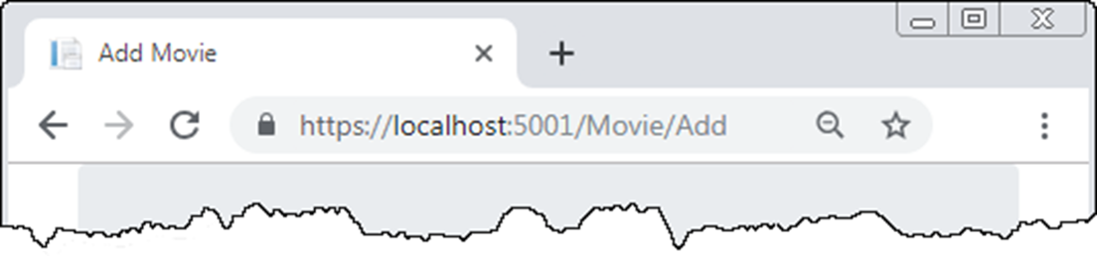
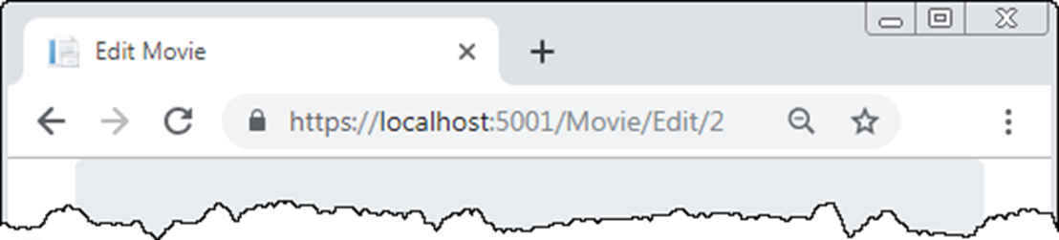
The default URLs of an MVC app

Slide 79
The ConfigureServices() method to make URLs lowercase with a trailing slash
public void ConfigureServices(IServiceCollection services) {
...
services.AddRouting(options => {
options.LowercaseUrls = true;
options.AppendTrailingSlash = true;
});
...
}

Slide 80
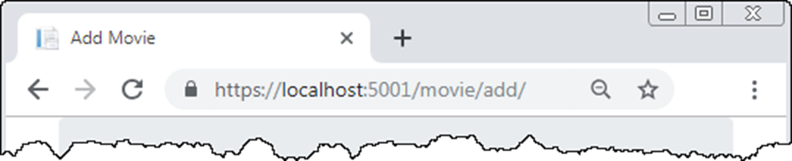
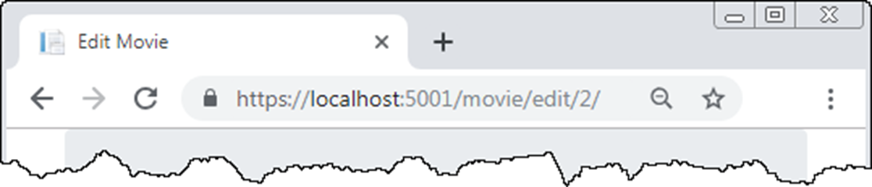
The reconfigured URLs

Slide 81
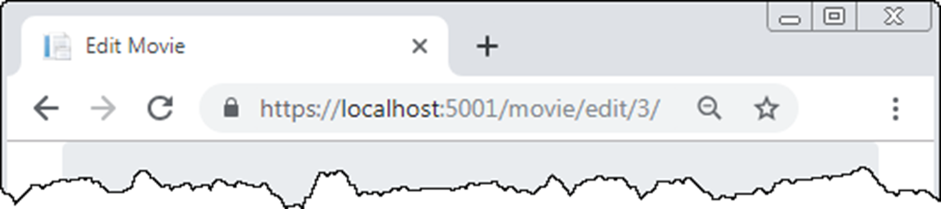
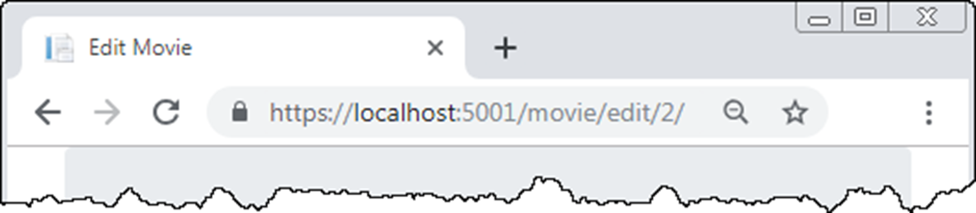
The Edit page with numeric ID values only in the URL

Slide 82
The default route updated to include a second optional parameter
app.UseEndpoints(endpoints =>
{
endpoints.MapControllerRoute(
name: "default",
pattern: "{controller=Home}/{action=Index}/{id?}/{slug?}");
});
A read-only property named Slug in the Movie class
public string Slug =>
Name?.Replace(' ', '-').ToLower() + '-' +
Year?.ToString();

Slide 83
The Edit/Delete links in the Home/Index view
<a asp-controller="Movie" asp-action="Edit"
asp-route-id="@movie.MovieId"
asp-route-slug="@movie.Slug">Edit</a>
<a asp-controller="Movie" asp-action="Delete"
asp-route-id="@movie.MovieId"
asp-route-slug="@movie.Slug">Delete</a>

Slide 84
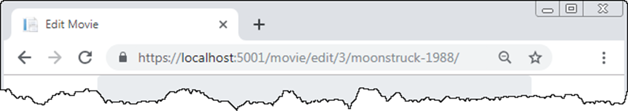
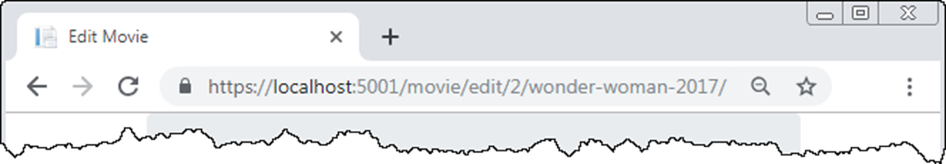
The Edit page with a slug in the URL

