Slide 1
Creating PowerShell Modules

Slide 2
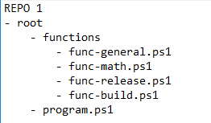
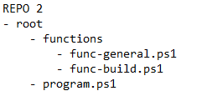
Problem
Code sharing within a large repo
Functions are nice, but complicate refactoring
Nobody likes long relative paths
Code sharing across repos
Functions often get copied across, creating a hard-to-debug and hard-to-maintain landscape of repos

Slide 3
Solution: code packages
Well known examples:
NuGet
NPM
PIP
For PowerShell:
PowerShell modules

