Slide 1
Creating PowerShell Modules

Slide 2
Assumptions
We want our code to be easy to maintain
We want our code to be easy to read
We want our code to be easy to refactor or rework
We want to stimulate reusability of code

Slide 3
Case
We’ve created a solution (repo 1) for a client that includes PowerShell scripts for deploying the solution.
The client asked us to create a second solution (repo 2) for them.
We want to reuse the PowerShell scripts in this second solution.

Slide 4
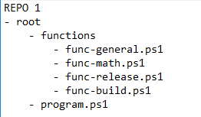
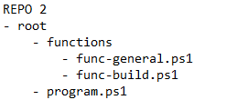
Problem
Code sharing across repos
Functions often get copied across, creating a hard-to-debug and hard-to-maintain landscape of repos
Code sharing within a large repo
Functions provide benefits, but complicate refactoring when using dot sourcing
Nobody likes long relative paths when using dot sourcing

Slide 5
Solution: code packages
Well known examples:
NuGet
NPM
PIP
For PowerShell:
PowerShell modules

