Slide 1
Introduction
System Selected: Library Management System
The Library Management System helps manage the catalog of books, handle member registrations, borrowing/returning of books, and generates reports.

Slide 2
System Features
- Add, update, and delete books
- Member registration and management
- Book borrowing and returning
- Fine calculation
- Book search (title, author, category)
- Reports on borrowed/available books

Slide 3
Literature Review of 3 Existing Systems
1. Koha:
- Open-source ILS
- Features: OPAC, cataloging, circulation
- Used in schools/universities
2. Evergreen:
- Designed for consortia
- Cataloging, acquisitions, circulation
- Used in large libraries
3. OpenBiblio:
- For small libraries
- Simple check-in/out
- Built with PHP/MySQL

Slide 4
Process Flow
1. Member Registers
2. Member Logs In
3. Searches for Books
4. Borrows a Book
5. Returns Book
6. System Calculates Fine (if late)

Slide 5
Collected Documents
- Book Registration Form
- Member Registration Form
- Borrow/Return Receipts
- Fine Payment Slip

Slide 6
Data Elements
Books: BookID, Title, Author, ISBN, Category
Members: MemberID, Name, Contact, JoinDate
Transactions: TransID, MemberID, BookID, BorrowDate, ReturnDate, Fine

Slide 7
Normalization (1NF → 3NF)
UNF: Mixed book/member data
1NF: Atomic values
- Separate book and member fields
2NF: Remove partial dependencies
- Split into Books and Borrows tables
3NF: Remove transitive dependencies
- Separate Members and Contacts tables

Slide 8
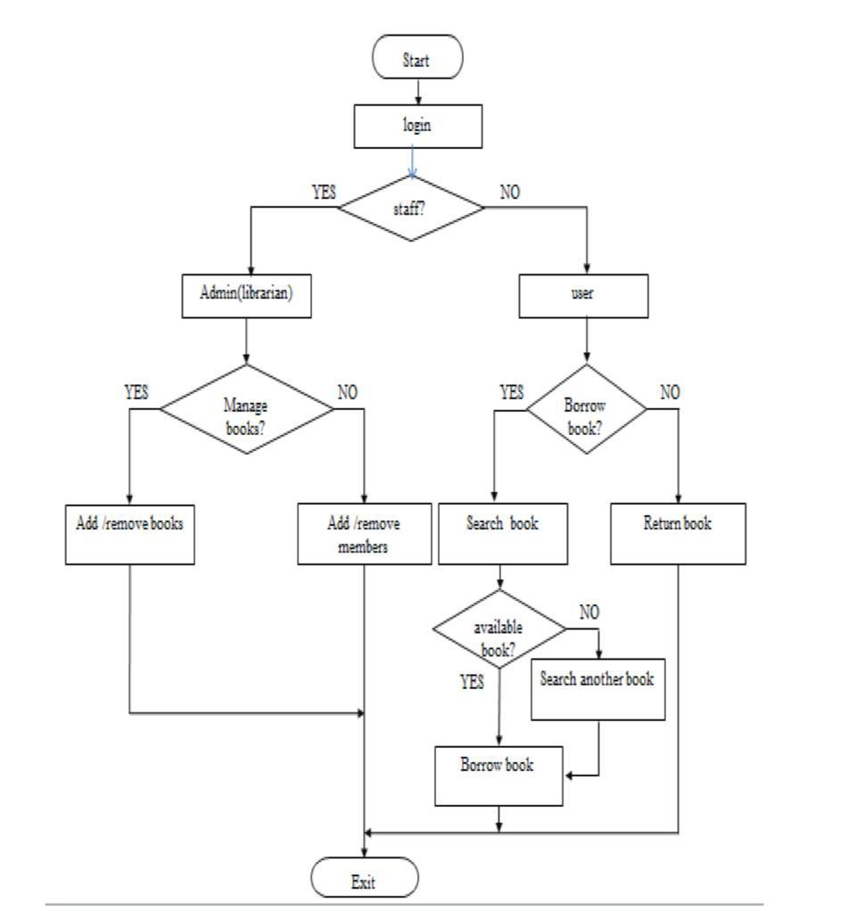

Slide 9
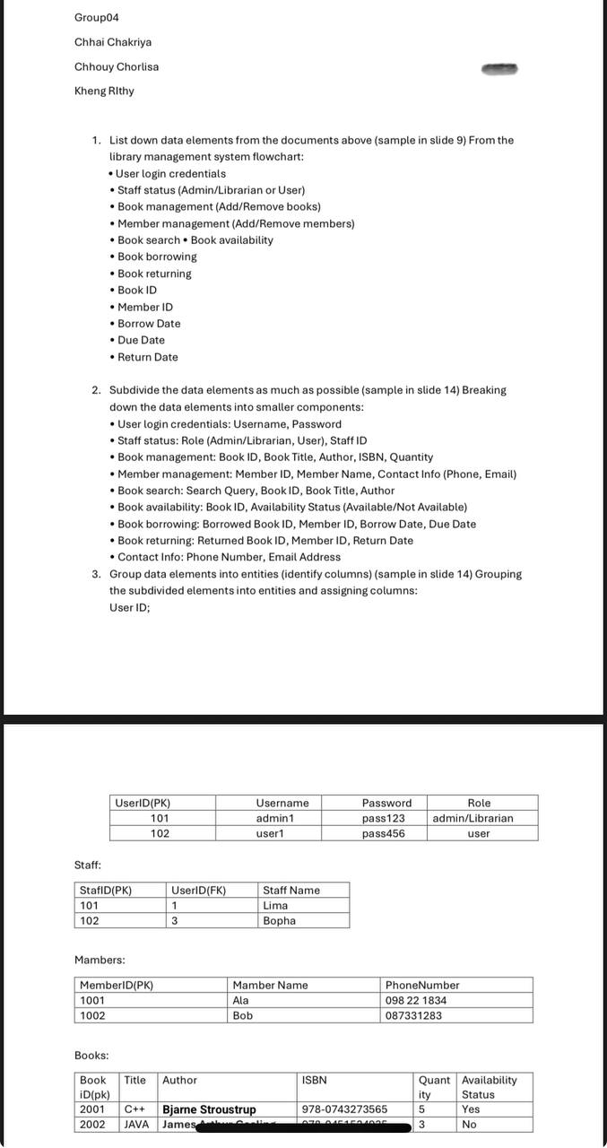

Slide 10
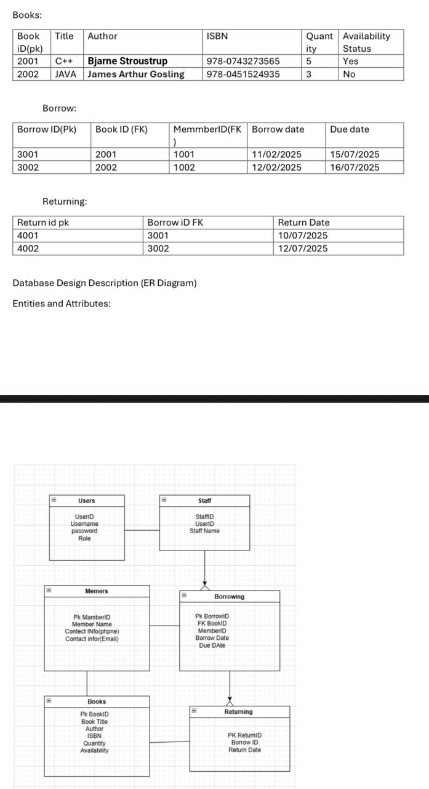

Slide 11
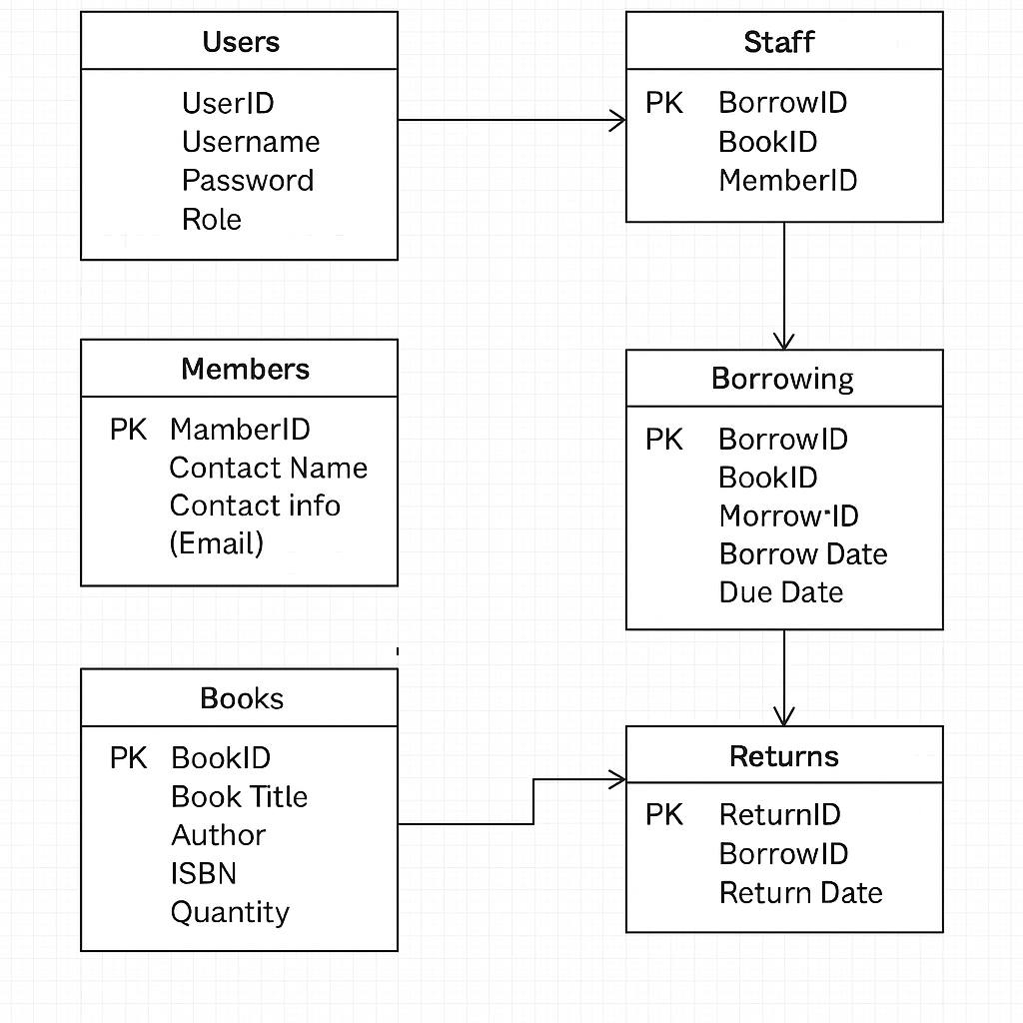

Slide 12
THANK YOU
For your attention!

