Slide 1

How to write an academic paper Dr Lowri Williams
awesome

Slide 2
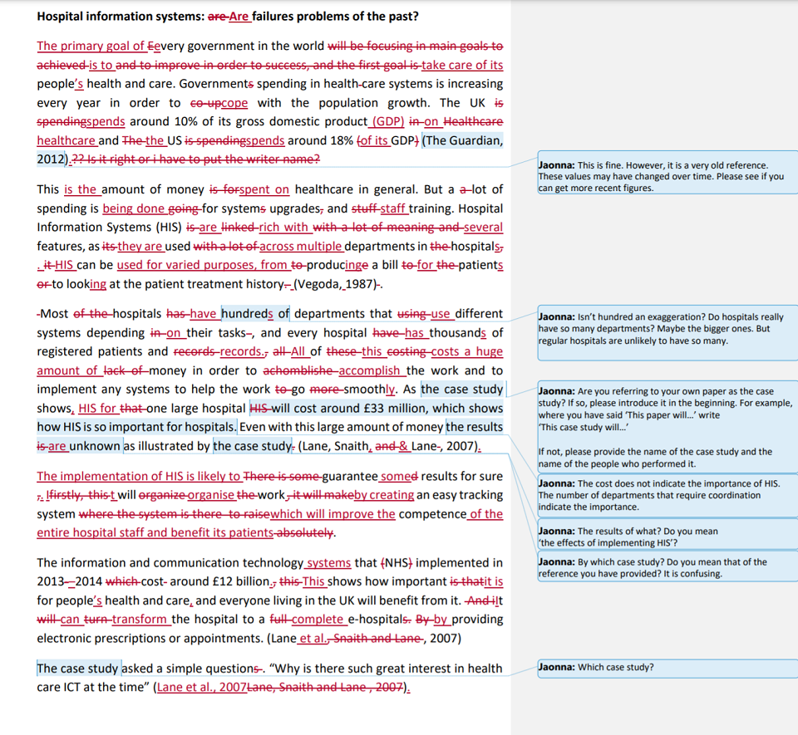

Slide 3
Structure
1. Title
2. Abstract
3. Introduction
4. Literature Review
5. Methodology
6. Results
7. Conclusion
8. Future Work
9. References
1. Methodology
2. Results
3. Introduction
4. Conclusion
5. Literature Review
6. Abstract
7. Future Work
8. Title
9. References

Slide 4
2. Introduction
1-3 short sentences introducing the field you’re writing about.
e.g. “IoT devices are becoming an important and prominent part of our daily lives… They routinely collect data which helps us stay connected and automate and simply some everyday tasks… This data is often contains personal data, such as our fitness tracking, or monitor how we drive our automated cards…”
What exactly is the problem?
What impact is this problem having?
Why is this problem… a problem?
Why should we care?
e.g. “However, IoT devices come with tremendous security flaws… Insufficient security measures means that personal data from such devices can often be exposed… This is an attractive target to attackers which can exploit this information… The impact of this can be significant, such as causing distribution to an automated car’s steering wheel which poses as a serious harm to human life…”

Slide 5
2. Introduction
So… what are others doing about it?
What have they done?
But why are these approaches still not good enough?
e.g. “Several approaches have attempted to improve the security of IoT devices by… However, they do not consider… As a result, X happens…”
What are you doing about it, then?
Your paper is motivated by this problem AND these other approaches.
Because other methods are not quite addressing it successfully, THIS IS WHERE YOURS BECOMES NOVEL!
e.g. “Whereas several approaches have been presented… This paper is motivated by the fact that this problem is yet to be addressed successfully because X still needs to be investigated”

Slide 6
2. Introduction
Your contributions
Where do you fit in the research field?
What are you bringing to the table?
New findings, new datasets, new experimental approaches, etc.
A quick study overview and paper structure
“The study was designed as follows…” Flow charts always help!
“The remainder of this paper is structured as follows… Section X presents…”

Slide 7
3. Literature Review
What have others done to approach the problem?
What data did they collect?
Did they achieve what you’re trying to achieve?
What was missing in this approach?
Any research flaws?
The purpose of a literature review is NOT to undermine or make other work ‘look bad’.
It is to report LIMITATIONS and how what others have done, has not achieved what you’re trying to achieve.
Or, if it’s comparable, why is it useful to you?
e.g. “X et al. look into THIS PROBLEM by doing X. However, this approach does not consider X, and therefore, does not address the problem of YOUR PROBLEM”
Tip – table to summarise literature and a limitations of comparable research

Slide 8
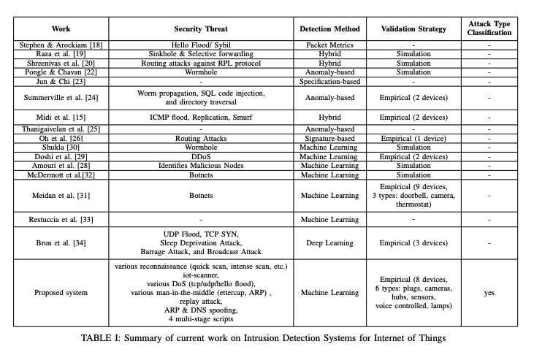
3. Literature Review

Slide 9
4. Methodology
Quick introduction paragraph to explain how you approached your experiments.
Data collection methods
Testbeds – how many devices, configurations, why X amount of devices (from literature review), etc.
Data collection – duration of collection, how many samples, graphs of distributions, etc.
Data pre-processing – what methods did you use, why? etc.
Machine Learning setup – which algorithms, why those algorithms, etc.
Etc.
JUSTIFY your choices!

Slide 10
5. Results
Present your findings in a CLEAR way.
Report what you see.
e.g. “Table X reports the overall classification performance of the machine learning algorithms… With an F1-score of 97%, the Naïve Bayes classifier outperforms the other classifiers…”
What does this mean to your problem?
Why do you think your results are the way they are? e.g. “This behavior is because X often does…”
Do your results mean you’ve achieved what you’re trying to achieve? e.g. “Overall, these findings illustrate that a machine learning approach can successfully be used an approach towards achieving the problem…”

Slide 11
6. Conclusion
Similar approach to how we structured the Introduction (with minor differences)
1-3 sentences introducing the field.
What is the problem you’re facing and what is the IMPACT? (why should we care?)
What have others done, that hasn’t quite achieved the problem? (very briefly)
Your NOVELTY and CONTRIBUTION
Your approach – you collected data, you did this, you did that…
Your results – very brief summary, picking out the important findings, what does this mean to your problem? What do we know now that we didn’t before?

Slide 12
7. Future Work
Not always necessary, but often good to have as it shows the reviewer you have future direction
What considerations do you have now that you know what you know!
1-2 short paragraphs.

Slide 13
8. Abstract
1 paragraph
First sentence – setting the scene of the research field – similar to the first sentence of the Introduction
What’s the problem?
What have others done, but haven’t quite achieved?
In this case, you’re going to approach it by… what does your paper present that hasn’t been presented before?
Brief explanation of how you achieved it
Brief explanation of your findings and how this shows you’ve successfully addressed the problem

Slide 14
9. Title
Accurate
Catchy
Don’t try to be too clever – if you’re using sense of humour, it could be received badly

Slide 15
EXTRAS
Language – THIRD PERSON, PAST TENSE
“To support the experiments in this paper, I collected data from the testbed…”
“To support the experiments in this paper, network data from the devices as part of the testbed discussed in Section X was collected.”
Spell and grammar check
Use Grammarly

