Slide 1


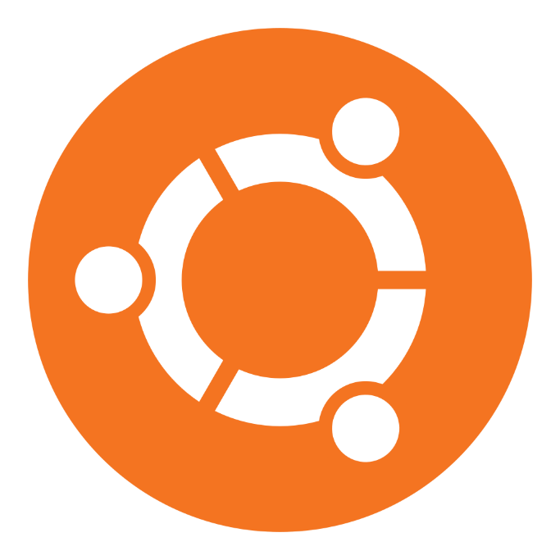
Ubuntu Operating System
Мухин Лев
Михайлович
АВТ-553
nstu.ru

Slide 2

What is Ubuntu?
Ubuntu is a Linux-based operating system created by Canonical Ltd. It was first introduced in 2004 by Mark Shuttleworth. Ubuntu is based on the Debian distribution and is suitable for use on computers, servers, and cloud environments. Its name comes from the African philosophy and means "I am because we are." This reflects the core idea of the project, which is about community, support, and collaboration.

Slide 3
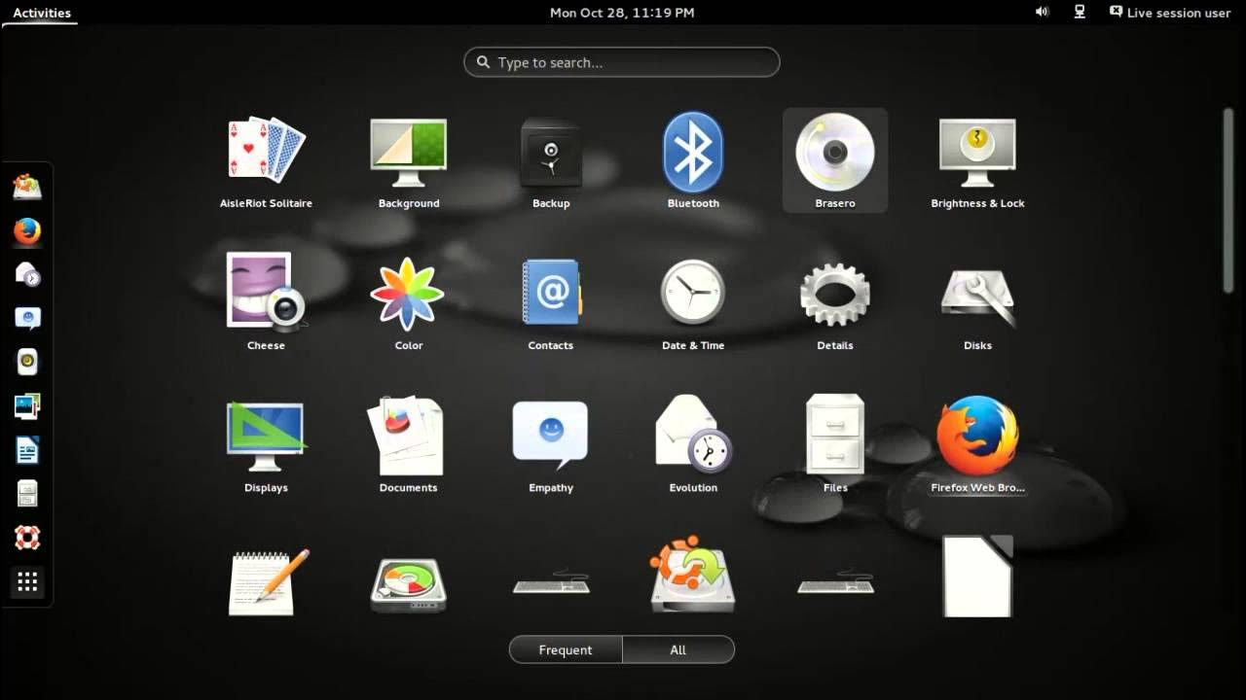
Key Features
Ubuntu is free and completely open-source — you can use, study, and modify its code without restrictions. The interface is simple and user-friendly, and the default desktop environment is GNOME. The system is highly secure, with a built-in firewall, regular updates, and no need for antivirus software.
Every two years, an LTS (Long-Term Support) version is released, which is supported for five years, making it ideal for stable performance. Installing software is easy with the Ubuntu Software Center, which offers a wide range of applications, from browsers to office software.

Slide 4
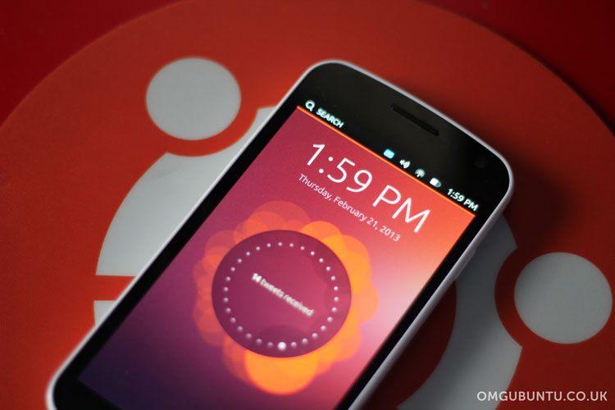
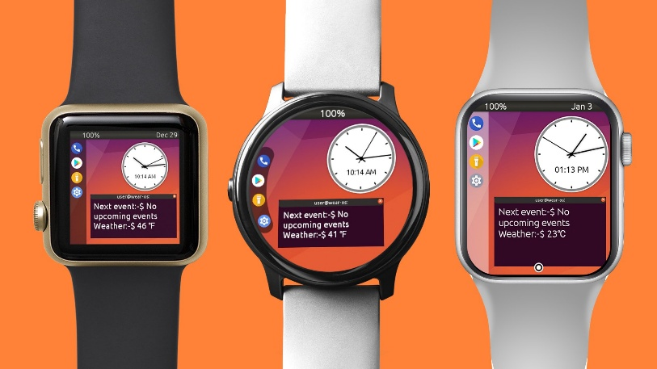
Ubuntu in the Real World
Ubuntu is not just a system for home computers. It is used by major companies such as IBM, Intel, and SAP. It runs on thousands of servers around the world and is the foundation for many cloud technologies.
Ubuntu is popular in education and scientific research, and it is widely used in the development of artificial intelligence and machine learning. Additionally, it has become the foundation for many other Linux distributions, making it one of the most influential systems in the open source world.

Slide 5
Fun Facts
A new version of Ubuntu is released every 6 months, in April and October. Every two years, a special LTS version is released, such as Ubuntu 24.04 LTS (2024), and the next version, 26.04 LTS, is expected in 2026.
The system supports more than 50 languages, including Russian, and is available to millions of users.
It is estimated that more than 40 million people worldwide use Ubuntu.
The best part is that it is completely free, even for businesses and commercial projects.

Slide 6

Conclusion
Ubuntu is more than just an operating system. It is a movement for openness, security, and freedom in the digital world. It is suitable for everyone: students, programmers, and companies.
Ubuntu provides:
Freedom - no restrictions or surveillance
Reliability - stable and glitch-free performance
Innovation - access to cutting-edge technologies

