Slide 1
ShopConnect : Shopping Behaviors
Our Team
Group 1
What they prefer to shop for & what it means for businesses?
Arjun Loya
Anurag Gher
Lokesh Thodkar

Slide 2
Problem Statement
The current shopping ecosystem faces inefficiencies due to disorganized product promotion, lack of clear user-influencer boundaries, and poor inventory management.
Users often encounter issues with out-of-stock products, influencers lack proper promotional guidelines, and admins struggle with inconsistent order and inventory tracking. This hampers user satisfaction and business operations.

Slide 3
Objective
To design and implement a robust system, ShopConnect, that streamlines the shopping experience by connecting users, influencers, and product managers through structured business rules, ensuring inventory management, accurate product promotions, and seamless order placements.

Slide 4
Proposed Solution
Develop a structured platform, ShopConnect, with well-defined business rules and roles for users, influencers, and admins.
Key features include:
A comprehensive inventory management system to prevent out-of-stock issues.
Role-specific permissions ensuring that influencers can only promote products and users can seamlessly place orders.
Automated triggers to update inventory after order placement and prevent invalid transactions like negative inventory.
Analytical tools to identify top-performing regions, products, and influencers, aiding in strategic decision-making and marketing campaigns.

Slide 5
Business Rule
Influencer Rules:
Only registered influencers can promote products.
An influencer can promote multiple products, but the user cannot become an influencer.
Influencers cannot update product prices or inventory; they can only promote products.
User Rules:
Users can browse products and place orders through influencer recommendations.
Users can place multiple orders but cannot influence prices or product availability.
A user must be registered and logged in to place an order.
Product and Inventory Rules:
Products have a fixed quantity in hand that decreases after each sale.
Products cannot be sold once quantity in hand reaches zero.
Only admins or Inventory managers can update inventory levels or product details.
Order Rules:
An order can include multiple products.
Orders cannot be placed for out-of-stock products.
Each order records the total amount, and the order status must be updated.

Slide 6
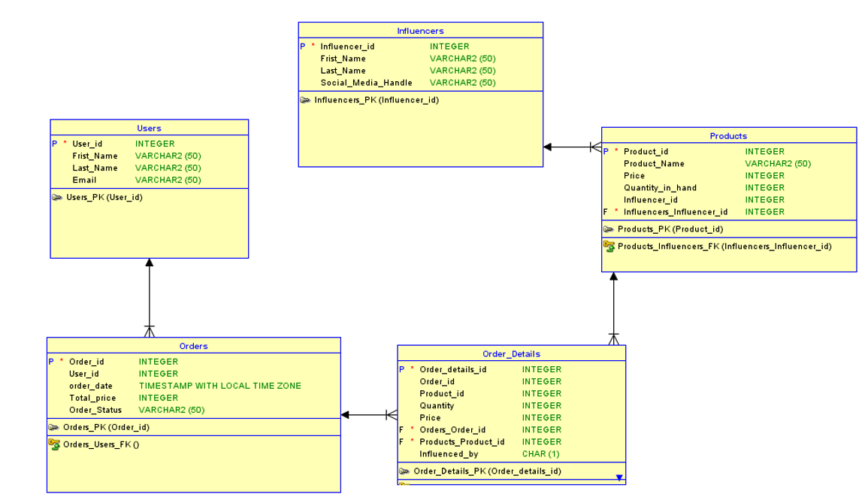
ER Diagram

Slide 7
ENTITY AND ATTRIBUTES
User
User_id
First_Name
Last_Name
Email
Location
Influencers
Influencer_id:
First_Name:
Last_Name:
Social_Media_Handle:
Orders
Order_id
User_id
Order_date
Total_price:
Order_Status
Products
Product_id
Product_Name:
Price
Quantity_in_hand:
Influencer_id:
Order_Detail
Order_details_id
Order_id
Orders(Order_id)
Product_idProducts
QuantityPrice_per_unit

Slide 8
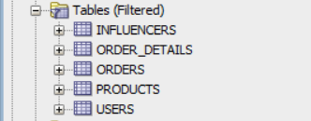
Tables

Slide 9
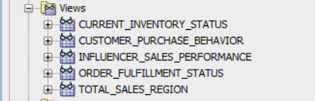
Views

Slide 10
Triggers
Update Inventory After an Order is Placed
Trigger Name: Update_Inventory_After_Order
Prevent Out-of-Stock Products from Being Ordered
Trigger Name: Prevent_Out_Of_Stock_Order
Prevent Negative Inventory Levels
Trigger Name: Prevent_Negative_Inventory

Slide 11

Procedures
Place Order Placed
Update Inventory
Update Order Status
Functions

Slide 12
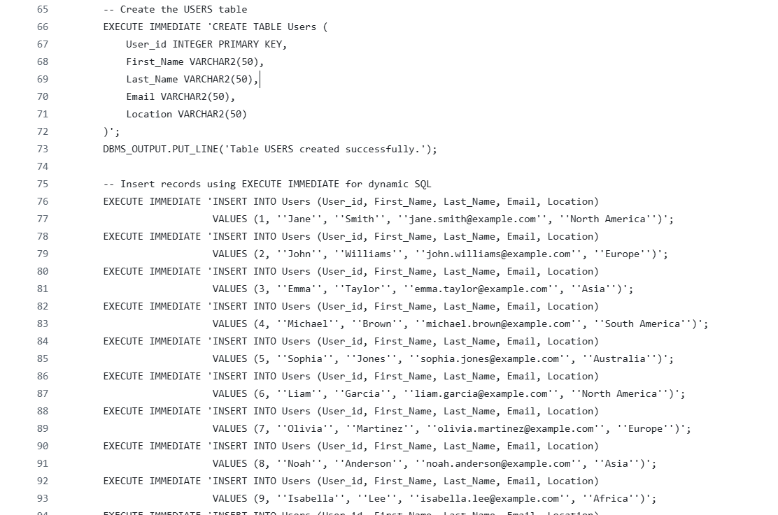
DDL
Statements

Slide 13
Security
Admin : Permissions: Full access to all tables and views. Can manage users, influencers, products, inventory, orders, sales reports.
Access:
Can view and update inventory status.
Can monitor all sales data (region-wise, weekly).
Can create and modify users and influencers.
Can modify product details, including price and stock.
Product Manager: Permissions: Can manage products and inventory but cannot access user or order data.
Access:
Can update quantity in hand and product pricing.
Cannot access user or influencer data.
Influencer: Permissions: Can only promote products; cannot change product details or view sales information.
Access:
Can view the products they promote.
Cannot view or modify inventory or order information.
Can track their promoted products but no detailed insights on user engagement.
User: Permissions: Can browse products and place orders.
Access:
Can view the list of products and influencers.
Can only view their own order history.
Cannot access inventory, product management, or sales data.

Slide 14
Roles
INVENTORY_MANAGER
Access to inventory-related tables and views.
Manages stock levels and order statuses.
APP_ADMIN
Full access to all tables, views, and operations.
Manages users, permissions, and overall database functionality.
INFLUENCER_USER
Access to influencer performance metrics and sales data.
Tracks individual contributions to overall sales.
APP_USER
Access to personal order history and statuses.
Restricted to their data for privacy.

Slide 15
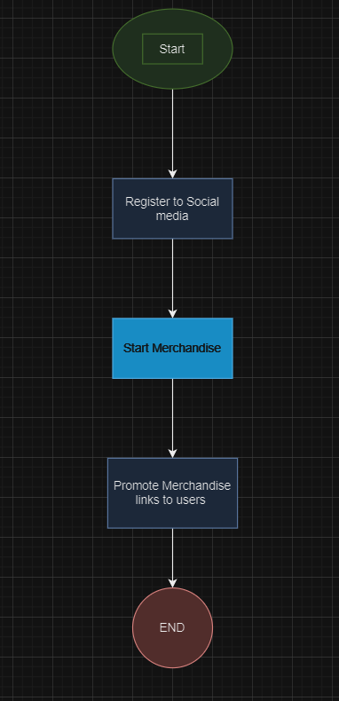
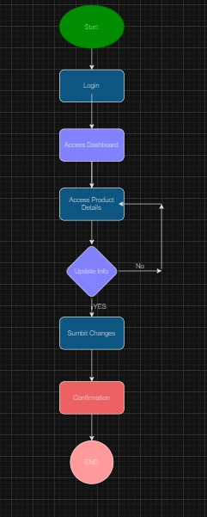
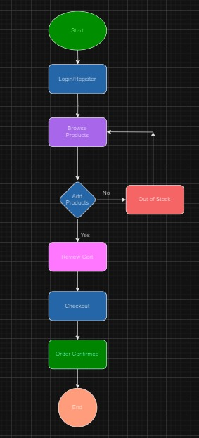
Data Flow Diagram
User

Slide 16
Report
Top Customers by Number of Orders Identifies the customers with the highest number of orders, highlighting loyal or high-frequency buyers.
Top Regions by Total Sales Highlights regions generating the most revenue, enabling targeted marketing and resource allocation.
Top Products by Quantity Sold Lists the best-selling products, helping to manage stock levels and identify popular items.
Influencers Driving the Most Sales Shows which influencers contribute the most to sales, aiding in strategic partnerships and campaigns.
Pending Orders and Their Customers Provides a list of pending orders along with the associated customers for efficient order tracking and fulfillment.
Top 5 Regions with Most Orders Displays regions with the highest order volumes, offering insights into market demand and operational focus areas.

Slide 17
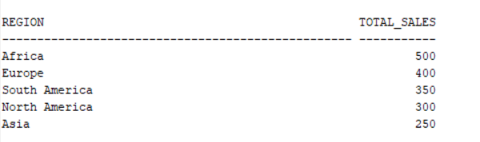
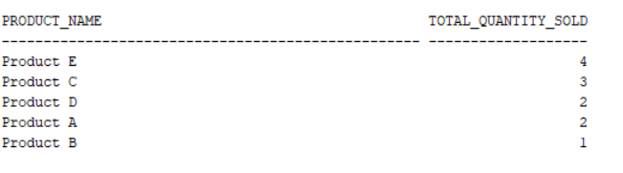
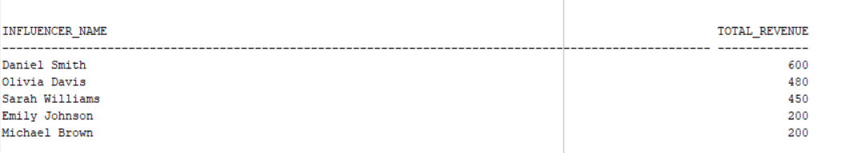
Top Regions by Total Sales
Top Products by Quantity Sold
Influencers Driving the Most Sales

Slide 18
Thank You

