Slide 1

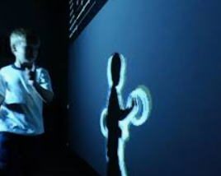
Computer Vision Hand Gesture Recognition
GROUP 3
Vinay Malik
Shreya Kiran Bhoir
Vikash Raj Chandrabalu
Priyanka Awasthi
Vignesh Ram Sundararaman

Slide 2
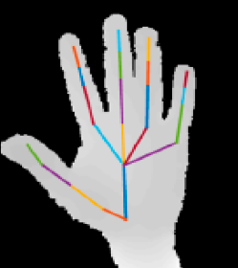
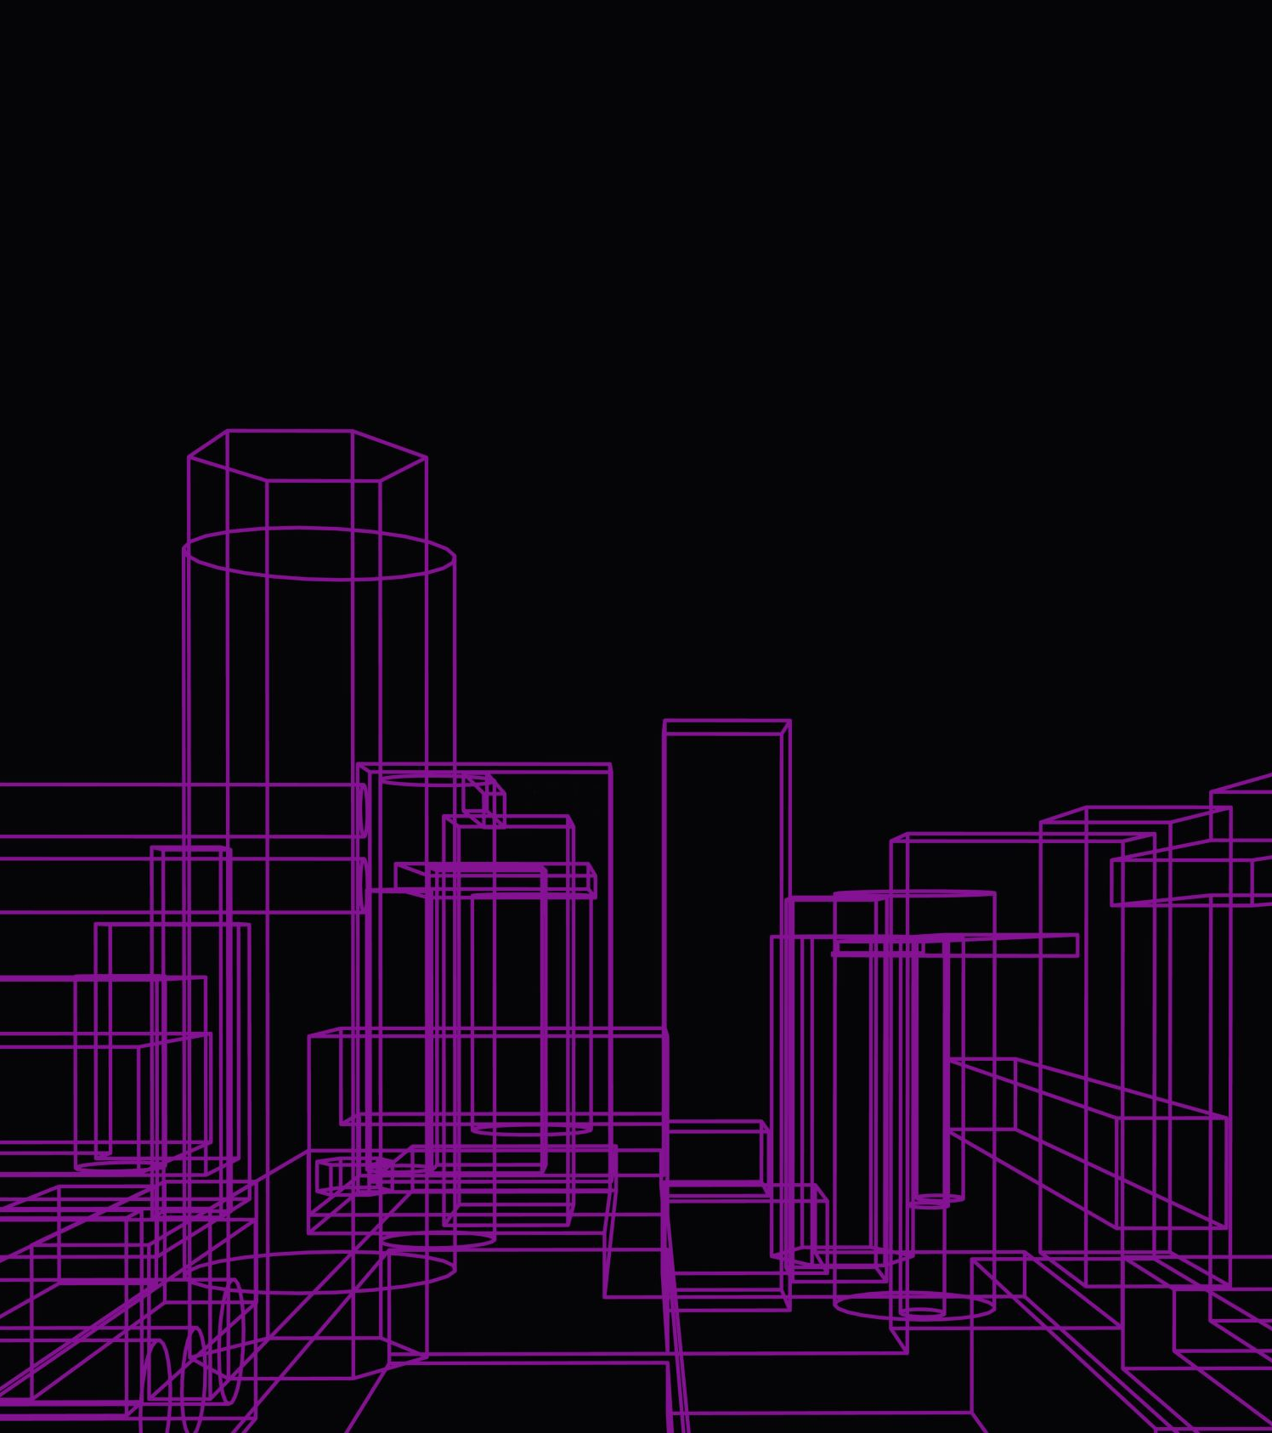
Introduction
The emergence of a new field - Human Computer Interaction (HCI) has gained a recent popularity as it allows two-way interaction in virtual spaces. We tried to build a common hand gesture recognition (HGR) system, which can be used in video conferencing services or home automation systems.
Hand gesture recognition is an application of computer vision for detecting and interpreting the movements or positions of a hand or fingers. The project's goal is to build a system which can detect hand motions.
https://www.mdpi.com/2313-433X/6/8/73

Slide 3
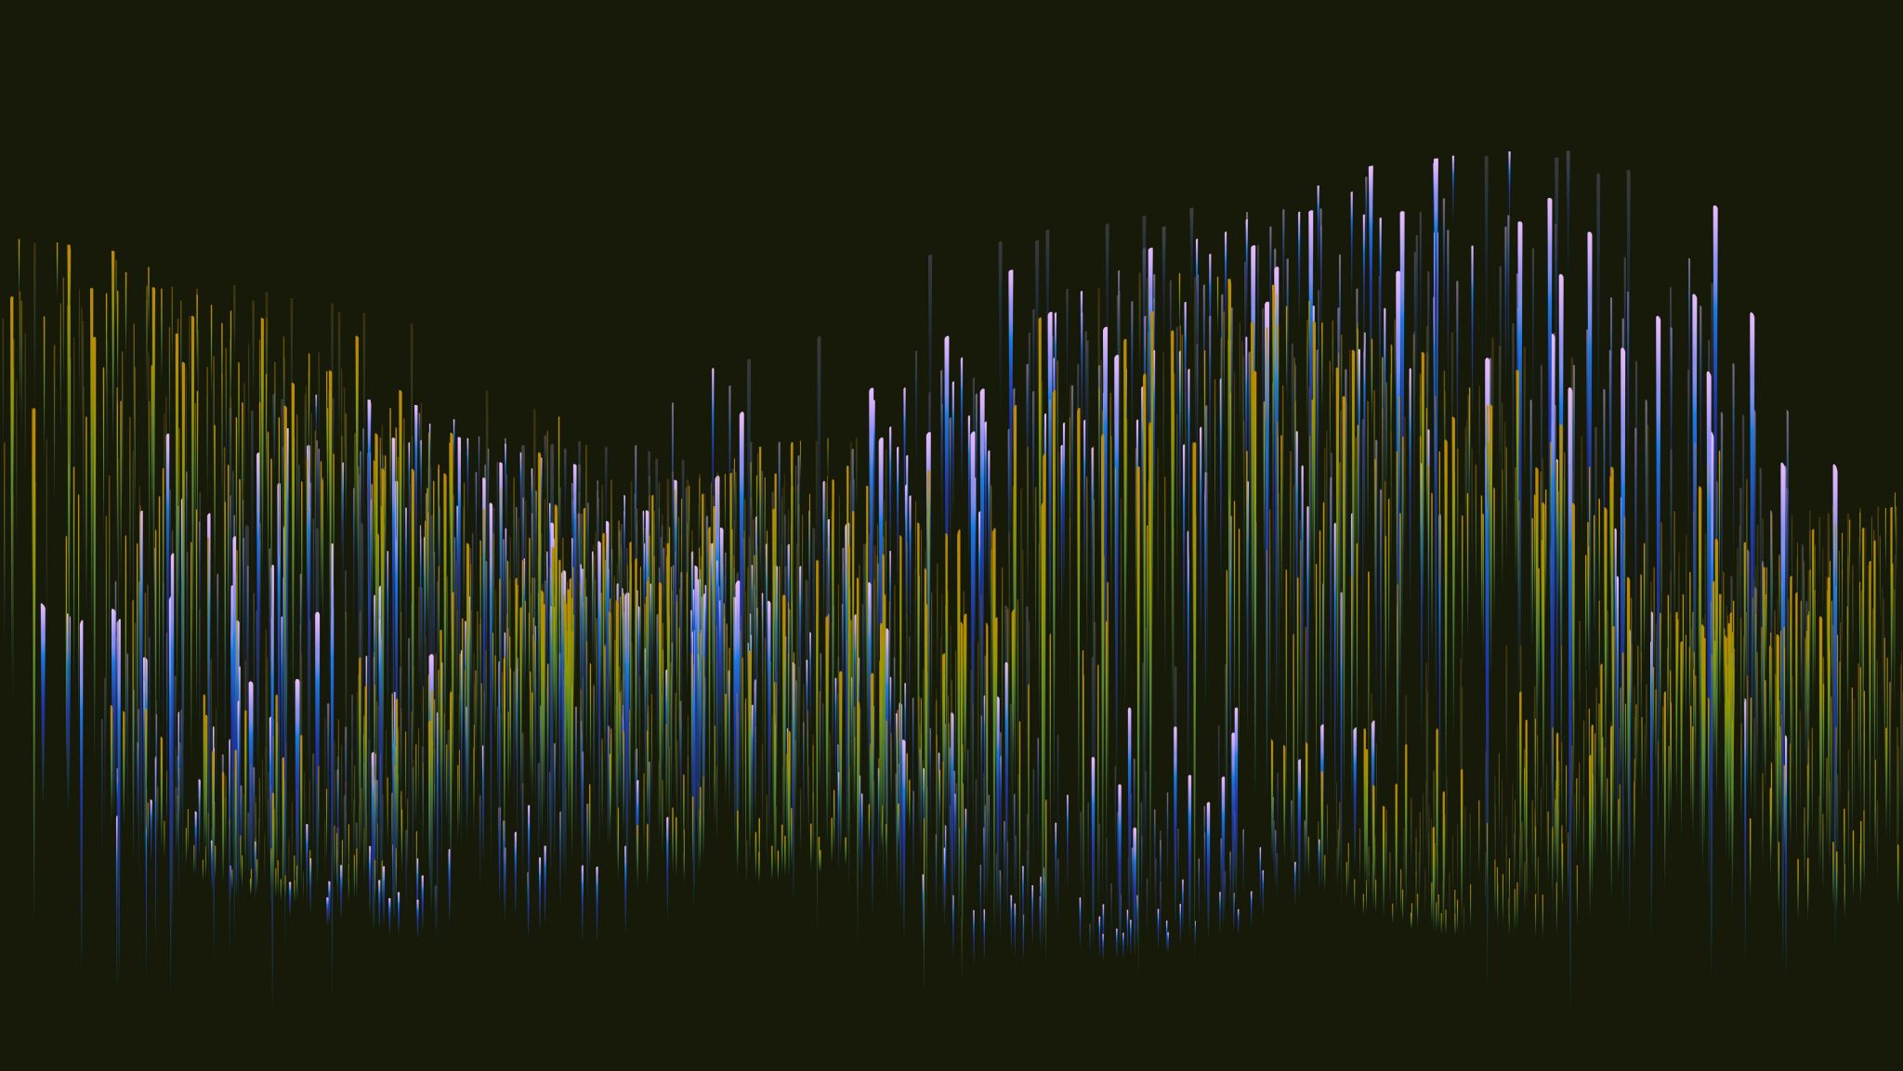
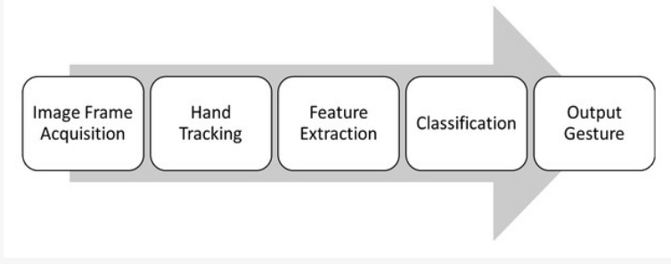
METHODOLOGY
To implement a hand gesture recognition system using computer vision techniques, the following methodology can be followed:
Extraction of features from the preprocessed data and then training a machine learning model using the extracted features followed by testing the model on a separate set of hand gesture data and at last evaluating the performance of the model.
DOI: 10.7717/peerjcs.218/fig-4

Slide 4
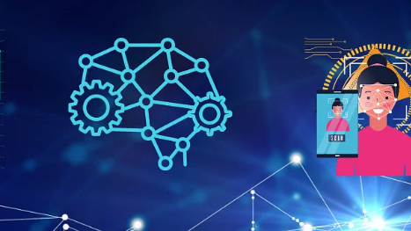
MODEL EVALUATION
We evaluated the model on the testing set using the evaluate() function, and printed the test accuracy. Mean Average Precision (mAP) function, a famous evaluation metric, is used in object detection and image segmentation tasks.
This is widely used to measure the accuracy of the model in terms of precision and recall. It estimates the average precision (AP) for each class of object detected, and then takes the mean over all the classes to get the final mAP score.
The MAP score in object detection measures how accurately an algorithm localises objects of interest and distinguishes them from other objects in the image. The score is calculated by averaging the precision-recall curves for each object class, where precision is the ratio of true positives to predicted positives and recall is the ratio of true positives to ground-truth positives.
A high MAP score indicates that the algorithm can retrieve relevant images with a high degree of precision and recall.

Slide 5
COMPUTER VISION CONCEPTS USED IN HAND GESTURE RECOGNITION
Hand detection: The process of identifying and localizing the hand in an image.
Feature extraction: The process of identifying key characteristics or features of the hand, such as its shape, size, and position.
Image preprocessing: Techniques used to enhance the input image.
Image segmentation: Techniques used to separate the hand from the background.
Feature extraction: Techniques used to extract relevant information from the preprocessed image.
Machine learning: Techniques used to train a model to classify the hand gesture based on the extracted features.
Classification: The process of assigning a specific gesture or action to the detected hand movements.
Deep learning: A machine learning approach that uses artificial neural networks to learn from data, which is commonly used in hand gesture recognition systems.
Gesture recognition: The process of identifying and interpreting specific hand gestures, such as pointing, waving, or making a fist.

Slide 6
Constraint setting : andom_seed = 42, batch_size = 16, num_epoch = 15 GestureDataset is defined below to load and preprocess the dataset Model class creation - Stochastic Gradient Descent (SGD) Optimizer is used Mean Average Precision (mAP) metric definition Training the model using the training dataset and testing the model's performance Creation of a list to store loaded images after using the PIL module Creation a new list of image tensors images_tensors_input by applying a PyTorch transform Inference on the input data by passing it through the specified PyTorch model with gradient calculation disabled, and returning the model's output tensor as out and stores them in Python lists. These lists can be used for further processing or visualization of the object detection results. Creation of a list of modified final_images with bounding boxes and adding text labels for the detected objects in the original images Creation of a new directory named out_images to save each modified image as a PNG file Final Step was creation of a GUI that allows to select an image file from the out_images and displays it
Steps Involved

Slide 7
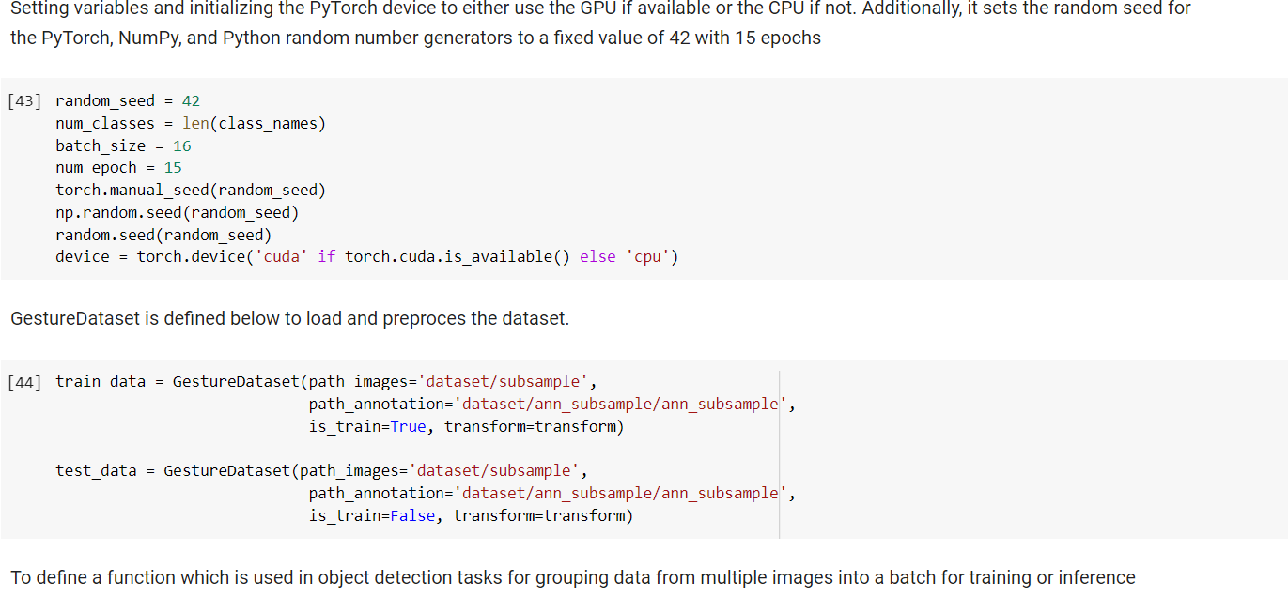

Slide 8
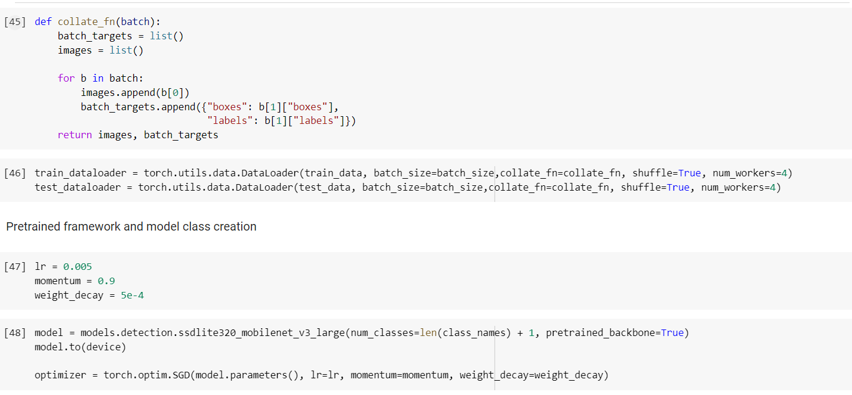

Slide 9
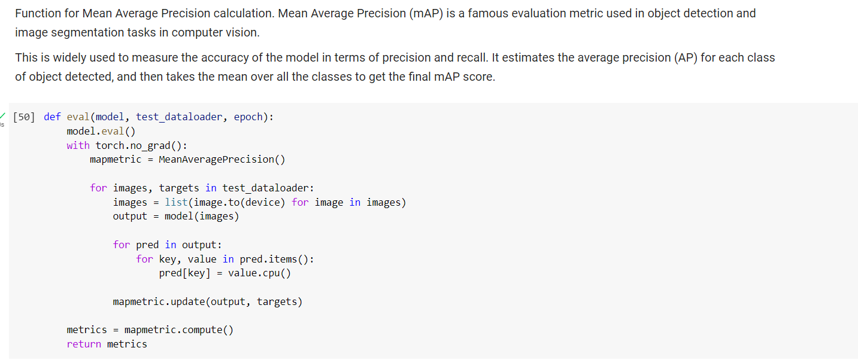

Slide 10
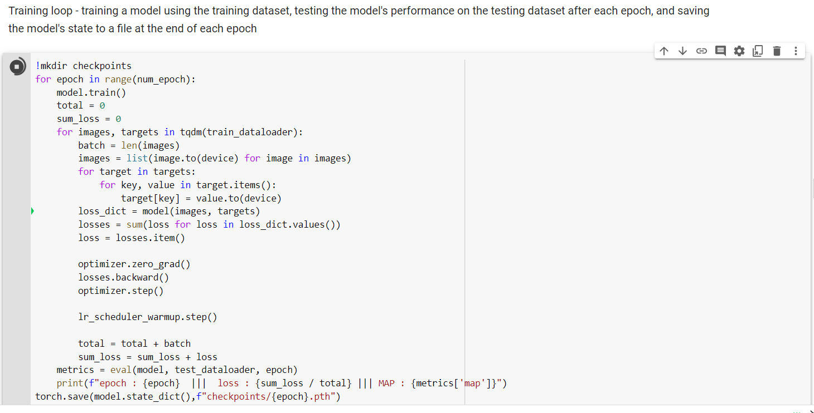

Slide 11
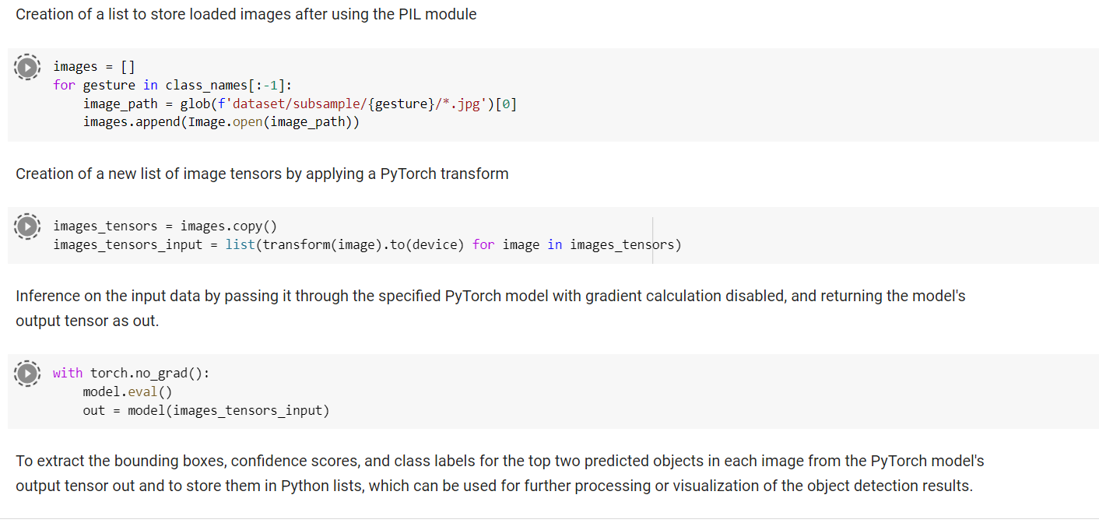

Slide 12
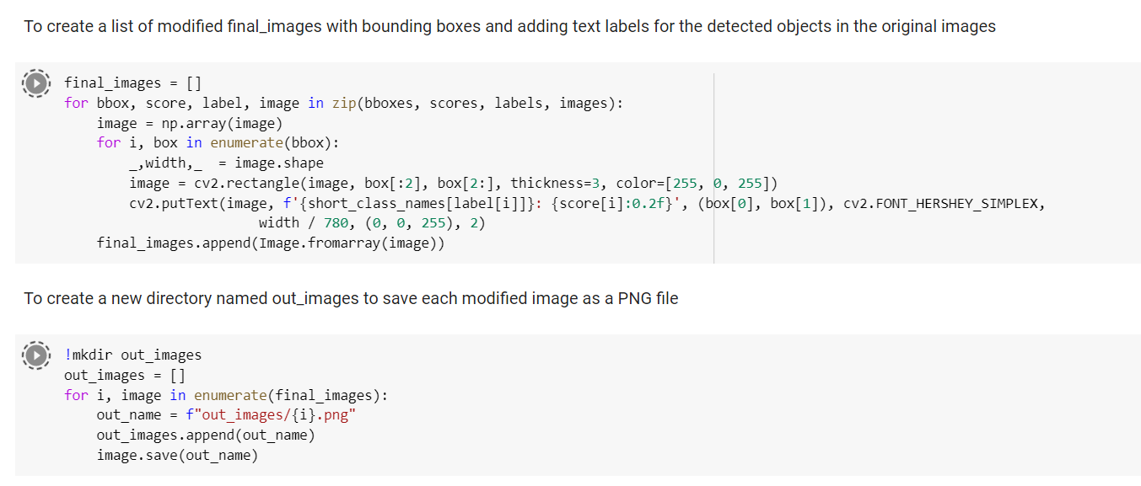

Slide 13
Conclusion
Our hand gesture recognition project results show that we achieved with MAP score 77% and a loss of 34% This demonstrates that our model can recognise hand gestures accurately in real-time using a webcam and can be used in a variety of applications such as human-computer interaction and robotics. It is worth noting, however, that our results were obtained using a controlled dataset and that additional testing on diverse datasets may be required to evaluate the model's generalisation performance.

Slide 14
REFRENCES AND CITATION
https://www.researchgate.net/publication/284626785_Hand_Gesture_Recognition_A_Literature_Review
https://www.ncbi.nlm.nih.gov/pmc/articles/PMC8321080/#:~:text=Algorithms%20have%20been%20developed%20based,deep%20learn%20detection%20and%20more.
https://www.mdpi.com/2313-433X/6/8/73
https://www.academia.edu/17775220/Hand_Gesture_Recognition_A_Literature_Review
https://www.researchgate.net/publication/284626785_Hand_Gesture_Recognition_A_Literature_Review
https://www.kaggle.com/code/adinishad/hand-sign-recognition-cnn-keras-97-accuracy?scriptVersionId=41482305&cellId=4
https://web.stanford.edu/class/cs231a/prev_projects_2016/CS231A_Project_Final.pdf
https://www.mdpi.com/2313-433X/6/8/73
https://peerj.com/articles/cs-218/
https://gitlab.aicloud.sbercloud.ru/rndcv/hagrid

Slide 15
PARTICIPATION REPORT
Vinay Malik: Involved in Deciding Project topic, Technical Analysis, Proof-Reading PPT Content and Interpretation of Results
Shreya Kiran Bhoir: Involved in Deciding Project topic, Methodology, Model Building, Preparation of Project Report, Interpretation of Results, preparation of PPT
Vikash Raj Chandrabalu: Involved in Deciding Project topic, In Proof Reading Project report with - Labelled Figures, Proper Referencing and Literature Review
Priyanka Awasthi: Involved in Deciding Project topic, Python Code Development, Model Building, Preparation of Report, Literature Review and Preparation of PPT
Vignesh Ram Sundararaman: Involved in Deciding Project topic, Evaluation of Model, Use of Computer Vision terms, Proof reading Project Report and PPT

