Slide 1
Hotel Booking Data Analysis
Presented by: LaMichael Harris

Slide 2
Project Overview
Objective: Understand booking patterns, cancellations, and revenue trends.
Dataset: Contains hotel reservation details, customer behavior, and pricing.
Goal: Provide actionable insights to improve booking management and revenue.

Slide 3
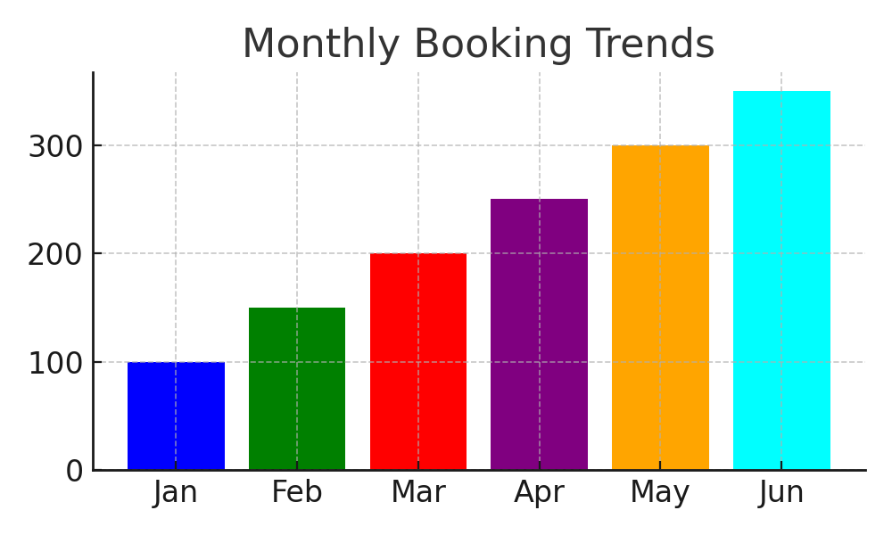
Key Booking Trends
Peak booking months: July & August.
City hotels are more frequently booked than resort hotels.
Seasonality significantly affects booking volumes.

Slide 4
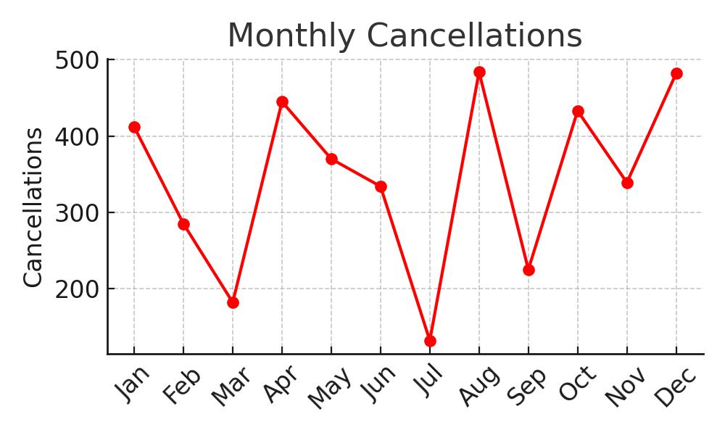
Cancellation Analysis
Higher cancellation rates observed in city hotels.
Longer lead times correlate with increased cancellations.
Customers with special requests tend to cancel less often.

Slide 5
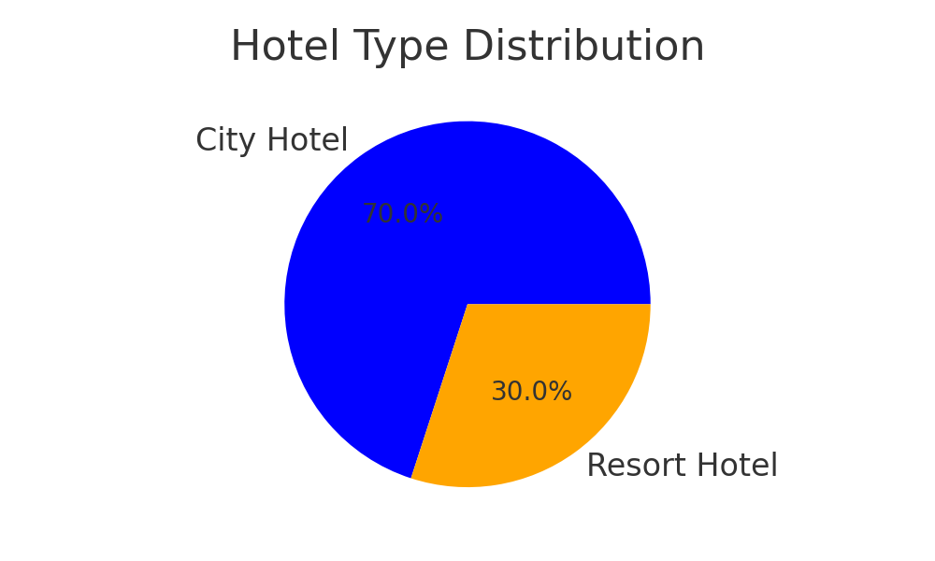
Revenue Insights
Average daily rate (ADR) spikes during peak seasons.
Resort hotels have lower occupancy but higher per-room revenue.
Discounts and promotions influence booking decisions significantly.

Slide 6
Business Recommendations
Implement dynamic pricing strategies for peak & off-peak seasons.
Introduce policies to reduce cancellations for long lead-time bookings.
Enhance customer experience and loyalty programs for retention.

Slide 7
Conclusion & Next Steps
Key takeaways: Trends, cancellations, revenue insights.
Next Steps: Apply recommendations, monitor impact.

