Slide 1
Data Representations
We know that a computer's CPU and main memory can only store binary bits.
  How are individual characters and character strings stored in a computer?
  How are integers stored in a computer?
  How are negative numbers represented?
  How are floating point numbers, such as 2.75, represented in a computer?

Slide 2
Characters
We need to distinguish between:
  The concept of a character.
  How a character looks on a screen or page.
The concept of “upper case A” can have many appearances depending on the font used to display the character.
  A (Arial) A (Times New Roman)
  A (Comic Sans MS) A (Brush Script MT)
The concept of “upper case A” is different from the concept of “numeral 4”.

Slide 3
Characters (2)
Each character (concept of a character) is represented by a sequence of ones and zeros.
  Rather than writing the individual ones and zeros we will group the bits into groups of 8 bits (called a byte) or groups of bytes (called words).
  Each byte will be given in hexadecimal notation.
    0x5E is the bit sequence 01011110
There are several standards for assigning a code to each character.

Slide 4
Characters (3)
The 2 main standards are:
  ASCII (American Standard Code for Information Interchange)
  Unicode
    An extension of ASCII to allow for different “languages”.
IBM has its own “standard” called EBCDIC.

Slide 5
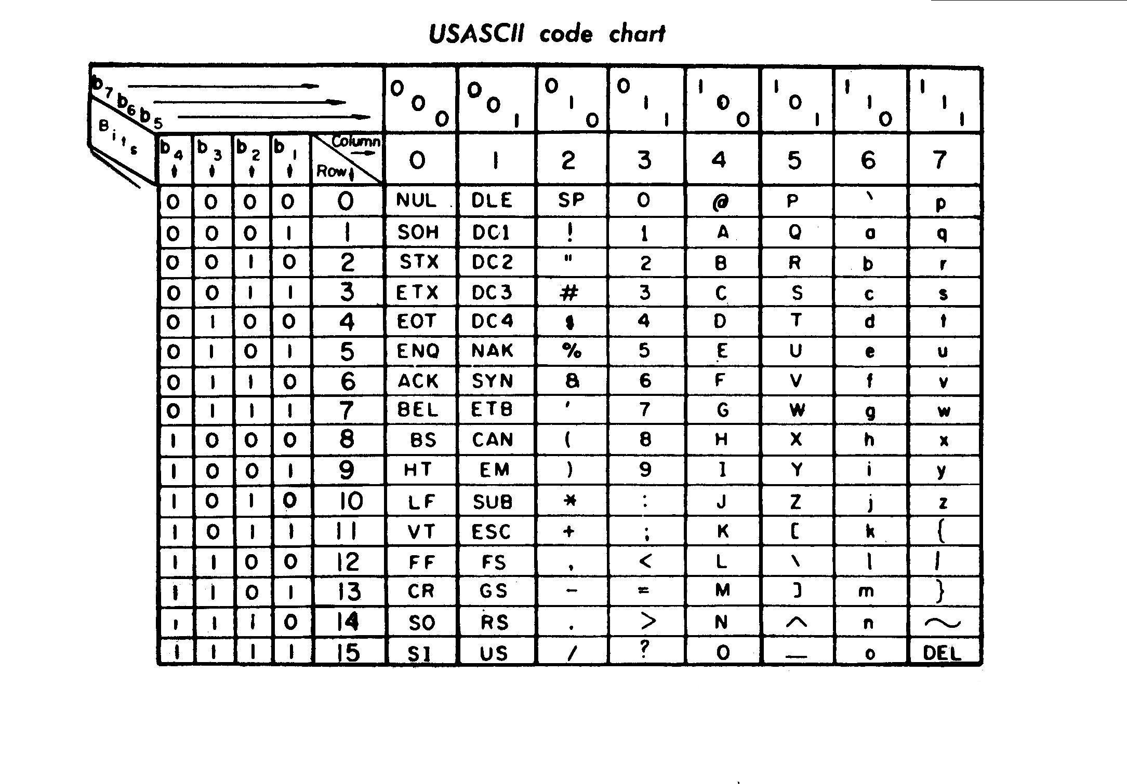
ASCII

Slide 6
Extending ASCII
While ASCII worked great for English and simple “typewriter” systems, it could not cope with accented characters very well.
  â could be made by an “a” character followed by a backspace (BS) character and then a circumflex (“^”) character.
Screen-based displays enabled simple graphics to be constructed from block graphics characters.

Slide 7
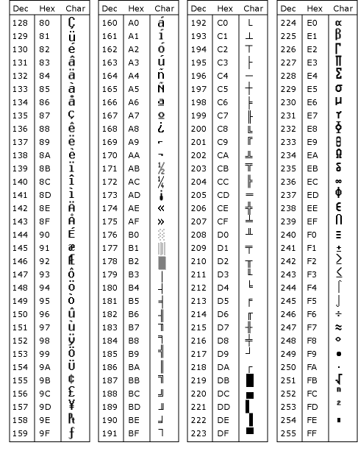
Extended ASCII Table

Slide 8
Unicode
Even with the extended ASCII table, the table is very oriented towards Latin based alphabets.
As computers became more prevalent across the world it became necessary to accommodate other alphabets.
  Cyrillic
  Kanji and Hiragana
  Arabic
Unicode uses 16-bit codes.
  256 tables of 256 characters each.
  ASCII is bottom half of the first table.

Slide 9
Strings
Strings are sequences of characters.
Fixed length strings
  Older programming languages, e.g. Pascal, used fixed length strings.
  The first byte gave the length of the string (number of characters in the string) and the remaining bytes were the characters in the string.
6 | H | e | l | l | o
+
5 | W | o | r | l | d
=
11 | H | e | l | l | o |  | W | o | r | l | d

Slide 10
Strings (2)
Variable length string
  These are much more flexible than fixed length strings.
  Variable length strings are terminated by a NULL character (0x00 or \0).
  Concatenating strings (joining strings together is a little more complicated.
H | e | l | l | o |  | \0
+
W | o | r | l | d | \0
=
H | e | l | l | o |  | W | o | r | l | d

Slide 11
Integers
A single byte can represent 256 different values, 0 up to 255.
For larger numbers we need to use multiple bytes.
  A 2 byte word can represent 2¹⁶=65,536 values, 0 up to 65535.
  A 4 byte word can represent 2³²=4,294,967,296 values.
  No matter how many bytes you add there is always a limit.

Slide 12
2's Complement Numbers
Lets us limit ourselves to bytes for the moment.
There are 2 ways to implement negative numbers.
  Use a sign bit.
    If the most significant bit is 1 then the number is negative, and if it is 0 then it is positive.
  Though simple it has a few problems.
    There are two ways to represent zero.
      0x00 = 00000000 = +0
      0x80 = 10000000 = -0

Slide 13
2's Complement Numbers (2)
    Arithmetic manipulation is messy
      Try adding 1 to -1 and you get:
      0x81 + 0x01 = 0x82 = -2 ??????
      You would need different hardware for adding two positive numbers and a positive number and a negative number.
  2's complement
    To convert a positive number into a negative number subtract it from 0x00.
0000 0010 = 0x02 | 2
0000 0001 = 0x01 | 1
0000 0000 = 0x00 | 0
1111 1111 = 0xFF | -1
1111 1110 = 0xFE | -2
1111 1101 = 0xFD | -3

Slide 14
2's Complement Numbers (3)
Now adding positive and negative numbers does not cause any complications.
  -1 + 2 = 0xFF + 0x02 = 0x01 = 1
  And we did not have to even involve a carry bit!
Multiplication by 2 still works as a shift left operation.
  4 x 2 = 0x04
  << 1 = 0000 0100
  << 1 = 0000 1000 = 0x08 = 8
  -2 x 2 = 0xFE
  << 1 = 1111 1110
  << 1 = 1111 1100 = 0xFC = -4

Slide 15
2's Complement Numbers (4)
Division by 2 is still a shift right but with a slight twist.
  4 / 2 = 0x04 >> 1 = 0000 0100 >> 1 = 0000 0010 = 0x02 = 2
  -4 / 2 = 0xFC >> 1 = 1111 1100 >> 1 = 1111 1110 = 0xFE = -2
If dividing a positive number by 2 we need to shift in a 0 to the most significant bit.
If dividing a negative number by 2 we need to shift in a 1 to the most significant bit.
Most CPUs have shift instructions that shift the carry bit into the register being shifted. The carry bit can be set depending on whether the register contains a negative 2's complement number (as determined by a bit in the status register).

Slide 16
Floating Point Numbers
If we only have binary numbers, how can we represent numbers such as:
  0.00000025
  1,000,000,000,000,000
  -127.5
  -0.075
First let us think back to how we humans have learnt to deal with very big and very small numbers.

Slide 17
Scientific Notation
Using scientific notation we can reduce very large numbers and very small numbers into manageable entities.
  0.00000025 = 2.5 x 10⁻⁷
  1,000,000,000,000,000 = 1.0 x 10¹⁵
  -127.5 = -1.275 x 10²
  -0.075 = -7.5 x 10⁻²
Each part of the scientific notation number has a specific name.
  2.5 x 10⁻⁷
mantissa
exponent

Slide 18
Scientific Notation in Binary
The standard for scientific notation in binary is the IEEE 754 standard.
First what does the binary number 0.1001 represent?
  (0 x 2⁰) + (1 x 2⁻¹) + (0 x 2⁻²) + (0 x 2⁻³) + (1 x 2⁻⁴)
  0 + (1 x 0.5) + (0 x 0.25) + (0 x 0.125)
  + (1 x 0.0625)
  0.5625

Slide 19
Scientific Notation in Binary (2)
Now let us try 1234.5625
Convert the part to the left of the decimal point into binary and the part to the right of the decimal point into binary.
  1234.5625 = 10011010010.1001
Now normalise the binary number
  1.00110100101001 x 2¹⁰¹⁰
A nice feature of normalised binary numbers is that the digit to the left of the binary point is always a 1!
exponent
mantissa

Slide 20
Scientific Notation in Binary (3)
IEEE 754 covers 32-bit, 64-bit and 128-bit floating point numbers.
A 32-bit IEEE 754 number is calculated and stored in memory as follows.
  Convert integer part into binary.
  Convert fractional part into binary
  Normalise, drop leading 1 and add sufficient 0's to the start to get a 23-bit mantissa
  Add 127 to the number of places shifted to get an 8-bit exponent (shift left is positive, shift right is negative).
31 | 30 |  |  |  |  |  |  | 23 | 22 |  |  |  |  |  |  |  |  |  |  |  |  |  |  |  |  |  |  |  |  |  | 0
Sign bit

Slide 21
Scientific Notation in Binary (4)
So 1234.5625 as a 32-bit IEEE 754 number is:
  1234.5625 = 10011010010.1001
  1.00110100101001 x 2¹⁰¹⁰
  Sign bit = 0
  Mantissa = 00000000000110100101001
  Exponent = 10 + 127 = 137 = 0x89 = 10001001
31 | 30 |  |  |  |  |  |  | 23 | 22 |  |  |  |  |  |  |  |  |  |  |  |  |  |  |  |  |  |  |  |  |  | 0
0 | 1 | 0 | 0 | 0 | 1 | 0 | 0 | 1 | 0 | 0 | 0 | 0 | 0 | 0 | 0 | 0 | 0 | 0 | 0 | 1 | 1 | 0 | 1 | 0 | 0 | 1 | 0 | 1 | 0 | 0 | 1

