Slide 1
Data Communications
The first key difference between different data communication techniques is parallel communications versus serial communications.
  Parallel communications
    Several bits are transferred at the same time. Typically a whole byte or word is transferred.
    High speed transfer of data
      Data transfer within the PC, Hard Disk ↔ CPU
D₀
D₁
Data Valid signal is high when the Data Bus has a valid value.
Data Acknowledgement signal is high to signal data has been received and the next byte can be sent.
D₂
D₃
D₄
D₅
D₆
D₇
Data Valid
Data Acknowledgement

Slide 2
Serial Communications
One problem with parallel communications
  requires a lot of signal (wires).
Serial communications: data is transmitted one bit at a time.
  If a byte has to be transmitted it has to be converted into a series of bits. This process is called serialisation.
  The reverse process, deserialisation, converts a series of bits into a byte.
    Shift registers perform this process.
Serial communications requires very few signals!

Slide 3
Serial Communications (2)
There are two types of serial communications.
  Synchronous
    The transfer of data is controlled by a clock signal.
  Asynchronous
    No clock signal.
With synchronous serial communications each bit is transferred in step with the clock.
  Usually with the rising edge of the clock signal.

Slide 4
Serial Communications (3)
clock
data
1
0
0
1
0
1
1
0
Data is transferred least significant bit first.
Received data byte is 01101001 = 0x69

Slide 5
Serial Communications (4)
A popular synchronous serial system is called the Serial Peripheral Interface (SPI) bus.
  Consists of a master device and a slave device
  SPI has four signals
    Serial Clock (SCLK)
    Slave Select (SS)
      If high the output is from the slave device. If low the output is from the master device.
    Master Output Slave Input (MOSI)
      Output from master device.
    Master Input Slave Output (MISO)
      Output from slave device.

Slide 6
Serial Communications (5)
SPI
  Advantages
    Full duplex (two-way) communications
    Less signals than parallel communications.
  Disadvantages
    Only works over short distances.
    No flow control or acknowledgements
      Master could be transmitting when the slave is not ready.
  Some applications
    MMC and SD cards
    Camera lenses (Canon EF mount)
    LCDs (liquid crystal displays)

Slide 7
Serial Communications (6)
Asynchronous serial communications.
  In asynchronous serial communications there is no shared clock signal. The transmitter and receiver have their own separate clock.
  Communications can be done over a single wire within a device.
    When communications is between two devices, two additional wires are required so both devices have a shared view of the voltage that represents 0 and the voltage that represents 1.
  Simple and least expensive to implement.
    Used in many PC devices (e.g. Mice, keyboards, etc.)

Slide 8
Serial Communications (7)
Communication can occur at any
Local clocks at the transmitting device and the receiving device may not be running in sync
Data byte being transferred needs to be framed by:
  A start bit to tell the receiver that the first bit of the byte is about to arrive.
  A stop bit to tell the receiver that the byte has been transferred.
    Different systems may use 1, 1.5 or 2 stop bits.
start bit is always low
stop bit is always high
start bit
bit 0
bit 1
bit 2
bit 3
bit 4
bit 5
bit 6
bit 7
stop bit

Slide 9
Serial Communications (8)
Both the transmitter and receiver have to be set for the same transmission speed.
  Transmission speed is measured in symbol per second, Baud. In most systems this is equivalent to bits per second.
Some systems add a parity bit between the last data bit and the stop bit.
  The parity bit is to detect data corruption.
  There are two types, even parity and odd parity.
  In even parity the parity bit is “1” if there is an odd number of “1” bits in the byte.
  In odd parity the parity bit is “1” if there is an even number of “1” bits in the byte.

Slide 10
Serial Communications (9)
Both the receiver and transmitter must agree on all the options for serial communications to work.
  Same number of data bits (7 or 8)
  Same speed
  Same number of stop bits
  Same parity (even or odd)

Slide 11
Flow Control
When two devices transfer data to each other, this transfer can be:
  Half-duplex
    Both devices can transmit but only one device transmits at a time.
  Full-duplex
    Both devices can transmit at the same time.
In order to prevent a device from having to receive data when it is not ready, flow control systems are implemented.

Slide 12
Flow Control (2)
Typically a receiver stored received data in a buffer.
When the buffer is nearly full
  the receiver needs to tell transmitter to stop send data until it has processed the data in the buffer.
Software Flow Control
  Does not require any additional signals.
  Receiver send an XOFF code, 0x13, to the transmitter.
  Transmitter does not send any more data until it receives an XON code, 0x11, from the receiver.

Slide 13
Flow Control (3)
Advantages:
  No extra signals required.
  Implemented in software so no additional hardware (and cost) is required.
Disadvantages:
  Sending and processing the XOFF and XON codes takes time. It is not instantaneous.
  You cannot use the XON and XOFF codes as part of the data being transmitted.

Slide 14
Flow Control (4)
Hardware Flow Control
  Common control lines are:
    RTS (Request To Send)
    CTS (Clear To Send)
    DSR (Data Set Ready)
    DTR (Data Terminal Ready).
  The transmitting device sets its RTS signal, which signals the opposite end (the slave end such as a DCE) to begin monitoring its data input line.
  When ready for data, the receiver sets its CTS signal.

Slide 15
Flow Control (5)
  If either end needs to stop the data, it lowers its respective line.
  For session-based data transfers, the DTR and DSR signals are set for the entire session (say a dialup internet call), and RTS and CTS are set for each block of data.
  Advantages:
    Immediate effect.
  Disadvantages:
    Additional hardware and cost.

Slide 16
Universal Serial Bus (USB)
A USB system has an asymmetric design, consisting of:
  a host,
  a multitude of downstream USB ports, and
  multiple peripheral devices connected in a tiered-star topology.
Additional USB hubs may be included in the tiers, allowing branching into a tree structure with up to five tier levels.

Slide 17
USB (2)
A USB host may have multiple host controllers and each host controller may provide one or more USB ports.
  Up to 127 devices, including the hub devices, may be connected to a single host controller.
USB devices are linked in series through hubs.
  There always exists one hub known as the root hub, which is built in to the host controller.

Slide 18
USB (3)
A physical USB device may consist of several logical sub-devices.
  These are referred to as device functions.
  A single device may provide several functions:
    a webcam (video device function) with a built-in microphone (audio device function).
USB endpoints actually reside on the connected device: the channels to the host are referred to as pipes.

Slide 19
USB (3)
USB device communication is based on pipes (logical channels). Pipes are connections from the host controller to a logical entity on the device named an endpoint.
  A USB device can have up to 32 active pipes, 16 into the host controller and 16 out of the controller.
Each endpoint can transfer data in one direction only, either into or out of the device, so each pipe is uni-directional.

Slide 20
USB (4)
USB supports three data rates:
  The Full Speed rate of 12 Mbit/s (1.5 MB/s). All USB hubs support Full Speed.
  A Low Speed rate of 1.5 Mbit/s (187.5 kB/s).
    It is intended primarily to save cost in low-speed devices such as keyboards, mice, and joysticks.
  A High-Speed (USB 2.0) rate of 480 Mbit/s (60 MB/s).
    All high-speed devices are capable of falling back to full-speed operation if necessary.

Slide 21
USB (5)
USB signals are transmitted on a twisted pair data cable labelled D+ and D−. These collectively use half-duplex differential signalling to combat the effects of electromagnetic noise on longer lines.
Normal serial signal
D+
Differential signalling
D-

Slide 22
USB (6)
When a USB device is first connected to a USB host, the USB device enumeration process is started.
The enumeration starts:
  by sending a reset signal to the USB device.
  The speed of the USB device is determined during the reset signalling.
After reset:
  the USB device's information is read by the host,
  then the device is assigned a unique 7-bit address.

Slide 23
USB (7)
If the device is supported by the host:
  the device drivers needed for communicating with the device are loaded
  and the device is set to a configured state.
If the USB host is restarted:
  the enumeration process is repeated for all connected devices.
The host controller polls the bus for traffic
  usually in a round-robin fashion
  so no USB device can transfer any data on the bus without an explicit request from the host controller.

Slide 24
USB Packets
USB communication takes the form of packets.
Initially, all packets are sent from the host, via the root hub and possibly more hubs, to devices.
Some of those packets direct a device to send some packets in reply.
Packets come in three basic types:
  Handshake packets
  Token packets
  Data packets

Slide 25
USB Packets (2)
Handshake packets:
  Handshake packets are generally sent in response to data packets.
  There are three basic types:
    ACK, indicating that data was successfully received,
    NAK, indicating that the data cannot be received at this time and should be retried, and
    STALL, indicating that the device has an error and some corrective action (such as device initialization) should be performed.

Slide 26
USB Packets (3)
Token packets
  Tokens are only sent by the host, never a device.
  IN and OUT tokens contain:
    a 7-bit device number
    4-bit function number (for multifunction devices) and
    command the device to transmit DATAx packets, or receive the following DATAx packets, respectively.

Slide 27
USB Packets (4)
An IN token expects a response from a device.
The response may be a NAK or STALL response, or a DATAx frame. In the latter case, the host issues an ACK handshake if appropriate.
An OUT token is followed immediately by a DATAx frame.
The device responds with ACK, NAK, or STALL, as appropriate.

Slide 28
USB Packets (5)
Data packets
  There are two basic data packets, DATA0 and DATA1.
  Both consist of:
    a DATAx PID field,
    0–1023 bytes of data payload (up to 1024 in high speed, at most 8 at low speed),
    and a 16-bit CRC.
  They must always be preceded by an address token, and are usually followed by a handshake token from the receiver back to the transmitter.

Slide 29
USB Packet (6)
The two packet types provide the 1-bit sequence number.
If a USB host does not receive a response (such as an ACK) for data it has transmitted
  it does not know if the data was received or not.
To solve this problem
  the device keeps track of the type of DATAx packet it last accepted.
  If it receives another DATAx packet of the same type, it is acknowledged but ignored as a duplicate.
  Only a DATAx packet of the opposite type is actually received.

Slide 30
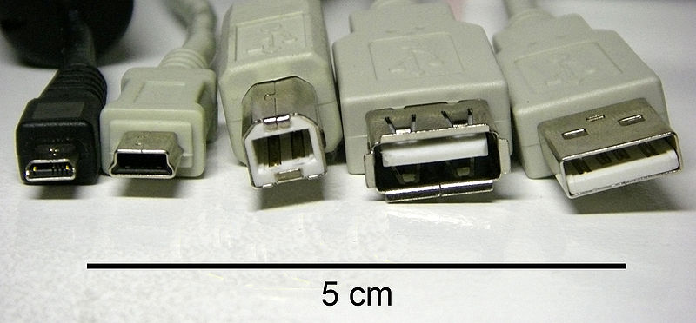
USB Connectors
Pin | Name | Colour | Description
1 | VCC | red | +5 volts
2 | D- | white | Data -
3 | D+ | green | Data +
4 | ID | none | Type A/Type B
5 | GND | black | GROUND
Pin | Name | Colour | Description
1 | VCC | red | +5 volts
2 | D- | white | Data -
3 | D+ | green | Data +
4 | GND | black | Ground
Mini-type A & Mini-type B
Normal type A & type B

Slide 31
Wireless Networking
Wireless networking, also known as WiFi, uses radio wave, like cell phones and TVs, to transmit data between devices.
  A computer's wireless adapter translates data into a radio signal and transmits it using an antenna.
  A wireless router receives the signal and decodes it. The router sends the information to the Internet using a physical, wired network connection.

Slide 32
WiFi (2)
The radios used for WiFi communication
  are very similar to the radios used for cell phones
  they can transmit and receive radio waves
  they can convert 1s and 0s into radio waves and convert the radio waves back into 1s and 0s.
But WiFi radios
  transmit at frequencies that are considerably higher than the frequencies used for cell phones, walkie-talkies and televisions.
  the higher frequency allows the signal to carry more data.

Slide 33
WiFi (3)
As long as they all have wireless adapters, several devices can use one router to connect to the Internet.
This connection is convenient, virtually invisible and fairly reliable.
  However, if the router fails or if too many people try to use high-bandwidth applications at the same time, users can experience interference or lose their connections.

Slide 34
802.11 standards
WiFi uses the 802.11 networking standards (1997), which come in several flavours:
  802.11a (1999)
    transmits at 5 GHz and can move up to 54 megabits of data per second.
  802.11b (1999)
    the slowest and least expensive standard.
    transmits in the 2.4 GHz frequency band of the radio spectrum
    can handle up to 11 megabits of data per second.
    For a while, its cost made it popular, but now it's becoming less common as faster standards become less expensive.
  802.11g (2003)
    transmits at 2.4 GHz like 802.11b, but it's a lot faster
    can handle up to 54 megabits of data per second.
    is faster because it uses the same coding as 802.11a.

Slide 35
802.11 (2)
  802.11n (2009)
    significantly improves speed and range.
    54 megabits of data per second (mb/d/s), 24 mb/d/s (real-word) due to network congestion.
  802.11ac (2013 in progress)
    will provide high throughput in the 5GHz band
    multi-station WLAN throughput of at least 1 gigabits per second
    maximum single link throughput of at least 500 megabits per second
  802.11ad (2014 proposal)
    will use 2.4 GHz, 5 GHz and 60 GHz
    theoretical maximum throughput of up to 7Gbit/s
    2016 – first router
802.11a? – other standards …….

Slide 36
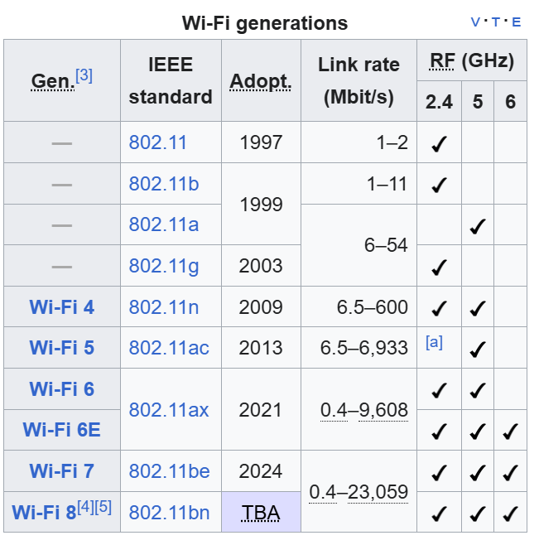
Reference: Wikipedia: https://en.wikipedia.org/wiki/IEEE_802.11

Slide 37
Building a Wireless Network
If you already have several computers networked in your home, you can create a wireless network with a wireless access point.
Otherwise you need a wireless router. This contains:
  A port to connect to your cable or DSL modem
  A router
  An Ethernet hub
  A firewall
  A wireless access point

Slide 38
Building a Wireless Network (2)
A wireless router allows you to use wireless signals or Ethernet cables to connect your computers to one another, to a printer and to the Internet.
Routers
  Usually provide coverage for about 100 feet (30.5 meters) in all directions, although walls and doors can block the signal.
  the range can be extended by range extenders or repeaters.

Slide 39
Building a Wireless Network (3)
When setting up a router you can specify:
  The name of the network, known as its Service Set IDentifier (SSID).
  The channel that the router uses.
    Most routers use channel 6 by default.
    If you are experiencing interference switch to a different channel to eliminate the problem.
  Your router's security options.
    Many routers use a standard, publicly available sign-on, so it's a good idea to set your own username and password.

Slide 40
WiFi Security
The Wired Equivalency Privacy (WEP) security measure was once the standard for WAN security (~1999).
  used a key 10 or 26 hexadecimal digits
  but hackers discovered vulnerabilities in the WEP approach,
  it's easy to find applications and programs that can crack WEP security
  now deprecated (i.e. no longer in use)
  128-bit WEP technology is more secure.

Slide 41
WiFi Security (2)
WiFi Protected Access (WPA)
  is a step up from WEP
  it uses Temporal Key Integrity Protocol (TKIP) encryption
        per-packet key (i.e. it dynamically generates a new 128-bit key for each packet)
        prevents the types of attacks that compromised WEP
WPA2 (or Robust Security Network RSN)
  full 802.11i implementation, better encryption
WPA3
  Simultaneous Authentication of Equals (SAE) exchange
  WPA3 support has been mandatory for devices which bear the "Wi-Fi CERTIFIED™" logo since July 2020
  uses an equivalent 192-bit cryptographic strength in WPA3-Enterprise mode
  TKIP not allowed
  Forward secrecy supported

Slide 42
WiFi Security (3)
Media Access Control (MAC) address filtering is a little different from WEP or WPA.
  It doesn't use a password to authenticate users, it uses a computer's physical hardware.
  Aka Ethernet Hardware Address (EHA)
Each computer has its own unique MAC address.
  MAC address filtering allows only machines with specific MAC addresses to access the network.
  You must specify which addresses are allowed when you set up your router. This method is very secure.

Slide 43

WiFi Security (4)
The system isn't foolproof.
MAC spoofing
      A clever hacker can spoof a MAC address, i.e. copy a known MAC address to fool the network that the computer he or she is using belongs on the network.
      can also hide a computer on the network
      Reason: reacquire connectivity after h/w failure
      Others: illegitimate?

