Slide 1

DP-RTF
DOA estimation using Direct-path relative transfer function

Slide 2
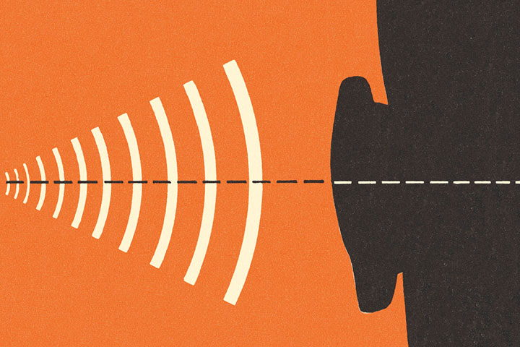
DOA Estimation
Applications of DOA
Radar
Sonar
Speech Recognition
Audio Localization
For determining the location of targets (e.g., aircraft, ships).
Determines the location of underwater objects (e.g., submarines, mines).
Improves the accuracy of speech recognition systems by determining the direction of arrival of a speaker's voice
Improves the quality of audio systems (e.g., headphones, speakers) by determining the location of sound sources
Determining the Direction of Arrival or Estimating the direction of arrival of sound sources in an acoustic environment.

Slide 3
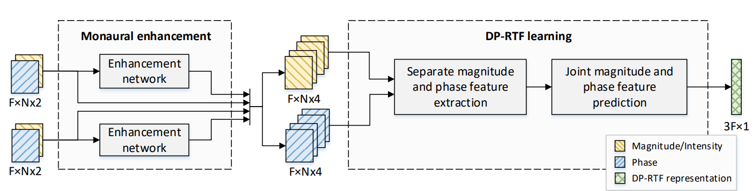
Narrowband and Broadband DOA estimation
Narrowband DOA estimation methods assume that the signal is narrowband, meaning that it has a single frequency
Broadband DOA estimation methods assume that the signal is broadband, meaning that it has a range of frequencies
Traditional DSP methods for DOA estimation
Multiple signal classification (MUSIC)
Time Difference of Arrival (TDOA)
Beamforming
Deep learning based methods for DOA estimation
Convolutional neural networks (CNNs)
Recurrent neural networks (RNNs) works
Direct-path relative transfer function (DP-RTF):

Slide 4
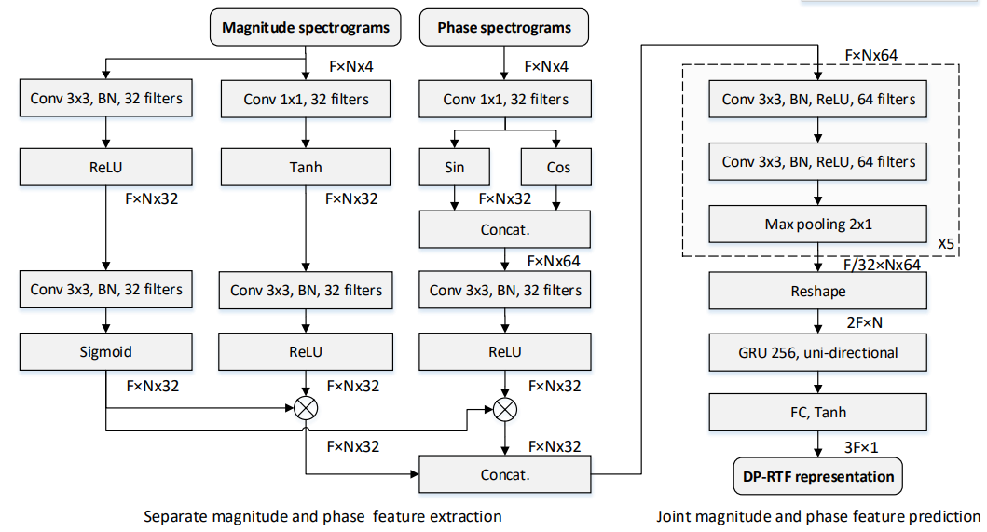
Methodology:
Deep neural network-based approach for DP-RTF estimation.
Training with simulated and real-world data with added noise.
Where DP-RTF Definition is:
R^{d}(f,θ) = H^{d}₁​(f,θ) / H^{d}₂​(f,θ)
H^{d}₂​(f,θ) and H^{d}₁​(f,θ ) are Direct-path acoustic transfer functions of left and right
For estimating Direction we use:
θ = arg min _{θ} ||r − r(θ)||²
r: DP-RTF prediction.
r(θ): Lookup in DP-RTF dictionary
Where Dictionary of DP-RTF is :
Collection of real-valued DP-RTF representations for different DOAs.
We use the averaged DP-RTF of all the CIPIC HRIRs to form the DP-RTF dictionary of the test array

