Slide 1
Direction Of Arrival Estimation Using Direct-Path Relative Transfer Function
Presented by:
S Harsha Vardhan
14-July

Slide 2
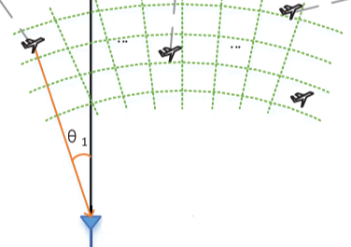
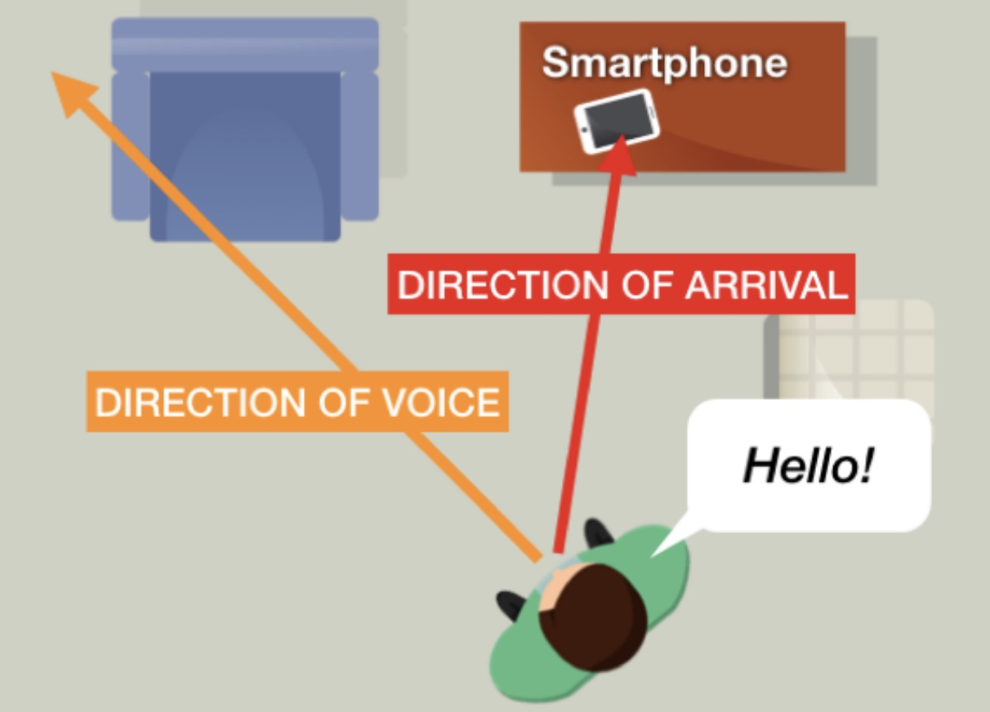
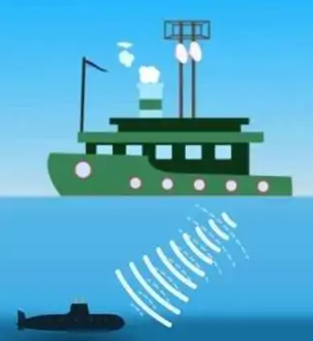
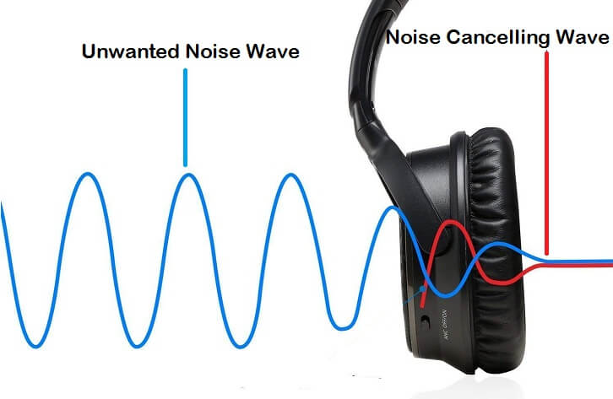
Applications of Direction of Arrival Estimation
Speech Recognition: Improves the accuracy of speech recognition systems by determining the direction of arrival of a speaker's voice and can be used to improve the accuracy of speech recognition systems.
Radar: Used to Determine the location of targets. This information can be used to track aircraft, ships, and other objects.
Audio Localization: It is used in audio localization to determine the location of sound sources. This information can be used to improve the quality of audio systems, such as headphones and speakers.
Sonar: Determines the location of underwater objects. can be used to track submarines, mines, ships etc.

Slide 3
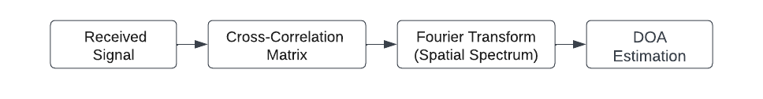
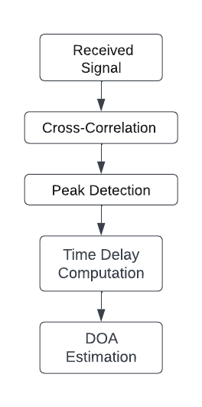
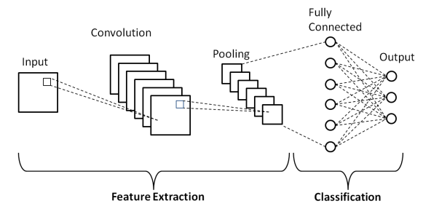
Different Methods in Direction Of Arrival estimation
Narrowband and Broadband
Narrowband DOA estimation methods assume that the signal is narrowband, meaning that it has a single frequency
Broadband DOA estimation methods assume that the signal is broadband, meaning that it has a range of frequencies, typically more accurate than narrowband DOA estimation methods.
Traditional DSP methods for DOA estimation
Multiple signal classification (MUSIC)
It works by first decomposing the received signal into its spatial and temporal components.
The spatial spectrum is computed by taking the Fourier transform of the cross-correlation matrix.
The peaks in the spatial spectrum correspond to the directions of arrival of the sound sources.
Time Difference of Arrival (TDOA)
Estimating the DOAof sound sources based on the time differences between the arrival of sound signals at different sensor locations.
It relies on the principle that sound travels at a finite speed, so the time delay between the arrival of the sound at different sensors can be used to determine the source's direction.
Deep learning based methods for DOA estimation
Convolutional neural networks (CNNs)
CNNs are designed to automatically learn hierarchical representations of input data by leveraging
convolutional layers, pooling layers, and fully connected layers.
These networks excel at capturing spatial patterns and features within the data.

Slide 4
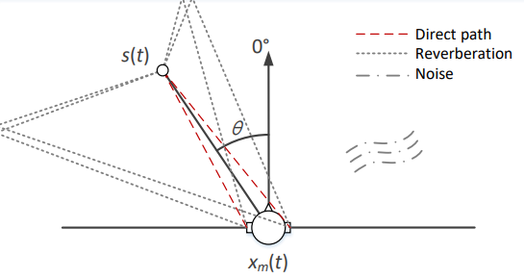





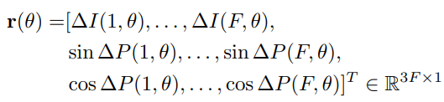

METHODOLOGY
The signal received by the m-th microphone where m is [1,2] i.e left or right
s(t) ,V_{m}(t) denotes the source signal, noise signal at the m-th microphone, and h_{m}(t, θ) is the acoustic impulse response from the source at θ
And we apply STFT to eq(1)
X_{m}(n, f), S(n, f) and V_{m}(n, f) represent the microphone, source and noise signals in the TF domain, respectively. The acoustic transfer function H_{m}(f, θ) is the Fourier transform of h_{m}(t, θ).
The acoustic transfer function involves the direct and reflected propagation paths of the sound source to the microphones, i.e.,
The direct-path relative transfer function (DPRTF) is defined as the ratio between the two directpath acoustic transfer functions,
Finally, the DOA of the sound source is estimated by looking up the DP-RTF dictionary (taking the direction that minimizes the dictionary matching result), i.e.,

Slide 5
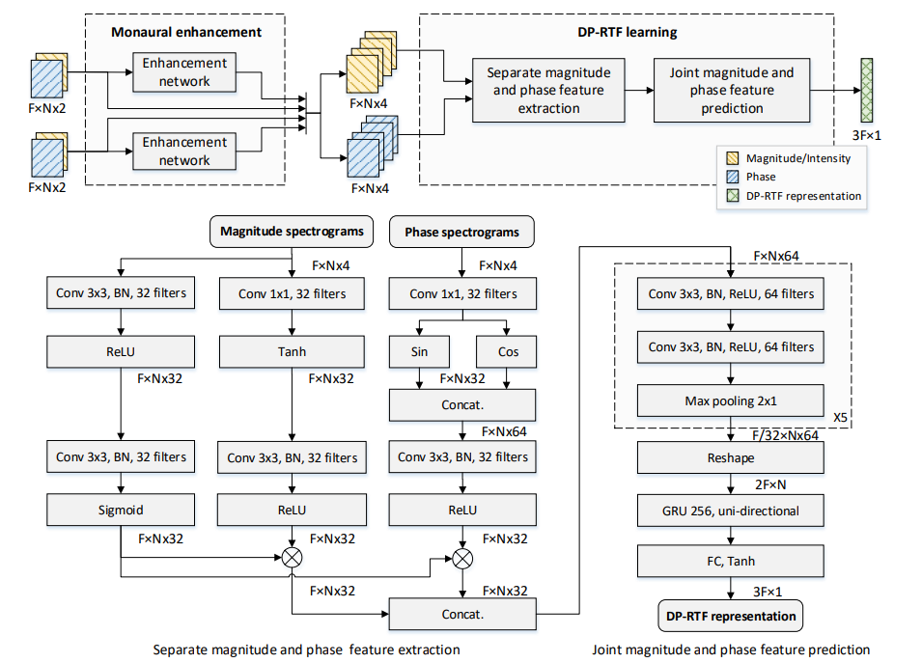
Model architecture for DP-RTF estimation. The model consists of two parts, namely the monaural enhancement network and the DP-RTF learning network.
Monaural enhancement
Deep learning has been widely used for monaural speech enhancement
It recovers the clean magnitude spectrogram by learning the structured magnitude spectral pattern of speech.
Accounting for the following DP-RTF learning, the clean direct-path sound is taken as the target signal, which means both noise reduction and dereverberation are conducted.
During testing, the binaural microphone signals are separately enhanced using the same monaural speech enhancement network.
DP-RTF learning
The magnitude and phase spectrograms of binaural signals are taken as the network input.
Both original and enhanced binaural signals are used, as they are complementary in the sense that the original signals are noisy but less speech-distorted, while the enhanced signals are less noisy but possibly speech-distorted.
The magnitude and phase spectrograms are processed by separate convolutional neural networks (CNNs).
The outputs of the CNNs are then combined and processed by a convolutional recurrent neural network (CRNN).
The CRNN extracts temporal features from the combined features and outputs a prediction of the DP-RTF.
The model is trained using a supervised learning approach. The training data consists of pairs of binaural signals and ground truth DP-RTFs. The model is trained to minimize the error between its estimated DP-RTFs and the ground truth DP-RTFs.

Slide 6
FUTURE WORK
Improved Robustness: Enhance the robustness of DP-RTF estimation in highly challenging environments, such as those with strong reverberation, multiple overlapping sources, and dynamic background noise.
Integration with Multi-Modal Information: Integration of DP-RTF estimation with other modalities, such as visual or depth information, to enhance the overall sound source localization performance.
Applications Beyond Speech: Explore non-speech domains for DP-RTF. Investigate its potential in areas such as environmental sound analysis, music processing, and object tracking, where accurate localization of sound sources is crucial.
Benchmarking and Standardization: Establish evaluation protocols and datasets. For Establishing standardized evaluation protocols ensures consistency and fairness when assessing the performance of DP-RTF estimation
algorithms
Real-Time Implementation: Develop real-time implementation strategies for DP-RTF estimation to enable its application in real-time audio processing systems, such as teleconferencing, virtual reality, and augmented reality.
Dataset Expansion: Expand the dataset used for training and evaluation to include a wider range of acoustic conditions, environments, and source characteristics.
Multichannel Extension: Extend DP-RTF estimation to multichannel scenarios. This can enable better localization accuracy and robustness, particularly in environments with complex sound propagation and multiple sound sources

Slide 7
THANK YOU

