Slide 1
LEON POULSON
6/26/2026
AN ANALYSIS OF
EMPORIUM

Slide 2
EQUIPO 5
15.10.2030
I was tasked with taking a look at EmporiUm’s sales data from the year 2022 to 2025. My task, see what trends we can capitalize on, different insights I can offer as well as seeing who their top authors are.
I was assigned the Northeast Region that included Maine, Massachusetts, Maryland and New Jersey.
SITUATION

Slide 3
TOP BOOKS
Harry Potter and the Sorcerer’s Stone
Black Holes and Baby Universes
The Art of War
A Brief History of Time
Of Mice and Men
During my journey in discovering the different trends within the different quarters over the years. I have discovered 5 overall bestsellers for the Northeast region of EmporiUm.
J.K Rowling
Stephen Hawking
Sun Tzu
Stephen Hawking
John Steinbeck
AND AUTHORS
15.10.2030

Slide 4

QUARTERS
Over the span of 3 years I have noticed that we have a rough patch in 2024 but we were able to turn it around for the start of the 2025 year. From Q1 in 2022 I am happy to announce that we have made 1.3million dollars since then!!
EQUIPO 5
15.10.2030

Slide 5
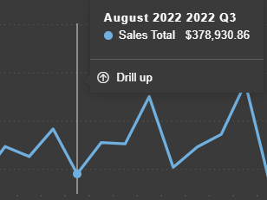
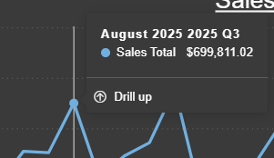
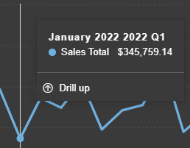
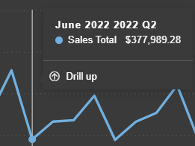
After continuing my insights I have discovered that during the end of the year, the middle of the year and towards the start of the year are times that we are starting off poorly then we are able to increase our overall sales
INSIGHTS

Slide 6
SUGGESTIONS
For Summer time we can hold deals catered towards people relaxing, like bundling some of our tech accessories with our best sellers.
For the end of the year we can hold movie nights that are about some of our more popular books to encourage buying.Breaking into the new year with a new book
For the beginning of the year we can offer different bundled deals with books and apparel
After looking though the data I was able to come up with 3 different Suggestions that should be able to start us off at better at the start of quarters!!

Slide 7
I believe that if we offer more interactive deals during our weak points in the quarters we can strengthen foot traffic to our stores which in turn can lead to more revenue being generated across the board.
OVER ALL

