Slide 1
Data Pipeline
Trending tweets regarding apple in the USA
Demo and Code walk through

Slide 2
Outline
Project Overview
Block Diagram
Example Result
Code Walkthrough

Slide 3
Project overview
Ability to track trending tweets in each state
regarding a specific topic or figure
Extracted data using Twitter’s API as a stream source
Loaded data into a database
Filtered data based on description and content
Recorded count in each state that matched the criteria

Slide 4






Architecture
Twitter API
Stores:
screename
location
description
content
Insert in database
Twitter Stream
Create input file
Run transformations on input file
Output data
Locations file
Count file

Slide 5
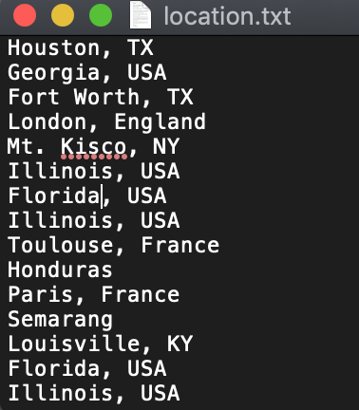
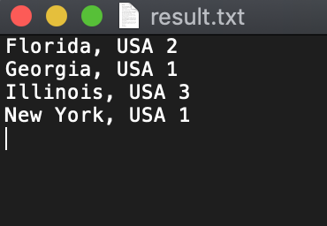
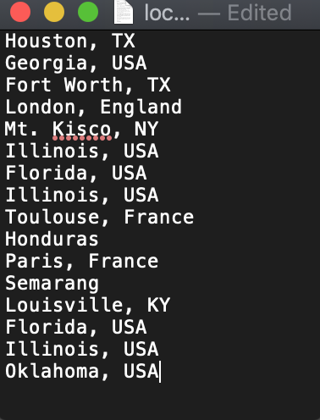
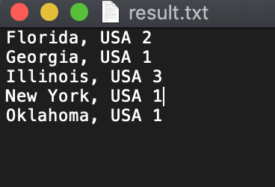
Example Result
When a new stream data that matches the criteria

Slide 6
JSON DATA
UserJSONImpl{id=220231054, name='PicassoBaby 👨🏾‍🎨〽️', email='null', screenName='Only1_Tayy', location='Behind The Scene.', description='#SHOTBYArtisticIntegrity. #BG4L M'sUp', isContributorsEnabled=false, profileImageUrl='http://pbs.twimg.com/profile_images/1059515583690084353/25ppFBEv_normal.jpg', profileImageUrlHttps='https://pbs.twimg.com/profile_images/1059515583690084353/25ppFBEv_normal.jpg', isDefaultProfileImage=false, url='null', isProtected=false, followersCount=720, status=null, profileBackgroundColor='000000', profileTextColor='0D9900', profileLinkColor='FA0505', profileSidebarFillColor='000000', profileSidebarBorderColor='FFFFFF', profileUseBackgroundImage=true, isDefaultProfile=false, showAllInlineMedia=false, friendsCount=726, createdAt=Fri Nov 26 23:23:46 EST 2010, favouritesCount=2500, utcOffset=-1, timeZone='null', profileBackgroundImageUrl='http://abs.twimg.com/images/themes/theme1/bg.png', profileBackgroundImageUrlHttps='https://abs.twimg.com/images/themes/theme1/bg.png', profileBackgroundTiled=true, lang='null', statusesCount=40386, isGeoEnabled=true, isVerified=false, translator=false, listed Count=4, isFollowRequestSent=false, withheldInCountries=null}
Used screename, location, content and description
Inconsistent location format
Would perform analysis on statusesCount in the future to see how frequent a user tweets about a topic

Slide 7
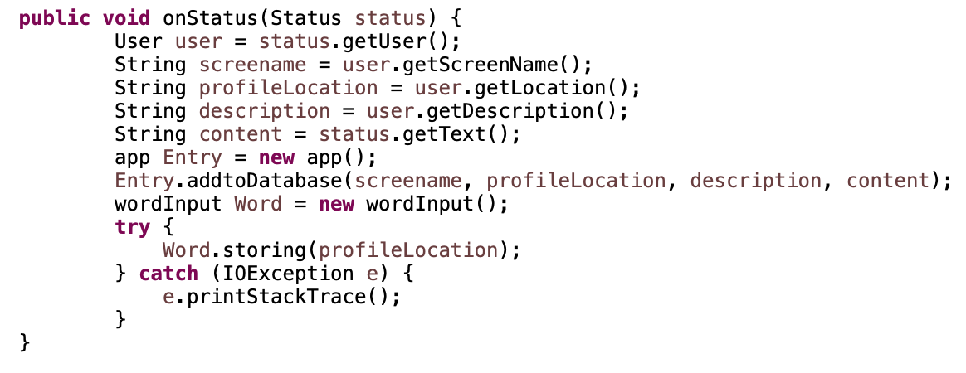
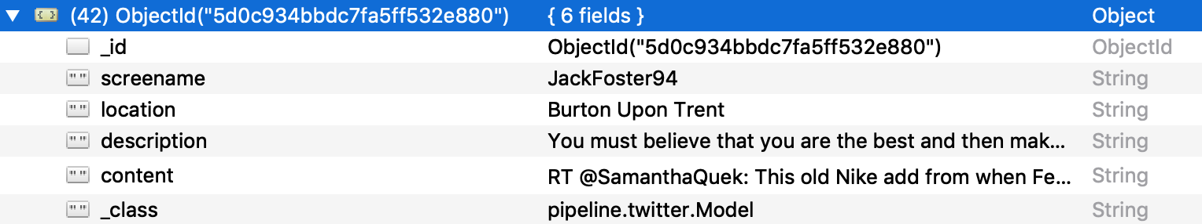
Code Walkthrough

Slide 8
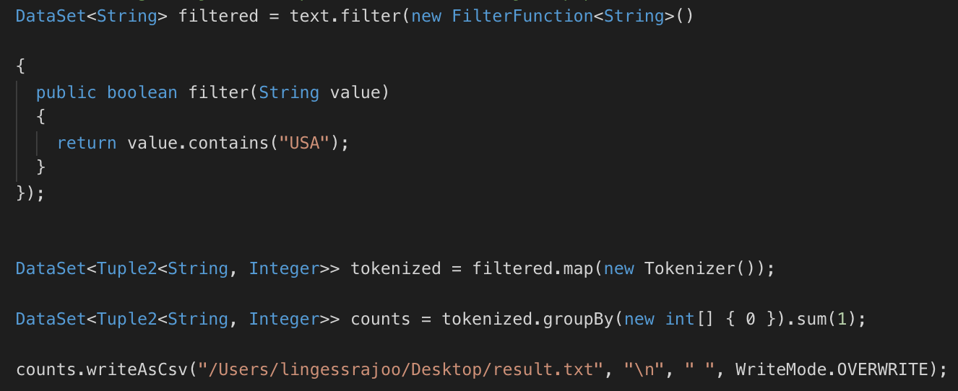
Code Walkthrough

Slide 9
Next
Would consider alternate data sources
Introduce Kafka
Use a REST API to post analysis data onto a website
Deploy on AWS

