Slide 1
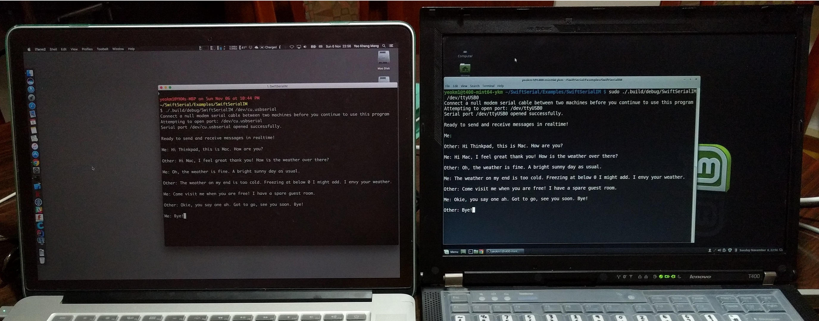
A Science Project: Swift Serial Chat
By: Yeo Kheng Meng (yeokm1@gmail.com)
https://github.com/yeokm1/SwiftSerial
iOS Dev Scout (23 Nov 2016)

Slide 2




Modern networking options for apps
X
X
X
X

Slide 3
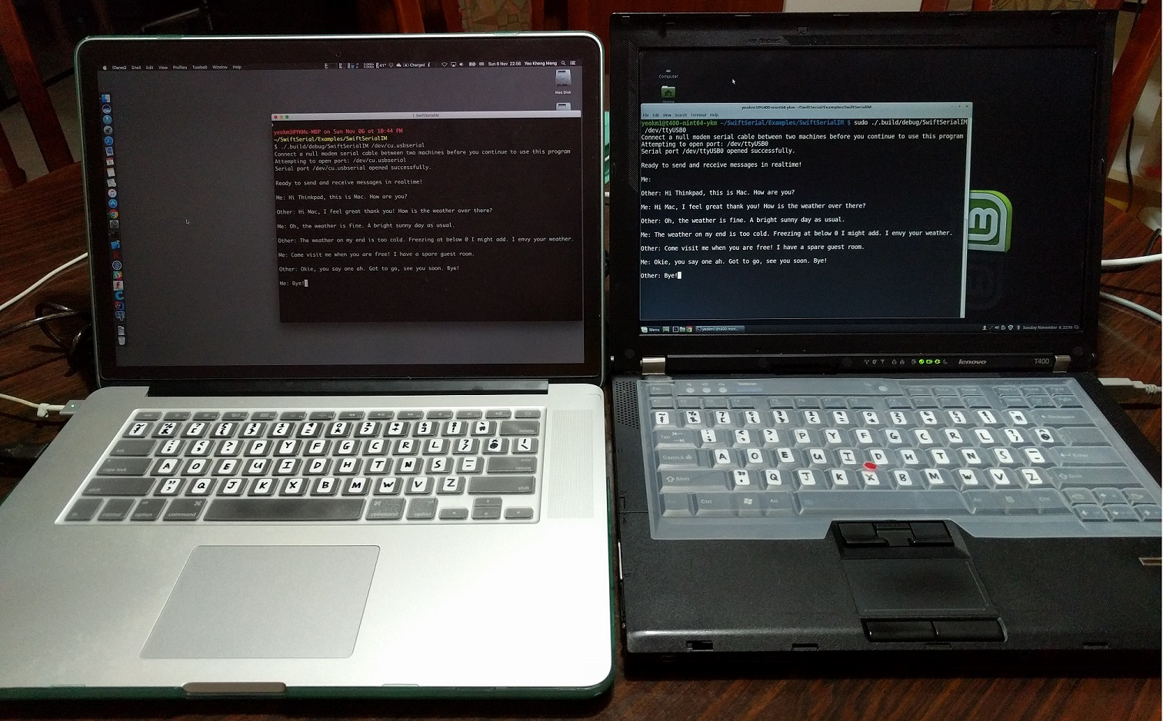
Live Swift app Demo

Slide 4
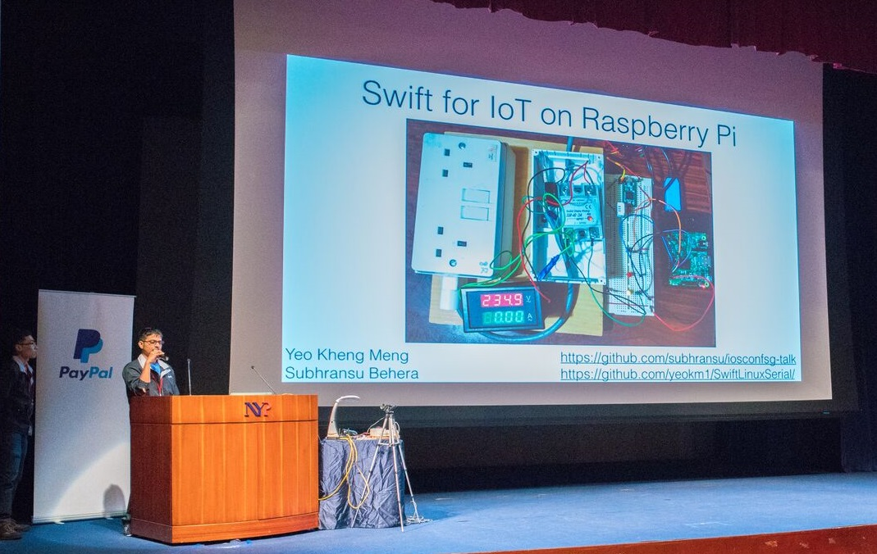

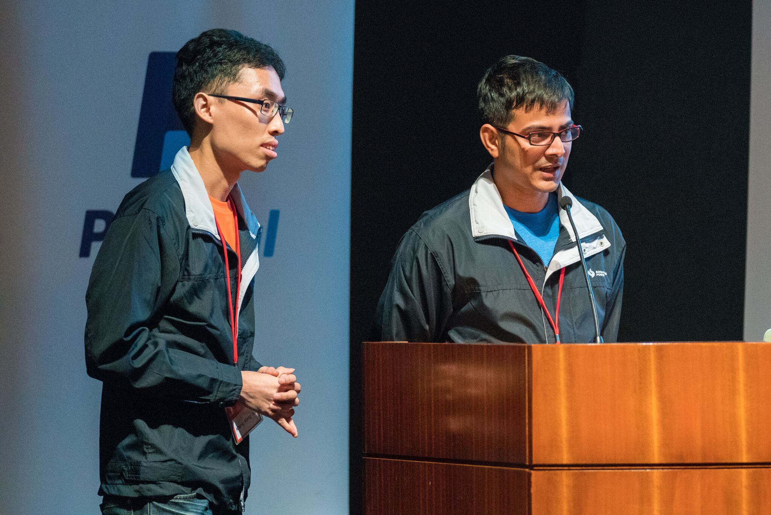
Swift for IoT @ iOS Conf 2016

Slide 5
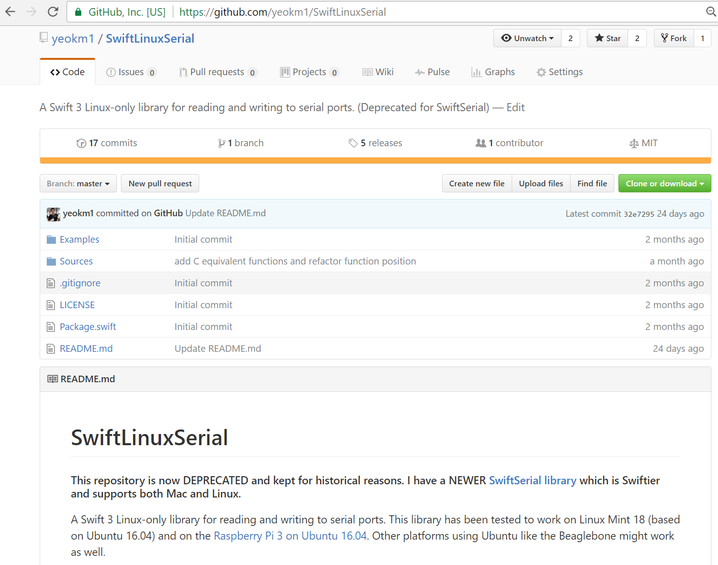
Swift Linux Serial Port library
https://github.com/yeokm1/SwiftLinuxSerial
Deprecated

Slide 6
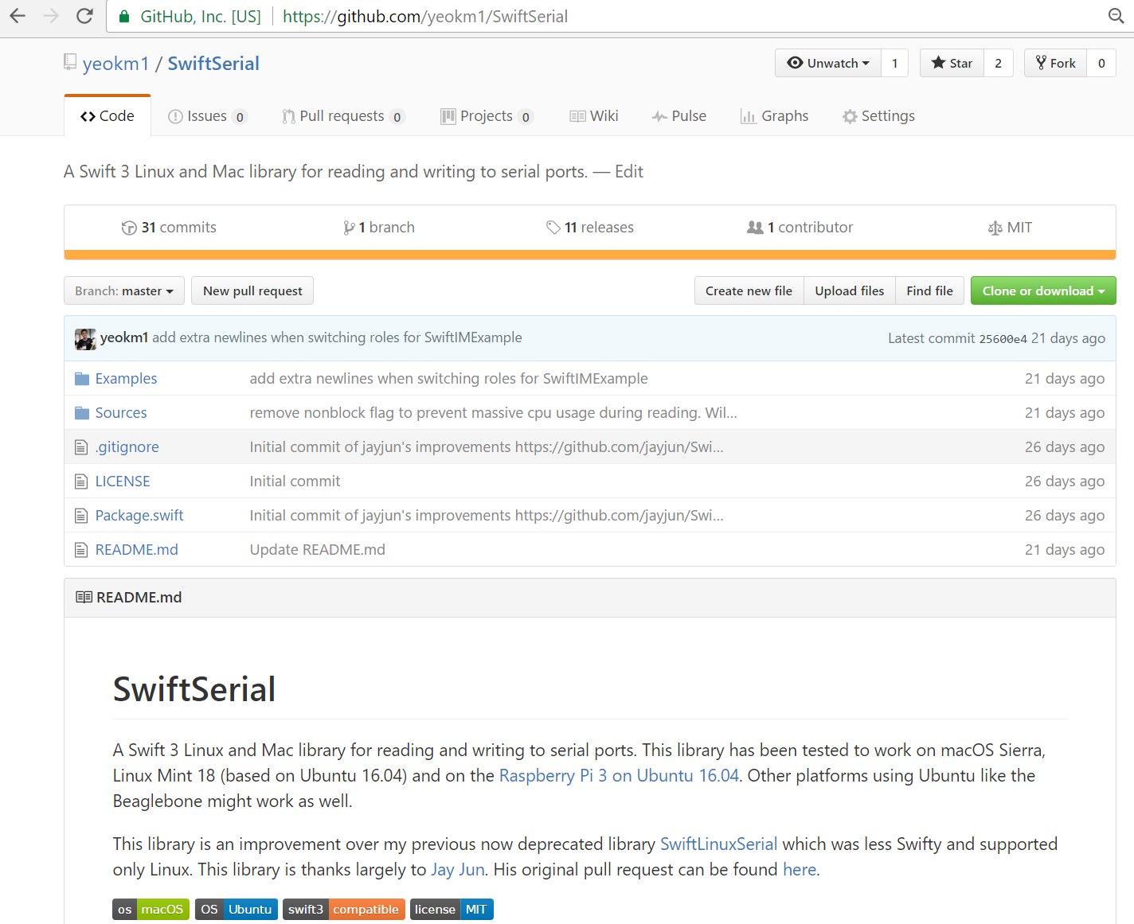

Updated Swift Serial Port library
https://github.com/yeokm1/SwiftSerial
Mac and Linux compatible
Swiftier: No more C in Swift!
Thanks to Jay Jun’s pull request
https://github.com/yeokm1/SwiftLinuxSerial/pull/1

Slide 7
Subh: Why not give a talk about your Swift Serial library?

Slide 8
Agenda
What is a Serial Port?
My hardware setup
Walkthrough of original Swift Linux Serial
Learning points of Jay Jun’s pull request
My cross-platform command-line Swift chat app

Slide 9
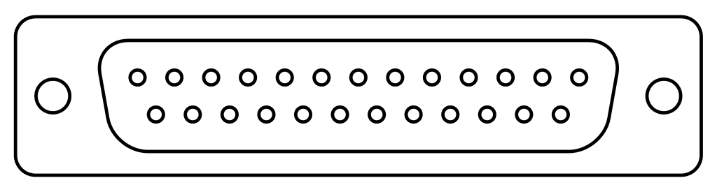
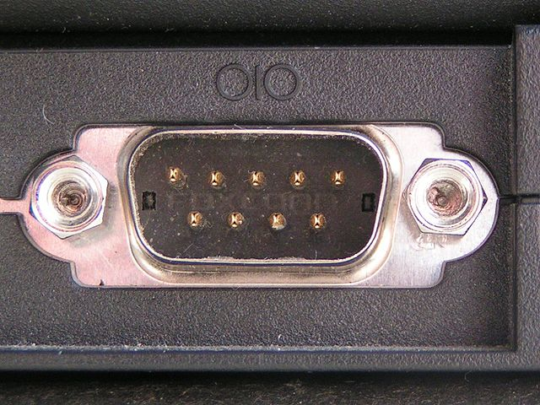
What is a Serial Port?
Hardware complying to RS-232 standard
Introduced in 1962 by Electronic Industries Alliance
Standardised as RS-232C in 1969
Vintage consumer usage
Modems
Mouse
Point-to-point network
Obsolete by 2000s
Modern Usage
Medical Devices
Scientific equipment
Industrial Control Systems
Uninterruptible Power Supply
Simpler/Cheaper to implement and longer distance (300m) compared to USB
Traditional DB-25 connector
Male DE-9 connector

Slide 10
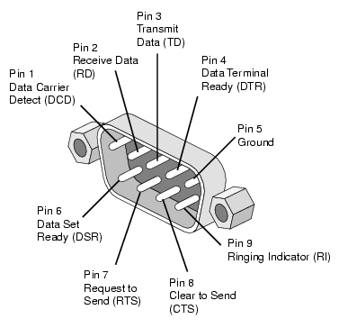
RS232 Hardware Pinout
Pins | Name | Function
1 | Data Carrier Detect (DCD) | Device is connected
2 | Receive (RD) | Receive data
3 | Transmit (TD) | Transmit data
4 | Data Terminal Ready (DTR) | Ready to start a session
5 | Ground | Zero reference voltage for transmission
6 | Ringing Indicator (RI) | Phone is ringing!
7 | Clear to Send (CTS) | Hardware flow control (You can send data now!)
8 | Request to Send (RTS) | Hardware flow control (Can I send data to you?)
9 | Data Set Ready (DSR) | Ready to receive commands or data
http://www.db9-pinout.com/

Slide 11
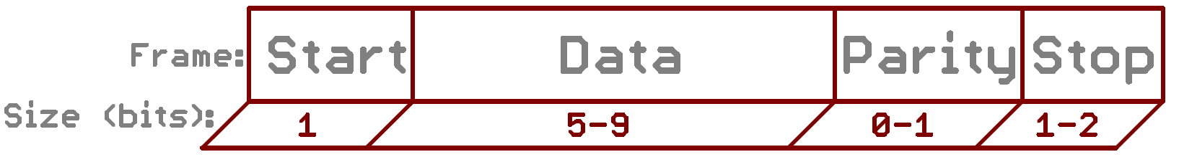
RS232 Communication Parameters
Baud Rate (Speed: bits/s)
Linux max = 4 million bits/s
Mac max = 230400 bits/s
Data bits
Indicates frame size
Parity
Error detection
Even/Odd/None
Makes number of 1 bits count even/odd
Stop bits
Number of bits to indicates end of frame
Hardware flow control
CTS/RTS Pins
Software flow control
Xon/Xoff = Transmit on /Transmit off
https://learn.sparkfun.com/tutorials/serial-communication/rules-of-serial

Slide 12
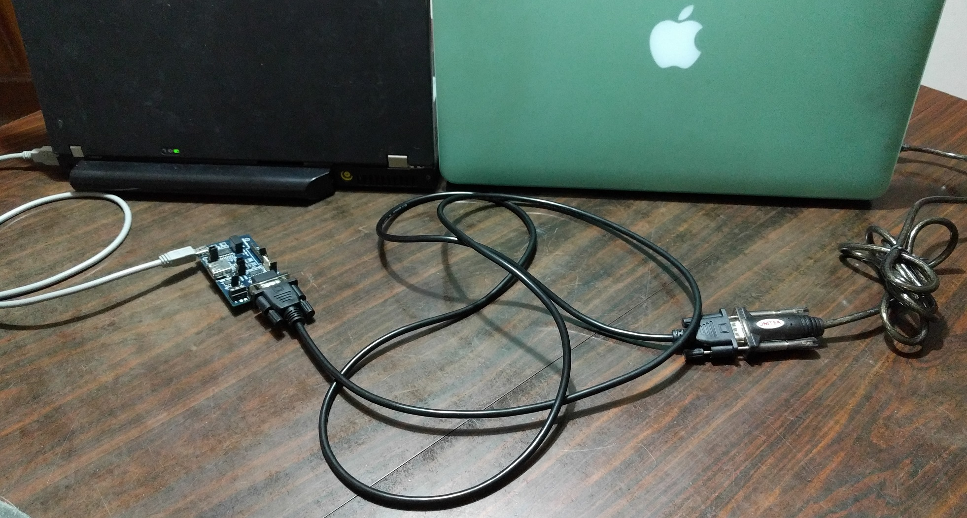
Hardware setup
Thinkpad T400 (2009)
Linux Mint 18
FTDI FT232 USB-Serial adapter
Macbook Pro Retina 15 (Late 2013)
macOS Sierra
Prolific PL-2303 USB-serial adapter
Null-modem cable

Slide 13
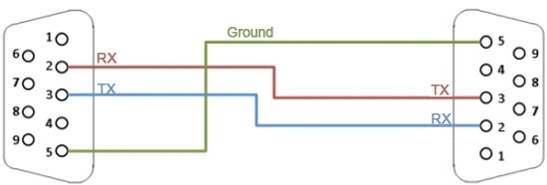
Simple null modem cable
GND <-> GND
TX -> RX
RX <- TX
http://digital.ni.com/public.nsf/allkb/1EE0DD8AF67922FA86256F720071DECF

Slide 14
Original Swift Linux Serial code
https://github.com/yeokm1/SwiftLinuxSerial/blob/master/Sources/SwiftLinuxSerial.swift
Enums for
Baud rate
Data bits
Stop bits
Termios configuration structure
c_cc C fixed array as Swift tuple
Reading and Writing bytes to port
UnsafeMutable Pointers required for C functions

Slide 15
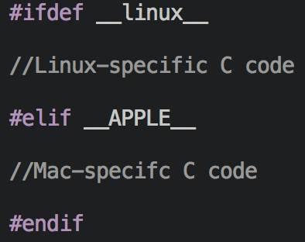
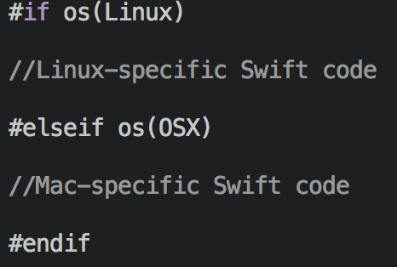
Improved Swift Serial code by Jay Jun
https://github.com/yeokm1/SwiftSerial/blob/master/Sources/SwiftSerial.swift
Cross platform Mac and Linux
Preprocessor directives:
C directive is line level
Swift directive is statement level
Baud rates, port opening
Swiftier
Guard statements
typealias c_cc objects of termios struct, synonyms for pre-existing types

Slide 16
My Swift chat app
Swift 3 command line desktop app
Uses Swift Serial library
Cross platform: Mac and Linux
Live chat between 2 machines
https://github.com/yeokm1/SwiftSerial/blob/master/Examples/SwiftSerialIM/Sources/main.swift

Slide 17
Swift chat app interesting details
openPort()
Using Swift Serial
prepareStdin()
Don’t echo immediately to screen when user is typing
Background thread reads from port
Mac: Grand Central Dispatch
Linux: Posix threads (pthreads) as GCD (libdispatch) does not work with Swift Package Manager on Linux
https://bugs.swift.org/browse/SR-397
Main thread reads from keyboard
getchar() instead of readline() to read without pressing ”Enter”
https://developer.apple.com/reference/swift/1641199-readline
Turn off output buffering
setbuf(stdout, nil)
If not multiple threads will have problems printing to screen
Print to screen without newline
print(“string”, terminator:"")
Default print prints the newline

Slide 18

What is a “Science Project”?
By Raymond Chen
Principal Software Engineer, Microsoft
Joined 1992
Runs a blog “Old New Thing”
Mar 2013 post: https://blogs.msdn.microsoft.com/oldnewthing/20130319-00/?p=4913
Raymond Chen image from: http://www.dailytech.com/Microsoft+Exec+Reveals+Steve+Ballmer+Created+Original+Blue+Screen+of+Death+Message/article36512.htm

Slide 19
A Science Project by Raymond Chen
A feature that is really cool and challenging from a technological standpoint but is overkill for the user-scenario:
Networked bouncing ball screen saver for computers in a building
Requires hardware few people have:
Tablet with 2 touch-enabled screens
Trying to solve a problem that nobody really considers to be a problem. You're doing it just for the Gee Whiz factor.
Taken from: https://blogs.msdn.microsoft.com/oldnewthing/20130319-00/?p=4913

Slide 20
Any questions for a world without these?
X
X
X
X

