Slide 1
Multi-Exposure Modelling of Information Spread Through Social Media Reposting
Lavanya Kumar
Designed for a 12-minute talk plus Q&A
Presentation focus
Why repeated exposure matters
How the ODE model is built
What the simulations show
What remains for the final report
I0
Not yet exposed
I1
One exposure
I2
Two exposures
S
Sharers
R
Saturated
MATH 4090 | Project presentation

Slide 2
1. Motivation and Background
Why this problem is interesting and where it fits in the literature
On platforms such as Instagram, users often encounter the same content more than once before deciding whether to repost it.
That means information spread can depend on accumulated exposure, not only on a one-time contact.
Classical rumor and epidemic-style models describe spreaders and non-spreaders, but they usually do not track repeated exposure explicitly.
This project adds a multi-exposure structure while keeping the model mathematically tractable.
Related modelling
Rumor models: spreaders and stiflers
Threshold models: adoption after sufficient influence
Complex contagion: reinforcement through repeated exposure
My model: ODE framework with explicit exposure classes
MATH 4090 Project Presentation

Slide 3
2. Compartments, Parameters, and Assumptions
Model ingredients stated before the equations
Assumptions
Population is fixed: I0 + I1 + I2 + S + R = N
Exposure rate is mean-field: lambda(t) = beta S(t)/N
At each exposure, a user can share, saturate, or move forward
Condition: 0 <= rho_i, sigma_i <= 1 and rho_i + sigma_i <= 1
Symbol | Meaning | Where it appears
I0, I1, I2 | Exposure classes before sharing | State variables
S | Active sharers | Drives lambda
R | Saturated users | Collects users leaving spread
beta | Repost intensity / visibility | lambda = beta S / N
gamma | Rate sharers stop sharing | dS/dt and dR/dt
rho_i | Probability of sharing at exposure i | Inflow into S
sigma_i | Probability of saturation at exposure i | Inflow into R
MATH 4090 Project Presentation

Slide 4
3. Governing Equations
The key point is how the exposure chain feeds into sharing
lambda(t) = beta S(t) / N
dI0/dt = - lambda I0
dI1/dt = (1-rho0-sigma0) lambda I0 - lambda I1
dI2/dt = (1-rho1-sigma1) lambda I1 - (rho2+sigma2) lambda I2
dS/dt = rho0 lambda I0 + rho1 lambda I1 + rho2 lambda I2 - gamma S
dR/dt = sigma0 lambda I0 + sigma1 lambda I1 + sigma2 lambda I2 + gamma S
How to explain I0 -> I1
Users in I0 are exposed at rate lambda I0.
If they neither share nor saturate after that exposure, they move to I1.
That is why the inflow into I1 is (1-rho0-sigma0) lambda I0.
Interpretation
beta makes exposure stronger
gamma removes current sharers
rho_i promotes growth of S
sigma_i removes users from further spreading
MATH 4090 Project Presentation

Slide 5
4. Equilibria and Local Stability
Professor feedback addressed: equilibrium first, then Jacobian
Disease-free equilibrium: (I0, I1, I2, S) = (N, 0, 0, 0), with R = 0.
Interpretation: nobody is sharing, so no new exposures occur.
Burned-out equilibrium: (I0, I1, I2, S) = (0, 0, 0, 0), with R = N.
Interpretation: the content has fully died out and everyone is in R.
Crucial clarification
At the disease-free equilibrium, I0 = N.
This is not the same as the simulation start.
In simulations, I use a seed such as S(0)=15, so I0(0)=985.
Sign checks
dI0/dt = -lambda I0 <= 0, so I0 never increases.
dR/dt >= 0, so R never decreases.
The key local sign is rho0 beta - gamma.
Negative: tiny sharing dies out. Positive: tiny sharing can grow initially.
J(E0) = [[0,0,0,-beta], [0,0,0,(1-rho0-sigma0)beta], [0,0,0,0], [0,0,0,rho0 beta-gamma]]
MATH 4090 Project Presentation

Slide 6
5. Simulation Setup and Main Outcomes
Three scenarios: viral, moderate, and fizzle
m = 2, N = 1000
Initial seed: S(0) = 15
I0(0) = 985, I1(0) = I2(0) = 0, R(0) = 0
Integrated over t in [0, 120]
Result summary
Viral reaches the largest and earliest large outbreak.
Moderate still spreads, but more slowly and less strongly.
Fizzle stays close to the initial seed and never develops into a cascade.
Scenario | Peak S(t) | Time to peak | R(120)
Viral | 321.66 | 51.29 | 981.56
Moderate | 171.51 | 114.39 | 593.46
Fizzle | 15.00 | 0.00 | 15.41
MATH 4090 Project Presentation

Slide 7
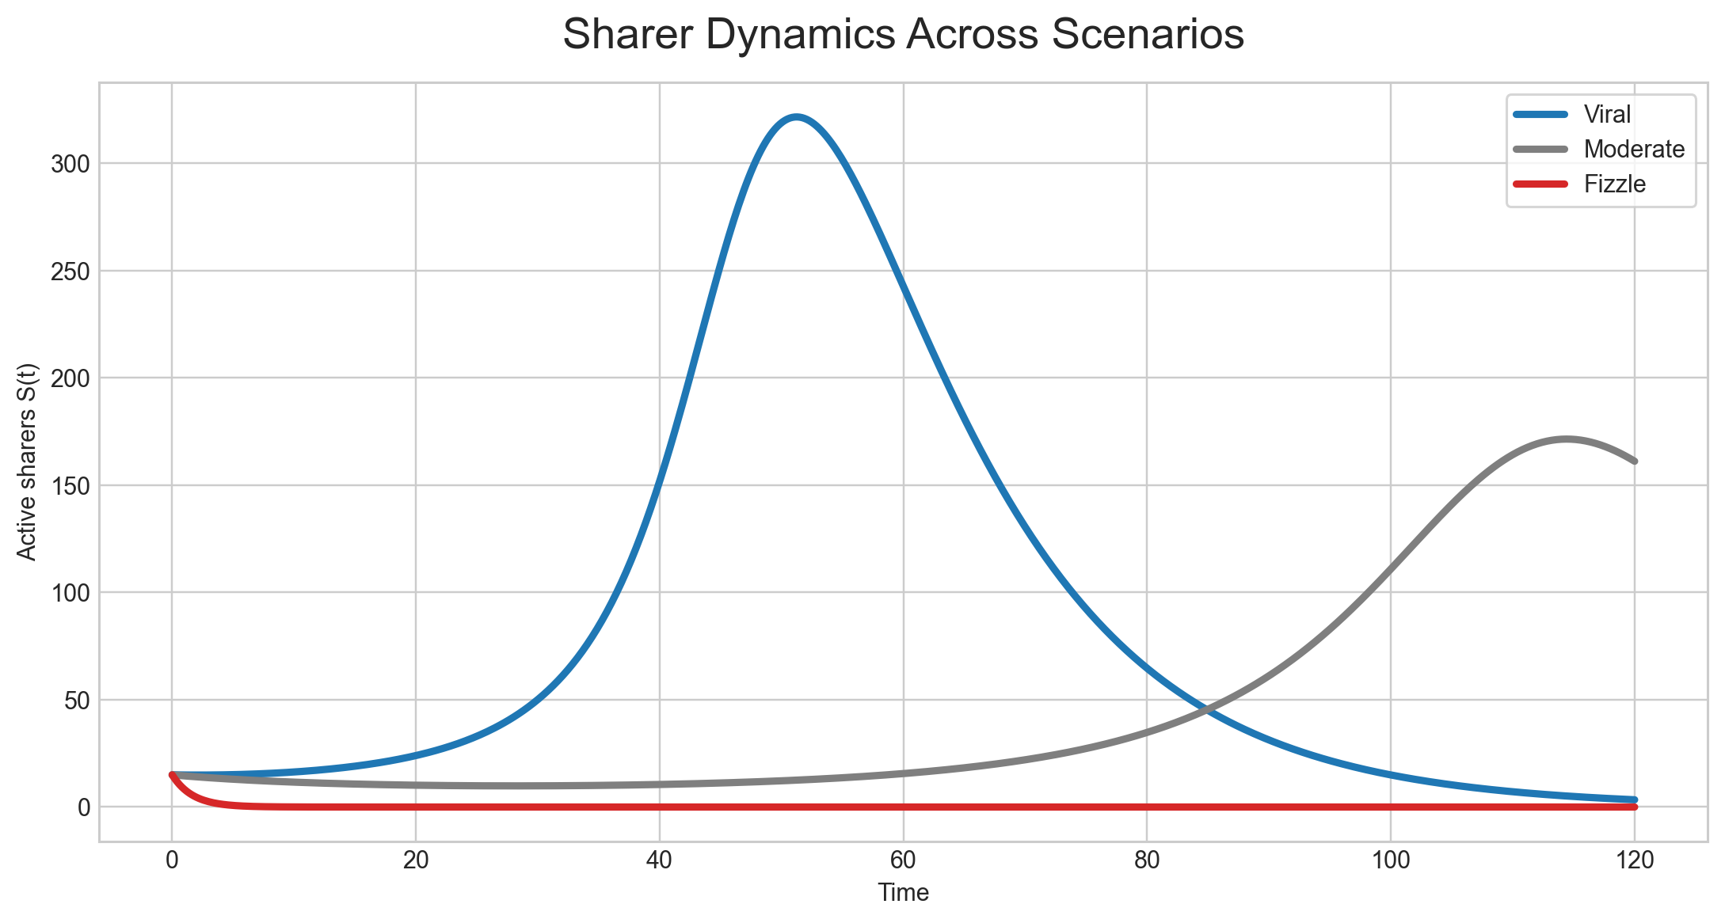
6. Comparison of Sharer Dynamics
The main result figure for peer interpretation
Interpretation
The three scenarios separate clearly.
Higher effective spread creates a larger and earlier peak.
Weak spread leaves the system close to the initial condition.
This figure directly supports the project's main comparative result.
Figure: Active sharers S(t) for viral, moderate, and fizzle scenarios.
MATH 4090 Project Presentation

Slide 8
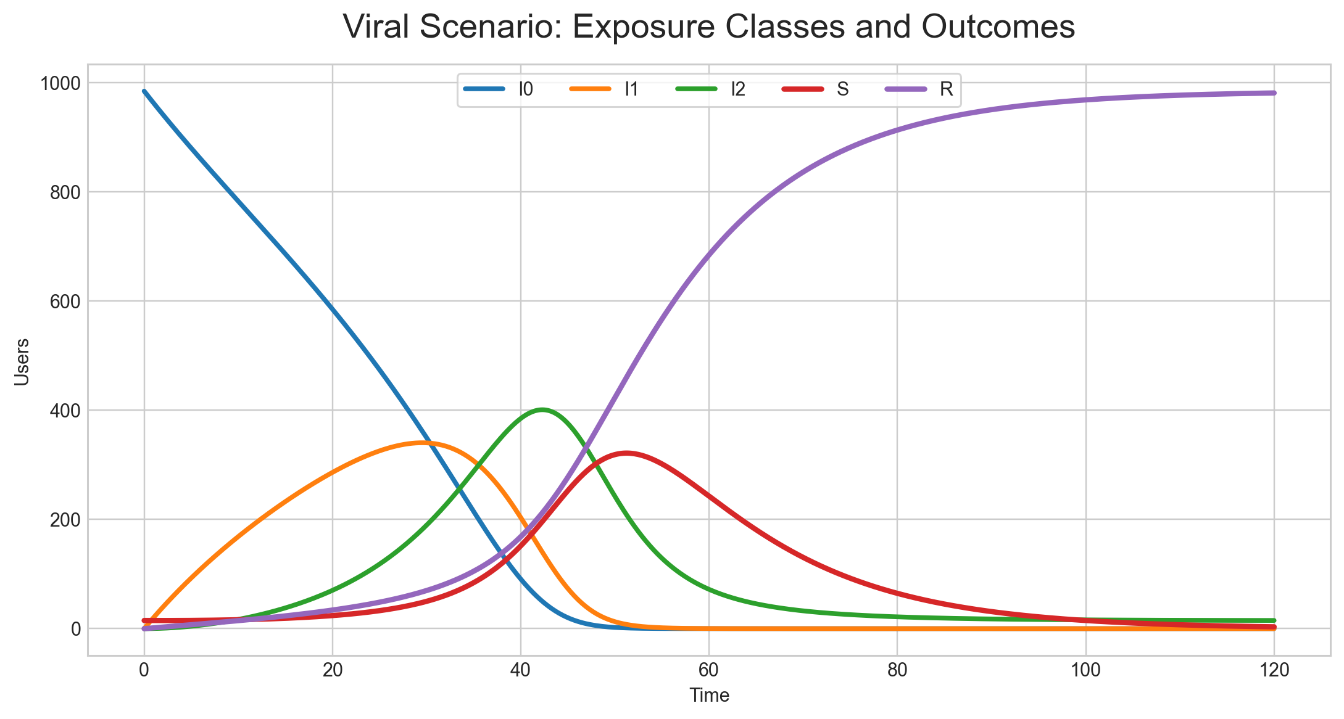
7. Exposure-Class Dynamics
Why the multi-exposure structure matters
Interpretation
Users leave I0 and move through higher exposure classes.
Some eventually join S, while others end in R.
This makes the reinforcement mechanism visible in a way a one-step model cannot.
Figure: Viral scenario showing I0, I1, I2, S, and R over time.
MATH 4090 Project Presentation

Slide 9
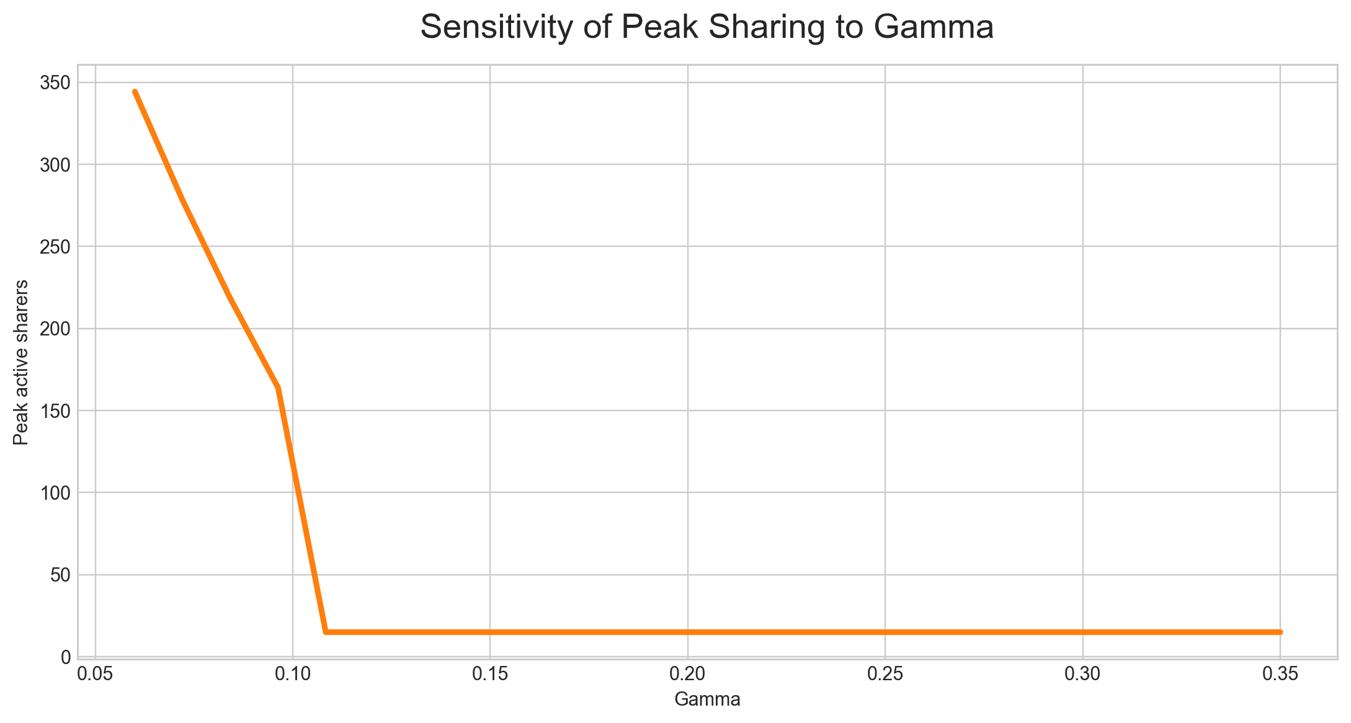
8. Sensitivity to Gamma
How sharer decay changes the peak
Interpretation
Gamma measures how quickly current sharers stop being active.
As gamma increases, the peak drops sharply.
In plain language: if attention fades faster, the post is much less likely to spread widely.
Figure: Peak active sharers as gamma varies, with other parameters fixed.
MATH 4090 Project Presentation

Slide 10
9. What Still Needs To Be Completed
Included explicitly to match the presentation guidelines
Refine the equilibrium and stability discussion in the written report.
Present the Jacobian analysis more cleanly and tie it more directly to the simulations.
Extend sensitivity analysis for gamma, rho_i, and sigma_i.
Strengthen the written discussion of figures and improve figure captions.
Tighten the interpretation connecting the mathematics to social-media behaviour.
Current status
The model formulation is complete.
The main simulations and figures are complete.
Most remaining work is analysis, explanation, and polishing for the final report.
MATH 4090 Project Presentation

Slide 11
10. Conclusion and Q&A
A concise ending that leaves time for discussion
Repeated exposure matters for repost behaviour.
A multi-exposure ODE model can produce viral, moderate, and fizzle outcomes within one framework.
The balance among beta, gamma, rho_i, and sigma_i determines whether content grows or dies out.
The model is simple enough to analyze, but rich enough to capture reinforcement before sharing.
Likely Q&A themes
Why not use a network model?
Why is I0 = N at equilibrium but not in simulations?
What do rho_i and sigma_i mean in social-media terms?
What does the Jacobian tell us, and what does it not tell us?
MATH 4090 Project Presentation

