Slide 1












This is a starter file for you to create your own diagrams. For the full set of icons, instructions, etc., download the toolkit for PowerPoint from the AWS Architecture Icons page. Copy and paste from there to here.
AWS Cloud
Availability Zone 1
Availability Zone 2
VPC
Public subnet
Public subnet
Auto Scaling group
NAT gateway
Bastion host
Bastion host
NAT gateway
Amazon S3
Private subnet
Private subnet
<Your product instances>
Elastic Load Balancing (ELB)
<Your product instances>
Amazon Route 53

Slide 2



















Rigado cloud
AWS Cloud
Device on boarding Service
Onboarding Service
Amazon API Gateway
AWS Lambda
Endpoints
IOT Certificate Bucket
Smart Kitchen
IoT certificate + MQTT Enpoint
Amazon Cognito
Amazon DynamoDB
Gateway Register
Device Setup cmd
Rigado HOBO MX-100
AWS IoT Events
3 States Detector Model Warming, Cooling, Stable
AWS IoT Core
Rigado HOBO MX-100
Cascade-500W (LTE) Gateway
IoT MQTT protocol
Amazon DynamoDB
Detector Output Data
Rigado HOBO MX-100
IoT rule
IoT topic
Amazon S3
Amazon QuickSight
Amazon Kinesis
Data Firehose
AWS Glue
Amazon Athena
MQTT broker routing rules:
Rule 1:
Rule: upon message reception, from the selected device (DEVICE_TYPE)
Action: Republish message to RIGADO_TEMPERATURE_TOPIC
Rule 2:
Rule: upon message reception, from the selected device (DEVICE_TYPE)
Action: Send message to IOT Event and Amazon Kinesis data Firehose
Rule 3:
Rule Forward the output of IOT Event monitor to DynamoDB
Action: record event to DynamoDB

Slide 3
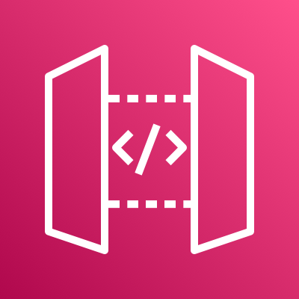

















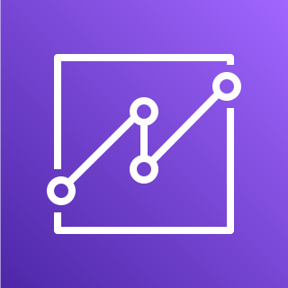
AWS Cloud
Device onboarding
Onboarding service
Lambda function
Endpoints
Bucket with
IoT Certificate
Amazon API Gateway
Amazon DynamoDB
IoT certificate & MQTT Endpoint
Amazon Cognito
AWS IoT Events
Device gateway
AWS IoT Core
IoT MQTT protocol
IoT rule
Amazon DynamoDB
IoT topic
Amazon Kinesis Data Firehose
Amazon Simple Storage Service (Amazon S3)
AWS Glue
Amazon Athena
Amazon QuickSight

Slide 4

AWS Cloud
Control plane
Amazon S3
bucket with
IoT certificate
Onboarding service
IoT certificate
and
MQTT endpoint
Amazon API Gateway
Lambda function
Amazon Cognito
Amazon DynamoDB
Data plane
Device gateway
IoT MQTT
protocol
AWS IoT Core
AWS IoT SiteWise
IoT rule
IoT topic
Amazon Kinesis Data Firehose
Amazon S3
AWS Glue
Amazon Athena
Amazon QuickSight

