Slide 1
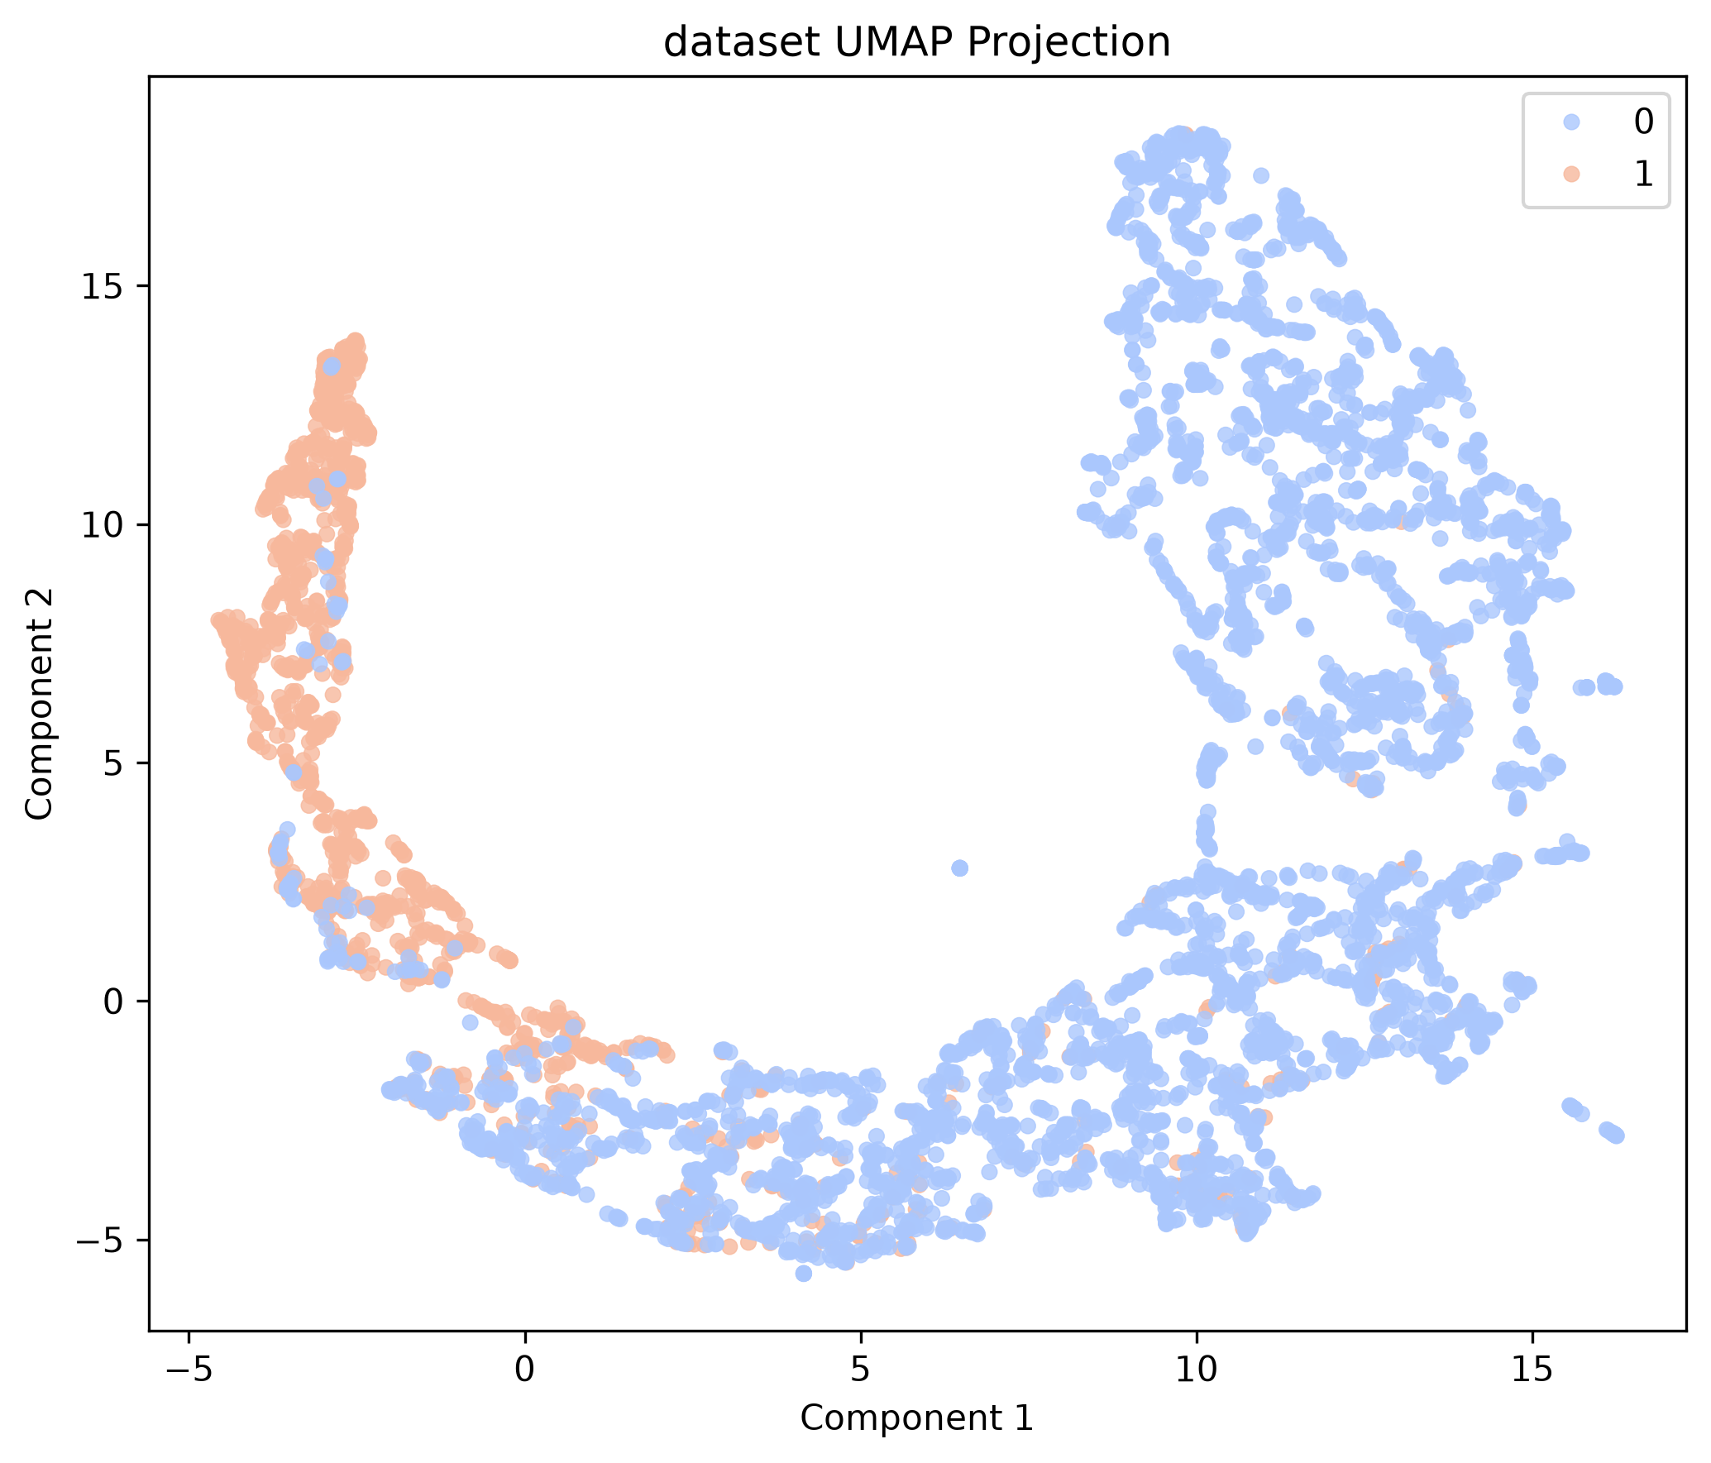
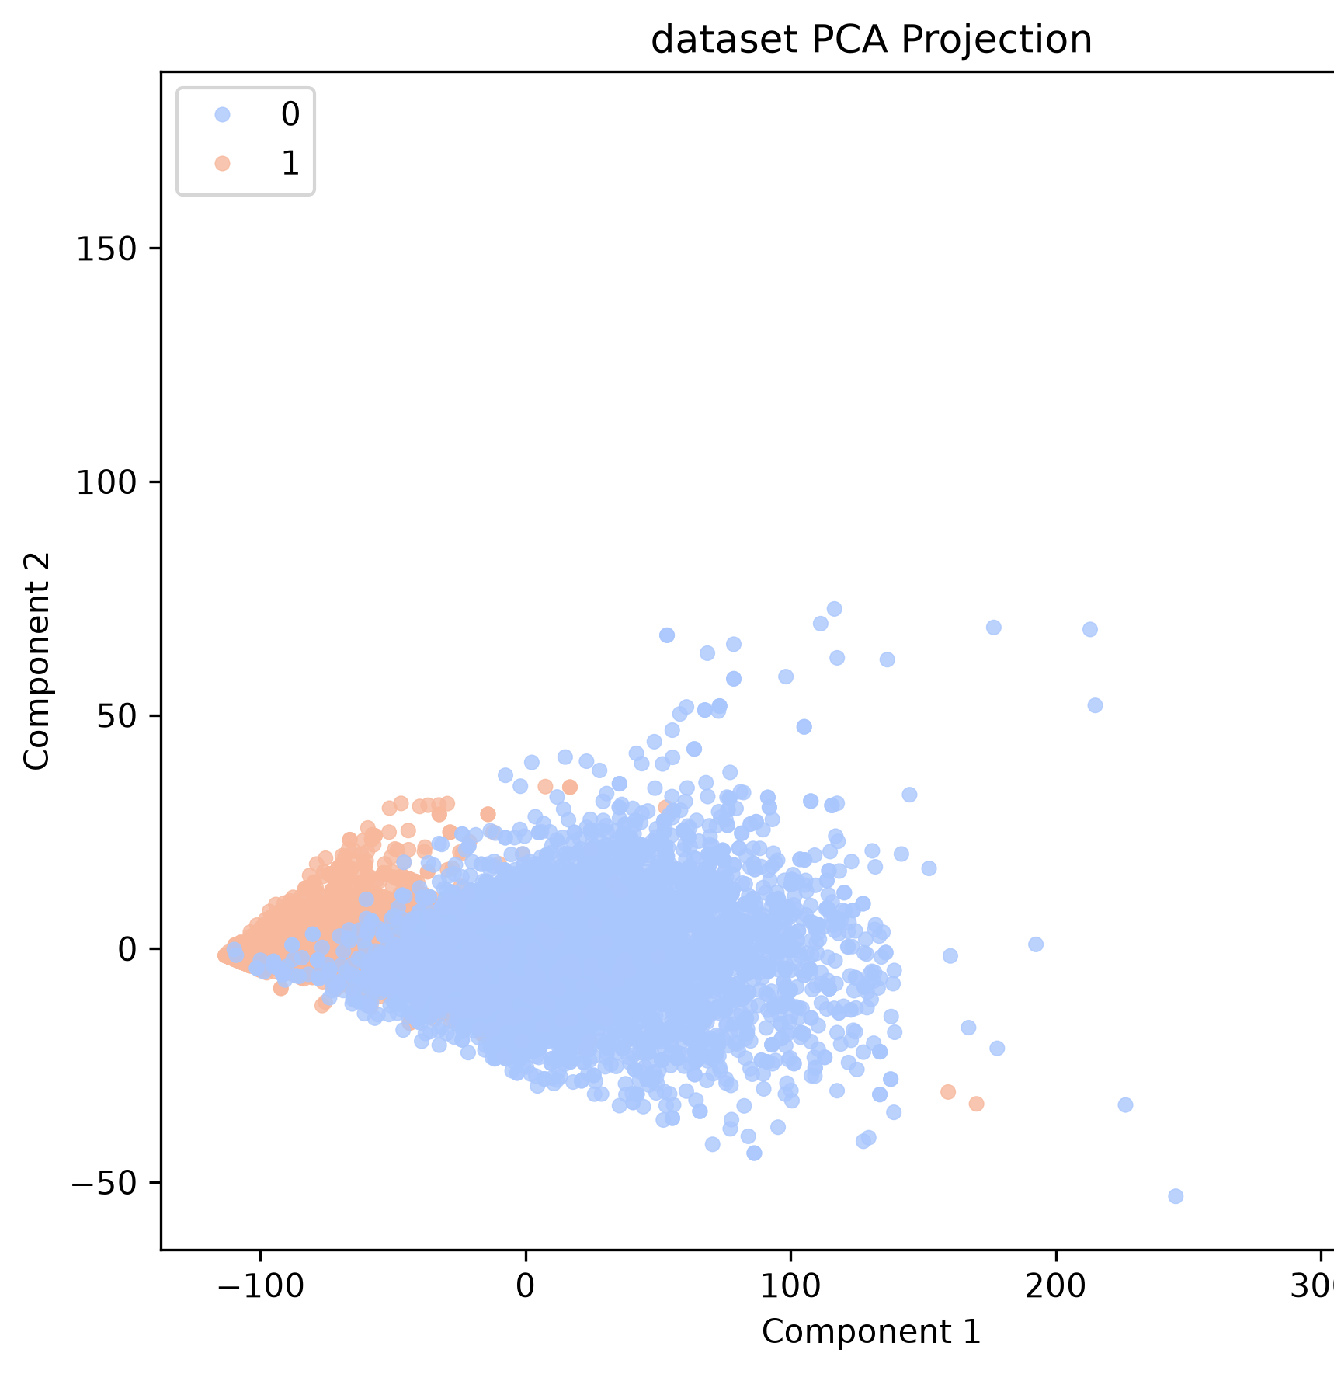
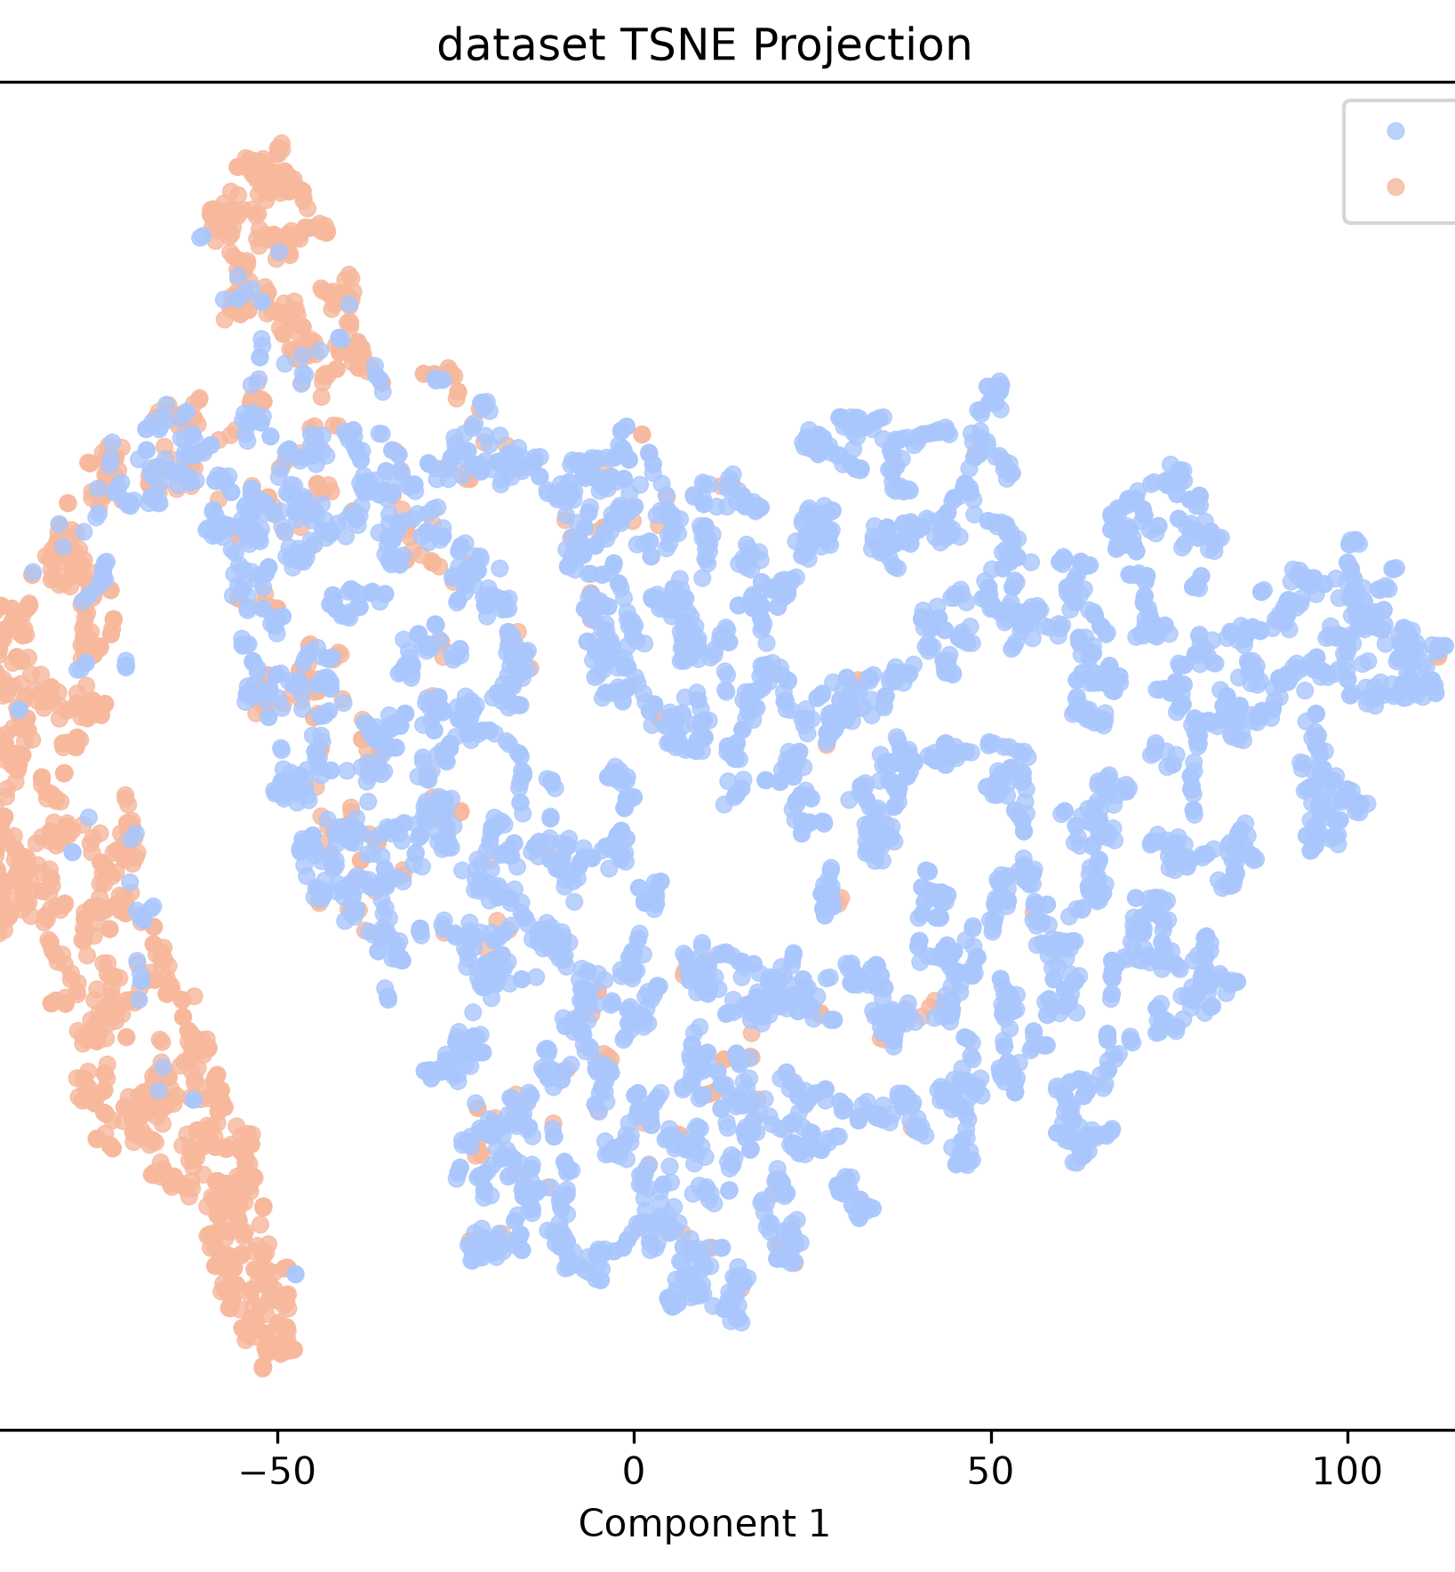
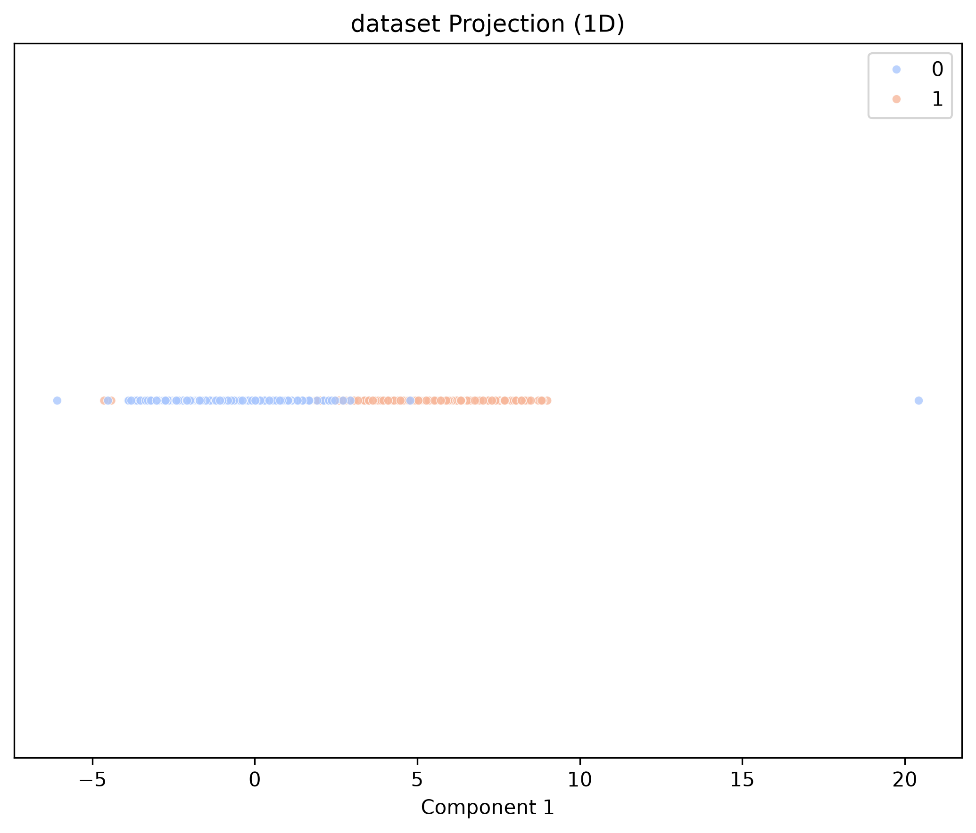
Week 1: Feature Extraction and Projections
sample_0
Mean: 6.2120
STD: 9.1278
Variance: 83.3159
Min: 0.0000
Max: 34.0000
IQR: 7.2350
Skew: 2.2506
Kurtosis: 4.2375
sample_1
Mean: 10.2546
STD: 18.3785
Variance: 337.7705
Min: 0.0000
Max: 67.0000
IQR: 7.4700
Skew: 2.4210
Kurtosis: 4.6460

Slide 2
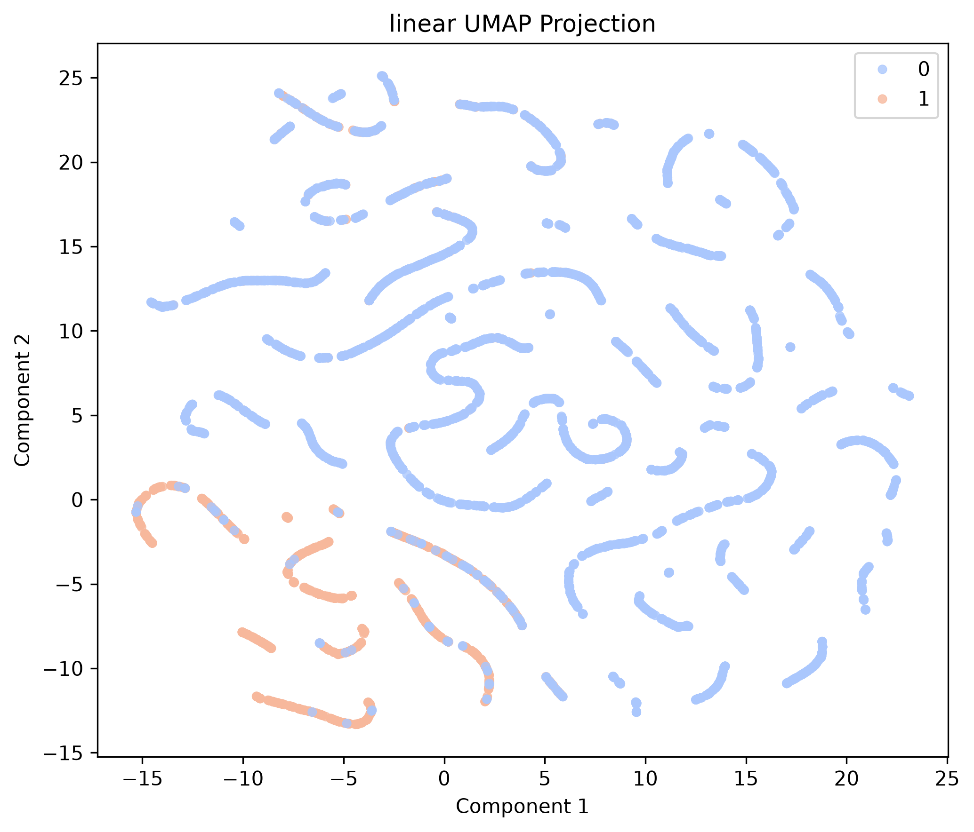
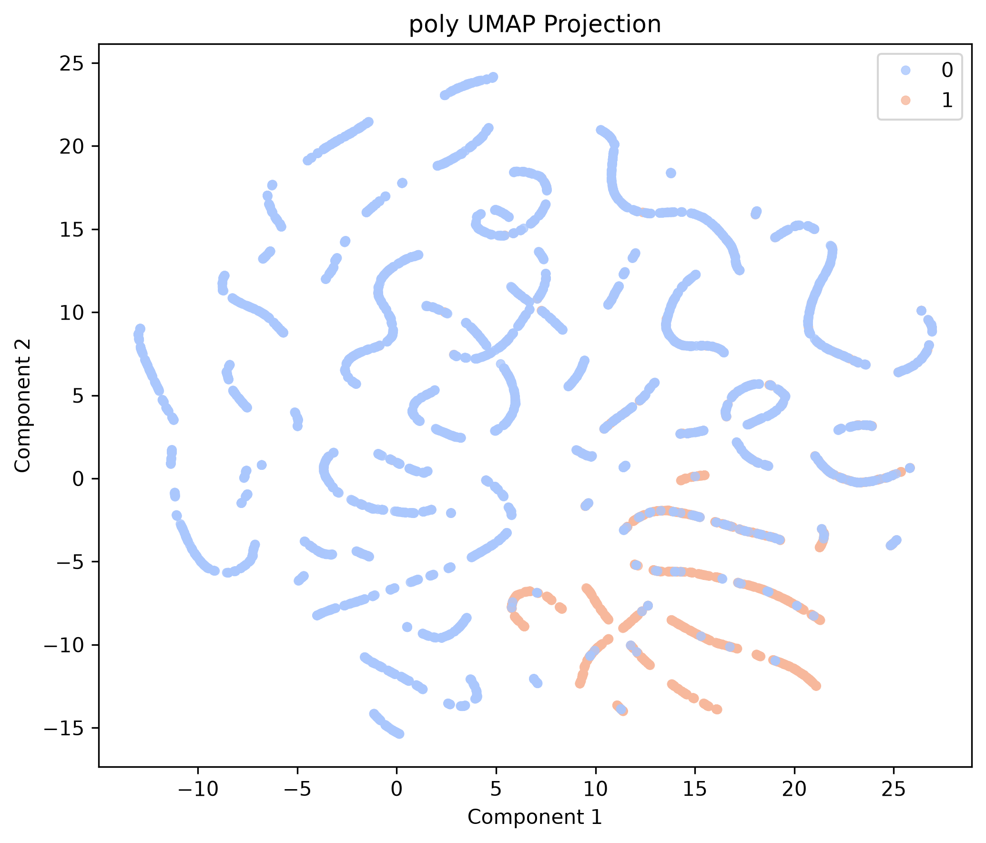
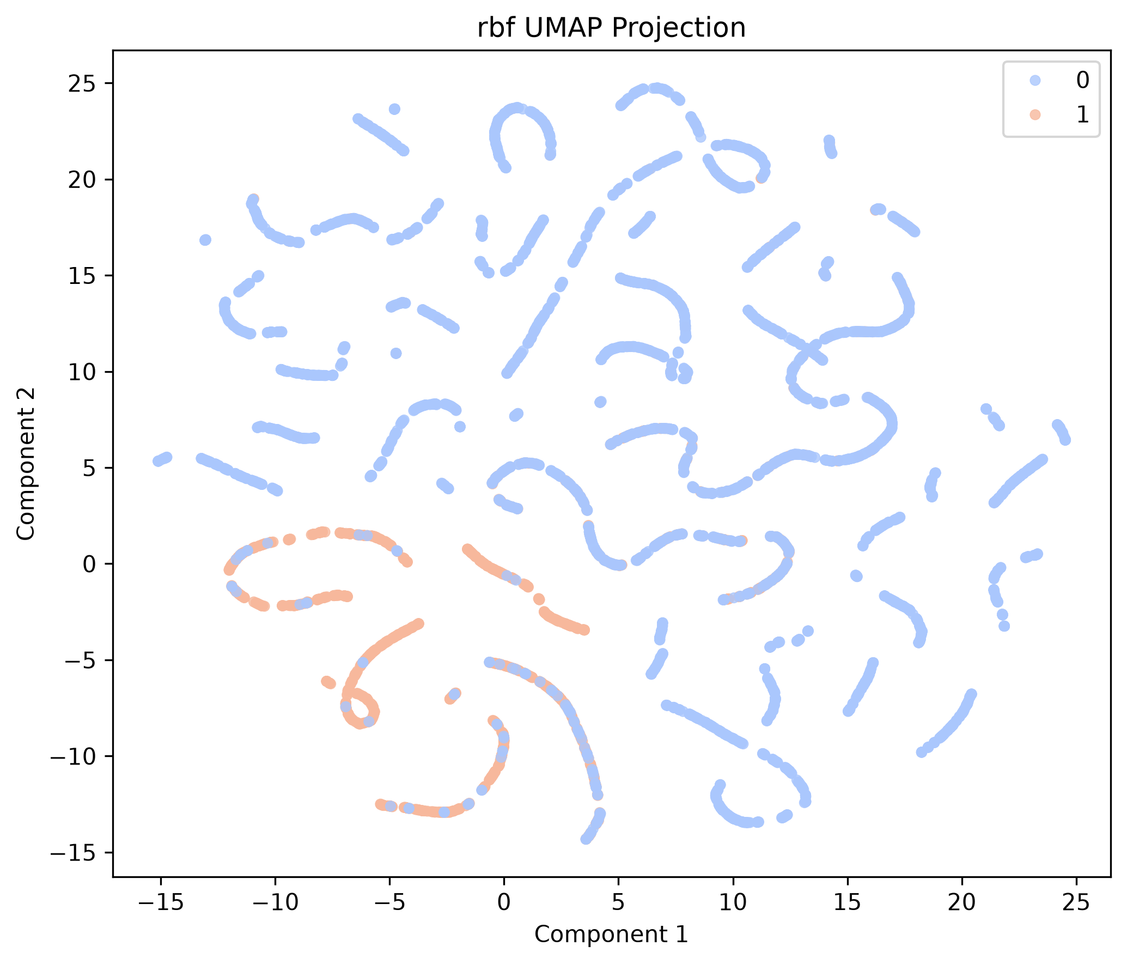
Week 2: Machine Learning and Kernel Projection
 | Accuracy | Precision | Recall | F1
Random Forest | 0.9920 | 0.9936 | 0.9737 | 0.9835
SVM – Linear | 0.9855 | 0.9809 | 0.9600 | 0.9701
SVM – Polynomial | 0.7991 | 0.2907 | 0.3356 | 0.3039
SVM – RBF | 0.9240 | 0.8912 | 0.7868 | 0.8355
One-Class SVM | 0.2223 | 0.2274 | 0.9000 | 0.3628
MLP | 0.9823 | 0.9827 | 0.9453 | 0.9635
CNN | 0.9841 | 0.9658 | 0.9705 | 0.9676

