Slide 1

面向时序迁移的家庭出行行为预测
大模型事件先验与历史模型校准
LLM event priors + historically calibrated prediction under target-year shift
冷启动选择器
时序迁移修正
因果/泄露护栏
多目标评估
LLM-rule selector
LLM-corrected XGBoost
causal guardrails
accuracy / bias / equity
Trip-count wMAE
Weighted bias
LLM calls
Outputs
2.502
-0.023
89
3+
-42.3% vs XGBoost
nearly unbiased
batch prior prompts
trips / mode / purpose

Slide 2
Mobility Inequality and Sustainable Development
00
目录 / Contents
按一条主线串起 selector branch 与 correction branch
章节
内容
本页以后怎么讲
01
研究背景与相关工作
为什么目标年迁移需要 LLM event-generalization
02
问题定义与数据
NHTS household behavior system：出行多少、方式、目的
03
方案设计
冷启动选择器 + LLM 修正 XGBoost 的统一框架
04
性能评估
传统基线、纯 LLM、rule tree、hybrid adapter 多指标比较
05
结论与展望
因果护栏、外部验证、本地开源 LLM 控制
主线不是“两个方案拼接”
The selector branch handles cold-start simulation; the correction branch handles target-year temporal adaptation.
LLM-Guided Temporal Adaptation for Household Mobility
02 / 25

Slide 3
Mobility Inequality and Sustainable Development
01
研究问题 / Research Gap
目标年不是普通跨年预测 | Target-year shift is not ordinary transfer
Traditional framing
Event-driven framing
2017 -> 2022 as smooth temporal transfer
2022 as target-year behavioral regime shift
Covariates explain most household differences
Household covariates miss remote work / transit avoidance
Model failure means weak tabular learner
Model failure reveals unobserved event mechanisms
Tune on target labels if available
Use no 2022 labels for training/calibration
Ordinary XGBoost
Systematic bias
Pre-COVID bias
Research target
4.34
+3.61
0.90
adapt
weighted MAE
over-predicts trips
mean abs. wBias
not just fit
核心问题：2022 的 weighted bias 远高于常规跨年验证；不使用 2022 标签调参时，能否用情境先验修正这种系统性高估。
Core question: can context priors correct target-year overprediction without using 2022 target labels for calibration?
LLM-Guided Temporal Adaptation for Household Mobility
03 / 25

Slide 4
Mobility Inequality and Sustainable Development
02
相关研究与缺口 / Related Work and Gap
2025-2026: LLM mobility, causal events, and foundation models
最新方向
2025-2026 代表线索
本项目的位置
Event-driven mobility
ELLMob ICLR'26; CausalMob KDD'25
把外部情境变化转成 label-free event priors
Zero-shot LLM mobility
AgentMove NAACL'25
直接 LLM 可做 baseline，但数值校准弱
Evidence-grounded agents
AgentMob 2026
routine fast path + low-confidence LLM reasoning
Efficient LLM pipeline
ELP-Mob GIS'25
batch prompting 和调用压缩是必要工程约束
Mobility foundation models
UniMob KDD'25; STFM survey'25
不训练大 FM；用轻量 adapter 处理 survey shift
Planning evaluation
causal guardrails + multi-objective metrics
同时报告 accuracy、bias、equity、mode/purpose
研究缺口
缺口：已有工作多关注 trajectory / flow / sensor forecasting；NHTS household survey 的 target-year label-free temporal adaptation 仍需要一个可解释、可审计框架。
LLM-Guided Temporal Adaptation for Household Mobility
04 / 25

Slide 5
Mobility Inequality and Sustainable Development
03
数据与目标 / Data and Target System
一个 household behavior system，多种 linked outputs
2001
2009
2017
2022
history
history
history + mode base
target-year eval
Output
Construction
Planning meaning
Main metric
Trip generation
CNTTDHH at household level
How much travel demand
weighted MAE / bias
Mode composition
TRPTRANS -> household share vector
How demand is distributed
TV / share MAE
Purpose composition
TRIPPURP -> household purpose vector
Why households travel
TV / purpose MAE
Mode-specific trips
predicted trips × mode share
Trips by mode for planning
derived output
目标不是只预测 CNTTDHH，而是构造 household travel behavior：出行多少次、用什么方式、为什么出行、每种方式多少次。
The target is a household behavior system: trip generation, mode composition, purpose composition, and derived mode-specific trip counts.
LLM-Guided Temporal Adaptation for Household Mobility
05 / 25

Slide 6
Mobility Inequality and Sustainable Development
04
问题定义 / Problem Definition
两个场景对应同一个 event-generalization 框架
场景 A：数据稀疏 / 字段缺失 / 冷启动
场景 B：有历史数据但目标年情境变化
Historical labels are weak or missing. LLM knowledge is distilled into fast executable rules; low-confidence cases can fall back to LLM.
Historical NHTS labels exist, but 2022 context changes the meaning of routine covariates. LLM event priors correct the historical predictor.
Pure data
Pure LLM
Selector
Correction
calibrated but brittle
general but unstable
cold-start branch
temporal-adaptation branch
模块
输入
LLM 做什么
输出
Selector branch
少量/缺失历史样本
提取 IF-THEN 规则与置信度
快速模拟预测 + 低置信回退
Correction branch
2001/2009/2017 历史 + 2022 无标签 profiles
生成 trip suppression / remote work / transit avoidance priors
修正 XGBoost 的 2022 household prediction
LLM-Guided Temporal Adaptation for Household Mobility
06 / 25

Slide 7
Mobility Inequality and Sustainable Development
05
方法谱系 / Method Spectrum
先把 selector branch 和 LLM-corrected XGBoost 串成一条线
Data-only
Pure LLM prior
LLM rule tree
Rule + history
Hybrid adapter
历史数据拟合
事件方向可用
零样本规则
少量历史校准
LLM 修正 XGBoost
wMAE 4.338
wMAE 2.718
wMAE 2.602
wMAE 2.772
wMAE 2.502
bias +3.605
bias -0.373
bias -0.407
bias +0.463
bias -0.023
阶段
核心假设
最适合回答的问题
本项目结论
Data-only
历史样本足够表达未来
常态年份迁移
2022 出现系统性高估
Pure LLM
预训练知识可直接预测
零样本方向判断
方向有用，数值校准不足
LLM rule
把常识蒸馏为规则树
老师追问的零样本 baseline
wMAE 2.602，弱于 hybrid
Rule + history
用少量历史标签校准规则
data-sparse / cold-start
合理桥梁，但不是本任务最优
Hybrid adapter
历史模型学 routine，LLM 学 target-year shift
目标年无标签模型修正
wMAE 2.502，bias 接近 0
整合口径：模拟预测选择器负责 cold-start / sparse-data 条件下的快速候选预测；LLM-corrected XGBoost 负责有历史标签但目标年情境变化的主任务。二者是同一 temporal-adaptation framework 的两个分支。
The selector branch handles sparse-data simulation, while the correction branch anchors routine mobility in historical survey labels and adapts it with LLM context priors.
LLM-Guided Temporal Adaptation for Household Mobility
07 / 25

Slide 8
Mobility Inequality and Sustainable Development
06
冷启动选择器 / Selector Branch
把同学方案纳入统一框架：LLM 不是逐条替代模型，而是提取预测路径
LLM rule extraction
Rule prediction
Confidence scoring
LLM fallback
从大模型提取可执行规则
常规样本快速预测
识别低置信或冲突样本
必要时再调用大模型
实验场景
为什么需要 selector
证明什么
数据稀疏
历史样本只有 100/500/1000 条
LLM priors 可缓解 cold-start
字段缺失
随机缺失 30%-70% 字段
规则/低置信机制比纯数据拟合更稳
新增因素
出现历史数据没有的新情境
需要 event-generalization 而不是只靠历史拟合
它和我们的主方法如何统一？
Selector branch solves when to trust distilled rules or call an LLM; correction branch solves how to numerically calibrate household travel under a known target-year shift.
LLM-Guided Temporal Adaptation for Household Mobility
08 / 25

Slide 9
Mobility Inequality and Sustainable Development
07
技术路线 / Technical Route
selector branch 处理冷启动，correction branch 处理目标年迁移
Historical routine branch
NHTS history
Feature harmonization
XGBoost CUDA
Leakage guardrails
2001 / 2009 / 2017
same household schema
learn f_hist(X)
禁止进入 LLM
原因
CNTTDHH
目标标签
LLM context-prior / selector branch
Target-year profile
GPT-5.5 prompt
Validated priors
WTHHFIN
样本权重
aggregated households
context + rule signals
s_event + selector
HOUSEID
个体标识
Two adaptation branches
ŷ_2022 = f_hist(X) × clip(1 − α × s_event, min_factor, 1)
Output behavior system
selector branch: LLM rules -> confidence gate -> optional fallback
Trip generation
Mode shares
household CNTTDHH
transit signal
target-year labels enter only here: final evaluation
LLM-Guided Temporal Adaptation for Household Mobility
09 / 25

Slide 10
Mobility Inequality and Sustainable Development
08
LLM 情境先验 / LLM Context Prior
从 cohort 描述生成结构化目标年响应变量
LLM output
变量含义
进入模型的位置
trip_suppression
总体出行折减压力
修正 total trips
remote_work
通勤被远程办公替代的可能性
解释出行下降来源
transit_avoidance
公共交通规避倾向
修正 transit share
delivery_substitution
购物/服务被线上替代
解释非通勤出行下降
recovery_sensitivity
恢复到常态出行的能力
刻画 rebound 差异
confidence
LLM 对判断的自评置信度
质量检查信号
LLM 输入
明确排除
cohort-level household profile
CNTTDHH / trip count label
urban context, vehicles, workers
sample weights / household IDs
generic 2022 pandemic context
aggregate 2022 outcomes
LLM-Guided Temporal Adaptation for Household Mobility
10 / 25

Slide 11
Mobility Inequality and Sustainable Development
09
对比体系 / Evaluation Design
传统模型、selector、纯 LLM 与 hybrid correction 逐层比较
Method
传统基线
LLM先验
目标年标签
对比作用
wMAE
Historical mean
●
×
×
只保留历史平均水平
5.51
Ordinary XGBoost
●
×
×
传统方法：家庭属性 -> 出行次数
4.34
Trend / indicator
●
×
×
统一趋势修正，不区分情境机制
4.15
LLM-only pressure
×
●
×
只有事件方向，缺少 household baseline
2.72
Zero-shot rule tree
×
●
×
LLM 直接构建规则树，无数值校准
2.60
Rule + 500 history
●
●
×
LLM 规则 + 少量历史标签校准
2.77
Global event rule
●
×
×
所有家庭使用同一目标年折减
2.52
Random pressure
●
×
×
随机 pressure 对照
2.65
Hybrid gated
●
●
×
历史基线 × LLM 事件折减
2.50
● 使用 / used × 不使用 / not used
对比逻辑：LLM 直接构树能给出事件方向，但缺少历史行为的数值锚点；小样本规则校准仍偏高估。主方法保留 household baseline，再用 LLM 事件先验做无标签修正。
The comparison isolates household grounding, zero-shot rule priors, small historical calibration, and the final gated event adapter.
LLM-Guided Temporal Adaptation for Household Mobility
11 / 25

Slide 12
Mobility Inequality and Sustainable Development
10
主结果 / Main Trip-Count Results
Hybrid adapters reduce error while controlling bias
Historical mean
5.51
Method
wMAE
wBias
wR2
Ordinary XGBoost
4.34
Ordinary XGBoost
4.338
+3.605
-0.637
Trend / indicator
4.15
CatBoost GPU
4.220
+3.487
-0.571
LLM-only pressure
2.72
LLM-only pressure
2.718
-0.373
0.079
Zero-shot rule tree
2.60
Zero-shot tree
2.602
-0.407
0.151
Rule + 500 history
2.77
Rule + 500 hist.
2.772
+0.463
0.154
Global event rule
2.52
Hybrid gated
2.502
-0.023
0.248
Hybrid gated
2.50
MAE reduction
Bias reduction
-42.3%
-99.4%
primary vs XGBoost
absolute weighted bias
CatBoost GPU、zero-shot LLM rule tree 和少量历史校准规则都没有超过主方法；加入 gated event adapter 后，wMAE 降到 2.50，bias 接近 0。
The main adapter outperforms stronger tabular, zero-shot rule-tree, and small-data calibration baselines while removing most systematic bias.
LLM-Guided Temporal Adaptation for Household Mobility
12 / 25

Slide 13
Mobility Inequality and Sustainable Development
11
统计验证 / Statistical Validation
用 household bootstrap 给主结果加不确定性
Metric
Point
95% CI
MAE gain
1.84
Baseline wMAE
4.338
[4.242, 4.431]
CI [1.74, 1.93]
Hybrid wMAE
2.502
[2.429, 2.581]
Bias gain
3.56
Hybrid bias
-0.023
[-0.130, +0.088]
CI [3.36, 3.67]
Within 2 trips
54.0%
[52.6%, 55.3%]
Bootstrap 结果说明：主方法的 MAE 改善和 bias 改善不是单个点估计的偶然波动，paired CI 保持为正。
The paired confidence intervals remain positive, supporting the robustness of the event-adaptation gain.
LLM-Guided Temporal Adaptation for Household Mobility
13 / 25

Slide 14
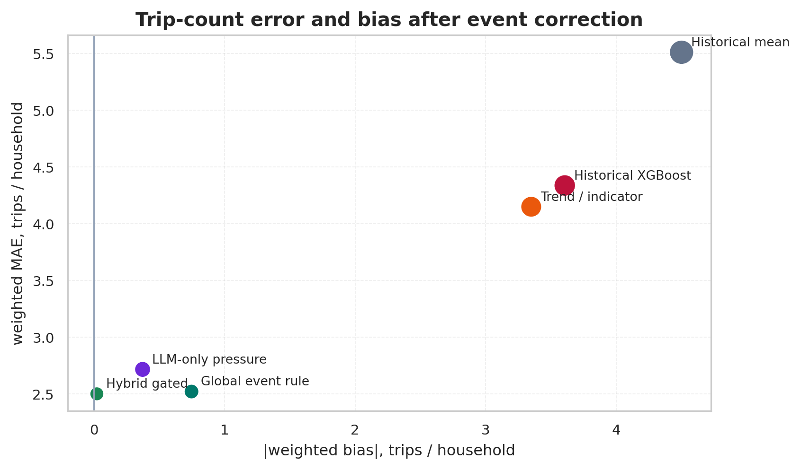
Mobility Inequality and Sustainable Development
12
误差与偏差权衡 / Error-Bias Tradeoff
横轴是 |bias|，纵轴是 wMAE，越靠左下越好
Hybrid 位于低误差、低偏差区域；普通 XGBoost 的偏差较大，说明 2022 的整体高估不能只靠家庭表格变量解决。
The hybrid method moves toward lower error and near-zero bias; the ordinary supervised baseline keeps a clear positive shift.
读图方式
含义
横轴
越接近 0，系统性偏差越小
纵轴
越低，家庭出行次数误差越小
点大小
代表 weighted RMSE，反映大误差风险
Hybrid
位于低误差、低偏差区域
LLM-Guided Temporal Adaptation for Household Mobility
14 / 25

Slide 15
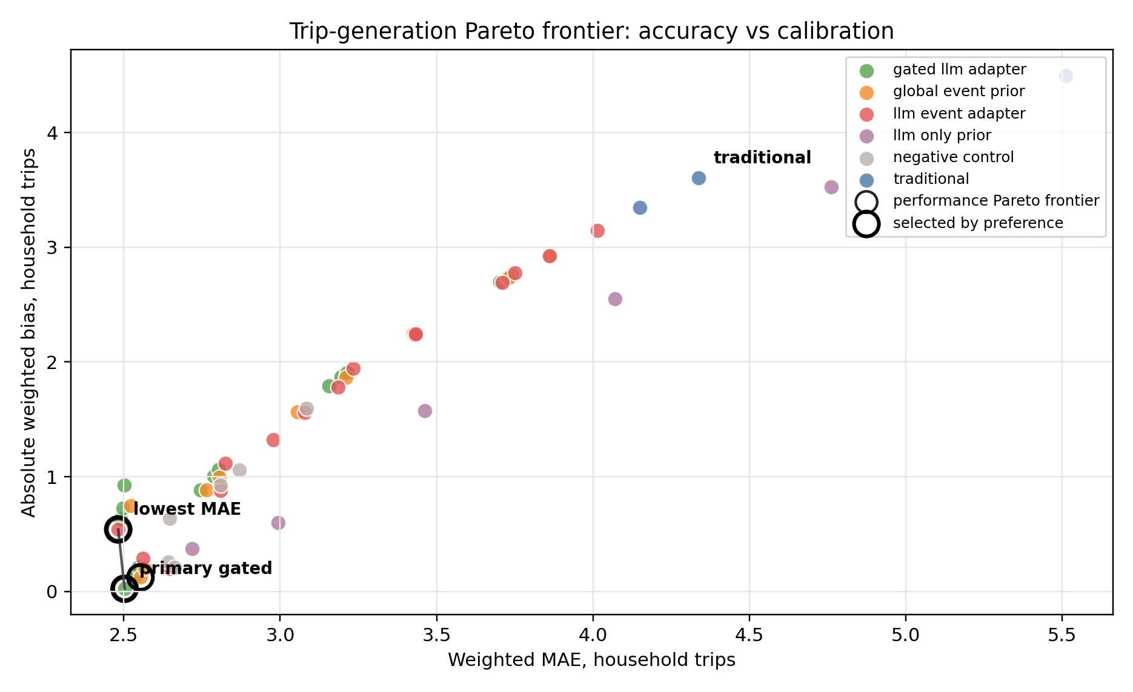
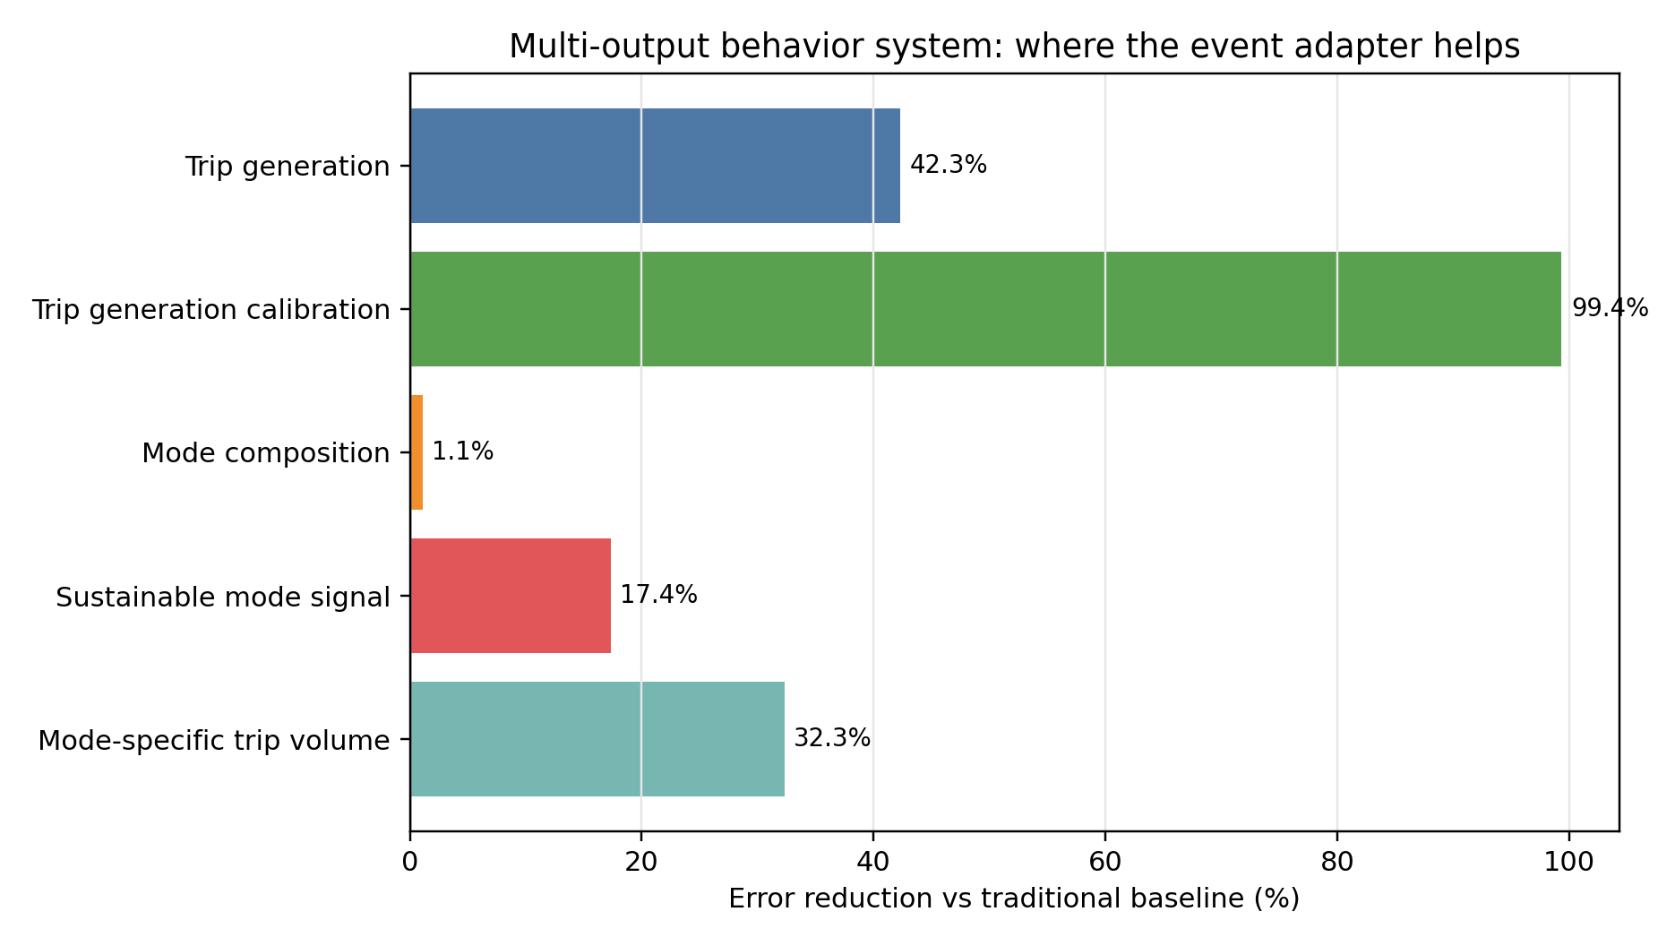
Mobility Inequality and Sustainable Development
13
多目标选择 / Multi-Objective Selection
从单一排行榜转向规划目标下的 operating point
Preference
Selected method
wMAE
|bias|
LLM req.
关键讲法：LLM 不是直接报一个答案，而是把事件机制转成候选修正；最终由规划目标选择 Pareto operating point。
Calibration
Gated LLM
2.502
0.023
89
Key message: LLM supplies event mechanisms; the solver selects a planning operating point.
Balanced / main
Gated LLM
2.502
0.023
89
Low-cost
Global prior
2.553
0.123
1
LLM-Guided Temporal Adaptation for Household Mobility
15 / 25

Slide 16
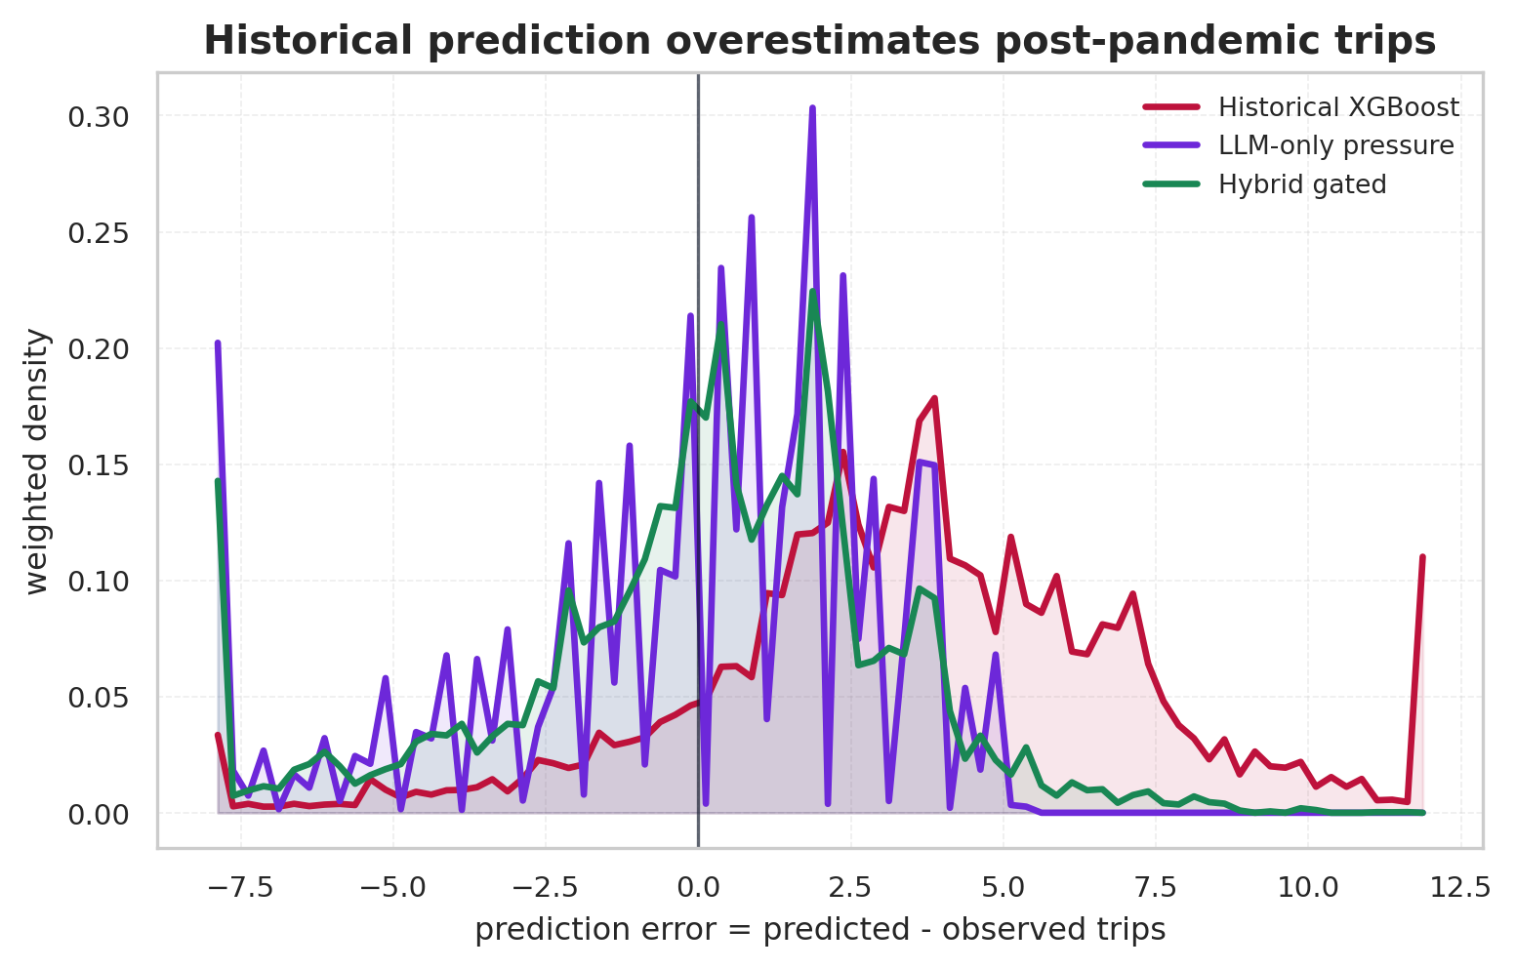
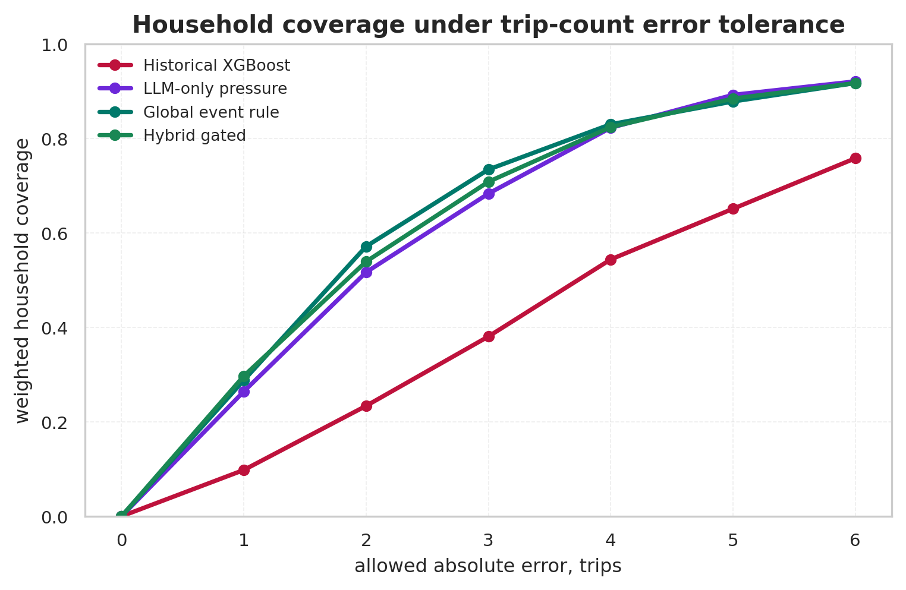
Mobility Inequality and Sustainable Development
14
误差分布与容忍度 / Error Distribution and Tolerance
误差分布看系统性高估，容忍曲线看 household-level 可用性
传统监督模型误差分布整体偏正，说明它系统性高估 2022 出行；事件修正后误差更集中，容忍阈值内覆盖率更高。
The traditional supervised baseline overpredicts many households; event correction shifts errors closer to zero and improves tolerance-level coverage.
LLM-Guided Temporal Adaptation for Household Mobility
16 / 25

Slide 17
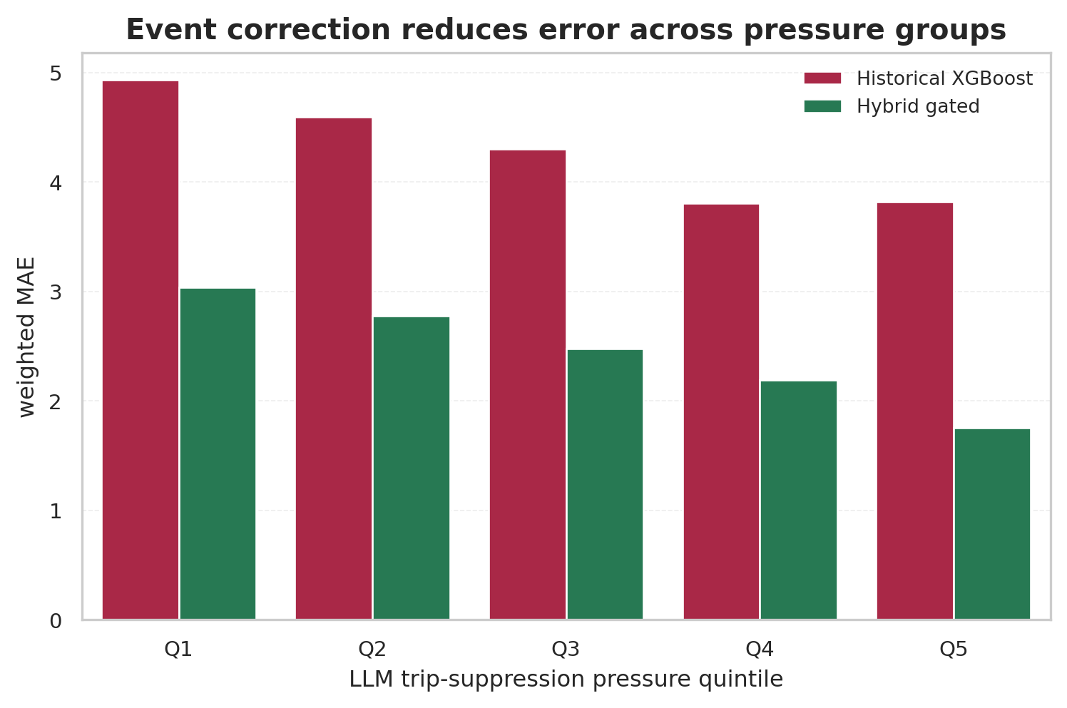
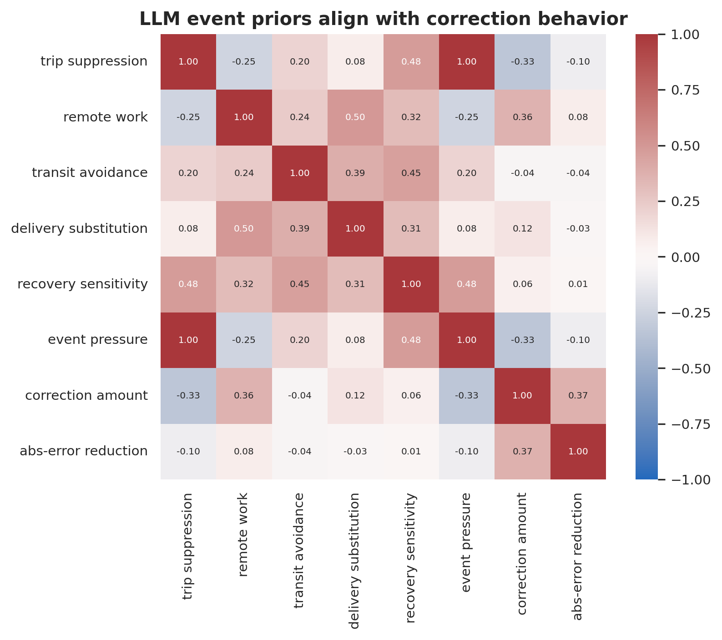
Mobility Inequality and Sustainable Development
15
情境影响异质性 / Event Heterogeneity
pressure 分层和先验相关性检验时序机制是否合理
LLM pressure 与目标年机制相符：高 pressure 组需要更强出行折减，remote work、transit avoidance 等先验之间也呈现可解释相关。
The LLM priors behave like event variables, with pressure strata and prior correlations matching target-year mobility mechanisms.
LLM-Guided Temporal Adaptation for Household Mobility
17 / 25

Slide 18
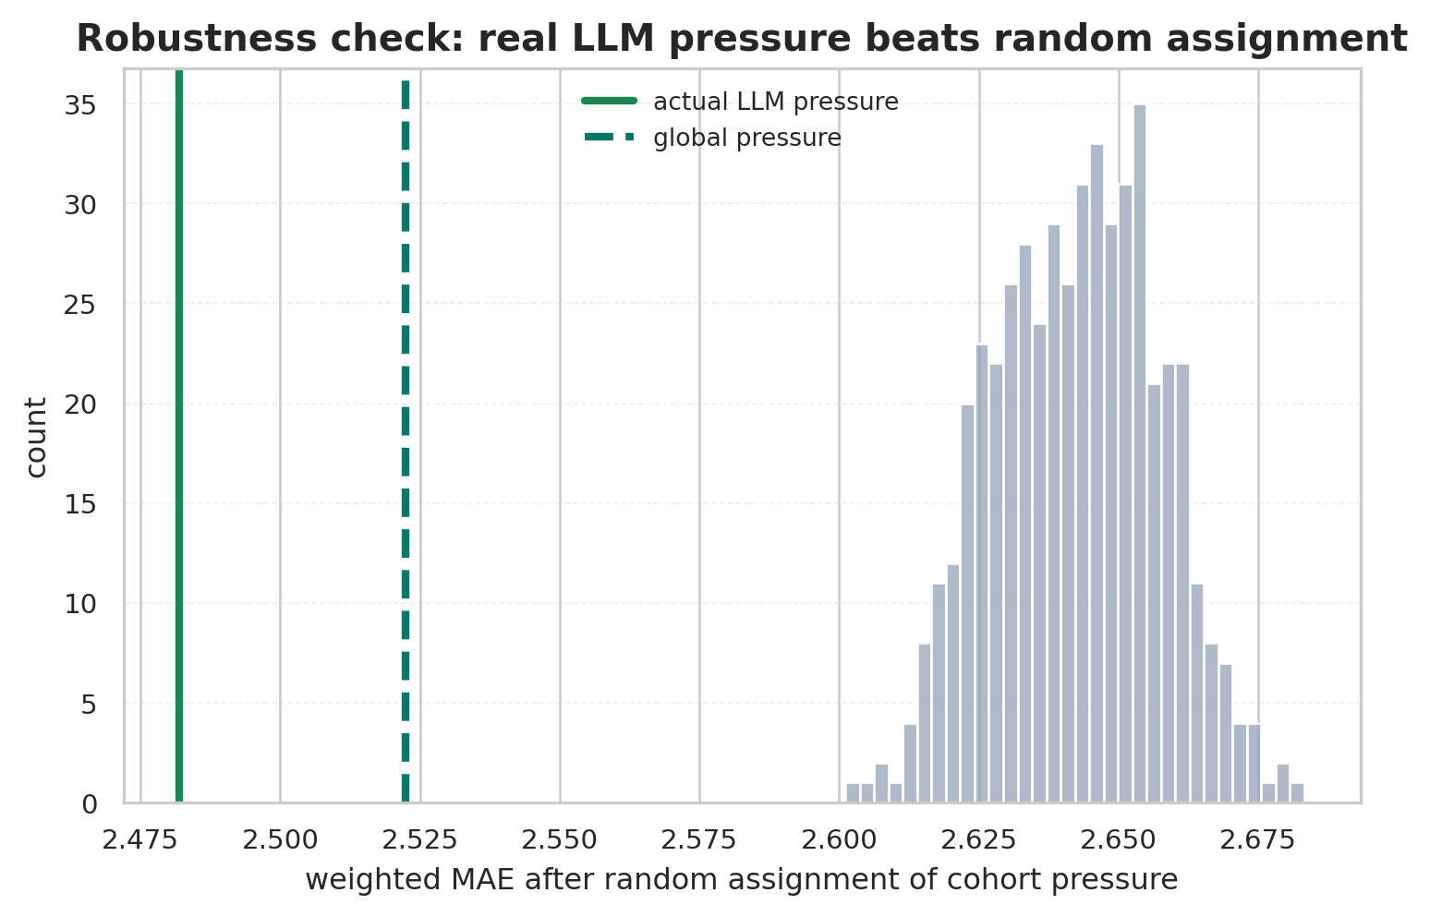
Mobility Inequality and Sustainable Development
16
稳健性检验 / Robustness Check
随机置换检验 LLM pressure 是否包含真实排序信息
真实 LLM pressure 的误差低于 500 次随机分配；同时 global pressure 也很强，说明主贡献是目标年事件层面的修正，cohort 排序是增量信息。
Real LLM pressure beats random assignment, while the strong global baseline shows that the main signal is event-level correction.
可能被问到的问题
我们的回答
global rule 是否已经足够？
它很强；LLM 排序提供增量价值
是否用了 2022 标签？
LLM 输入排除目标值、权重和 ID
LLM 能否替代传统模型？
不能；hybrid 明显更稳
是否只是通用下调？
pre-COVID placebo 中 full suppression 会过度修正
LLM-Guided Temporal Adaptation for Household Mobility
18 / 25

Slide 19
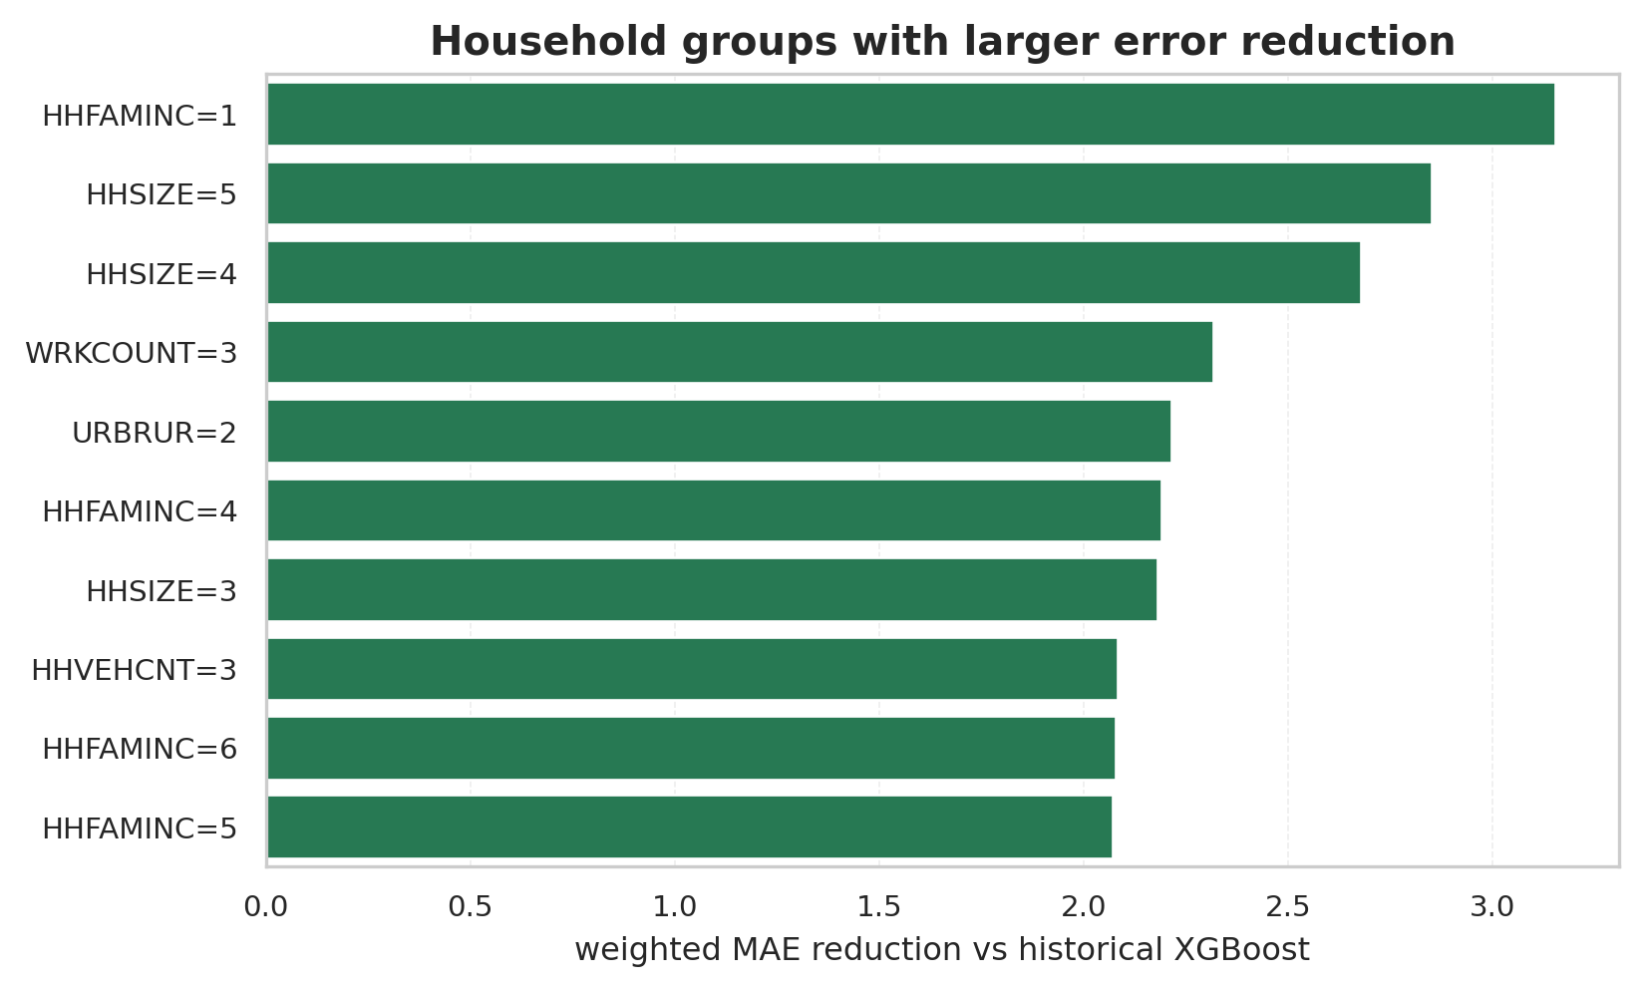
Mobility Inequality and Sustainable Development
17
分组稳健性 / Equity-Aware Subgroup Check
比较不同家庭群体中的 MAE 改善与 worst-subgroup error
分组结果显示，改进不只来自总体均值；worst-subgroup wMAE 从 8.38 降到 4.71，所有纳入分组均优于历史 XGBoost。
Worst-subgroup wMAE drops from 8.38 to 4.71, and all evaluated subgroups improve over historical XGBoost.
汇报时怎么讲
注意边界
预测层面 equity
worst-subgroup error 下降
注意表述边界
不是因果公平性结论
联系规划含义
识别更难预测的家庭
LLM-Guided Temporal Adaptation for Household Mobility
19 / 25

Slide 20
Mobility Inequality and Sustainable Development
18
误差洞察 / Error Insight
主收益来自消除 target-year over-prediction
Exact rounded
Within 2 trips
Within 3 trips
Weighted R2
17.7%
54.5%
71.2%
0.248
household accuracy
practical tolerance
broad tolerance
primary gated rule
Weighted bias comparison
Observation
Interpretation
Historical mean
+4.50
Ordinary XGBoost
+3.61
XGBoost: household signal + positive bias
history routine is too high for 2022
Trend / indicator
+3.35
LLM-only: direction useful, calibration weak
event semantics cannot replace household baseline
LLM-only pressure
-0.37
Hybrid: bias close to zero
routine demand and event response are separated
Hybrid gated
-0.02
0
LLM-Guided Temporal Adaptation for Household Mobility
20 / 25

Slide 21
Mobility Inequality and Sustainable Development
19
LLM 的角色 / What the LLM Adds
LLM 提供 selector signal 和 correction prior
事件信息弱
事件信息强
家庭基线弱
Historical mean
LLM-only pressure
neither household heterogeneity nor event semantics wMAE 5.51
event direction without household baseline wMAE 2.72
Ordinary XGBoost
Hybrid gated
家庭基线强
household grounding without pandemic semantics wMAE 4.34
household baseline + event prior wMAE 2.50
汇报讲法
LLM-only has direction but weaker calibration: wMAE 2.72 -> 2.50; wBias -0.37 -> -0.02.
LLM-Guided Temporal Adaptation for Household Mobility
21 / 25

Slide 22
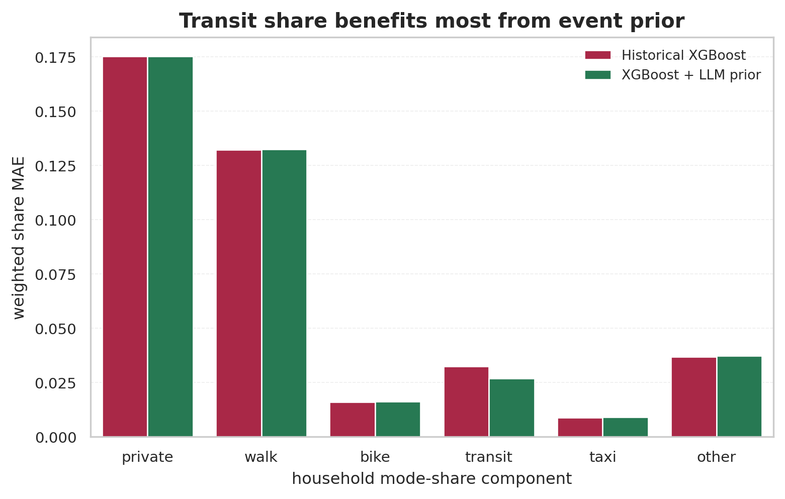
Mobility Inequality and Sustainable Development
20
综合行为输出 / Behavior Outputs
从出行次数扩展到方式结构和方式出行量
private
walk
bike
transit
taxi
other
Mode-trip MAE
Reduction
3.28
32.3%
household mode-share vector
gated count × LLM mode
vs traditional combo
Method
weighted TV
transit MAE
Interpretation
Historical XGBoost
0.2008
0.0325
routine mode pattern
XGB + LLM prior
0.1985
0.0269
transit correction
Improvement
1.1%
17.4%
clearer on transit
方式结构不是主要增益来源，但 transit share 明显改善；这与目标年公共交通规避机制一致。
Mode composition gains are modest overall, but transit-share error improves in the direction suggested by pandemic transit avoidance.
LLM-Guided Temporal Adaptation for Household Mobility
22 / 25

Slide 23
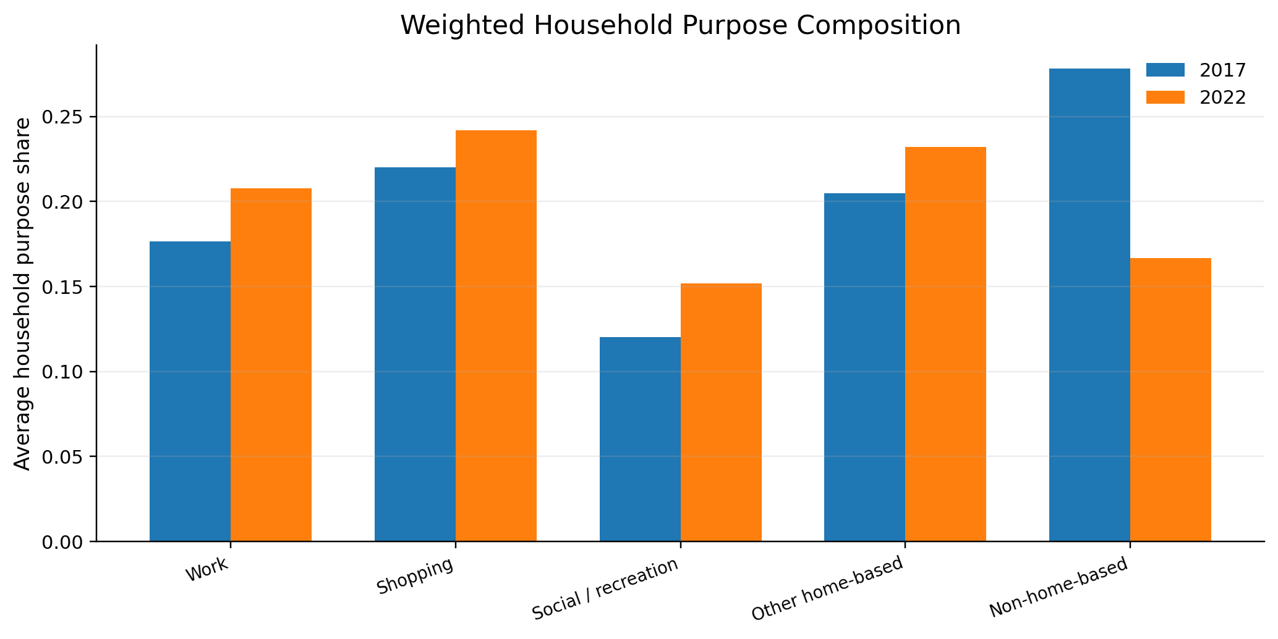
Mobility Inequality and Sustainable Development
21
出行目的扩展 / Purpose Composition
第三个行为维度：为什么出行
Method
TV
Component MAE
Role
Traditional XGBoost
0.566
0.202
strongest overall
LLM purpose prior
0.586
0.201
directional components
Global purpose prior
0.580
0.249
shopping improves
purpose 结果说明综合目标已经扩展到“为什么出行”；但 LLM prior 目前不是整体最优，适合作为边界和未来工作，而不是主贡献。
Purpose composition broadens the behavior system, while also showing a clear limitation: event priors need stronger task-specific calibration.
LLM-Guided Temporal Adaptation for Household Mobility
23 / 25

Slide 24
Mobility Inequality and Sustainable Development
22
LLM 先验生成与部署 / Prior Generation & Deployment
从逐户调用转成 batch prior、规则提取和置信度回退
Direct LLM
Cohort batch
Structured priors
Rule adapter
Confidence gate
逐户预测成本高；校准弱
1,327 cohorts -> 89 prompts
JSON schema -> event variables
fixed no-label correction
global fallback; online LLM optional
Household requests
Batch size
Main inference
Optional fallback
-98.9%
15
0 LLM
low-conf
7893 -> 89 prompts
stable JSON parsing
adapter is deterministic
deployment extension
部署层
在本研究中的角色
为什么这样设计
Batch prior
离线生成 cohort 级情境先验
保留 LLM 泛化能力，避免逐户调用
Rule extraction
把自然语言判断压缩成 s_event 和 fixed adapter
比直接 LLM 输出 CNTTDHH 更可审计
Confidence gate
低置信 cohort 退回 global pressure
主实验保持 no-label、可复现
LLM fallback
作为线上部署扩展，不进入主结果
有预算时处理边界样本
汇报口径：LLM 不是每户都报答案，而是把目标年 context 蒸馏成结构化 priors 或 selector signals；主实验预测阶段是 deterministic adapter，低置信 LLM 回退属于可部署扩展。
LLM-Guided Temporal Adaptation for Household Mobility
24 / 25

Slide 25
Mobility Inequality and Sustainable Development
END
总结 / Conclusion
模拟预测选择 + LLM 修正 XGBoost 的时序适应框架
我们研究的不是“LLM 直接预测出行次数”，而是： 当目标年情境变化打破历史连续性时，能否用 LLM 的时序泛化能力，为传统 household travel model 提供无标签修正先验。
Accuracy
Bias
Scope
LLM role
-42.3%
-0.023
4 outputs
adapter
weighted MAE
weighted bias
trips / modes / purposes
not standalone predictor
一句话总结
用 NHTS 历史数据学习正常出行规律，用 LLM 情境先验泛化目标年变化，并输出家庭层面的出行强度、方式结构和目的结构。
LLM-Guided Temporal Adaptation for Household Mobility
25 / 25

Slide 26
Mobility Inequality and Sustainable Development
BACKUP
为什么不直接让 LLM 构建 2022 决策树？
Why not ask the LLM to build the 2022 decision tree directly?
Short answer
已经实现为 baseline；方向有用，但数值校准弱于 hybrid adapter。
Evidence
Value / implication
Zero-shot LLM rule tree
wMAE 2.6019; wBias -0.4072
Pseudo-label tree
wMAE 2.6040; still follows LLM belief labels
Primary hybrid gated
wMAE 2.5023; wBias -0.0230
Key issue
No target labels for split thresholds and leaf values
答法：LLM 可以生成 qualitative belief tree，但没有 2022 标签时无法学习真实 NHTS 的 split threshold 和 leaf value。我们的设计把数值预测锚定在历史 NHTS household baseline 上，只让 LLM 提供事件机制先验。
Appendix: reviewer and instructor Q&A
B1

Slide 27
Mobility Inequality and Sustainable Development
BACKUP
有没有使用 2022 标签或 retrospective leakage？
Did the pipeline use 2022 labels or retrospective leakage?
Short answer
主方法不使用 2022 CNTTDHH 训练或校准；2022 只做最终 evaluation。
Evidence
Value / implication
Main method
gated_trip_suppression_a1_d0p15 fixed before evaluation
LLM inputs
Exclude HOUSEID, CNTTDHH, WTHHFIN
Leakage audit
LLM-facing files pass forbidden-column scan
Prospective context
prospective_event_context_2022 documents event assumptions
答法：LLM 输入是 cohort-level household profile 和泛化目标年事件语境，不含目标值、权重和 household ID。我们用 leakage audit、zero-shot baseline、placebo 和 fixed adapter 共同约束 no-label claim。
Appendix: reviewer and instructor Q&A
B2

Slide 28
Mobility Inequality and Sustainable Development
BACKUP
Global event prior 已经很强，LLM 还贡献什么？
If the global prior is strong, what does the LLM add?
Short answer
主贡献应表述为 event-level correction；cohort ranking 是增量 refinement。
Evidence
Value / implication
Global event prior
wMAE 2.5223; wBias -0.7477
Primary gated adapter
wMAE 2.5023; wBias -0.0230
Same-alpha decomposition
0.0508 lower wMAE; 77.8% subgroup-cell wins
Gate usage
cohort-specific pressure used for 17.5% weighted households
Pseudo-event ranked
best placebo wMAE 2.6274
答法：不能夸大成 LLM cohort ranking 独自贡献全部提升。更准确的说法是：global event correction 是主体，LLM cohort prior 在差异足够大的家庭上提供 selective refinement，改善 calibration 和 subgroup robustness。
Appendix: reviewer and instructor Q&A
B3

Slide 29
Mobility Inequality and Sustainable Development
BACKUP
和 2025-2026 mobility foundation model 有什么区别？
How is this different from recent mobility foundation-model work?
Short answer
最新工作多是 trajectory / flow / sensor forecasting；我们是 NHTS household survey 的 event adaptation。
Evidence
Value / implication
Event-driven LLM mobility
ELLMob ICLR'26; CausalMob KDD'25
Zero-shot / agentic LLM mobility
AgentMove NAACL'25; AgentMob 2026
Efficient LLM mobility pipeline
ELP-Mob GIS'25
Foundation model direction
UniMob KDD'25; STFM survey'25
Our unit
Household survey record, not trajectory or road node
答法：我们借用了 event-generalization 思路，但不声称训练 universal mobility foundation model。LLM 是 structured event-prior generator，数值需求预测仍由 NHTS 历史标签锚定。
Appendix: reviewer and instructor Q&A
B4

Slide 30
Mobility Inequality and Sustainable Development
BACKUP
Mode / purpose 是否已经解决？
Are mode and purpose choice solved?
Short answer
没有。trip generation 是主贡献；mode/purpose 是 behavior-system extension。
Evidence
Value / implication
Transit-share MAE
0.0325 -> 0.0269
Mode-trip volume MAE
4.8467 -> 3.2802
Purpose composition
Exploratory; LLM prior not overall best
Safe claim
Planning relevance, not solved full mode-choice model
答法：综合目标是预测 household behavior system，但最强结果仍是 target-year trip generation。方式和目的模块说明可扩展到规划相关输出，也明确了未来工作边界。
Appendix: reviewer and instructor Q&A
B5

Slide 31
Mobility Inequality and Sustainable Development
BACKUP
这些指标怎么用一句话解释？
How should the metrics be interpreted?
Short answer
wMAE 是加权平均误差，wBias 是系统性高估/低估，越接近 0 越好。
Evidence
Value / implication
Historical XGBoost
wMAE 4.3377; wBias +3.6052
Primary gated
wMAE 2.5023; wBias -0.0230
Within 2 trips
54.5% households
Within 3 trips
71.2% households
答法：MAE 看单个家庭预测误差，bias 看总需求是否系统性偏高或偏低。我们的核心收益不是只降低误差，而是几乎消除了 2022 的系统性高估。
Appendix: reviewer and instructor Q&A
B6

Slide 32
Mobility Inequality and Sustainable Development
BACKUP
有没有 NHTS 之外的外部验证？
Do we have validation beyond NHTS?
Short answer
有机制级验证和 PSRC household microdata；但不是 NHTS 2022 的直接复刻。
Evidence
Value / implication
ACS work from home
2019 5.7% -> 2022 15.2%; supports remote-work prior
ACS public transit
2019 5.0% -> 2022 3.1%; supports transit-avoidance prior
PSRC microdata
2017+2019->2023 wMAE 3.4271->3.2498; wBias +1.0532->+0.2605
Safe claim
External mechanism + recovery-transfer support
答法：我们用 ACS 证明目标年通勤机制确实发生了远程办公和公共交通下降；用 PSRC 独立 household microdata 做 recovery-transfer 验证；同时用 BTS 做 guardrail，说明 device mobility trips 不能直接当作 NHTS household trip-count 的外部标签。
Appendix: reviewer and instructor Q&A
B7

Slide 33
Mobility Inequality and Sustainable Development
BACKUP
规则提取和低置信 LLM 回退怎么并入本方法？
How do rule extraction and low-confidence LLM fallback fit into the method?
Short answer
它们是同一条技术路线的部署层：LLM 先验被蒸馏成规则，低置信样本可选回退。
Evidence
Value / implication
Distilled rule layer
LLM priors -> fixed event adapter, not per-household answers
Batch prompting
1,327 cohorts -> 89 prompts with batch size 15
Reported experiment
No target-year labels; low-confidence uses global pressure fallback
Deployable extension
Online LLM fallback only for uncertain cohorts if cost allows
答法：可以把“LLM 规则蒸馏 + 置信度回退”理解为我们方法的工程化外壳。论文主结果为了避免 target-year leakage，使用离线 batch 先验和固定 adapter；如果未来做线上系统，可以在低置信 cohort 上再调用 LLM，而不是改变本文主实验口径。
Appendix: reviewer and instructor Q&A
B8

Slide 34
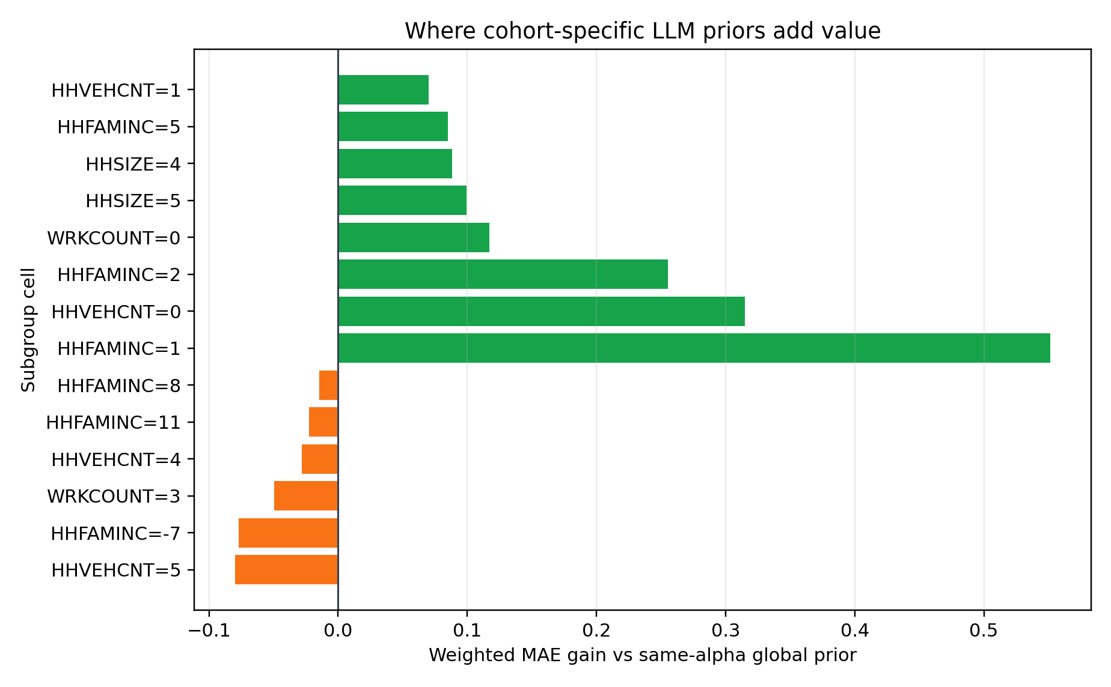
Mobility Inequality and Sustainable Development
BACKUP
Global prior 很强时，cohort LLM 还贡献什么？
Same-alpha decomposition of global event correction and selective cohort refinement
Same-alpha gain
Subgroup win
Gate active
0.0508
77.8%
17.5%
wMAE lower
cells vs global
weighted HHs
正确解释：global event correction 是主体，cohort-specific LLM pressure 只在差异足够大时启用，提供选择性校准增益。
The safe claim is global event adaptation plus selective cohort refinement, not that cohort ranking explains the full gain.
Evidence
Implication
primary vs global-a1
0.0508 lower wMAE
primary vs global-a1.25
0.0201 lower wMAE
where it helps most
lower-income / zero-vehicle / no-worker cells
boundary
some high-vehicle/high-income cells prefer global
Appendix: reviewer and instructor Q&A
B9

Slide 35
Mobility Inequality and Sustainable Development
BACKUP
开源/本地 LLM 复刻做到哪一步？
What is the status of local open-source LLM replication?
Short answer
脚本和环境审计已经实现；当前 Python 环境是 CPU-only PyTorch，不能声称已完成 GPU local run。
Evidence
Value / implication
GPU hardware
RTX 4090 visible through nvidia-smi
Current blocker
PyTorch CUDA available = False
Implemented artifact
src/run_local_llm_prior_replication.py
Paper-safe wording
protocol + audit implemented; generation pending
答法：这是我们下一步最值得补的实验。只要换成 CUDA-enabled PyTorch，并准备本地 Qwen/Llama 类 instruct model，就能在 32/64 个 cohort 上生成 local priors，再和 GPT-5.5 prior 做 Spearman/Pearson 排序一致性比较。
Appendix: reviewer and instructor Q&A
B10

