Slide 1

基于 NHTS 与 LLM 事件先验的 疫情感知家庭出行行为预测
Pandemic-Aware Household Travel Behavior Prediction
LLM event priors for label-free adaptation under post-pandemic shift
历史 NHTS
2022 疫情冲击
LLM 事件先验
家庭出行行为
routine mobility
event-driven shift
semantic adapter
trips + modes
Trip-count MAE
Weighted bias
Within 2 trips
Transit MAE
-42.3%
-0.023
54.5%
-17.4%
vs ordinary XGBoost
nearly unbiased
household tolerance
mode signal
PRE FOR Big Data and Urban Planning
01 / 19

Slide 2
PRE FOR Big Data and Urban Planning
00
汇报结构 / Content
从研究问题到技术路线，再到结果解释
01
Research gap
为什么传统 cross-year transfer 会失效
02
Data and target system
CONTENT
家庭层面预测：出行次数 + 方式结构
一条主线： 2022 不是普通预测年，而是疫情后事件冲击下的 label-free adaptation。
Method
03
historical routine predictor + LLM event prior
04
Evaluation design
不使用 2022 标签校准的对比体系
05
Insights
准确率提升来自哪里，LLM 的真实角色是什么
Pandemic-Aware Household Travel Behavior Prediction
02 / 19

Slide 3
PRE FOR Big Data and Urban Planning
01
研究问题 / Research Gap
2022 不是普通跨年预测 | 2022 is not an ordinary transfer year
Traditional framing
Event-driven framing
2017 -> 2022 as smooth temporal transfer
2022 as post-pandemic behavioral regime
Covariates explain most household differences
Household covariates miss remote work / transit avoidance
Model failure means weak tabular learner
Model failure reveals unobserved event mechanisms
Tune on target labels if available
Use no 2022 labels for training/calibration
Ordinary XGBoost
Systematic bias
Target labels
Research target
4.34
+3.61
0
adapt
weighted MAE
over-predicts trips
used for calibration
not just fit
核心问题：历史 household travel model 在 2022 会系统性高估出行，因此我们研究 label-free event adaptation，而不是单纯调参。
Core question: can structured LLM event priors repair post-pandemic shift without using 2022 target labels for calibration?
Pandemic-Aware Household Travel Behavior Prediction
03 / 19

Slide 4
PRE FOR Big Data and Urban Planning
02
数据与目标 / Data and Target System
一个 household behavior system，三个 linked outputs
2001
2009
2017
2022
history
history
history + mode base
post-pandemic eval
Output
Construction
Planning meaning
Main metric
Trip generation
CNTTDHH at household level
How much travel demand
weighted MAE / bias
Mode composition
TRPTRANS -> household share vector
How demand is distributed
TV distance / share MAE
Mode-specific trips
predicted trips x predicted mode share
Trips by mode for planning
derived output
目标不是只预测 CNTTDHH，而是构造 household travel behavior：出行多少次、用什么方式、每种方式多少次。
The prediction target is a household behavior system: trip generation, mode composition, and derived mode-specific trip counts.
Pandemic-Aware Household Travel Behavior Prediction
04 / 19

Slide 5
PRE FOR Big Data and Urban Planning
03
技术路线 / Technical Route
Routine predictor + LLM event prior + fixed no-label adapter
Historical routine lane
NHTS 2001/09/17
Feature harmonization
XGBoost CUDA
pre-2022 labels
stable household covariates
f_hist(X)
LLM event lane
2022 household profiles
GPT-5.5 prompts
Event priors
cohort aggregation
structured event reasoning
trip suppression / transit avoidance
No-label adapter lane
Fixed correction
Predicted behavior
Final evaluation
no 2022 label tuning
trip count + mode shares
2022 labels only here
Core rule
prediction = historical routine prediction x clip(1 - alpha x event_pressure, min_factor, 1)
Pandemic-Aware Household Travel Behavior Prediction
05 / 19

Slide 6
PRE FOR Big Data and Urban Planning
04
LLM 事件先验 / LLM Event Prior
约束 LLM 解释 event response，而不是直接预测标签
Prior field
Interpretation
Expected 2022 effect
trip_suppression
overall travel reduction pressure
lower total trip count
remote_work
work-trip substitution probability
fewer commute-related trips
transit_avoidance
public-transit perceived risk
lower transit share
delivery_substitution
online replacement of shopping trips
fewer discretionary trips
recovery_sensitivity
ability to return to routine mobility
heterogeneous rebound
confidence
LLM self-reported certainty
audit / filtering signal
Allowed in prompt
Excluded to avoid leakage
cohort-level household profile
CNTTDHH / trip count label
urban context, vehicles, workers
sample weights and household IDs
generic 2022 pandemic context
aggregate target-year outcomes
Design implication
The LLM contributes event semantics; the historical model keeps household-level numerical grounding.
Pandemic-Aware Household Travel Behavior Prediction
06 / 19

Slide 7
PRE FOR Big Data and Urban Planning
05
对比设计 / Evaluation Design
Every baseline answers a different design question
Method
pre-2022 labels
LLM prior
2022 labels
Role
wMAE
Historical mean
No
No
No
naive historical level
5.51
Ordinary XGBoost
Yes
No
No
routine transfer baseline
4.34
Trend / indicator
Yes
No
No
simple non-semantic shift
4.15
LLM-only pressure
No
Yes
No
event direction without baseline
2.72
Global event rule
Yes
No
No
common pandemic downscaling
2.52
Random pressure
Yes
No
No
placebo heterogeneity
2.65
Hybrid gated
Yes
Yes
No
proposed semantic adapter
2.50
公平性原则：2022 标签只用于最后 evaluation，主方法使用固定 no-label 参数，避免把测试年标签隐含用于调参。
Fairness rule: 2022 labels are held out until final evaluation; the primary method uses fixed parameters rather than target-year calibration.
Pandemic-Aware Household Travel Behavior Prediction
07 / 19

Slide 8
PRE FOR Big Data and Urban Planning
06
主结果 / Main Trip-Count Results
Hybrid adapters reduce error while controlling bias
Historical mean
5.51
Method
wMAE
wBias
wR2
Ordinary XGBoost
4.34
Ordinary XGBoost
4.338
+3.605
-0.637
LLM-only pressure
2.718
-0.373
0.079
Trend / indicator
4.15
Hybrid gated
2.502
-0.023
0.248
LLM-only pressure
2.72
Global event rule
2.52
MAE reduction
Bias reduction
-42.3%
-99.4%
Hybrid gated
2.50
primary vs XGBoost
absolute weighted bias
结果主线：普通 XGBoost 学到的是正常时期出行强度，所以 2022 明显高估；LLM prior 提供缺失的疫情方向。
Main insight: the historical model transfers routine mobility into a post-pandemic year, while the LLM prior supplies the missing event direction.
Pandemic-Aware Household Travel Behavior Prediction
08 / 19

Slide 9
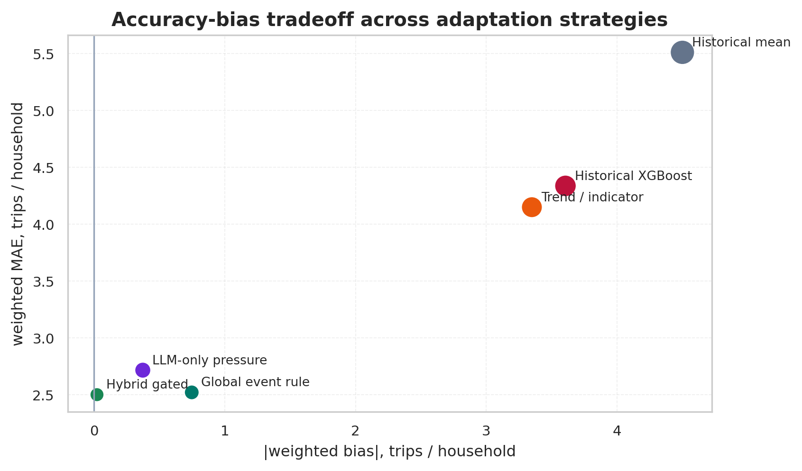
PRE FOR Big Data and Urban Planning
06A
准确率-偏差权衡 / Accuracy-Bias Tradeoff
论文图1：主方法同时降低误差和系统性偏差 | Paper-style Figure 1
这张图要讲的不是“哪个点最低”这么简单，而是说明我们的方法同时移动到低 MAE 和低 bias 的区域。
The proposed adapter improves the accuracy-bias Pareto position instead of only trading one metric for another.
Reading guide
Story
x-axis
closer to zero means lower systematic shift
y-axis
lower means smaller household trip-count error
point size
weighted RMSE, reflecting large-error risk
hybrid gated
near the lower-left region
Pandemic-Aware Household Travel Behavior Prediction
09 / 19

Slide 10
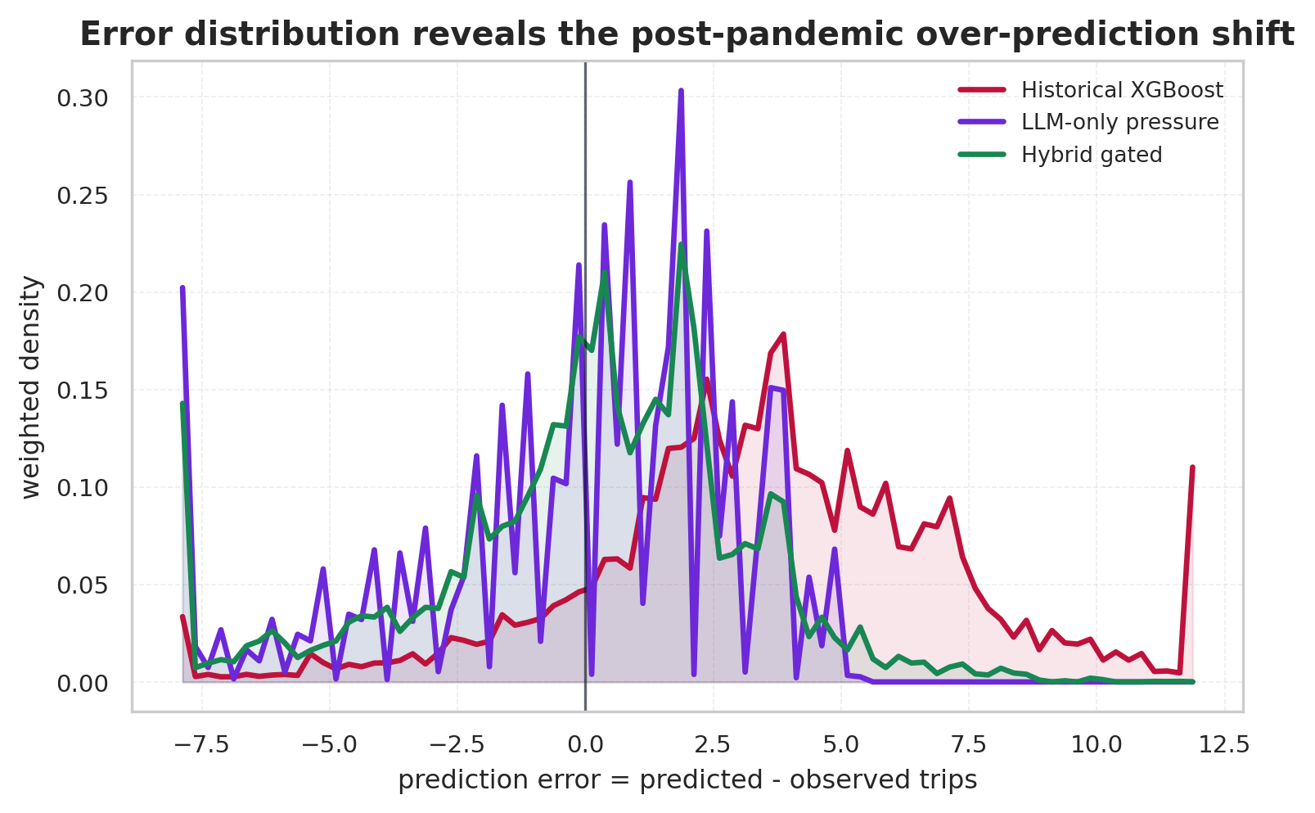
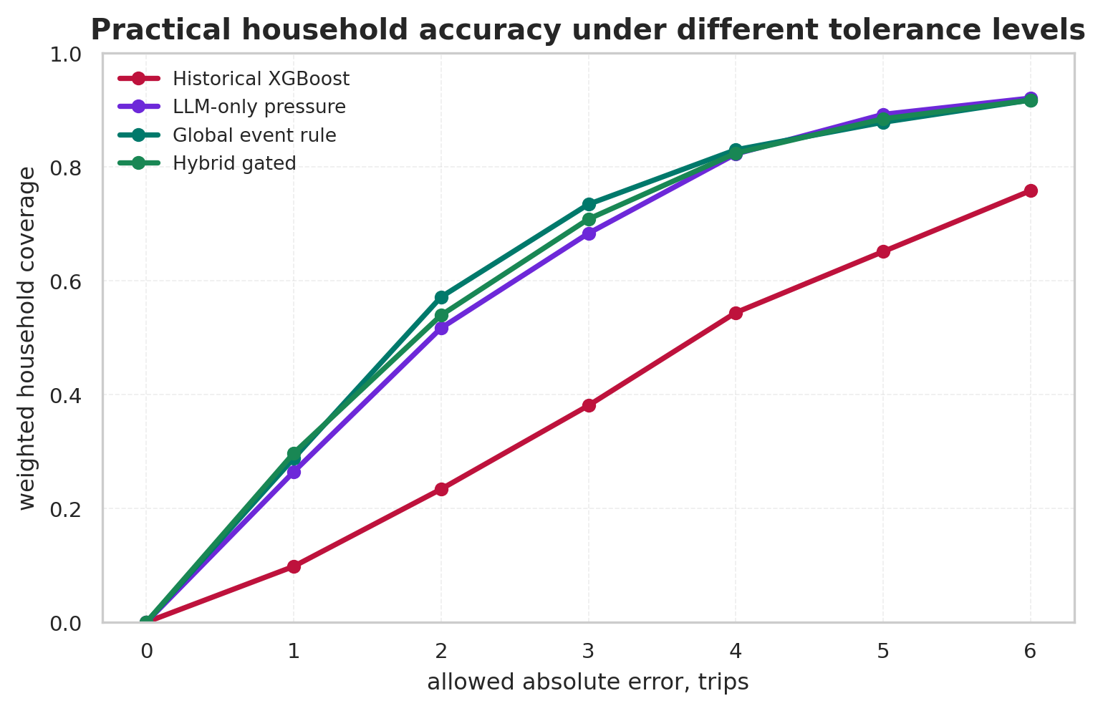
PRE FOR Big Data and Urban Planning
06B
误差分布与容忍度 / Error Distribution and Tolerance
论文图2：从平均误差走向 household-level 可解释准确率
左图说明历史模型的误差分布明显向正方向偏移；右图说明 hybrid 方法在不同容忍阈值下都有更高的家庭覆盖率。
The distributional view explains why weighted MAE improves, while the tolerance curve translates the result into household-level prediction usability.
Pandemic-Aware Household Travel Behavior Prediction
10 / 19

Slide 11
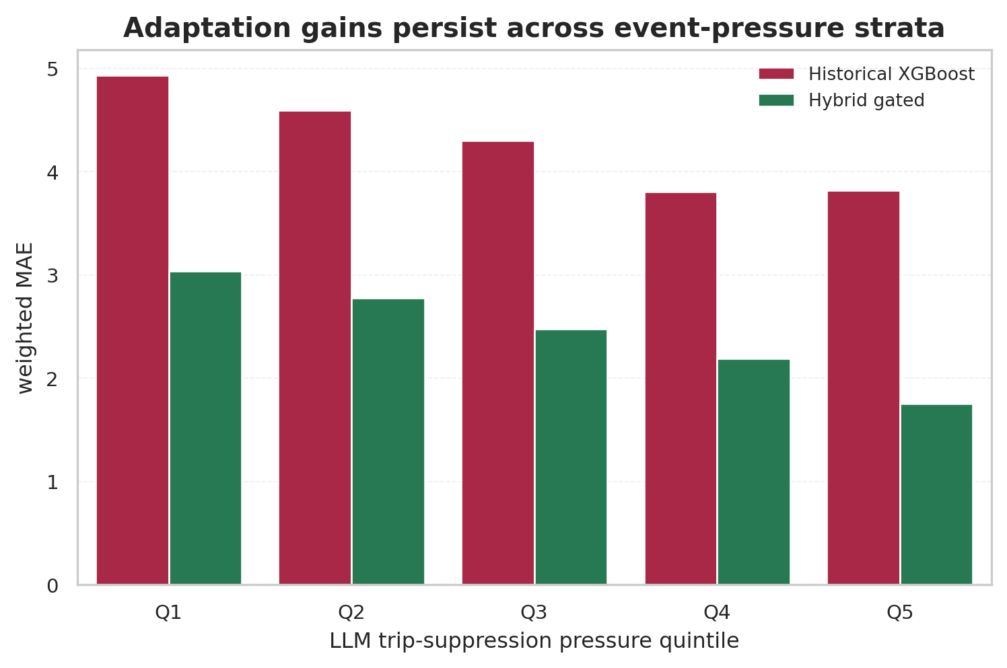
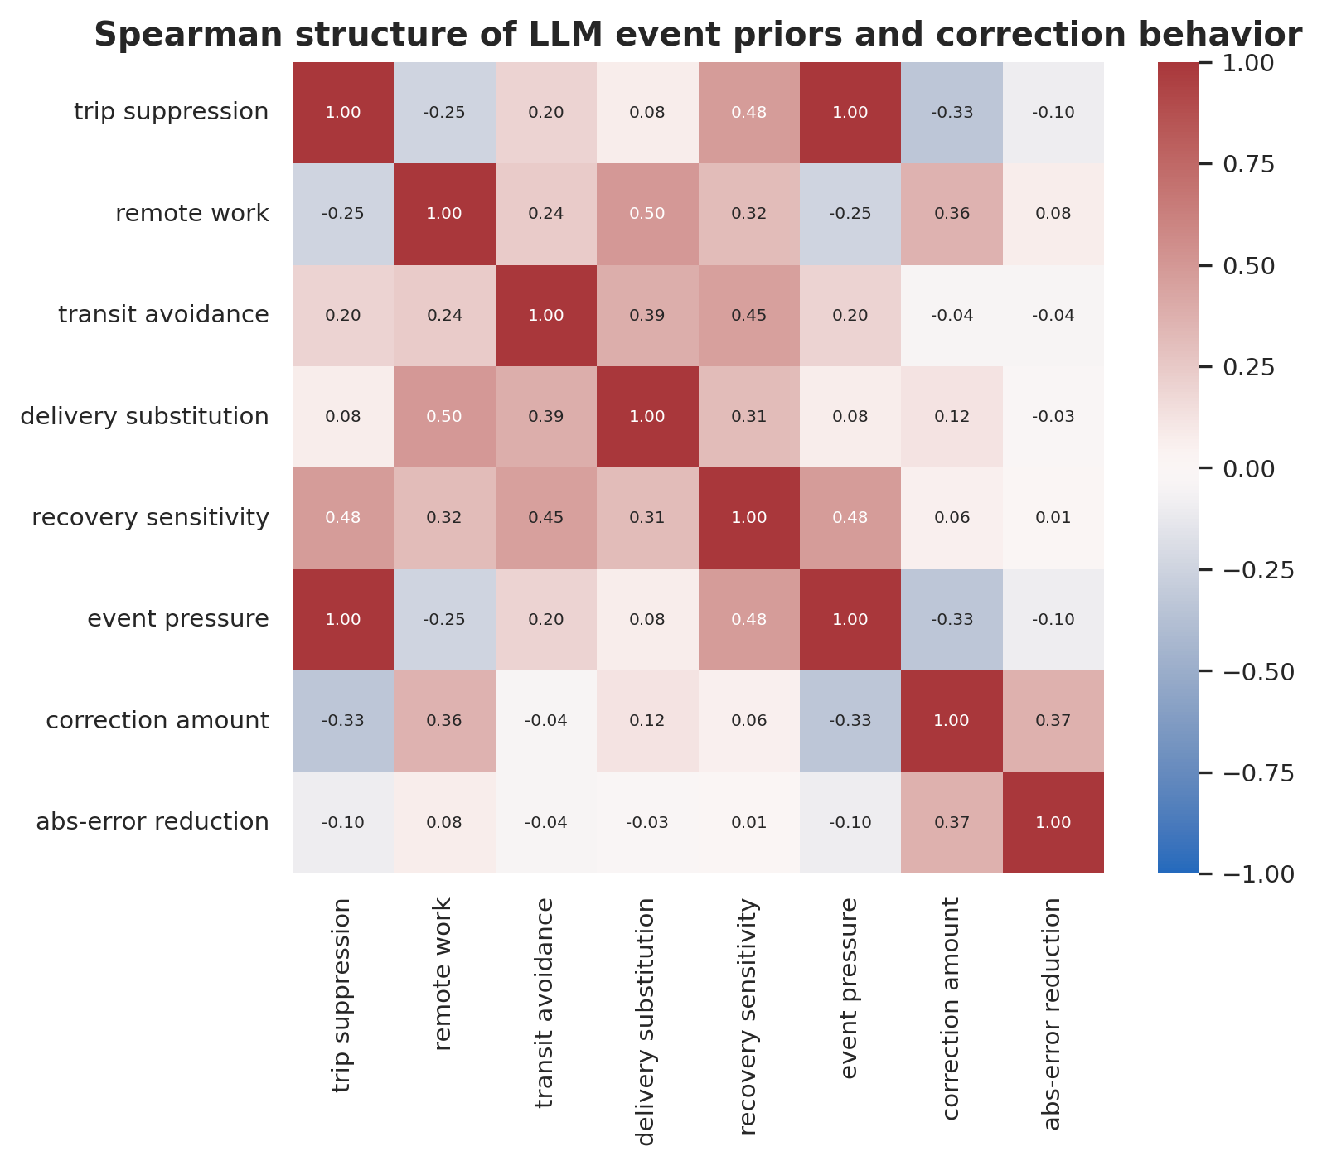
PRE FOR Big Data and Urban Planning
07
事件异质性 / Event Heterogeneity
论文图3：LLM prior 是否真的在表达疫情机制
这页的故事是：LLM event pressure 不是装饰变量。它在不同 pressure strata 中都能带来修正，并且内部 prior 之间有可解释的相关结构。
The event-prior structure is auditable: pressure-stratified gains and prior correlations show semantic consistency rather than arbitrary numerical fitting.
Pandemic-Aware Household Travel Behavior Prediction
11 / 19

Slide 12
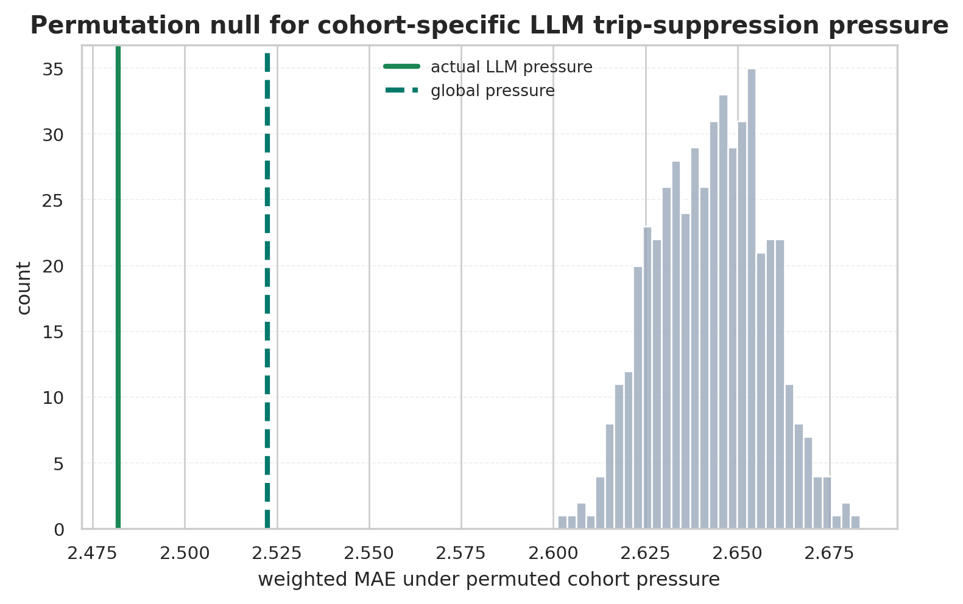
PRE FOR Big Data and Urban Planning
07A
对抗性审计 / Adversarial Audit
主动回应审稿人最可能质疑的地方
审计结论：真实 LLM cohort pressure 明显优于 500 次随机置换，但 global event pressure 本身也很强，所以不能把贡献夸大成强个体化 LLM 预测。
Audit verdict: cohort-specific LLM pressure beats permutation controls, but global event downscaling explains much of the gain; the defensible claim is label-free event adaptation.
Reviewer concern
Answer
Is global rule enough?
Strong baseline; LLM ranking adds incremental value
Is it label leakage?
LLM inputs exclude target, weights, and IDs
Can LLM replace model?
No; hybrid beats LLM-only
Is mode solved?
No; transit-specific extension only
Pandemic-Aware Household Travel Behavior Prediction
12 / 19

Slide 13
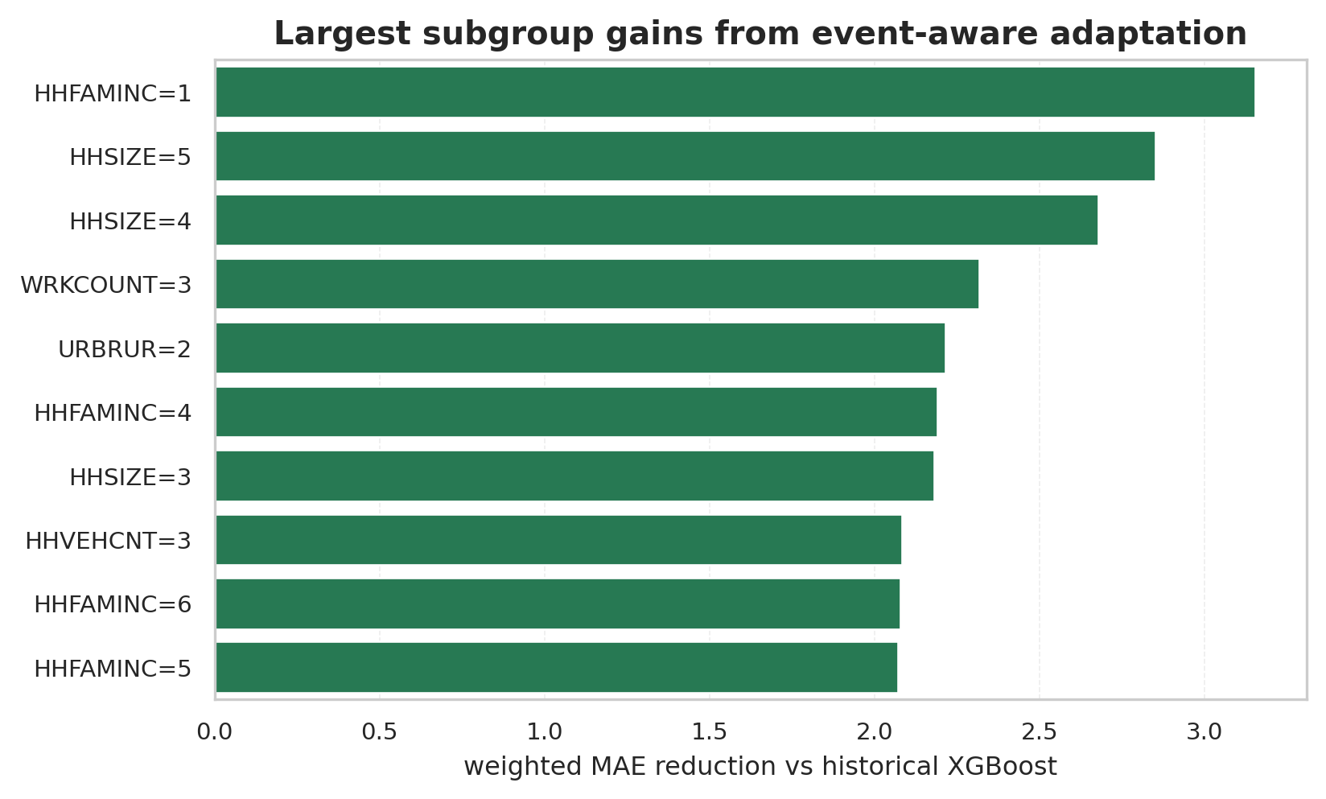
PRE FOR Big Data and Urban Planning
07B
分组鲁棒性 / Subgroup Robustness
论文图4：哪些家庭群体从事件修正中获益更多
这张图用于回答老师可能会问的 fairness / heterogeneity 问题：提升不是只来自一个总体均值，而是在多个 household subgroup 中都能观察到。
The subgroup view reframes the result as heterogeneous adaptation, which is more convincing than only reporting one aggregate test-set metric.
How to present
Caveat
Use it as diagnostic evidence
not a causal subgroup claim
Focus on broad gain pattern
codes need explanation in appendix
Connect to planning
which household segments are harder
Pandemic-Aware Household Travel Behavior Prediction
13 / 19

Slide 14
PRE FOR Big Data and Urban Planning
08
误差洞察 / Error Insight
主收益来自消除 post-pandemic over-prediction
Exact rounded
Within 2 trips
Within 3 trips
Best sensitivity
17.7%
54.5%
71.2%
2.482
household accuracy
practical tolerance
broad tolerance
wMAE, not main claim
Weighted bias comparison
Observation
Interpretation for paper story
Historical mean
+4.50
XGBoost has strong household signal but positive bias
routine mobility from history is too high for 2022
Ordinary XGBoost
+3.61
LLM-only improves direction but lacks calibration
event semantics alone cannot replace household baseline
Trend / indicator
+3.35
Hybrid gated is nearly unbiased
separating routine demand and event response is the key design
LLM-only pressure
-0.37
Hybrid gated
-0.02
0
Pandemic-Aware Household Travel Behavior Prediction
14 / 19

Slide 15
PRE FOR Big Data and Urban Planning
09
LLM 的角色 / What the LLM Adds
事件方向有用，但需要和 household baseline 结合
low event semantics
high event semantics
weak household grounding
Historical mean
LLM-only pressure
neither household heterogeneity nor event semantics wMAE 5.51
event direction without household baseline wMAE 2.72
Ordinary XGBoost
Hybrid gated
strong household grounding
household grounding without pandemic semantics wMAE 4.34
household baseline + event prior wMAE 2.50
Paper sentence
LLM is not a black-box travel model; it is a semantic event adapter for rare temporal shocks.
Pandemic-Aware Household Travel Behavior Prediction
15 / 19

Slide 16
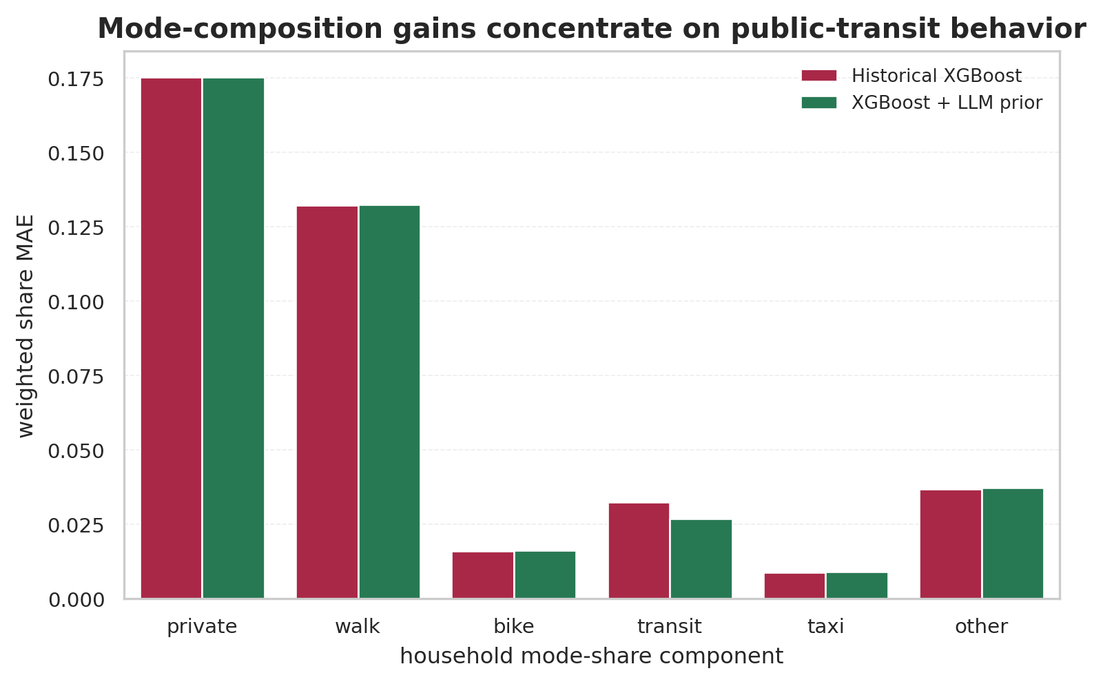
PRE FOR Big Data and Urban Planning
10
方式结构扩展 / Mode Composition Extension
同一个事件先验也能解释 transit-specific shift
private
walk
bike
transit
taxi
other
household mode-share vector
Method
weighted TV
transit MAE
Interpretation
Historical XGBoost
0.2008
0.0325
routine mode pattern
XGBoost + LLM transit prior
0.1985
0.0269
event-aware transit correction
Improvement
1.1%
17.4%
clearer on transit
方式结构的总体提升不如出行次数大，但 transit component 明显改善，正好对应疫情期间公共交通规避这个机制。
Mode composition is a weaker but useful extension: transit-share improvement supports the semantic validity of the COVID event prior.
Pandemic-Aware Household Travel Behavior Prediction
16 / 19

Slide 17
PRE FOR Big Data and Urban Planning
11
可扩展性与审计 / Scalability and Auditability
Cohort prompting makes LLM use measurable and reviewable
7,893 households
1,327 cohorts
15 concurrency
validated JSON
fixed adapter
2022 rows
aggregated profiles
full generation setting
normalized priors
reproducible output
Request reduction
Invalid records
Re-runnable
83.2%
0
Yes
5.95x fewer prompts
after validation
fixed adapter rule
Risk
Control
LLM hallucination
structured schema + numeric range validation
target leakage
no target labels / weights / household IDs in prompt
cost explosion
cohort-level prompting instead of per-household prompting
unreproducible tuning
main rule uses fixed no-label parameters
Pandemic-Aware Household Travel Behavior Prediction
17 / 19

Slide 18
PRE FOR Big Data and Urban Planning
12
学术故事 / Academic Story
From a course project to a defensible paper narrative
Contribution
Why it matters
Event-driven temporal adaptation framing
turns 2022 prediction into a distribution-shift research problem
LLM as event-prior generator
uses LLM generalization without asking it to hallucinate exact labels
Label-free hybrid adapter
separates routine travel demand from pandemic response
Behavior-system output
covers both trip generation and mode composition
Current limitation
How to discuss it honestly
Cohort heterogeneity gain is smaller than global event downscaling
the strongest signal is event-level trip suppression
Mode-composition gain is concentrated in transit
this is expected because transit avoidance is the clearest COVID channel
No prospective external event feed yet
future work can use news/mobility indices available before survey release
Pandemic-Aware Household Travel Behavior Prediction
18 / 19

Slide 19
PRE FOR Big Data and Urban Planning
END
总结 / Final Takeaway
A clean story: routine mobility + event semantics
我们研究的不是“LLM 直接预测出行次数”，而是： 当 2022 疫情后分布变化打破历史连续性时，能否用 LLM 的事件泛化能力，为传统 household travel model 提供无标签修正先验。
Accuracy
Bias
Scope
LLM role
-42.3%
-0.023
2 tasks
adapter
weighted MAE
weighted bias
trip count + modes
not standalone predictor
Suggested one-sentence claim
LLM event priors enable label-free adaptation of household travel behavior prediction under rare post-pandemic temporal shift.
Pandemic-Aware Household Travel Behavior Prediction
19 / 19

