Slide 1
Pandemic-Aware Household Travel Behavior Prediction
LLM event priors for label-free adaptation under post-pandemic shift
Trip-count MAE
-42.3%
primary gated rule
Bias
-99.4%
gated correction absolute bias
LLM calls
-83.2%
cohort prompting
NHTS LLM Event Adaptation | 1

Slide 2
What this project predicts
A household-level travel behavior prediction system
Output | Target | Granularity | Metric family | Role in system
Trip generation | CNTTDHH | Household | MAE / RMSE / Bias / R2 | How many trips
Mode composition | Mode shares | Household | TV / share MAE / dominant mode | How trips are distributed
Mode-specific trips | Trips by mode | Household | Derived count error | How many trips by each mode
The project predicts household travel behavior as trip volume plus mode structure.
The LLM contribution is label-free event adaptation under a 2022 pandemic shift.
NHTS LLM Event Adaptation | 2

Slide 3
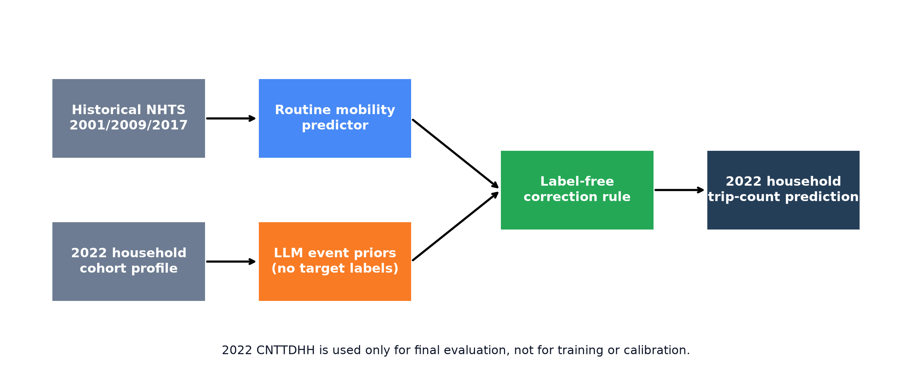
Experimental guardrail
2022 labels are evaluation-only in the main setting
LLM sees cohort attributes and pandemic-response context, not 2022 trip-count labels.
NHTS LLM Event Adaptation | 3

Slide 4
Trip-count methods
What each row means
Method | Uses 2022 labels? | LLM? | Purpose
Historical predictor | No | No | Routine mobility baseline
Historical trend shift | No | No | Mean-trend control
LLM-only pressure | No | LLM only | No household predictor
Zero-shot rule tree | No | LLM-authored | Cold-start ablation
Rule + 500 history | No | LLM rules + data | Small-data bridge
Global event prior | No | Only global mean | Event-level downscaling control
Random prior control | No | Shuffled scores | Negative control
Gated LLM correction | No | Cohort-specific when confident | Primary no-label rule
NHTS LLM Event Adaptation | 4

Slide 5
Trip-count comparison
Weighted metrics on 2022 households
Method | MAE | RMSE | Bias | R2 | MAE gain
Historical predictor | 4.338 | 5.317 | 3.605 | -0.637 | 0.0%
Historical trend shift | 4.150 | 5.146 | 3.348 | -0.533 | 4.3%
LLM-only pressure | 2.718 | 3.988 | -0.373 | 0.079 | 37.4%
Zero-shot LLM rule tree | 2.751 | 3.783 | 0.500 | 0.171 | 36.6%
Zero-shot pseudo-label tree | 2.777 | 3.820 | 0.500 | 0.155 | 36.0%
LLM rule + 500-history calibration | 2.772 | 3.823 | 0.463 | 0.154 | 36.1%
Global event prior | 2.522 | 3.743 | -0.748 | 0.189 | 41.9%
Random prior control | 2.647 | 3.881 | -0.637 | 0.128 | 39.0%
Gated LLM correction | 2.502 | 3.604 | -0.023 | 0.248 | 42.3%
Primary no-label gated rule: MAE 2.502, bias -0.023.
LLM-only pressure: MAE 2.718; hybrid keeps household-level baseline.
Parameter-sweep sensitivity rows are kept out of the public method comparison.
NHTS LLM Event Adaptation | 5

Slide 6
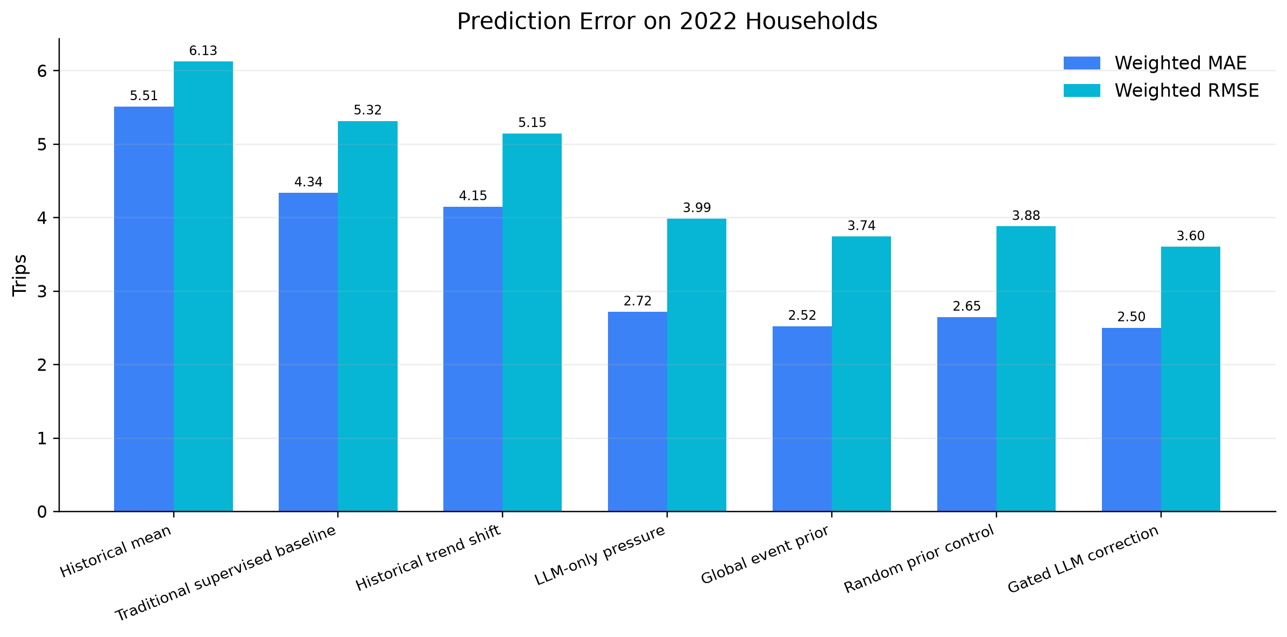
Trip-count error drops sharply
LLM event priors repair the 2022 overprediction
NHTS LLM Event Adaptation | 6

Slide 7
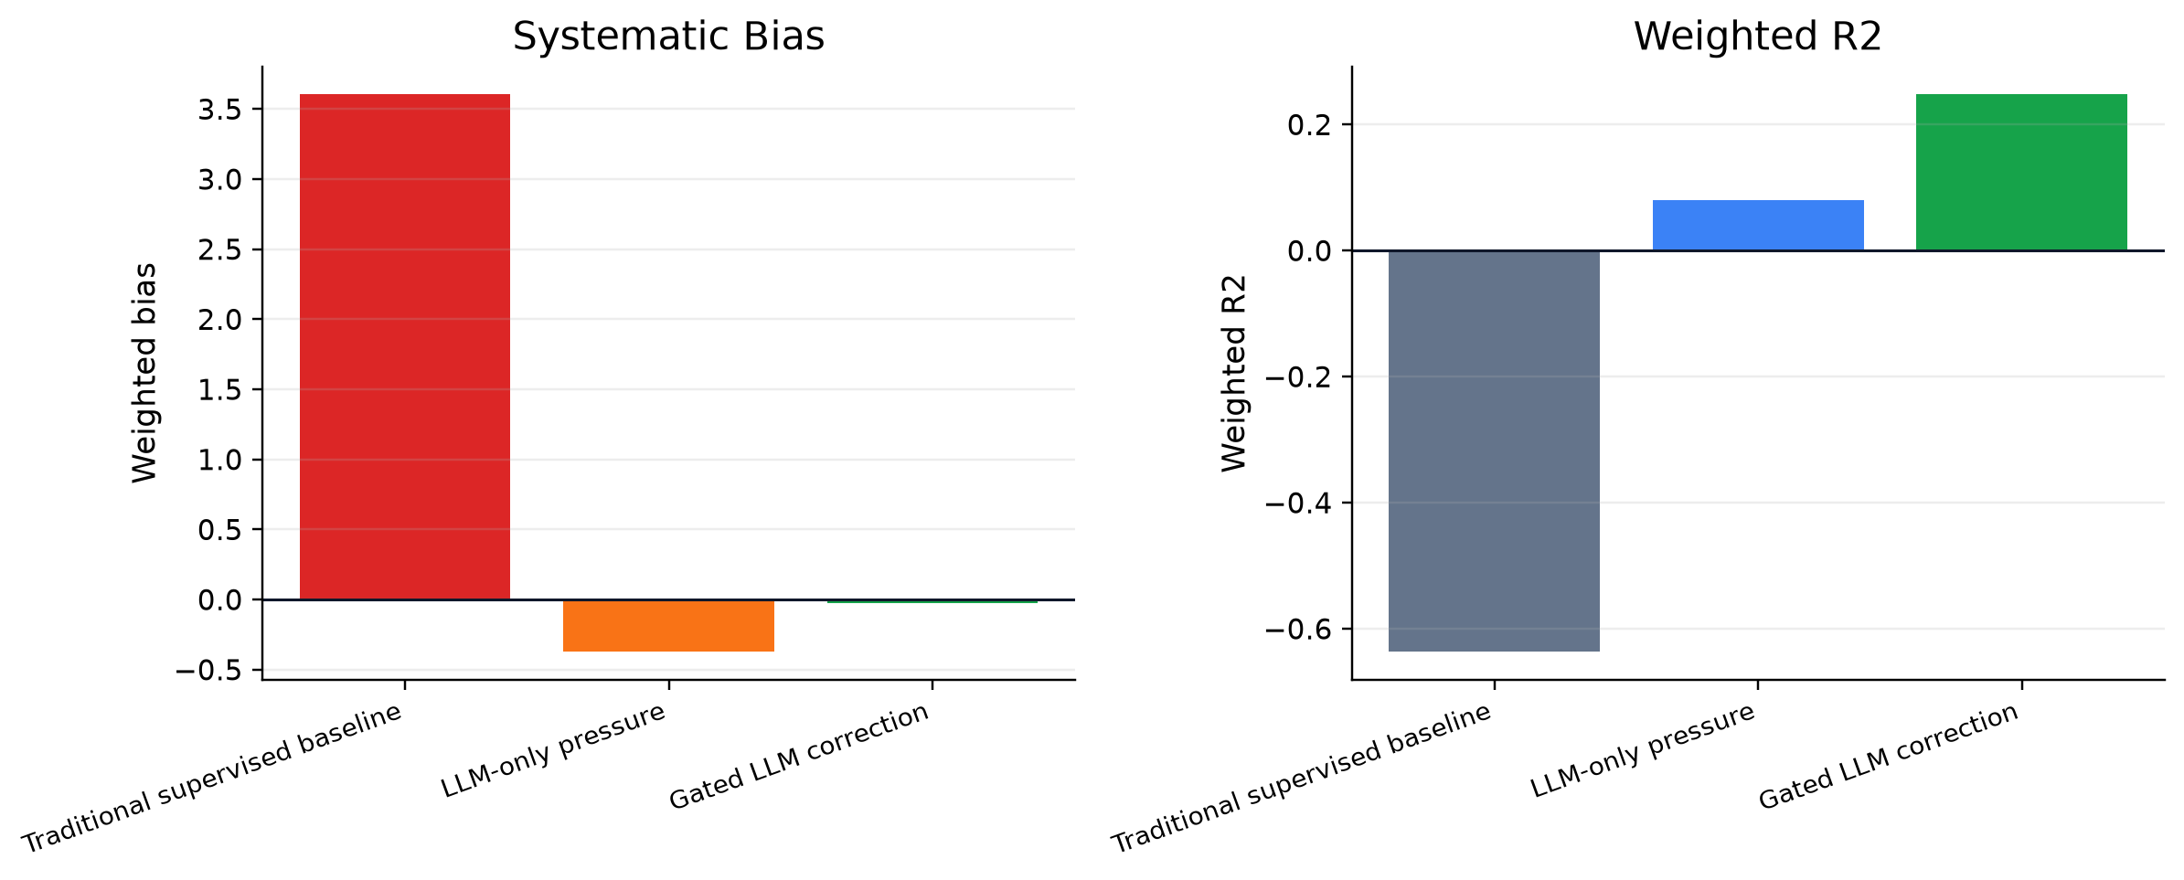
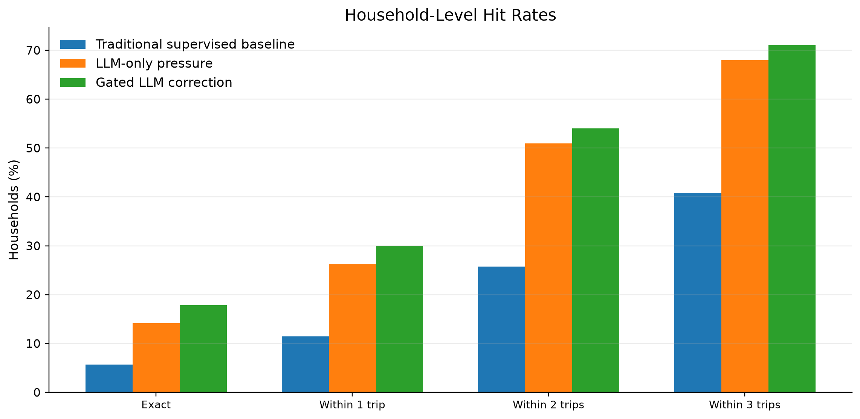
Bias and household-level interpretation
Accuracy bands make the regression result tangible
Gated MAE: 2.48 trips per household.
Within 2 trips: 54.0%; within 3 trips: 71.1%.
NHTS LLM Event Adaptation | 7

Slide 8
Mode-composition extension
What changed besides trip counts?
Component | Definition
Private vehicle | Car / van / SUV / pickup / motorcycle / rental vehicle
Walk / bike | Non-motorized travel modes
Transit | Public bus / rail / ferry / paratransit categories
Taxi / ridehail | Taxi, limo, Uber/Lyft-style services
Other | School bus, airplane, other specified modes
2017 and 2022 TRPTRANS codes are mapped with year-specific official codebooks.
NHTS LLM Event Adaptation | 8

Slide 9
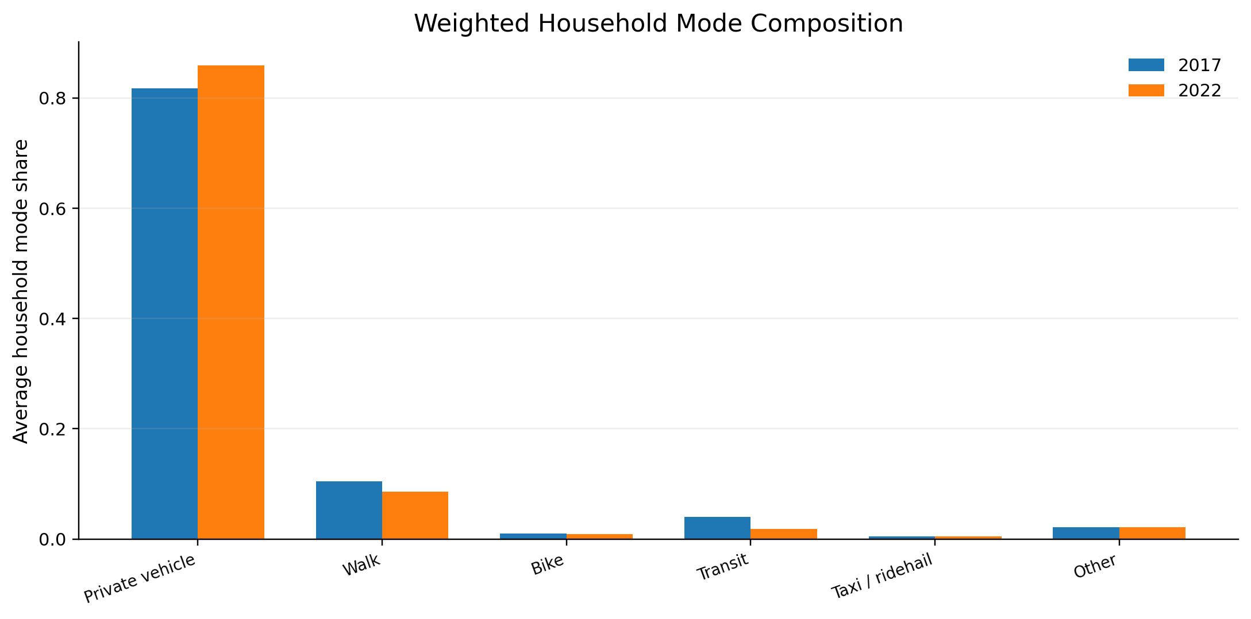
Mode distribution shift
2022 has fewer trips and lower transit share
NHTS LLM Event Adaptation | 9

Slide 10
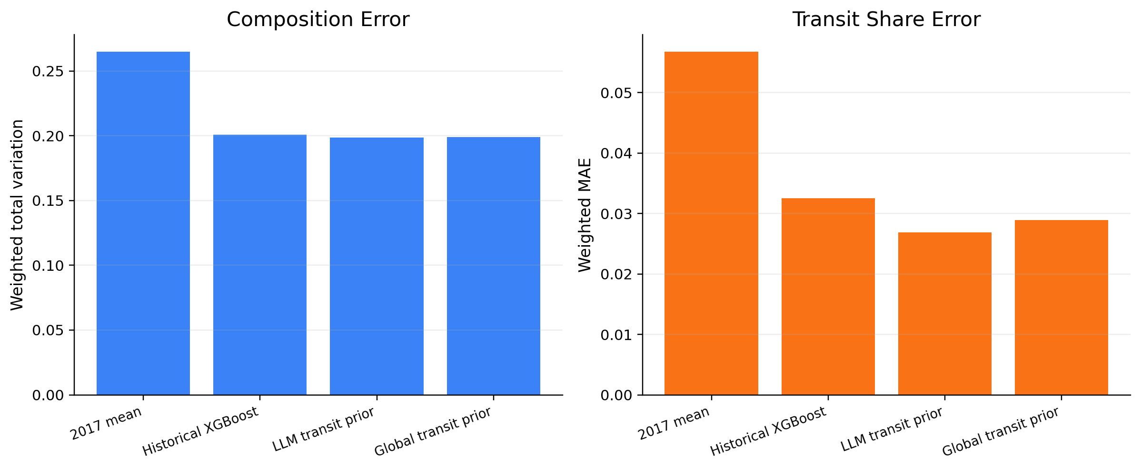
Mode-composition method comparison
LLM helps the transit component of household behavior
Transit-share weighted MAE: 0.0325 -> 0.0269.
Overall mode-composition gain is small, while the transit component shows a clearer pandemic-related signal.
NHTS LLM Event Adaptation | 10

Slide 11
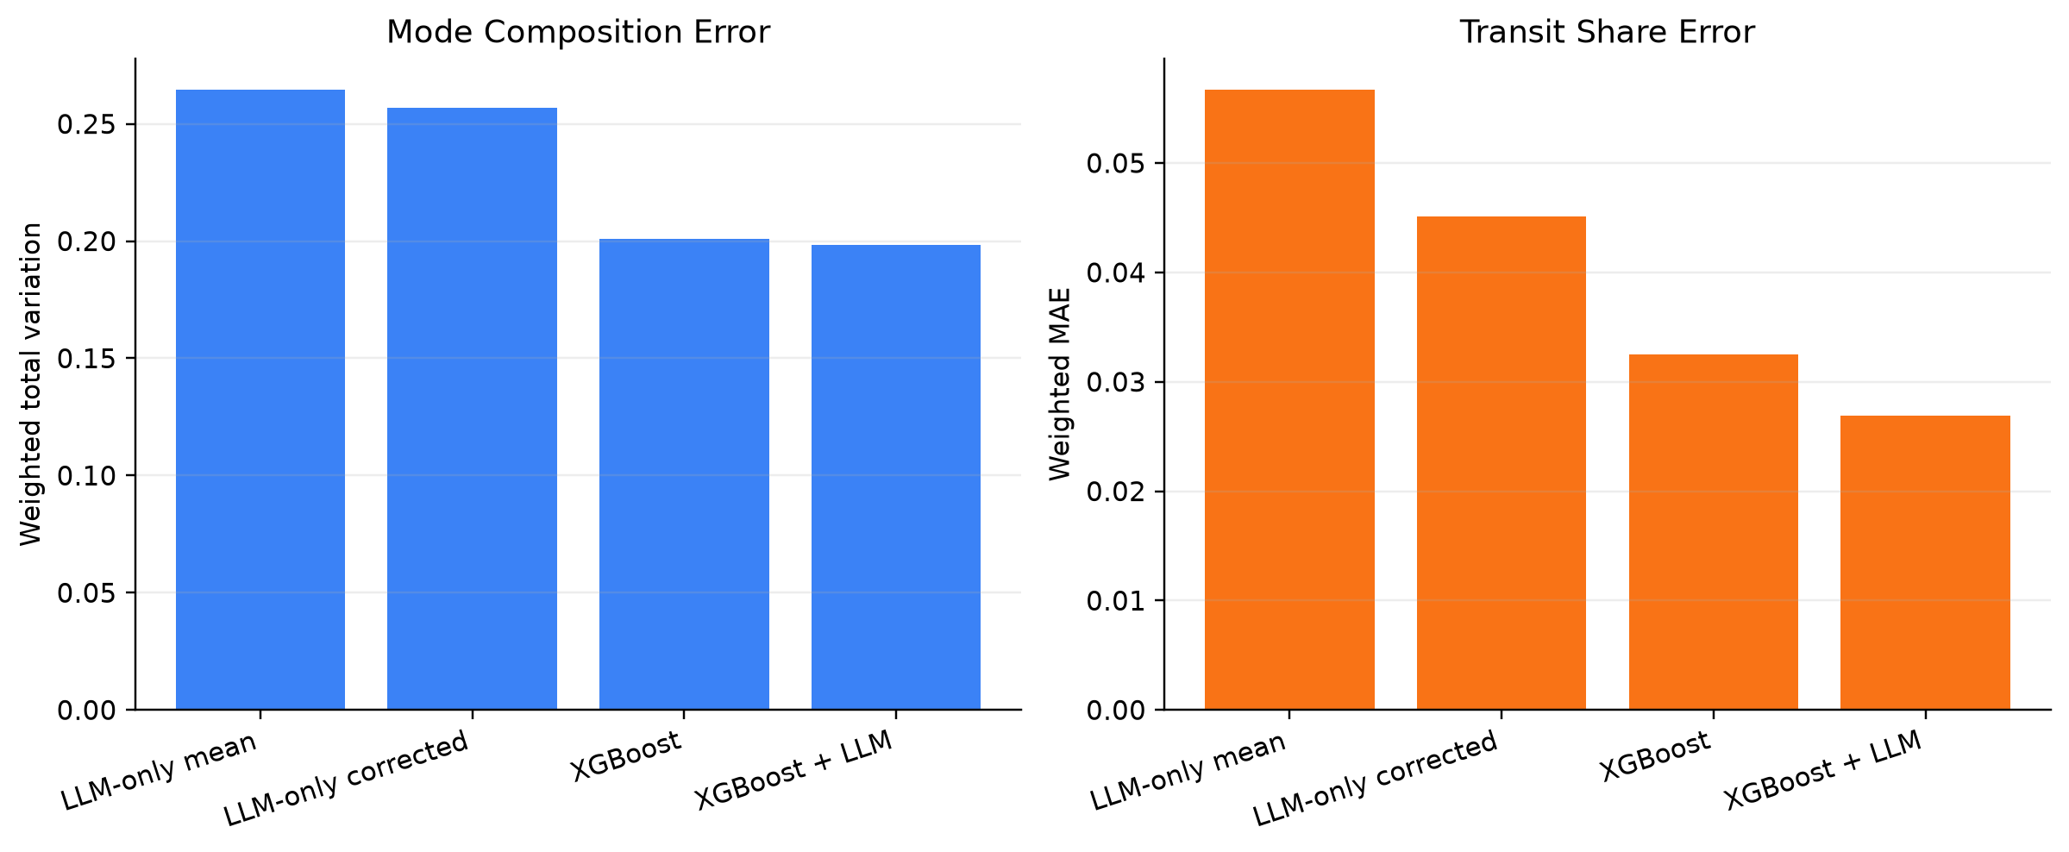
Pure LLM-style baseline
LLM direction alone helps, but it does not replace household predictors
LLM-only corrected transit MAE: 0.0451.
XGBoost + LLM transit MAE: 0.0269.
NHTS LLM Event Adaptation | 11

Slide 12
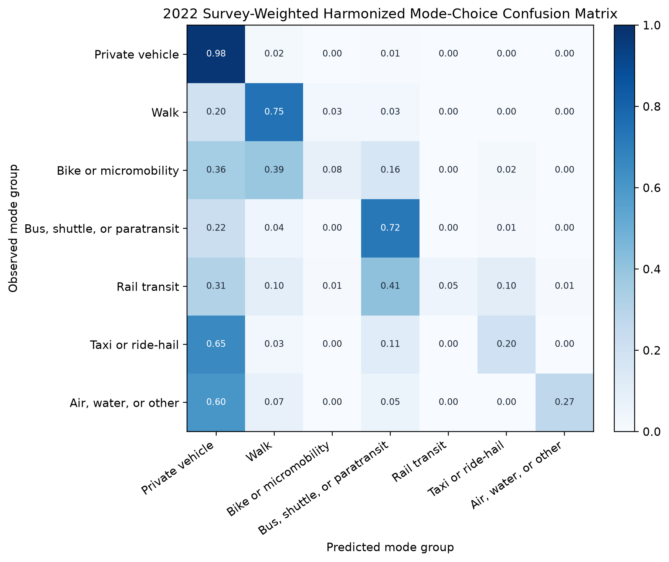
Trip-level mode-choice transfer
Harmonized MODE_GROUP avoids raw TRPTRANS code mismatch
Model | Weighted acc. | W-balanced acc. | W-macro F1
Survey-weighted XGB | 0.9297 | 0.4343 | 0.4663
Class-balanced | 0.7852 | 0.5501 | 0.3722
Train on 2017 labels; use 2022 labels only for final evaluation.
Accuracy is high because private vehicle dominates.
Macro F1 and the confusion matrix expose rare-mode limitations.
NHTS LLM Event Adaptation | 12

Slide 13
Metric guide
How to read the numbers
Metric | Task | Meaning
Weighted MAE | Trip count | Average absolute trip-count error
Weighted Bias | Trip count | Systematic over/under prediction
Within-k | Trip count | Households within k trips
Weighted TV | Mode composition | Whole share-vector error
Transit-share MAE | Mode composition | Public-transit share error
Lower is better for errors; bias closer to zero is better; R2 and accuracy are higher-is-better.
NHTS LLM Event Adaptation | 13

Slide 14
What the LLM contributes
Event semantics, not direct numerical prediction
The historical predictor learns routine household mobility from NHTS.
The LLM supplies post-pandemic event priors: trip suppression, remote work, transit avoidance, delivery substitution, recovery sensitivity.
The LLM-only pressure baseline improves over naive history but is weaker than the hybrid model.
Global controls show that broad event downscaling is strong.
Random controls and subgroup diagnostics show that cohort-specific LLM ranking adds smaller but measurable signal.
NHTS LLM Event Adaptation | 14

Slide 15
Caveats
What we should not overclaim
Do not claim that LLM directly predicts household trip counts.
Keep parameter-sweep sensitivity rows in appendix/internal analysis, not in the main comparison.
Present trip generation and mode composition as two household-level outputs, not as separate projects.
Mode composition and trip-level mode choice add behavior-system evidence, but rare modes remain harder.
Future work should add external event context, stronger LLM priors, and prospective validation.
NHTS LLM Event Adaptation | 15

Slide 16
Final takeaway
A defensible story for the course project
Primary trip-count rule
-42.3%
gated weighted MAE reduction
Bias
-99.4%
gated absolute bias reduction
Transit-share error
-17.4%
mode-structure result
LLMs are most useful here as event-prior generators.
The best model is not pure LLM and not pure historical prediction; it is a label-free hybrid adapter.
NHTS LLM Event Adaptation | 16

