Slide 1
Label-Free LLM Event Adaptation
Post-pandemic household travel prediction with no 2022 training labels
Weighted MAE
-42.3%
primary gated rule
Weighted Bias
-99.4%
gated absolute bias reduction
LLM Requests
-83.2%
cohort-level generation
NHTS 2022 Event Adaptation | 1

Slide 2
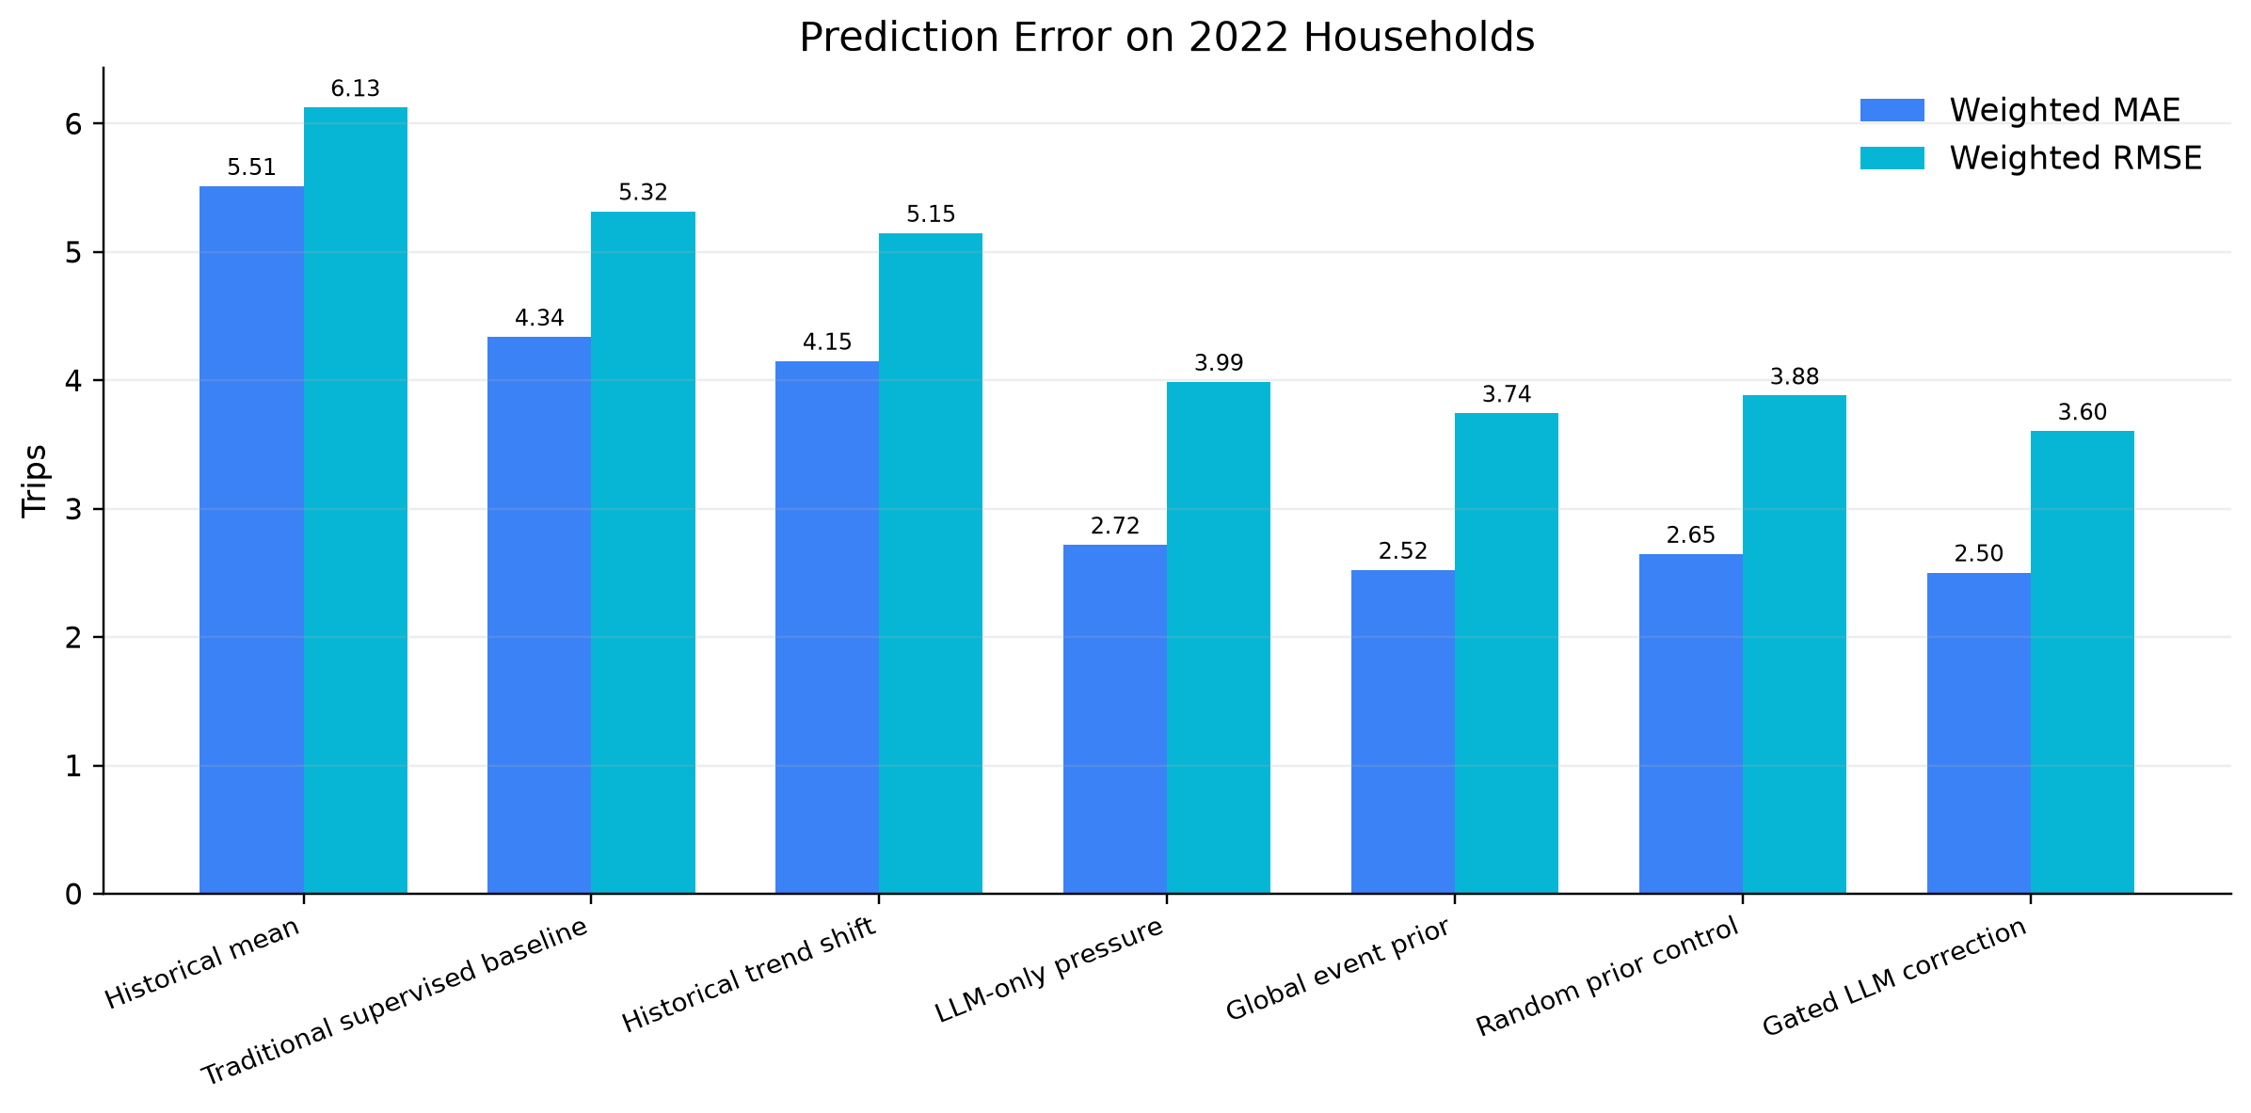
Problem: 2022 breaks routine mobility continuity
Pre-pandemic historical waves learn routine household mobility.
COVID-era recovery changed commuting, shopping, transit use, and discretionary activity.
The target is household daily trip count, evaluated on 7,893 2022 households.
NHTS 2022 Event Adaptation | 2

Slide 3
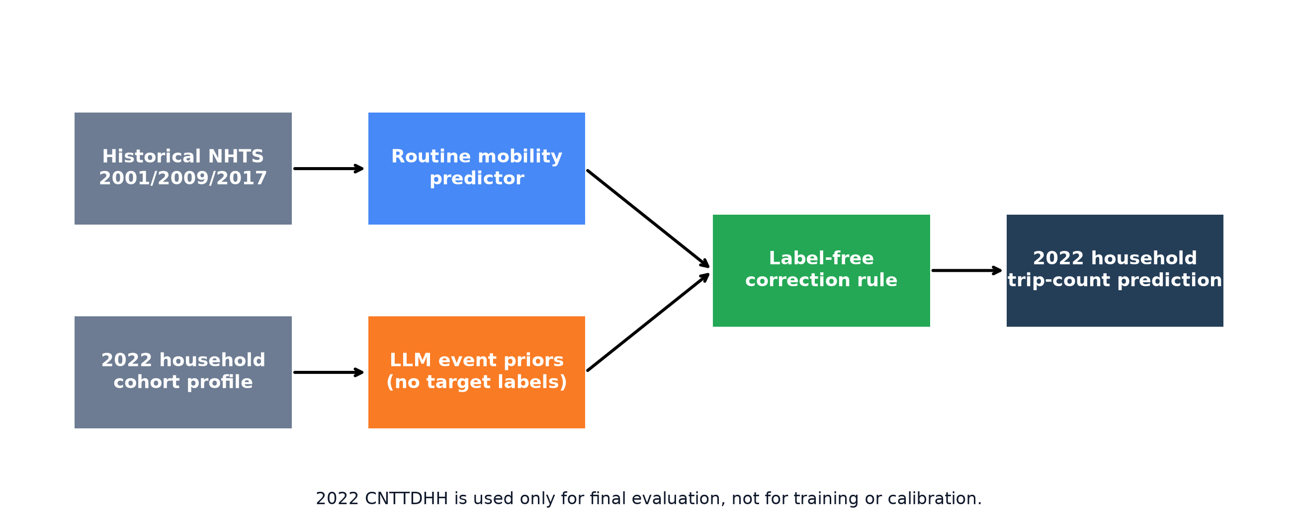
Research question
Can event semantics repair 2022 prediction without target-year labels?
No 2022 CNTTDHH labels are used for training or calibration.
LLM is not used as a direct numerical predictor.
LLM generates structured pandemic-response priors for household cohorts.
NHTS 2022 Event Adaptation | 3

Slide 4
Method overview
Distill LLM event semantics into a lightweight correction rule
Final rule: prediction = routine prediction × clip(1 - alpha × event pressure, min_factor, 1)
NHTS 2022 Event Adaptation | 4

Slide 5
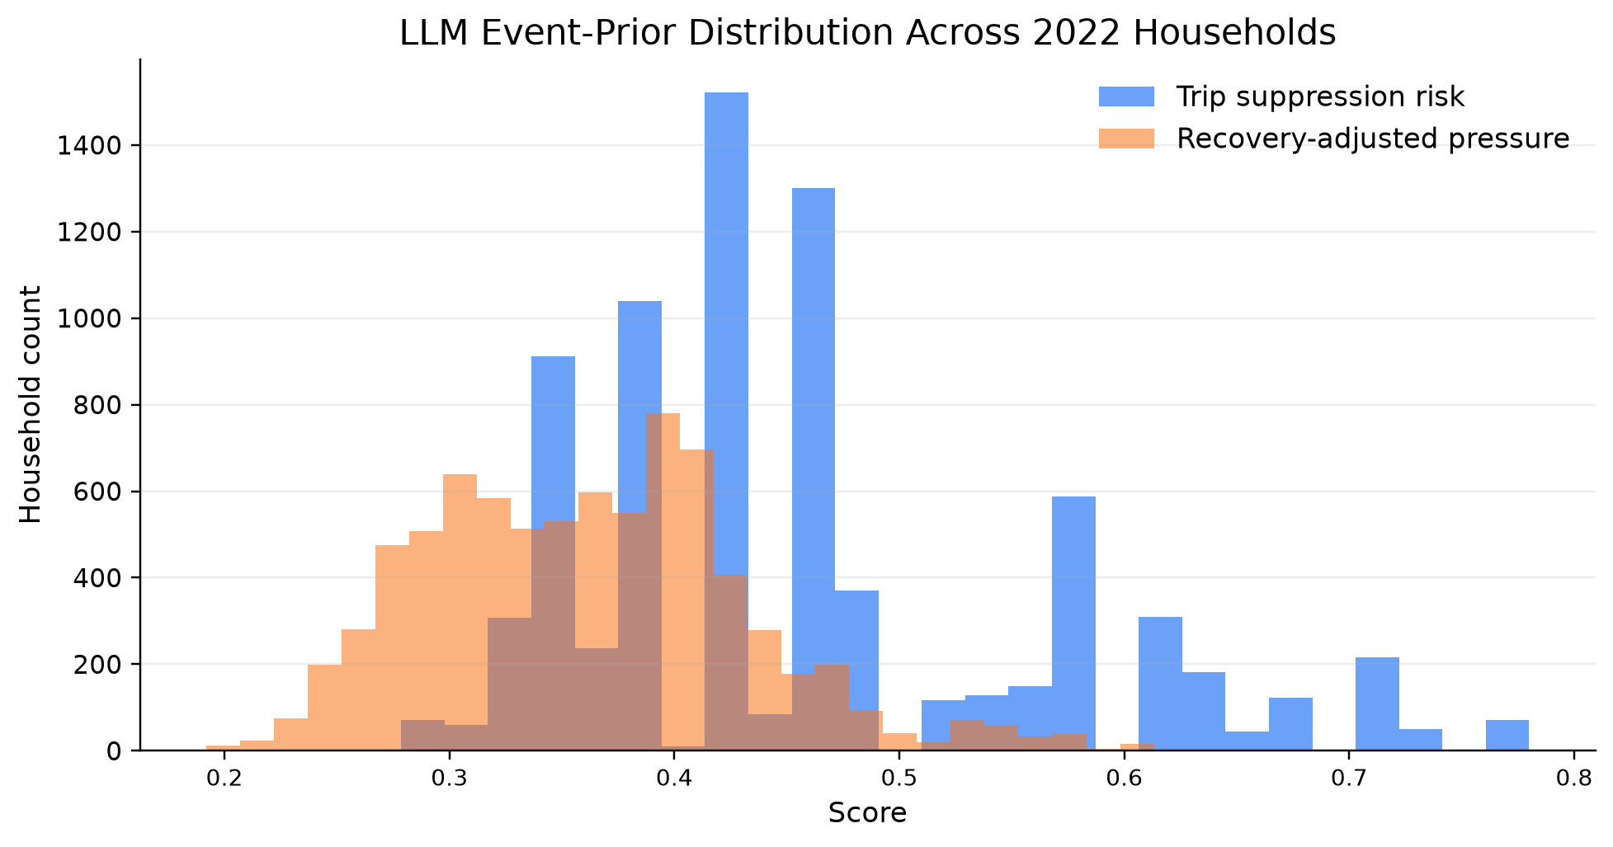
LLM event priors
Cohort-level generation improves cost and auditability
1,327 cohort prompts cover 7,893 households.
Request reduction: 83.2%, about 5.95x fewer calls.
Primary useful feature: trip_suppression_risk.
NHTS 2022 Event Adaptation | 5

Slide 6
Main result
Fixed gated LLM event prior sharply reduces household prediction error
NHTS 2022 Event Adaptation | 6

Slide 7
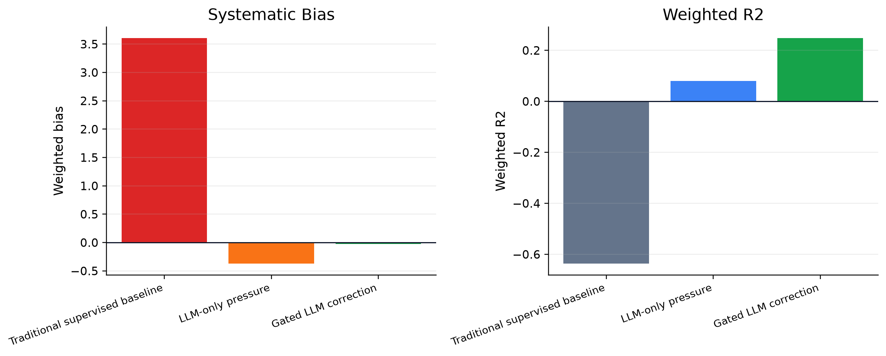
Bias and distributional fit
Gated correction is nearly unbiased
NHTS 2022 Event Adaptation | 7

Slide 8
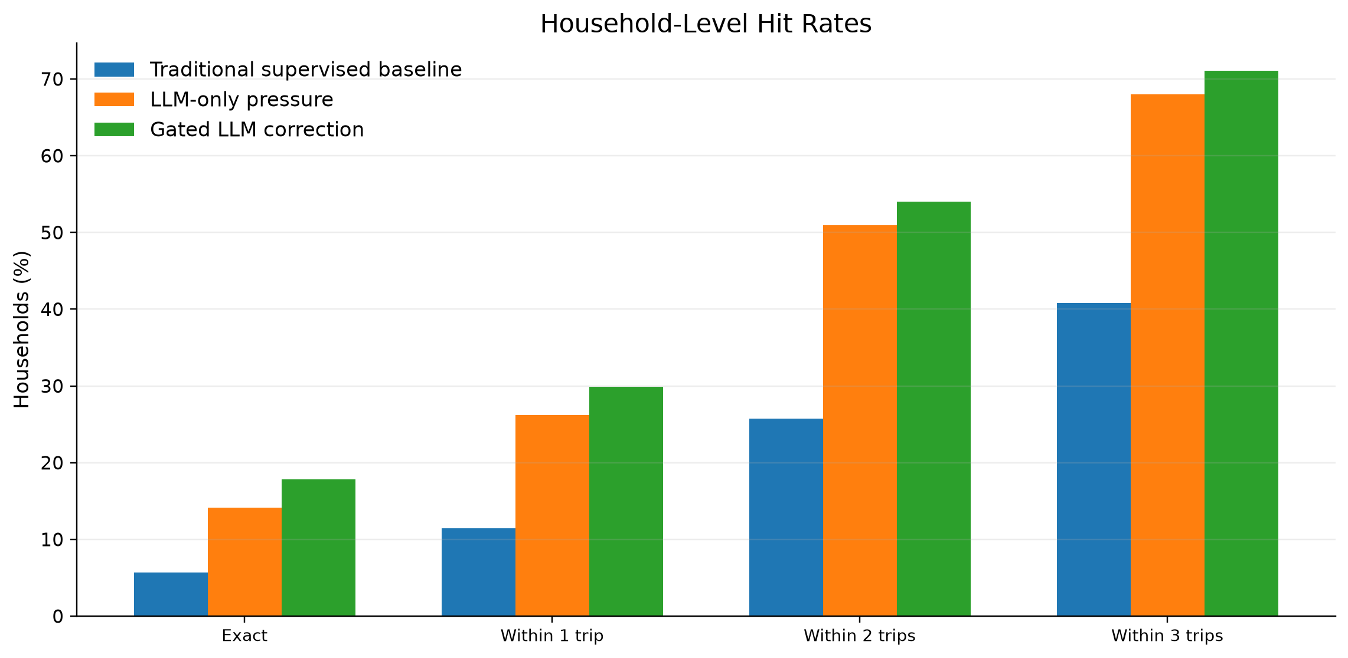
Household-level accuracy
Interpret regression results with tolerance bands
Gated correction: MAE 2.48; 54.0% within ±2 trips; 71.1% within ±3 trips.
NHTS 2022 Event Adaptation | 8

Slide 9
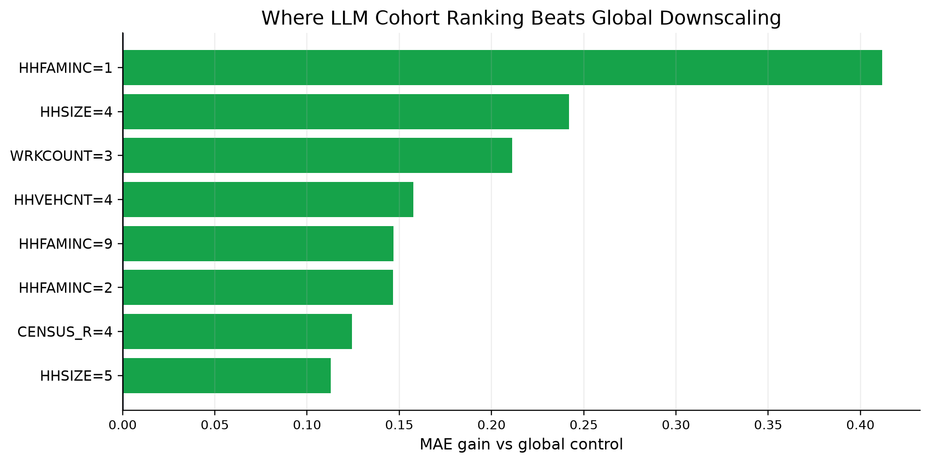
Diagnostics
Event-level downscaling is the main effect; cohort ranking adds local signal
Global controls are strong: the pandemic shift is a broad event-level effect.
Random controls are weaker than structured event adaptation.
Subgroup gains show where cohort-specific ranking adds value.
NHTS 2022 Event Adaptation | 9

Slide 10
Takeaway
LLMs are useful as event-prior generators, not direct trip-count predictors
Contribution: label-free event adaptation for post-pandemic travel demand.
Accuracy: primary weighted MAE reduction 42.3%; near-zero weighted bias.
Bias: primary gated correction reduces absolute weighted bias by 99.4%.
Efficiency: cohort prompting reduces LLM requests by 83.2%.
Future work: stronger priors, external event context, and prospective validation.
NHTS 2022 Event Adaptation | 10

