Slide 1
HaN SPRINT II
HEALTH & NUTRITION APPLICATION
KEVIN KEMMERER
MIKE DESCH
THANG HUYNH
KEVIN HER
LIBAN SALAD

Slide 2
Opportunity Statement
OS: Websites are a place where people go to look for information they might be interested in. There is room for error and bias in some of the current health and nutrition websites with their only purpose being to make money off advertisements and vulnerable people. The opportunity that this Health and Dietary Application aims to fulfill is to help these people by having one area where someone is able to find and customize all of their dietary needs.
Goals:
1.) Help people manage their dietary plans and make informed decisions
2.) Display detailed information and nutritional values of different food items
3.) Create a user inviting website that is simple but displays useful information
4.) Receive funding and support for continued implementation

Slide 3
Vision & Scope
Business Objectives and Success Criteria
BO-1: Provide somewhere that has current and reliable macronutrient information.
BO-2: Reduce false information about diets and allow that to be accessible for everyone.
BO-3: Create a user friendly experience that will attract customers so that our project receives support and funding.
SC-1: Having people that are interested in improving their lifestyle be able to get access to the current information on the website.
SC-2: Achieve and increase the number of satisfied customers who have improved their lifestyle by visiting our website and using our software

Slide 4
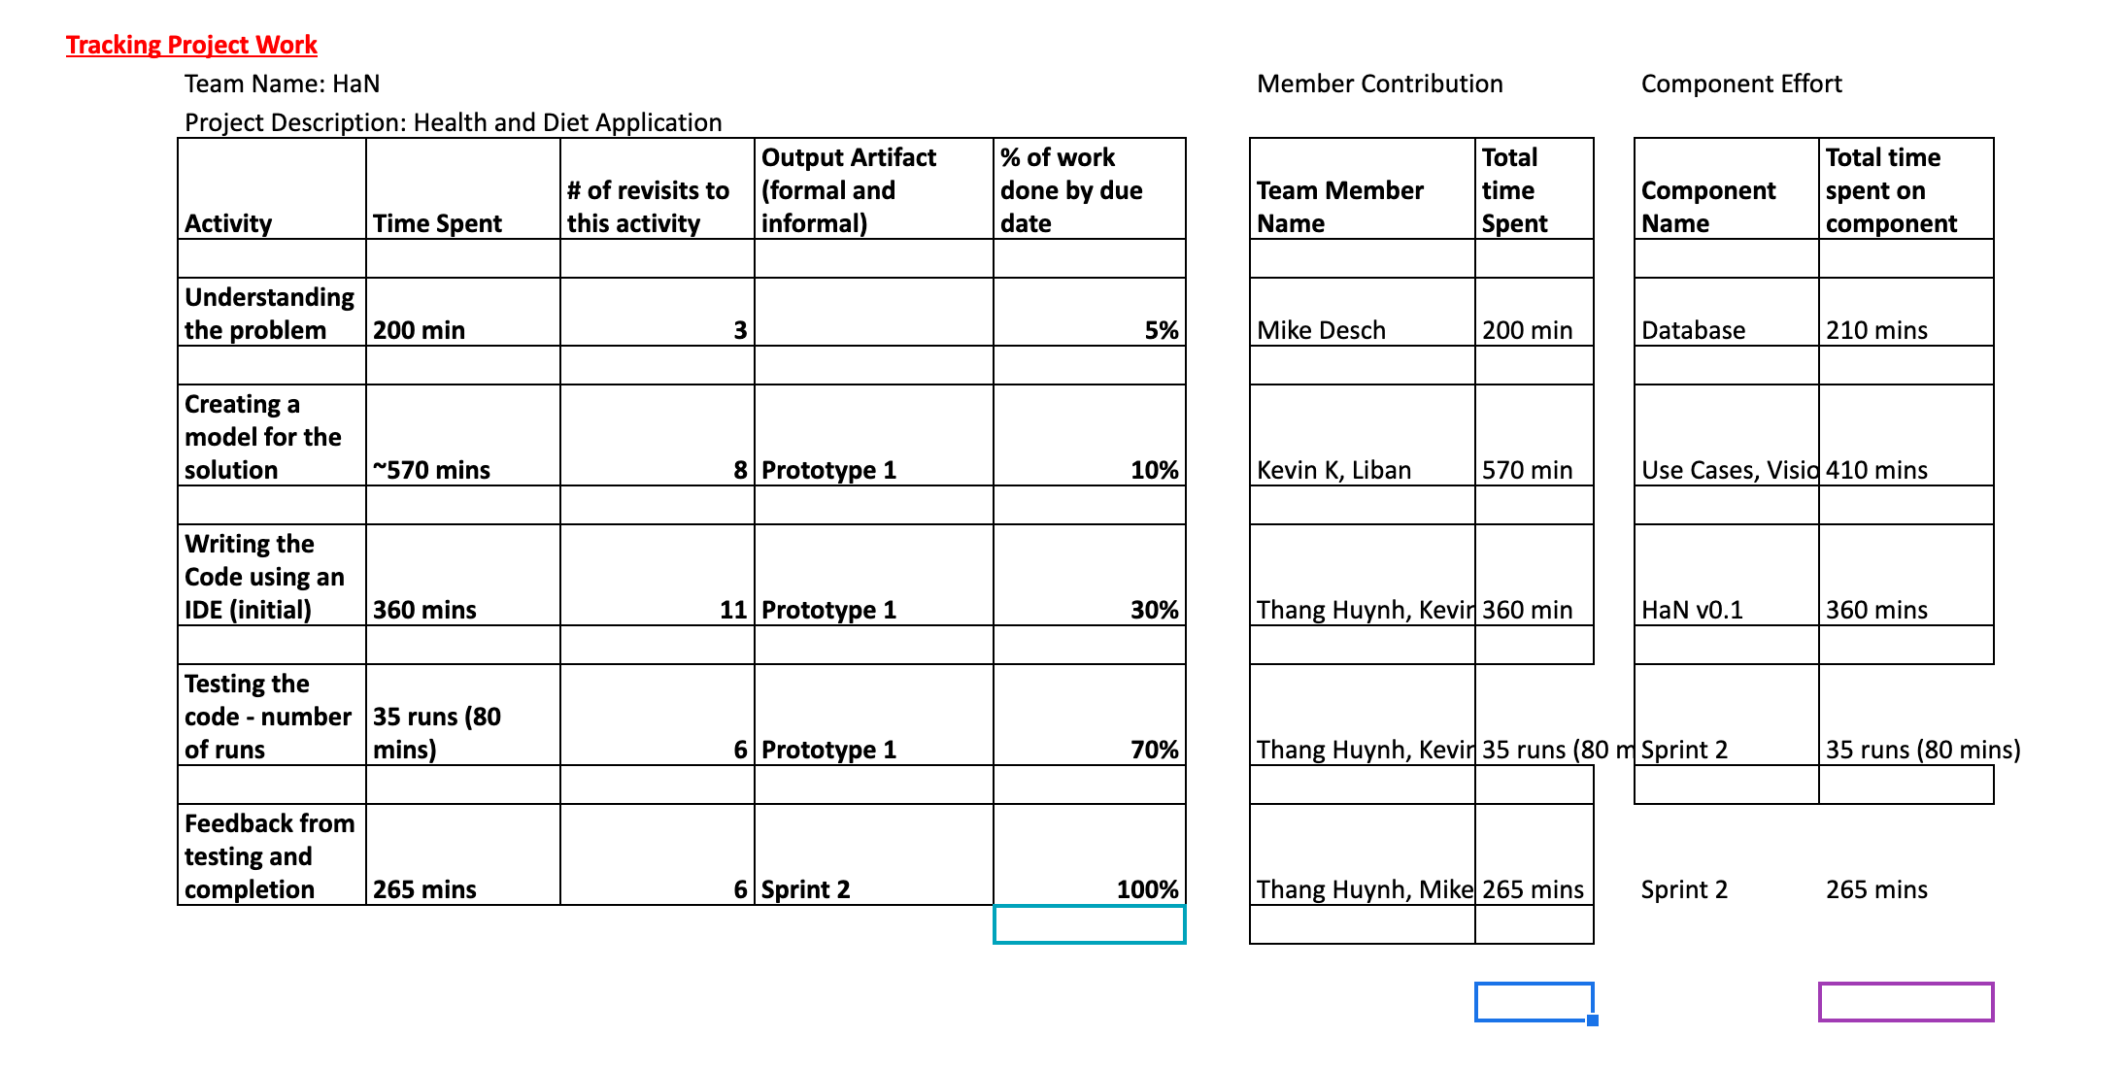
Scum dashboard

Slide 5
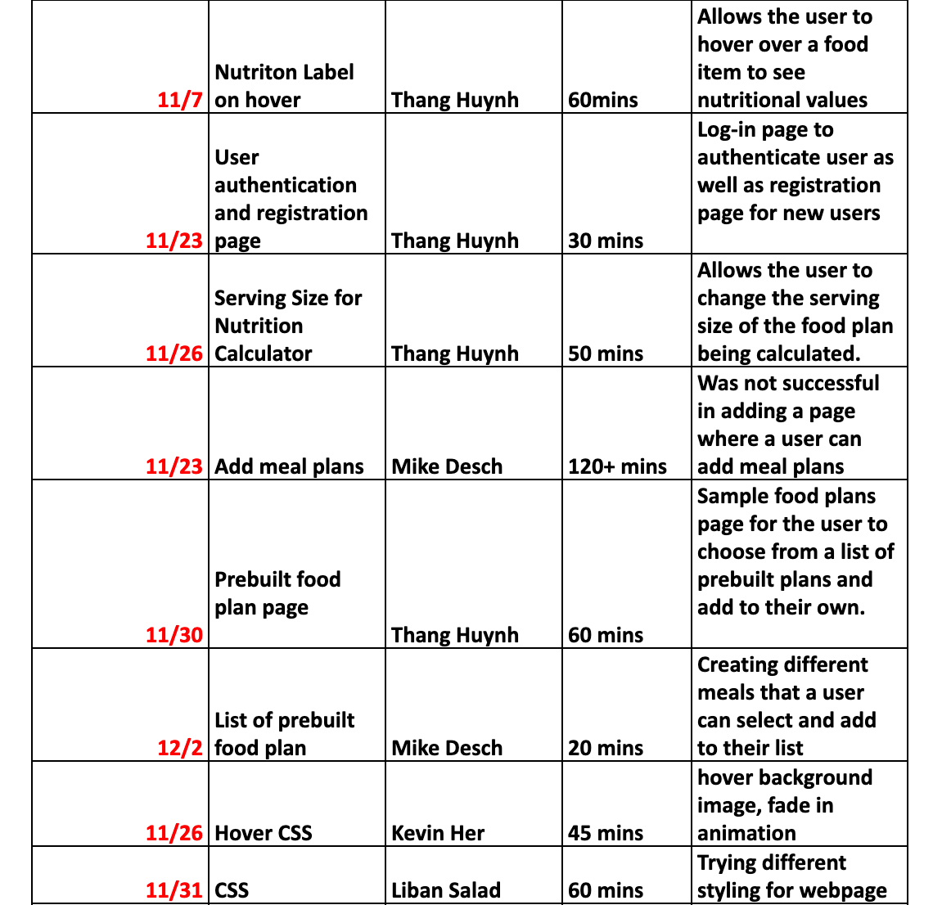
Writing the code

Slide 6
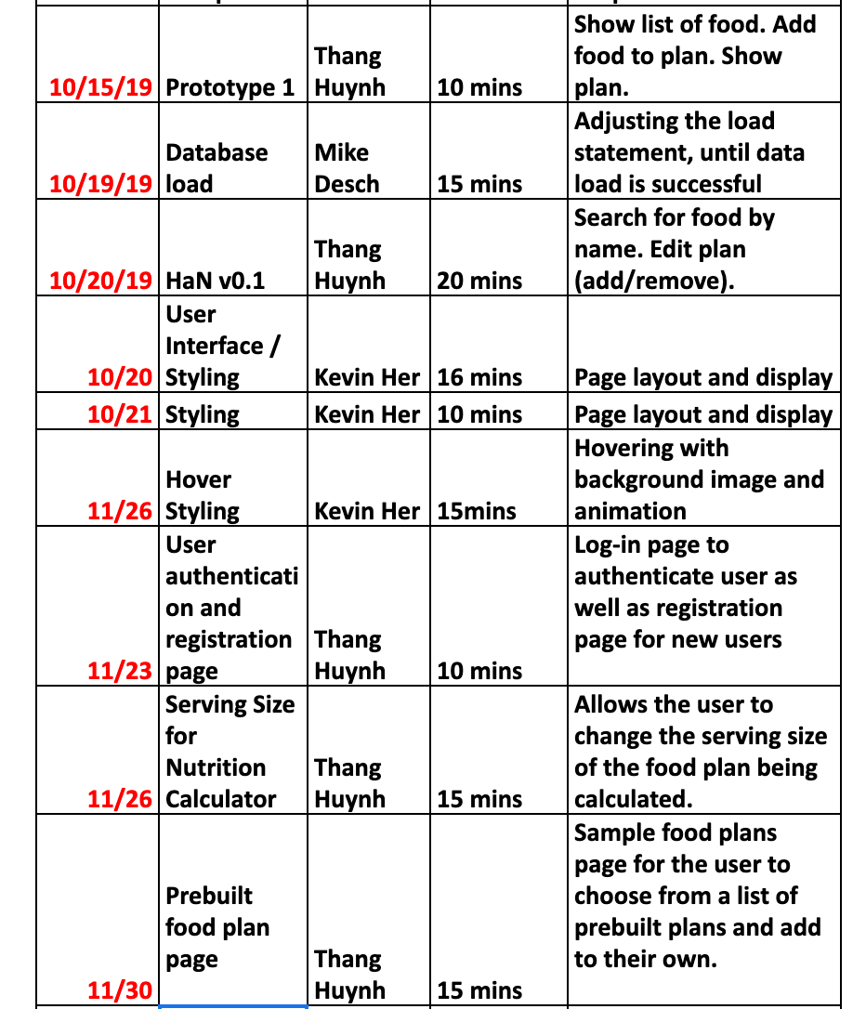
Testing the code

Slide 7
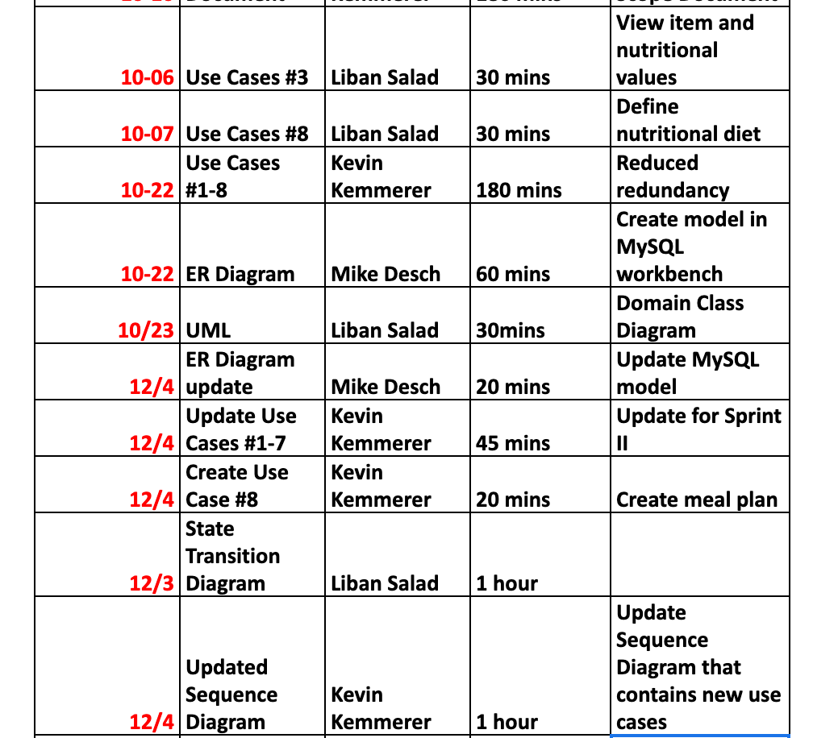
Creating the model

Slide 8
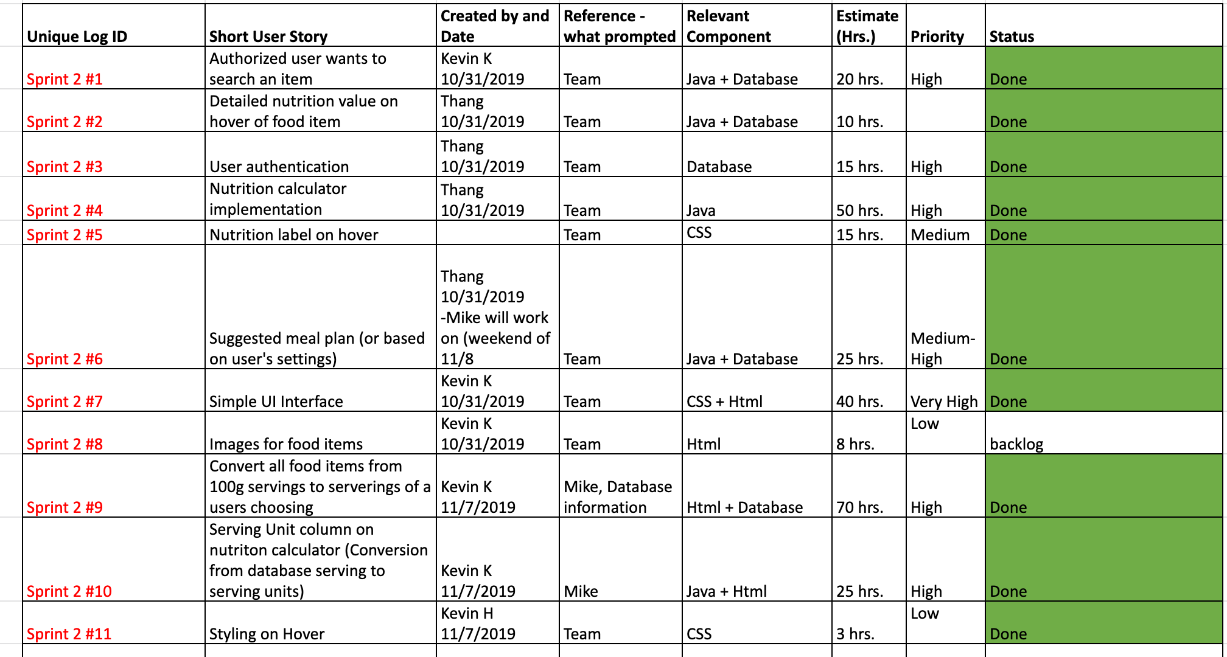
Product backlog

Slide 9
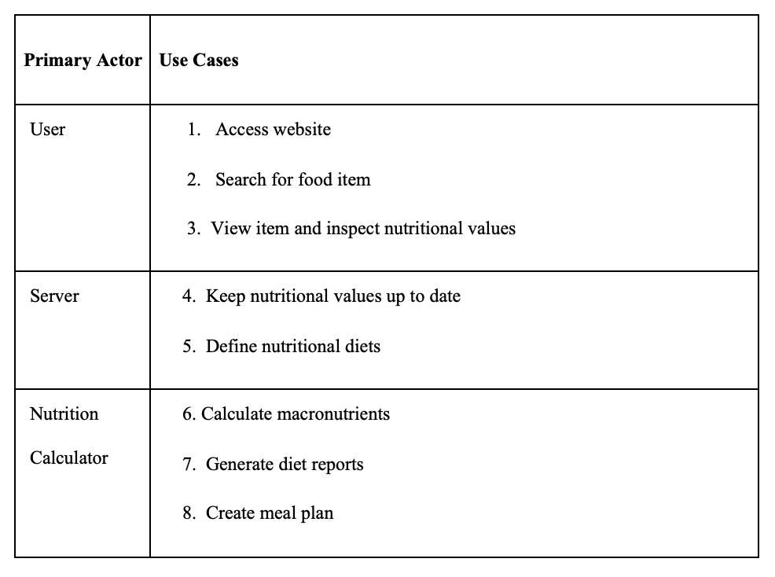
Use cases

Slide 10
Use cases undertaken in sprint II
UC #4: Keep nutritional values up to date
UC #5: Define nutritional diets
UC #6: Calculate macronutrients
UC #7: Generate Diet Reports
UC #8: Create meal plan

Slide 11
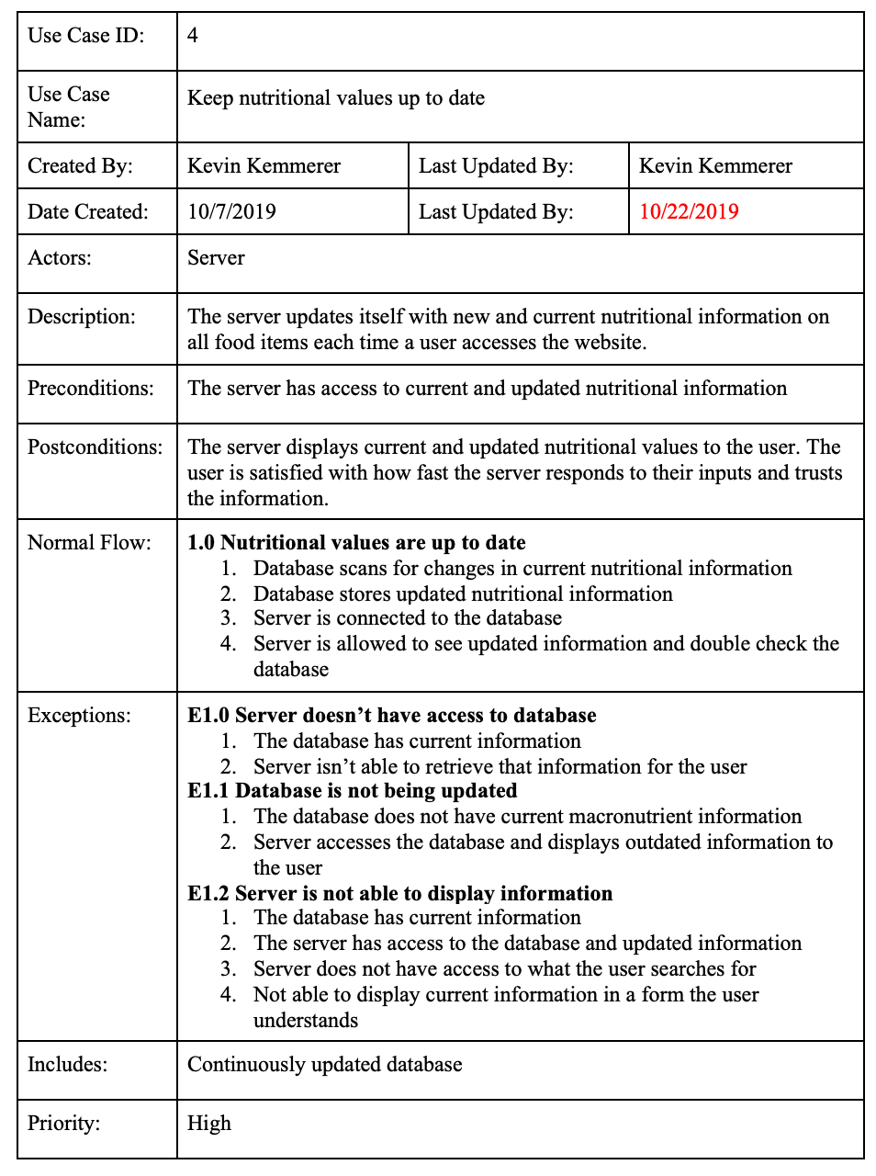
UC #4: Keep nutritional values up to date
(Scenario): User wants to have all new and current nutritional information for food items when searched.

Slide 12
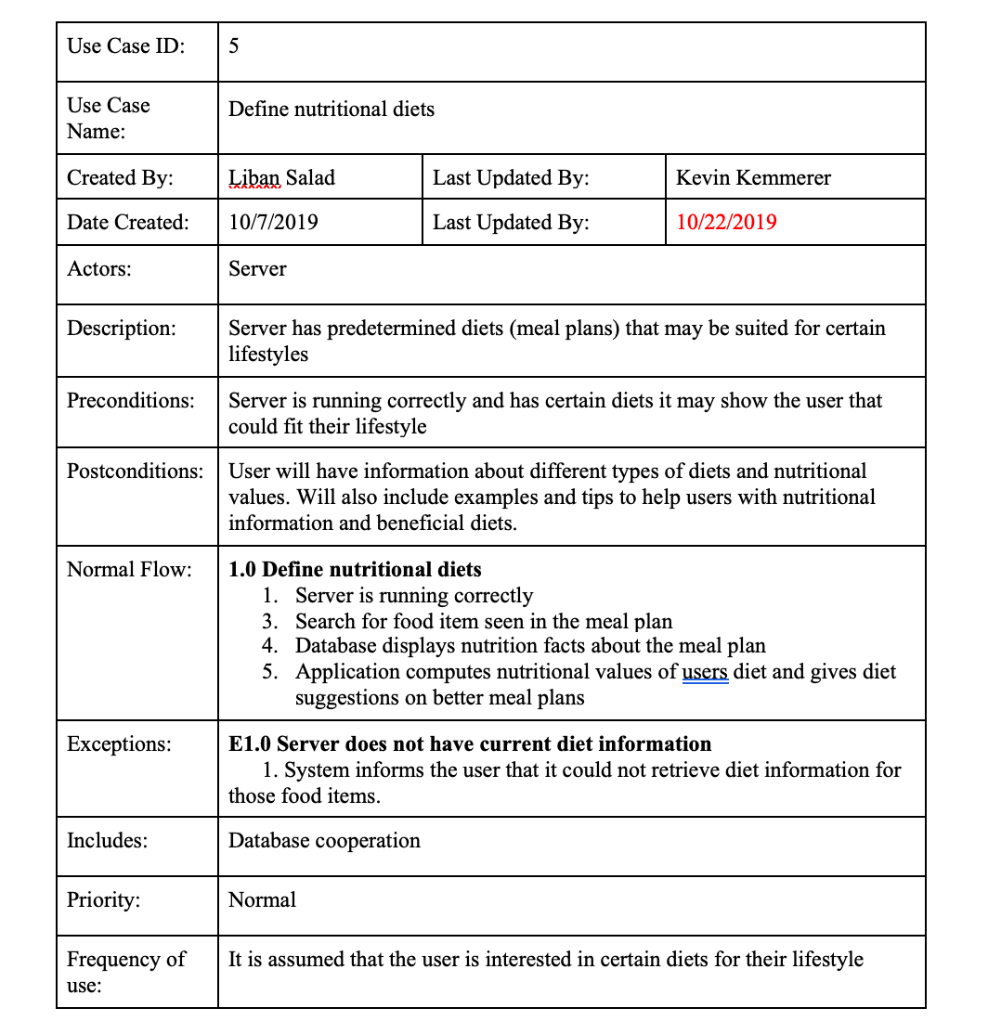
UC #5: Define nutritional diets
(Scenario): User wants an easy way to choose meal plans that fit their lifestyle

Slide 13
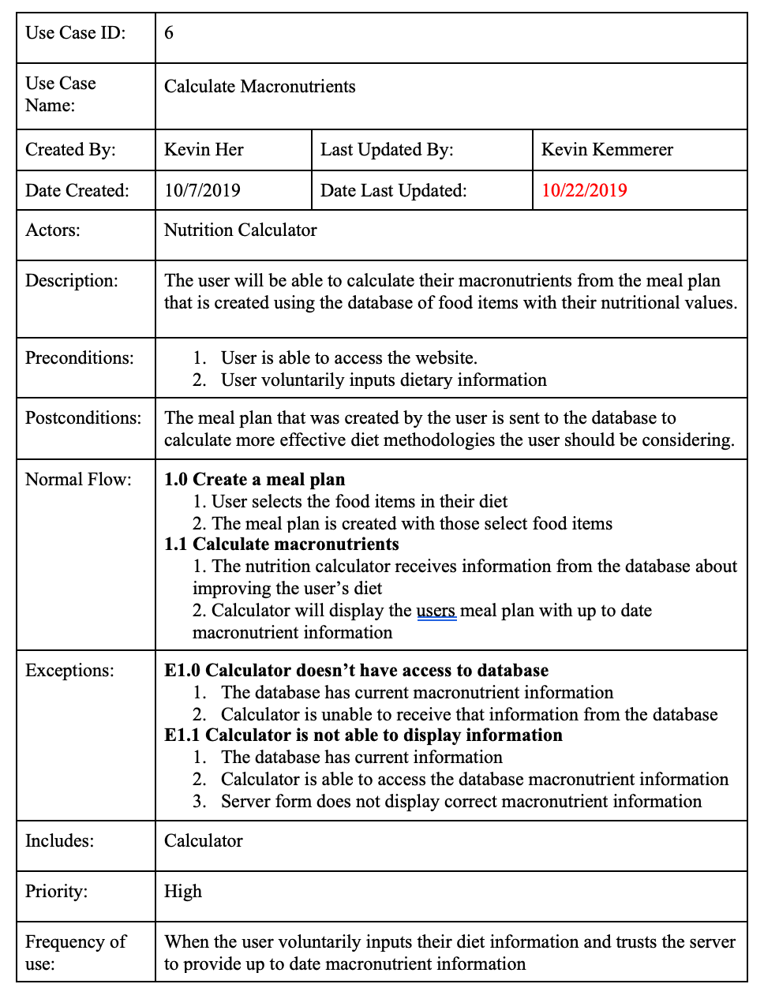
UC #6: Calculate Macronutrients
(Scenario): The user wants to see all macronutrient information for each item they searched for. The nutrition calculator shows all macronutrient information.

Slide 14
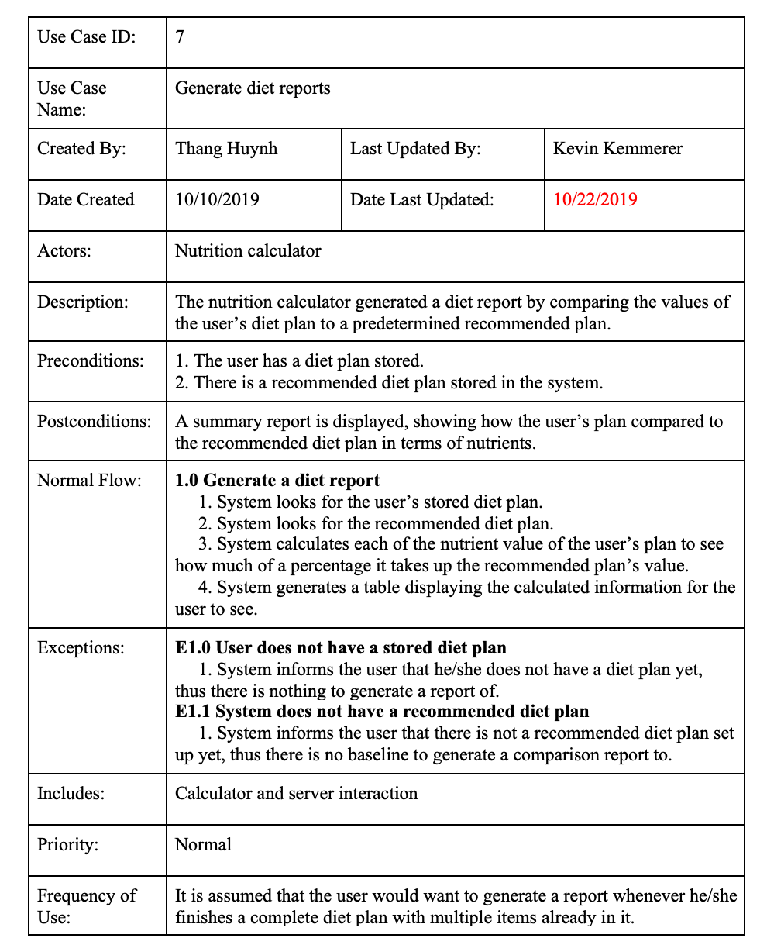
UC #7: Generate diet reports
(Scenario): The user wants to see nutrient information for each item added to the calculator. After adding each item to the calculator a user is displayed all pertinent macronutrient information.

Slide 15
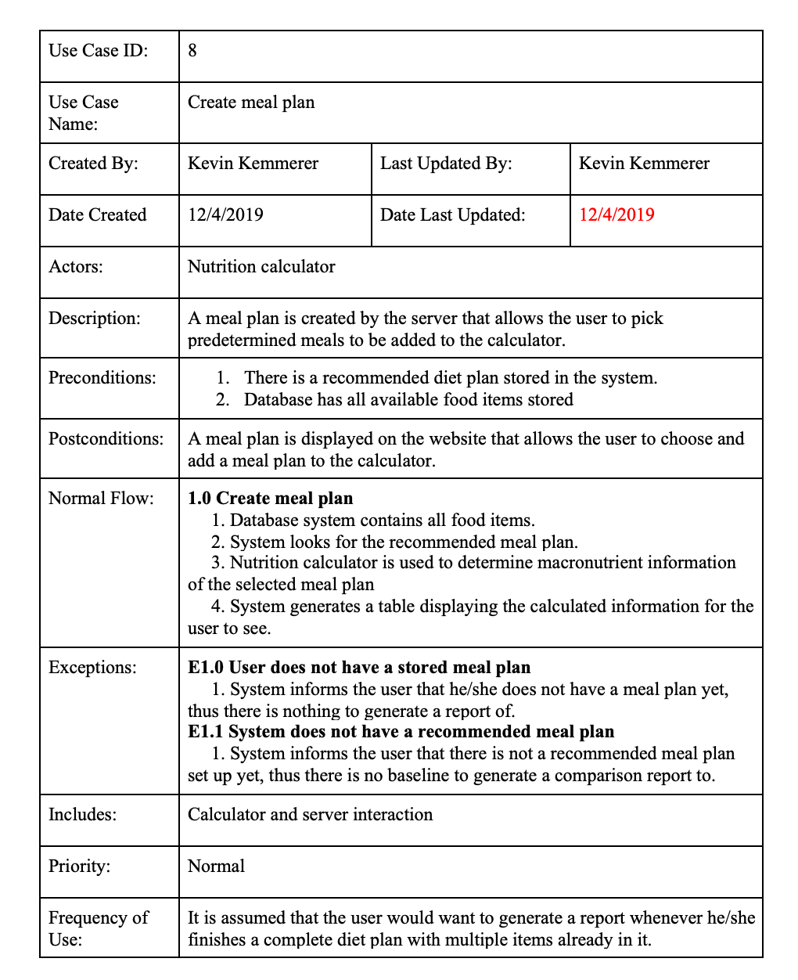
UC #8: Create meal plan
(Scenario): A user wants to create a meal plan for later use. The meal plan allows them to create one place where all food items they’ve added to the calculator are contained.

Slide 16
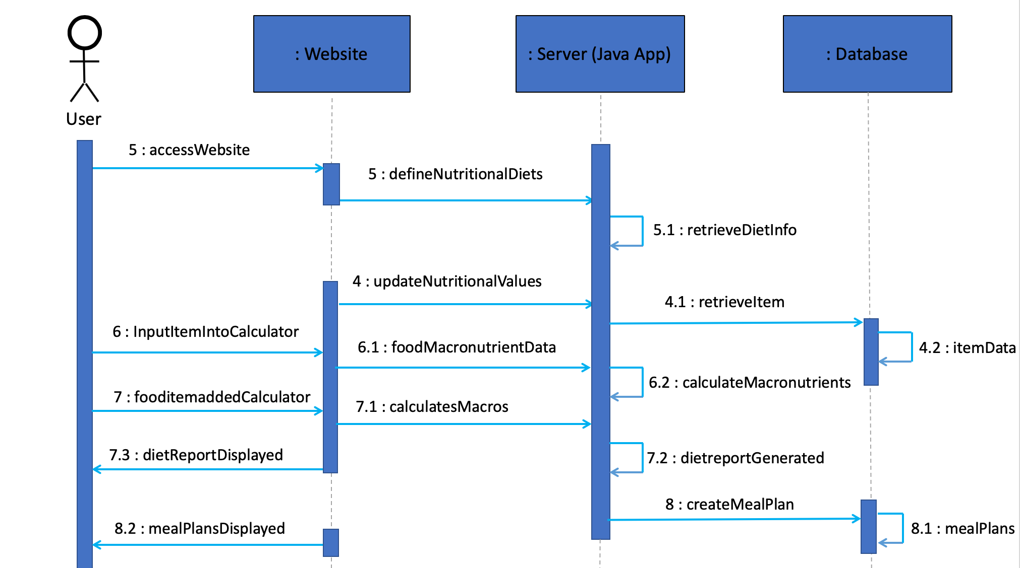
Updated Sequence diagram

Slide 17
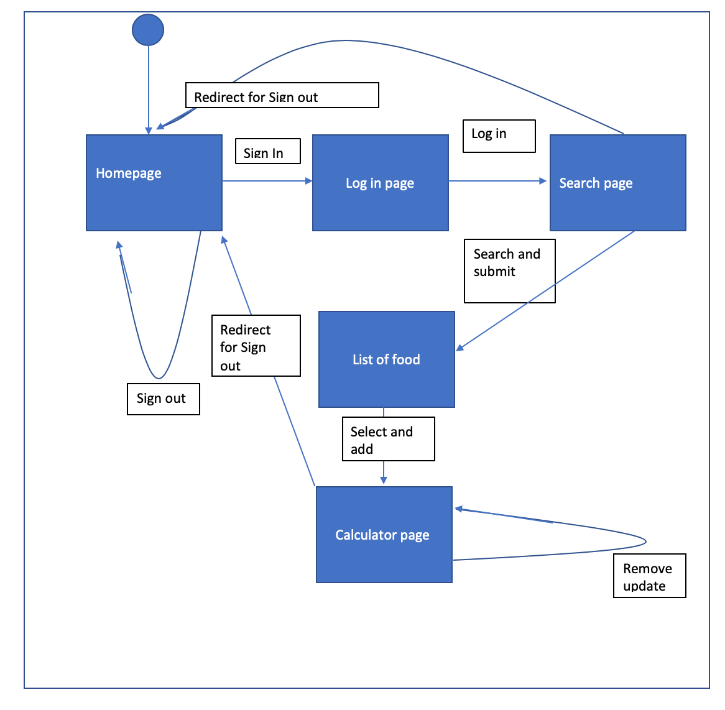
State transition diagram

Slide 18
Test plan
Considerations:
Who will the audience be?
What hardware and software does the app need, and what does the audience have?
Which components of the app will be most used?
Environments to test on:
macOS
Windows
Technologies used:
Eclipse
Java Server Pages,
JDBC
Hibernate
Training & Support
- Demo to users each functionality of the app
- Provide contact information to users
Results
Finished Testing:
Initial prototype of the application - connect UI with DB
Loading data from file into MySQL
Styling the UI
Ability to select a serving size to add
Add a meal of multiple food items all at once
Ongoing testing:
Use of GitHub to share code between group members (changes tested as code is finished)
Debugging tools in Eclipse and MySQL Workbench
Print statements
Future Testing:
Testing user inputs, such as unexpected characters or data types
Testing application in phases, as components are completed
Testing on different browsers / operating systems to ensure compatibility

Slide 19
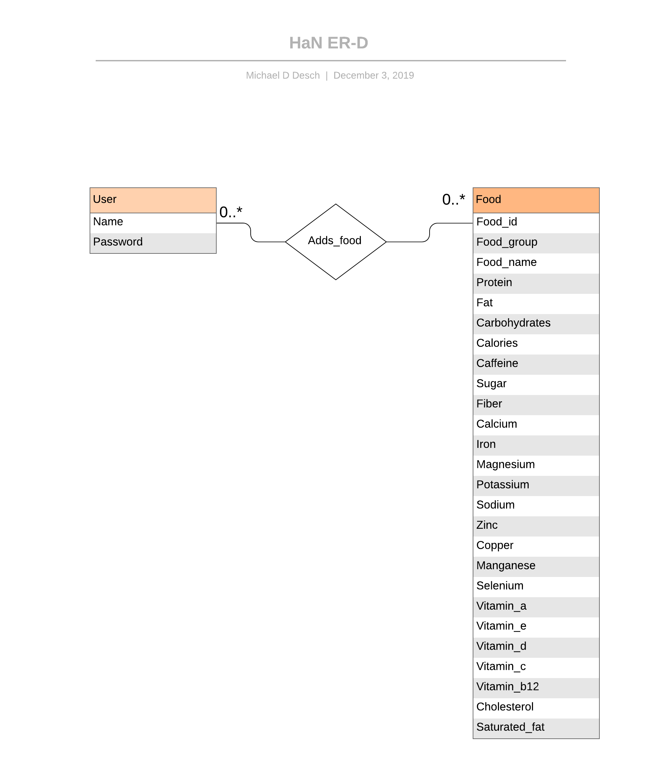
Entity Relationship Diagram

Slide 20
Changes to be made
Integrate the IDE with GitHub for more efficient handling of project documents and code
Make improvements to the website UI
Allow the user to create a custom meal plan
Locate a customer that is interested in the HaN project for funding and support

Slide 21
DEMO OF NEW USE CASES IMPLEMENTED

