Slide 1
HaN SPRINT I
HEALTH & NUTRITION APPLICATION
KEVIN KEMMERER
MIKE DESCH
THANG HUYNH
KEVIN HER
LIBAN SALAD

Slide 2
Opportunity Statement
OS: Websites are a place where people go to look for information they might be interested in. There is room for error and bias in some of the current health and nutrition websites with their only purpose being to make money off advertisements and vulnerable people. The opportunity that this Health and Dietary Application aims to fulfill is to help these people by having one area where someone is able to find all of their dietary needs.
Goals:
1.) Help people manage their dietary plans and make informed decisions
2.) Display detailed information and nutritional values of different food items
3.) Create a user inviting website that is simple but displays useful information

Slide 3
Vision & Scope
Business Objectives and Success Criteria
BO-1: Provide somewhere that has current and reliable macronutrient information.
- Image: Nutrient information on any and all food items.
BO-2: Reduce false information about diets and allow that to be accessible for everyone.
BO-3: Increase life productivity by having an area where people can improve on their own lifestyle.
- Calculator: Improving the current diets of everyone.
SC-1: Having people that are interested in improving their lifestyle be able to get access to the current information on the website.
SC-2: Achieve and increase the number of satisfied customers who have improved their lifestyle by visiting our website and using our software This example shows the use of plain language as a way to precisely state a business objective or other requirement.

Slide 4
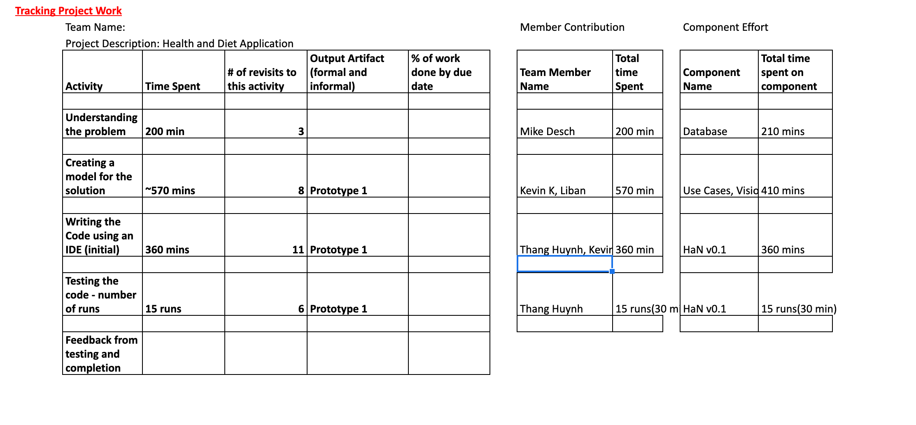
Scum dashboard

Slide 5


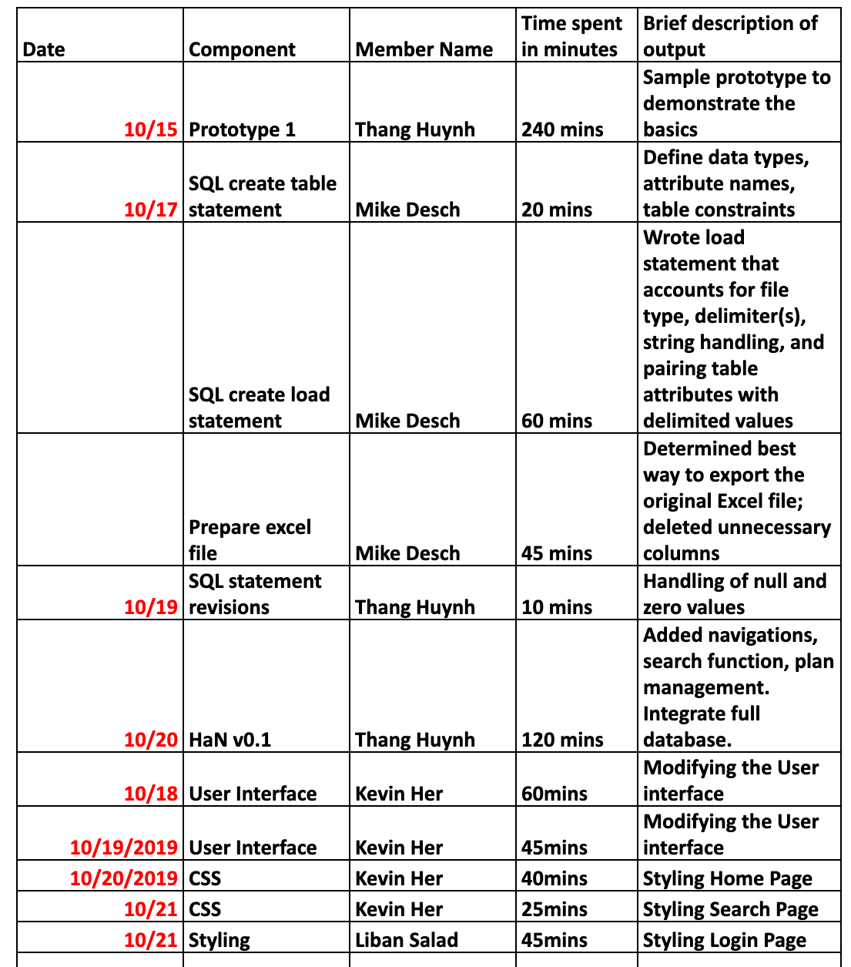
Writing the code

Slide 6
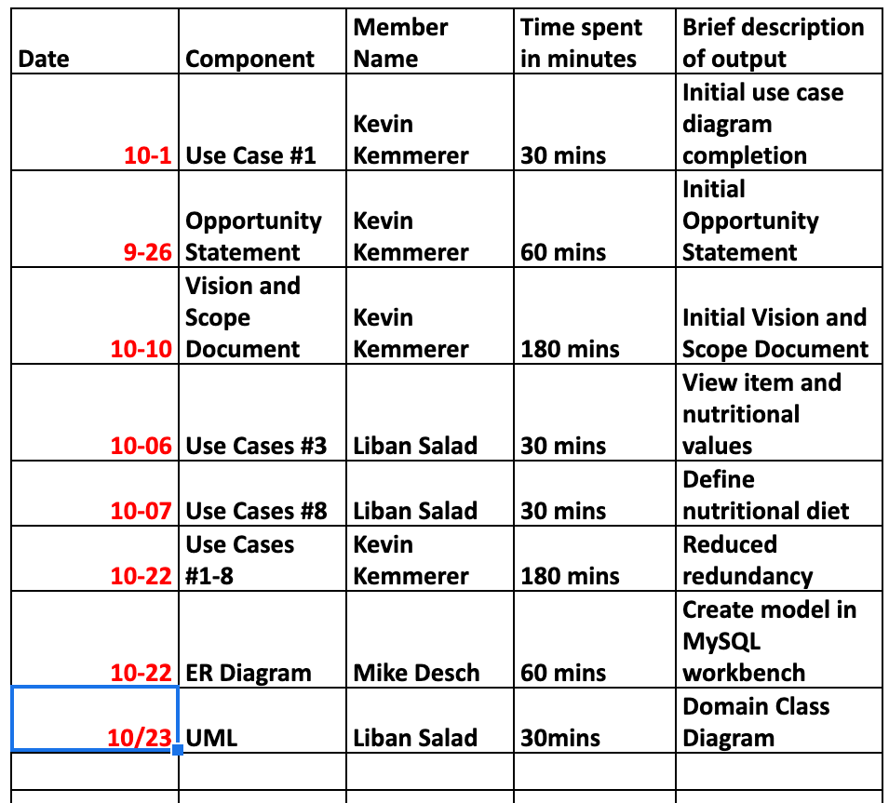
Creating the model

Slide 7
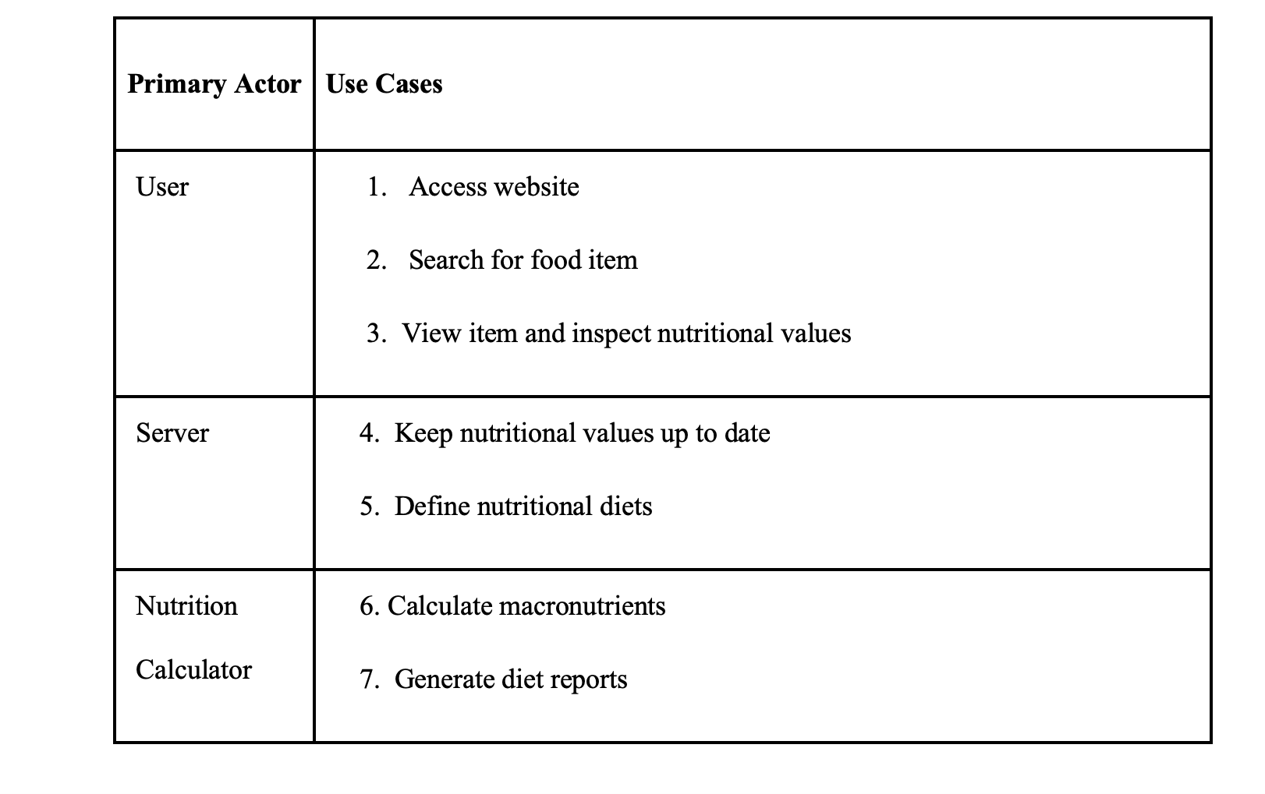
Use cases

Slide 8
Use cases undertaken in sprint i
UC #1: Access website
UC #2: Search for food item
UC #3: View item and inspect nutritional values

Slide 9
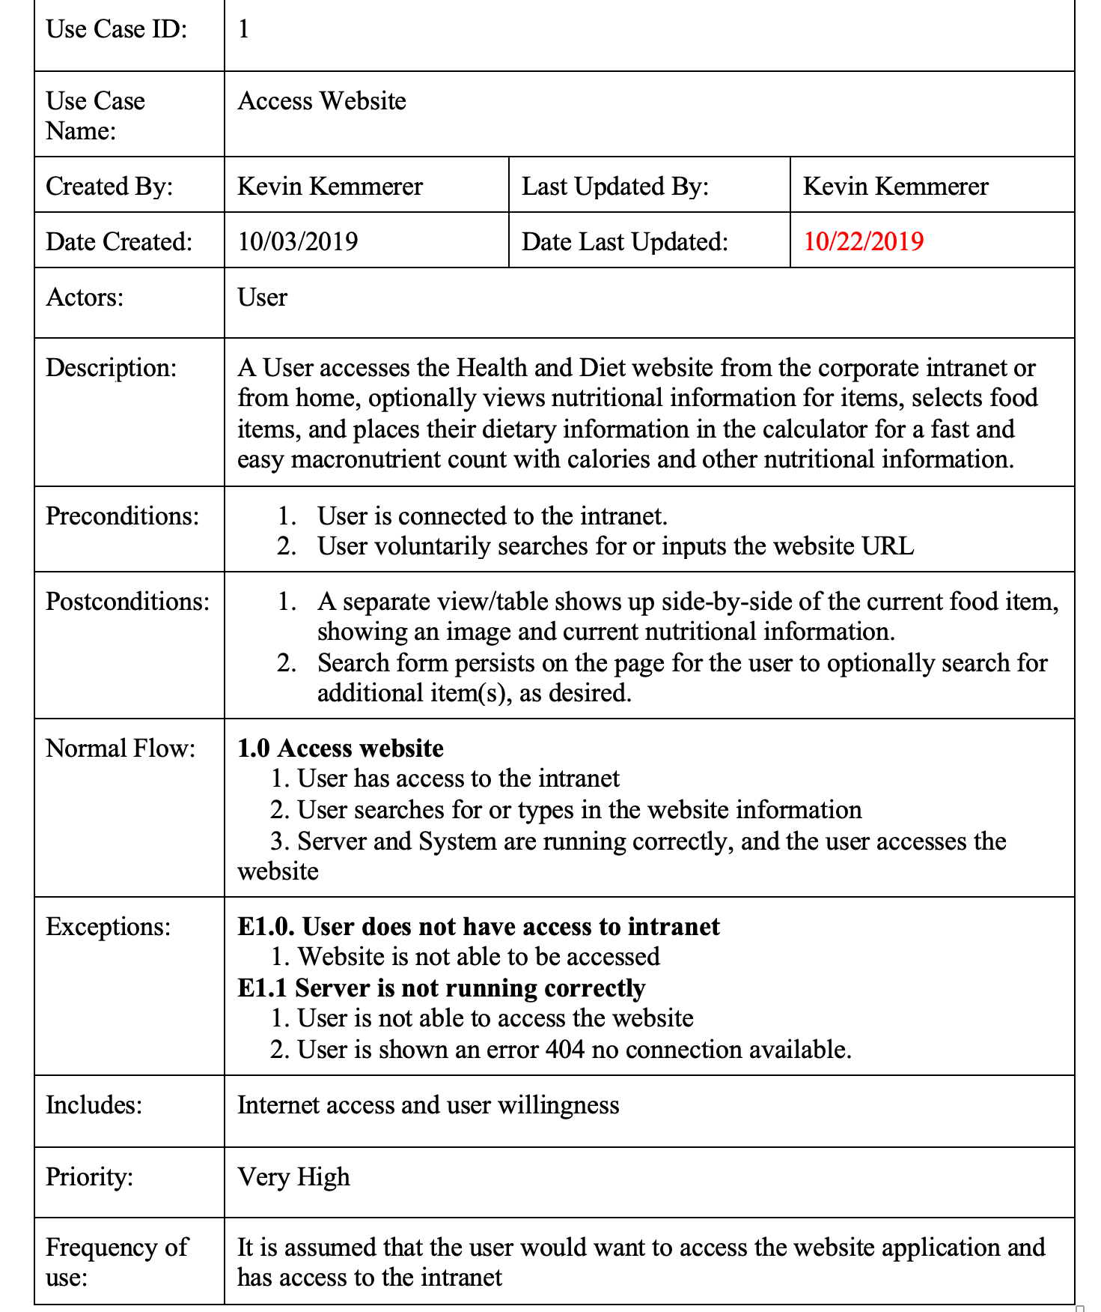
UC #1: Access website
(Scenario): User hears about a new website that allows them to improve their dietary health from a coworker. The user types in their server browser the website URL and connects to the server.

Slide 10
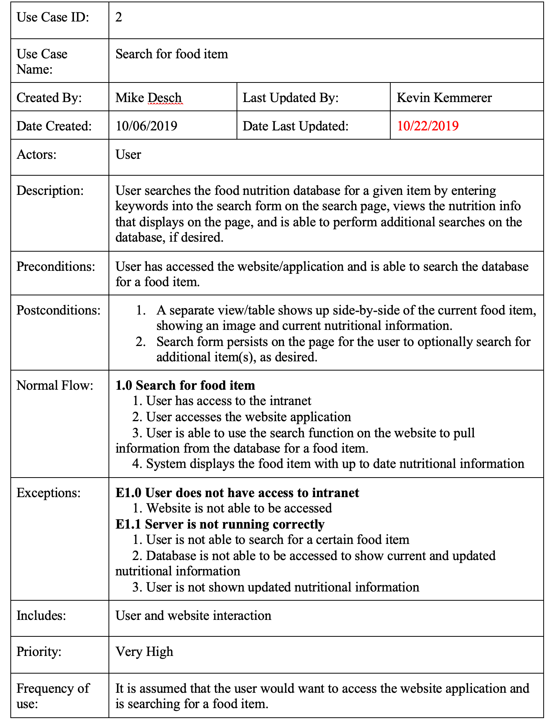
UC #2: Search for food item
(Scenario): After hearing about this new website, the user figures why not try and improve themselves. They search for a food item that is in their current diet.

Slide 11
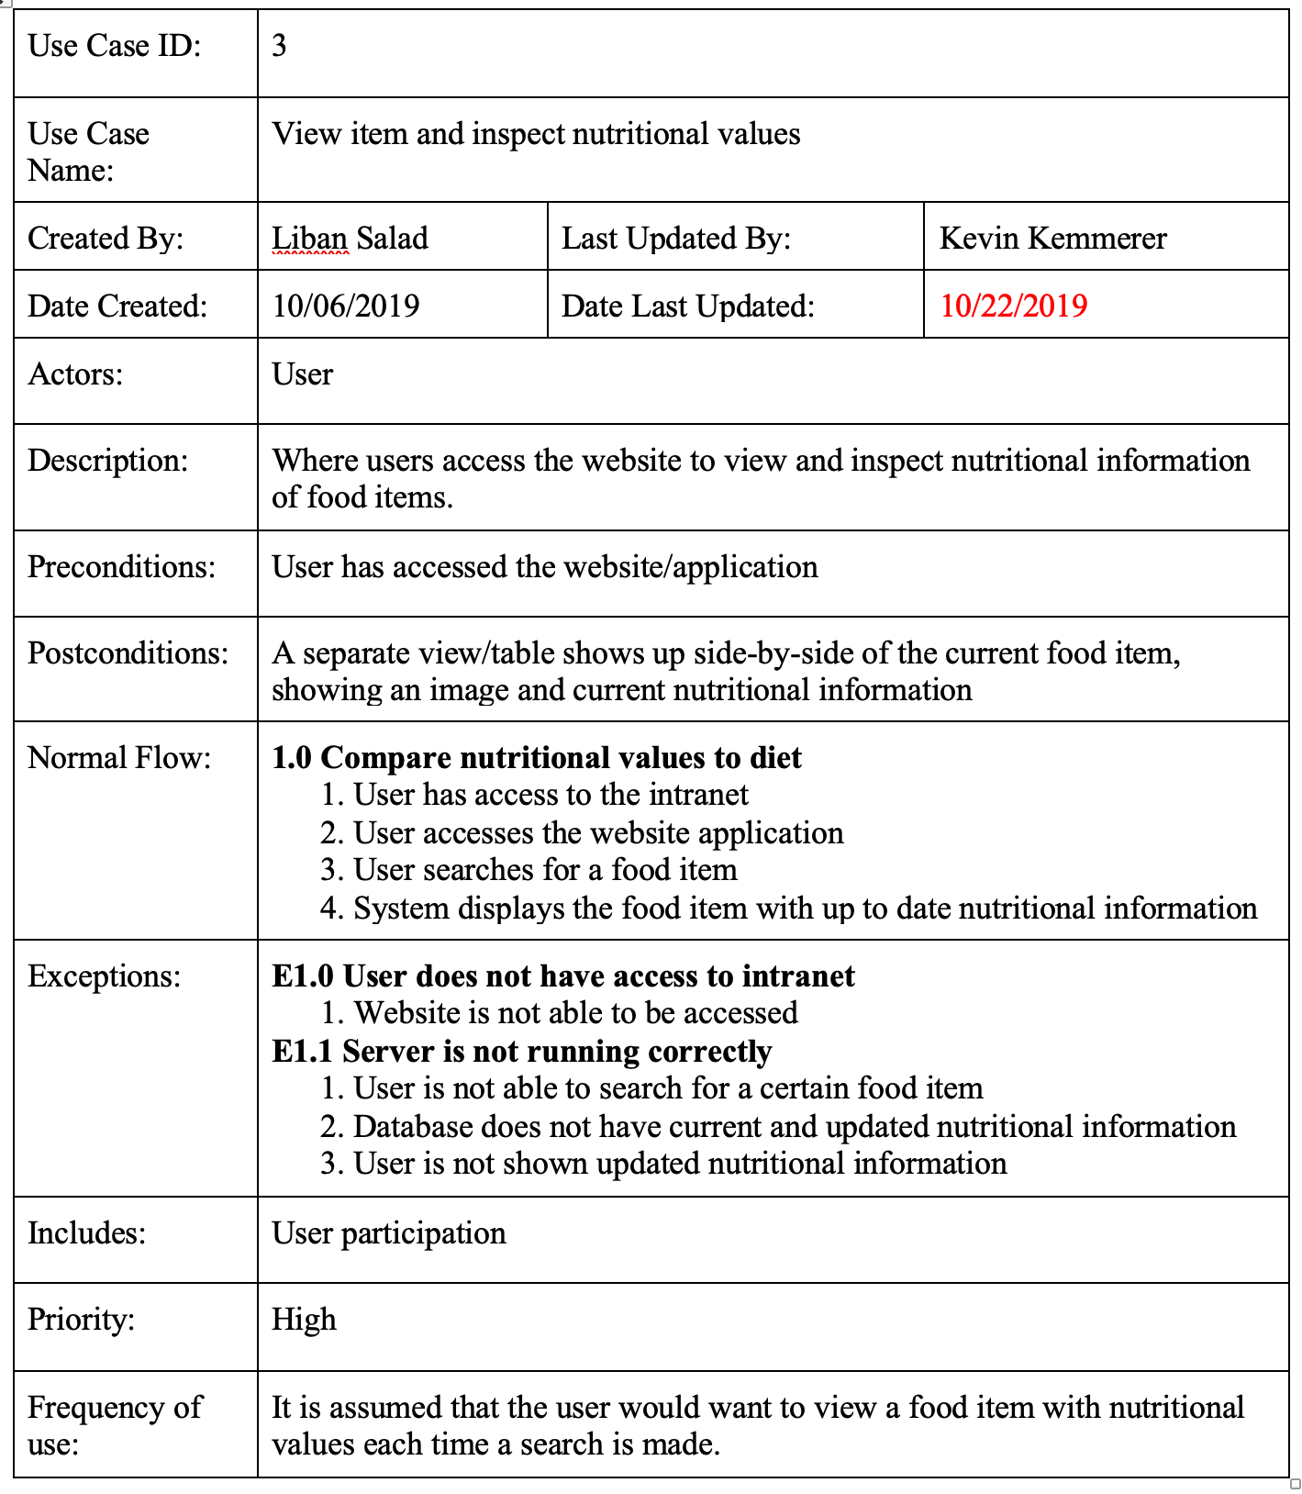
UC #3: View item and inspect nutritional values
(Scenario): Searching for a food item leads the user to inspect the nutritional values of it.

Slide 12
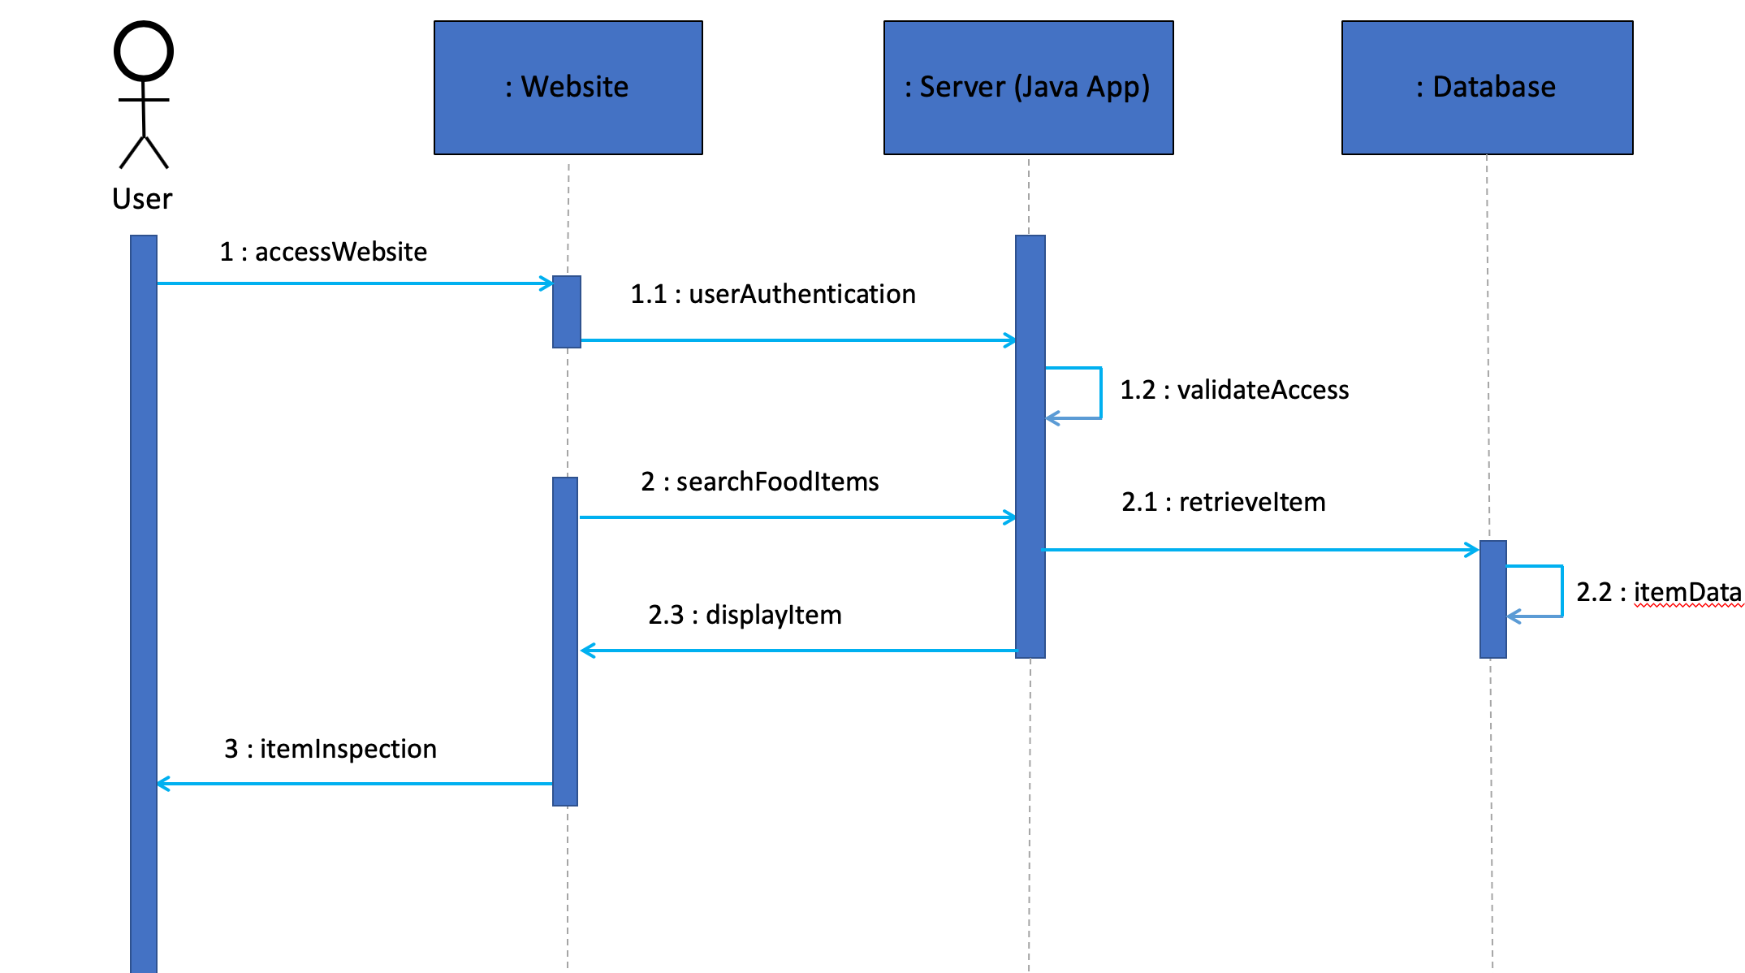
Sequence diagram

Slide 13
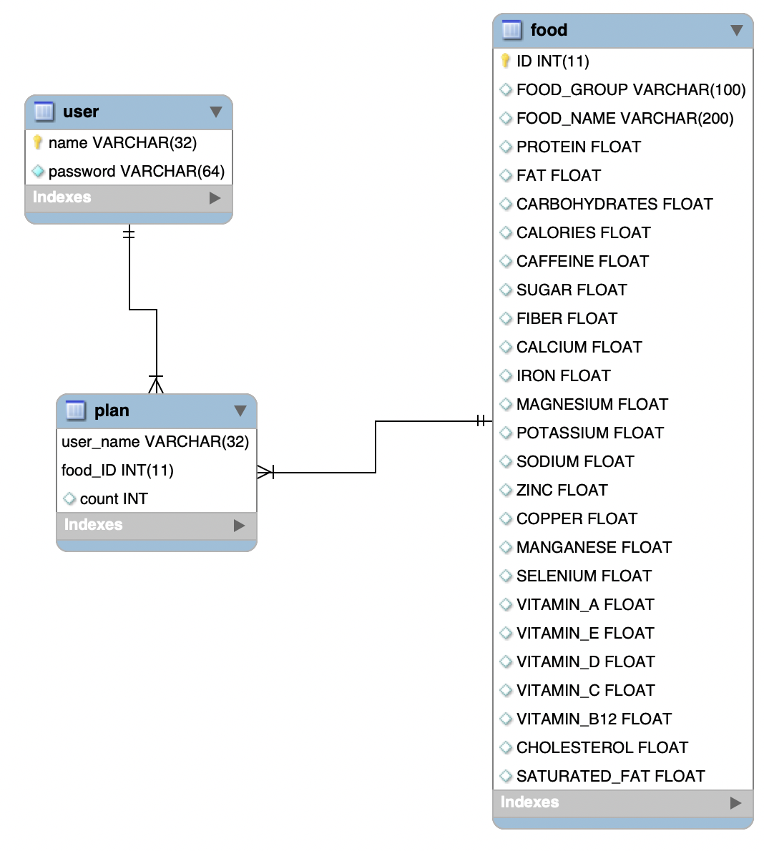
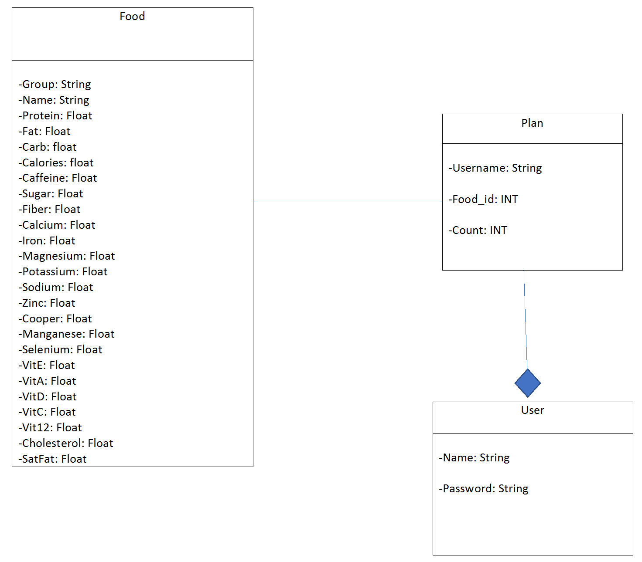
ERD/Domain Class Diagram

Slide 14
DEMO

