Slide 1


BigData Analytics and Applications
Recommendation System
using Deep Neural Network
Presented by:
Sarath Kumar Lella
Avinash Reddy T

Slide 2
Goal and Objective
The goal is to create a recommendation system for the Movie Lens dataset, however the model may be applied to any dataset.
We create a recommendation system that uses movie and user information to suggest movies to new users based on their likes and prior choices.
Motivation
Recommender systems are designed to anticipate users' interests and propose products that are likely to be of interest to them.
They are one of the most sophisticated machine learning algorithms used by internet businesses to boost sales.

Slide 3
Features
We utilize the MovieLens-100k dataset
This is made up of a set of user ratings for movies taken from the MovieLens website, which is a movie recommendation service.
There are 943 users and 1664 movies on it.
As features, we employ a variety of film genres.

Slide 4
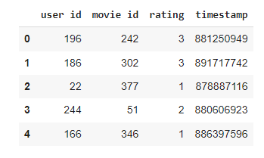
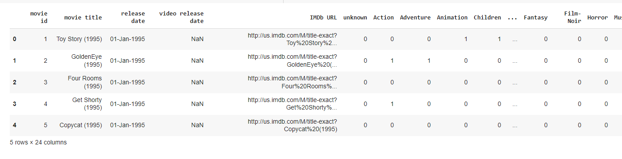
Dataset (Images)

Slide 5
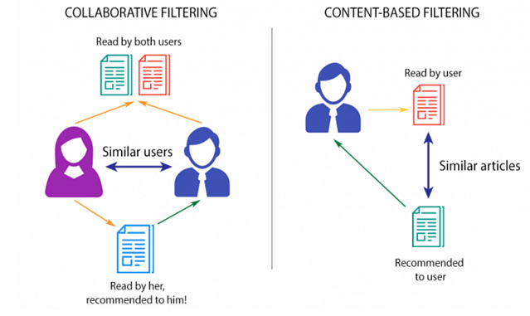
Workflow
There are two types of recommender systems:
Content-based - This strategy recommends items based on the content of a specific item.
Collaborative Filtering - This forecasts a user's rating for a certain item based on that user's previous ratings and the preferences of other users. It captures the user-item interaction matrix in a nutshell

Slide 6
Proposed Model
We use a deep neural network to conduct matrix factorization in the suggested model.
We begin by employing a label encoder for both the user and the movies.
This encoding is used as an embedding input.
The embedding’s listed below are what we learn
user embedding
movie embedding
embedding for feature space
The size of the embedding is a hyperparameter, and we fine-tune the hyperparameters using the validation dataset.

Slide 7
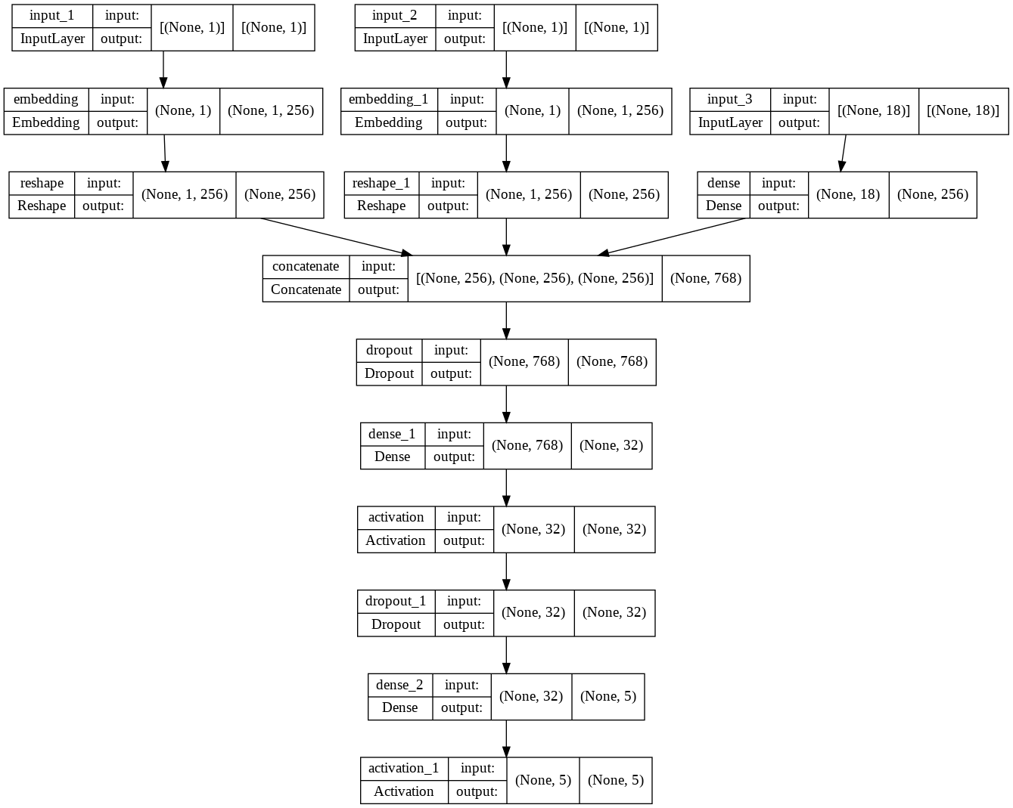
Proposed Model (Cont.)

Slide 8
Proposed Model (Cont.)

Slide 9
Model Prediction
We take input of the userid and number of movies to be recommended.
We call the user defined prediction function and prepare the user, user’s unseen movies and features of that unseen movies as the input for this prediction test case.
The model returns the prediction ratings.

Slide 10
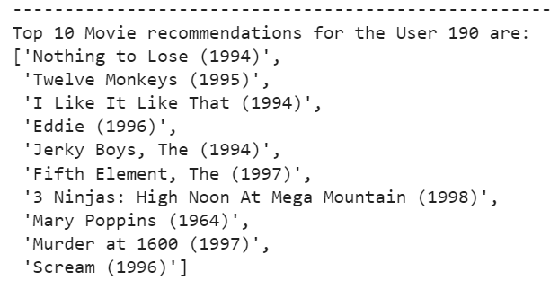
Model Prediction

Slide 11
Results
Test | Epochs | Embed_dim | Dropout | L2reg | Val_accuracy
Test 1 | 100 | 128 | 0.05 | 1e-3 | 0.1283
Test 2 | 300 | 64 | 0.05 | 1e-3 | 0.1372
Test 3 | 300 | 256 | 0.05 | 1e-3 | 0.1198

Slide 12
Conclusion
For the Movie Lens dataset, we built an AI-based recommendation engine that recommends movies to a user. To do this, we used movie and user features.
On the validation dataset, we experimented with various hyperparameter values before settling on the ideal option for test data.
A test accuracy of 0.1302 and test loss of 0.3271 is reported.

Slide 13
References
https://d2l.ai/chapter_recommender-systems/recsys-intro.html
https://towardsdatascience.com/recommendation-system-series-part-6-the-6-variants-of-autoencoders-for-collaborative-filtering-bd7b9eae2ec7
https://colab.research.google.com/github/keras-team/keras-io/blob/master/guides/ipynb/intro_to_keras_for_engineers.ipynb

Slide 14
Thank you….!

