Slide 1
Python And Deeplearning
Faculty Advisors:
Yugyung Lee
Ahmed Albishri
Saeed Al-Qarni

Slide 2
Group -2 NARS
VEGETABLE IMAGE CLASSIFICATION
Nikhil Reddy Dumpala
Sarath Lella
Rahul Kundaram
Adishwar Suresh
Explanation and Execution Video Link: https://youtu.be/mFIM40F4goU

Slide 3
TABLE OF CONTENTS
01
02
03
Introduction
Architecture
Image preprocessing

Slide 4
TABLE OF CONTENTS
04
05
Model training
Model evaluation
06
Prediction

Slide 5
Introduction
We are performing Image Classification and predicting the type of Vegetable in an image.
Convolutional neural networks are commonly utilized in classification, segmentation, and image recognition nowadays.
The goal of this work is to use CNN and pre-trained DCNN to more accurately classify vegetable photos with transfer learning.
Deep network design is CNN’s most powerful feature, allowing it to learn mid-to high-level concepts from fresh data automatically

Slide 6
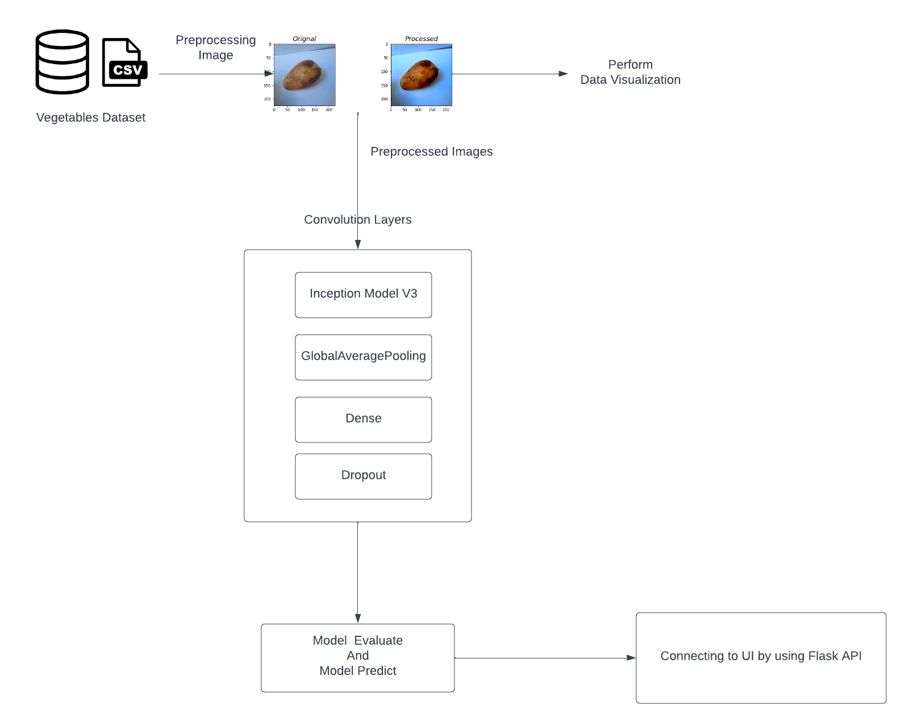

Architecture CNN Model
Conv
Dropout
MaxPooling2D
Flatten
Dense

Slide 7
Architecture Model with transfer learning

Slide 8
Dataset
The Dataset contains a total of 21000 photos in 15 categories, with 1400 images of size 224*224 in.jpg format in each category.
The data was divided into three main sections: 70% for training, 15% for validation, and 15% for testing.

Slide 9
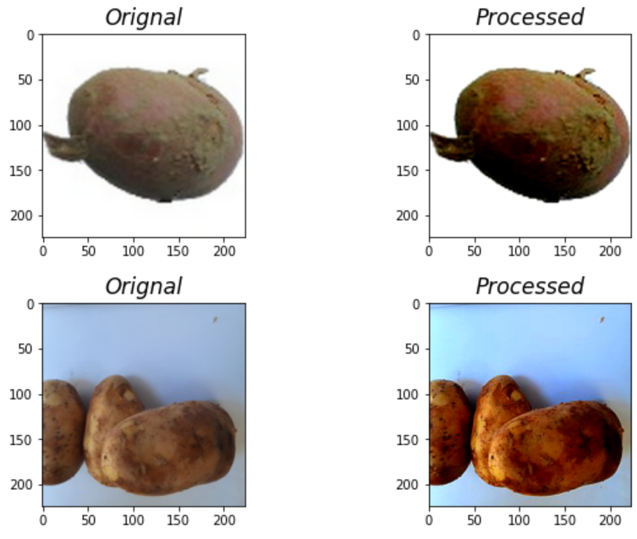
Image preprocessing
The purpose of image processing is to make visual data more interpretable for humans.
Basic manipulation and filtering might also help you grasp feature extraction better.
To add texture and attention, we boosted the color saturation and contrast while sharpening the image.
After processing, the image becomes more appealing and brighter.

Slide 10
Convolutional Neural Networks
Convolutional neural networks(CNN) learns multi-level features and classifier in a joint fashion, It performs much better compare to Traditional Neural Networks.
CNN starts with an input layer and finishes with an output layer, with numerous hidden layers. The hidden layer includes convolutional, pooling, normalizing (ReLU), and fully-connected layers.
Main purpose of Convolution in case of CNN is to extract high –level features from the input image.

Slide 11
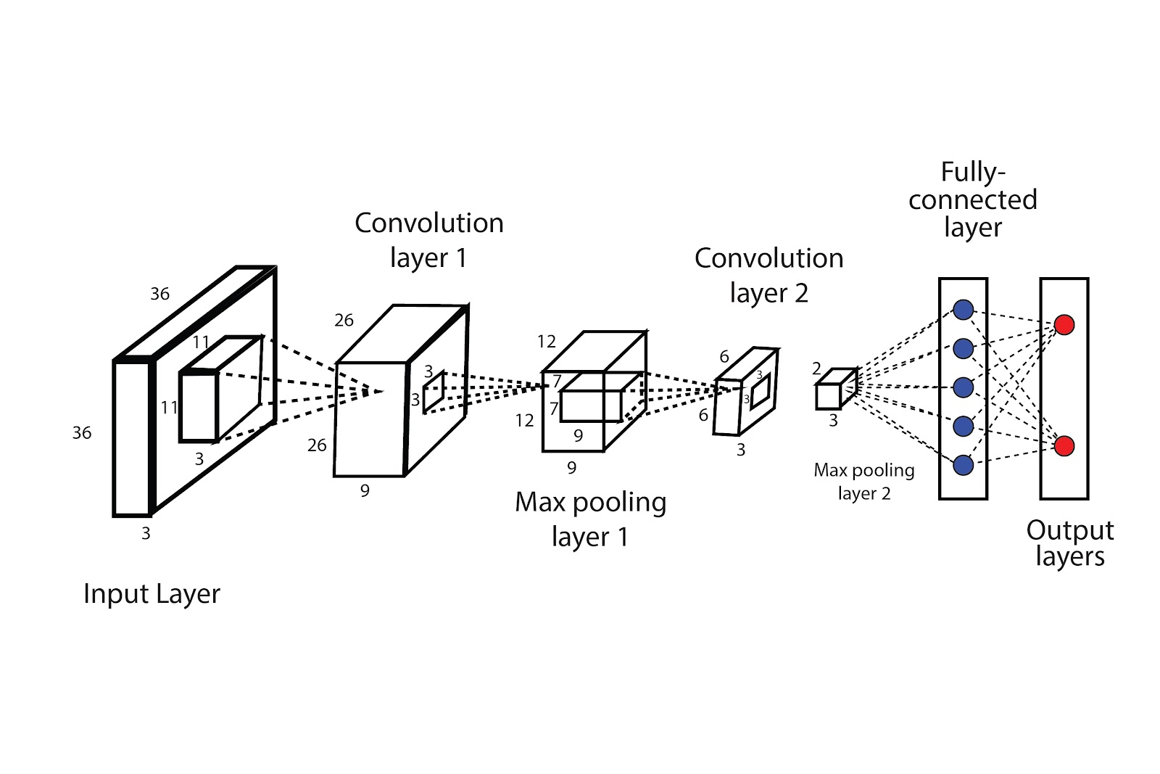
Convolutional Neural Networks Process
cs

Slide 12
Why Transfer LEarning
Transfer learning is a Deep Learning (DL) research subject that focuses on storing and applying knowledge gained while training one model to another.
To put it simpler way, transfer learning is a machine learning technique in which a model that has been taught for one task is retrained to do a related task.

Slide 13
Incpection V3
Inception v3 is a convolutional neural network for assisting in image analysis and object detection.It has48 layers in InceptionV3 and 24 million parameters.
The model itself is made up of symmetric and asymmetric building blocks, including convolutions, average pooling, max pooling, concatenations, dropouts, and fully connected layers.
Batch normalization is used extensively throughout the model and applied to activation inputs. Loss is computed using Softmax.

Slide 14
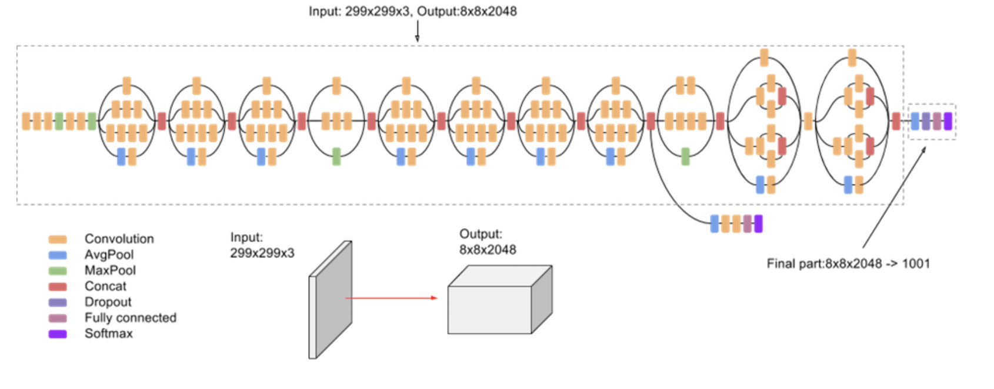
Inception v3- (architecture)

Slide 15
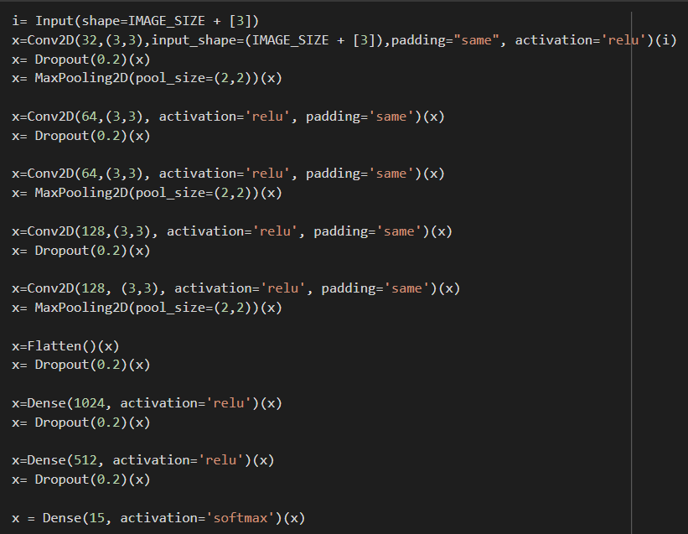
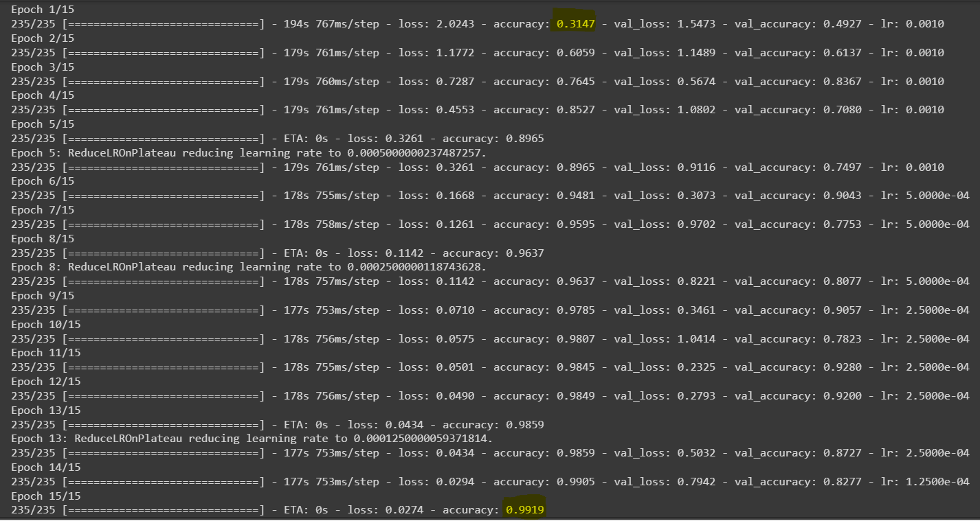
Model with cnn
Training

Slide 16
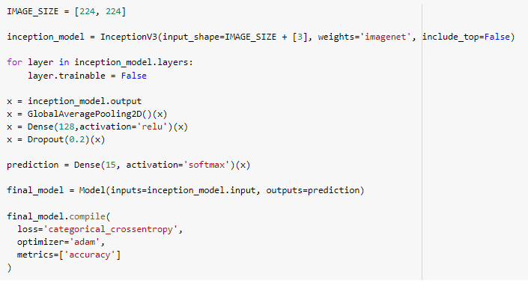
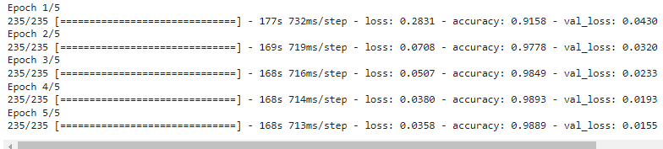
Model with transfer learning
Training

Slide 17
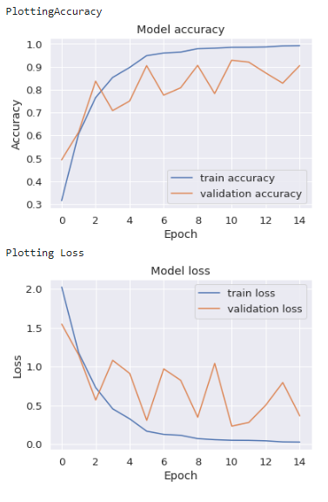
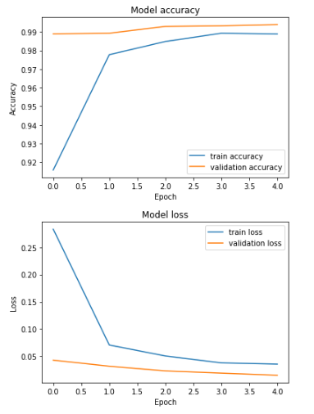
Plotting Accuracy and Loss
MODEL WITH CNN
MODEL WITH TRANSFER LEARNING

Slide 18
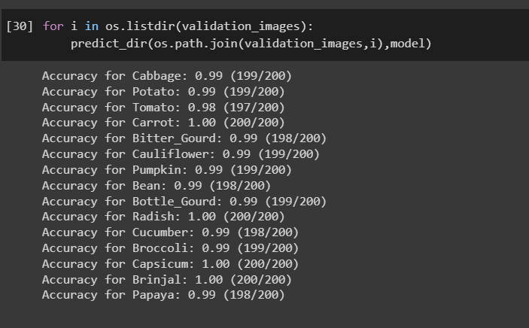
VALIDATION Accuracy for Each class
We have received validation accuracy of 99.19 for model with CNN and 99.8 for the model with transfer learning, where we used Inception V3

Slide 19
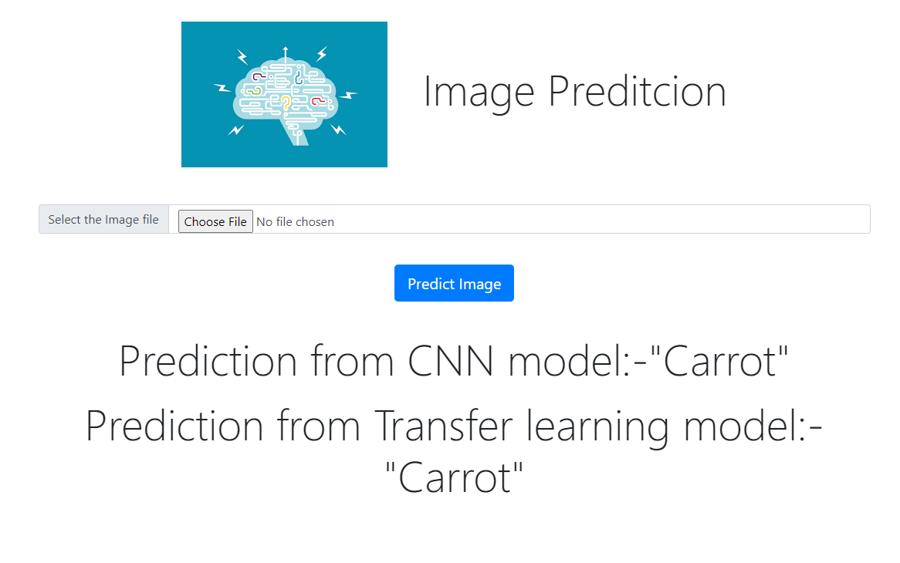
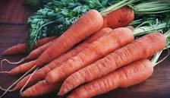
Implenting with flask api
We have used Flask API to host our model, which will help to visualize the picture and predict the name of the vegetable. If we upload an image, the page returns the name of the vegetable.
Sample image

Slide 20
References
https://www.kaggle.com/code/databeru/fruit-and-vegetable-classification/ data
https://medium.com/mlearning-ai/vegetableimageclassification-using-cnn
https://www.researchgate.net/publication/352846889_DCNN-Based_Vegetable_Image_Classification_Using_Transfer_Learning_A_Comparative_Study
https://cloud.google.com/tpu/docs/inception-v3-advanced
https://medium.com/analytics-vidhya/transfer-learning-using-inception-v3
https://www.analyticsvidhya.com/blog/2020/02/learn-image-classification
Git repo: https://github.com/Lsarath25/Live-twitter-data-analysis/tree/main/Vegetable-Image-Classification/

Slide 21
Thank you

