Slide 1
Orvessa
How far does a small LLM learn a language it has never seen?
Group Number: 14
Names: Kavinraj
Roll Numbers: 24IM10055
Code: github.com/Lsidvd234/alien-rosetta
Notes:
Orvessa: we invent a language, teach it to a small LLM with LoRA, and measure exactly where the learning stops.

Slide 2
Problem Statement
Why an invented language?
Small LLMs are often adapted to new languages, scripts and notations with LoRA. Real languages make this hard to study: the model may have seen them, gold translations are noisy, and no single property can be changed on its own.
We invent the language instead: an exact answer key, never seen in pretraining, and every property (grammar, script, vocabulary, structures in training) can be changed one at a time.
Research question
What does it take for a small LLM to learn a language it has never seen, and where does that learning stop?
Input → process → output
Input: an English sentence x, e.g. “Tom is going to beat you.”
Process: Qwen3-0.6B + LoRA reads x, writes its meaning analysis m, then the translation y.
Output: S=NAME.Tom V=beat.FUT O=PRON.2sg => [glyphs: Tom you-ACC beat-FUT-3sg]
Notes:
Motivation, research question, and the input/process/output of the task.

Slide 3
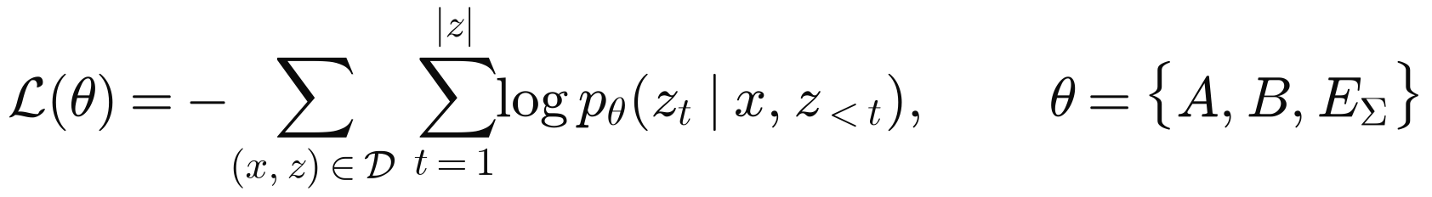
Problem Statement
Mathematical formulation
A generator defines meanings m ∈ M, an English renderer x = E(m, v) (v = surface variant) and a deterministic glyph renderer R (SOV order, endings, sound changes, 27 glyphs).
The model writes the meaning first, then the glyphs. Training minimises cross-entropy on the target only; only the LoRA matrices A, B and the new glyph embeddings EΣ are trained.
Because R is deterministic, every wrong output is exactly one of two kinds:
The experiments vary how often each key occurs in training (0 = held out, a small dose, or many):
Notes:
The formal setup: generator, target string, loss, error split, coverage.

Slide 4
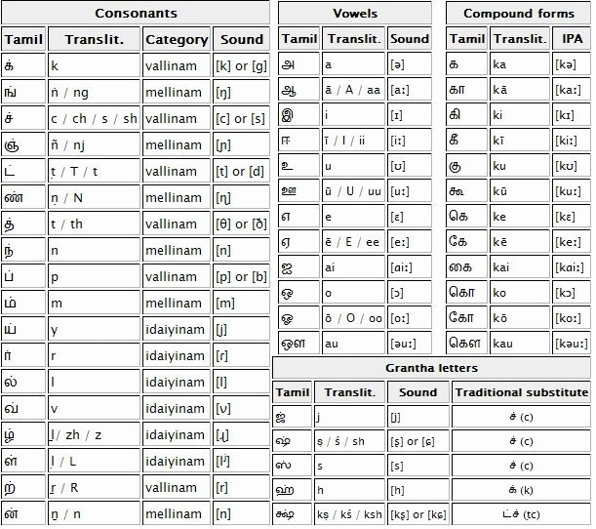
Problem Statement
Data pipeline
1. Sample a meaning first from families (statement, question, command, fragment; tense, aspect, modality, negation; subject/object kinds; 21 relation fields), so labels are right by construction.
2. Render English with a surface variant (word order, voice, contractions, casing, typos, synonyms).
3. Render glyphs deterministically: 11,078 roots + built words, case and agreement endings, sandhi, 27 glyphs (Unicode Private Use Area), each one new token.
4. Word floor: every word at least 12 times; 80,000 pairs + 2,500 refusals + 6,000 replay = 88,500.
5. One change per experiment: hold structures out, put a dose back, spell words by a sound rule, replace 15% with real Tatoeba sentences, add everyday English, paraphrase.
Test sets: 300 generated, 600 real Tatoeba sentences, and a sealed set of 147 + 25 free sentences written by the author, frozen by hash and used only as totals.
The grammar and the abugida script are modelled on Tamil (subject–object–verb, case endings, one sign per syllable). Chart: public domain, Wikimedia Commons.
Notes:
How the training and test data are produced.

Slide 5
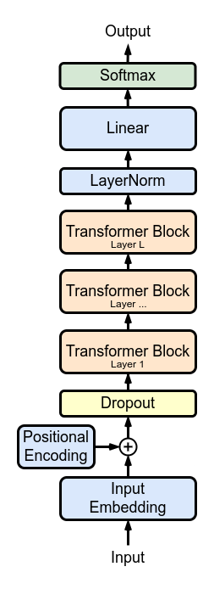
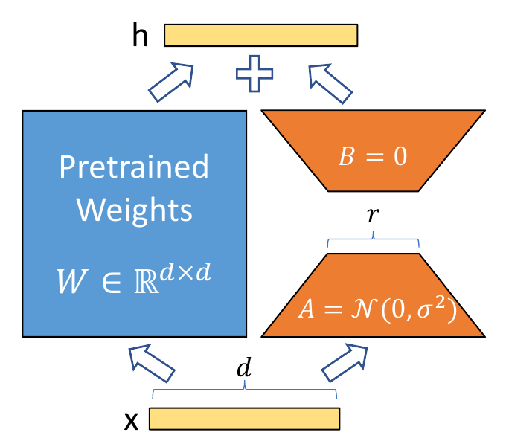
Architecture
Model
Qwen3-0.6B-Base: 28 layers, hidden size 1024, 16 query / 8 key-value heads, 596M parameters, frozen.
LoRA r = 16, α = 32 on q, k, v, o, gate, up and down projections of every layer.
27 new glyph tokens with trainable, tied input/output embeddings; each starts at the embedding of its sound (k, zh, aa, …). 10.1M trainable parameters in total (1.7%).
Output format: meaning analysis, then “=>”, then glyphs (analysis-first); direct models write glyphs only. A reader-only and a writer-only model split the two steps.
Training
AdamW, lr 2e-4, no weight decay, 3% warm-up then linear decay, batch 32, 4 epochs (11,064 steps), fp16; about 6 GPU-hours per run on a free Kaggle T4. 165 runs in total.
LoRA: only A and B are trained (Hu et al., 2021, Fig. 1).
Decoder-only transformer. Marxav, CC BY-SA 4.0 (Wikimedia Commons).
Notes:
Base model, adapter, new tokens and training settings.

Slide 6
Contribution Code
1. New glyph tokens that start from their sound (train/run.py)
Each invented glyph becomes one token whose embedding starts at the embedding of the Latin token for its sound; LoRA is then added on every projection.
def add_glyph_tokens(model, n_old, k, seed, init="mean", donor_ids=None):
"""Give k new glyph tokens a trainable embedding (rows n_old..n_old+k-1)."""
emb = model.get_input_embeddings()
w = emb.weight[:n_old].float()
if init in ("latin", "latin_shuffled"): # donor_ids: token ids of each glyph's sound
g = torch.Generator(device="cpu").manual_seed(seed)
rows = []
for ids in donor_ids:
if ids: # start at the embedding of the glyph's own sound
rows.append(w[torch.tensor(ids, device=w.device)].mean(0))
else: # no sound (virama): neutral start
rows.append(w.mean(0) + torch.randn(w.shape[1], generator=g).to(w.device) * w.std(0) * 0.1)
delta = torch.nn.Parameter(torch.stack(rows))
...
model.model.embed_tokens = AddedEmbed(emb, n_old, delta) # new rows trained, old rows frozen
model.lm_head = AddedHead(model.lm_head, n_old, delta) # tied output rows
return delta
lcfg = LoraConfig(r=16, lora_alpha=32, lora_dropout=0.0, task_type="CAUSAL_LM",
target_modules=["q_proj", "k_proj", "v_proj", "o_proj",
"gate_proj", "up_proj", "down_proj"])
delta = add_glyph_tokens(model, n_old, len(added), a.seed, a.new_tok_init, donors)
model = get_peft_model(model, lcfg)
delta.requires_grad_(True) # glyph embeddings train with the adapter
All code: github.com/Lsidvd234/alien-rosetta
Notes:
The glyph-token initialisation and the LoRA setup.

Slide 7
Contribution Code
2. Splitting every error into reading vs writing (analysis/error_split.py)
Rendering a meaning is deterministic, so a wrong output is classified by re-rendering the model's own analysis with the language generator.
def split(gen, items):
"""items: (gold analysis, gold glyphs, model output 'analysis => glyphs')."""
c = collections.Counter()
for ana_g, gly_g, p in items:
ana_p, _, gly_p = p.partition("=>")
ana_p, gly_p = ana_p.strip(), gly_p.strip()
a_ok, g_ok = ana_p == ana_g, gly_p == gly_g
if a_ok: # read right: any glyph error is a WRITING error
c["both right" if g_ok else "translation error"] += 1
continue
if g_ok:
c["lucky glyphs"] += 1
continue
own, missing = set(), False # READING error: render the model's own (wrong) meaning
try:
cls, _ = from_analysis(ana_p, spell_name)
for gs in itertools.product("mf", repeat=min(len(cls), 6)):
own.add(" ".join(gen.rep.target(with_gender(cl, g)) for cl, g in zip(cls, gs + ("m",) * 9)))
except KeyError:
missing = True # a word key the language does not have
c["understanding error" if gly_p in own else
("both wrong" if own else ("word not in language" if missing else "unreadable"))] += 1
return c
Notes:
The error split used for claim D.

Slide 8
Contribution Code
3. Steering from the English hidden states (analysis/inside_claim4_steer2.py)
A mean-difference direction is added to one layer while the model reads the English; the translation it then writes is checked for the target value.
# direction a -> b (e.g. tense PRES -> PAST): mean English-word state of b minus that of a, at layer L
d = stats[(feat, b)][L][0].mean(0) - stats[(feat, a)][L][0].mean(0)
vec = d / d.norm() * alpha * scale # scale = mean hidden-state norm of layer L
add = (mask * vec.view(1, 1, -1)).to(device) # mask = the English-word positions of the prompt
def hook(_m, _inp, output):
h = output[0] if isinstance(output, tuple) else output
if h.shape[1] == n: # only while the prompt is read
h = h + add.to(h.dtype)
return (h,) + tuple(output[1:]) if isinstance(output, tuple) else h
return output
handle = layers_of(model)[layer - 1].register_forward_hook(hook)
out = model.generate(input_ids=ids, attention_mask=att, do_sample=False, max_new_tokens=40)
handle.remove()
# flip = output analysis now has the target value; control = same-size random direction
Shortened from the project code (loops over batches and settings removed).
Notes:
The steering hook used for claim E.

Slide 9
Benchmark Methods and Evaluation
Methods compared (one change each)
Test sets
Generated 300: same generator, never trained; shared by all runs.
Tatoeba 600: real sentences; gold from an automatic reader (≈0.6 right by hand-check).
Sealed 147 + 25: free English by the author, frozen by hash, totals only.
Metrics and statistics
Meaning exact, glyphs exact, word accuracy, refusal rate; reading vs writing errors.
Paired McNemar tests, bootstrap 95% intervals, Holm correction over 21 tests.
Predictions written before most runs; every number gives its run count.
Group | Methods
Baseline | Qwen3-0.6B + LoRA, analysis first, 80k pairs, floor 12
Training tricks | focal loss (γ = 2), 6 epochs, word floor 25 (+ size-matched control)
Data tricks | paraphrased English (1.4%, 8%), two-stage rewriter
Decoding | beam search (4), majority vote of 5 samples
Scale | Qwen3-1.7B, same data
English variety | everyday English words; 15% real Tatoeba text
Controls | random / shuffled directions; bag-of-words probe; seeds
Notes:
What we compare against and how we score.

Slide 10
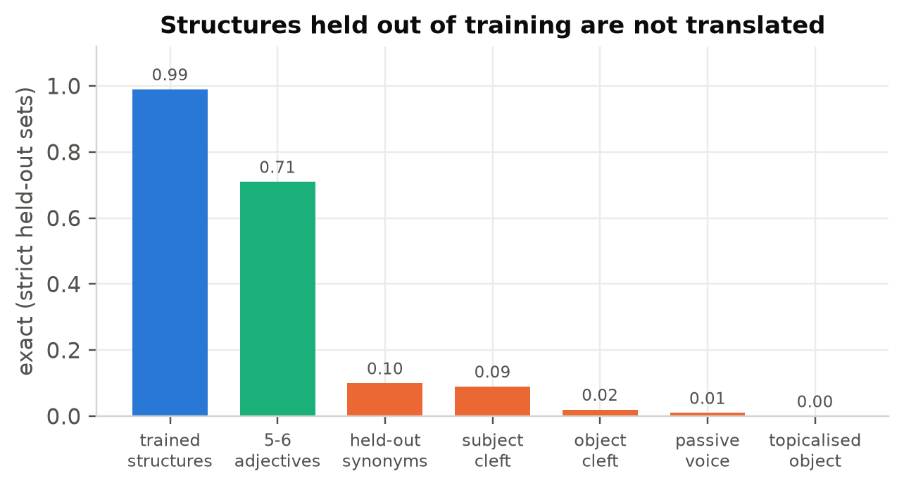
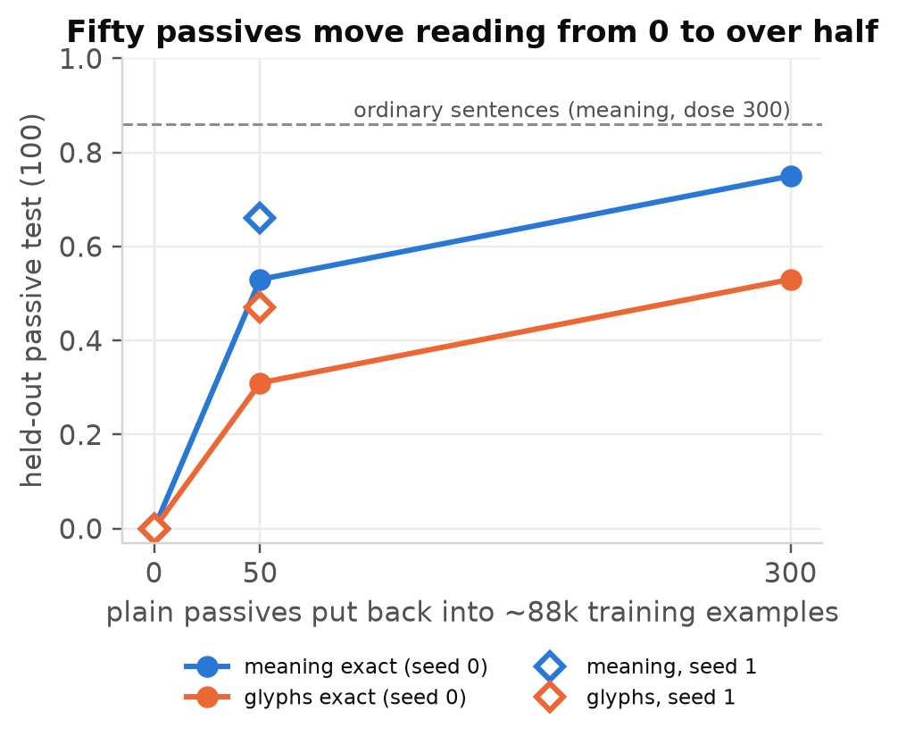
Results and Discussion
A. Generalisation stops at what training covers (strong)
Held-out English structures score 0.00–0.09 (3 runs) while trained ones stay at 0.97–0.99.
Putting back only 50 passives (0.06% of the data) lifts passive reading from 0.00 to 0.53 (0.66 on seed 1).
Maths in glyph digits: removing one fact drops problems needing it to 0.05 (others 0.92); a scratchpad copies its longest training working (2 rows × 3 steps on 1,798 of 1,800 longer rows).
Notes:
Claim A.

Slide 11
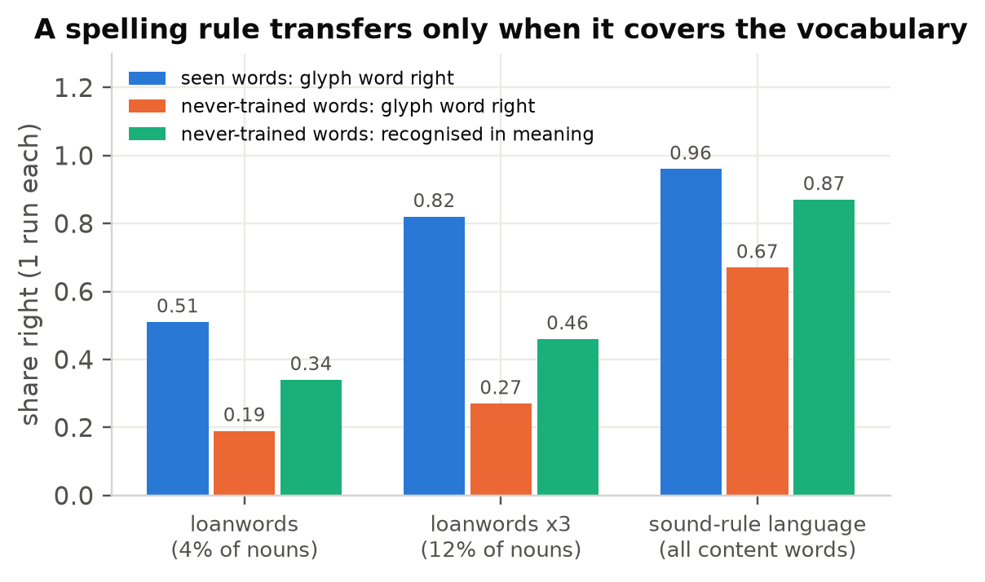
Results and Discussion
B. A spelling rule transfers only when it covers the vocabulary (moderate)
Same letter-to-sound rules in both settings.
Minority (loanwords): new loans 0.19; tripling the loans lifts seen ones to 0.82 but new ones only to 0.27 (the predicted +0.10 missed): a better list, not the rule.
Whole vocabulary: 2,232 never-trained words spelled right 0.67 and recognised 0.87.
One-letter mappings transfer better than multi-letter ones (0.23 vs 0.12, p = 0.005).
1 run per condition; consistent with the Tolerance Principle; no threshold claimed.
Notes:
Claim B.

Slide 12
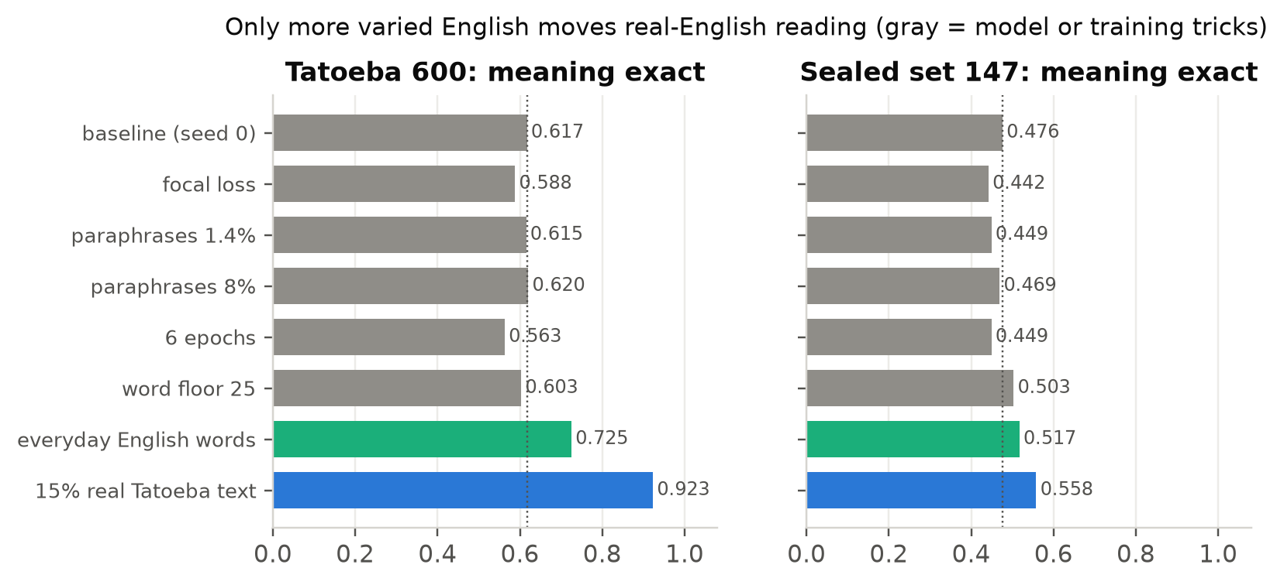
Results and Discussion
C. Only English variety helps real English (strong on Tatoeba)
15% real text: Tatoeba 0.62 → 0.92 (2 seeds, p < 1e-48); sealed 0.47 → 0.56 (paired p = 0.04 / 0.01).
Everyday words, no reader labels: +0.11 / +0.04.
Focal loss, paraphrases, floor 25, 6 epochs, rewriter, beam, voting, 3× model: null or worse.
Caveat: Tatoeba gold comes from the same automatic reader as the real training labels; a hand-check puts about +0.19 of the +0.31 on correct labels. The sealed gain is the fairer size.
Notes:
Claim C.

Slide 13
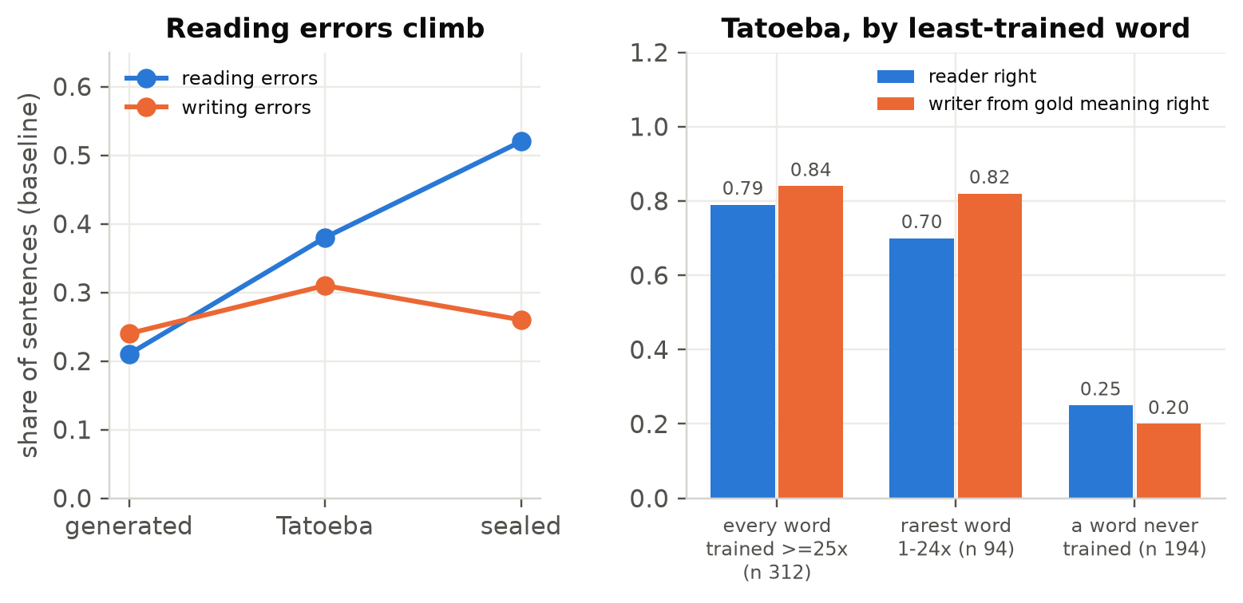
Results and Discussion
D. On real English, reading fails; with untrained words, both (moderate)
Writing errors stay flat (0.24 / 0.31 / 0.26) while reading errors climb (0.21 / 0.38 / 0.52).
Separate reader and writer: the reader causes 74% (Tatoeba) and 90% (sealed) of failures.
The writer fails mostly where a word was never trained (0.20 vs 0.84); the sealed set agrees.
Mechanism for passives: a probe cannot find the doer in the hidden states of the model trained without passives (0.746 vs 0.704 surface baseline), but does in models trained on them (0.871, 0.950).
Notes:
Claim D.

Slide 14
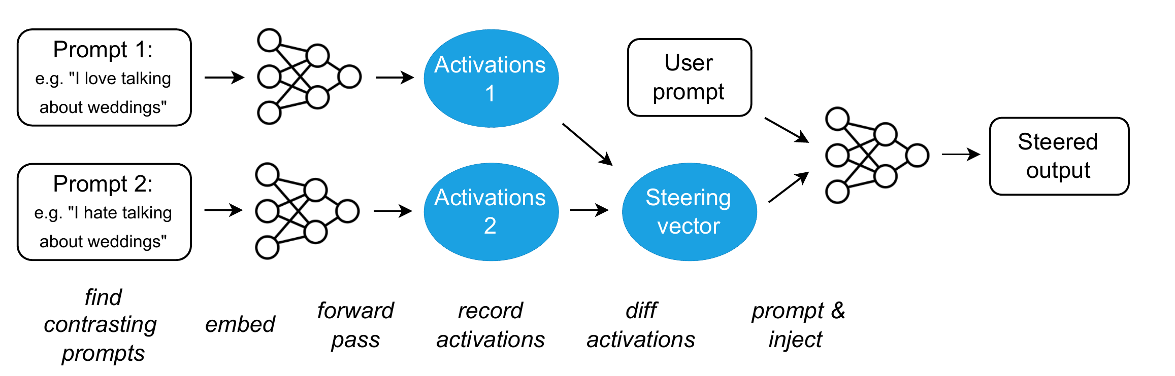
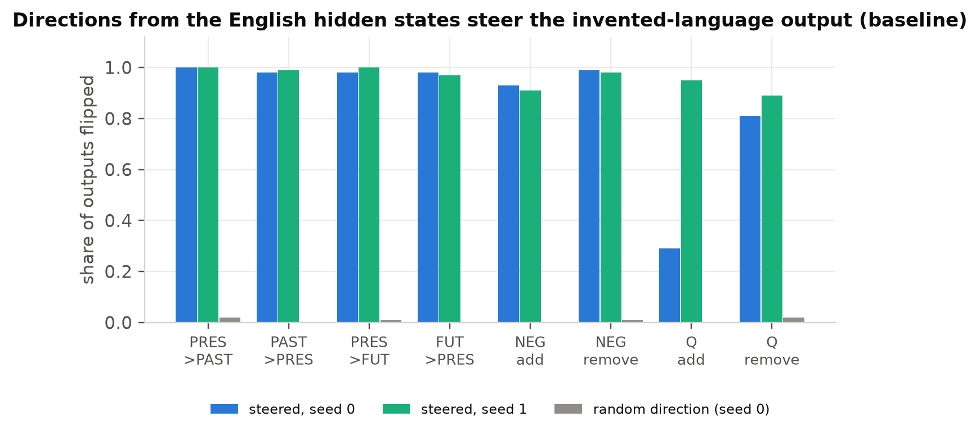
Results and Discussion
D (continued). Inside the model: the errors are in the English representation
Probes read tense, negation, subject … from every model's hidden states (0.90–1.00).
Where the output is wrong, the probe is wrong too (0.41 vs 0.79 majority), and 59% of the time it reads the same wrong value.
Steering the English-side direction flips the output (tense 0.97–1.00 vs ≤ 0.02 random) and repairs 11/12 and 10/10 real subject errors.
Activation addition, the method we apply (Turner et al., 2023, Fig. 1).
Notes:
Why reading fails: the translation is written from the English meaning representation, and most real-English errors are already wrong there.

Slide 15
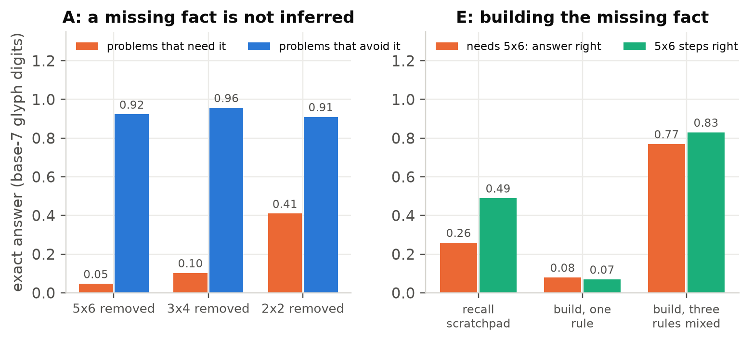
Results and Discussion
E. In maths, a missing fact is rebuilt only from facts seen in the same role
Base-7 arithmetic in glyph digits; 5×6 and 6×5 removed from training.
1. Recall scratchpad: every other step right, but 5×6 steps only 0.49 (guessing; voting does not help).
2. Build from a smaller fact, one rule: 0.08. It writes the block 5×4 wrong, though it computes 5×4 right as a step.
3. Mix three building rules: 0.77. Steps from blocks seen in that role: 99.6% right; never seen in that role: 17%.
Notes:
Claim E, part 1: how we got the model to build the missing fact.

Slide 16
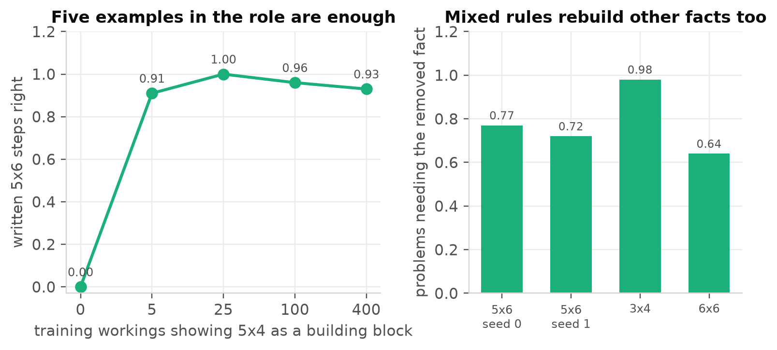
Results and Discussion
E (continued). Five examples of the role are enough
4. Role dose: showing 5×4 as a block in just 5 training workings makes 5×6 right 0.91 (0.00 with none): a step, not a slope.
The same recipe rebuilds 3×4 (0.98) and 6×6 (0.64); 15 of 18 forced routes follow the role rule.
The dose never reaches the reverse order 6×5 (≤ 0.06), but with 5×6 present, the never-seen 6×5 is right 172/174.
Caveat: one training run per condition, and same-seed maths runs vary by about ±0.1–0.2 (GPU non-determinism).
Notes:
Claim E, part 2: the role dose and the replicates.

Slide 17
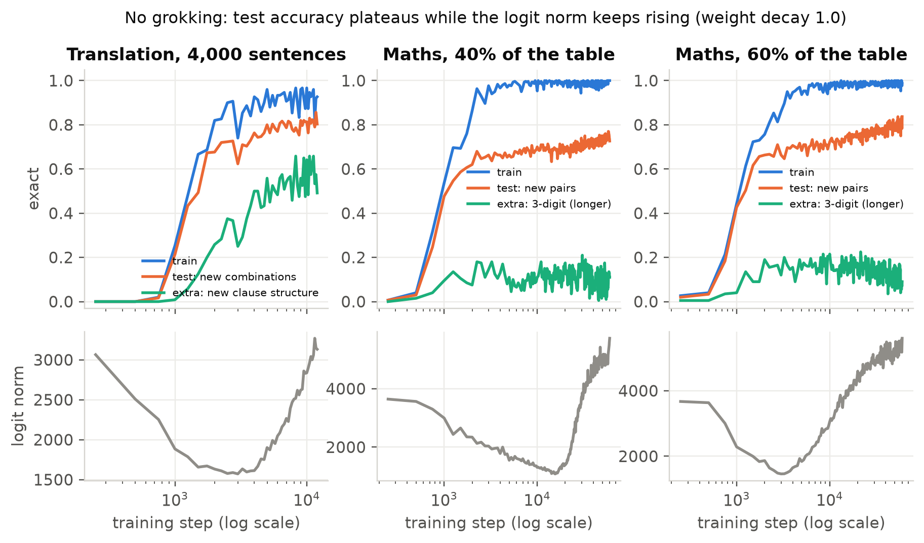
Results and Discussion
Side study: does longer training help? No grokking
Grokking = a late jump in test accuracy long after training saturates (Power et al., 2022).
We trained 3 settings far past saturation with weight decay 1.0 (12k steps translation, 60k maths).
No jump: test accuracy plateaus (0.73–0.84), longer problems stay at 0.09–0.11.
The logit norm keeps rising: the model grows more confident in what it memorised instead of simplifying.
Notes:
Grokking side study: none observed.

Slide 18
Results and Discussion
Limitations
Most extension results are single training runs; real text, steering and the 0/50 passive dose have two seeds.
Tatoeba gold comes from an automatic reader (about a third wrong); the sealed set has 147 sentences (differences below ≈0.11 are noise).
Same-seed maths runs differ by ±0.1–0.2 (non-deterministic attention backward); language runs reproduce exactly in deterministic mode.
One model family and size, one invented grammar; claims B and D were partly formed after the first data.
Future work
Second training seed of the sound-rule language (claim B).
Languages with 25% and 50% rule-spelled words: is the change from list to rule gradual or sharp?
Three deterministic seeds of the role-rule maths runs and the 0 / 5 role doses (claim E), judged against the written thresholds.
Confirm bit-identical maths runs with the attention fix, then re-judge the single-run maths thresholds.
Notes:
Limitations and future work.

Slide 19
Results and Discussion
Conclusion
Finding | Evidence | Strength
A. Learning stops at training coverage | held-out 0.00–0.09; 50 passives → 0.53–0.66 | strong
B. Rule only when it covers the vocabulary | new words 0.67 vs new loans 0.19–0.27 | moderate
C. Only English variety helps real English | Tatoeba 0.62 → 0.92; 8 alternatives null | strong / moderate
D. Reading fails; with new words, both | reader 74–90% of failures; probes: errors already inside | moderate
E. Missing fact rebuilt only from its role | mixed rules 0.77 vs one rule 0.08; 5 examples suffice | moderate (1 run each)
A small model learns the invented language itself well, but generalises only as far as its training covers: in structure, and in spelling only when the rule covers the vocabulary.
On real English the limit is reading the English, and only more varied English in the data moves it, not loss functions, decoding, more epochs or a larger model.
Notes:
Conclusion.

