Slide 1
Alien Rosetta
How far does a small LLM learn a language it has never seen?
Group Number: 14
Names: Kavinraj
Roll Numbers: 24IM10055
Code: github.com/Lsidvd234/alien-rosetta
Notes:
Alien Rosetta: we invent a language, teach it to a small LLM with LoRA, and measure exactly where the learning stops.

Slide 2
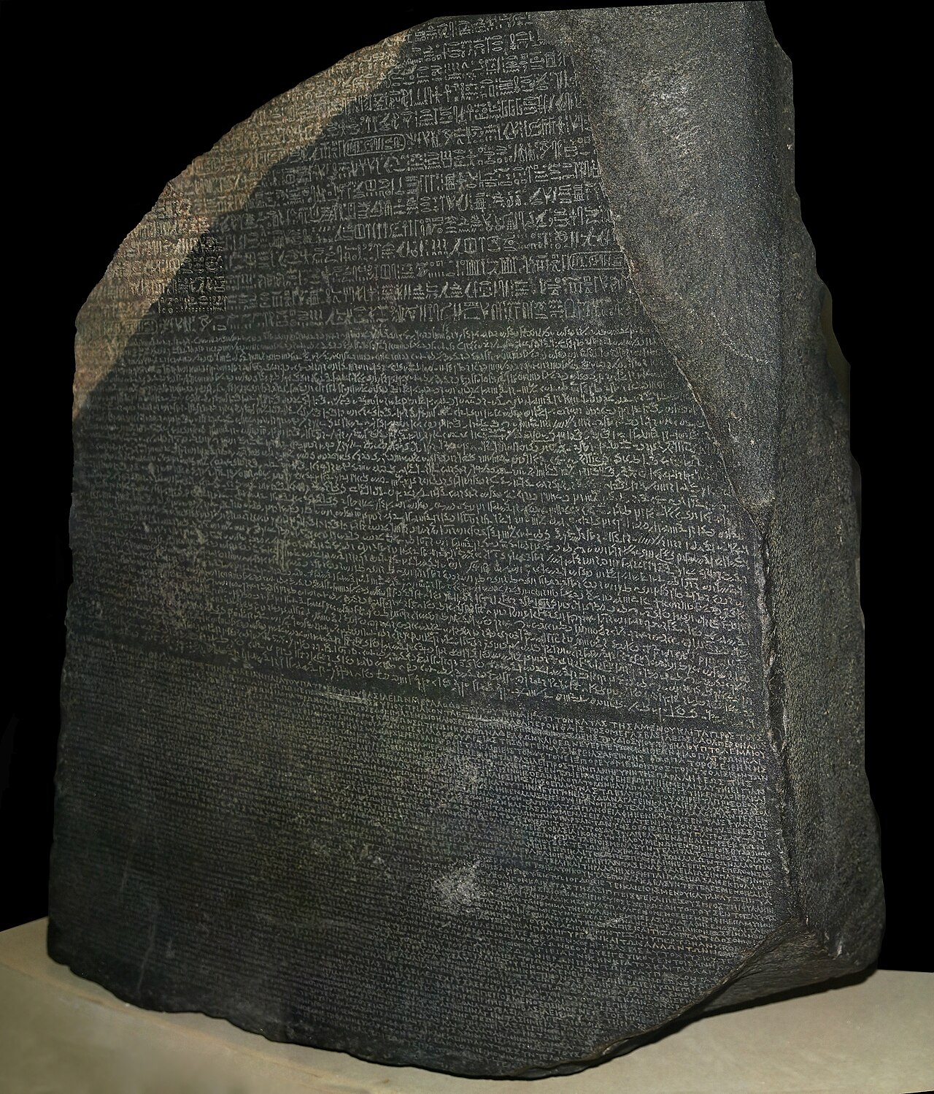
Problem Statement
Why an invented language?
Small LLMs are often adapted to new languages, scripts and notations with LoRA. Real languages make this hard to study: the model may have seen them, gold translations are noisy, and no single property can be changed on its own.
We invent the language instead: an exact answer key, never seen in pretraining, and every property (grammar, script, vocabulary, structures in training) can be changed one at a time.
Research question
What does it take for a small LLM to learn a language it has never seen, and where does that learning stop?
Input → process → output
Input: an English sentence x, e.g. “Tom is going to beat you.”
Process: Qwen3-0.6B + LoRA reads x, writes its meaning analysis m, then the translation y.
Output: S=NAME.Tom V=beat.FUT O=PRON.2sg => [glyphs: Tom you-ACC beat-FUT-3sg]
The Rosetta Stone: one text in three scripts, the idea behind the name. Photo: Hans Hillewaert, CC BY-SA 4.0 (Wikimedia Commons).
Notes:
Motivation, research question, and the input/process/output of the task.

Slide 3
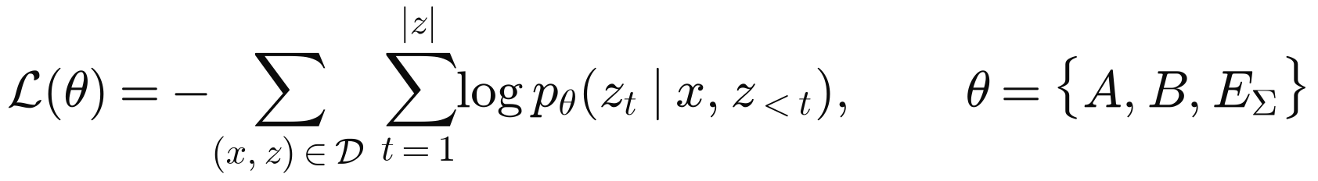
Problem Statement
Mathematical formulation
A generator defines meanings m ∈ M, an English renderer x = E(m, v) (v = surface variant) and a deterministic glyph renderer R (SOV order, endings, sound changes, 27 glyphs).
The model writes the meaning first, then the glyphs. Training minimises cross-entropy on the target only; only the LoRA matrices A, B and the new glyph embeddings EΣ are trained.
Because R is deterministic, every wrong output is exactly one of two kinds:
The experiments vary how often each key occurs in training (0 = held out, a small dose, or many):
Notes:
The formal setup: generator, target string, loss, error split, coverage.

Slide 4
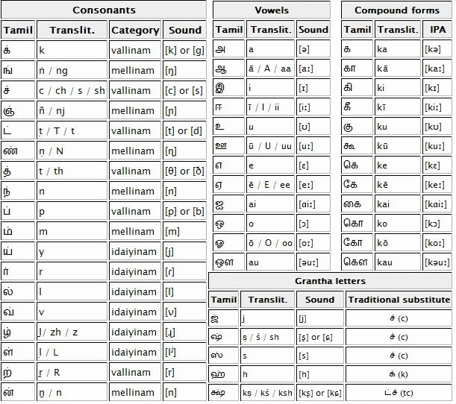
Problem Statement
Data pipeline
1. Sample a meaning first from families (statement, question, command, fragment; tense, aspect, modality, negation; subject/object kinds; 21 relation fields), so labels are right by construction.
2. Render English with a surface variant (word order, voice, contractions, casing, typos, synonyms).
3. Render glyphs deterministically: 11,078 roots + built words, case and agreement endings, sandhi, 27 glyphs (Unicode Private Use Area), each one new token.
4. Word floor: every word at least 12 times; 80,000 pairs + 2,500 refusals + 6,000 replay = 88,500.
5. One change per experiment: hold structures out, put a dose back, spell words by a sound rule, replace 15% with real Tatoeba sentences, add everyday English, paraphrase.
Test sets: 300 generated, 600 real Tatoeba sentences, and a sealed set of 147 + 25 free sentences written by the author, frozen by hash and used only as totals.
The grammar and the abugida script are modelled on Tamil (subject–object–verb, case endings, one sign per syllable). Chart: public domain, Wikimedia Commons.
Notes:
How the training and test data are produced.

Slide 5
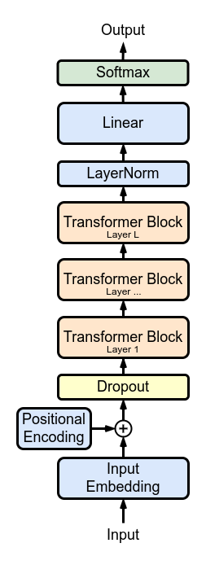
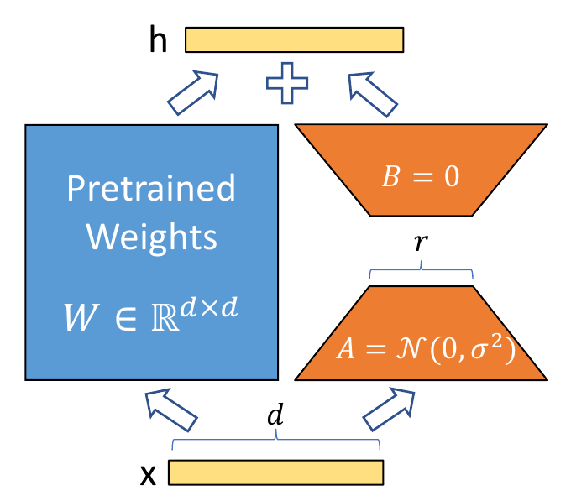
Architecture
Model
Qwen3-0.6B-Base: 28 layers, hidden size 1024, 16 query / 8 key-value heads, 596M parameters, frozen.
LoRA r = 16, α = 32 on q, k, v, o, gate, up and down projections of every layer.
27 new glyph tokens with trainable, tied input/output embeddings; each starts at the embedding of its sound (k, zh, aa, …). 10.1M trainable parameters in total (1.7%).
Output format: meaning analysis, then “=>”, then glyphs (analysis-first); direct models write glyphs only. A reader-only and a writer-only model split the two steps.
Training
AdamW, lr 2e-4, no weight decay, 3% warm-up then linear decay, batch 32, 4 epochs (11,064 steps), fp16; about 6 GPU-hours per run on a free Kaggle T4. 165 runs in total.
LoRA: only A and B are trained (Hu et al., 2021, Fig. 1).
Decoder-only transformer. Marxav, CC BY-SA 4.0 (Wikimedia Commons).
Notes:
Base model, adapter, new tokens and training settings.

Slide 6
Contribution Code
1. New glyph tokens that start from their sound (train/run.py)
Each invented glyph becomes one token whose embedding starts at the embedding of the Latin token for its sound; LoRA is then added on every projection.
def add_glyph_tokens(model, n_old, k, seed, init="mean", donor_ids=None):
"""Give k new glyph tokens a trainable embedding (rows n_old..n_old+k-1)."""
emb = model.get_input_embeddings()
w = emb.weight[:n_old].float()
if init in ("latin", "latin_shuffled"): # donor_ids: token ids of each glyph's sound
g = torch.Generator(device="cpu").manual_seed(seed)
rows = []
for ids in donor_ids:
if ids: # start at the embedding of the glyph's own sound
rows.append(w[torch.tensor(ids, device=w.device)].mean(0))
else: # no sound (virama): neutral start
rows.append(w.mean(0) + torch.randn(w.shape[1], generator=g).to(w.device) * w.std(0) * 0.1)
delta = torch.nn.Parameter(torch.stack(rows))
...
model.model.embed_tokens = AddedEmbed(emb, n_old, delta) # new rows trained, old rows frozen
model.lm_head = AddedHead(model.lm_head, n_old, delta) # tied output rows
return delta
lcfg = LoraConfig(r=16, lora_alpha=32, lora_dropout=0.0, task_type="CAUSAL_LM",
target_modules=["q_proj", "k_proj", "v_proj", "o_proj",
"gate_proj", "up_proj", "down_proj"])
delta = add_glyph_tokens(model, n_old, len(added), a.seed, a.new_tok_init, donors)
model = get_peft_model(model, lcfg)
delta.requires_grad_(True) # glyph embeddings train with the adapter
All code: github.com/Lsidvd234/alien-rosetta
Notes:
The glyph-token initialisation and the LoRA setup.

Slide 7
Contribution Code
2. Splitting every error into reading vs writing (analysis/error_split.py)
Rendering a meaning is deterministic, so a wrong output is classified by re-rendering the model's own analysis with the language generator.
def split(gen, items):
"""items: (gold analysis, gold glyphs, model output 'analysis => glyphs')."""
c = collections.Counter()
for ana_g, gly_g, p in items:
ana_p, _, gly_p = p.partition("=>")
ana_p, gly_p = ana_p.strip(), gly_p.strip()
a_ok, g_ok = ana_p == ana_g, gly_p == gly_g
if a_ok: # read right: any glyph error is a WRITING error
c["both right" if g_ok else "translation error"] += 1
continue
if g_ok:
c["lucky glyphs"] += 1
continue
own, missing = set(), False # READING error: render the model's own (wrong) meaning
try:
cls, _ = from_analysis(ana_p, spell_name)
for gs in itertools.product("mf", repeat=min(len(cls), 6)):
own.add(" ".join(gen.rep.target(with_gender(cl, g)) for cl, g in zip(cls, gs + ("m",) * 9)))
except KeyError:
missing = True # a word key the language does not have
c["understanding error" if gly_p in own else
("both wrong" if own else ("word not in language" if missing else "unreadable"))] += 1
return c
Notes:
The error split used for claim D.

Slide 8
Contribution Code
3. Steering from the English hidden states (analysis/inside_claim4_steer2.py)
A mean-difference direction is added to one layer while the model reads the English; the translation it then writes is checked for the target value.
# direction a -> b (e.g. tense PRES -> PAST): mean English-word state of b minus that of a, at layer L
d = stats[(feat, b)][L][0].mean(0) - stats[(feat, a)][L][0].mean(0)
vec = d / d.norm() * alpha * scale # scale = mean hidden-state norm of layer L
add = (mask * vec.view(1, 1, -1)).to(device) # mask = the English-word positions of the prompt
def hook(_m, _inp, output):
h = output[0] if isinstance(output, tuple) else output
if h.shape[1] == n: # only while the prompt is read
h = h + add.to(h.dtype)
return (h,) + tuple(output[1:]) if isinstance(output, tuple) else h
return output
handle = layers_of(model)[layer - 1].register_forward_hook(hook)
out = model.generate(input_ids=ids, attention_mask=att, do_sample=False, max_new_tokens=40)
handle.remove()
# flip = output analysis now has the target value; control = same-size random direction
Shortened from the project code (loops over batches and settings removed).
Notes:
The steering hook used for claim E.

Slide 9
Benchmark Methods and Evaluation
Methods compared (one change each)
Test sets
Generated 300: same generator, never trained; shared by all runs.
Tatoeba 600: real sentences; gold from an automatic reader (≈0.6 right by hand-check).
Sealed 147 + 25: free English by the author, frozen by hash, totals only.
Metrics and statistics
Meaning exact, glyphs exact, word accuracy, refusal rate; reading vs writing errors.
Paired McNemar tests, bootstrap 95% intervals, Holm correction over 21 tests.
Predictions written before most runs; every number gives its run count.
Group | Methods
Baseline | Qwen3-0.6B + LoRA, analysis first, 80k pairs, floor 12
Training tricks | focal loss (γ = 2), 6 epochs, word floor 25 (+ size-matched control)
Data tricks | paraphrased English (1.4%, 8%), two-stage rewriter
Decoding | beam search (4), majority vote of 5 samples
Scale | Qwen3-1.7B, same data
English variety | everyday English words; 15% real Tatoeba text
Controls | random / shuffled directions; bag-of-words probe; seeds
Notes:
What we compare against and how we score.

Slide 10
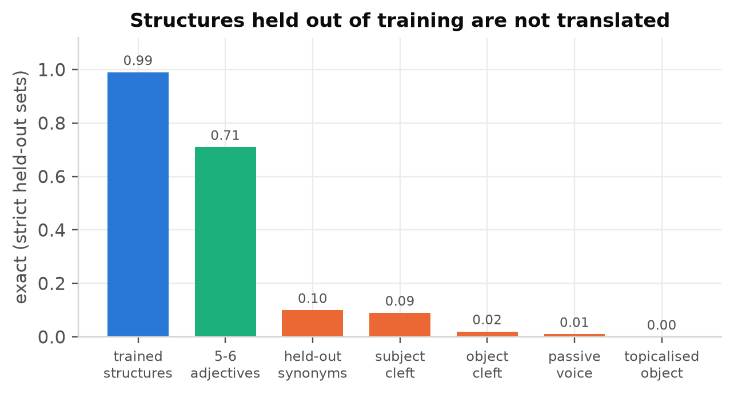
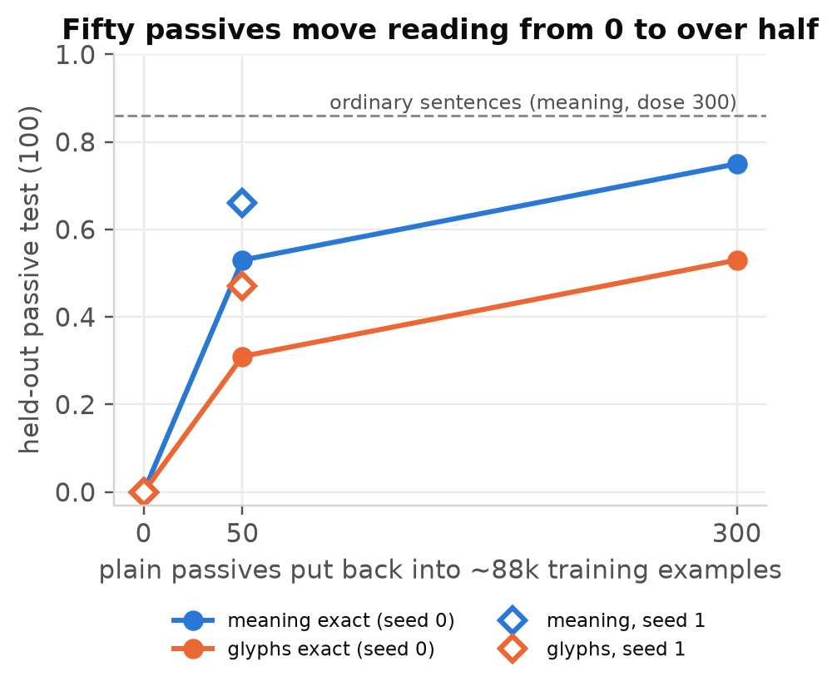
Results and Discussion
A. Generalisation stops at what training covers (strong)
Held-out English structures score 0.00–0.09 (3 runs) while trained ones stay at 0.97–0.99.
Putting back only 50 passives (0.06% of the data) lifts passive reading from 0.00 to 0.53 (0.66 on seed 1).
Maths in glyph digits: removing one fact drops problems needing it to 0.05 (others 0.92); a scratchpad copies its longest training working (2 rows × 3 steps on 1,798 of 1,800 longer rows).
Notes:
Claim A.

Slide 11
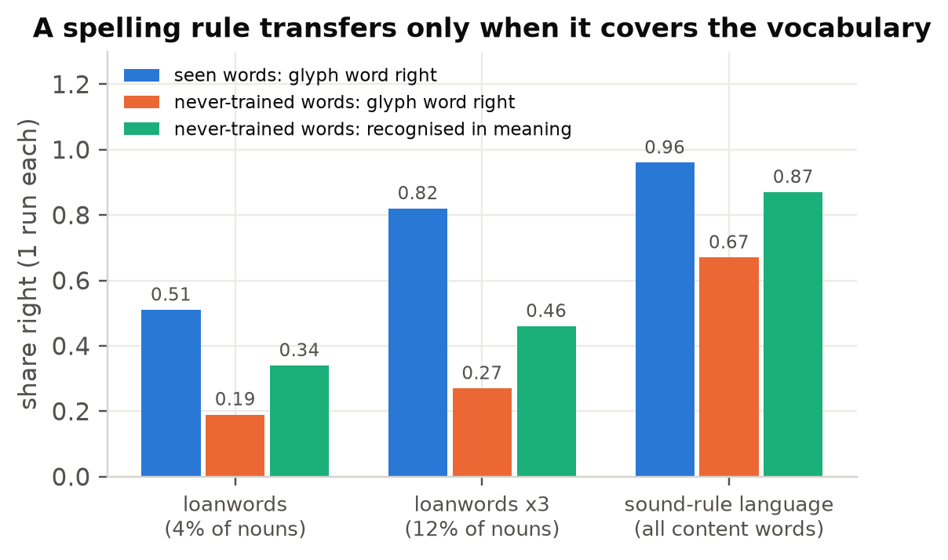
Results and Discussion
B. A spelling rule transfers only when it covers the vocabulary (moderate)
Same letter-to-sound rules in both settings.
Minority (loanwords): new loans 0.19; tripling the loans lifts seen ones to 0.82 but new ones only to 0.27 (the predicted +0.10 missed): a better list, not the rule.
Whole vocabulary: 2,232 never-trained words spelled right 0.67 and recognised 0.87.
One-letter mappings transfer better than multi-letter ones (0.23 vs 0.12, p = 0.005).
1 run per condition; consistent with the Tolerance Principle; no threshold claimed.
Notes:
Claim B.

Slide 12
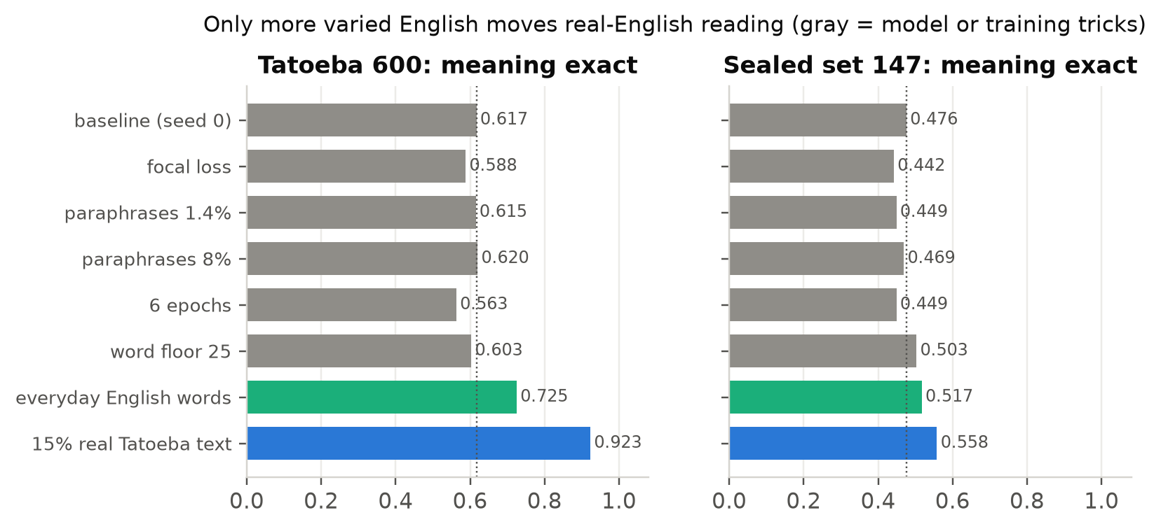
Results and Discussion
C. Only English variety helps real English (strong on Tatoeba)
15% real text: Tatoeba 0.62 → 0.92 (2 seeds, p < 1e-48); sealed 0.47 → 0.56 (paired p = 0.04 / 0.01).
Everyday words, no reader labels: +0.11 / +0.04.
Focal loss, paraphrases, floor 25, 6 epochs, rewriter, beam, voting, 3× model: null or worse.
Caveat: Tatoeba gold comes from the same automatic reader as the real training labels; a hand-check puts about +0.19 of the +0.31 on correct labels. The sealed gain is the fairer size.
Notes:
Claim C.

Slide 13
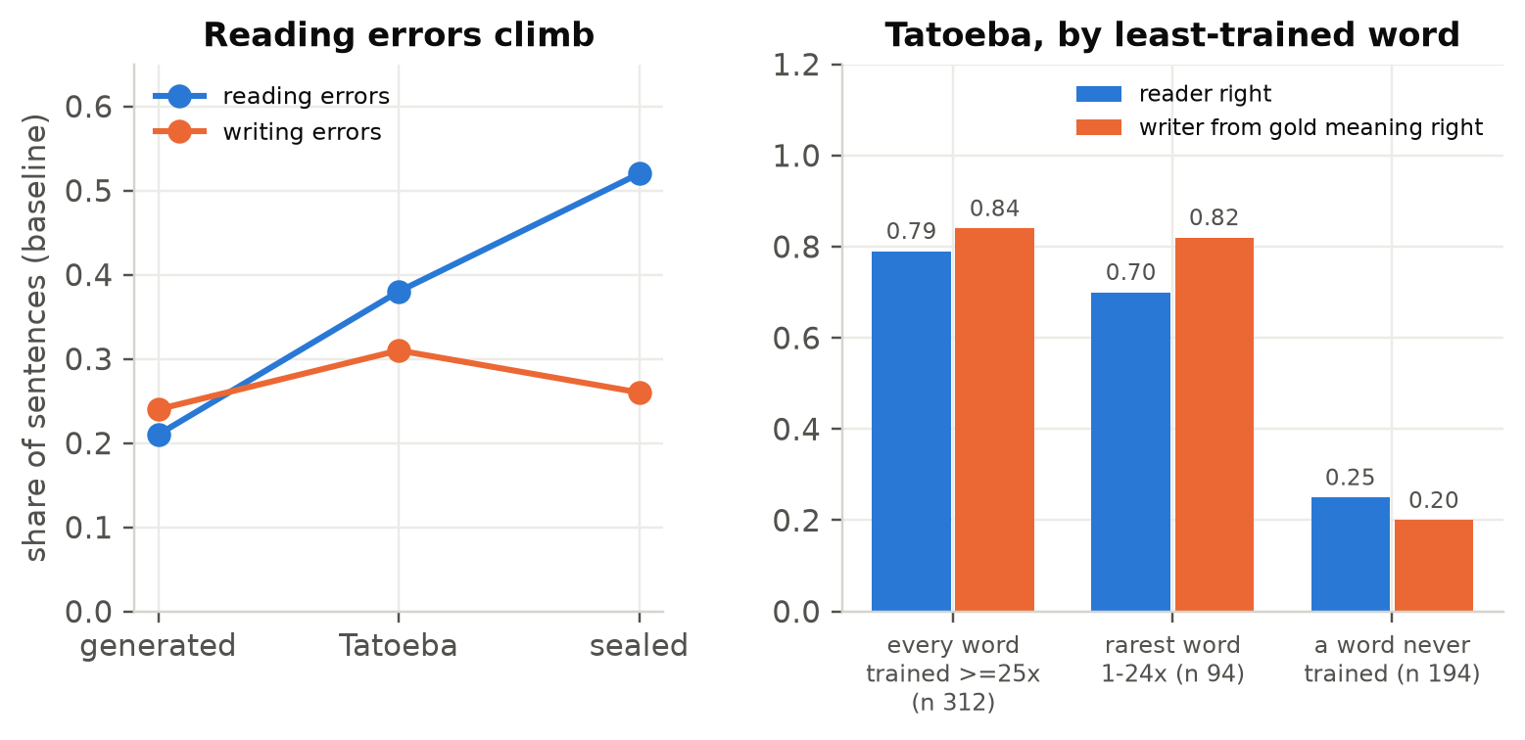
Results and Discussion
D. On real English, reading fails; with untrained words, both (moderate)
Writing errors stay flat (0.24 / 0.31 / 0.26) while reading errors climb (0.21 / 0.38 / 0.52).
Separate reader and writer: the reader causes 74% (Tatoeba) and 90% (sealed) of failures.
The writer fails mostly where a word was never trained (0.20 vs 0.84); the sealed set agrees.
Mechanism for passives: a probe cannot find the doer in the hidden states of the model trained without passives (0.746 vs 0.704 surface baseline), but does in models trained on them (0.871, 0.950).
Notes:
Claim D.

Slide 14
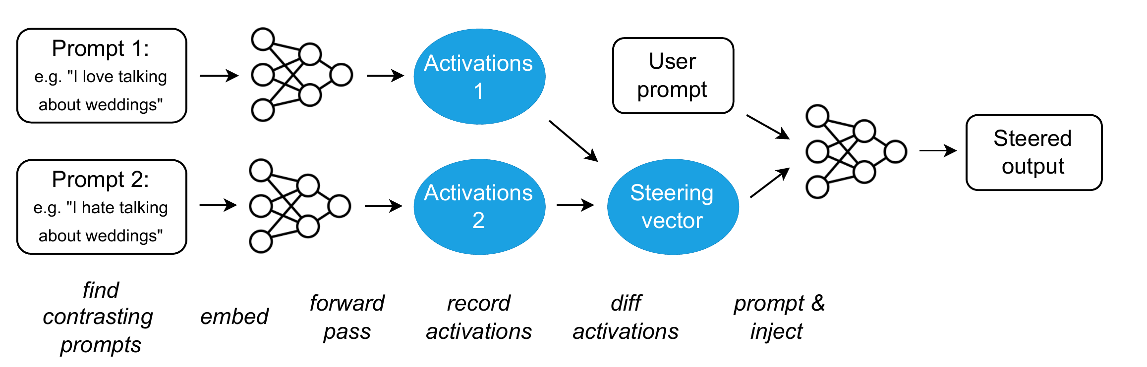
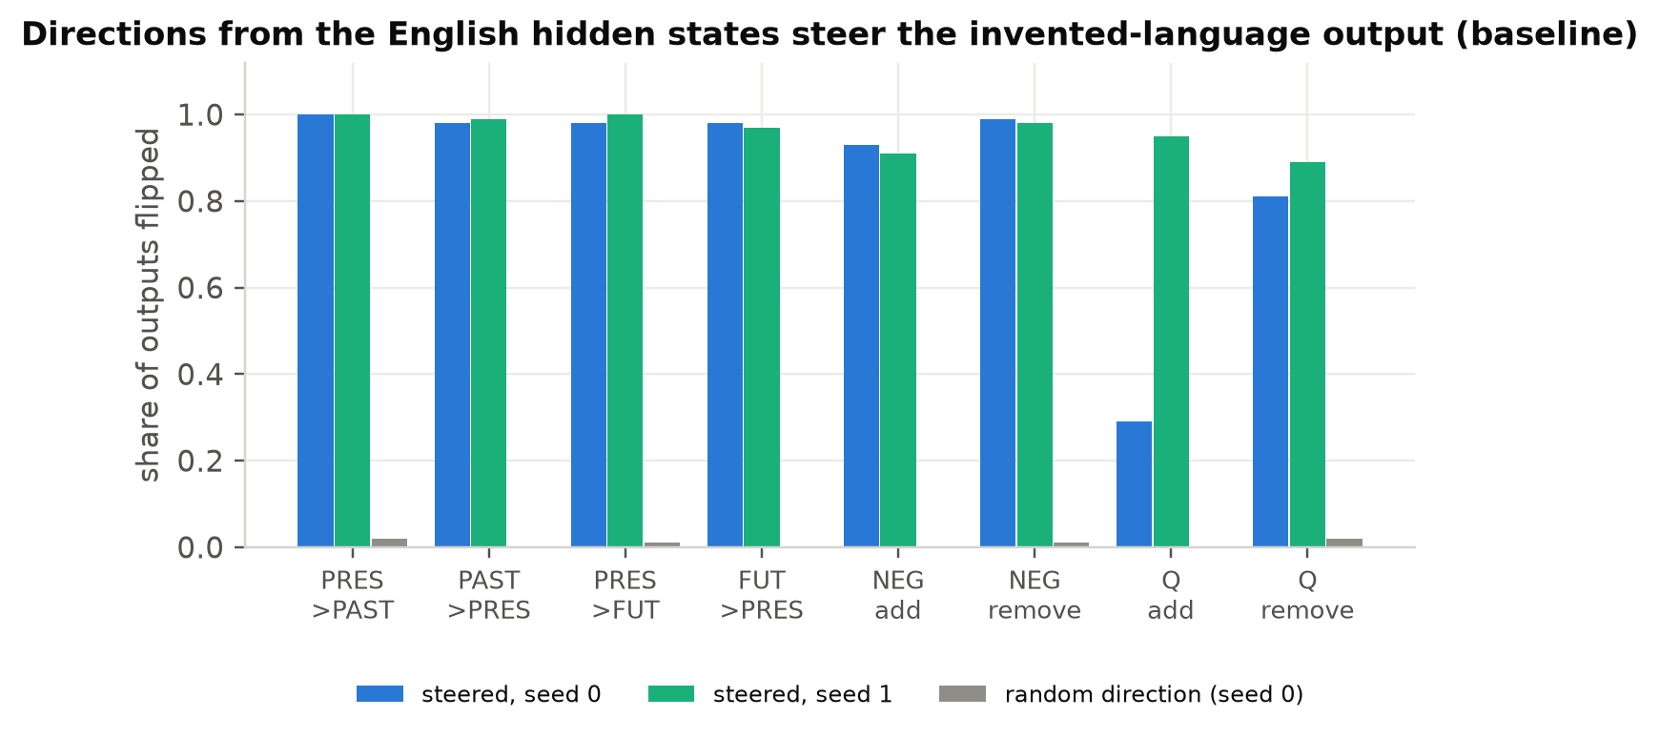
Results and Discussion
E. English meaning directions steer the invented-language output (moderate)
Tense flips 0.97–1.00 and negation 0.91–0.99 vs ≤ 0.02 for random directions, on 4 models.
Subject pushes repair 11/12 and 10/10 real Tatoeba subject errors (2 seeds).
Tense steering is known (Klerings et al., 2025): new is the setting.
Activation addition, the method we apply (Turner et al., 2023, Fig. 1).
Notes:
Claim E.

Slide 15
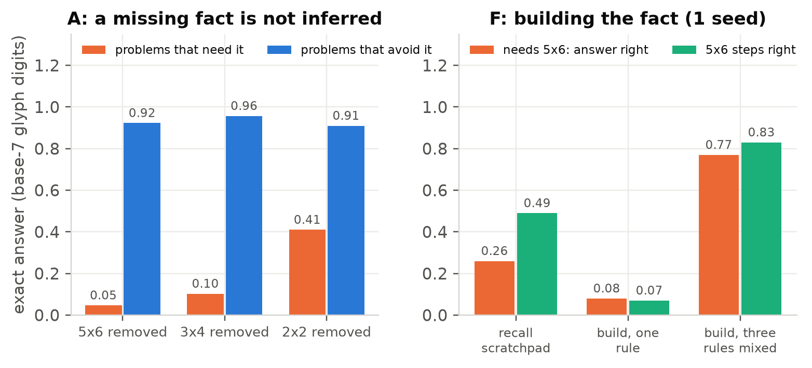
Results and Discussion
F (preliminary) and what did not hold
F, maths: a missing fact is rebuilt only from blocks already seen in the same role (mixed rules 0.77 vs one rule 0.08; 15 of 18 forced routes fit). Not rated: 1 seed, and same-seed maths runs vary ±0.1–0.2 (GPU non-determinism).
Tested and dropped
Glyph start: letter starts learn on 6/6 seeds, others on 3/6 (p = 0.18, not significant); kept as a finding: a wrong letter works as well as the right one, and embeddings stay near their start.
Word floor 25: half of its +0.11 was extra data; no real-English gain.
Meaning first: learned faster only in the first language version.
Notes:
Claim F and the negative results.

Slide 16
Results and Discussion
Limitations
Most extension results are single training runs; real text, steering and the 0/50 passive dose have two seeds.
Tatoeba gold comes from an automatic reader (about a third wrong); the sealed set has 147 sentences (differences below ≈0.11 are noise).
Same-seed maths runs differ by ±0.1–0.2 (non-deterministic attention backward); language runs reproduce exactly in deterministic mode.
One model family and size, one invented grammar; claims B and D were partly formed after the first data.
Future work
Second training seed of the sound-rule language (claim B).
Languages with 25% and 50% rule-spelled words: is the change from list to rule gradual or sharp?
Three deterministic seeds of the role-rule maths runs and the 0 / 5 role doses (claim F), judged against the written thresholds.
Confirm bit-identical maths runs with the attention fix, then re-judge the single-run maths thresholds.
Notes:
Limitations and future work.

Slide 17
Results and Discussion
Conclusion
Finding | Evidence | Strength
A. Learning stops at training coverage | held-out 0.00–0.09; 50 passives → 0.53–0.66 | strong
B. Rule only when it covers the vocabulary | new words 0.67 vs new loans 0.19–0.27 | moderate
C. Only English variety helps real English | Tatoeba 0.62 → 0.92; 8 alternatives null | strong / moderate
D. Reading fails; with new words, both | reader 74–90% of failures; writer 0.84 vs 0.20 | moderate
E. English directions steer the output | flips 0.91–1.00 vs ≤ 0.02 random | moderate
F. Maths role rule | mixed rules 0.77 vs 0.08 (1 seed) | preliminary
A small model learns the invented language itself well, but generalises only as far as its training covers: in structure, and in spelling only when the rule covers the vocabulary.
On real English the limit is reading the English, and only more varied English in the data moves it, not loss functions, decoding, more epochs or a larger model.
Notes:
Conclusion.

