Slide 1
NetCDF
What a NetCDF file?
How can you use a NetCDF file?
Examples in using a NetCDF file.
Useful Links

Slide 2
Overview
What is a NetCDF file? NetCDF is a set of software libraries and self-describing, machine-independent data formats that support the creation, access, and sharing of array-oriented scientific data. NetCDF was developed and is maintained at Unidata. Unidata provides data and software tools for use in geoscience education and research. Unidata is part of the University Corporation for Atmospheric Research (UCAR) Community Programs (UCP). Unidata is funded primarily by the National Science Foundation. The NetCDF homepage may be found at http://www.unidata.ucar.edu/software/netcdf/. The NetCDF source-code is hosted at GitHub, and may be found directly at http://github.com/Unidata/netcdf-c.
info taken from: https://docs.unidata.ucar.edu/netcdf-c/current/

Slide 3
How you can use a NetCDF file: 3 ways to convert to csv
Python Script
Panoply
netcdf4excel
Examples of code are at:
https://confluence.ecmwf.int/display/CKB/How+to+convert+NetCDF+to+CSV
Download from NASA website.
You must have Java 9 to use.
https://www.giss.nasa.gov/tools/panoply/download/
Info from this came from:
https://confluence.ecmwf.int/display/CKB/How+to+convert+NetCDF+to+CSV
Instructions can be found:
https://confluence.ecmwf.int/display/CKB/How+to+convert+NetCDF+to+CSV

Slide 4
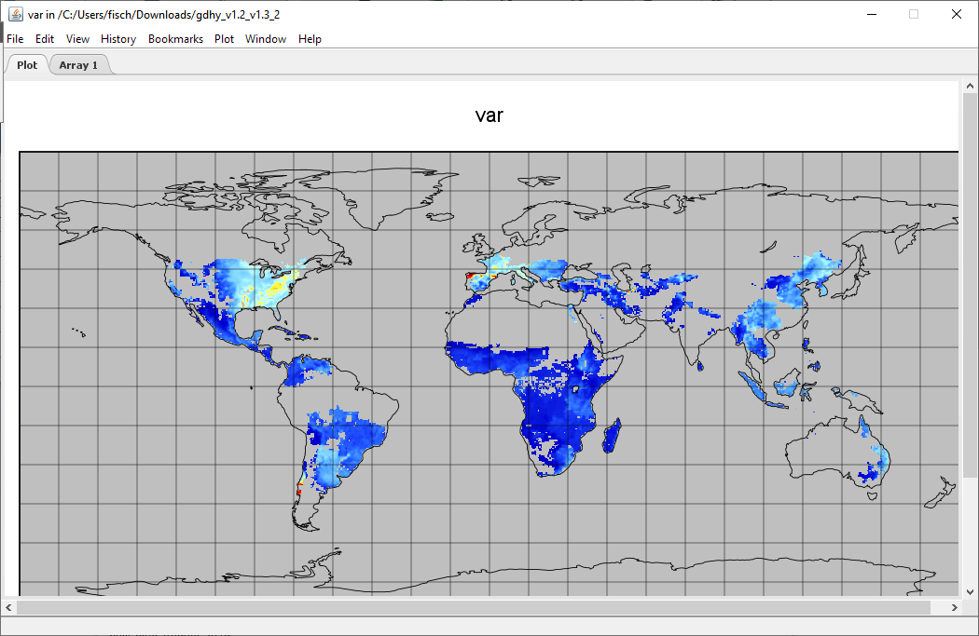
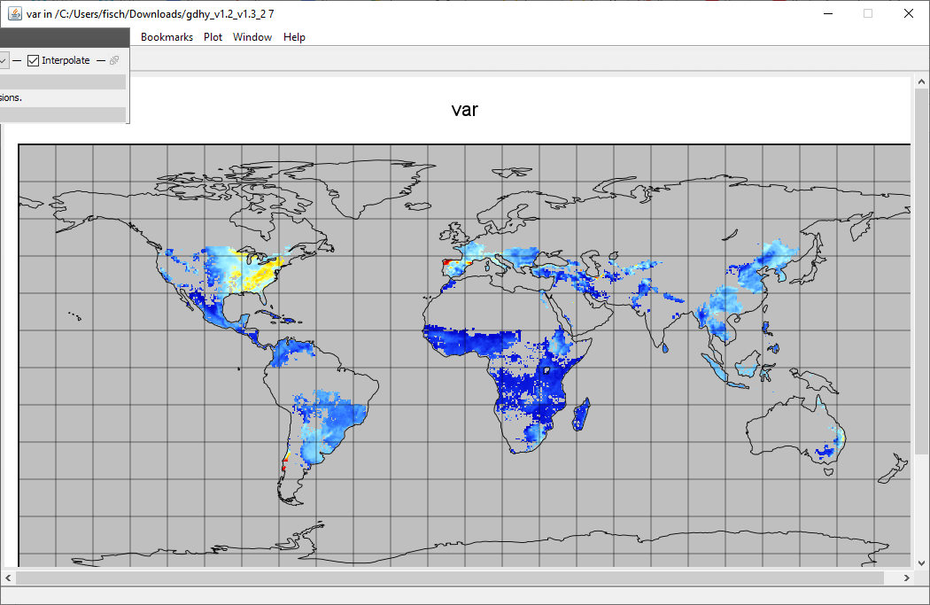
Maize Panoply plot examples
1999 2016

Slide 5
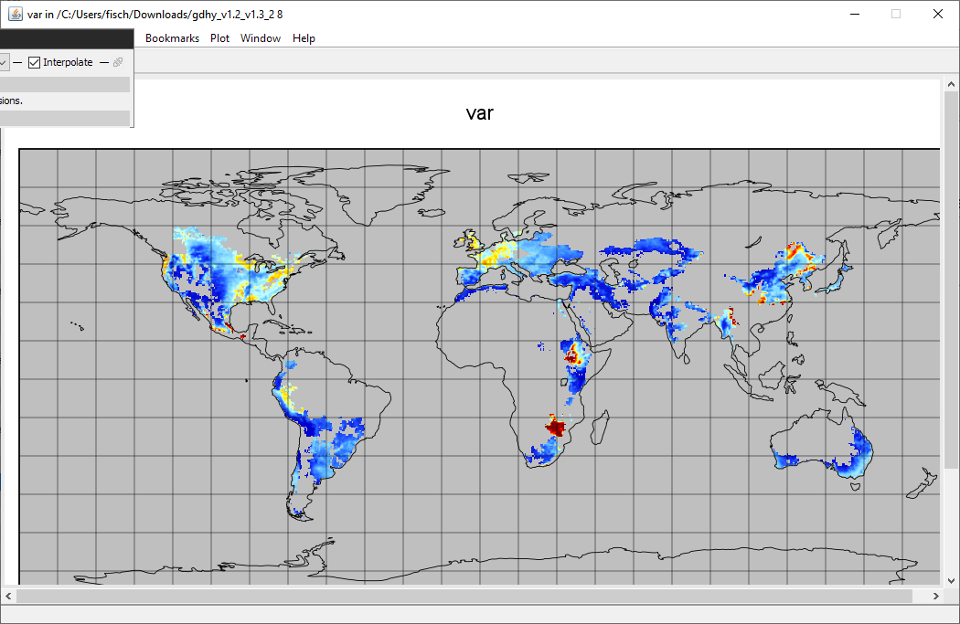
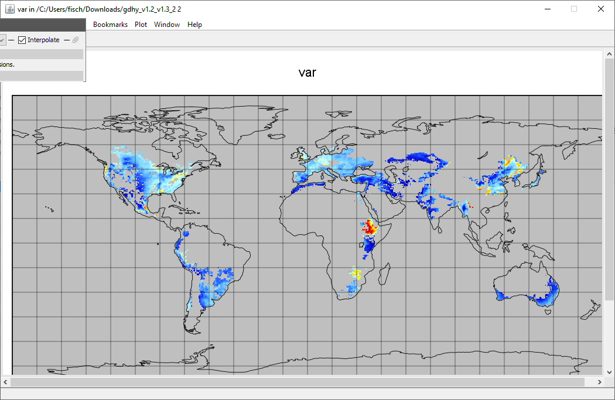
Wheat Panoply plot Examples
1999 2016

Slide 6

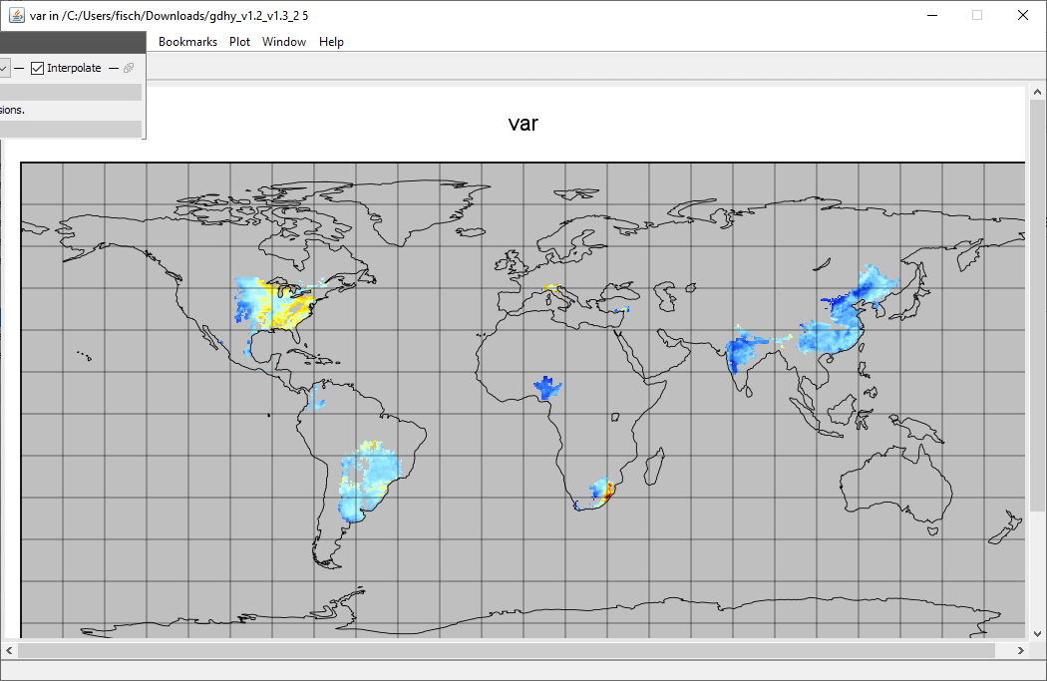
Soybean Panoply plot examples
1999 2016

Slide 7
Links and Examples
Really good video that explains NetCDF files and shows examples of how to visualize the data
https://www.youtube.com/watch?v=XqoetylQAIY
Interesting basic understanding of how a NetCDF works
https://www.youtube.com/watch?v=UvNBnjiTXa0
An hour plus long video that shows some Jupyter Notebook examples with code
NetCDF Why and How: Creating Publication Quality NetCDF Datasets
https://www.youtube.com/watch?v=7YYTXa4qyfo
For R: https://cirrus.ucsd.edu/~pierce/ncdf/
https://www.r-bloggers.com/2016/08/a-netcdf-4-in-r-cheatsheet/
NetCDF4 info: https://unidata.github.io/netcdf4-python/#reading-data-from-a-multi-file-netcdf-dataset
https://www.guillaumedueymes.com/courses/tutorial_python_netcdf/3-cartopy_library/

Slide 8
More Links
NASA’s info on NetCDF:
https://earthdata.nasa.gov/esdis/esco/standards-and-references/netcdf-classic
Python code examples:
https://www.earthinversion.com/utilities/reading-NetCDF4-data-in-python/#reading-and-analyzing-netcdf-data-with-the-help-of-xarray
https://towardsdatascience.com/read-netcdf-data-with-python-901f7ff61648
https://medium.com/analytics-vidhya/how-to-read-and-visualize-netcdf-nc-geospatial-files-using-python-6c2ac8907c7c
Converting to CSV: https://stackoverflow.com/questions/44359869/convert-netcdf-file-to-csv-or-text-using-python
For Visual Studio:
https://docs.unidata.ucar.edu/netcdf-c/current/winbin.html
https://www.unidata.ucar.edu/software/netcdf/examples/files.html
NetCDFexcel
https://github.com/NetCDF4Excel/project/wiki/Functionnalities

