Slide 1
Topical Similarity Using Transformers
Yehuda Snow
Jacob Khalili

Slide 2
What is a Transformer (2017)
A Deep Neural Network
Generates vector representations

Slide 3
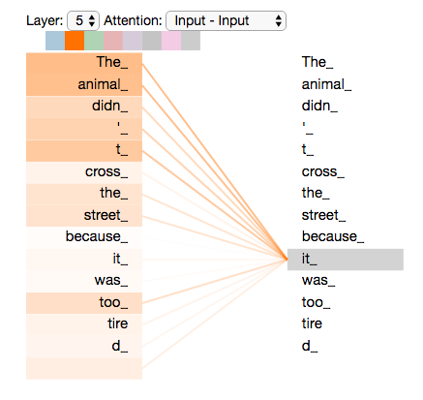
Benefits of Transformers
Can process entire sequences in parallel (speed)
Attention mechanisms (track long distance relations between words)

Slide 4
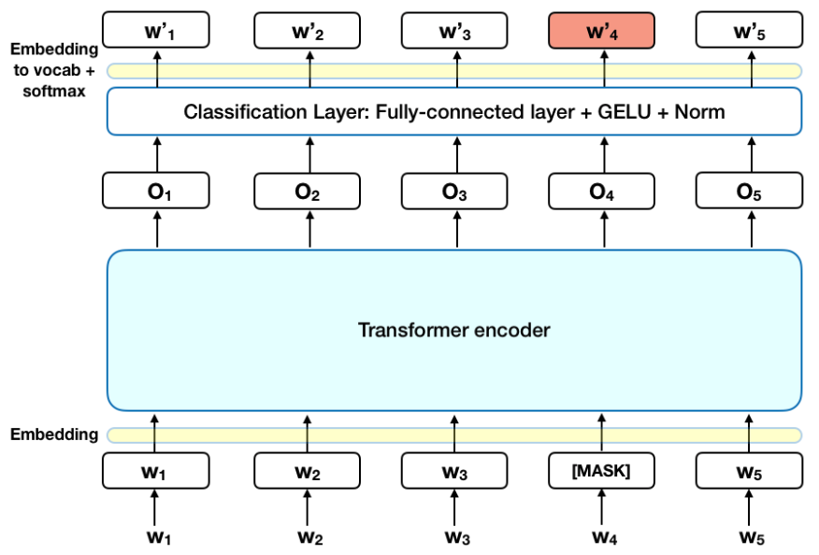
BERT (2018)
Bidirectional Encoder Representation for Transformers
Helps capture context going both ways
Trained using Masked Language Modeling and Next Sentence Prediction (more on next slide)

Slide 5
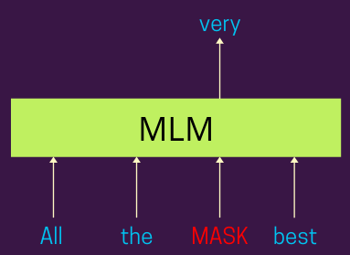
How to train transformers
Masked Language Modeling (MLM)
Next sentence prediction (NSP)
Many different ways to train

Slide 6
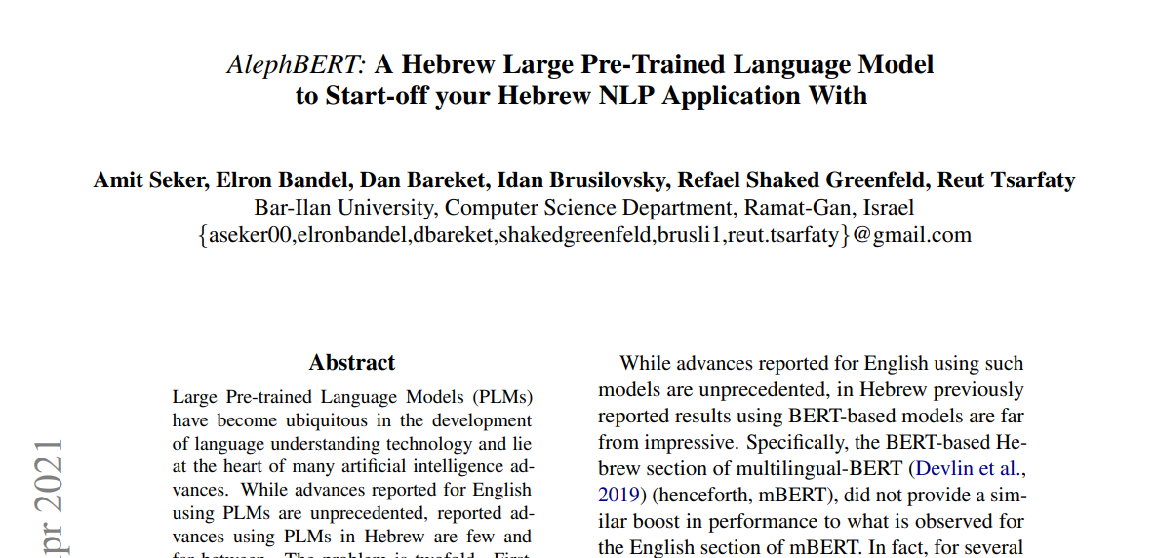
Alephbert-base
On Hugging Face Hub
Pretrained using Masked Language Modeling on OSCAR, Wikipedia, and tweets from Twitter

Slide 7
Alebhbert-base-fine-tuned-for-shut
Fine-tuned based on 26801 sheilos utshuvos
Adjusting the weights by doing Masked Language Modeling on our dataset
Optimize them to predict the correct word

Slide 8
How we found similarity
for each paragraph we generated a vector
we took the distances between the vectors
vectors with least distance were most similar

Slide 9
Usage of our model
Bar ilan responsa project
Will shows most similar responsa to the current responsa

Slide 10
Challenges encountered
Correctly formatting the data in order to train the model
First time ever doing machine learning (for me)

Slide 11
Next steps
Using a model trained on jewish literature
Use general document embeddings in conjunction with paragraph embeddings

Slide 12
Thank you!

