Slide 1

RenewAgra Technical Solution Design Exemplar
THE FUTURE OF CROPS

Slide 2
Where are we?
Start
Fit-to-Standard Workshop Preparation
Technical Solution Design – Initial Approach
Customer Feedback Incorporation
Redesign and Finalization of Technical Solution Design
Q-Gate and Signoff
End

Slide 3
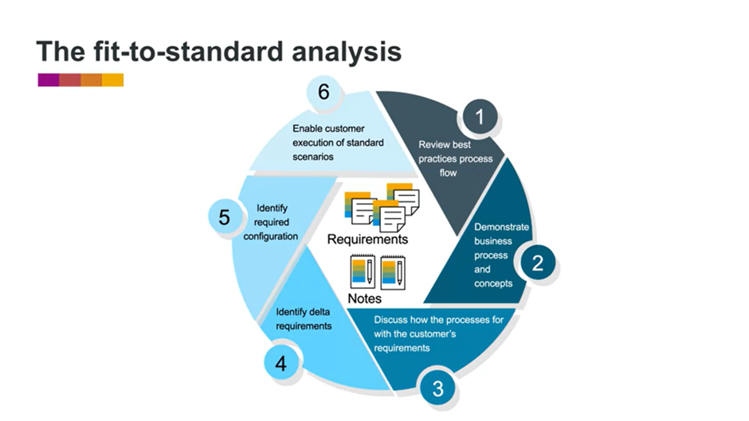
How does fit-to-standard work?
Task 1, Activity 1

Slide 4
Example of a standard functionality
Task 1, Activity 2
SAP Fiori Apps for Agricultural Insights:
Key Features:
Real-time crop monitoring with satellite imagery.
Weather forecasting and analysis.
Soil condition assessments.
Predictive analytics for crop management.
Fit-to-Standard Alignment:
Leverages standard SAP Fiori UX and Analytics solutions.
Aligns with RenewAgra's goal of providing a unified and user-friendly interface for accessing real-time agricultural data.
Benefits:
Efficiency and User Adoption: By adopting standard Fiori Apps, RenewAgra ensures streamlined processes and improved user adoption due to the familiar and intuitive interface.
Sustainability and Future Updates: Reducing customization ensures sustainability, making it easier to incorporate future updates and enhancements from SAP.
Next Steps:
Stakeholder Engagement: Engage with stakeholders to gather feedback on the demonstrated functionality and understand specific business requirements.
Feasibility Analysis: Perform a feasibility analysis to ensure seamless integration with existing systems and alignment with long-term goals.

Slide 5
Where are we?
Start
Fit-to-Standard Workshop Preparation
Technical Solution Design – Initial Approach
Customer Feedback Incorporation
Redesign and Finalization of Technical Solution Design
Q-Gate and Signoff
End

Slide 6
What will we do? CropCo
Task 2, Activity 4
Implement SAP S/4HANA for CropCo to replace outdated systems.
Integrate reporting, asset management, and logistics for a unified solution.

Slide 7
What will we do? TransCorp
Task 2, Activity 4
Develop a Fiori UX for TransCrop, providing a fully mobile data access and analytics platform.
Enhance data transformation for real-time monitoring of transportation activities.

Slide 8
What will we do? EnvoData
Task 2, Activity 4
Provide advanced analytics tools for EnvoData's Data Analysts for forecasting and simulation in SAP HANA.
Explore drone technology for land analysis and integrate with SAP solutions.

Slide 9
How ready are we?
Task 2, Activity 4
CropCo currently relies on outdated systems. Transition to SAP S/4HANA is feasible with proper planning and data migration strategies.
TransCrop has a specialized trading system. Developing Fiori UX aligns with their need for a mobile platform, and data transformation is feasible with EnvoData's capabilities.
EnvoData has a robust SAP landscape, including SAP HANA. Advanced analytics tools align with their capabilities. The drone integration needs further assessment for technical feasibility and regulatory compliance.

Slide 10
Where are we?
Start
Fit-to-Standard Workshop Preparation
Technical Solution Design – Initial Approach
Customer Feedback Incorporation
Redesign and Finalization of Technical Solution Design
Q-Gate and Signoff
End

Slide 11
Addressing customer feedback
Task 3, Activity 4
 | Customer Feedback | Resolution
 | CropCo expressed concern about the potential challenges and resistance from engineers accustomed to their existing systems during the transition to SAP S/4HANA. | Conduct Change Management Workshops: Implement comprehensive change management workshops to communicate the benefits of the new system, address concerns, and provide hands-on training. Engage Stakeholders Early: Involve engineers in the decision-making process and gather their input to make them feel a sense of ownership in the transition.
 | EnvoData raised a question about the regulatory compliance and data security implications of integrating drone technology for land analysis. | Regulatory Compliance Assessment: Collaborate with legal and regulatory experts to conduct a thorough assessment of regulations related to drone technology in each operating country. Data Security Protocols: Develop and implement robust data security protocols to ensure compliance with industry standards and address any potential concerns.

Slide 12
Where are we?
Start
Fit-to-Standard Workshop Preparation
Technical Solution Design – Initial Approach
Customer Feedback Incorporation
Redesign and Finalization of Technical Solution Design
Q-Gate and Signoff
End

Slide 13
What will we do? CropCo
Task 4, Activity 2
CropCo - Integrated Data Management Solution:
Revised Approach:
Implement SAP S/4HANA for CropCo, emphasizing a phased approach to mitigate resistance.
Incorporate comprehensive change management workshops for engineers.
Discarded Solutions:
Initial plan included a rapid transition, now revised for a phased approach.

Slide 14
What will we do? TransCorp
Task 4, Activity 2
TransCrop - Mobility and Logistics Enhancement:
Revised Approach:
Develop Fiori UX with enhanced data transformation capabilities.
Integrate GPS for real-time monitoring and enhance re-routing capabilities.
Added Solutions:
Integration of GPS for improved real-time monitoring and re-routing.
Configurations:
Fiori UX customization for specific TransCrop needs.

Slide 15
What will we do? EnvoData
Task 4, Activity 2
EnvoData - Advanced Analytics and Drone Integration:
Revised Approach:
Continue providing advanced analytics tools for EnvoData's Data Analysts in SAP HANA.
Initiate a comprehensive assessment for drone technology integration, considering regulatory compliance.
Added Solutions:
Regulatory compliance assessment for drone technology.
Configurations:
Fine-tuning advanced analytics tools for specific EnvoData requirements.

Slide 16
RenewAgra – How ready are we?
Task 4, Activity 2
Infrastructure Upgrades:
Assess and execute any required infrastructure upgrades to support the proposed solutions.
Staff Training:
Develop a comprehensive training program for all employees to ensure a smooth transition.
Stakeholder Communication:
Maintain open communication channels with stakeholders for continuous feedback and updates.

Slide 17
Where are we?
Start
Fit-to-Standard Workshop Preparation
Technical Solution Design – Initial Approach
Customer Feedback Incorporation
Redesign and Finalization of Technical Solution Design
Q-Gate and Signoff
End

Slide 18
RenewAgra – Product Backlog
Task 5, Activity 2
CropCo - Integrated Data Management Solution:
Develop and conduct Change Management Workshops for engineers.
Plan and execute phased SAP S/4HANA implementation.
Create a comprehensive data migration strategy for transitioning to SAP S/4HANA.
TransCrop - Mobility and Logistics Enhancement:
Commence Fiori UX development with a focus on user-friendly interfaces.
Evaluate existing infrastructure for GPS integration feasibility.
Develop a detailed training program for TransCrop employees on the new system.
EnvoData - Advanced Analytics and Drone Integration:
Collaborate with legal experts for a thorough regulatory compliance assessment for drone technology.
Fine-tune and customize advanced analytics tools based on EnvoData's specific requirements.
Provide advanced analytics training sessions for EnvoData's Data Analysts.
General Product Backlog Items Across Businesses:
Assess and execute any required infrastructure upgrades to support proposed solutions.
Develop end-user material and documentation for the new systems.
Establish continuous communication channels with stakeholders for ongoing feedback.

Slide 19
RenewAgra – Q-Gate Checklist
Task 5, Activity 2
Realize Phase:
CropCo - Integrated Data Management Solution:
Verify completion of Change Management Workshops.
Validate successful implementation of phased SAP S/4HANA transition.
Conduct user acceptance testing for data migration.
TransCrop - Mobility and Logistics Enhancement:
Review completion of Fiori UX development.
Ensure successful integration of GPS with real-time monitoring capabilities.
Verify completion of employee training on the new system.
EnvoData - Advanced Analytics and Drone Integration:
Confirm regulatory compliance assessment completion for drone technology.
Validate fine-tuned advanced analytics tools and customization.
Conduct a follow-up session to ensure Data Analysts are proficient in utilizing advanced analytics.
General Q-Gate Checklist Items Across Businesses:
Validate infrastructure upgrades.
Review completion of end-user documentation and training material.
Confirm ongoing stakeholder communication channels are established and effective.

Slide 20
RenewAgra – Lessons Learned
Task 5, Activity 2
Customer Engagement:
What Went Well:
Effective communication during customer engagement.
Good alignment of solutions with customer requirements.
Successful incorporation of customer feedback into the technical solution design.
What Went Wrong:
Initial challenges in understanding CropCo's resistance to system transition.
Some gaps in regulatory understanding related to drone technology in EnvoData.
Approach Effectiveness:
Effective Approaches:
Phased implementation strategy for CropCo.
Tailoring advanced analytics tools based on EnvoData's specific needs.
Areas for Improvement:
Better clarification on regulatory aspects related to EnvoData's business.
More comprehensive initial stakeholder engagement to understand resistance in CropCo.

Slide 21
Where are we?
Start
Fit-to-Standard Workshop Preparation
Technical Solution Design – Initial Approach
Customer Feedback Incorporation
Redesign and Finalization of Technical Solution Design
Q-Gate and Signoff
End

