Slide 1
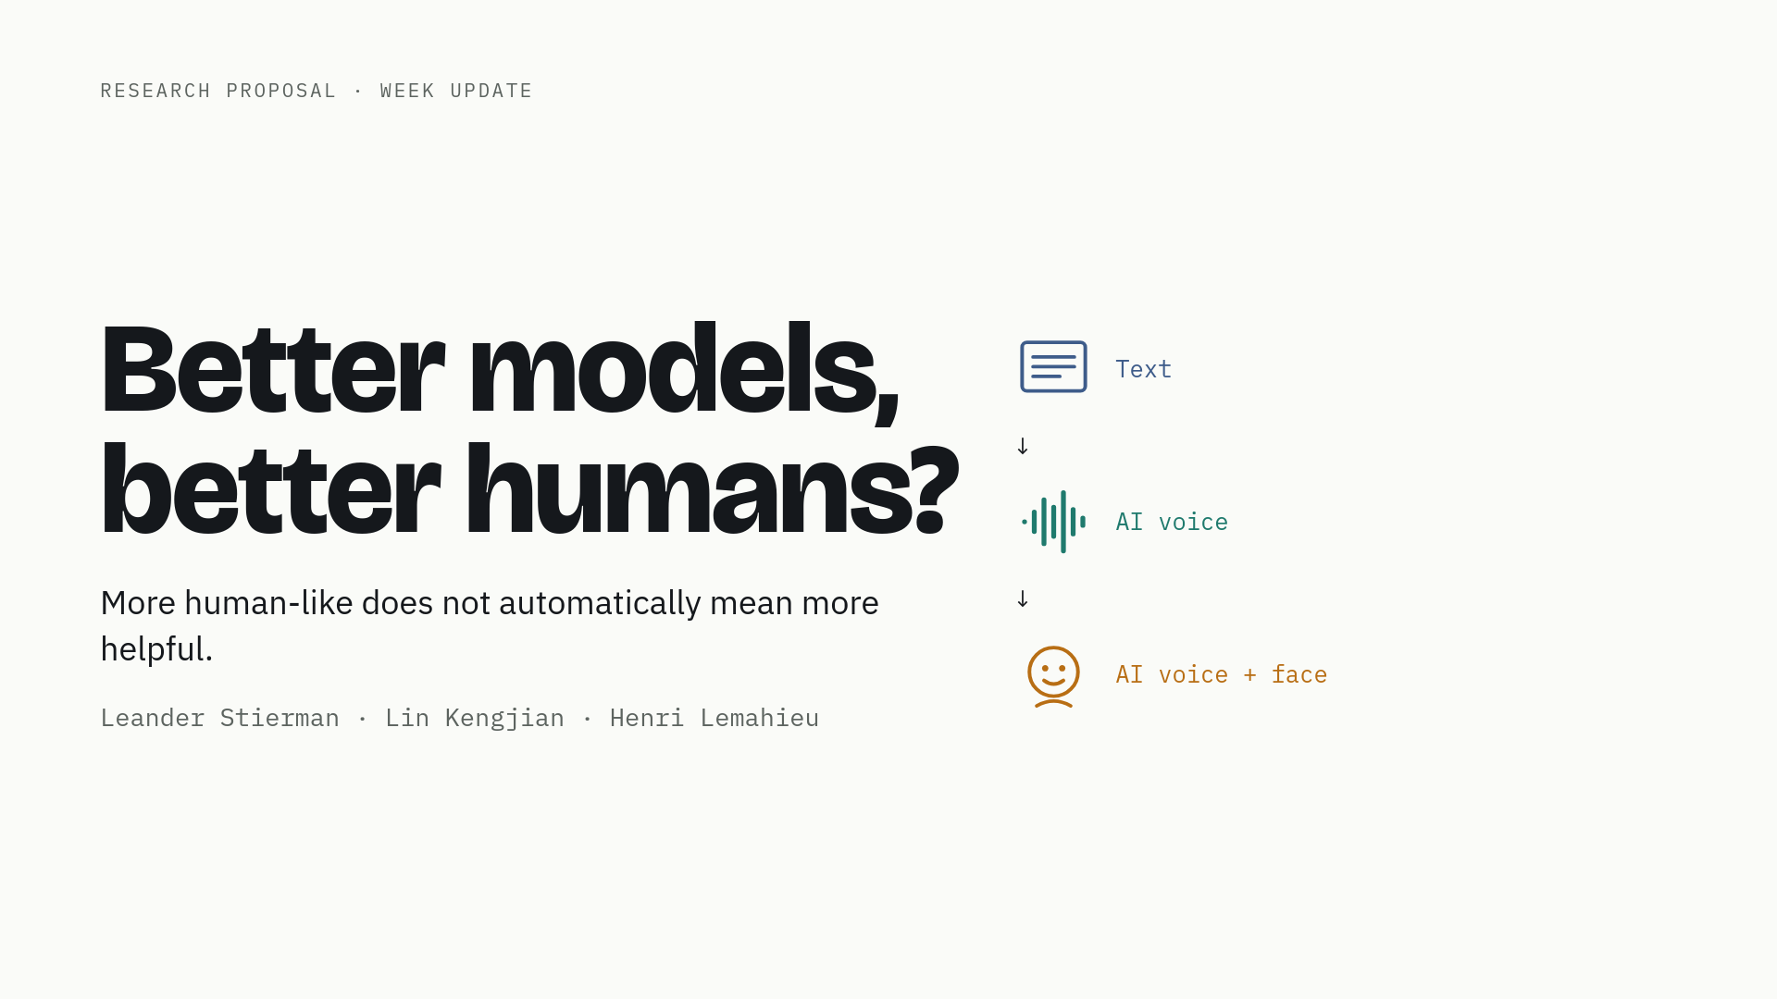
1 / 19
Notes:
Good morning. Last week we introduced the question: better models, better humans? Today we do three things. First, six slides on the design. Then the materials we have built, and an honest account of what we can and cannot claim about them. Finally, the evidence base: forty-four papers on delivery, errors and detection, and the gap we are filling. The thesis is unchanged: more human-like does not automatically mean more helpful.

Slide 2
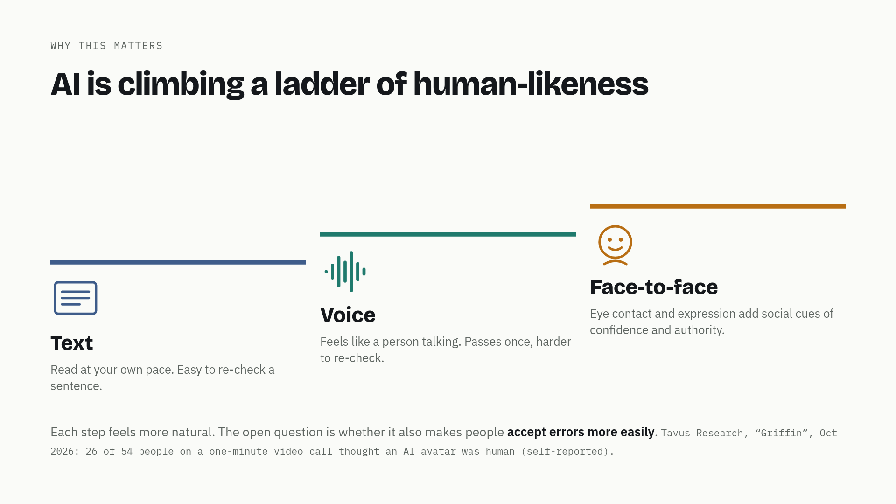
2 / 19
Notes:
AI is climbing this ladder: first chat, then voice assistants, now faces that look at you. Each step feels more natural and more trustworthy. But trust only helps if it matches how good the AI actually is. If a face makes a wrong explanation more convincing, human-likeness makes our decisions worse, not better. A concrete signal of where this is going: last month Tavus reported that in a one-minute video call, 26 out of 54 people thought their AI avatar was a real person. That is their own number, not peer-reviewed, but it shows the direction.

Slide 3
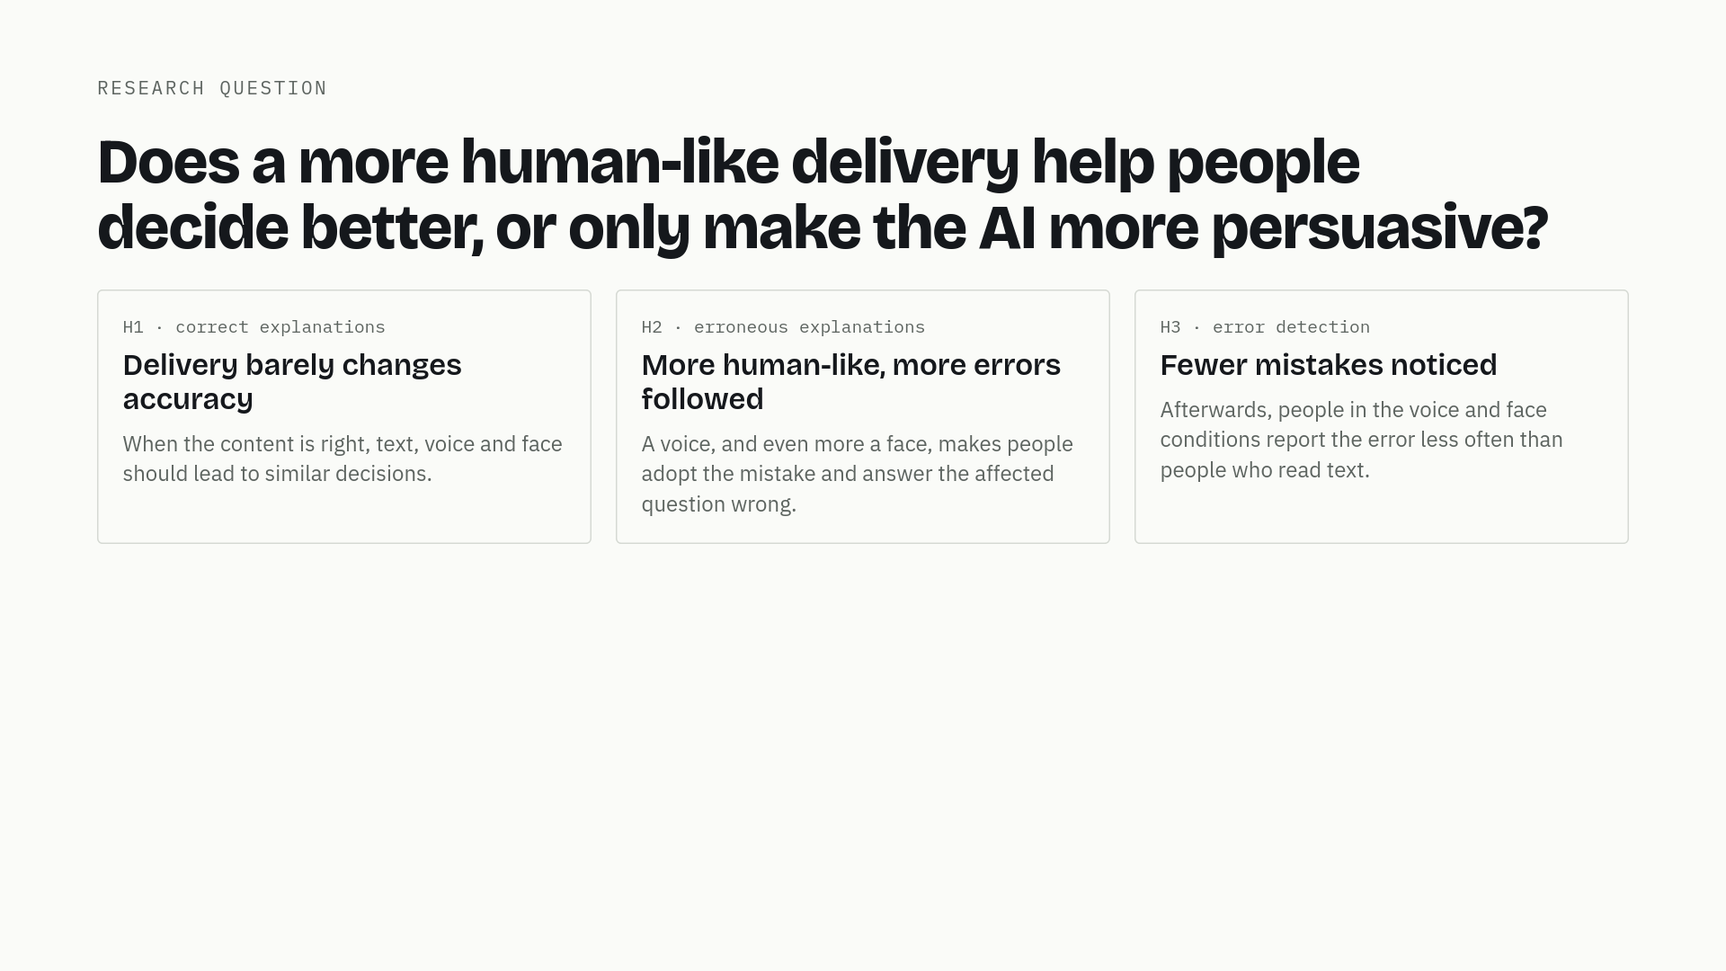
3 / 19
Notes:
Our question: when people learn something new from an AI, does a more human-like format make them more likely to adopt its mistakes? We expect three things. First, when the explanation is correct, delivery barely changes accuracy. Second, and this is the interesting case: when the explanation is wrong, a voice, and even more a face, makes people adopt the mistake. Third, afterwards, people in the voice and face conditions report the error less often. All tests are two-sided: if text turns out to be more misleading, that is also a finding.

Slide 4
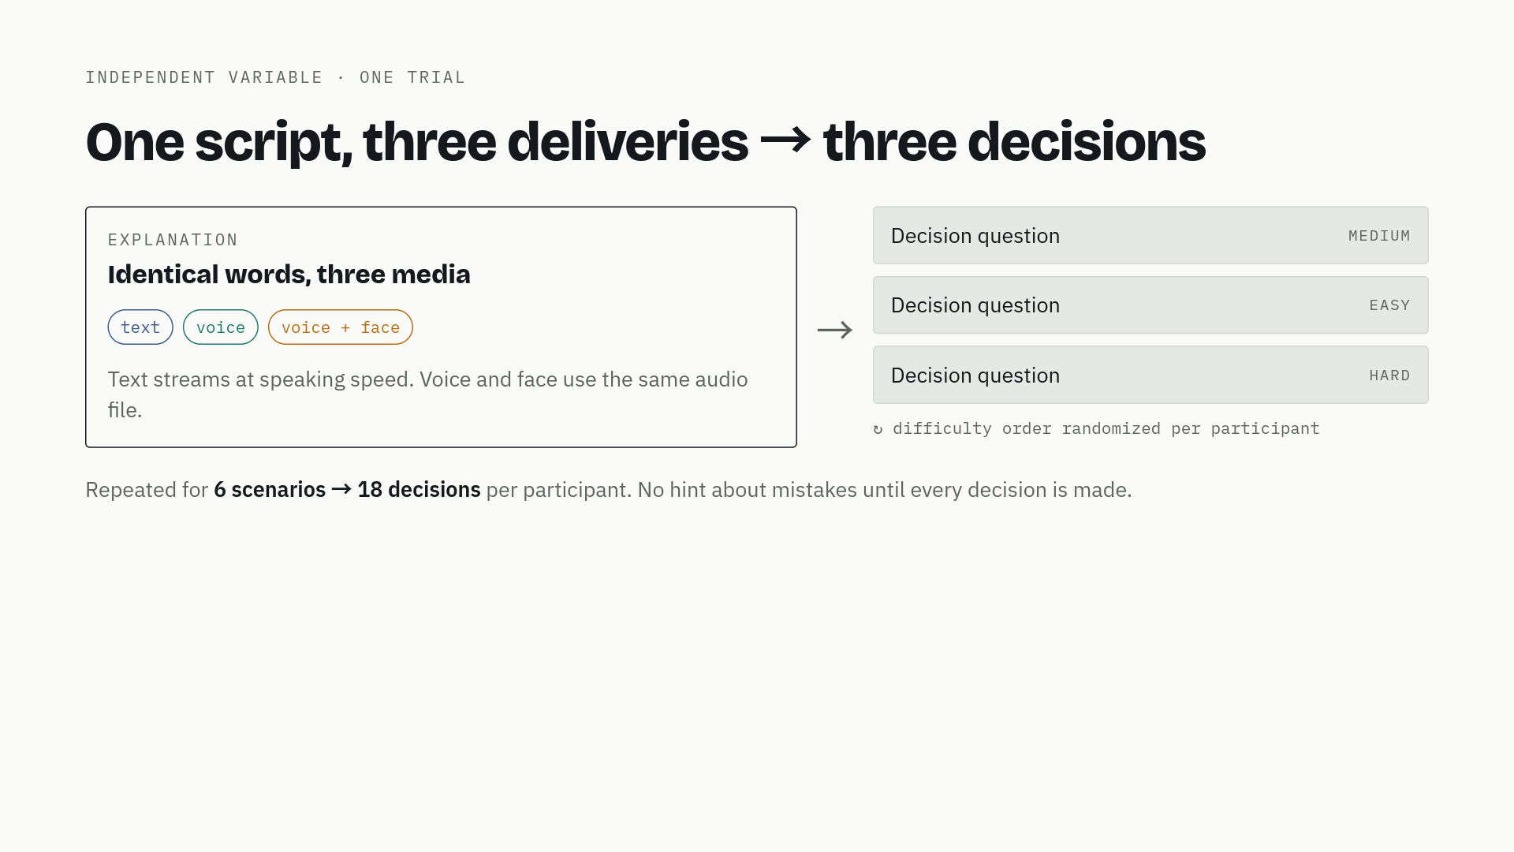
4 / 19
Notes:
The core control: we write one script per explanation and deliver it three ways. The words are identical; only the medium changes. Voice and face use the exact same audio file, so comparing those two isolates the effect of the face. One trial is an explanation, then three multiple-choice questions at easy, medium and hard difficulty. The order of difficulties is shuffled for every participant. Six scenarios give eighteen decisions per person.

Slide 5
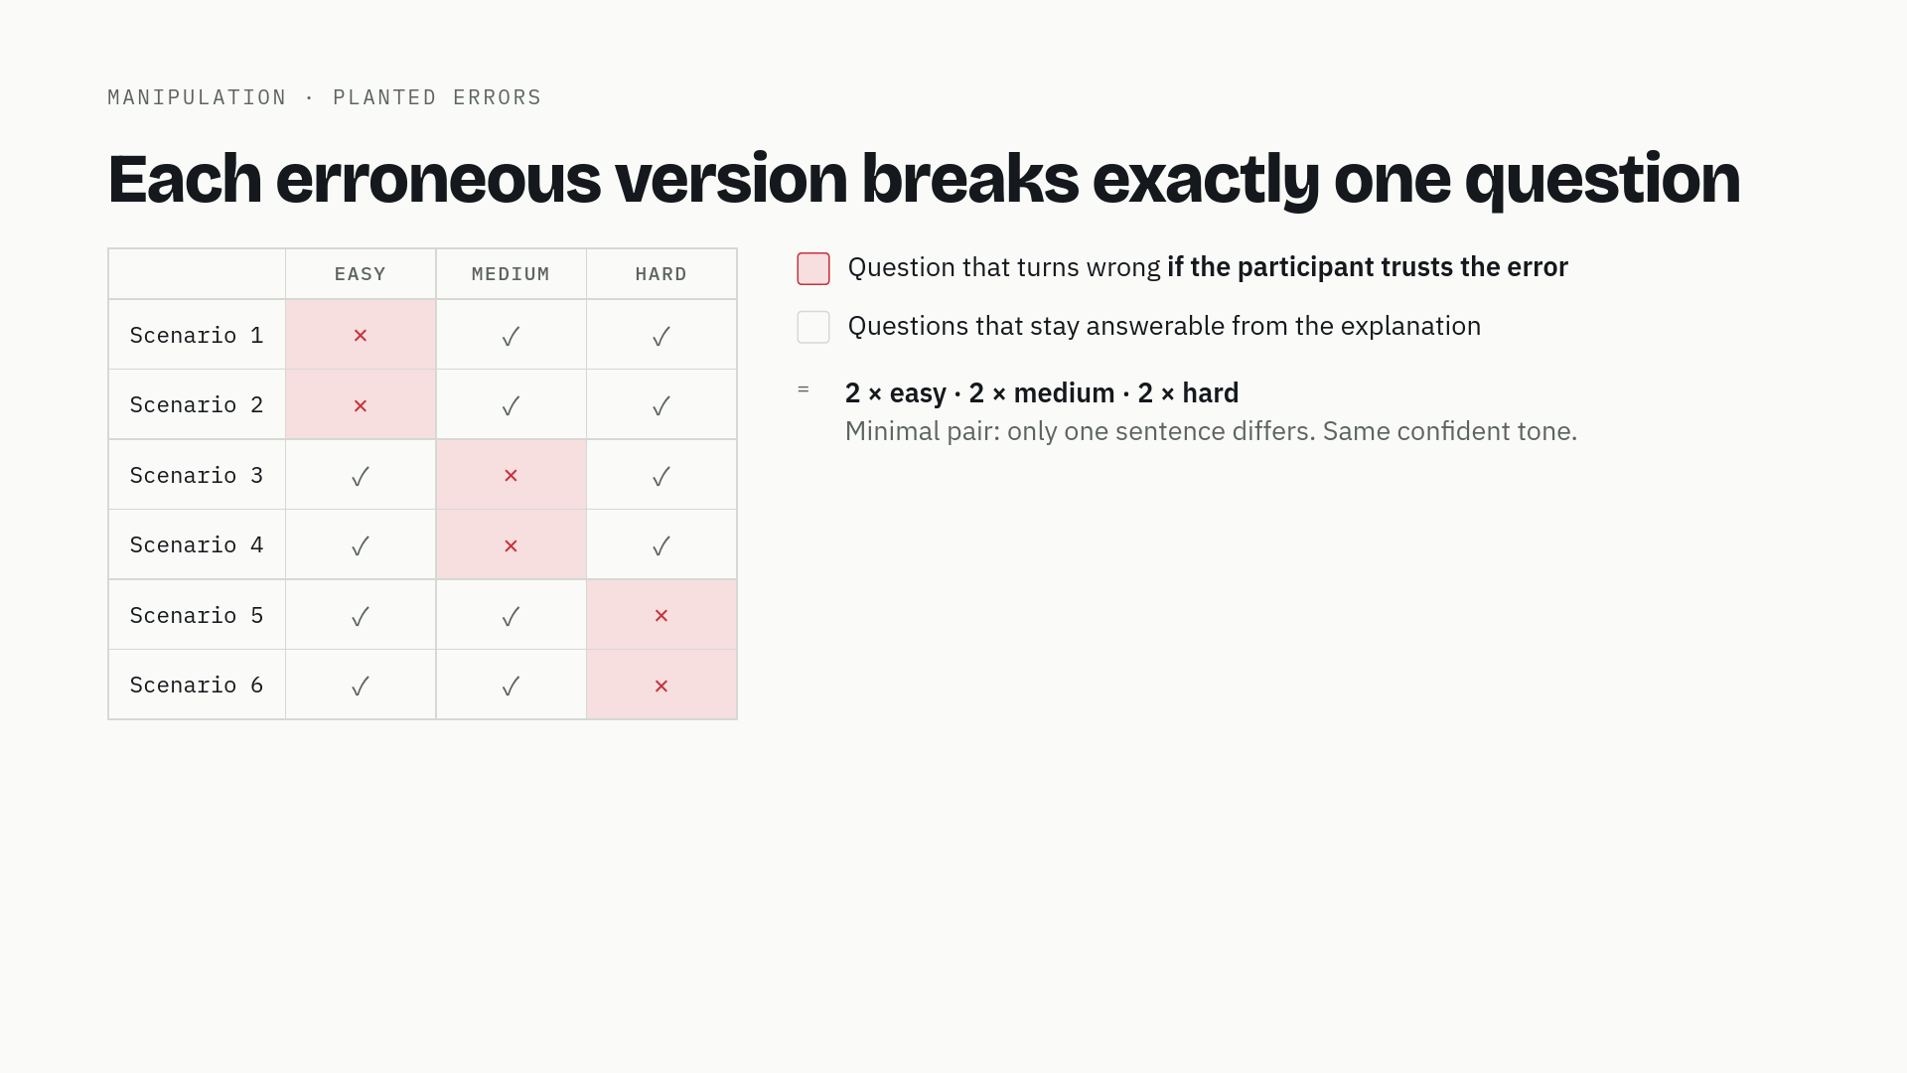
5 / 19
Notes:
Every scenario has a correct version and an erroneous version. The error is planted so that exactly one of the three questions becomes wrong if you trust it. Across the six scenarios the error is balanced: two hit the easy question, two the medium, two the hard one. The flawed version differs from the correct one in only one sentence, said in the same confident tone. That keeps length and fluency matched.

Slide 6
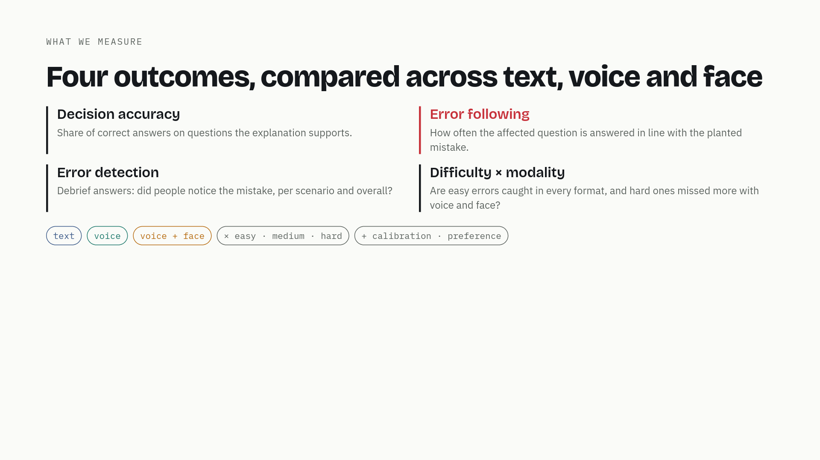
6 / 19
Notes:
What we compare across text, voice and face. Decision accuracy on questions the explanation supports. Error following — the main outcome — how often the affected question is answered in line with the planted mistake. Error detection from the debrief. And the interaction with difficulty: are obvious errors caught in every format, and subtle ones missed more with voice and face? We also look at calibration — does confidence match correctness — and which format people prefer.

Slide 7
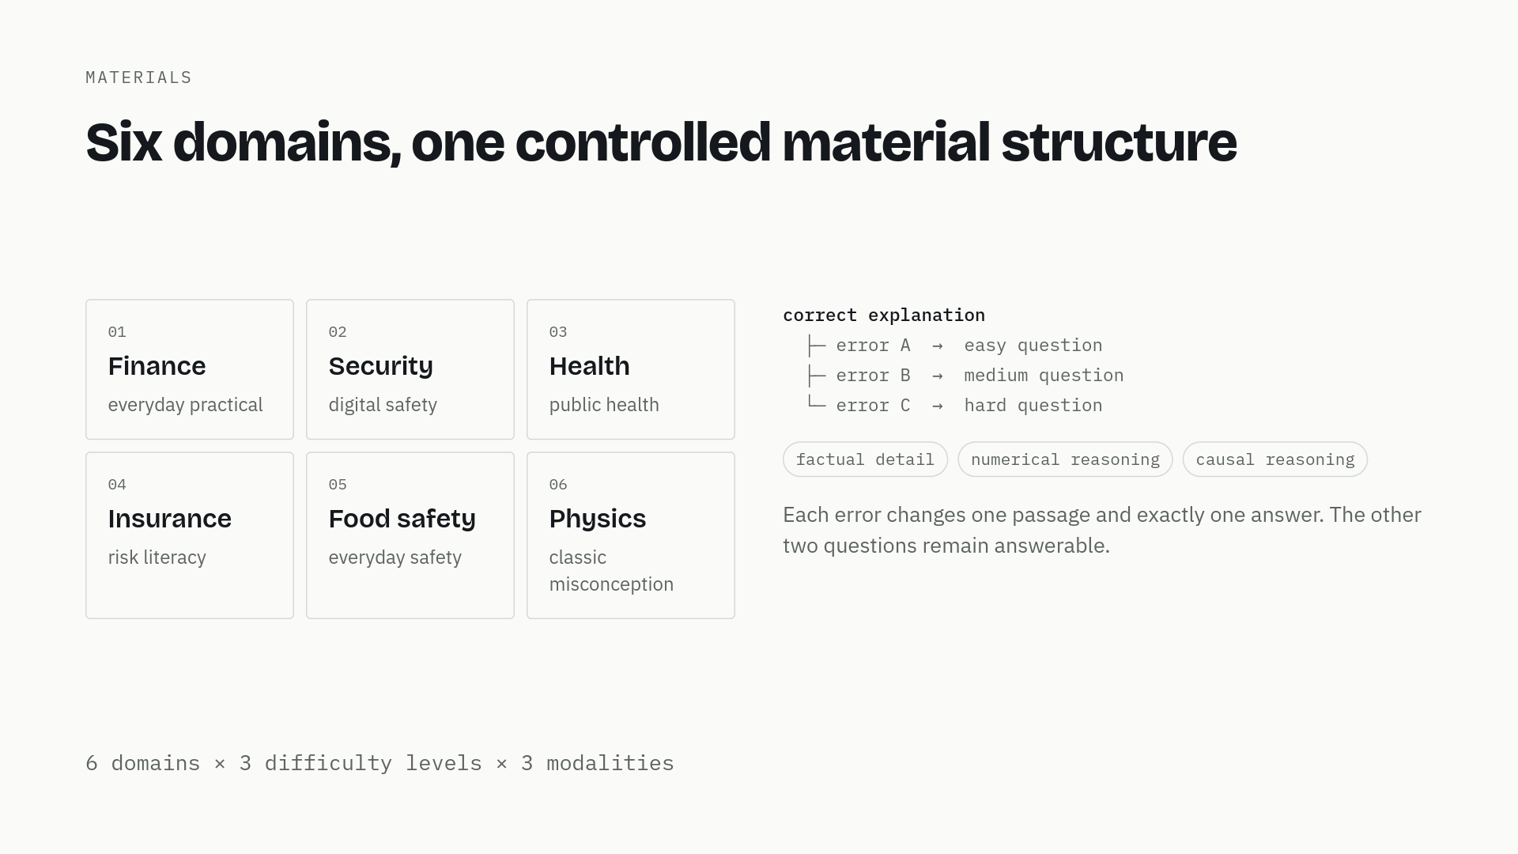
7 / 19
Notes:
We chose six everyday domains so the materials vary in breadth and in how much prior knowledge they need. The point is not to cover all knowledge. Every topic has one correct explanation and three minimal-pair error versions. Each error replaces one passage and changes exactly one of the three decision questions; the other two answers stay correct. Depth also varies: some errors are factual, some numerical, some causal.

Slide 8
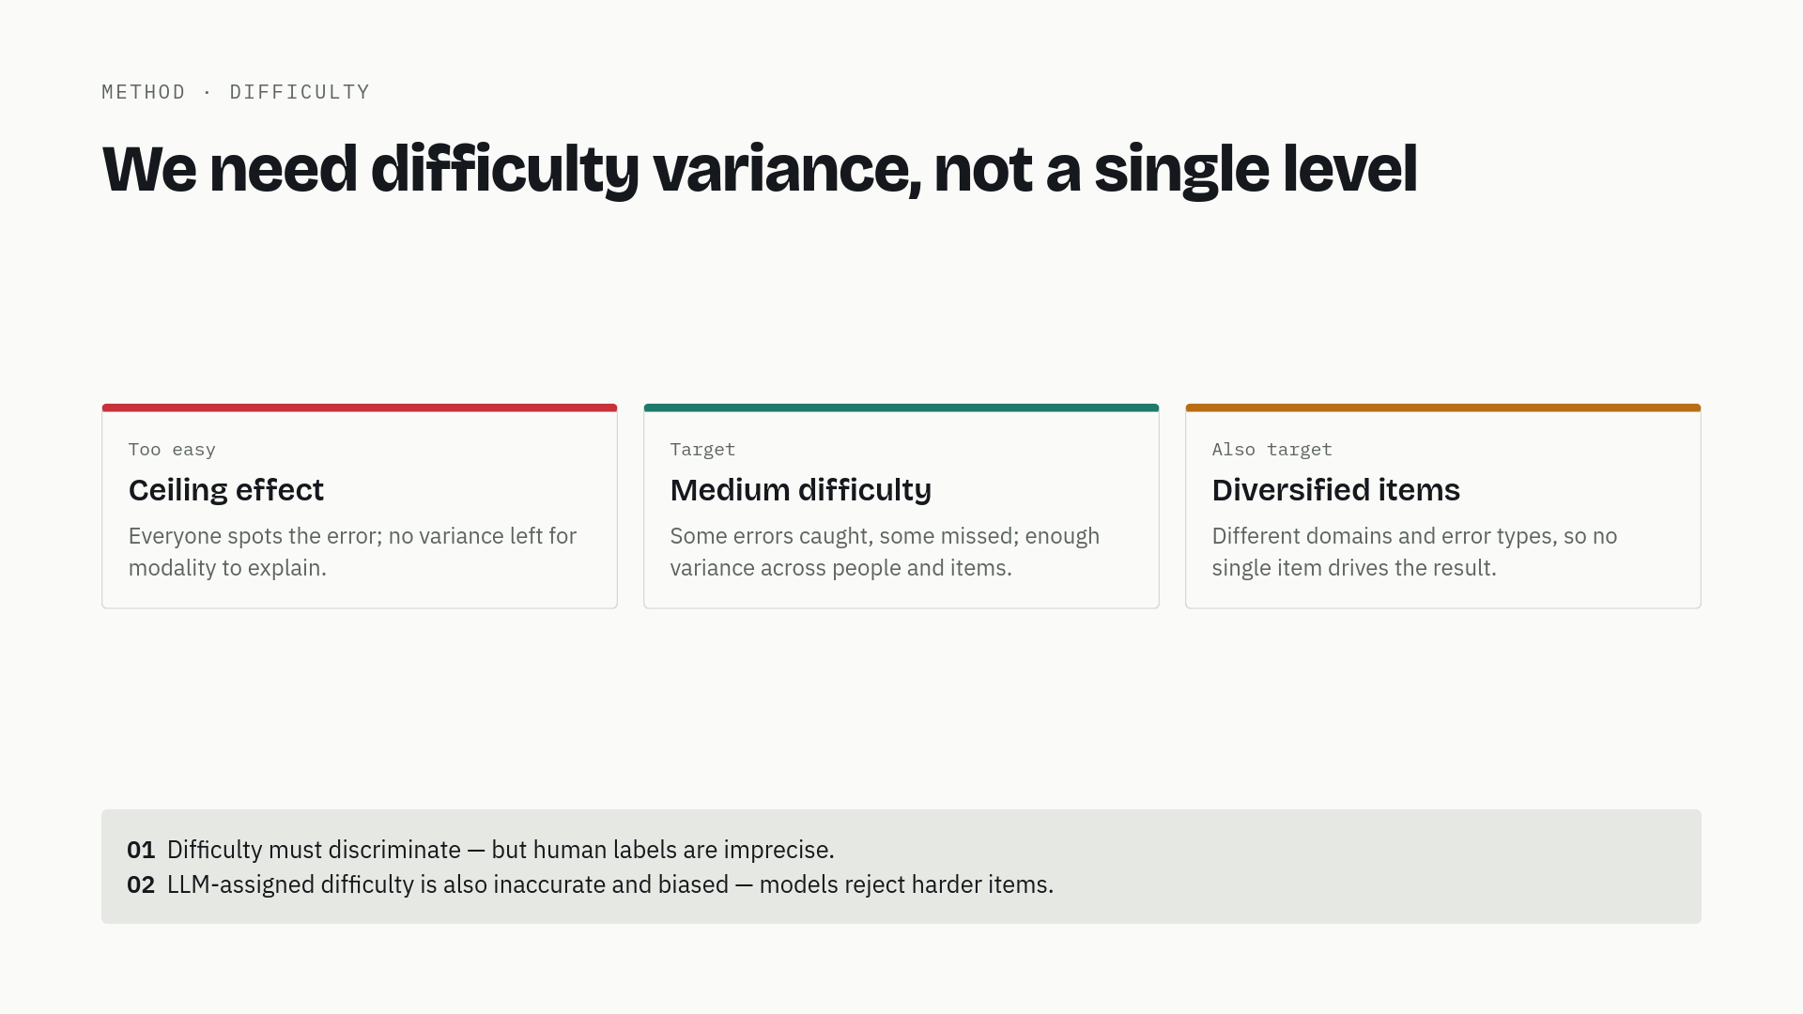
8 / 19
Notes:
Difficulty is the main design risk. If every error is obvious we get a ceiling: everyone detects it and modality has no room to matter. So we aim for medium difficulty, and more importantly for diversification: different domains, different error types, a spread of item difficulty, so the result does not hang on one item. Two cautions. Human-labelled difficulty is not precise. And LLM-labelled difficulty is also inaccurate and biased — models tend to reject exactly the harder items. So labels are provisional; a human pretest is the right validation.

Slide 9
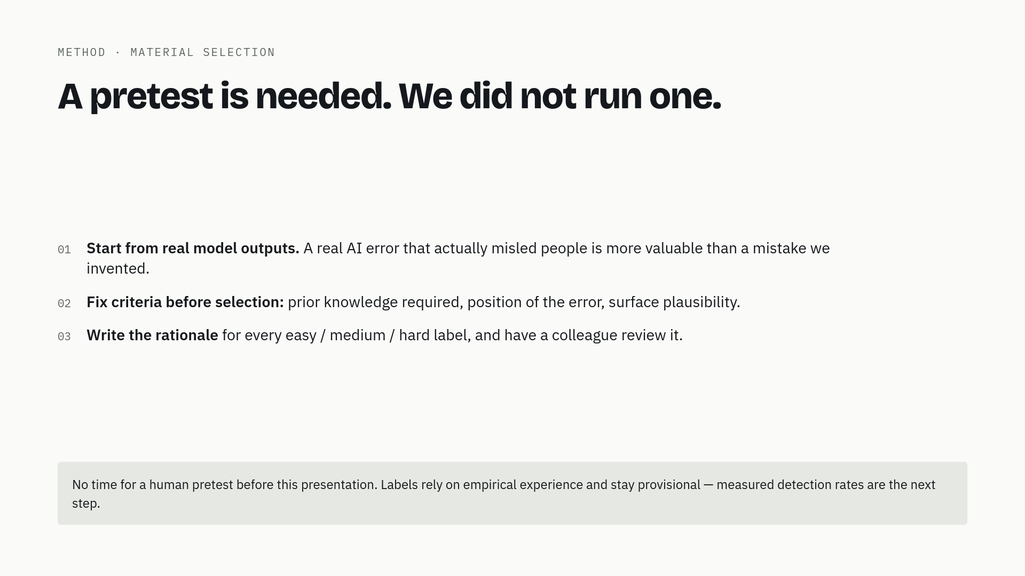
9 / 19
Notes:
We know a pretest is the right way to validate difficulty, and we did not run one in time. What we did instead: start from real model outputs, because a real AI error that actually misled people is worth more than a mistake we invented. We fixed the criteria before choosing: prior knowledge, where the error sits, surface plausibility. We wrote down why each item should be easy, medium or hard, and a colleague reviewed it. The labels remain provisional; a pretest is the first thing to do next.

Slide 10
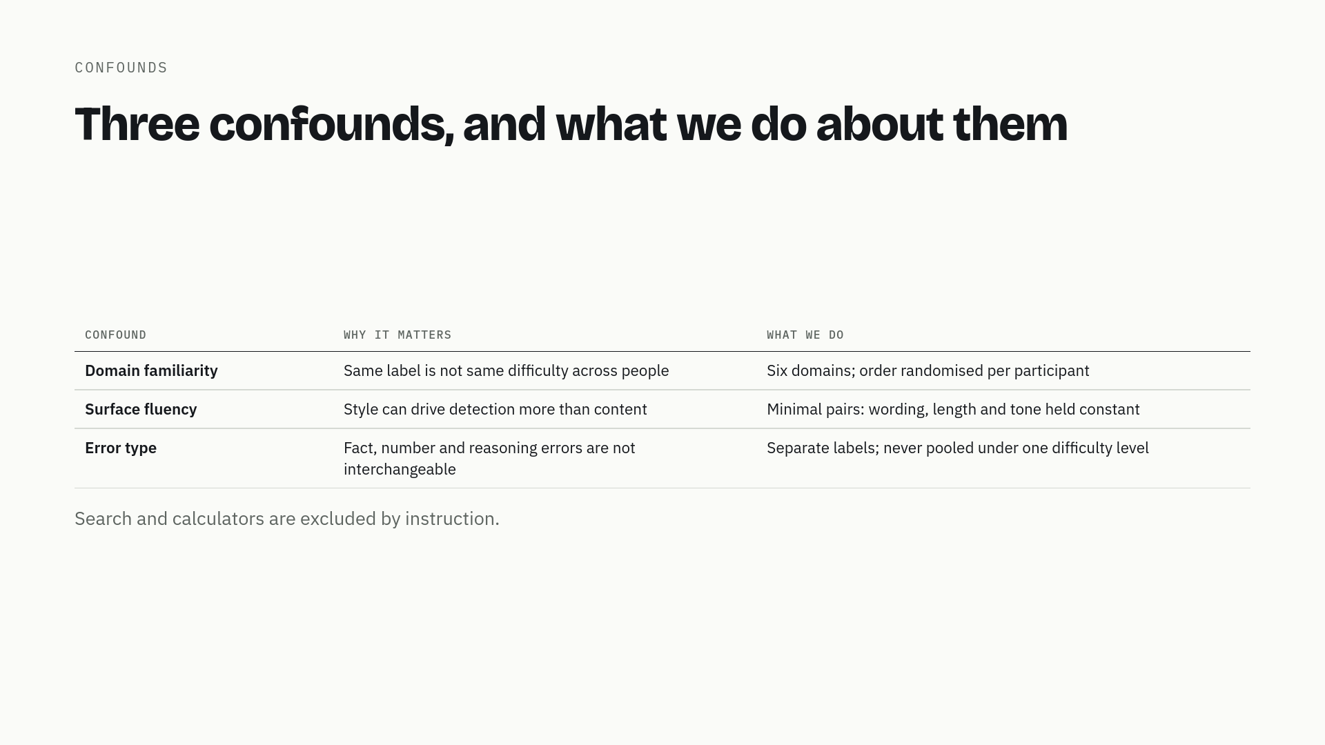
10 / 19
Notes:
Three confounds remain. Domain familiarity: the same label is not the same difficulty for everyone, so we use six domains and randomise order. Surface fluency: style can drive detection more than content, so correct and error versions are minimal pairs. Error type: a factual slip and a reasoning flaw are not the same task, so we label them separately and never pool them under one difficulty level. Search and calculators are excluded by instruction.

Slide 11
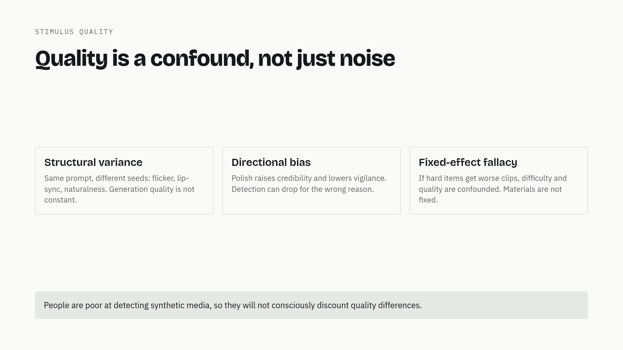
11 / 19
Notes:
Generative video and speech vary in quality even with the same prompt and model. That is not just noise. A polished clip is trusted more and checked less, so quality can lower detection for the wrong reason. And if our hard-error clips happen to look worse, difficulty and quality are confounded: we would see lower detection and wrongly credit difficulty. People are also poor at detecting synthetic media, so they will not consciously discount quality differences. We cannot fully control this in the time we have; we report it as a limitation.

Slide 12
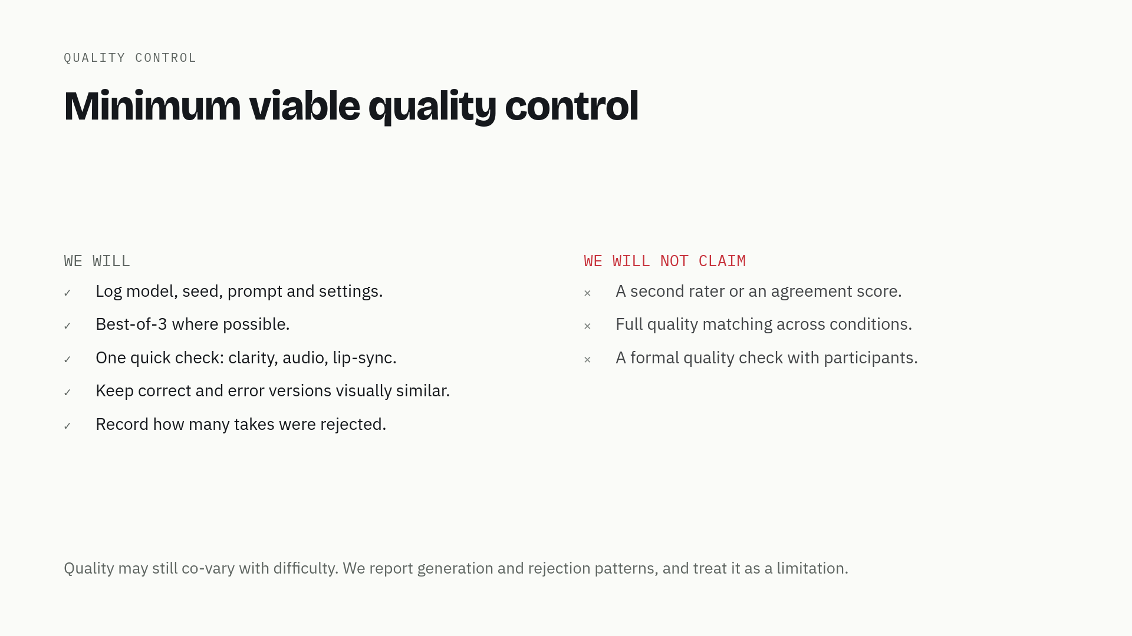
12 / 19
Notes:
We cannot run a full quality pipeline in the time we have, so we do the minimum and say what is missing. We log every generation, generate best-of-three where possible, do one quick check on clarity, audio and lip-sync, keep correct and error versions visually similar, and record how many takes were rejected. We do not claim a second rater, an agreement score, full quality matching, or a quality check with participants. Quality stays a limitation.

Slide 13
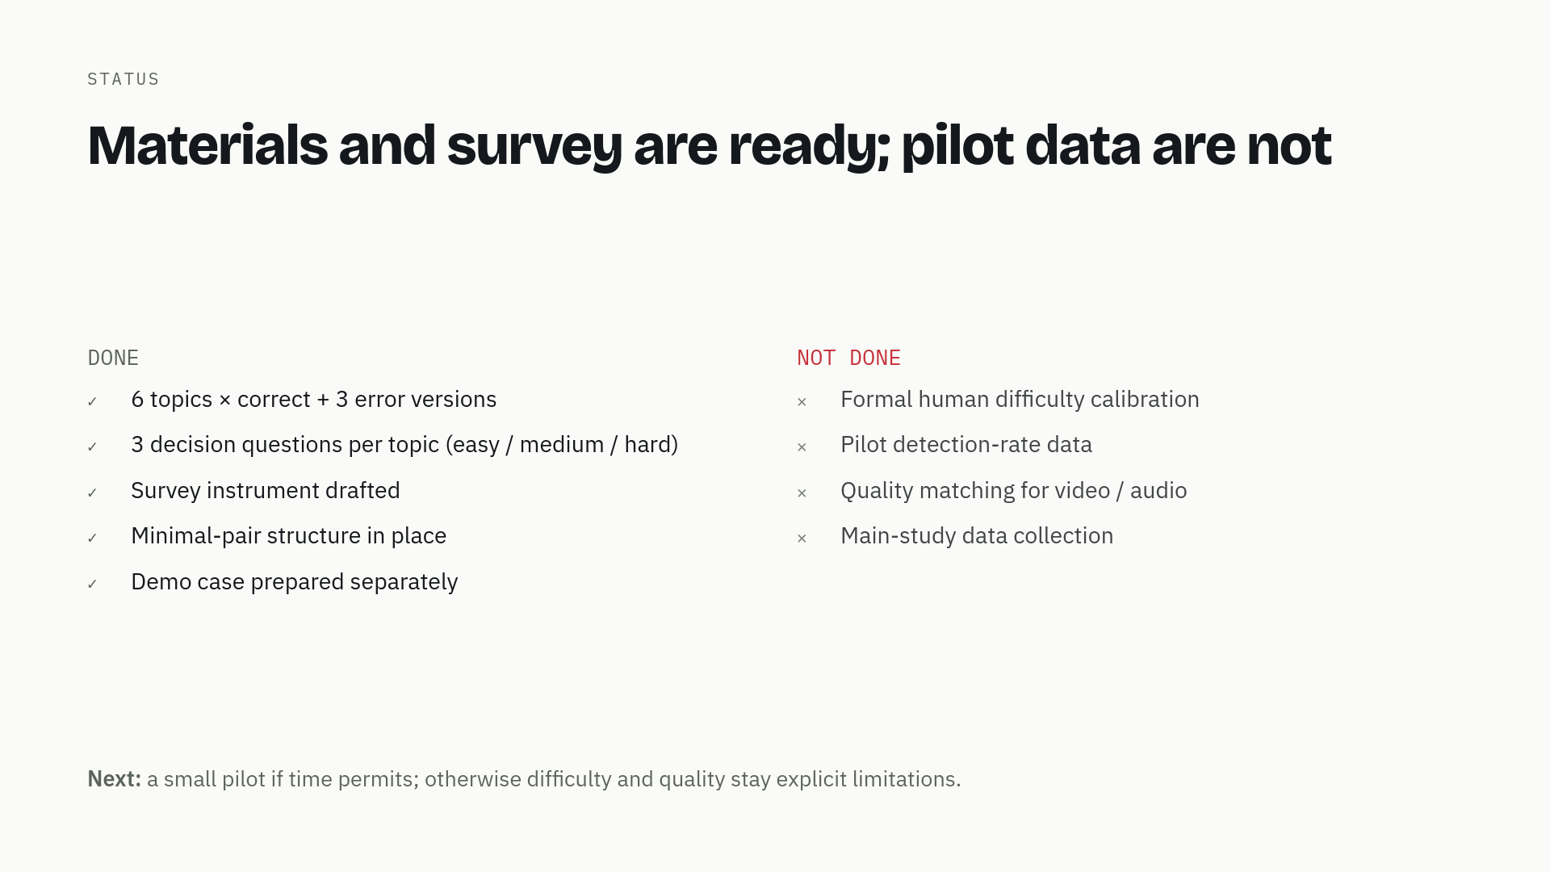
13 / 19
Notes:
Where are we? The materials are built: six topics, correct plus three error versions each, three questions per topic, minimal pairs, and a separate demo case. The survey instrument is drafted. What is not done: a formal difficulty calibration, pilot detection data, quality matching for video and audio, and of course the main data. The honest next step is a small pilot if time permits; otherwise difficulty and quality stay explicit limitations.

Slide 14
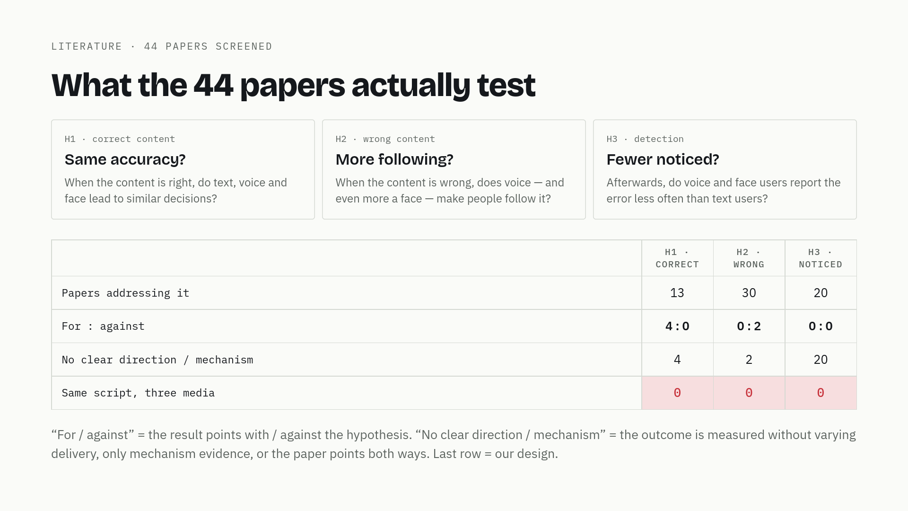
14 / 19
Notes:
Before the numbers, the three hypotheses. H1 is about correct content: when the explanation is right, do text, voice and face lead to similar decisions? H2 is about wrong content: when the explanation is wrong, does a voice or a face make people follow it more? H3 is about detection: afterwards, do people in voice and face conditions report the error less often? Now the table. Thirteen papers address H1, thirty address H2, twenty address H3. But when you ask which way the result points, it is four against zero, zero against two, and zero against zero. And the last row is the one that matters: no paper runs the same script in text, voice and face.

Slide 15
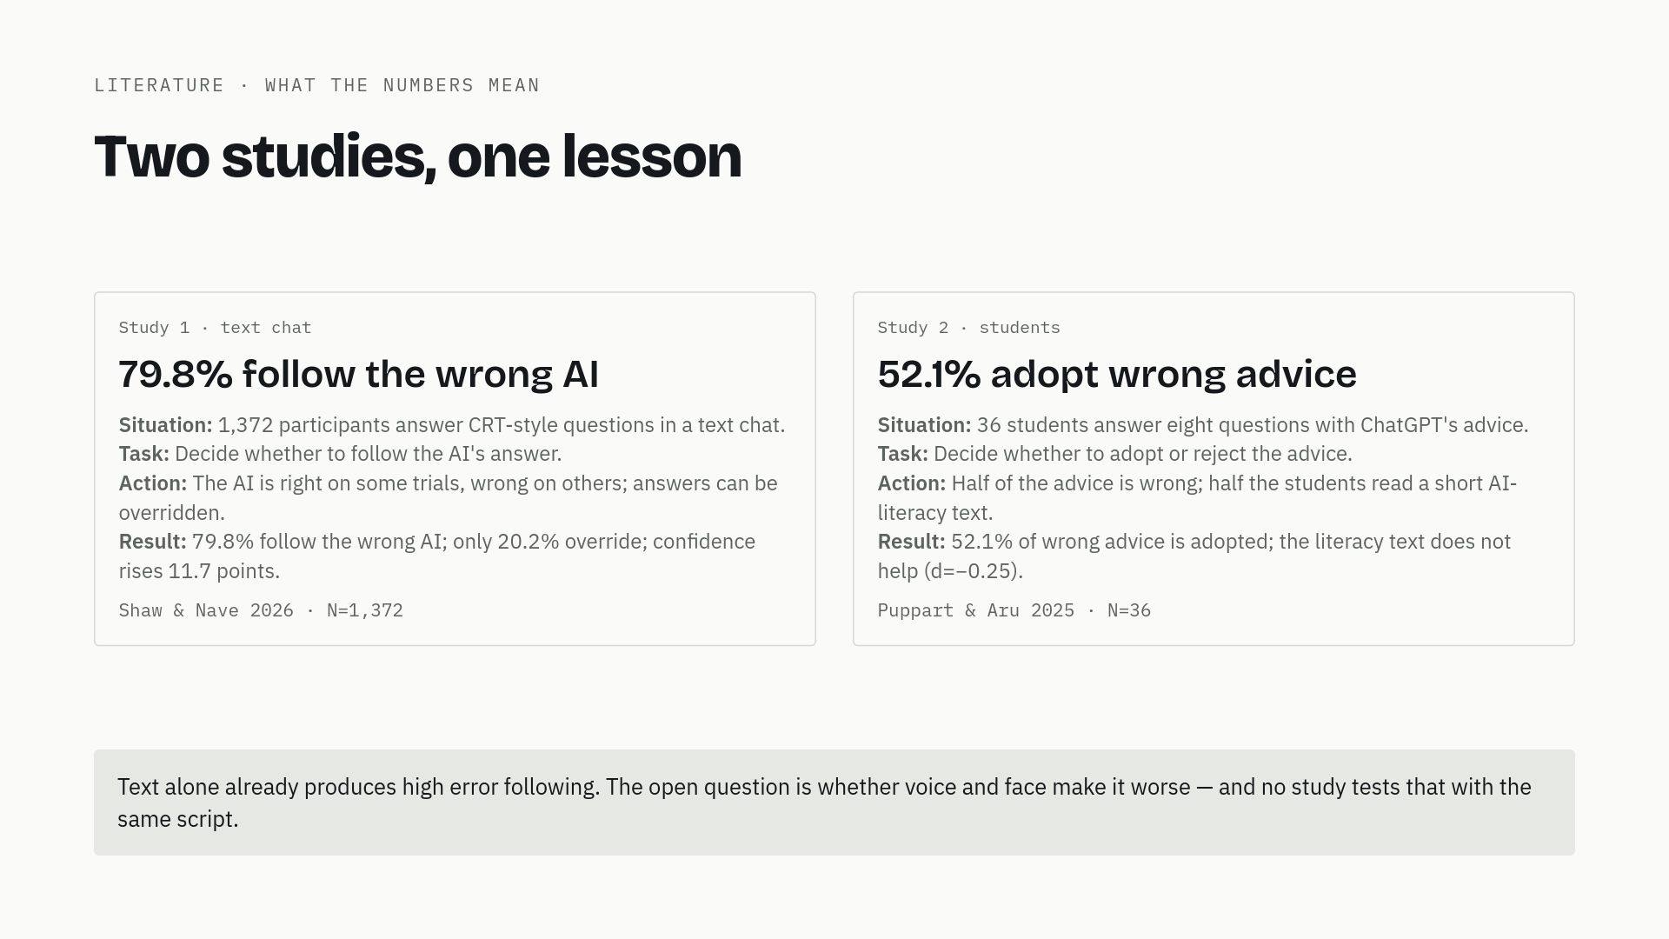
15 / 19
Notes:
Two studies show what those numbers mean. Study one: Shaw and Nave gave 1,372 people CRT-style questions in a text chat, and on some trials the AI was right and on others wrong. People could override it. They followed the wrong AI in 79.8% of faulty trials, overrode only 20.2%, and their confidence went up rather than down. That is the baseline: text alone already produces massive error following. Study two: Puppart and Aru gave 36 students eight questions, with half of ChatGPT's advice wrong. 52.1% of the wrong advice was adopted, and a short AI-literacy text did not help. So the problem is not lack of knowledge. The lesson: the phenomenon is strong, but all of this is text. Whether a voice or a face makes it worse is exactly what nobody has tested with the same script. So the direction points our way; the evidence is not yet strong enough to carry the design.

Slide 16
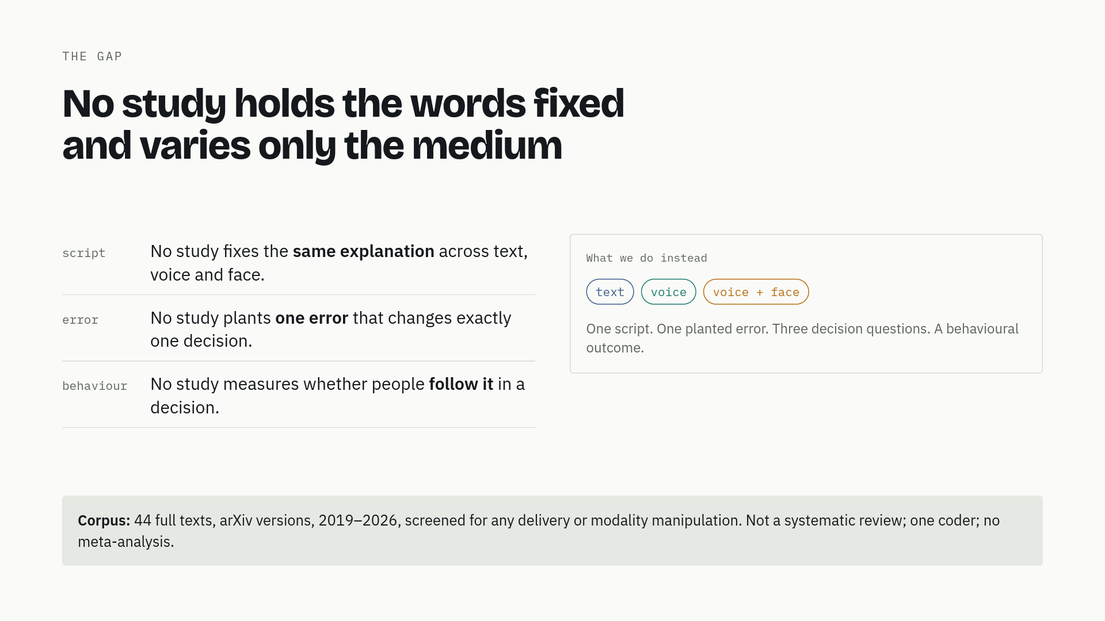
16 / 19
Notes:
The gap is specific and it has three parts. No study fixes the same script across text, voice and face. No study plants one error that changes exactly one decision. And no study measures whether people actually follow that error in a behavioural decision. The corpus is forty-four full texts, arXiv versions, screened for any delivery or modality manipulation. It is not a systematic review, and we say so.

Slide 17
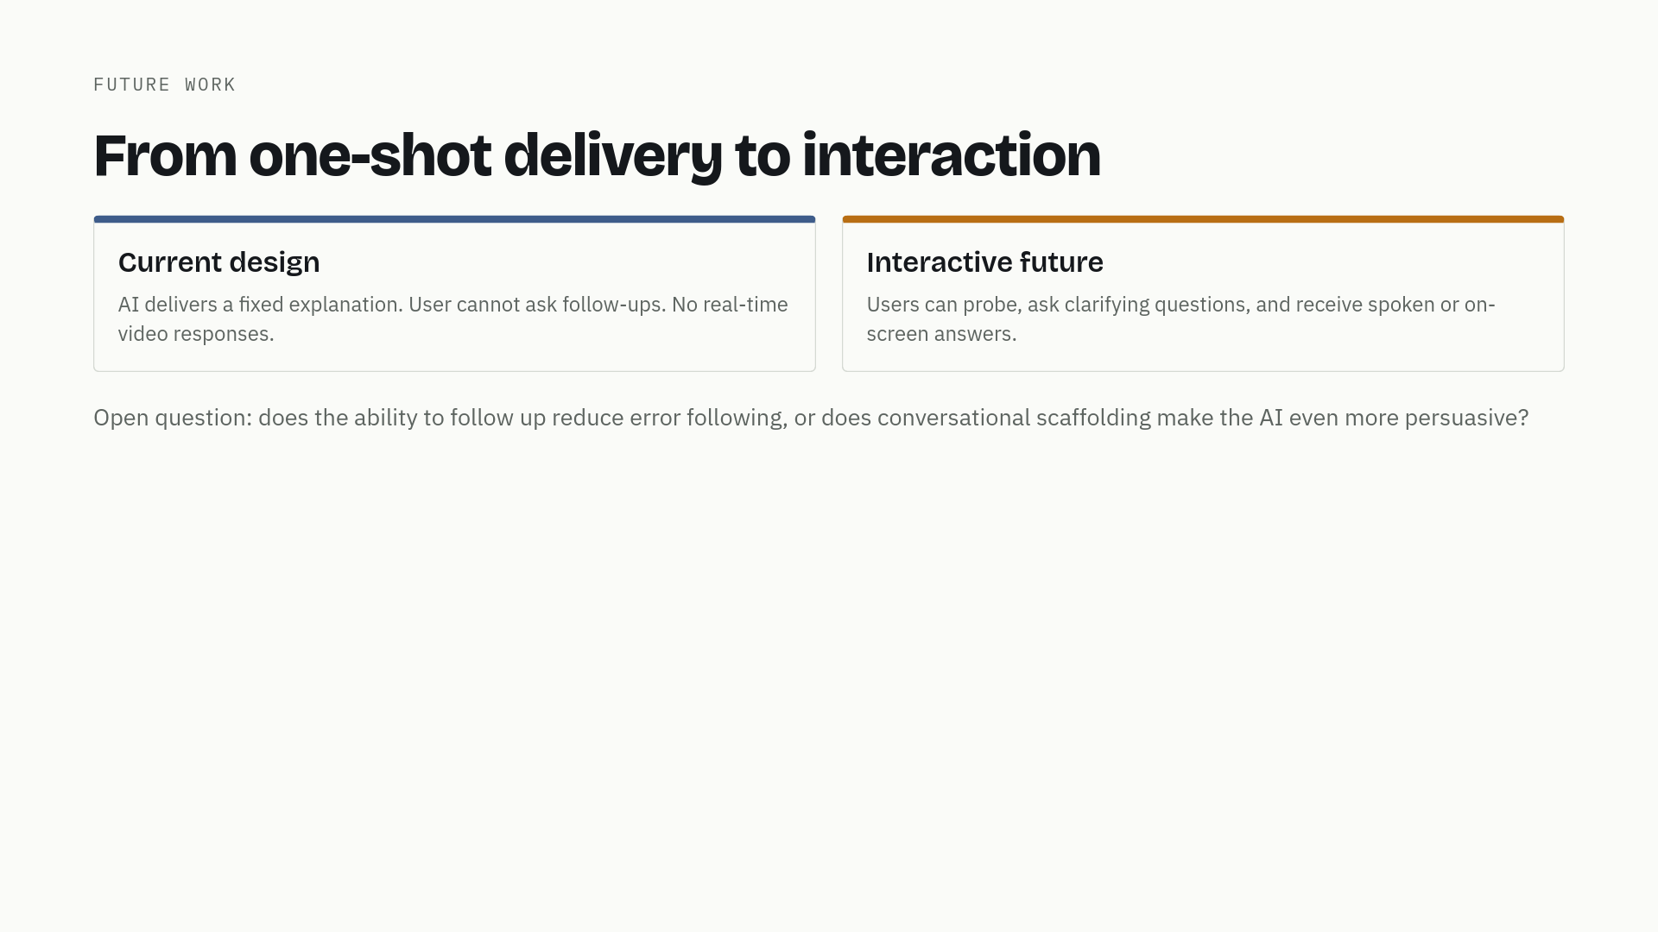
17 / 19
Notes:
Looking further ahead, the current design is one-shot: the AI explains, the person decides. Real systems let people ask follow-up questions, and future ones may answer in voice or on screen. Interaction could cut both ways. It might help people catch errors by probing. Or it might amplify persuasion through conversational scaffolding and social presence. We do not yet know which.

Slide 18
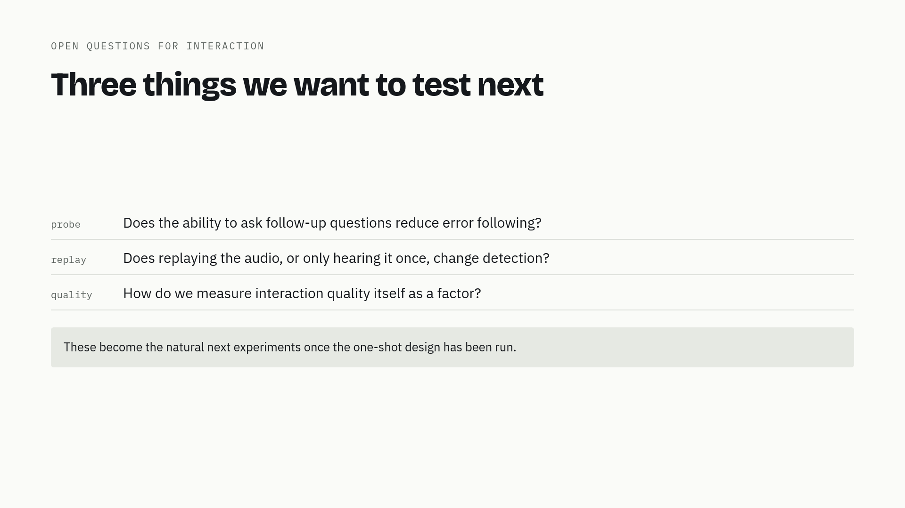
18 / 19
Notes:
Concrete open questions for the interaction direction. Does letting people ask clarifying questions reduce the rate at which they adopt mistakes? Does replaying the audio, or only being able to hear it once, change detection? And how do we measure the quality of the interaction itself as a factor, not just the final decision? These are the natural next experiments once the one-shot design has been run.

Slide 19
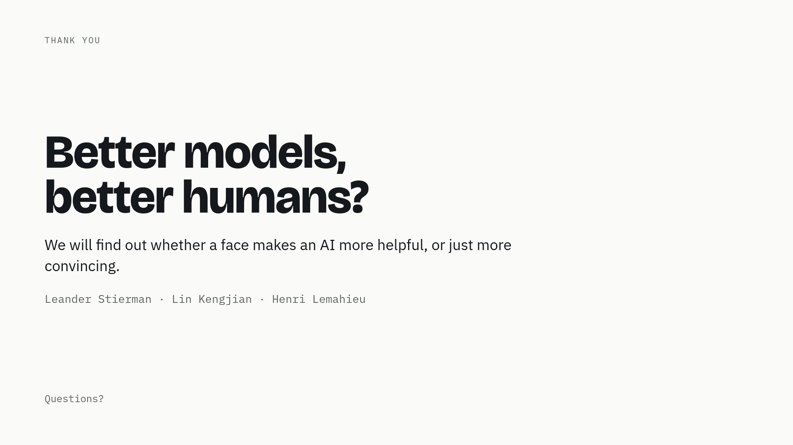
19 / 19
Notes:
To wrap up: AI is getting a voice and a face, fast. We want to find out whether that makes it more helpful, or just more convincing. If it is the second, the people designing these interfaces, and anyone teaching people how to use AI, need to know. We have the materials and a clear statement of what is still unvalidated — difficulty labels and production quality. The next step is a small pilot if time permits. Thank you. We are happy to take your questions.

