Slide 1
Java Advanced
Day 3

Slide 2
Bootstrap Spring
Console
public class SpringExample {
public static void main(String[] args) {
ApplicationContext ctx
= new ClassPathXmlApplicationContext("context.xml");
Service service = ctx.getBean("customerService");
…
// register shutdown hook to ensure container shuts down singletons gracefully
((AbstractApplicationContext) ctx).registerShutdownHook();
}
}

Slide 3
Bootstrap Spring (cont.)
WebApplication (/WEB-INF/web.xml)
<web-app …>
<context-param>
<param-name>contextConfigLocation</param-name>
<param-value>/WEB-INF/context.xml</param-value>
</context-param>
<listener>
<listener-class>org.springframework.web.context.ContextLoaderListener</listener-class>
</listener>
</web-app>
NOTE: ContextLoaderListener vs DispatcherServlet
Notes:
ContextLoaderListener loads contexts/beans which can be accessed within entire web app
DispatcherServlet loads contexts/beans which can be only accessed by servlets only

Slide 4
Spring JDBC
Simple query
String sql = "select count(*) from t_table“;
int count = jdbcTemplate.queryForObject(sql, Integer.class);
Map to a DTO
String query = "select first_name, last_name from t_actor where id = ?“;
Actor actor = jdbcTemplate.queryForObject(query,
new Object[]{1212L}, // parameter
new RowMapper<Actor>() {
public Actor mapRow(ResultSet rs, int rowNum) throws SQLException {
Actor actor = new Actor();
actor.setFirstName(rs.getString("first_name")); actor.setLastName(rs.getString("last_name"));
return actor;
}
});

Slide 5
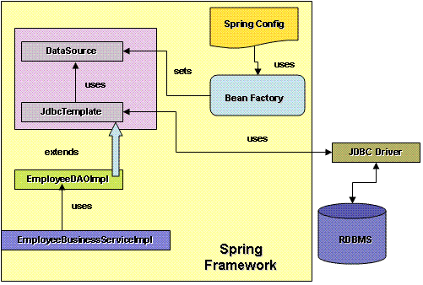
Spring JDBC (cont.)
Insert/update/delete
String sql = "insert into t_actor (first_name, last_name) values (?, ?)“;
jdbcTemplate.update(sql, "Leonor", "Watling");
DDL/StoredProcedure
String sql = “call support.refresh_actors_summary (?)“;
jdbcTemplate.execute(sql, "Leonor");
NOTE: More advanced usage,
please check Spring Documentation

Slide 6
Spring JMS
Sending messages
public class JmsQueueSender {
private JmsTemplate jmsTemplate;
private Queue queue;
public void sendMessage() {
jmsTemplate.send(queue, new MessageCreator() {
public Message createMessage(Session session)
throws JMSException {
return session.createTextMessage("hello queue world");
}
});
}
}

Slide 7
Spring JMS (cont.)
Message-Driven POJOs (MDP)
Java code:
public class ExampleListener implements MessageListener {
public void onMessage(Message message) {
…
}
}
XML config:
<bean id="msgListener" class="jms.example.ExampleListener" />
<bean id="jmsContainer"
class="org.springframework.jms.listener.DefaultMessageListenerContainer">
<property name="connectionFactory" ref=“…"/>
<property name="destination" ref=“…"/>
<property name="messageListener" ref="msgListener" />
</bean>

Slide 8
Spring RMI
Expose as RMI object
<bean class="org.springframework.remoting.rmi.RmiServiceExporter"> <property name="serviceName" value="AccountService"/> <property name="service" ref="accountSvcBean"/>
<property name="serviceInterface" value=“…"/>
<property name="registryPort" value="1199"/>
</bean>
<bean id=“accountSvcBean” class=“…” />

Slide 9
Spring RMI (cont.)
Link to the RMI client
<bean id=“rmiClient” class=“…">
<property name=“service" ref="accountRMIService"/>
</bean>
<bean id="accountRMIService“
class="org.springframework.remoting.rmi.RmiProxyFactoryBean">
<property name="serviceUrl" value="rmi://HOST:1199/AccountService"/>
<property name="serviceInterface" value=“…"/>
</bean>

Slide 10
Homework
Install CheckStyle plugin for Eclipse
Install FindBugs plugin for Eclipse
Install EclEmma plugin for Eclipse

