Slide 1
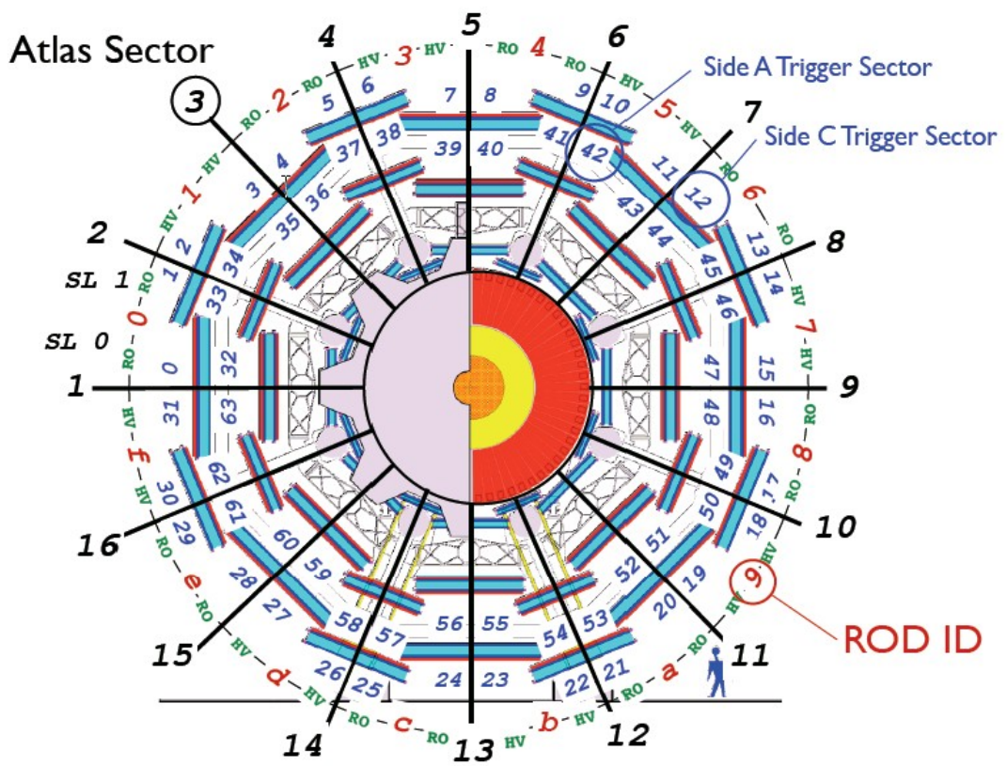
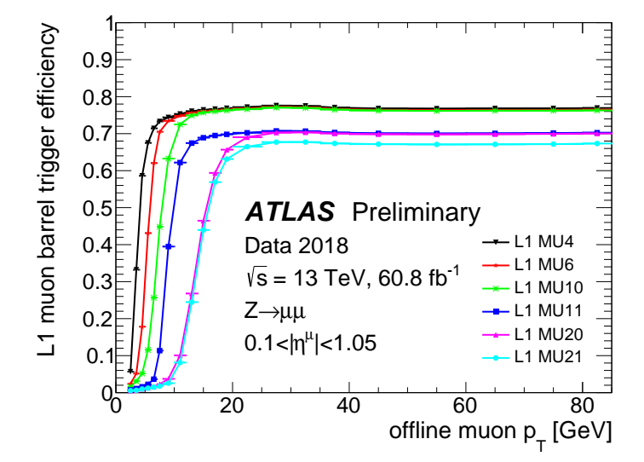
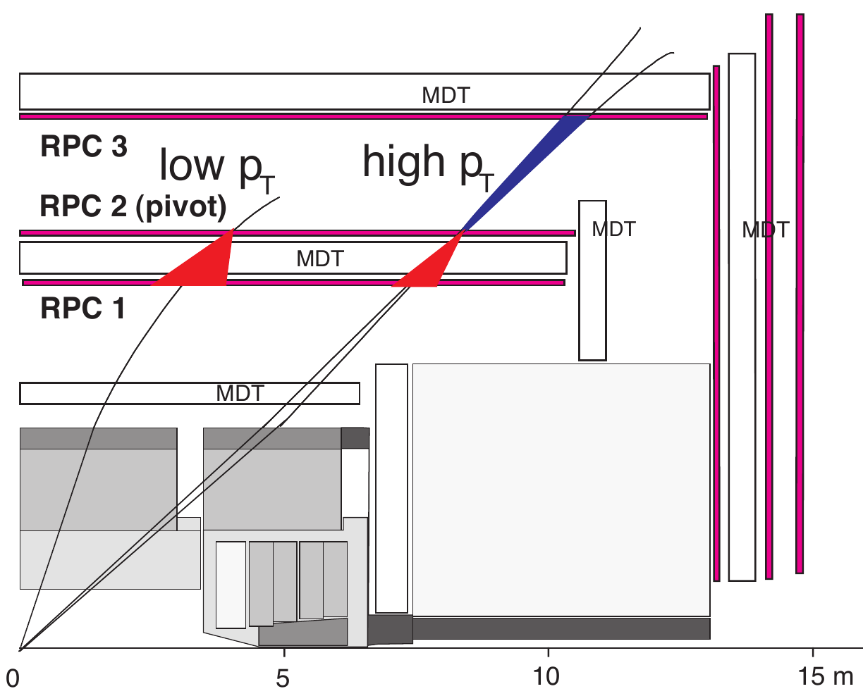
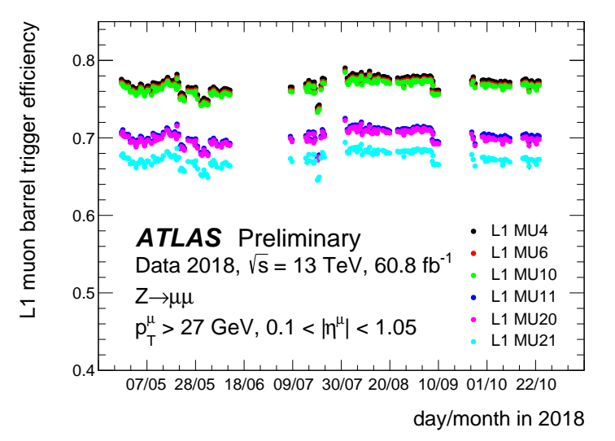
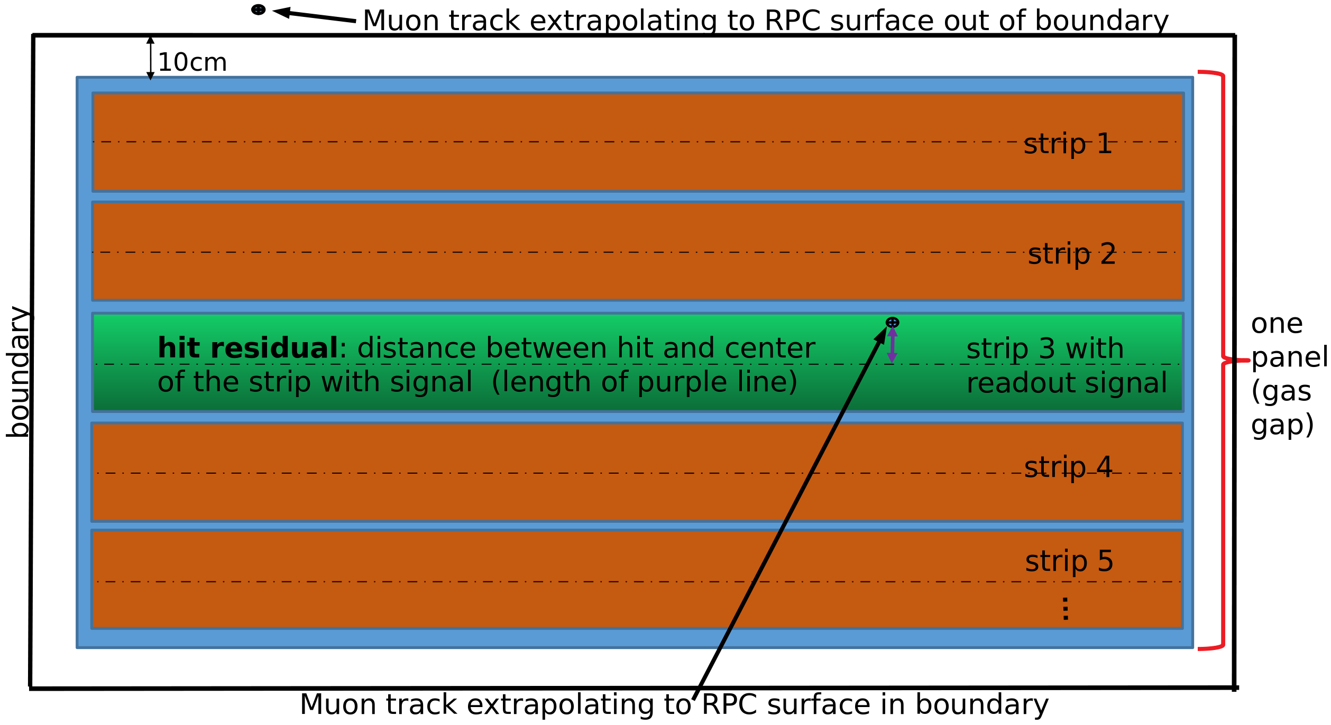
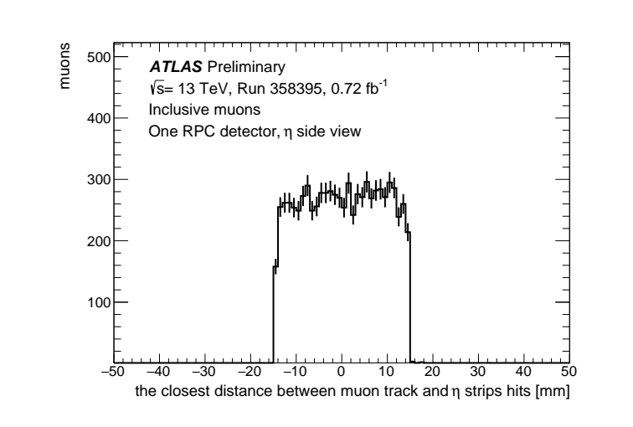
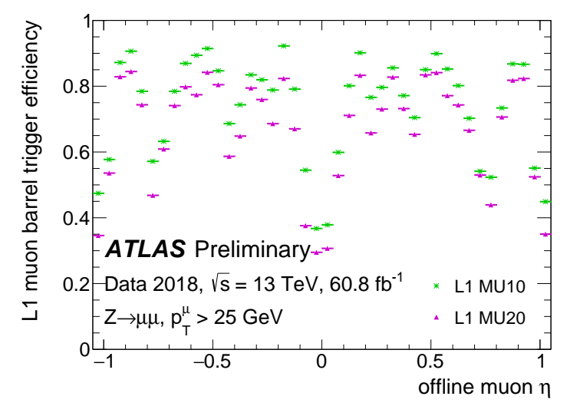
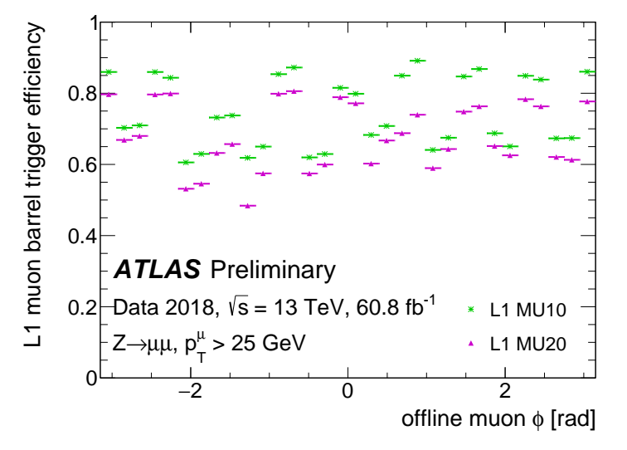
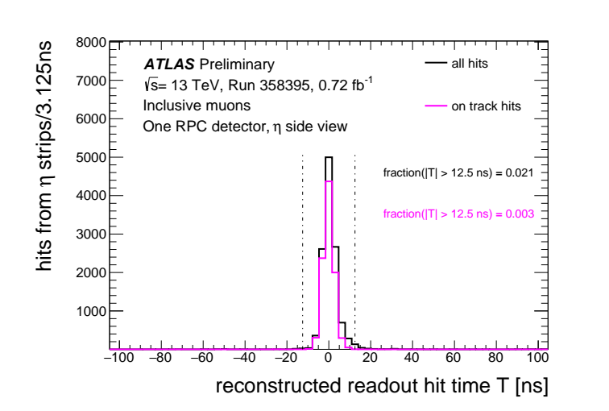
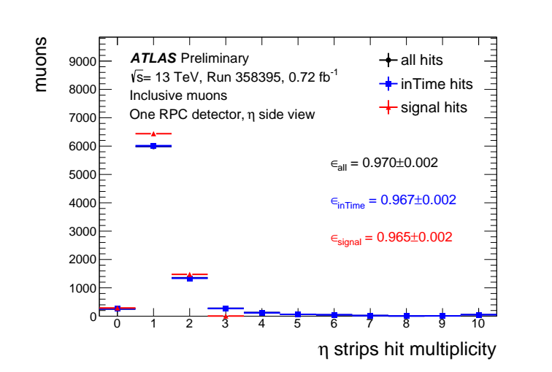
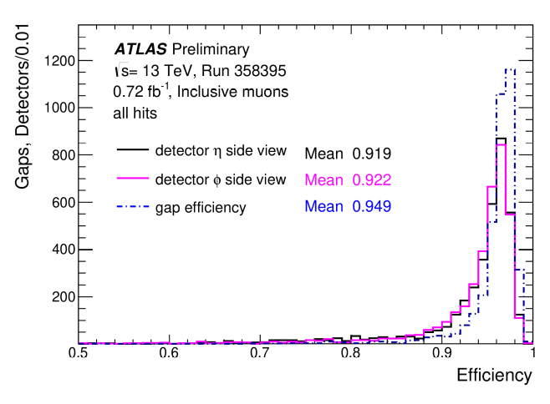
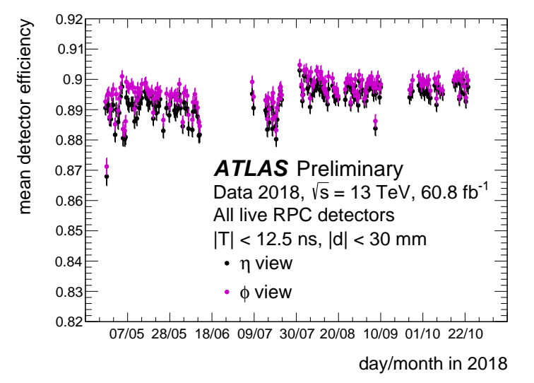
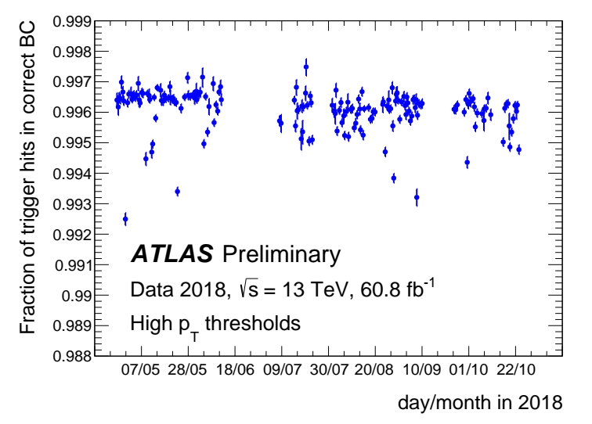
LHCC Poster Session - CERN, 27 February 2019
Performance of the ATLAS RPC detector and trigger at 13 TeV
Introduction
The ATLAS experiment utilises the Resistive Plate Chambers detector (RPC) for the first level muon trigger system in the barrel region of the detector. This poster presents measurements of RPC detector and trigger performance using proton-proton collisions at a centre-of-mass energy of 13 TeV collected in 2018, showing results in terms of the detector and trigger timing and efficiency.
The ATLAS RPC Detector and Trigger System
Trigger efficiency vs. offline muon p_{T}
The present ATLAS muon trigger in the barrel region based on
3 concentric RPC layers
16 physical sectors, ~3700 gas volumes
each physical sector is segmented in 4 trigger sectors
64 trigger sectors in side A and side C
each trigger sector is segmented along η in towers [1] [3]
L1 muon barrel trigger efficiency for offline muons as a function of their transverse momentum [4].
efficiencies are measured using a tag-and-probe method with candidates
efficiencies for the low p_{T} trigger thresholds (MU4, MU6, MU10) reach a plateau of about 78%
efficiencies for high p_{T} trigger thresholds (MU11, MU20, MU21) rise to around 68% [1]
Fit per run
The Level-1 (L1) trigger algorithm is based on hit coincidence of 3 concentric RPC stations [3]
low p_{T} trigger: coincidence between the innermost two RPC stations
ligh p_{T} trigger: additional confirmation on the third external station
Plateau value of the L1 muon barrel trigger efficiency for offline muons as a function of time [4].
each point corresponds to a different ATLAS run recorded in 2018
only runs with integrated luminosity greater than 50 pb⁻¹ are used
Performance in one detector gas gap
all muon tracks are extrapolated to the RPC surface from MDT detector
only muons with tracks extrapolated inside the boundary are used for the study of this gas gap
Trigger efficiency vs. offline muon η and φ
the closest distance between the extrapolated muon track position and hits (d) from η strips
Level 1 muon barrel trigger efficiency for offline muons with p_{T} > 25 GeV as a function of η (left) and φ (right) coordinates [4].
the width of the distribution corresponds to the width of one RPC readout strip
reconstructed readout hit time (T) for η strips
efficiencies for trigger threshold MU10 (low p_{T}) and trigger threshold MU20 (high p_{T})
the left plot shows a lower trigger efficiency in regions where the detector coverage is lower due to the barrel toroid mechanical structures
the regions with lower efficiency around ϕ = -2 and ϕ = -1 in right plot correspond to the ”feet” structures that support the ATLAS calorimeters, in which the muon chamber coverage is reduced
the time is calibrated by the triggered bunch crossing but without offline calibration
on track hits: hits with |d| < 30 mm
hit multiplicity for three selections of hits
all hits: all recorded RPC readout hits
inTime hits: all hits with |T| < 12.5 ns
signal hits: inTime hits with |d| < 30 mm
Detector efficiency overall performance
Trigger timing performance
Fraction of RPC high-pT trigger hits associated correctly to the collision Bunch Crossing(BC) for the whole RPC trigger system as a function of time [4].
each point corresponds to a different ATLAS run recorded in 2018
only runs with integrated luminosity greater than 50 pb⁻¹ are used
the fraction of high p_{T} muons associated to the correct BC is 99.6% [1]
Distribution of the RPC "gap efficiency" of each gas volume and the "detector efficiency" for each strip panel in η and φ view.
Mean detector efficiency as a function of time in η view and φ view of all live RPC panels.
"gap efficiency": the presence of hits on at least one of the two strip panels
"detector efficiency": the presence of hits in the related strip panel
each point corresponds to a different ATLAS run recorded in 2018
only runs with integrated luminosity greater than 50 pb⁻¹ are used
[1] M. Corradi, Performance of ATLAS RPC Level-1 muon trigger during the 2015 data taking, 6032 Journal of Instrumentation 11 (2016) C09003
[2] ATLAS Collaboration, ATL-COM-MUON-2018-065
[3] C. Luci, The Level-1 Trigger Muon Barrel System of the ATLAS experiment at CERN, 2009 JINST 4 P04010
[4] ATLAS Collaboration, ATL-COM-DAQ-2018-181
Heng Li (University of Science and Technology of China) on behalf of the ATLAS Collaboration

