Slide 1
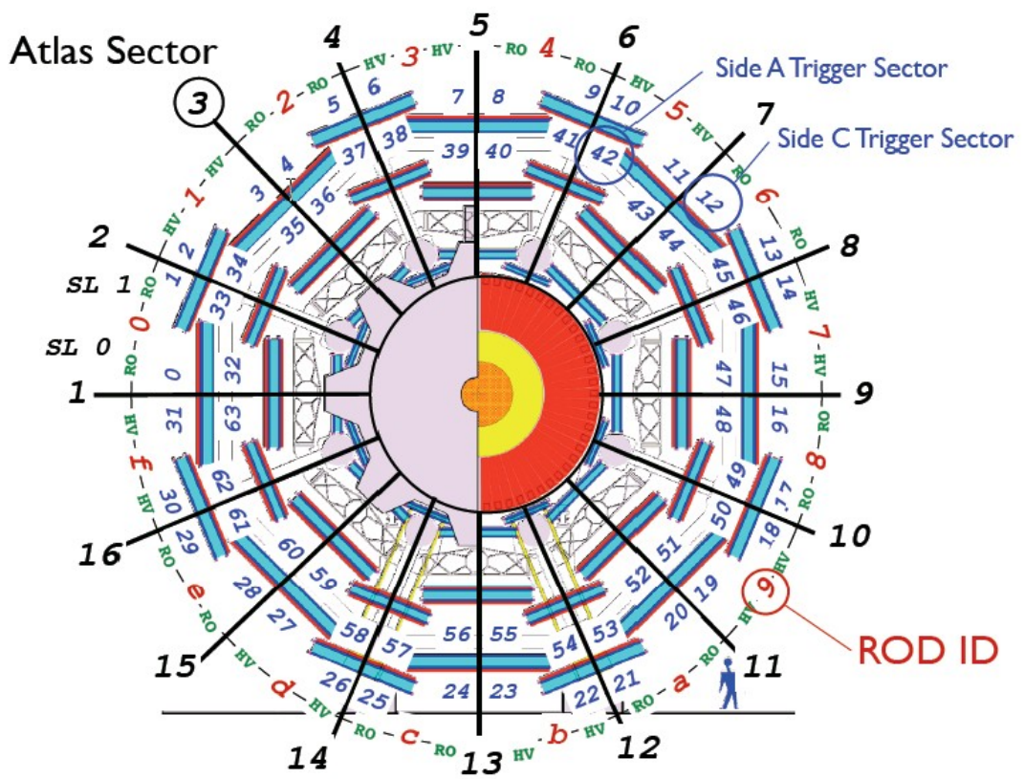
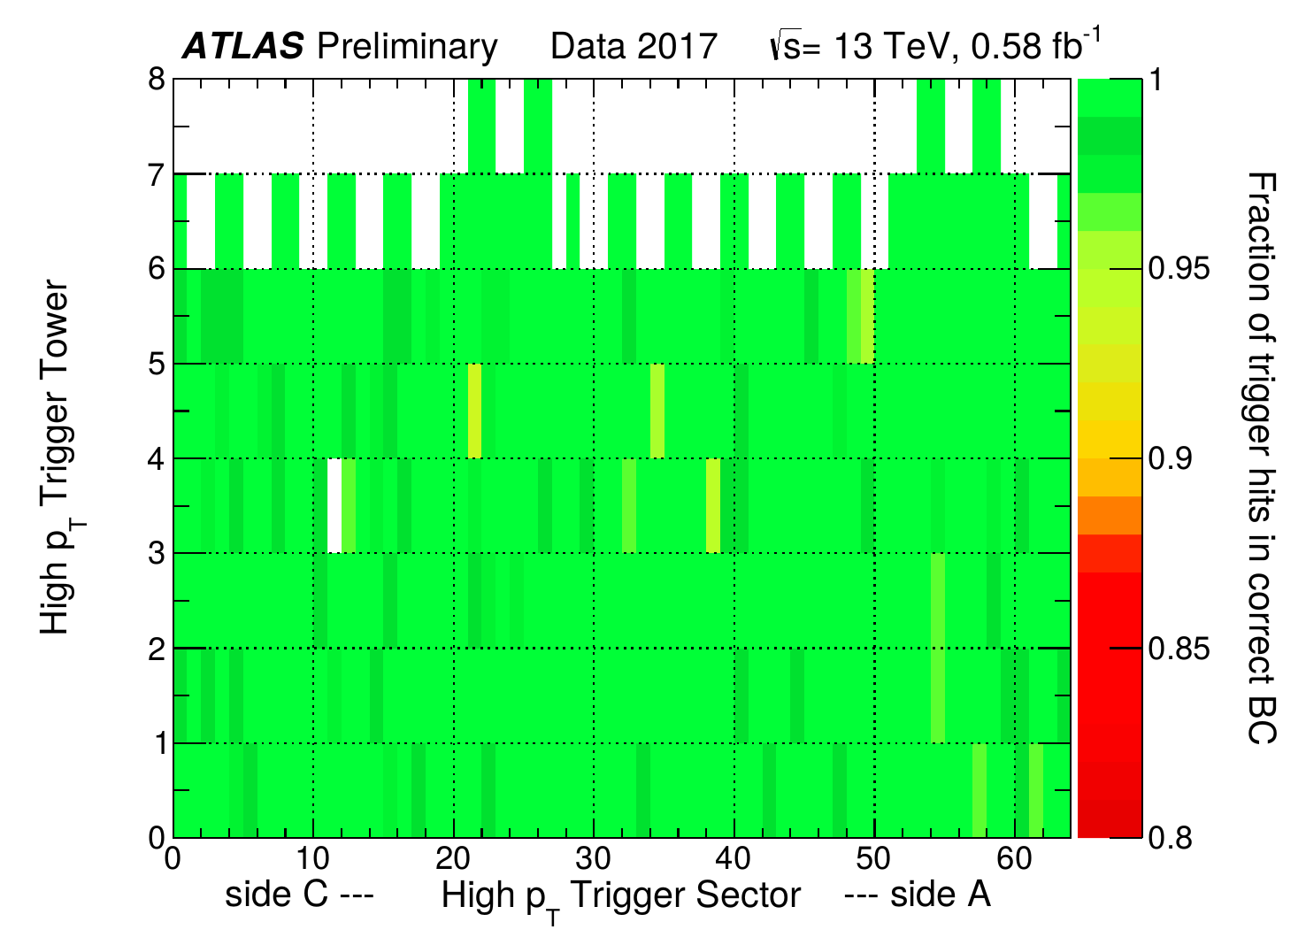
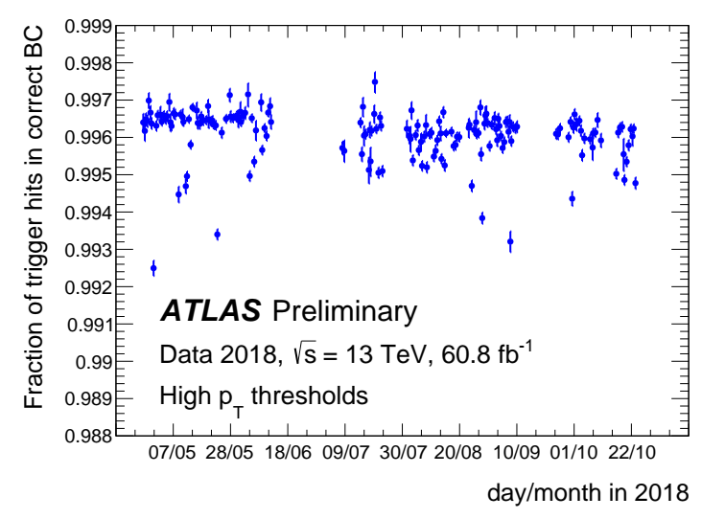
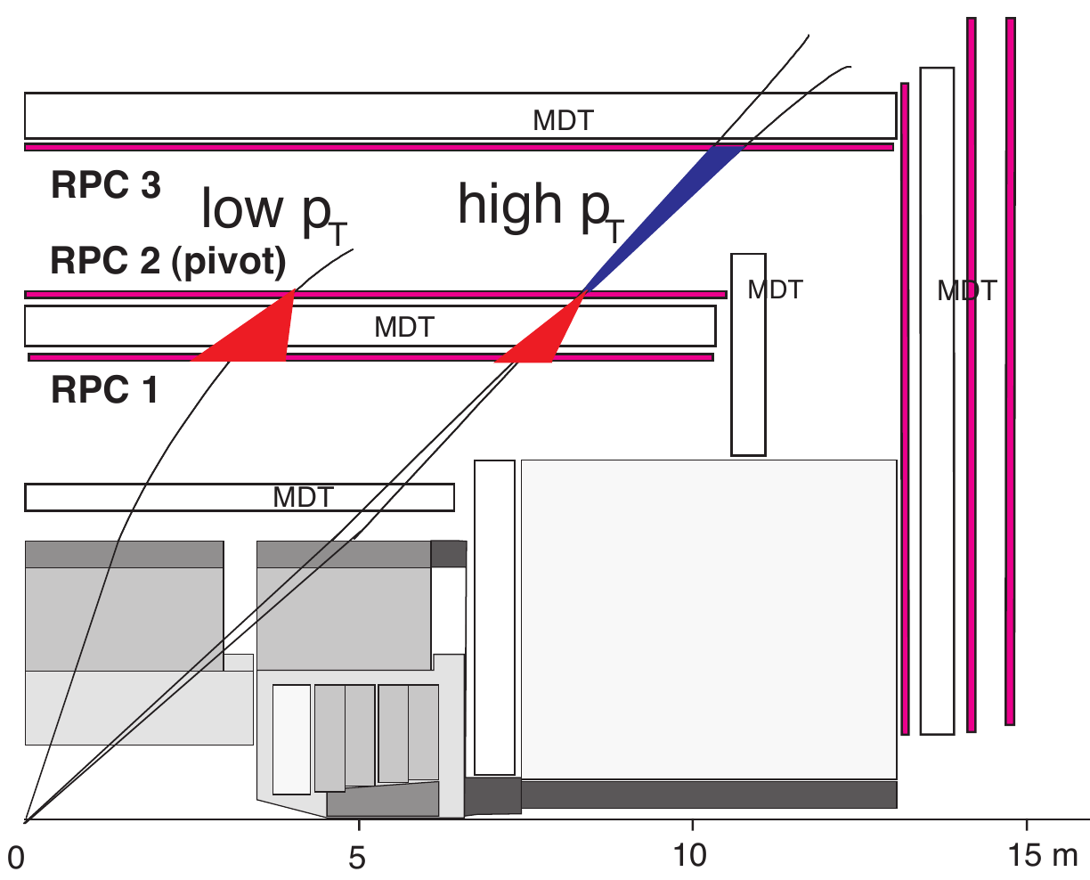
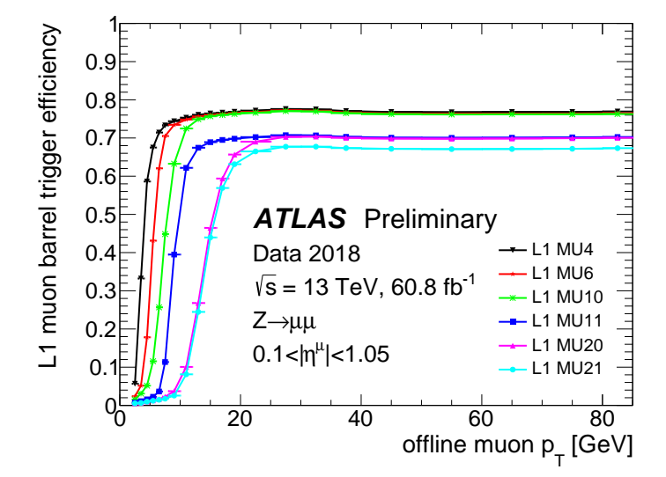
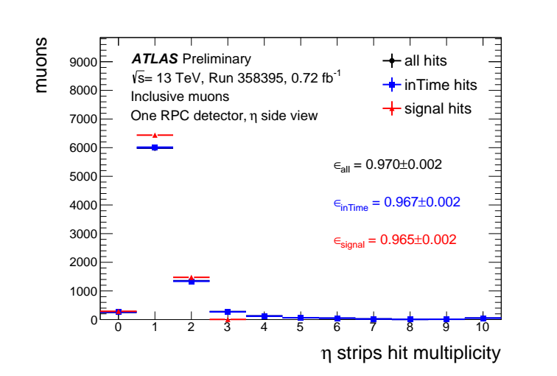
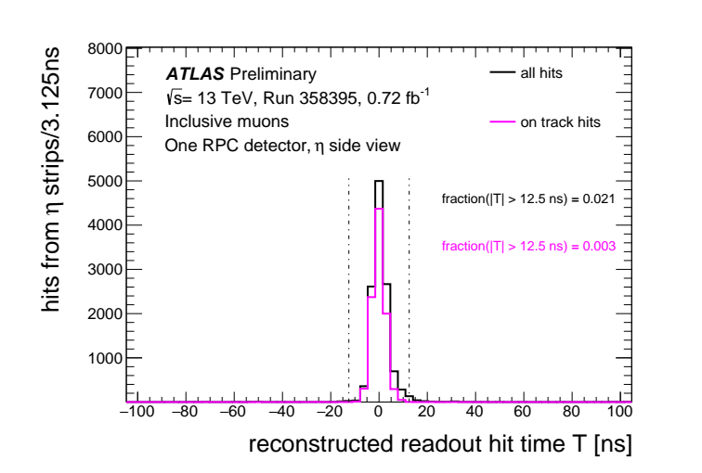
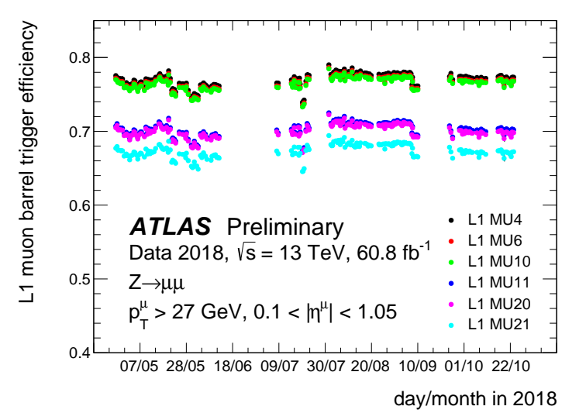
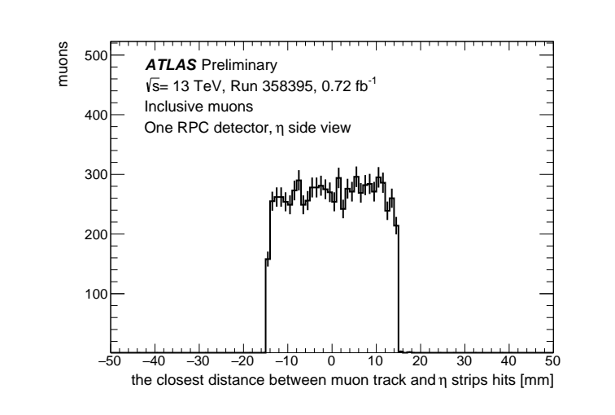
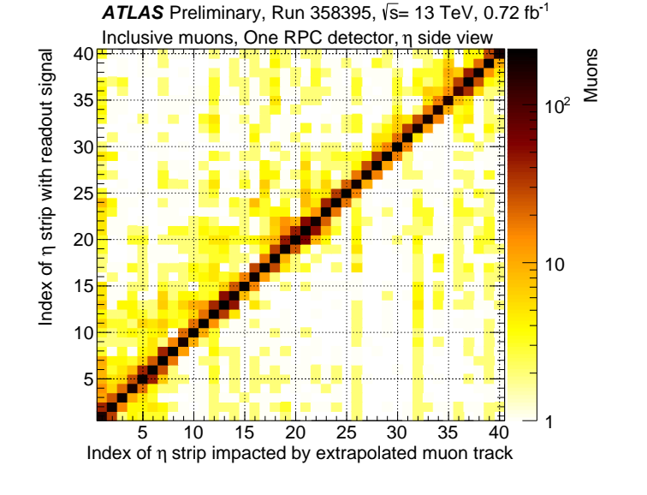
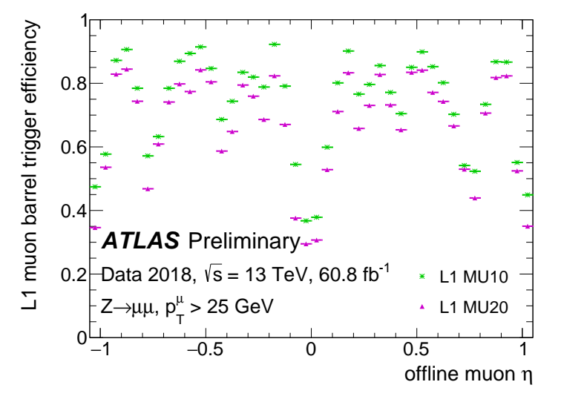
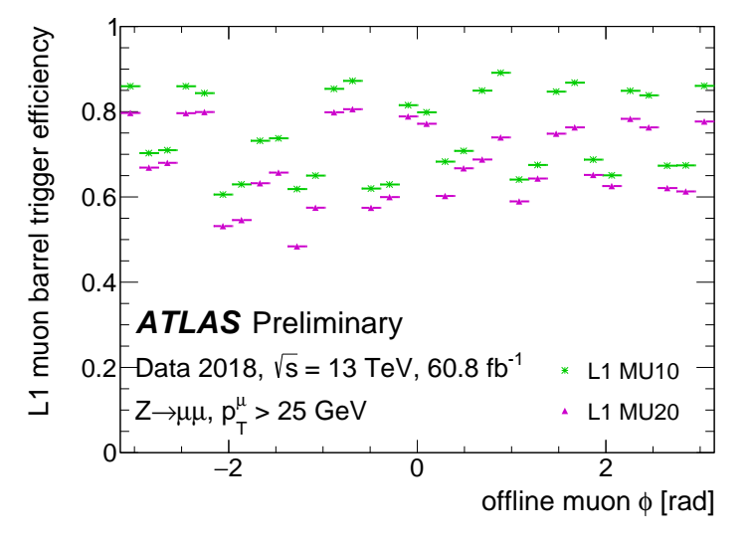
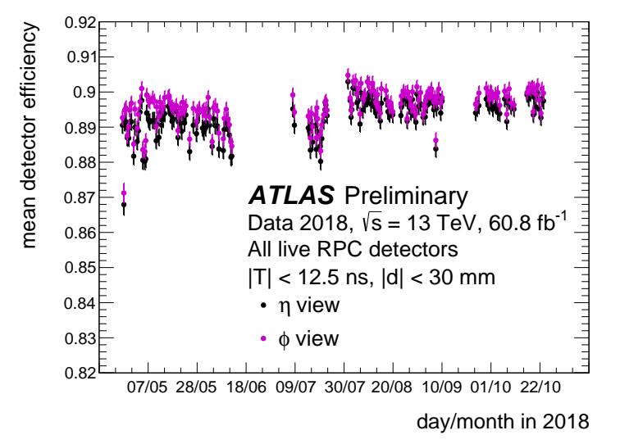
LHCC Poster Session - CERN, 27 February 2019
Performance of the ATLAS RPC detector and trigger at 13 TeV
Introduction
The ATLAS experiment utilises the Resistive Plate Chambers detector (RPC) for the first level muon trigger system in the barrel region of the detector. This poster presents measurements of RPC detector and trigger performance using proton-proton collisions at a centre-of-mass energy of 13 TeV collected in 2018, showing results in terms of the trigger timing and efficiency.
The ATLAS RPC Detector and Trigger System
Trigger timing performance
The present ATLAS muon trigger in the barrel region based on
3 concentric RPC layers
16 physical sectors, 37
each physical sector is segmented in 2 trigger sectors
totally 64 trigger sectors in side A and side C
each trigger sector is segmented along η in towers
Fraction of RPC trigger hits associated to the correct BC [1] for each of the barrel muon trigger towers for one example run in 2017 [2].
Fraction for the whole RPC trigger system as a function of time. Each point corresponds to a different ATLAS run recorded in 2017 [2]. The fraction of high p_{T} muons associated to the correct BC is 99.6% [1].
The Level-1 (L1) trigger algorithm is based on hit coincidence of 3 concentric RPC stations
Low p_{T} trigger: coincidence between the innermost two RPC stations
High p_{T} trigger: additional confirmation on the third external station
Trigger efficiency vs. offline muon p_{T}
L1 muon barrel trigger efficiency for reconstructed muons as a function of transverse momentum is shown for 6 L1 thresholds [2].
efficiencies for the low p_{T} trigger thresholds (MU4, MU6, MU10) reach a plateau of about 80%
efficiencies for high p_{T} trigger thresholds (MU11, MU20, MU21) rise to around 70% [1]
Trigger efficiency vs. offline muon η
Fit per run
Plateau value of the trigger efficiency as a function of time [2].
each point corresponds to a different ATLAS run recorded in 2017
only runs with integrated luminosity greater than 50 pb⁻¹ and at least 1000 muons collected are used
Trigger efficiency vs. offline muon η/φ
Efficiency of L1 MU10 and MU11 trigger in 2017 including (in green) or excluding (yellow) the newly commissioned trigger chambers in the “feet” region of the ATLAS Muon Spectrometer as a function of η of the offline muon candidates in the barrel detector region, for sector 12 and 14 of the “feet” region [2].
Trigger efficiency vs. offline muon φ
η-φ map of the ratio between the Level-1 Barrel muon trigger efficiency in 2017 and 2016 for the trigger threshold MU10 and MU11 are shown [2].
slight decrease in trigger efficiency in 2017 mainly due to gas leaks → HV disconnected
efficiency gained in the feet sectors credited with re-cabling of the high p_{T} feet trigger performed in the 2016-2017 shutdown
improvement in sector 13 where the "elevator" chambers in Medium Layer work now
[1] M. Corradi, Performance of ATLAS RPC Level-1 muon trigger during the 2015 data taking, 6032 Journal of Instrumentation 11 (2016) C09003
[2] ATLAS Collaboration, ATL-COM-DAQ-2018-008
Heng Li (University of Science and Technology of China) on behalf of the ATLAS Collaboration

