Slide 1
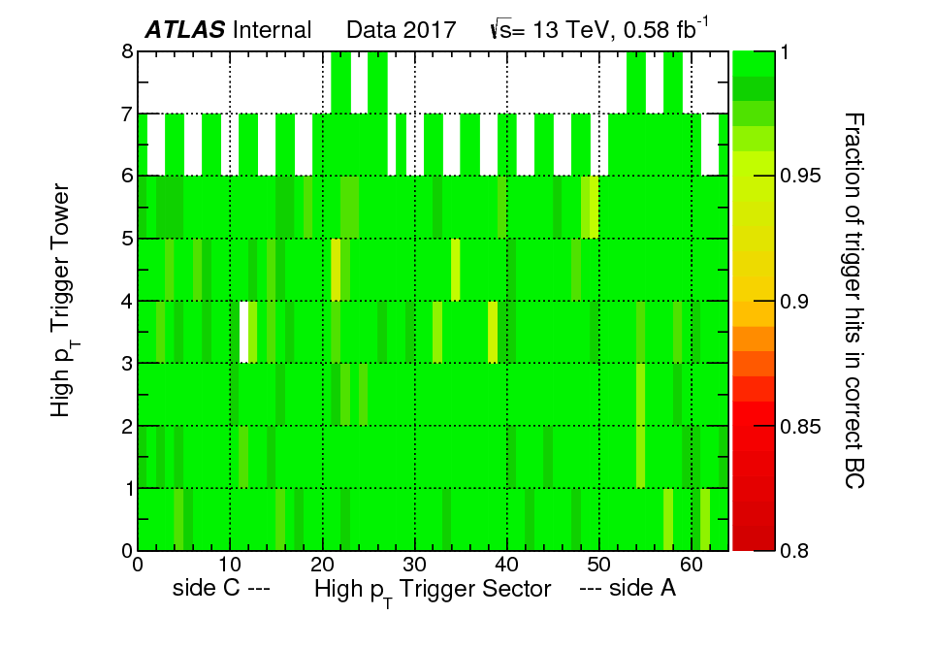
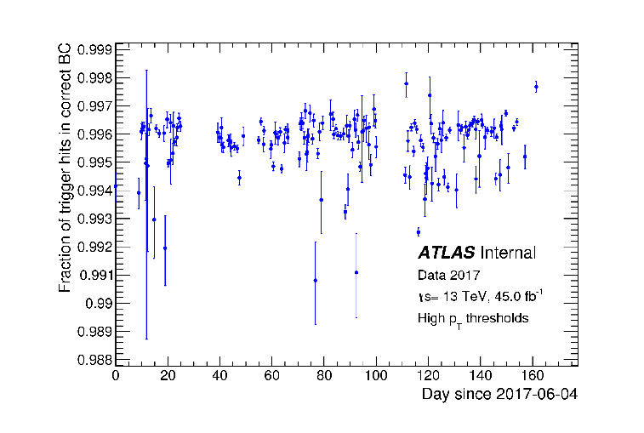
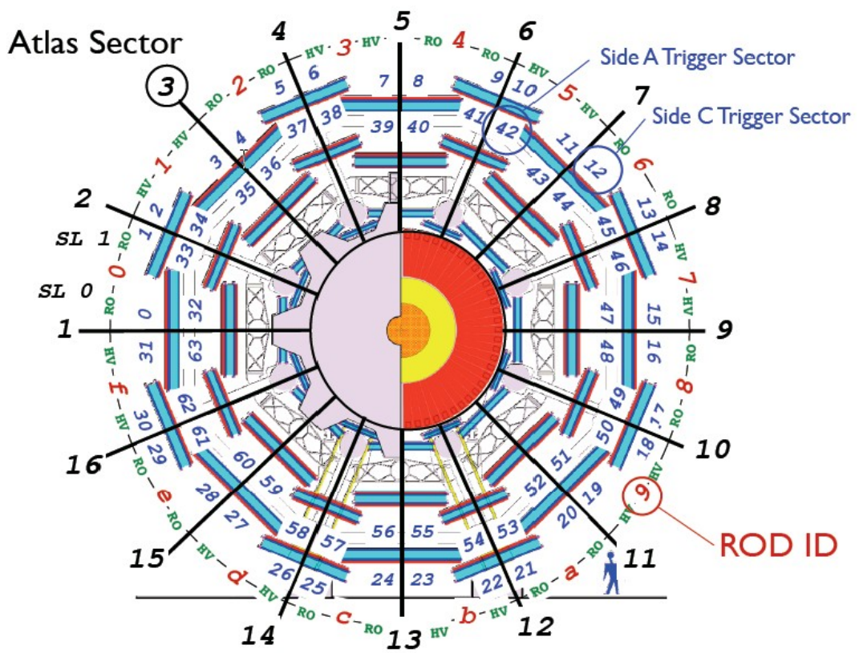
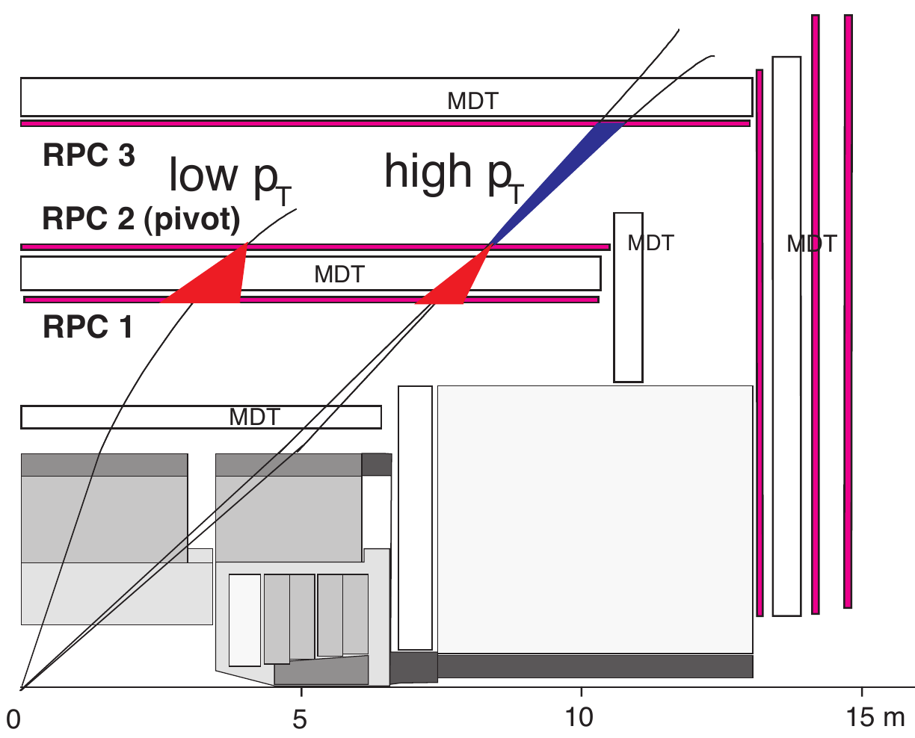
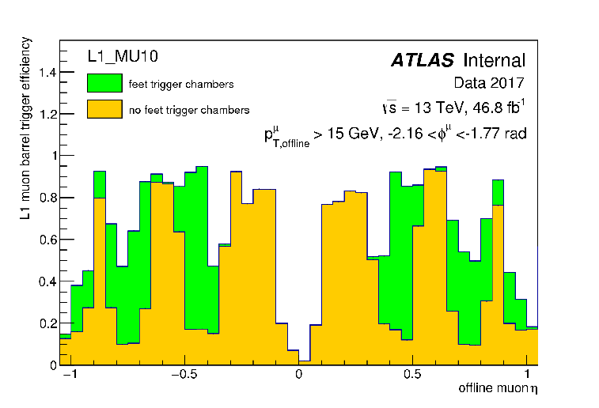
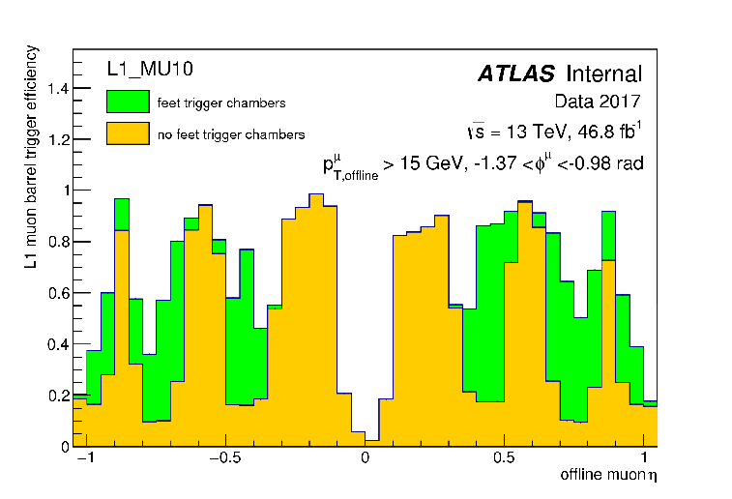
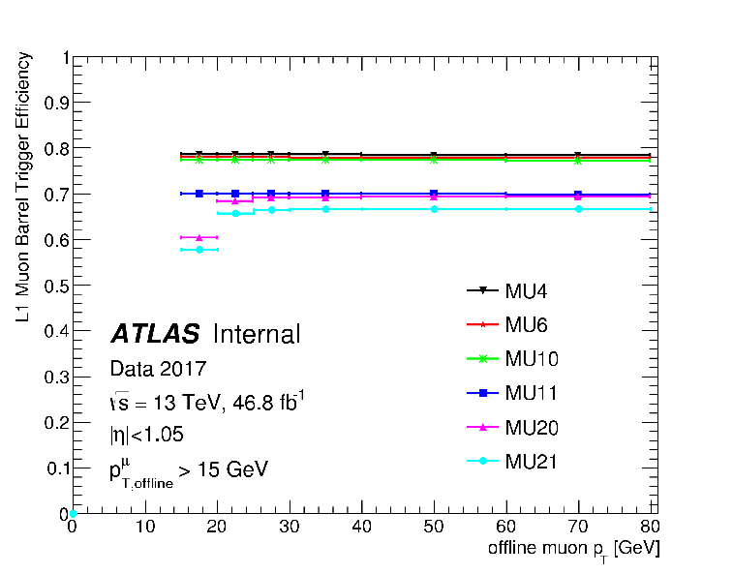
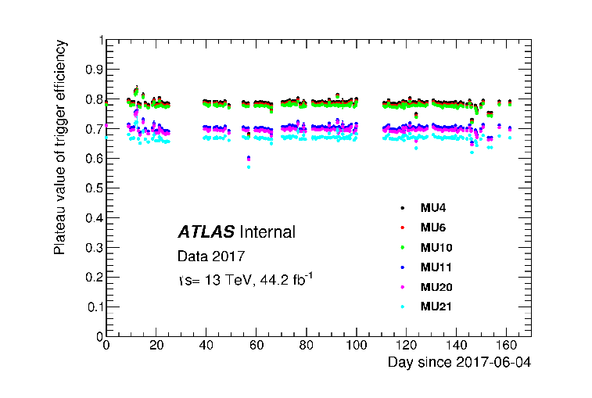
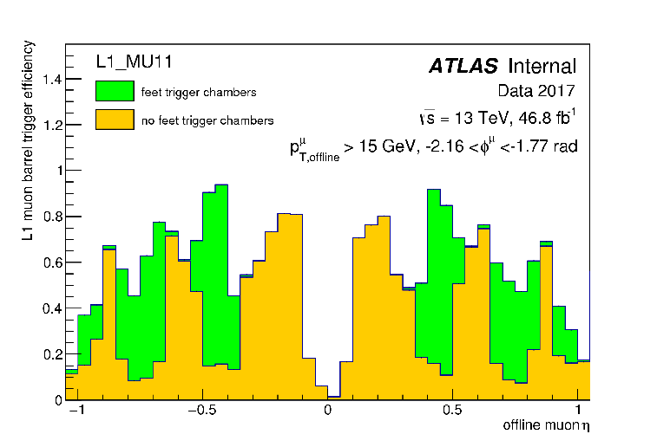
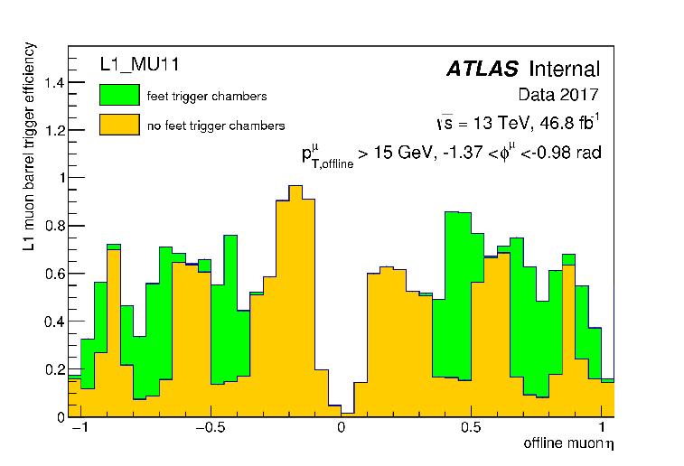
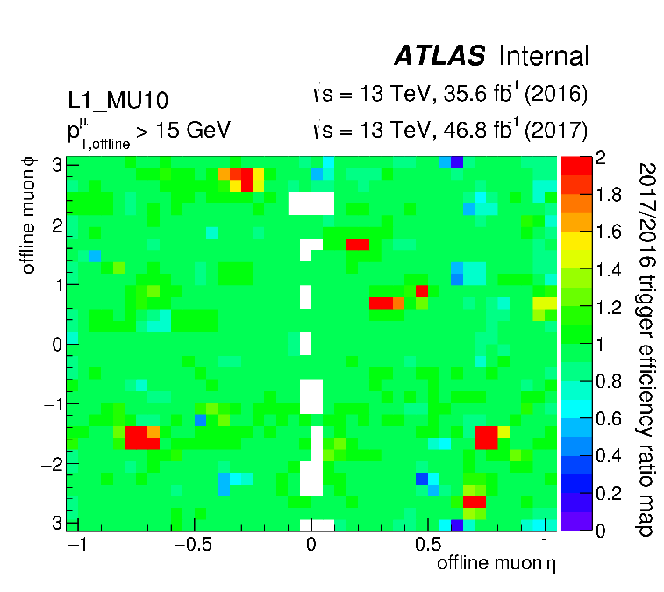
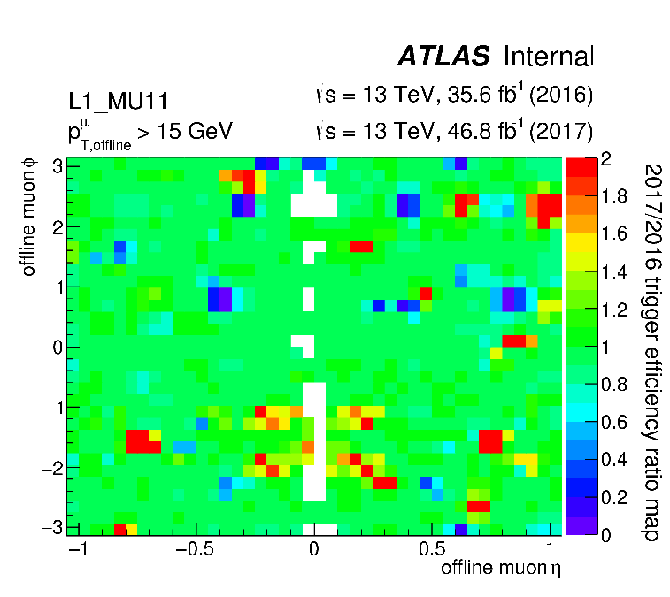
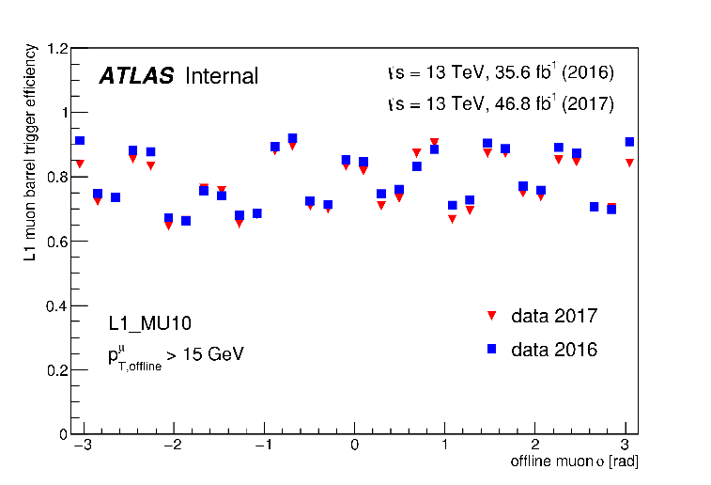
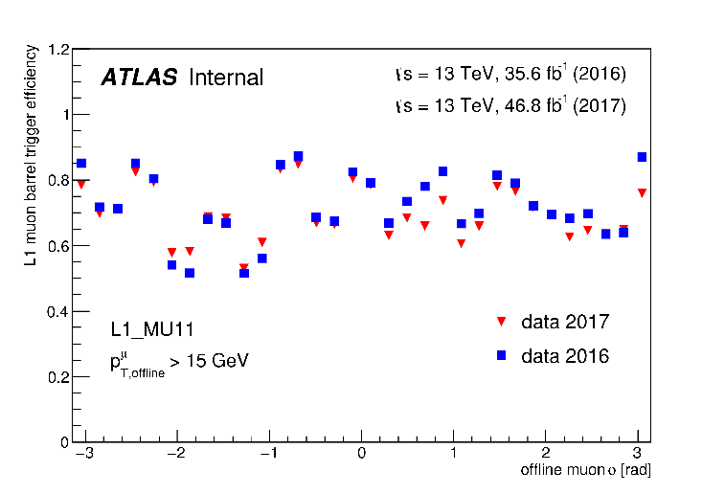
LHCC Poster Session - CERN, 28 February 2018
ATLAS Muon Barrel Level-1 trigger performance in 2017 data
Introduction
The ATLAS experiment utilises the Resistive Plate Chambers detector (RPC) for the first level muon trigger system in the barrel region of the detector. This poster presents measurements of RPC detector and trigger performance using proton-proton collisions at a centre-of-mass energy of 13 TeV collected in 2017, showing results in terms of the trigger timing and efficiency.
The ATLAS RPC Detector and Trigger System
Tigger timing performance
- There are 3 concentric RPC layers arranged in 16 physical sectors. Each physical sector is segmented in 2 trigger sectors, totally 64 trigger sectors in side A and side C. Each trigger sector is segmented along η in towers.
- The Level-1 (L1) trigger algorithm is based on hit coincidence of three concentric RPC stations (both in η and φ projections). The low p_{T} trigger requires a coincidence between the innermost two RPC stations while the high p_{T} trigger requires an additional confirmation on the third external station.
One of the main requirements of the Level-1 trigger system is the association of the triggering muon to the correct collision bunch crossing (BC).
- Left plot shows the fraction of RPC trigger hits associated to the correct BC for each of the barrel muon trigger towers for one example run in 2017.
- Right plot shows the fraction for the whole RPC trigger system as a function of time. Each point corresponds to a different ATLAS run recorded in 2017. The fraction of reconstructed high p_{T} muons associated to the correct BC is 99.6%.
Trigger efficiency vs. offline muon p_{T}
Trigger efficiency vs. offline muon η
- Level-1 muon barrel trigger efficiency for reconstructed muons as a function of transverse momentum is shown for the 6 Level-1 thresholds. The efficiency for the low p_{T} trigger thresholds (MU4, MU6, MU10) reach a plateau of about 80% while the efficiency for high p_{T} trigger thresholds (MU11, MU20, MU21) lift to around 70%.
- Plateau value of the trigger efficiency as a function of time is shown on the right. Each point corresponds to a different ATLAS run recorded in 2017. Only runs with integrated luminosity greater than 50 pb⁻¹ and at least 1000 muons collected are used.
The other important parameter for the trigger system is its efficiency.
Plots show Efficiency of Level-1 MU10 and MU11 trigger in 2017 including (in green) or excluding (yellow) the newly commissioned trigger chambers in the “feet” region of the ATLAS Muon Spectrometer as a function of η of the offline muon candidates in the barrel detector region, for sector 12 and 14 of the “feet” region.
Ratio of trigger efficiencies (2017/2016)
η-φ map of the ratio between the Level-1 Barrel muon trigger efficiency in 2017 and 2016 for the trigger threshold MU10 and MU11 are shown.
Trigger efficiency vs. offline muon φ
Efficiency of Level-1 MU10 and MU11 trigger in 2017 and comparison with 2016 trigger efficiency are shown. The efficiency is plotted as a function of φ of offline muon candidates in the barrel detector region.
Trigger efficiency in 2017 is slightly lower than that in 2016, mainly due to new chambers HV disconnected because of gas leak. We gain efficiency in the feet sectors credited with re-cabling of the high p_{T} feet trigger performed in the 2016-2017 shutdown and in sector 13 where the BME chambers do work.
Heng Li (University of Science and Technology of China) on behalf of the ATLAS Collaboration

