Slide 1



Fetch data from Nasjonal Vegdatabank (NVDB) with FME
Jan Kristian Jensen
Norwegian Road Administration
FME World Tour 2014, May 6th, Oslo
jan.kristian.jensen@vegvesen.no
@LtGlahn

Slide 2
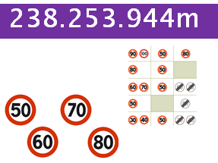
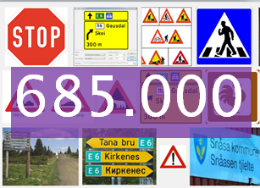
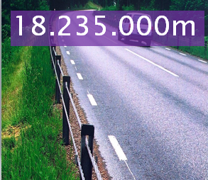
Norwegian Road database (NVDB)
Repository of Norwegian road network
… and road related objects
- 370 different object types
Very flexible schema
Object definition in separat data catalogue
187 516
1714

Slide 3

27. September 2013
Tons of Norwegian geographic data are freely available

Slide 4


REST api, Nasjonal vegdatabank
Datacatalogue – definition and structure
https://www.vegvesen.no/nvdb/api/datakatalog/
Generic, powerful search function
https://www.vegvesen.no/nvdb/api/sok/
The different objects
https://www.vegvesen.no/nvdb/api/vegobjekter
Functionality to calculate x,y <=> road network
https://www.vegvesen.no/nvdb/api/vegreferanse
Formats: XML, JSON.
Do specify MediaType in http header.
Accept:application/vnd.vegvesen.nvdb-v1+json
Accept:application/vnd.vegvesen.nvdb-v1+xml
Per 2014: Only road related objetcts, not the road network)
187 516
1714

Slide 5
Special cortecy @KenAtSafe
187 516
Our development blog:
1714
vegdata.no
http://www.vegdata.no/2014/02/19/a-little-note-to-oor-our-international-fans/
https://github.com/LtGlahn/vegdatalabs_fme

Slide 6
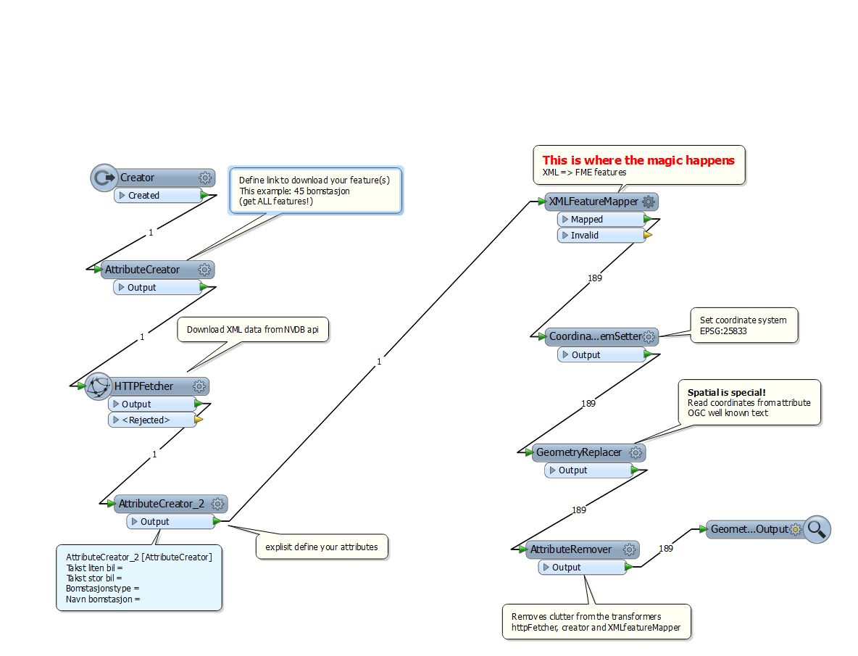

Slide 7
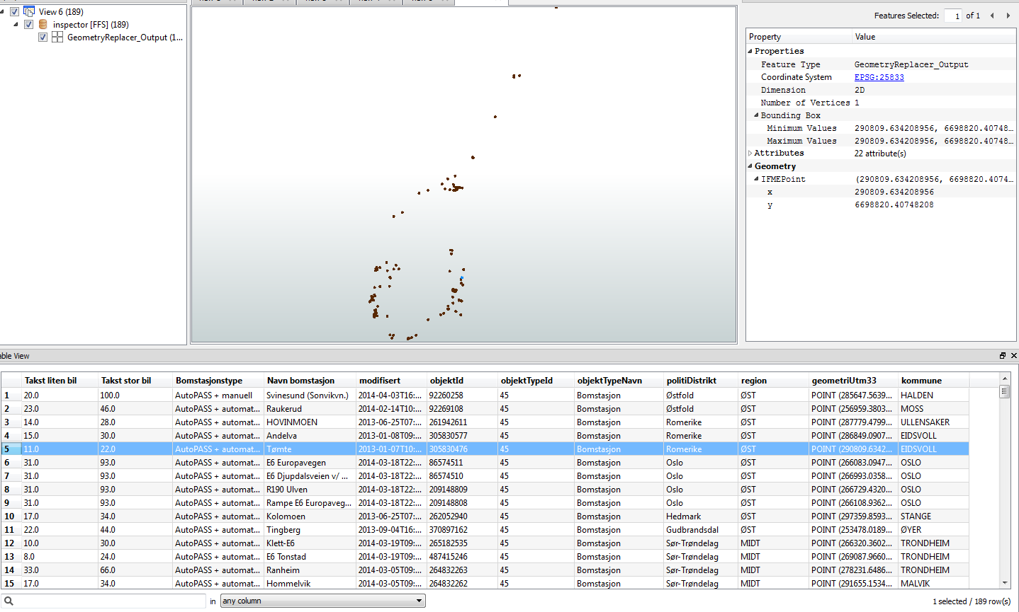
Looking good…

Slide 8
https://www.vegvesen.no/nvdb/api/vegObjekter/{Id}
Essentially: Give me ALL (or a number of) objects
Optionally: Whithin bbox..
Let’s try the SEARCH function!
VERY powerful: Search for objects with:
- Road network properties
- Attribute values
- bbox, region, county, municipality
Plus a bit more…
https://www.vegvesen.no/nvdb/api/sok?

Slide 9
Vegkart example
FME workspace modification example

Slide 10
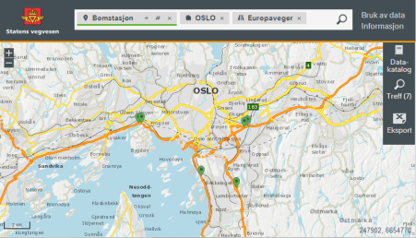
A fancy Vegkart-search
URL decoding
Template for
creating of valid
Search-URI’s

Slide 11
A fancy Vegkart-search
https://www.vegvesen.no/vegkart/vegkart/#!/vegreferanse:296070.0829735:6732223.668614/sok:{"lokasjon":{"kommune":[301]},"objektTyper":[{"id":45,"antall":"1000","filter":[{"type":"vegreferanse","operator":"=","verdi":["EV"]}]}]}
sok:{"lokasjon":{"kommune":[301]},"objektTyper":[{"id":45,"antall":"1000","filter":[{"type":"vegreferanse","operator":"=","verdi":["EV"]}]}]}
https://www.vegvesen.no/nvdb/api/sok/?kriterie={"lokasjon":{"kommune":[301]},"objektTyper":[{"id":45,"antall":"1000","filter":[{"type":"vegreferanse","operator":"=","verdi":["EV"]}]}]}
Please note that MS-office truncates long links; clicking on them won’t work.
Use cut-and-paste if you want to test these links.

Slide 12
A little more detail

Slide 13
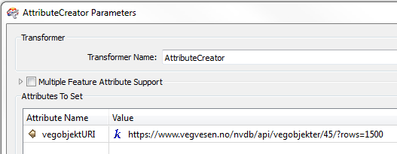
https://www.vegvesen.no/nvdb/api/vegobjekter/45/?rows=1500

Slide 14
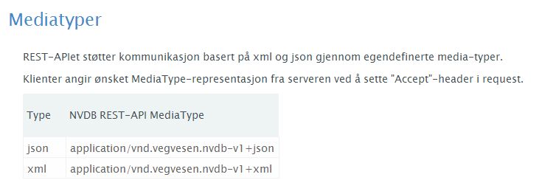
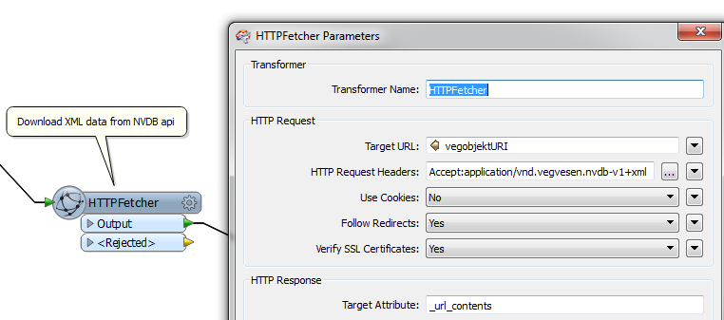
NVDB api – http headers
https://www.vegvesen.no/nvdb/api/dokumentasjon

Slide 15
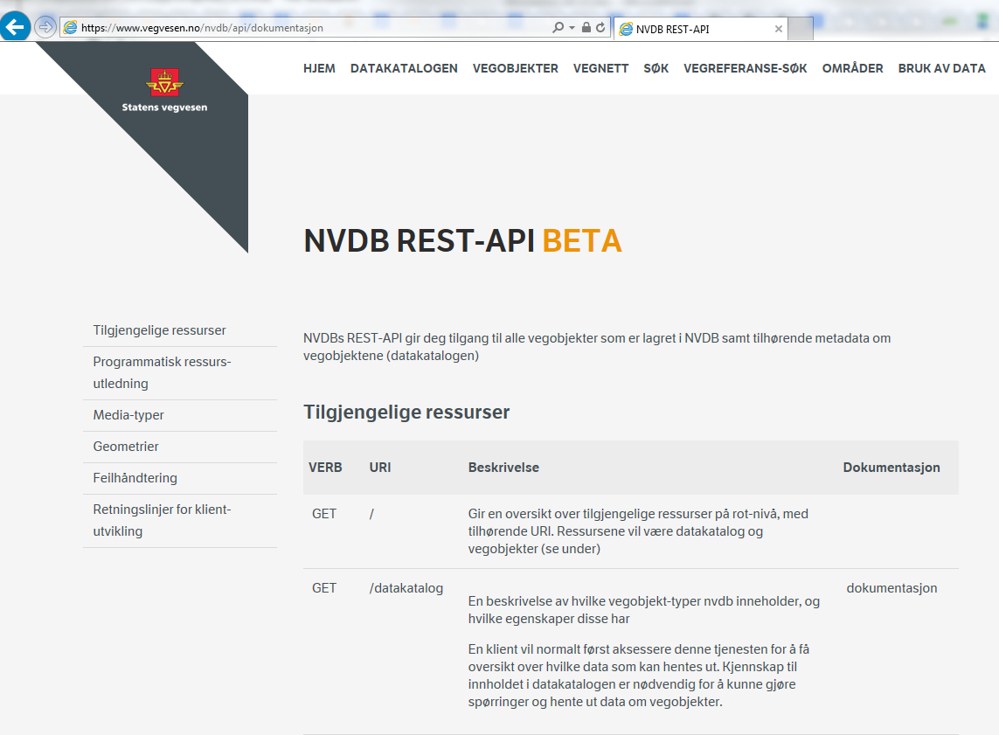

Slide 16
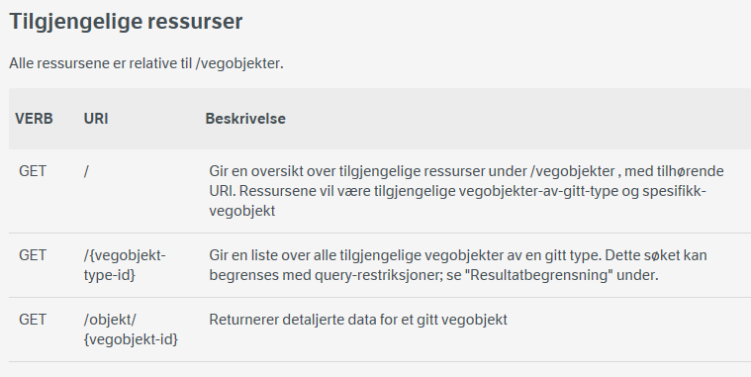
NVDB api/vegobjekter
https://www.vegvesen.no/nvdb/api/dokumentasjon/vegobjekter
Example: All toll stations (Bomstasjoner)
https://www.vegvesen.no/nvdb/api/vegobjekter/45/?rows=1500
(If you omit the «rows» part you get 100 items… )

Slide 17
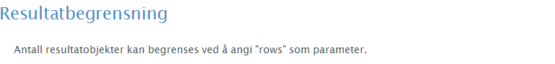
NVDB api/vegobjekter: Explaining the «rows» part …
https://www.vegvesen.no/nvdb/api/dokumentasjon/vegobjekter
https://www.vegvesen.no/nvdb/api/vegobjekter/45/?rows=1500
(If you omit the «rows» part you get 100 items… )

Slide 18
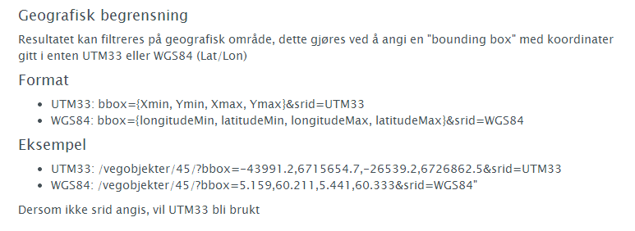
NVDB api/vegobjekter BoundingBox
https://www.vegvesen.no/nvdb/api/dokumentasjon/vegobjekter
Easy to implement in FME! (left as excercise to the reader…)

Slide 19
NVDB api/vegobjekter
https://www.vegvesen.no/nvdb/api/dokumentasjon/vegobjekter
Or you could ask for a specific objekt (by ID)
https://www.vegvesen.no/nvdb/api/vegobjekter/objekt/487458624
We’ll do some nifty cool things with this function!

Slide 20
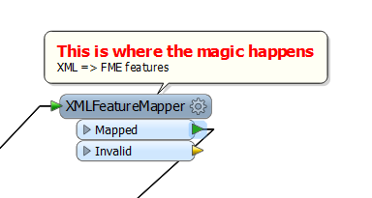
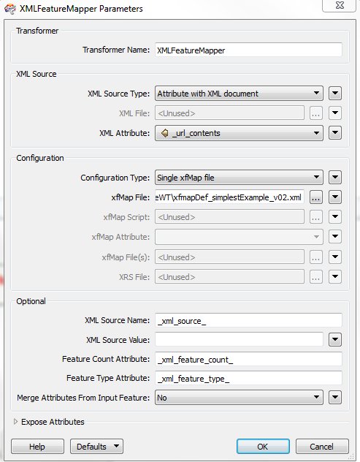
What’s inside XMLfeatureMapper ?
We take a look inside
the xfmap definition

Slide 21
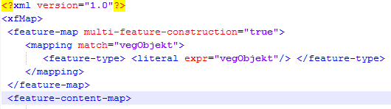
Inside XMLfeatureMapper xfsmap definition
Telling xfmap to construct a feature each time it finds «vegObjekt»

Slide 22
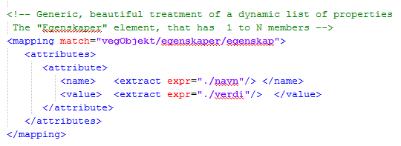
The cool part: Extract values from a list of egenskaper

Slide 23
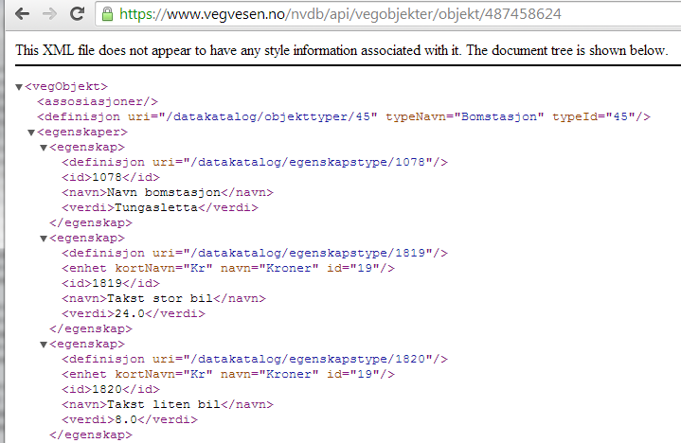
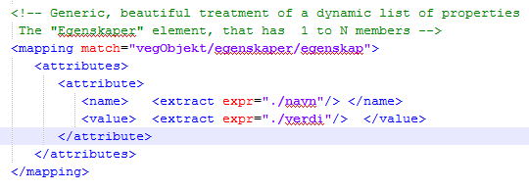
How does that work?
Attribute name = «Takst liten bil»
Attribute value = 8

Slide 24
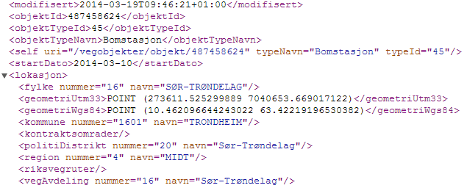
Explisit treatment of some standard elements (at root level, or within the «lokasjon» element)

Slide 25
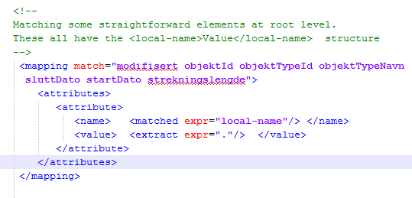
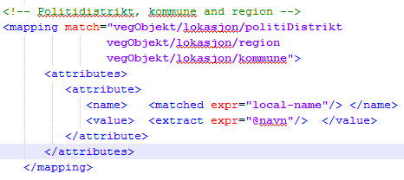
Attribute names & values
are part of XML-tag
<tagname>value<tagname>
Attribute names & values
are part of XML-tag
<tagname navn=″value″>

Slide 26
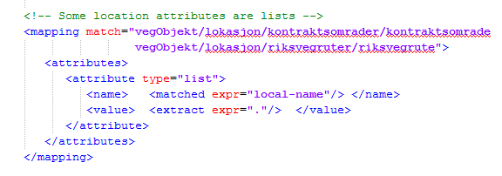
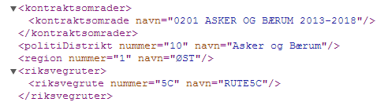
Treatment of lists
(Example from
https://www.vegvesen.no/nvdb/api/vegobjekter/objekt/225760360 )

Slide 27
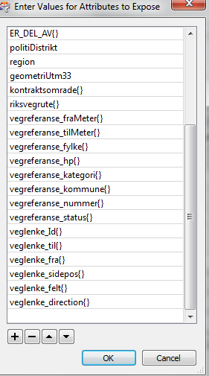
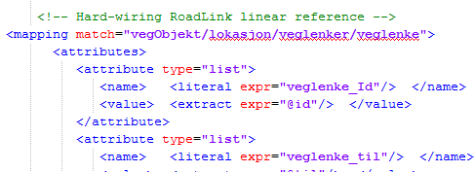
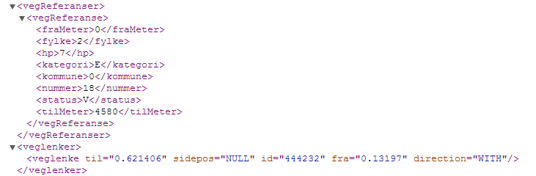
Hardwiring list of linear references

Slide 28
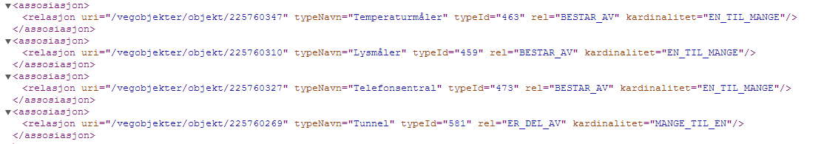
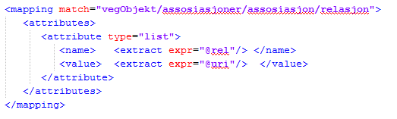
The übercool treatment of associations
Composition (consist of)
Also called daugther objects
<assosiasjoner>
</assosiasjoner>
Composition (is part of)
Also called Mother
Produces lists
BESTAR_AV{}
ER_DEL_AV{}
Example data from
https://www.vegvesen.no/nvdb/api/vegobjekter/objekt/225760360

Slide 29
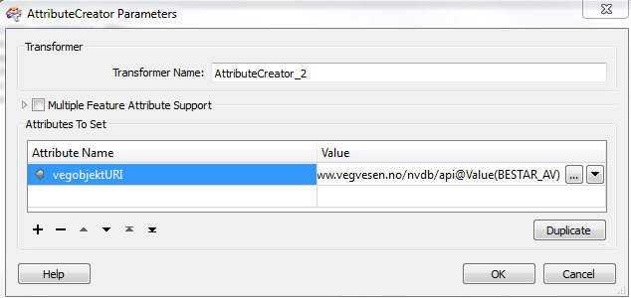
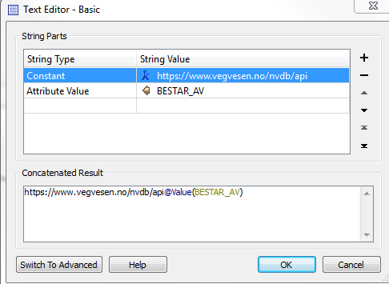
Making valid URI to each object is supereasy

Slide 30
Get all «daughter» and «granddaughter» objects recursively
Oh, and you’d need a more generic attribute definition...
ListExploder
BESTAR_AV{}
Feed that link
into HTTPFetcher
AttributeCreator:
Construct link to each object

Slide 31
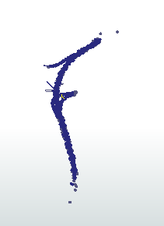
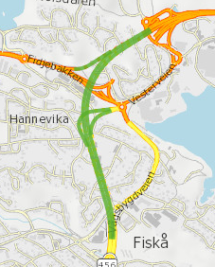
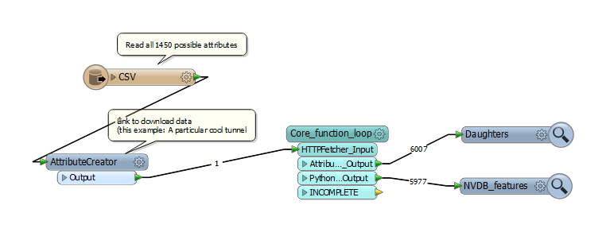
A rather hairy recursive example… Vågsbygdporten tunnel https://www.vegvesen.no/nvdb/api/vegobjekter/objekt/359603347
~60 objects, 35 minutes

Slide 32
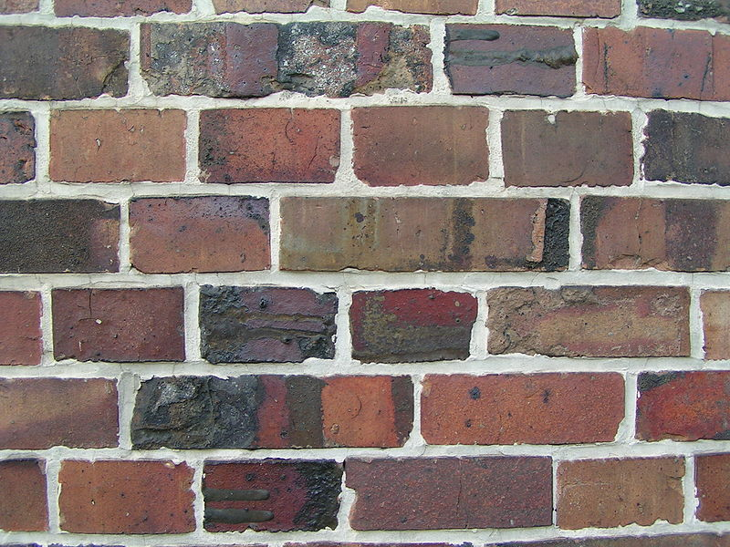
The uncool parts

Slide 33
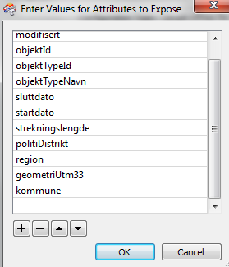
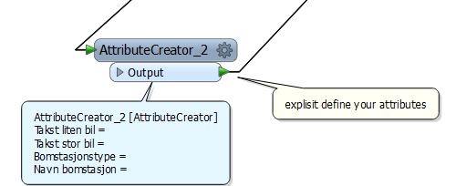
370 different objects
1750 different attributes (not counting the «standard» elements (road reference, region,
police district, county, … )
This gets old really fast!

Slide 34
FME attribute names must be known to the workspace definition if you want to do cool stuff with them.
Besides the standard attribute Creation/exposing – methods, there are more or less cludgy ways of making attributes spring into existence
- FeatureReader? Dynamically write feature type definition to a file (with python?) WorkspaceRunner?
I’ve yet to see a nice, elegant way of true dynamic way of creating schema definitions
- But I do have hopes for FME schema reader…

Slide 36
My own half-cludgy way around these limitations
Python routine:
Read data catalogue definiton https://www.vegvesen.no/nvdb/api/datakatalog
Write attributes to CSV file
Read that definition into FME
Do the XMLFeatureReader-magic
Get rid of empty attributes (python caller)
Example from FME community answers
http://goo.gl/hRa3Lu
(Easy way to remove all Empty attributes)

Slide 38
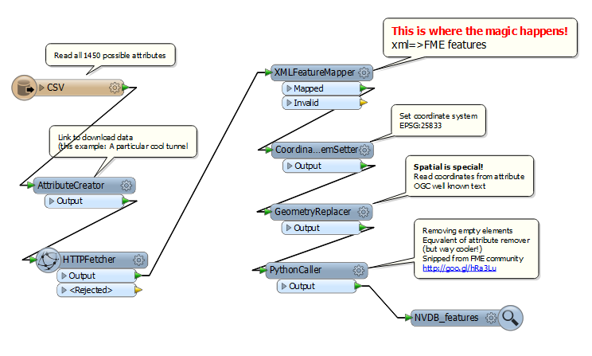

Slide 39
Recommendation 1:
NVDB is data catalogue driven.
Data catalogue updated about 4-5 times/year
You should verify / update feature definiton accordingly
Best solution: Feature defintion created dynamically based on https://www.vegvesen.no/nvdb/api/datakatalog
Any tips on how to achieve this is greatly appreciated!

Slide 40
Data catalogue resources
The official data catalogue
http://www.vegvesen.no/Fag/Teknologi/Nasjonal+vegdatabank/Datakatalogen
Data catalogue through NVDB api
https://www.vegvesen.no/nvdb/api/dokumentasjon/datakatalog
… which again is used by these implementations:
Data catalogue embedded in Vegkart
https://www.vegvesen.no/vegkart/vegkart/
Our own playground example
http://labs.vegdata.no/nvdb-datakatalog/

Slide 41
Recommendation 2:
KISS – as simple as possible
If you’re happy with a (very) limited subset of object types and/or attributes from NVDB
my «simplest possible» workspace should be a good starting point
FMEWT_simplestExample.fmw
FMEWT_apisearch.fmw

Slide 42
Recommendation 3:
… but not simpler
When you’re tired of «attributeCreator» the more generic workspace should provide fertile starting ground.
Far from perfect (cludgy, in fact), but easy to improve upon & adapt
FMEWT_genericExample.fmw

Slide 43
Recommendation 4:
Learn python
It is super fun – and it will greatly enhance your FME skills!
https://www.pythonanywhere.com/ is a truly great place to start
And NVDB api is white listed, so you can access it from a free acount! https://www.pythonanywhere.com/forums/topic/1290/

Slide 44
Recommendation 5:
These examples provide messy attribute names
UTF-8 encoding, white space, non-ascii Norwegian characters (Æ, Ø, Å).
Not all writers and formats are too happy about that…
AttributeRenamer is your friend…
The «NVDB» way is to always refer to the ID of the attribute definition. (The name is supplemententary).

Slide 45
Have fun! http://vegdata.no <= our blog http://labs.vegdata.no <= experimental stuff https://github.com/LtGlahn/vegdatalabs_fme

