Slide 1
Cache Money
RISC-V Pipelined Processor

Slide 2
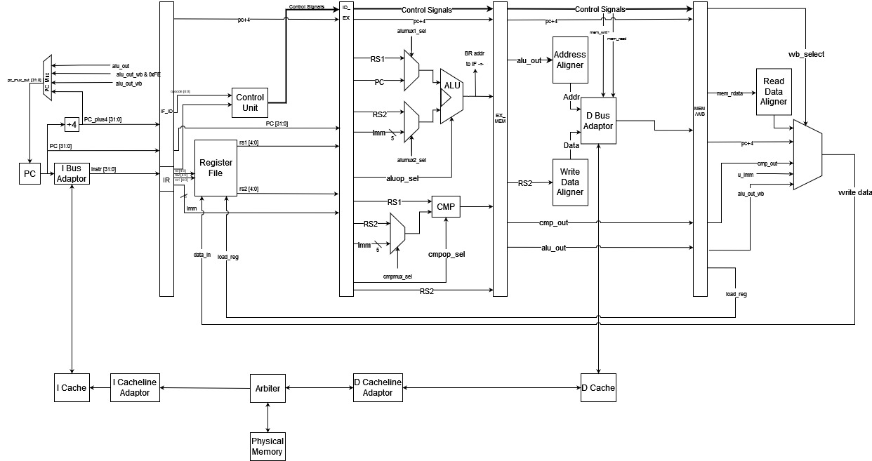
CPU Overview
Frequency (MHz)
IPC
Branch Hit Rate
285.71
0.21
35%

Slide 3
Advanced Features

Slide 4
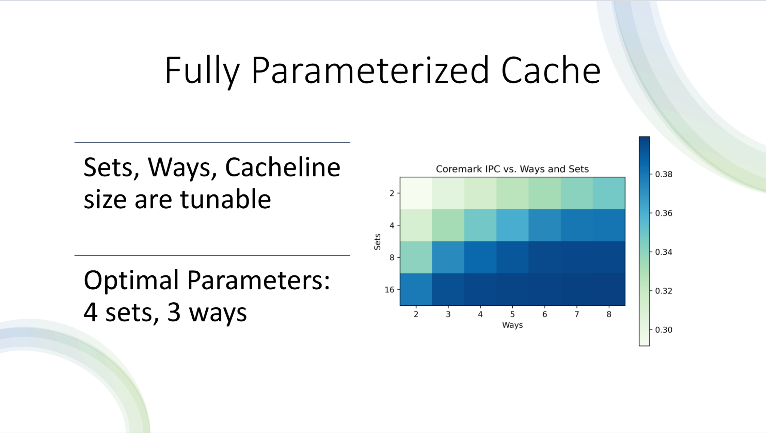

Slide 5
Branch Prediction: BHT
Hit Rate: 71%
Array stores 1 bit (T/NT) for each index
Indexed by bottom n bits (parametrized) of PC
Read from Fetch stage, determine whether to read from BTB for next instruction
Write from Execute stage, fill entry with result from compare unit

Slide 6
Branch Prediction: BTB
Hit Rate: 71%
Buffer stores 32-bit predicted address for each index, size parameterized
Tagged by 32-bit current PC
Read from Fetch stage, set next instruction to predicted address if BHT is high
Write from Execute stage, fill entry with result from ALU

Slide 7
Branch Prediction: G-Share
Hit Rate: 90%
Exploits the possibility of branches being correlated
Use Branch History Register (BHR) to keep track of branch predictor's history
XOR current instruction's PC with BHR before bit slicing to hash into BTB
Increases hit rate by about 20%!

Slide 8
Branch Prediction: Performance Recap

Slide 9
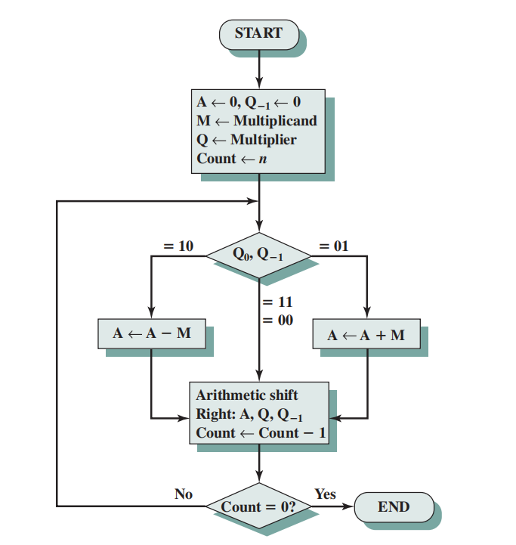
M Extension: Multiplier
Booth's Algorithm works by decomposing the multiplication into partial products for signed and unsigned binary multiplication
Performs a series of additions and right shifts to accumulate the partial products and generate the final product
O(n) time complexity where n = 33, 33-bit multiplier to effectively perform signed multiplication

Slide 10
M Extension: Divider
Algorithm
Restoring division algorithm – 32-bit operands
Common divides complete in 1 clock cycle
All other divides complete in 32 clock cycles
Start remainder at 32-bit 0
Result = {Remainder, Dividend)
Shift Result left
Subtract Divisor from Remainder
Repeat 32 times

Slide 11
Potential for Improvement
Pipelined Cache
Return Address Stack
Prefetching

Slide 12
Thank You!
Questions?

