Slide 1

Semester Project (MScIS)
Louis Tochon
Supervised by Pr. Huguenin

Slide 2
Background
K-anonymity
Generalization Tree (VGH)
Name | Gender | Zipcode | Illness
Simon | M | 1226 | Cancer
Louis | M | 1212 | Flu
Theo | M | 1212 | HIV+
Laura | F | 1217 | Cancer
Leo | M | 1212 | Flu
Lisa | F | 1211 | HIV+
Ana | F | 1227 | Flu
1200
1210
1220
1211
1212
1217
1226
1227

Slide 3
Algorithm proposal
Algorithm’s definition
Achieve a level of k-anonymity by minimizing the loss of utility during generalization steps (expressed by weights)
Propose an algorithm that includes weights on the different steps of generalization
CH
W : 3
GE
W : 1
Carouge
Versoix
Genève

Slide 4
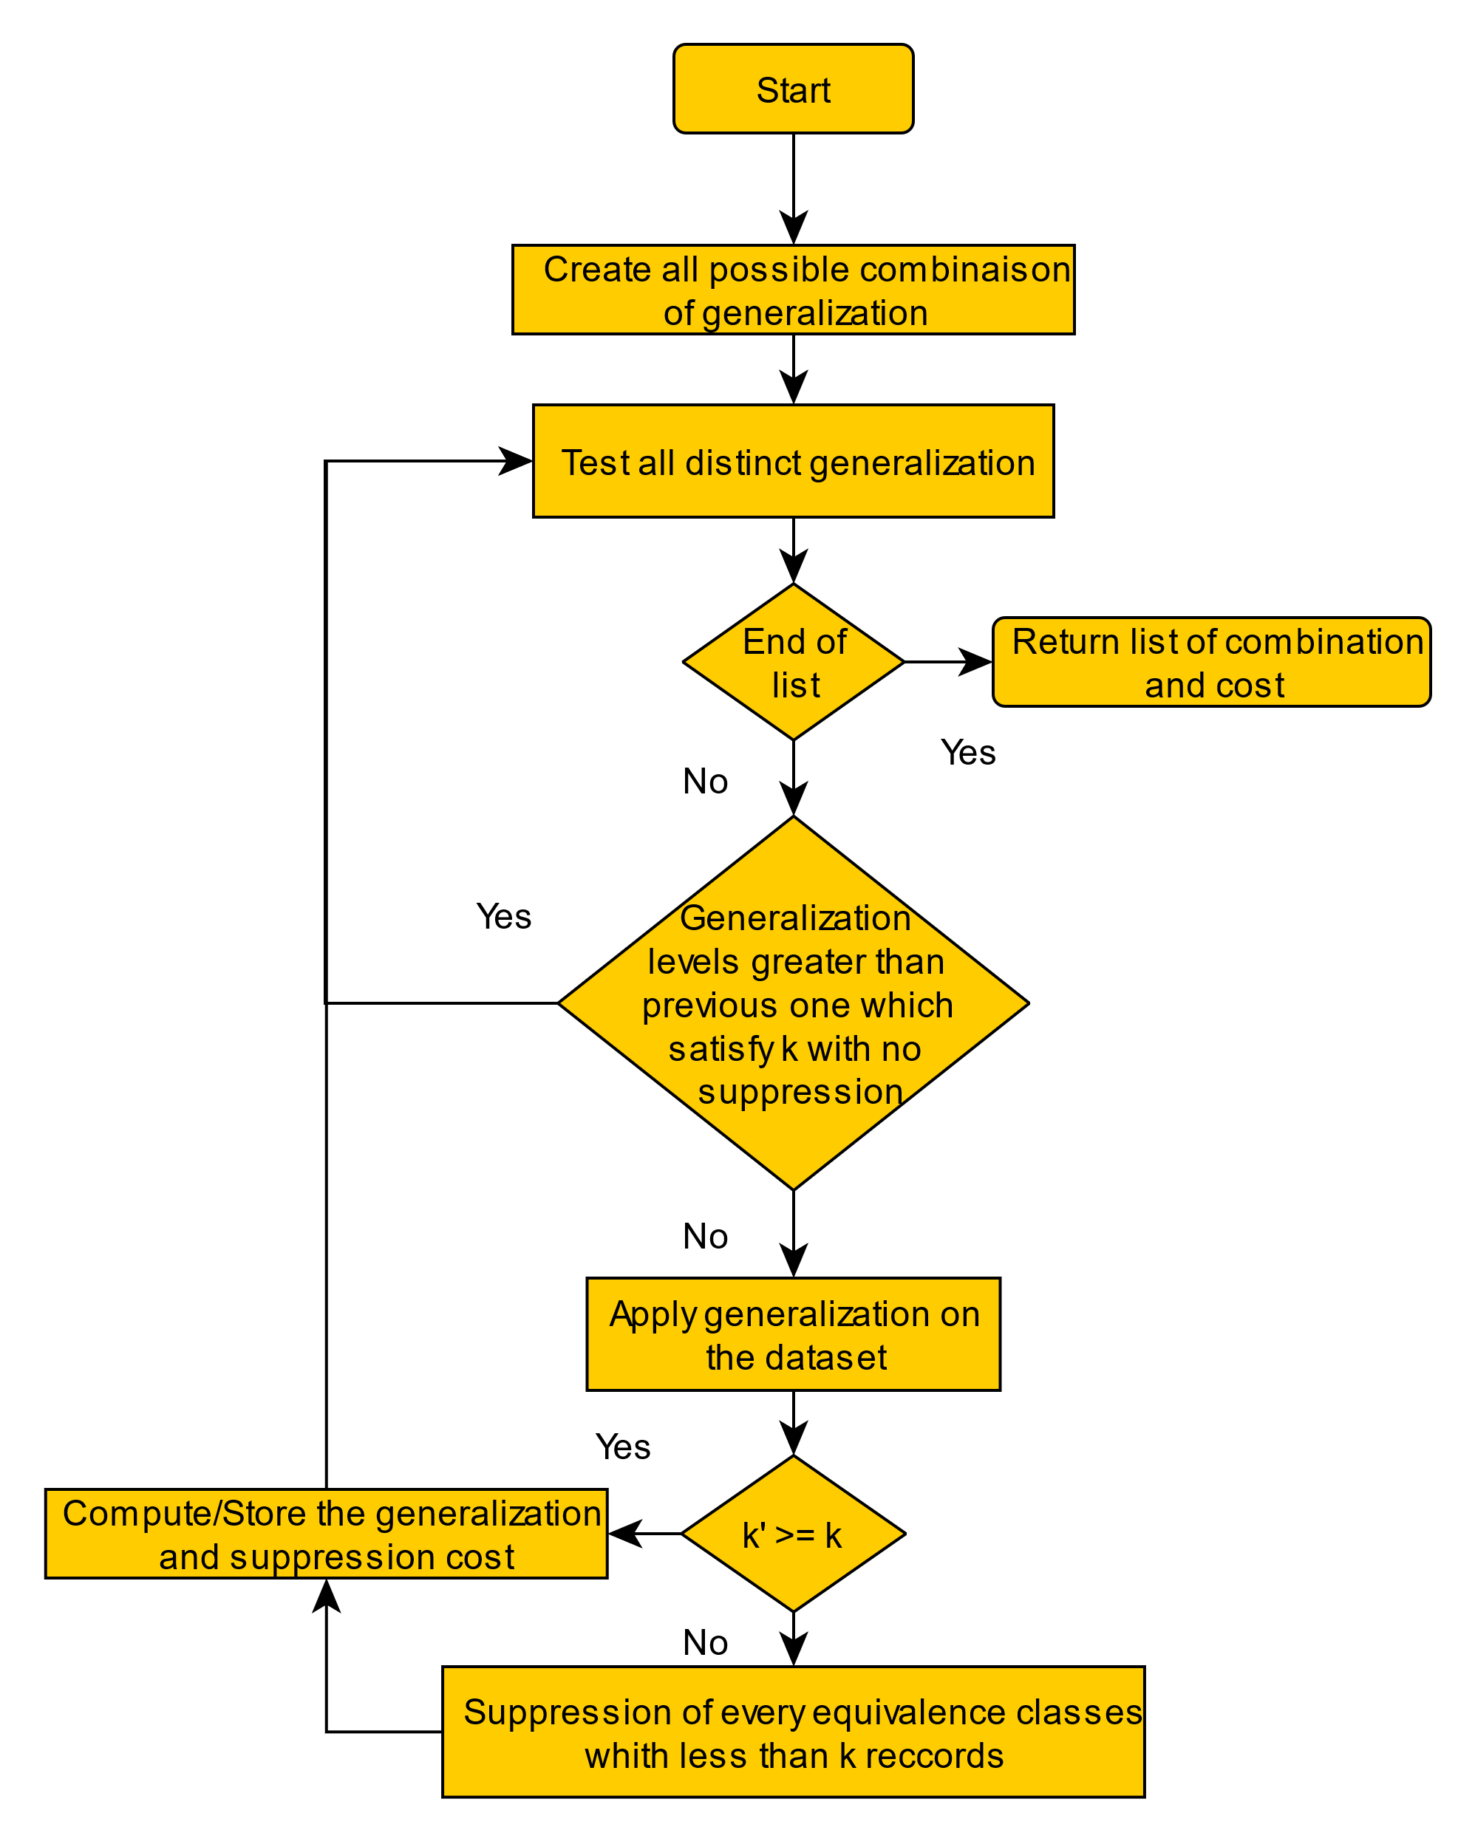
SW algorithm
First version of the algorithm
Problem :
- Computational time increases exponentially

Slide 5
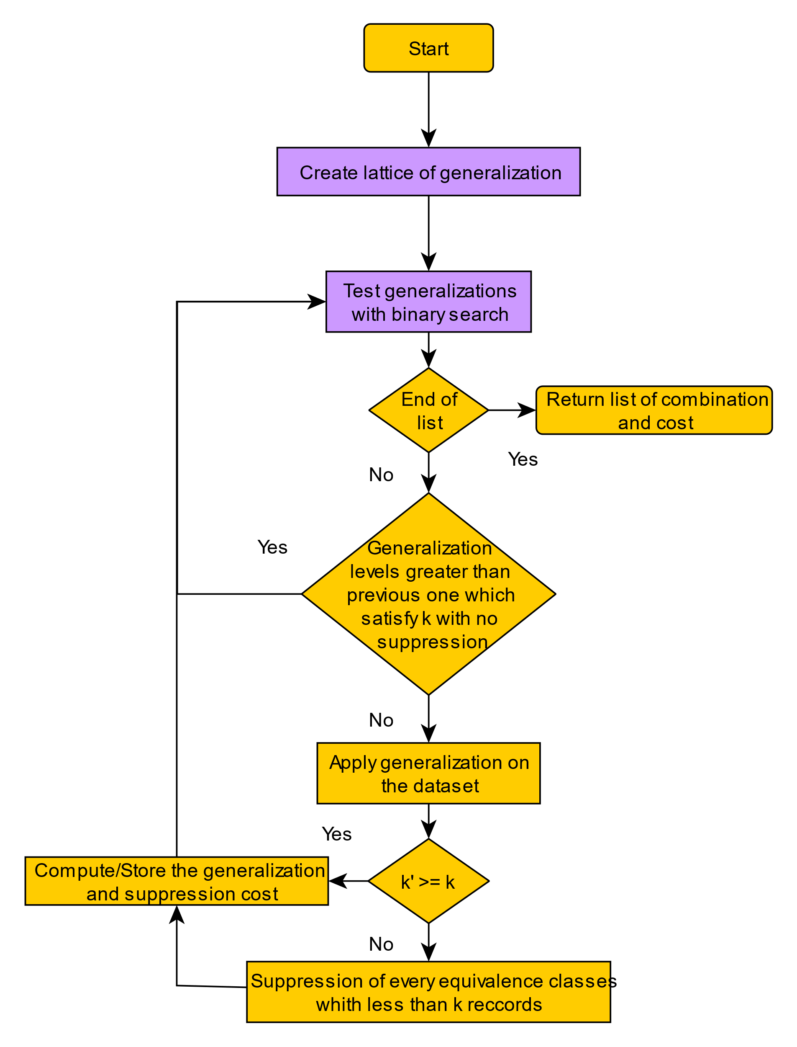
SSW algorithm
Second version of the algorithm
Includes Samarati binary search tree
→ O(n^{k} * n²) vs O(k * log2(n) * n²)

Slide 6
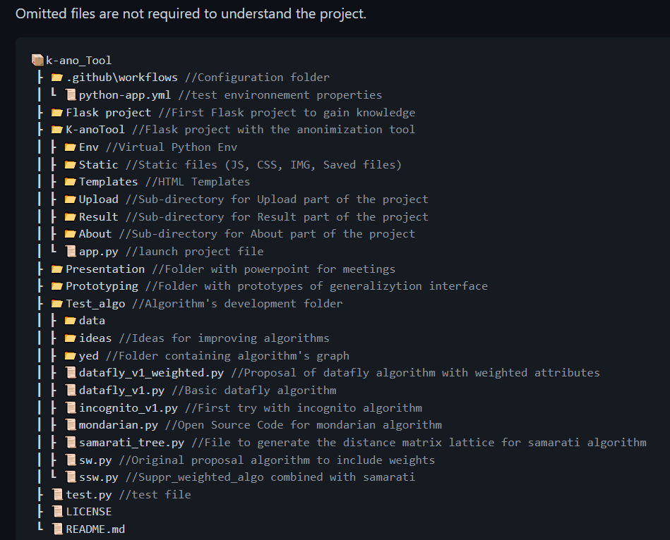
Web application
Enables users to use the SSW algorithm
Contains a user-friendly interface to build VGH with custom weights on edges
Downloadable result dataset
Create a full documentation

Slide 7
Demonstration

Slide 8
Thank you for your attention
Special thanks to my supervisor Pr. Kévin Huguenin

