Slide 1
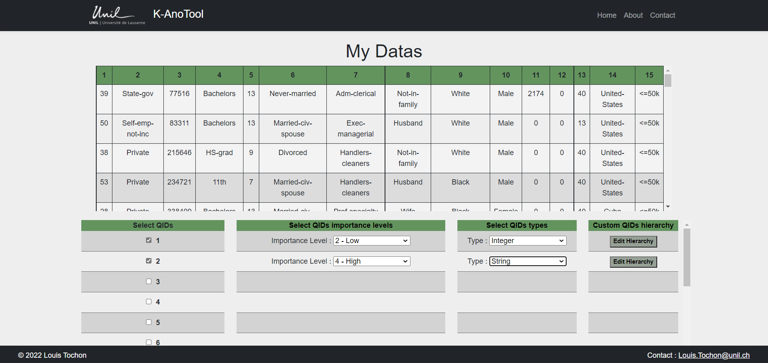

Slide 2
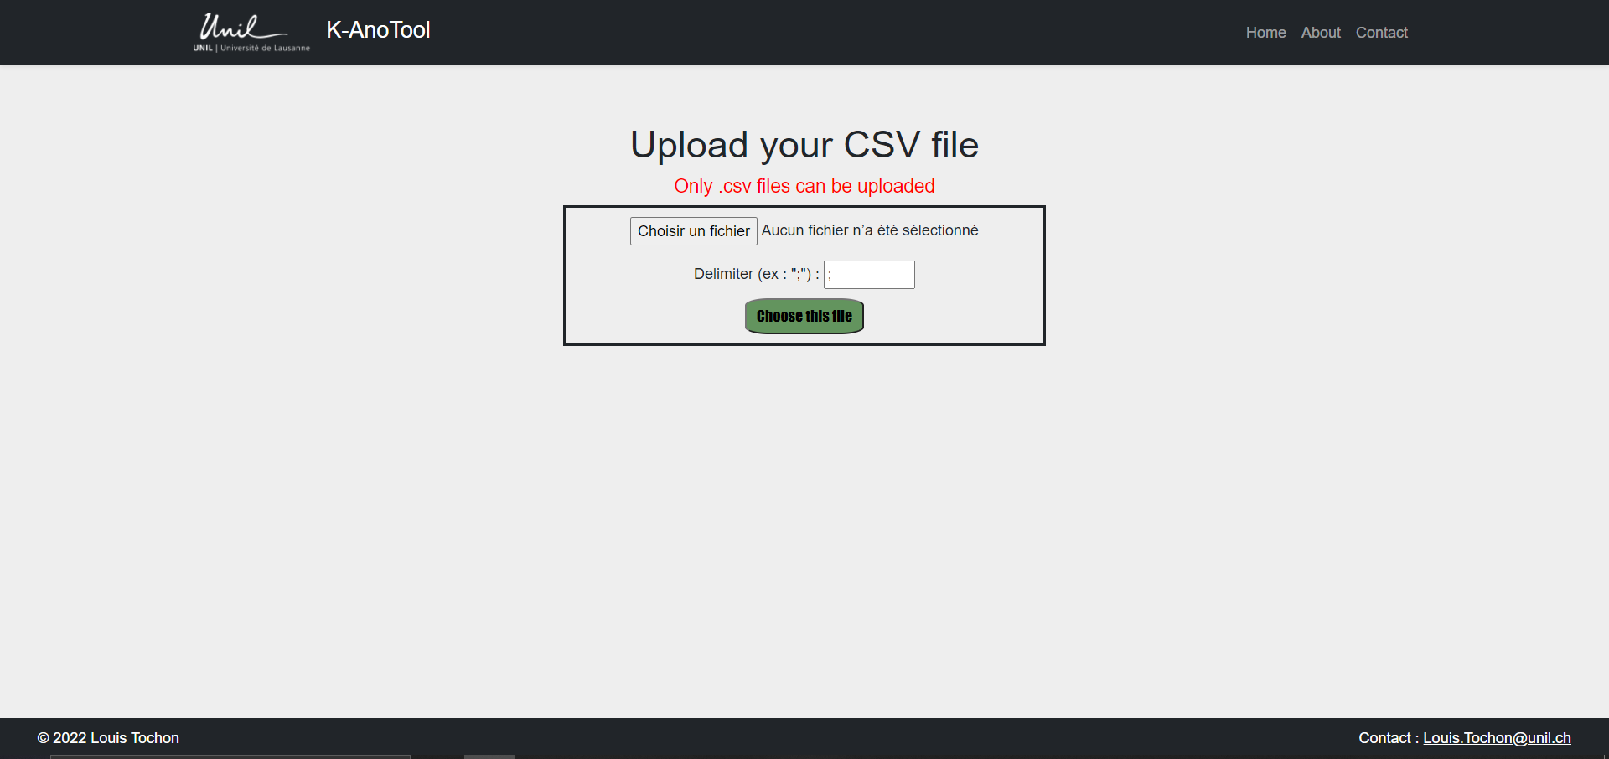
QID :
1
Values : {39, 50, 58, …}
Add a level
Confirm

Slide 3
QID :
1
Pop-up
Values : {39, 50, 58, …}
Initial set of values :
{39, 50, 58, …}
Add a level
Range :
[min , max]
Add a Range
Confirm

Slide 4
QID :
1
Pop-up
Values : {39, 50, 58, …}
Initial set of values :
{39, 50, 58, …}
Add a level
Range :
[min , 50]
[50 , max]
Add a Range
Confirm

Slide 5
QID :
1
Values : {39, 50, 58, …}
Range : [min, 50]
Range : [50, max]
Add a level
Confirm

Slide 6
QID :
2
Values : {State-gov, …}
Add a level
Confirm

Slide 7
QID :
1
Pop-up
Values : {39, 50, 58, …}
Initial set of values :
{State-gov, …}
Add a level
Generalization rule :
Remove char
Dictionnary
Custom Rule

Slide 8
QID :
1
Rule : Delete Char
Values : {39, 50, 58, …}
Initial set of values :
{State-gov, …}
Add a level
Deletion :
Delete char n°
1
to
4
from the
Beginning
End
Example :
{State-gov} → {State****}
Back
Confirm

Slide 9
QID :
2
Values : {State-gov, …}
Deletion
Values : {State****, …}
Add a level
Confirm

Slide 10
Other String’s rule chosen

Slide 11
QID :
1
Rule : Dictionnary
Values : {39, 50, 58, …}
Distinct Values | New value
State-gov
Private
Self-Emp-not-inc
Add a level
Back
Confirm

Slide 12
QID :
2
Values : {State-gov, …}
Dictionnary
Values : {newval1, …}
Add a level
Confirm

