Slide 1
Materials
Levi Tracy

Slide 2
Materials
Materials were introduced as a design language that was developed by Google in 2014. Material Design is a tool for front-end frameworks, which helps you with visual, motion, and interaction design. It also helps you adapt across different devices and different screen sizes

Slide 3
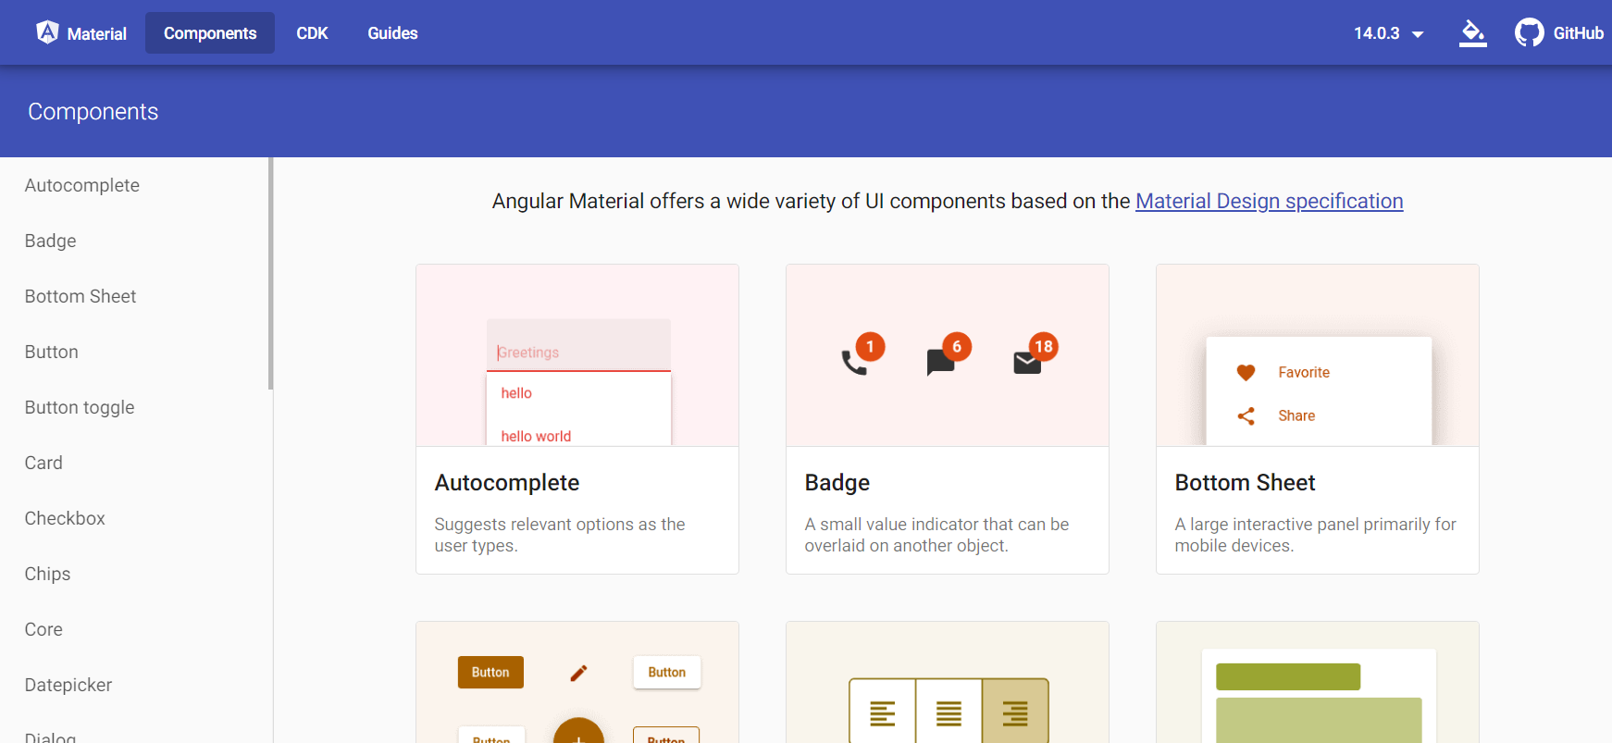
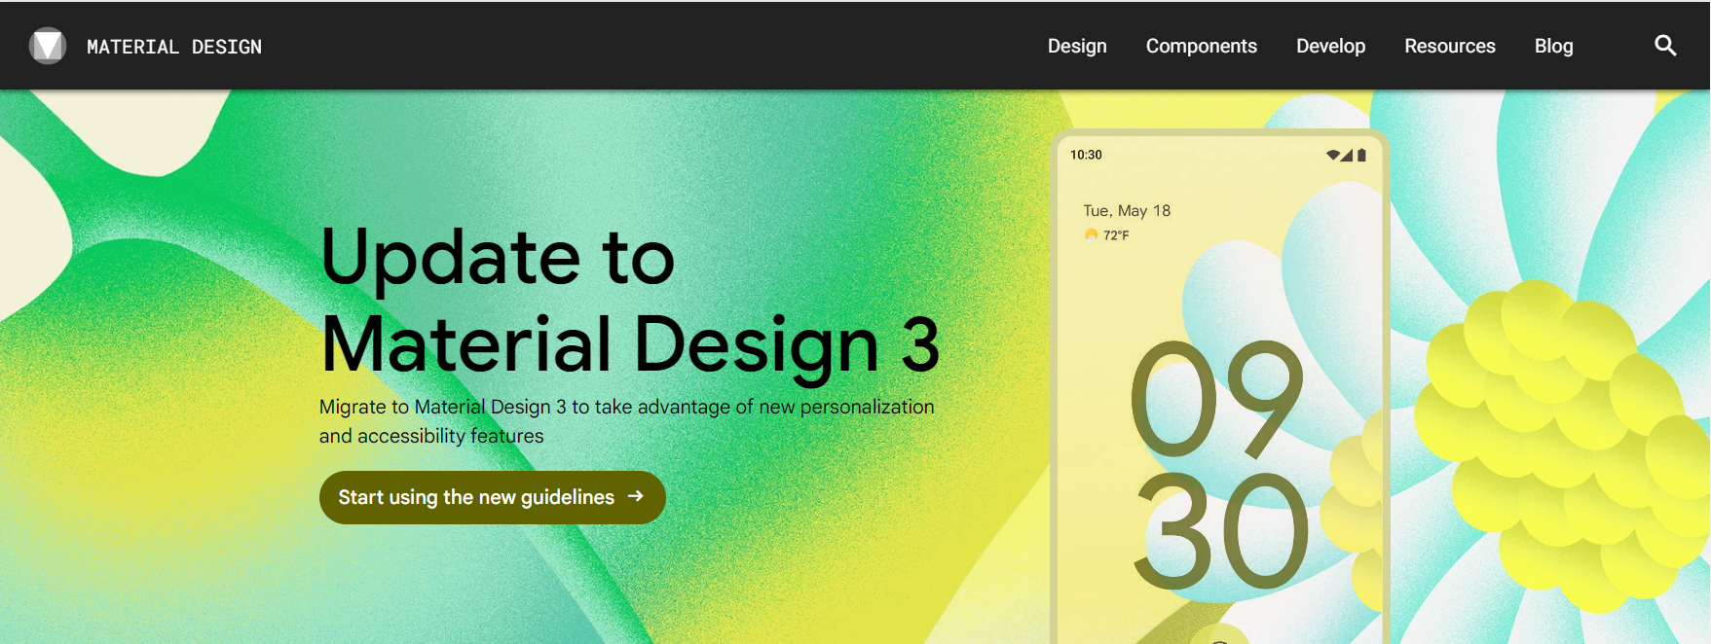
resources to get started?
material.angular.io
material.io (won’t be covered)

Slide 4
Angular Material OVERVIEW
Components
Just like Bootstrap, Angular has a large list of components to choose from. These Components come with 3 separate sections listed below.
Overview
--Explanation of how to use the Component if this is the first time using the component, or even if you need to refresh
API
--Required import/export to be added within your module form to ensure the API runs
Examples
--Examples of the Component in use.

Slide 5
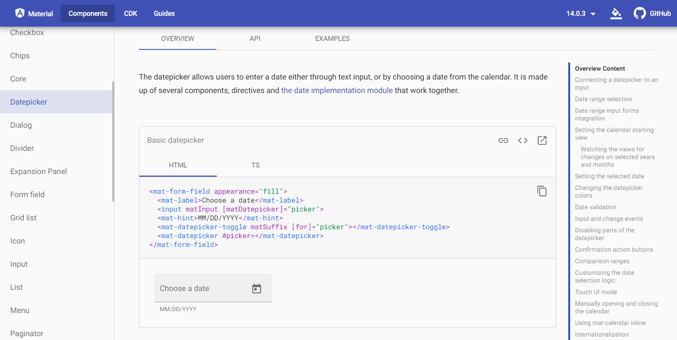

Overview
For this example we are reviewing the DatePicker Components Overview section. We’re given a thorough explanation of the use and even access to the HTML formatting and TS information required to implement the chosen DatePicker into the code. ➔ ➔ ➔ ➔ ➔ ➔ ➔ ➔ ➔ ➔ ➔ ➔
Overview Content: The table on the right of the overview tab allows for quick access to common questions or customization options you may want to see, selecting from that list will move you to that section of the page.

Slide 6
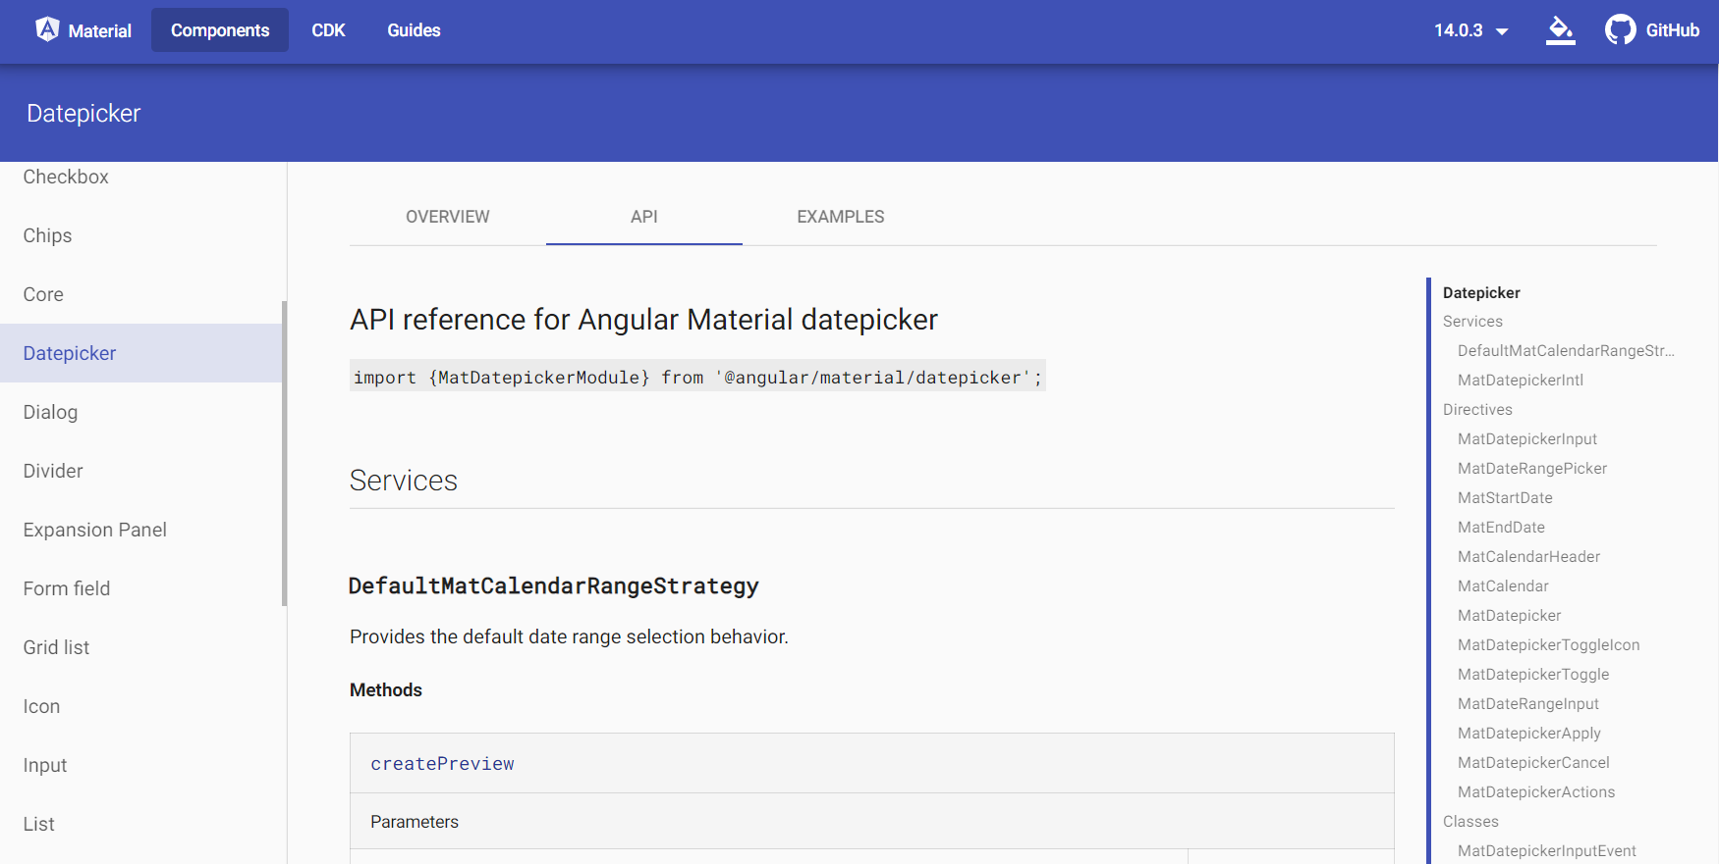
API
For this example we are reviewing the DatePicker API. If you want to use the DatePicker, it is imperative you have the module imported/exported within your program through your app.module.ts or the DatePicker will not work. *This process is followed for all Components for them to work
DatePicker : Again, the table on the right of the DatePicker tab allows for quick access to Directives/Classes/Interfaces/Aliases and more, selecting from that list will move you to that section of the page.

Slide 7
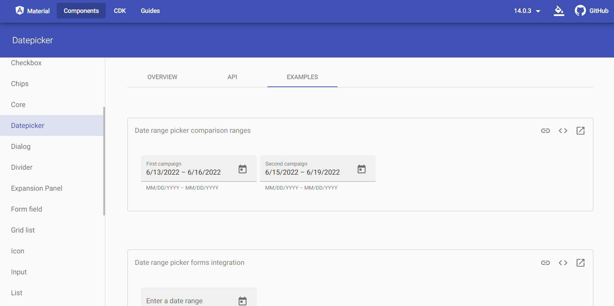
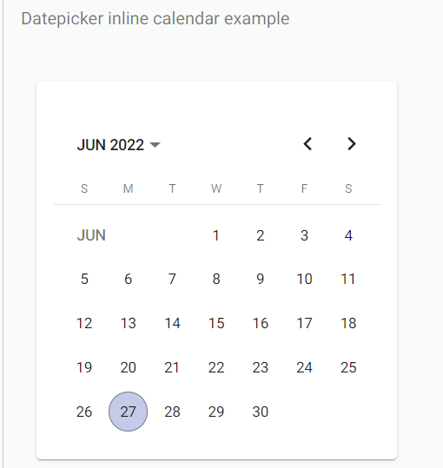
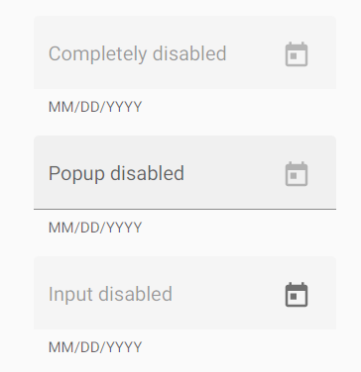
Examples
For the final section we are reviewing the DatePicker Examples. If you’ve joined me thusfar, you will the above page has multiple options for different DatePickers, you can scroll through the whole page looking for the specific DatePicker you may require.
Extra Options listed ➔ ➔

Slide 8
Materials in Practice

Slide 9
Topics Today
Side Bar navigation
Excellent, clean, smooth option to navigate seamlessly through your website
Menu Buttons
The hamburger button exist!!!! This button toggles the side bar Navigation!
Forms
Creation of a User or Login all available on the front page.
Title Bars
Just like the website we had placed the menu button on every page, but the title bar has the additional navigation options that tether to it, holding the Forms, Menu Button, Side Bar Navigation.

Slide 10
Side-Bar Navigation
ABSTRACT
We based our research on market trends and social media
DESIGN
We believe people need more products specifically dedicated to this niche market
RESEARCH
Minimalist and easy to use

Slide 11
Menu Buttons
ABSTRACT
We based our research on market trends and social media
DESIGN
We believe people need more products specifically dedicated to this niche market
RESEARCH
Minimalist and easy to use

Slide 12
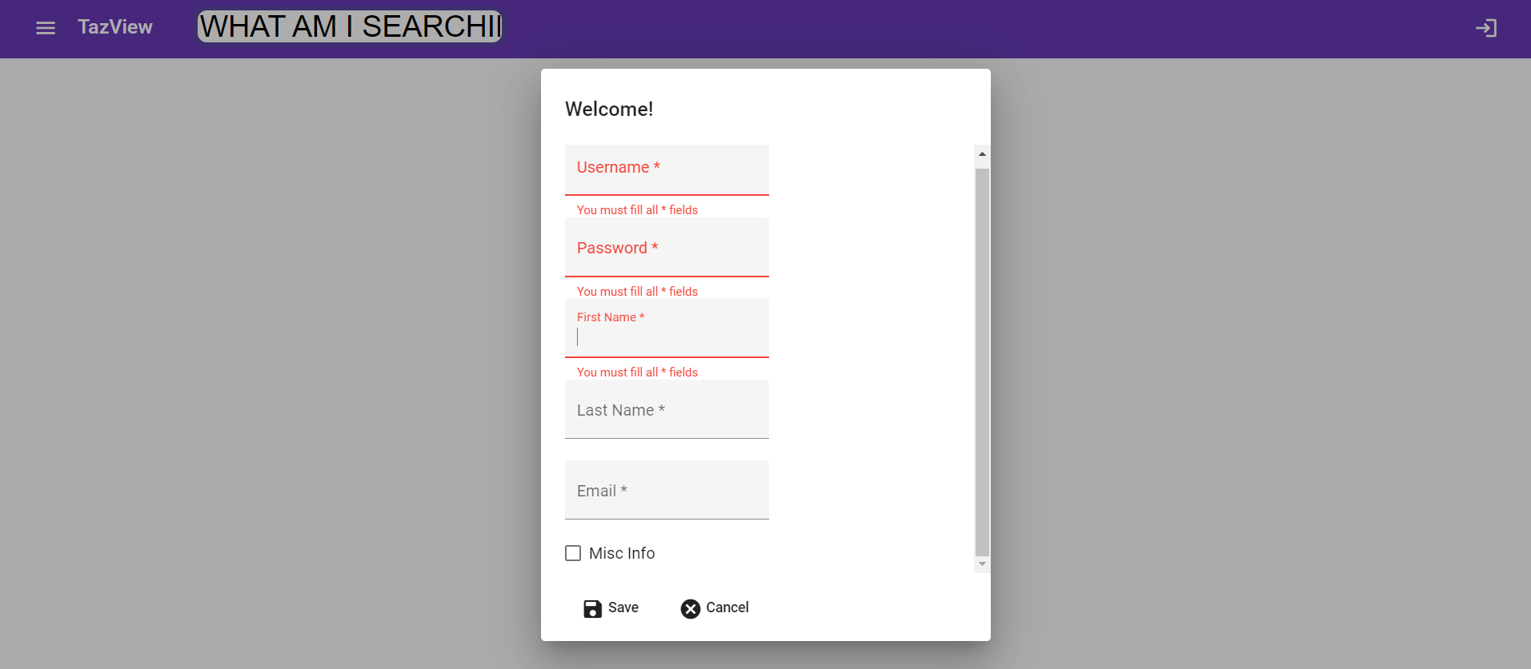
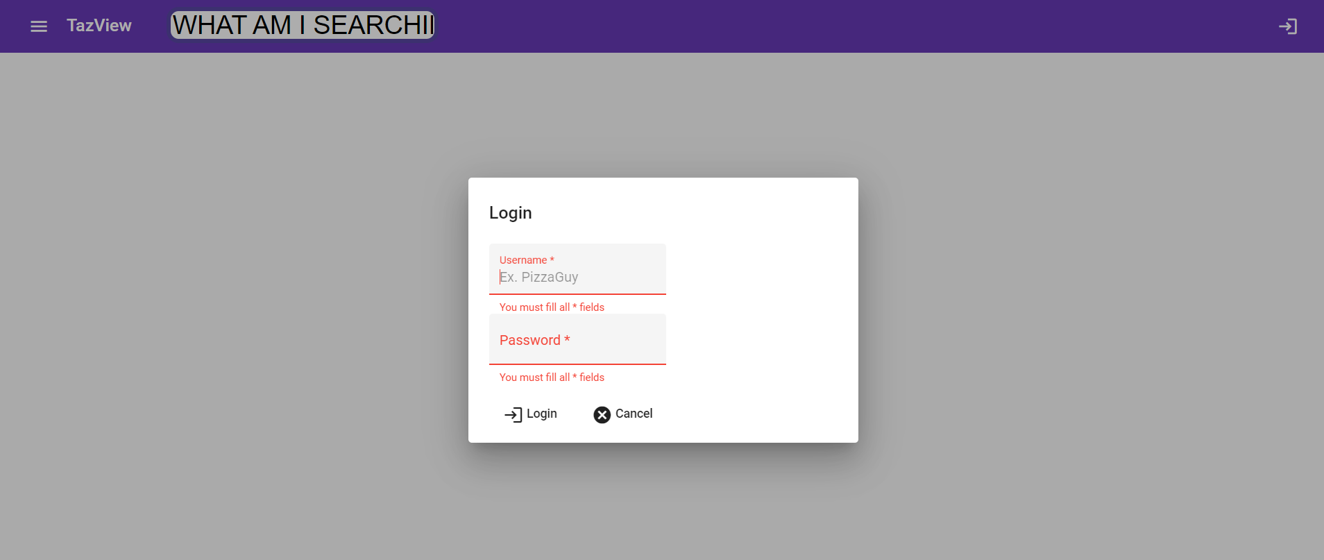
Forms
ABSTRACT
We based our research on market trends and social media
DESIGN
We believe people need more products specifically dedicated to this niche market
RESEARCH
Minimalist and easy to use

Slide 13
Title Bar!
ABSTRACT
We based our research on market trends and social media
DESIGN
We believe people need more products specifically dedicated to this niche market
RESEARCH
Minimalist and easy to use

Slide 14
MARKET OVERVIEW
$3 Billion
$1 Billion
$2 Billion
Freedom to invent
Selectively inclusive market
Serviceable available market
Opportunity to build
Fully inclusive market
Total addressable market
Few competitors
Specifically targeted market
Serviceable obtainable market

Slide 15
Market comparison
$3B
$2B
$1B
Opportunity to build
Freedom to invent
Few competitors
Addressable market
Serviceable market
Obtainable market

Slide 16
OUR COMPETITION
CONTOSO
COMPETITORS
Our product is priced below that of other companies on the market
Design is simple and easy to use, compared to the complex designs of the competitors
Affordability is the main draw for our consumers to our product
Company A Product is more expensive
Companies B & C Product is expensive and inconvenient to use
Companies D & E Product is affordable, but inconvenient to use

Slide 17
Our competition
Convenient
Contoso
Competitor A
Affordable
Expensive
Competitor D
Competitor C
Competitor B
Competitor E
Inconvenient

Slide 18
Growth strategy
Feb 20XX
Roll out product to high profile or top-level participants to help establish the product
Mar 20XX
Release the product to the general public and monitor press release and social media accounts
Oct 20XX
Gather feedback and adjust product design as necessary

Slide 19
TRACTION
Forecasting for success
Key Metrics
 | Clients | Orders | Gross revenue | Net revenue
20XX | 10 | 1100 | $10,000 | $7,000
20XX | 20 | 200 | $20,000 | $16,000
20XX | 30 | 300 | $30,000 | $25,000
20XX | 40 | 400 | $40,000 | $30,000
REVENUE BY YEAR

Slide 20
TWO-YEAR ACTION PLAN
DRAFT BLUEPRINTS
GATHER FEEDBACK
DELIVER TO CLIENT
20XX
JAN
FEB
MAR
APR
MAY
JUN
JUL
AUG
SEP
OCT
NOV
DEC
20XX
JAN
FEB
MAR
APR
MAY
JUN
JUL
AUG
SEP
OCT
NOV
DEC
RUN FOCUS GROUPS
TEST DESIGN
LAUNCH DESIGN

Slide 21
FINANCIALS
 | Year 1 | Year 2 | Year 3
INCOME
Users | 50,000 | 400,000 | 1,600,000
Sales | 500,000 | 4,000,000 | 16,000,000
Average price per sale | 75 | 80 | 90
Revenue @ 15% | 5,625,000 | 48,000,000 | 216,000,000
GROSS PROFIT | 5,625,000 | 48,000,000 | 216,000,000
Expenses
Sales & marketing | 5,062,500 | 38,400,000 | 151,200,000 | 70%
Customer service | 1,687,500 | 9,600,000 | 21,600,000 | 10%
Product development | 562,500 | 2,400,000 | 10,800,000 | 5%
Research | 281,250 | 2,400,000 | 4,320,000 | 2%
TOTAL EXPENSES | 7,593,750 | 52,800,000 | 187,920,000

Slide 22

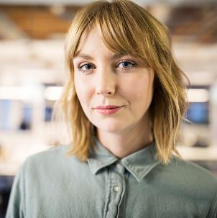


MEET THE TEAM
TAKUMA HAYASHI​
MIRJAM NILSSON​
FLORA BERGGREN​
RAJESH SANTOSHI​
President
Chief Executive Officer
Chief Operations Officer
VP Marketing

Slide 23








MEET THE TEAM
TAKUMA HAYASHI
MIRJAM NILSSON​
FLORA BERGGREN​
RAJESH SANTOSHI
President
Chief Executive Officer
Chief Operations Officer
VP Marketing
GRAHAM BARNES
ROWAN MURPHY
ELIZABETH MOORE
ROBIN KLINE
VP Product
SEO Strategist
Product Designer
Content Developer

Slide 24
FUNDING
$14,000
$12,000
$82,000
$32,000
ANGEL INVESTMENTS
PROPERTY
SHARES
CASH
Amount obtained through other investors
Revenue obtained from property rentals
Number of shares converted into USD
Liquid cash we have on hand

Slide 25
SUMMARY
At Contoso, we believe in giving 110%. By using our next-generation data architecture, we help organizations virtually manage agile workflows. We thrive because of our market knowledge and great team behind our product. As our CEO says, "Efficiencies will come from proactively transforming how we do business.”

Slide 26
Any Questions?

